Slide 1
Introduction to intelligent robotics
Antoine Germay
Pierre Nicolay

Slide 2
Strategy
Exploration
Landmark detection
Object detection
Object placement in baskets

Slide 3
Exploration
Dstar (Dx form when the map is fully explored)
Tweaked cost map to attract the robot in the corners
Holonomic controller implementing a pure pursuit algorithm

Slide 4
Landmark detection
Use of a bag features to create a bag of visual words
SVM classifier to classify each image
Look for a global optimum by computing the score of each permutation

Slide 5
Object detection
3 turns around the table
Precise localization of the table
Creation of 3D map of the objects
Determination of the color of each object

Slide 6
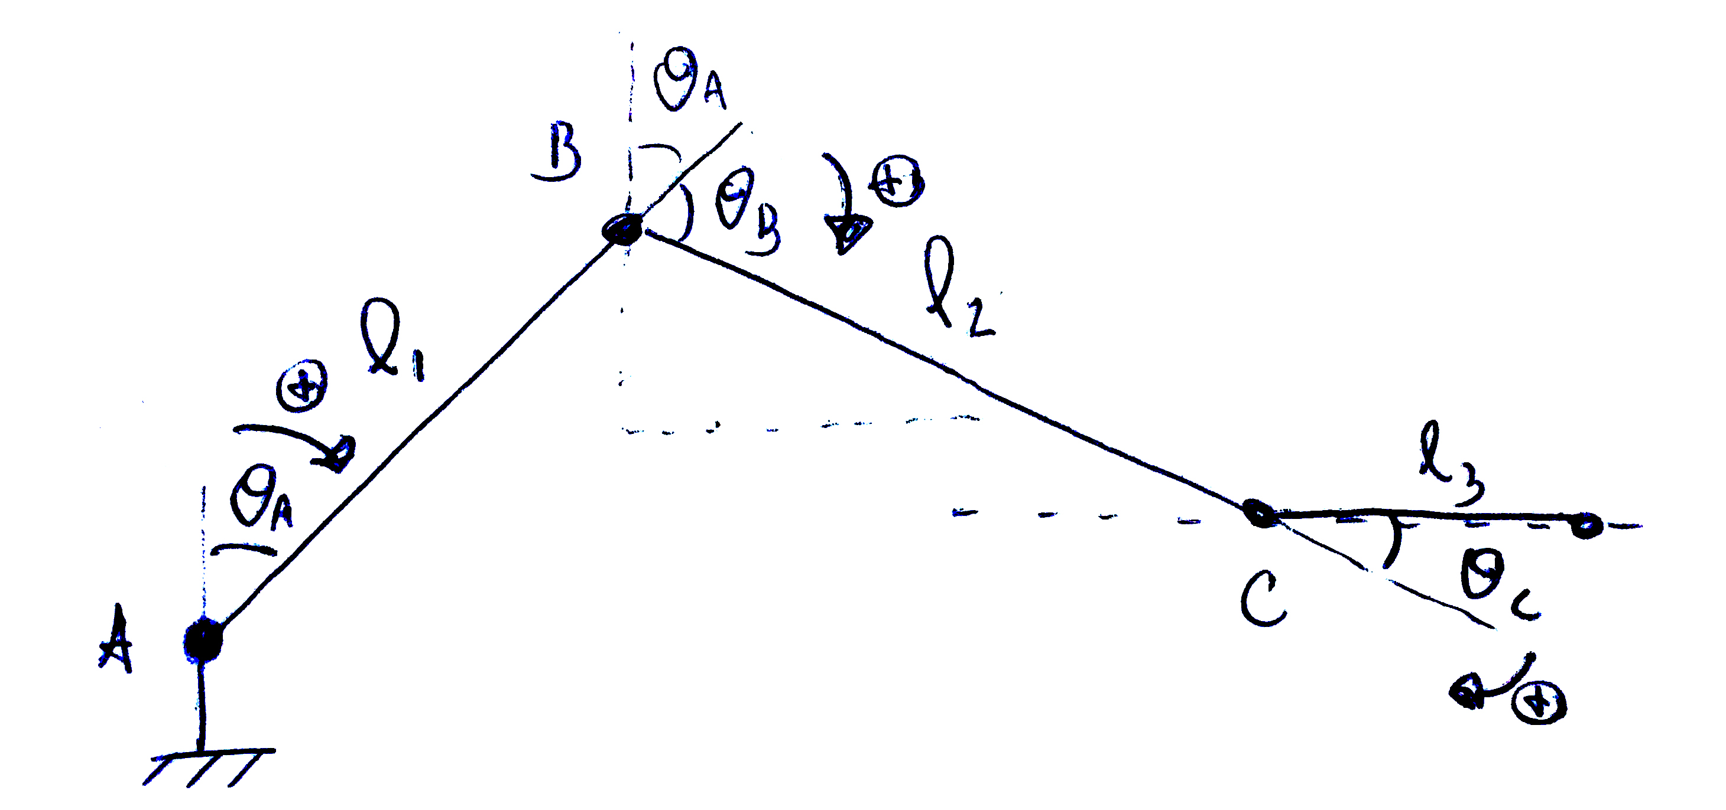
Object placement in baskets
Simplified procedure = 2D control of the arm and use of the holonomic capabilities of the youbot
Invert kinematics problem solving

