Slide 1
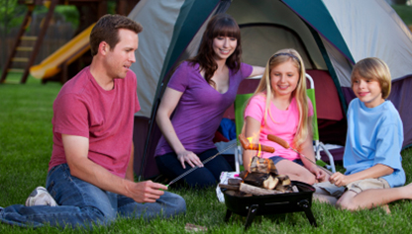
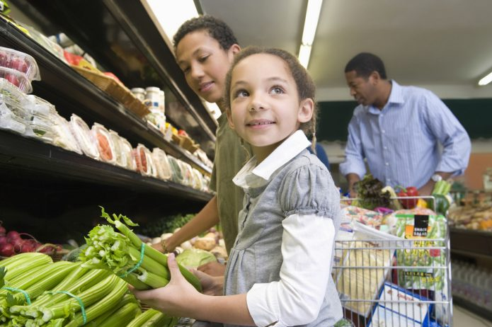
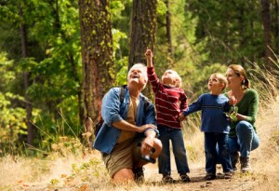
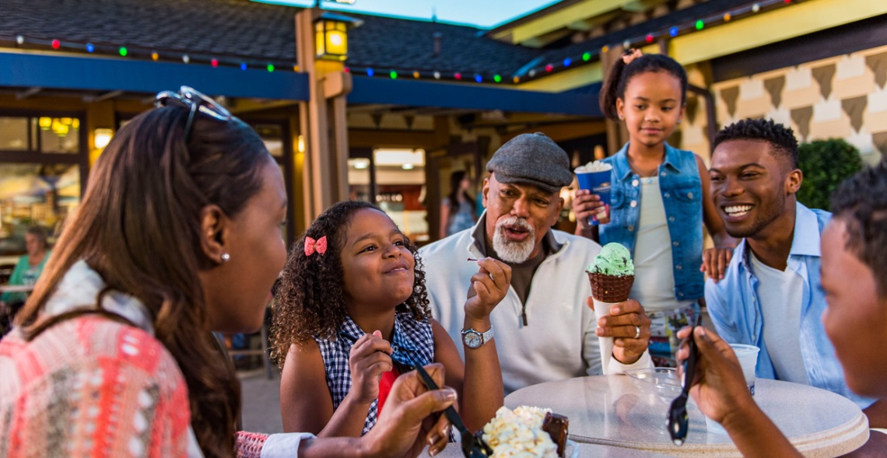
Everyday Ways to Build Language Out and About

Slide 2

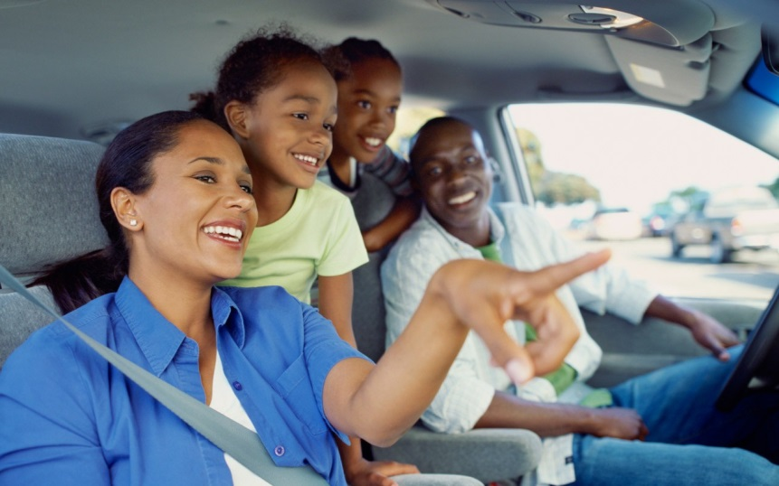
Let’s go!...
Getting ready to leave - model language such as “open door, climb in, buckle seatbelt.” Why do we wear seatbelts?
While driving – Talk about where you are going and the purpose. Point out things you see, “Look! There’s the library.” “I see a bus. Do you see the big truck?” Point out traffic signs and talk about their meaning. Red light – Stop! Green light – Go!

Slide 3

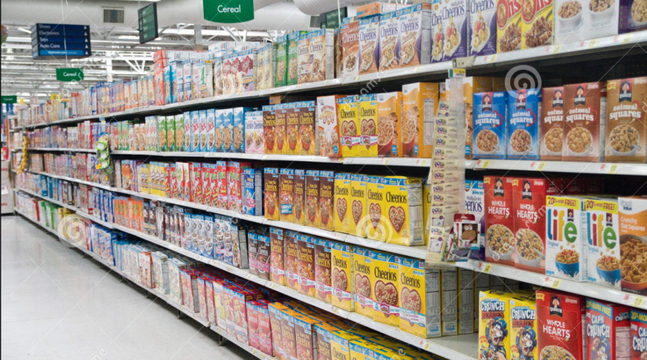
A “Krogering” We Go… Grocery shopping with your child
Talk about the colors and names of fruits & vegetables
Count items as you put them in your cart
Ask your child to find an item. Is it “up high” or “down low?”
Is your cart “full” or “empty?”
Point out the numbers on aisle signs
Go on a “letter hunt” in the cereal aisle – look for letters on the boxes

Slide 4

Explore Nature
Visit a park – What sounds do you hear? Name things you see.
Use action words such as walking, running, hiking, exploring to talk about what you are doing.
What animals might you see at a park? What about in the forest?
Take pictures of things you see while exploring. Make an “Adventure Book.” Read it!

Slide 5
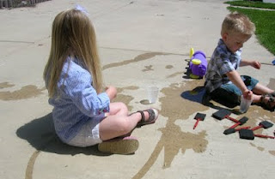
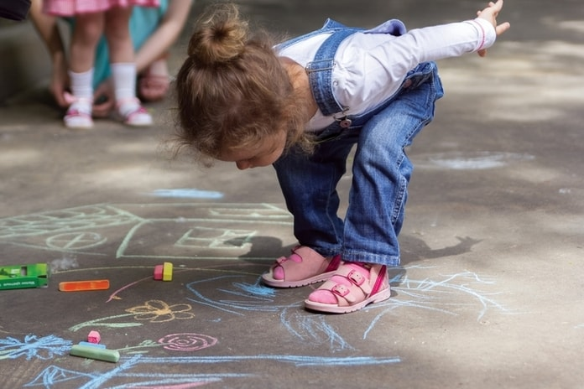
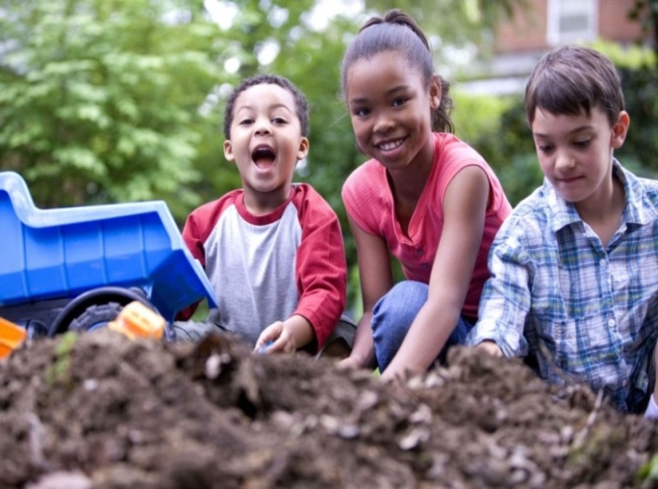
Outdoor Play
Water play – use a bucket of water and paintbrush. Let your child “paint” the sidewalk or driveway. Talk about what shapes or pictures they are painting. Use words such as “wet” and “dry.”
Chalk – Draw lines or shapes. Make lines long and short. Have your child jump over the shapes, walk around shapes. Talk about the colors.
Dirt – let your child explore! Use words such as “push, dig, scoop, and dump.” How does the dirt feel?

Slide 6






Take advantage of everyday opportunities to build language skills.

