Slide 1

2022.10.11
~10.17
DrugAI周汇报
蔡丰锦

Slide 2
本周工作：
1.安装pytorch
2.跟着pytorch官方文档实现LeNet代码
下周工作：
1.安装tensorflow2
2.复现经典论文的代码
（比如AlexNet）

Slide 3


Slide 4
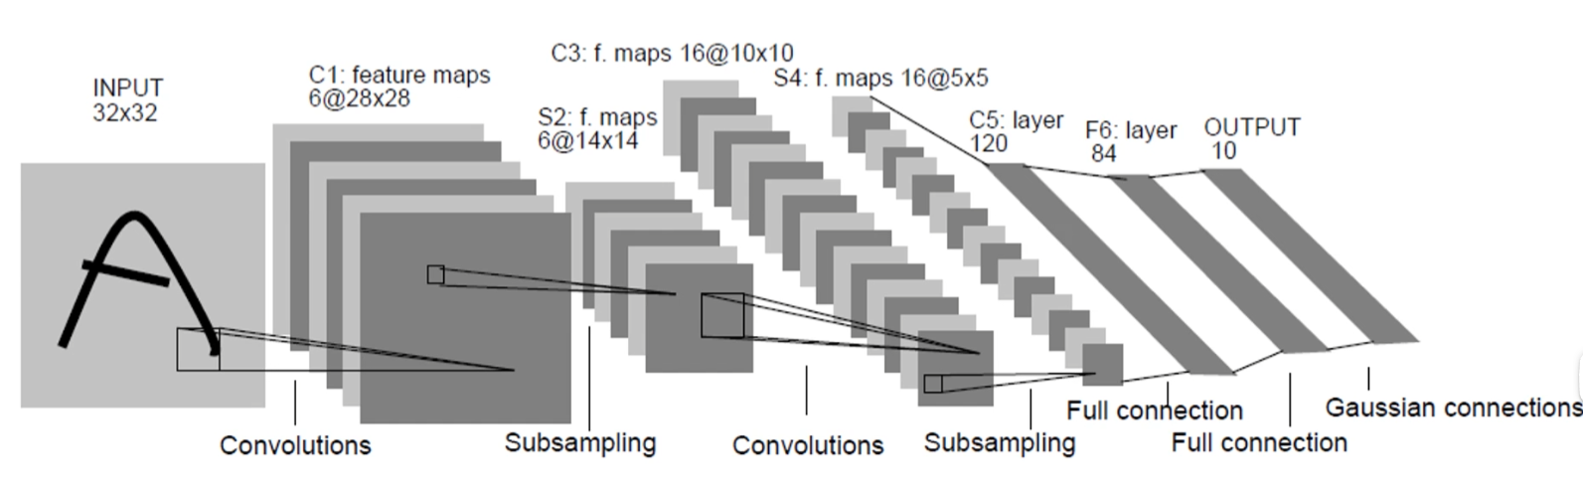
LeNet(1998)网络结构

Slide 5
import torch.nn as nn import torch.nn.functional as F class LeNet(nn.Module): def __init__(self): super(LeNet, self).__init__() self.conv1 = nn.Conv2d(3, 16, 5) self.pool1 = nn.MaxPool2d(2, 2) self.conv2 = nn.Conv2d(16, 32, 5) self.pool2 = nn.MaxPool2d(2, 2) self.fc1 = nn.Linear(32*5*5, 120) self.fc2 = nn.Linear(120, 84) self.fc3 = nn.Linear(84, 10) def forward(self, x): x = F.relu(self.conv1(x)) # input(3, 32, 32) output(16, 28, 28) x = self.pool1(x) # output(16, 14, 14) x = F.relu(self.conv2(x)) # output(32, 10, 10) x = self.pool2(x) # output(32, 5, 5) x = x.view(-1, 32*5*5) # output(32*5*5) x = F.relu(self.fc1(x)) # output(120) x = F.relu(self.fc2(x)) # output(84) x = self.fc3(x) # output(10) return x
1.初始化网格形状
2.定义正向传播过程

Slide 6
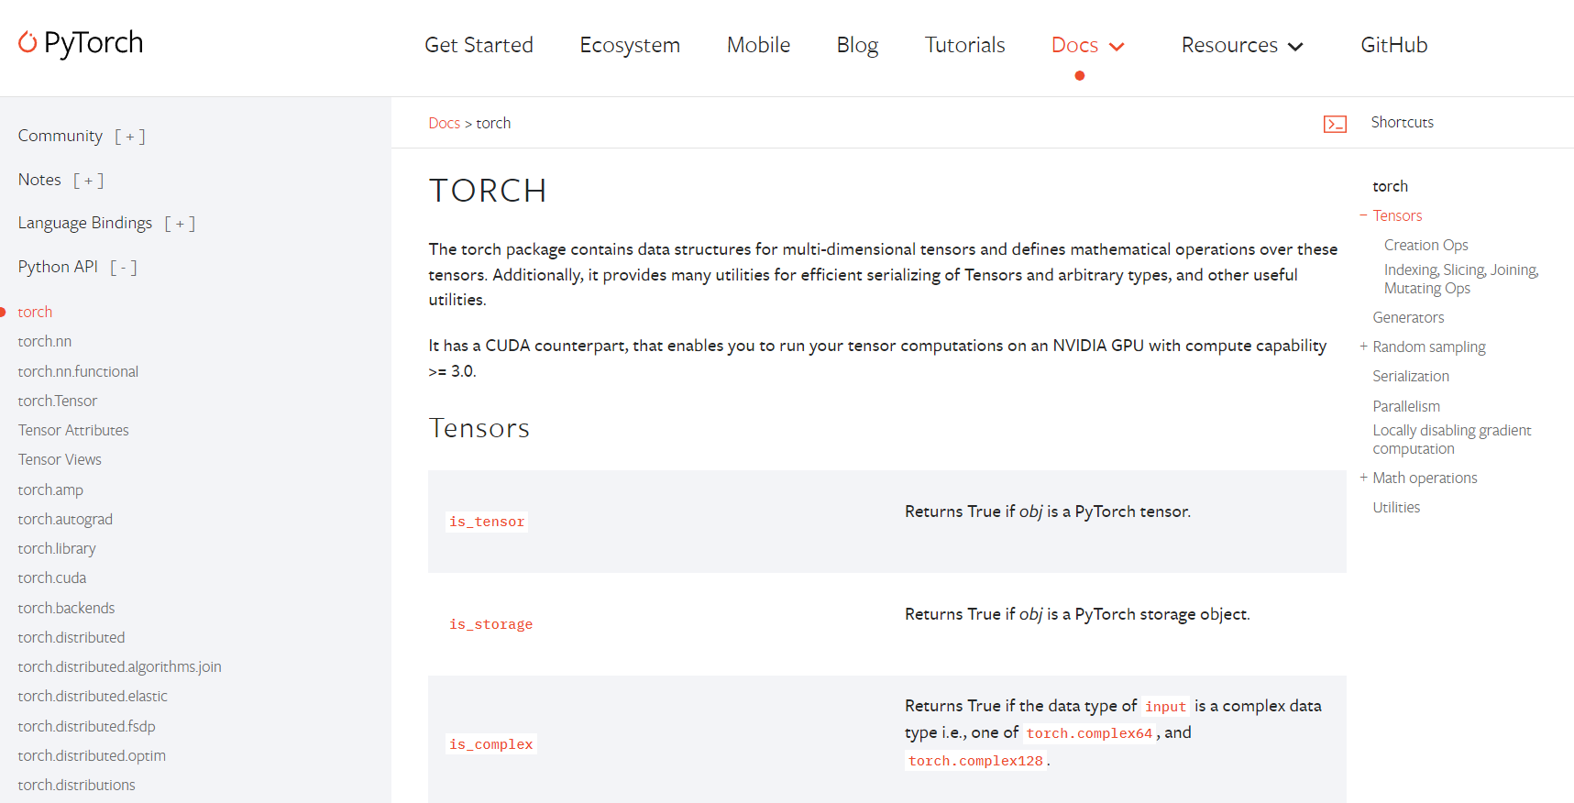
官方API查询

Slide 7
卷积（Conv2d）在pytorch中对应的函数是：
torch.nn.Conv2d(in_channels, out_channels, kernel_size, stride=1, padding=0, dilation=1, groups=1, bias=True, padding_mode='zeros')

Slide 8
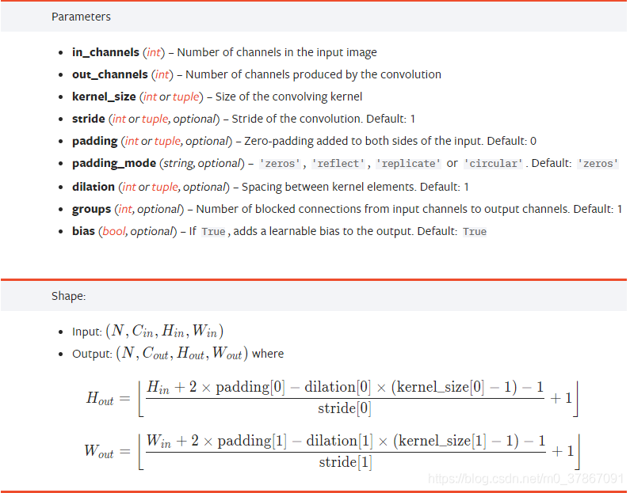
self.conv1 = nn.Conv2d(3, 16, 5)
#16个卷积核，尺度为5X5
· in_channels：输入特征矩阵的深度。
· out_channels：输出特征矩阵的深度。也等于卷积核的个数。
· kernel_size：卷积核的尺寸。可以是int类型，如3 代表卷积核的height=width=3，也可以是tuple类型如(3, 5)代表卷积核的height=3，width=5

Slide 9
kernel_size：卷积核的尺寸。可以是int类型，如3 代表卷积核的height=width=3，也可以是tuple类型如(3, 5)代表卷积核的height=3，width=5
Stride:步长，默认设置好
池化 MaxPool2d
MaxPool2d(kernel_size, stride)

Slide 10
import torch import torchvision import torch.nn as nn from model import LeNet import torch.optim as optim import torchvision.transforms as transforms def main(): transform = transforms.Compose( [transforms.ToTensor(), transforms.Normalize((0.5, 0.5, 0.5), (0.5, 0.5, 0.5))])
训练模型
1.导入需要的包
2.数据预处理

Slide 11
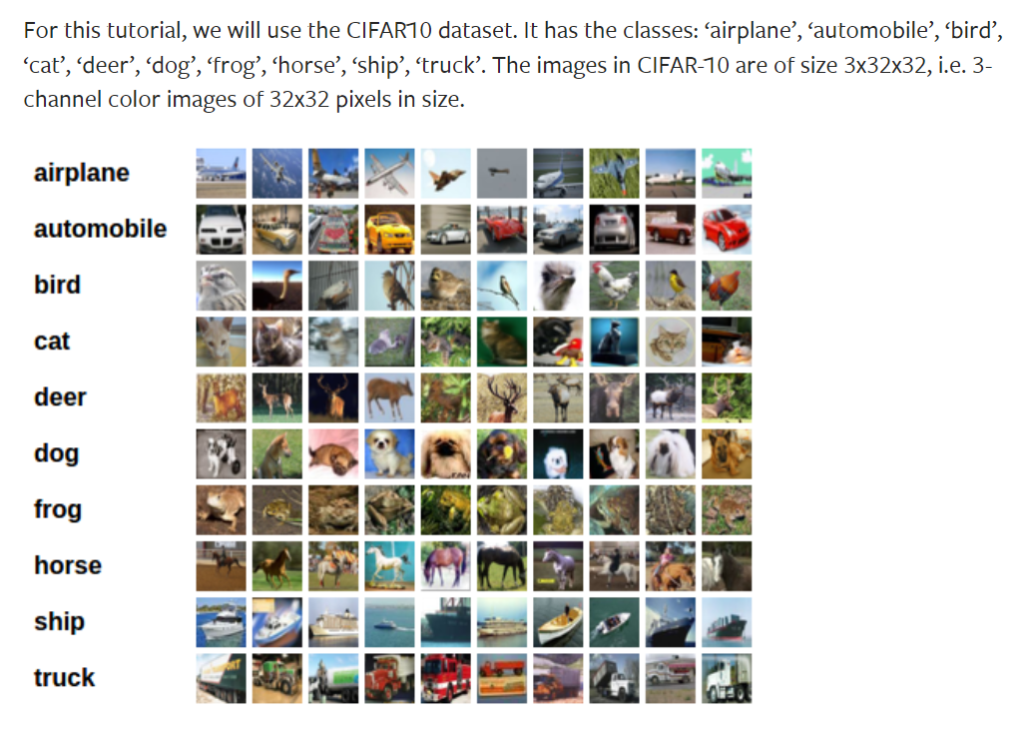
batch_size = 5 # 50000张训练图片 # 第一次使用时要将download设置为True才会自动去下载数据集 train_set = torchvision.datasets.CIFAR10(root='./data', train=True, download=False, transform=transform) train_loader = torch.utils.data.DataLoader(train_set, batch_size=36, shuffle=True, num_workers=0) # 10000张验证图片 # 第一次使用时要将download设置为True才会自动去下载数据集 val_set = torchvision.datasets.CIFAR10(root='./data', train=False, download=False, transform=transform) val_loader = torch.utils.data.DataLoader(val_set, batch_size=5000, shuffle=False, num_workers=0) val_data_iter = iter(val_loader) val_image, val_label = val_data_iter.next() classes = ('plane', 'car', 'bird', 'cat', 'deer', 'dog', 'frog', 'horse', 'ship', 'truck')
数据集下载
一共包含 10 个类别的 RGB 彩色图片（32X32）

Slide 12
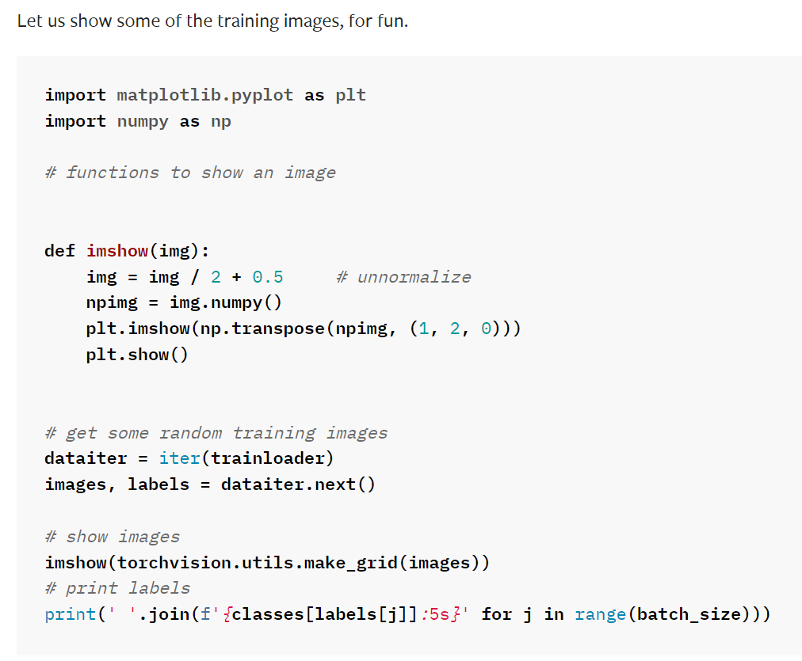
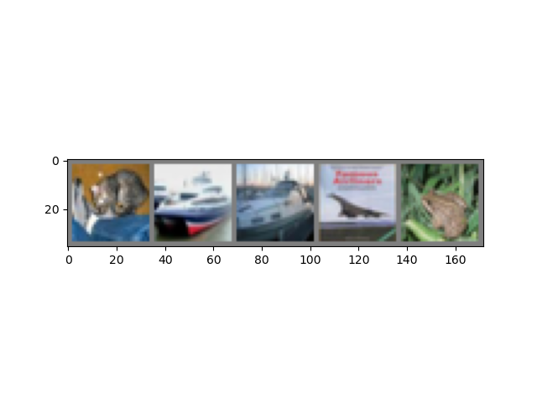
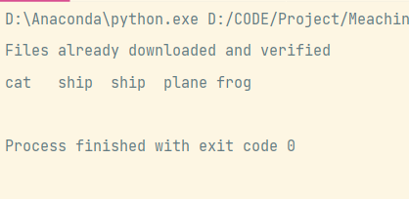

Slide 13
数据集训练过程
for epoch in range(5): # loop over the dataset multiple times running_loss = 0.0 for step, data in enumerate(train_loader, start=0): # get the inputs; data is a list of [inputs, labels] inputs, labels = data # zero the parameter gradients optimizer.zero_grad() # forward + backward + optimize outputs = net(inputs) loss = loss_function(outputs, labels) loss.backward() optimizer.step()
# print statistics running_loss += loss.item() if step % 500 == 499: # print every 500 mini-batches with torch.no_grad(): outputs = net(val_image) # [batch, 10] predict_y = torch.max(outputs, dim=1)[1] accuracy = torch.eq(predict_y, val_label).sum().item() / val_label.size(0) print('[%d, %5d] train_loss: %.3f test_accuracy: %.3f' % (epoch + 1, step + 1, running_loss / 500, accuracy)) running_loss = 0.0 print('Finished Training')

Slide 14
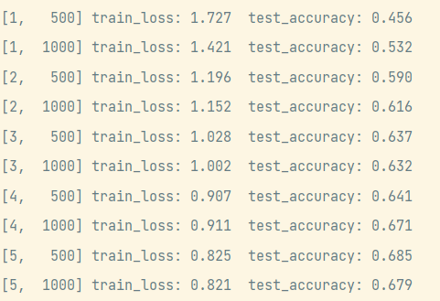

打印输出的结果
save_path = './Lenet.pth' torch.save(net.state_dict(), save_path)
生成权重文件
Train_loss:训练损失
Train_accuracy:训练准确度

Slide 15
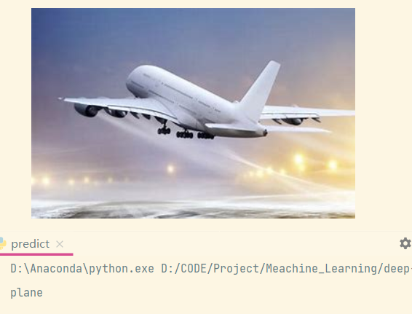
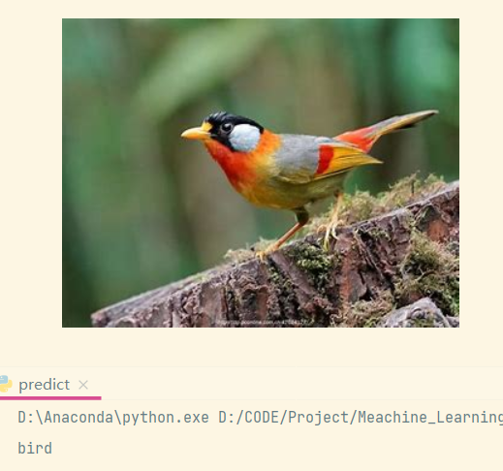
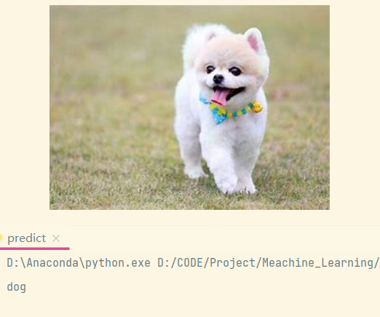
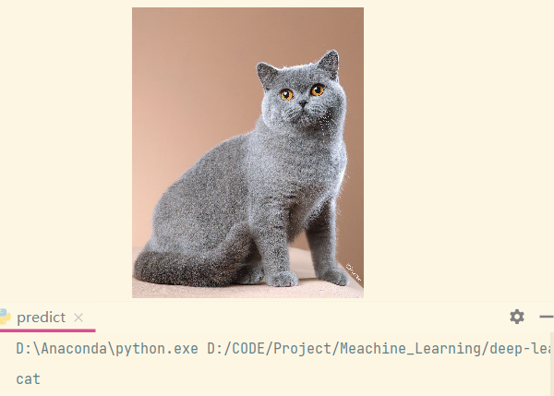

Slide 16
谢谢！

