Slide 1


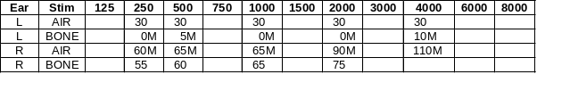
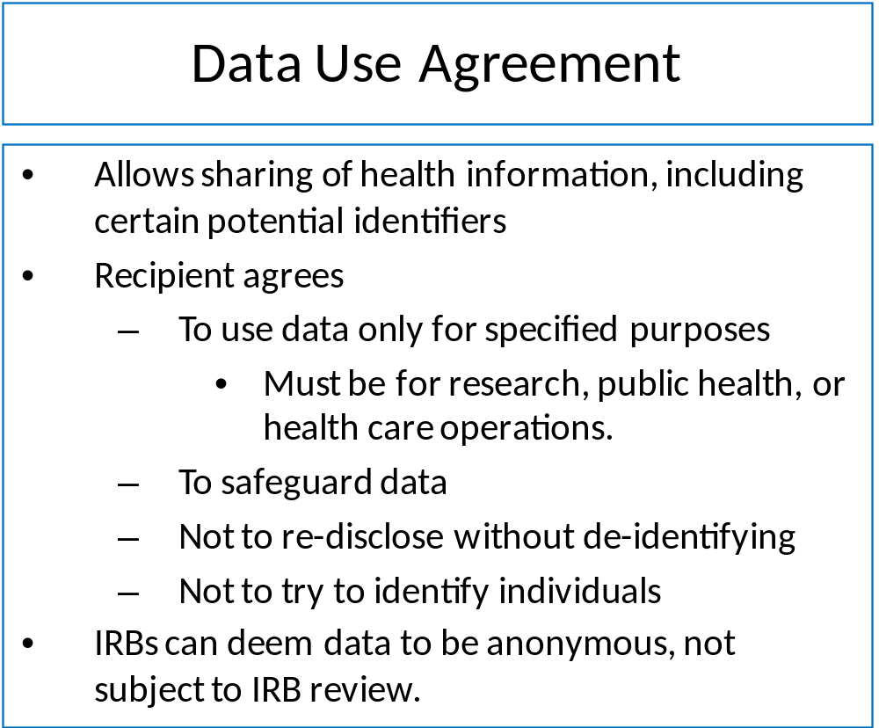
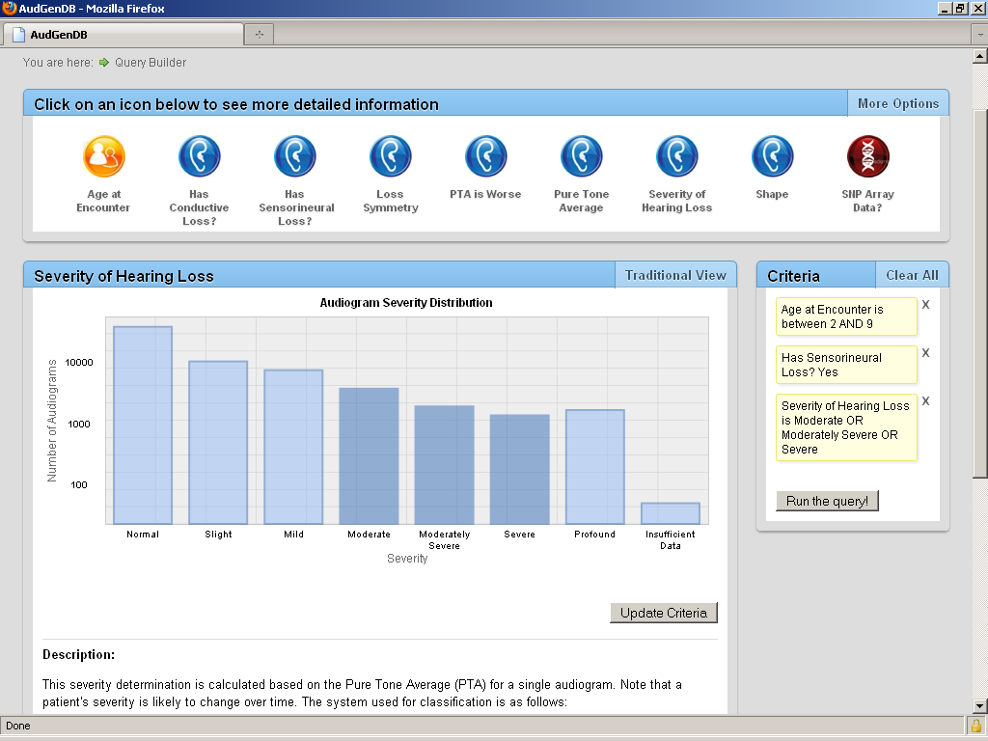
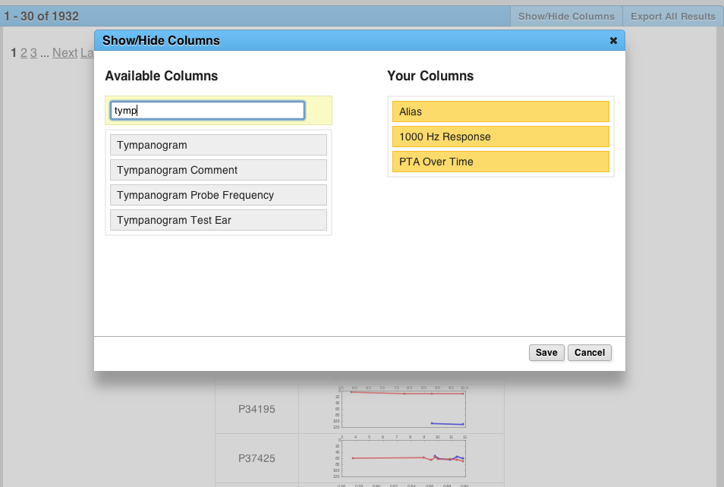
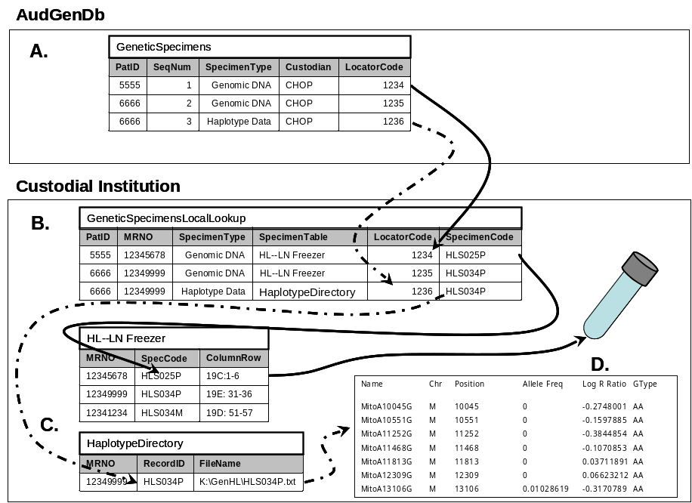
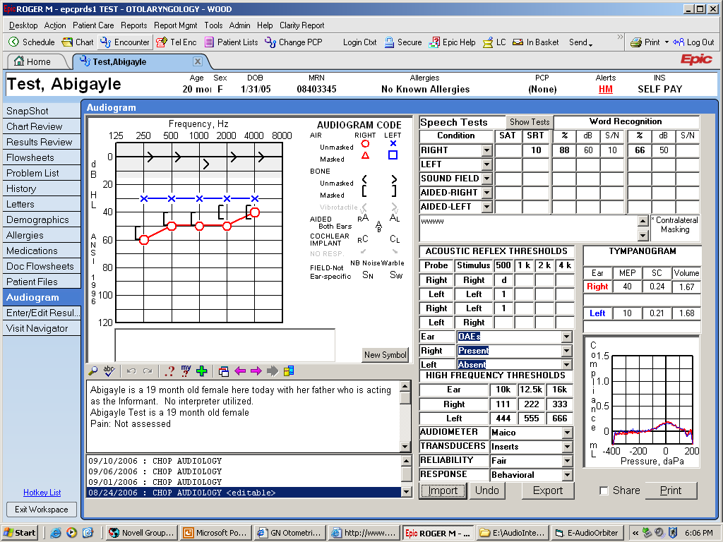
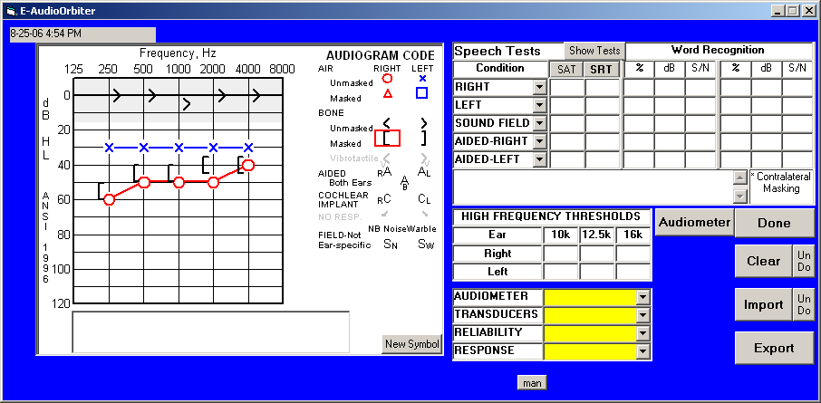
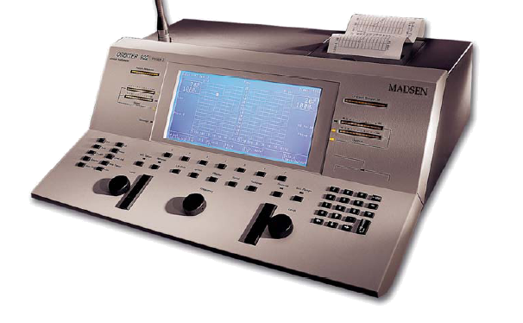
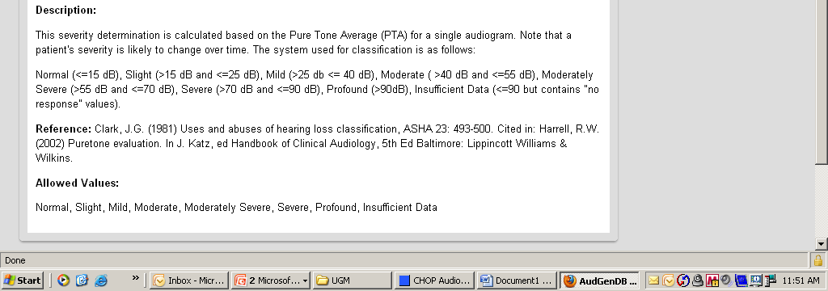
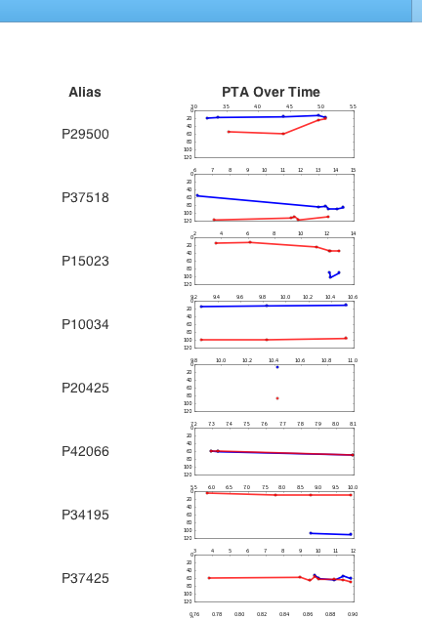
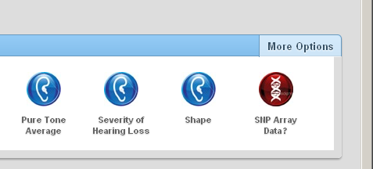
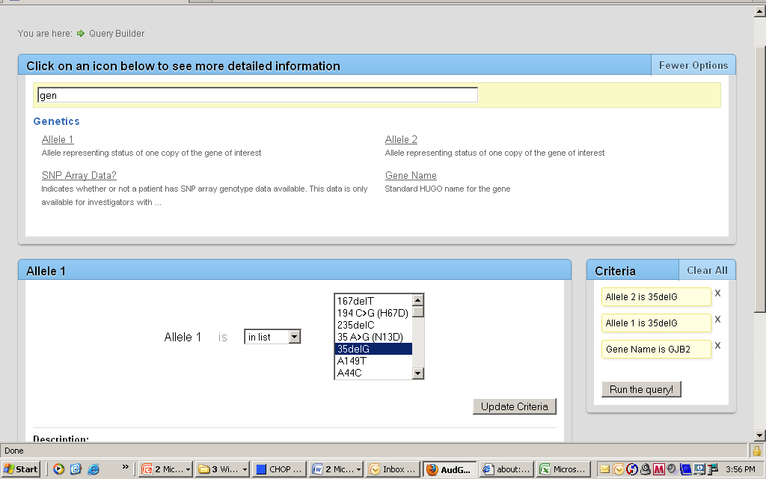
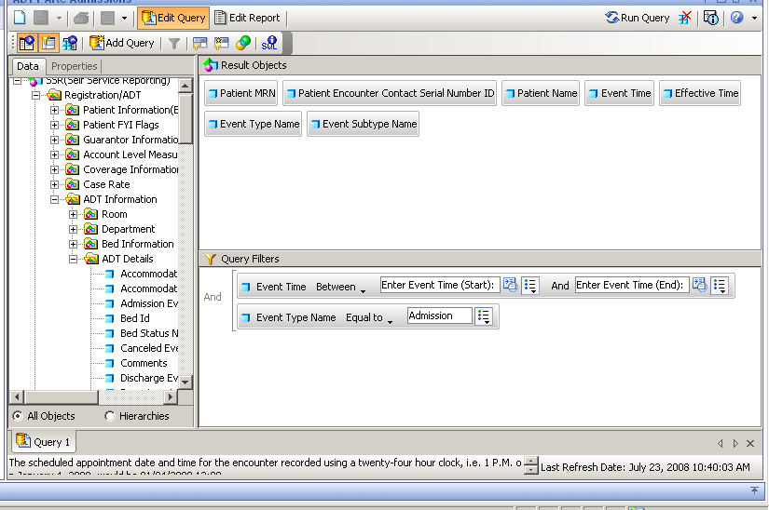
AudGenDB: The Audiology and Genetics Database
Roger R. Marsh, PhD, John A. Germiller, MD, PhD, Michael Italia, MS, Joy Peterson, AuD, Samuel J. Cohn, BA, E. Bryan Crenshaw III, PhD
Center for Childhood Communication, Department of Pediatric Otolaryngology and Center for Biomedical Informatics
The Children’s Hospital of Philadelphia
Introduction.
In clinical hearing research there is often a need for a large dataset, containing many more cases than a single institution can provide. Such a dataset would have applications in areas as diverse as genetics of hearing loss, patterns of cochlear implantation, and age of identification of hearing impairment. At The Children's Hospital of Philadelphia (CHOP), we have begun developing the infrastructure for the Audiology and Genetics Database—AudGenDB. Our objective is to create a repository of clinical data for tens or hundreds of thousands of children from a consortium of institutions, and to make this repository freely available to researchers world-wide, while protecting the privacy of the individuals whose healthcare information we are using. This is truly a multidisciplinary collaboration, involving many colleagues in the Center for Childhood Communication, the Center for Biomedical Informatics, and the Departments of Clinical Genetics and Otolaryngology.
3. Once a month, all new audiograms are loaded to AudGenDB
1. Pick field
1. Begin typing
2. View data
3. Drag to insert in list
2. Any matches appear
1. Data are plotted from audiometer to interface screen
2. Audiogram is transferred to medical record
3. Click values of interest
4. Add to query
Figure 8. Once the cases of interest have been located, it is a simple matter to find other data to include in the report. Here the tympanogram—a graphic representation of the data—is selected.
Figure 10. DNA specimens and genome-wide analyses pose challenges. These materials often were acquired under research protocols and consent forms that limit the use and sharing of the specimens and data. They reside in the custody of multiple investigators nationwide. AudGenDB provides a mechanism for investigators to locate materials of interest and contact the custodian to arrange collaborations. The investigator and custodian are responsible for complying with any IRB requirements at their institutions.
A table (A) in AudGenDB shows that certain materials—specimens or data—exist and identifies the custodian. Deidentified codes for the patient and the specimen itself are shown. At each institution a lookup table (B), behind the institution’s firewall, links these codes to the institution’s own tables (C.) that lead to the materials themselves. The outside investigator transmits the code numbers to the custodian, who locates the materials.
Figure 2. Data flow directly from audiological test equipment into the electronic health record (EHR)through custom interfaces. From the EHR, data are periodically downloaded to AudGenDB, with no risk of transcription error.
5. See results
The Team
Figure 4. The HIPAA Privacy Rule permits sharing of data that could identify an individual, under a Data Use Agreement, which obligates the recipient to protect the privacy of the patients. IRB approval is not required.
Center for Childhood Communication
E. Bryan Crenshaw III, PhD (PI) Roger R. Marsh, PhD
Joy Peterson, AuD
Otolaryngology
John A. Germiller, MD, PhD Samuel J. Cohn, BA
Genetics
Ian N. Krantz, MD
Center for Biomedical Informatics
Peter S. White, PhD Jeffrey W. Pennington, BS
Michael Italia, MS Byron Ruth, BS
Figure 6. AudGenDB helps investigators to navigate the data by making core fields easy to find, showing the distribution of data, and letting the user pick values of interest. Below the graphical representation of the data, text from the Data Dictionary shows the source of the data, defined vocabulary (permitted values) and notes about any calculations.
Figure 9. In addition to raw data, calculated values and graphical representations can be included in the report. Here, plots of changes in pure-tone average over time are shown. The investigator searching for cases of progressive hearing loss can easily browse the data.
Data Access
Who has access? A major objective of AudGenDB is to make data freely available to investigators world-wide, while protecting the patients’ privacy. Four levels of access have been defined (Fig. 3), crafted to comply with both the HIPAA Privacy Rule and the Common Rule (45 CFR 46), which governs NIH-funded research. The keystone to this system is the Data Use Agreement, which allows disclosure of potentially identifiable information (Fig 3). Data released under this Privacy Rule provision is considered not to be “identifiable private information,” and thus is not subject to the Common Rule; use the such data does not require IRB approval. We are seeking as much data as possible available to the public in aggregate form, without need for a Data Use Agreement. Inference controls—measures to protect against snooping by using multple seemly innocuous queries to identify an individual—will protect against attempts to find patient-level data. For those investigators needing patient-level data, we are working with our IRB and Privacy Office to streamline the Data Use Agreement process. Some investigators will need patient-level data beyond that in AudGenDB. Because each institution will have a key to match AudGenDB patient numbers to internal medical record numbers, the investigator can reach out to colleagues at that institution to establish collaborative arrangements for multicenter studies.
How do I get the data out? Even with sophisticated graphical interfaces, finding data in complex databases can be a challenge (Fig 5). Much effort has been devoted to an intuitive interface with user support. A very simple screen lets the beginner make simple queries (Fig. 6). A mouse click leads to a more advanced screen that lets users search for fields with no need to learn the underlying data structure or even to learn the names of the fields (Fig. 7). Once the desired cases are selected, a drop-and-drag window lets the user add fields of interest. This too has a search function for easy navigation among the many possible fields (Fig. 8).
Database reports are often not conducive to easy browsing of the data; viewing trends over time, for example, is not always easy, nor is visualizing audiograms from numeric data. Certain data are available graphically within a report—no need to navigate to the individual patient’s page. Figure 9, for example shows thumbnails of graphs of threshold shift over time. Likewise, thumbnails of audiograms and tympanograms can be browsed.
Figure 1. AudGenDB is a collaboration of many individuals in research and clinical specialties.
Data Sources
In deciding what data to collect, we considered data quality, utility for research and ease of abstraction. The introduction of the electronic health record (EHR) has greatly facilitated data acquisition in Audiology (Fig. 1) and Otolaryngology, and we expect improved access to Genetics data as that department goes on-line. For each specialty, key data have been identified. Certainly, not all of these datasets are loaded yet, and not all of the loaded data are yet searchable.
Audiology
  All information from audiological evaluations—57,000 so far; ABR thresholds ad waveforms; OAE data
Patient/family history
Hearing aid and cochlear implant fittings
Otolaryngology
  Surgeries
Temporal bone imaging (radiologists’ reports now; images coming soon!)
Complete history on 2000+ cases of sensorineural hearing loss
Genetics
  Clinical tests for point mutations—more than 1000 for
Summary of family history
Link to research data and specimens (research data themselves are not in database), including 4000+ genome-wide SNP arrays collected by CHOP’s Center for Applied Genomics
1. Click More Options
Challenges
Free text. Much of the medical record traditionally has been free text, often illegibly written. Even with the electronic record, many clinicians prefer the flexibility of free text over drop-down lists and checkboxes. Computer abstraction has promise, but works best as an aid to manual abstraction. Identifiers must be redacted if the text is to be made available to users. Deleting the patient’s name is easy enough (if it is spelled correctly and has not changed), but nicknames as well as names of teachers, other clinicians and family members creep in.
Genetic data. For research purposes, clinically obtained genetic tests, for example for GJB2 mutations, is no different from other clinical data. Genome-wide analyses are a different matter. They uniquely identify the individual and their use is often constrained by the research protocol and consent form under which specimens were collected. Rather than police the IRB and privacy matters involved, AudGenDB will simply note the existence of these resources, and facilitate communication between investigators and custodians of specimens and data (Fig. 10).
Giving away data? It is difficult to let go of data that one has been hoarding for years. Our team has taken another perspective: If we make the data freely available, we will be motivated to finally publish that study we’ve been meaning to do. There is a more pragmatic issue—inadvertent duplicate publication. Two investigators, working independently, might analyze the same dataset. A reader might not realize that the studies are not independent and take one as confirmation of the other’s findings. We have not arrived at a governance document that will address this issue. Should we require investigators to submit abstracts of proposed studies? Will other investigators be able to see them to avoid duplication? Will there be complaints of “stealing ideas” if other investigators then pursue similar studies. A small, but important, part of the plan will be to require citation of AudGenDB in the article, with sufficient description of the dataset that a reader can identify overlapping samples.
The Future
At present we have data from several areas on about 30,000 children, available only to the AudGenDB team. By July, AudGenDB will be available throughout The Children's Hospital of Philadelphia, and (we hope) to the world by the end of the year. But we will never have enough cases for some large-scale studies. In the next year, we will work with colleagues elsewhere to make AudGenDB a repository for data from a consortium of children’s hospitals.
2. Begin typing
3. Any matches in Data Dictionary appear*
*Match can be in
  Field name
  Description
  Defined vocabulary—standard values for the field
4. Click field of interest
Data Access Privileges
Where is inpatient admission information?
Public
  May view static displays, such as number of cases, distributions of certain data.
  May run queries that return approximate aggregate counts or means.
Registered Investigators
  Must execute a Data Use Agreement.
  May access patient-level data, including dates and other potential identifiers.
Internal Investigators
  May access identifiers, including name and medical record number of patients from their institutions only.
  Must have IRB approval from research uses, or a work-related need for non-research uses.
Down here somewhere in a sub-sub-folder
4. Click values of interest
4. Add to query
…and the field is called Event Type
Figure 7. For more advanced queries, the Data Dictionary can be searched to find the fields of interest. Here, genotype data are located easily, even though the field names—Allele1 and Allele2—might not be obvious.
Figure 5. Navigating databases can be daunting. In this example, the desired data—inpatient admissions—are hidden in complex data structures and non-obvious terminology.
Acknowledgements
Supported by NIDCD Grant 5R33DC008630, “Audiological and Genetic Resource for Pediatric Hearing Research,” E. Bryan Crenshaw III, Principal Investigator.
The initial phase was supported by NIDCD Grant 5R21DC008630, “Audiological and Genetic Resource for Pediatric Hearing Research,” Judith S. Gravel, PhD, Principal Investigator.
Figure 3. Several levels of access have been defined, balancing privacy concerns with needs of investigators

