Slide 1


VOTING AND ELECTION SYSTEM.
Objective: Develop a secure and efficient voting system to manage elections digitally.
Target users: Election officials, voters, government agencies.
Expected benefits: Prevent election fraud, ensure transparency, provide real-time vote counting.

Slide 2

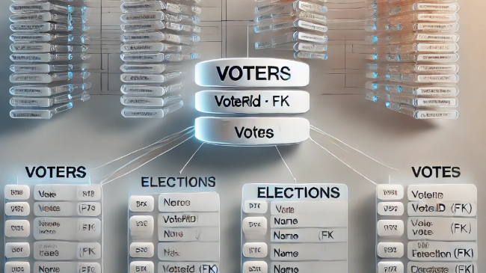
Main database entities.
Voters: Stores voter details ( name, ID, eligibility status)
Candidates: Contains information about election candidates.
Elections: Tracks election types, dates, and rules.
Votes: Records each vote cast and links it to a voter and candidate.
Results: Stores final vote counts and winner declaration.

Slide 3
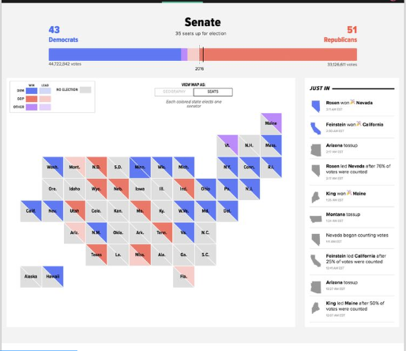
Benefits of the system.
Prevents voter fraud: Uses secure digital authentication.
Ensures transparency: Real-time vote tracking and monitoring.
Reduces manual work: Automates vote counting and reporting.
Faster result declaration: No delays in election outcomes.

