Slide 1

Independent Study – First Term
By Auden Davis

Slide 2

Go – Learning the Basics
Before I could do anything, I had to learn Go.
I started with simple thing, similar to what we do it the first part of AP CSA

Slide 3
Running and Compiling Programs
package main
import "fmt"
func main() {
fmt.Println(” ")
fmt.Println(" ___")
fmt.Println(" 🌸＞ フ")
fmt.Println(" | _ _ | ")
fmt.Println(" /` ミ__x_ﾉ ")
fmt.Println(" / | ")
fmt.Println(" / ヽ ﾉ ")
fmt.Println(" │ | | | ")
fmt.Println(" ／￣ | | | |")
fmt.Println(" | (￣ヽ__ヽ__)__)")
fmt.Println(" ＼二つ")
fmt.Println(” ")
}
After learning "hello world", I experimented with building go programs
Output:
_____
🌸＞ フ
| _ _ |
／` ミ＿_x_ノ
/ |
/ ヽ ﾉ
│ | | |
／￣| | | |
(￣ヽ＿_ヽ___)___)
＼二)

Slide 4
Memory References and Pointers
I also learned about the difference between values and pointers in Go
package main
import "fmt"
func main() {
var myVarOne int = 1
var myVarTwo *int = &myVarOne
fmt.Println(myVarOne)
fmt.Println(myVarTwo)
fmt.Println(myVarTwo)
myVarOne = 1
fmt.Println(myVarOne)
fmt.Println(myVarTwo)
fmt.Println(myVarTwo)
}
Output:
1
0x1400000e0b8
1
1
0x1400000e0b8
1

Slide 5
Functions
After pointers, I learned about functions and how to use them.
package main
import "fmt"
func main() {
fmt.Println(myFunction(2))
myFunctionButNoReturn(2)
}
func myFunction(value int) int {
return value * 2
}
func myFunctionButNoReturn(value int) {
fmt.Println(value, ", but no print")
}
Output:
4
4, nothing to print though

Slide 6
Slices and Arrays
package main
import (
"fmt"
"math/rand"
)
func main() {
slice := []int{}
for i := 0; i < 100; i++ {
slice = append(slice, rand.Intn(100)+1)
}
fmt.Println(slice)
result := []int{}
largestIndex := 0
for i := 0; i < len(slice); i++ {
if slice[largestIndex] <= slice[i] {
largestIndex = i
result = append(result, slice[largestIndex])
}
}
fmt.Println(result)
}
I experimented with Go equivalent of lists.
I implemented different sorting methods to test it out.
Output:
[13 74 8 25 25 39 5 21 63 43 21 78 64 66 19 4 32 43 65 80 8 11 71 25 51 83 54 77 40 55 14 45 37 56 21 25 1 34 58 63 79 39 81 76 25 27 97 52 81 10 35 71 22 58 21 95 58 87 93 69 29 77 98 96 80 95 27 87 100 38 53 32 67 3 58 55 47 81 32 93 73 86 43 61 21 33 73 45 9 81 53 17 24 42 93 18 84 13 24 64]
[13 74 78 80 83 97 98 100]

Slide 7
User Input
package main
import (
"bufio"
"fmt"
"math"
"os"
"strconv"
"strings"
)
func main() {
reader := bufio.NewReader(os.Stdin)
fmt.Print("Enter Intial Value: ")
initial, _ := reader.ReadString('\n')
initial, _ = strings.CutSuffix(initial, "\n")
initial2, _ := strconv.ParseFloat(initial, 64)
fmt.Print("Enter Yearly Interest (%): ")
interest, _ := reader.ReadString('\n')
interest, _ = strings.CutSuffix(interest, "\n")
interest2, _ := strconv.ParseFloat(interest, 64)
fmt.Print("Enter Time: ")
time, _ := reader.ReadString('\n')
time, _ = strings.CutSuffix(time, "\n")
time2, _ := strconv.ParseFloat(time, 64)
fmt.Println(getInterest(initial2, interest2, time2))
}
func getInterest(initial, interest, time float64) float64 {
return initial * math.Pow((interest)/100+1, time)
}
After learning functions, I tried making a simple interest calculator that takes user input.
Output:
Enter Intial Value: 1
Enter Yearly Interest (%): 1
Enter Time: 100
2.704813829421529

Slide 8
Recursion
package main
import (
"bufio"
"fmt"
"os"
"strconv"
"strings"
)
func main() {
reader := bufio.NewReader(os.Stdin)
fmt.Print("Enter an int to find: ")
stringInput, _ := reader.ReadString('\n')
stringInput = strings.TrimSuffix(stringInput, "\n")
input, _ := strconv.Atoi(stringInput)
fmt.Println(GetFactorial(int64(input)))
}
func GetFactorial(i int64) int64 {
if i <= 1 {
return i
}
return GetFactorial(i-1) * i
}
Once I had functions under my tool belt, I tested it out with recursion
Output:
Enter an int to find: 4
24

Slide 9
Structs and Methods
package main
import "fmt"
type Animal interface {
makeSound()
setName(string)
}
type Dog struct {
name string
age int
weight float32
}
func (dog Dog) makeSound() {
fmt.Println("sound made")
}
func (dog Dog) setName(newName string) {
dog.name = newName
}
func (dog Dog) doTrick() {
fmt.Println("Trick completed")
}
func main() {
var marigold Dog = Dog{"Marigold", 8, 35.0}
marigold.doTrick()
fmt.Println(marigold)
}
I then learned about Go's approach to Object Oriented Programming
Output:
Trick completed
{Marigold 8 35}

Slide 10
Reading Files
I also experimented with Bufio readers and how to read txt files.
package main
import (
"bufio"
"fmt"
"os"
)
func main() {
fmt.Println(getFile("./test.txt"))
}
func getFile(fileName string) []rune {
file, _ := os.Open(fileName)
reader := bufio.NewReader(file)
runeVal, _, _ := reader.ReadRune()
myRunes := []rune{}
for i := 0; i < reader.Size(); i++ {
if runeVal != 0 {
myRunes = append(myRunes, runeVal)
}
runeVal, _, _ = reader.ReadRune()
}
defer file.Close()
return myRunes
}
test.txt:
hello world
Output:
[104 101 108 108 111 32 119 111 114 108 100]

Slide 11
String Formatting
Now that I learned some basics, I tried to make a larger program and use string formatting.
Output:
+--------------+
|XXXXXXXXXXXXXX|
|X X|
|X X|
|X X|
|X X|
|X X|
|X X|
|XXXXXXXXXXXXXX|
|Player X: 1 |
|Player Y: 2 |
+--------------+
func (myGame *game) PrintGameInfo() {
fmt.Print("+")
for i := 0; i < len(myGame.gameMap[0]); i++ {
fmt.Print("-")
}
fmt.Println("+")
for y := 0; y < len(myGame.gameMap); y++ {
fmt.Print("|")
for x := 0; x < len(myGame.gameMap[0]); x++ {
fmt.Print(string(myGame.gameMap[y][x]))
}
fmt.Print("|\n")
}
fmt.Printf("|Player X: %-"+strconv.Itoa(len(myGame.gameMap[0])-10)+"d|\n", myGame.player.x)
fmt.Printf("|Player Y: %-"+strconv.Itoa(len(myGame.gameMap[0])-10)+"d|\n", myGame.player.y)
fmt.Print("+")
for i := 0; i < len(myGame.gameMap[0]); i++ {
fmt.Print("-")
}
fmt.Println("+")
}

Slide 12
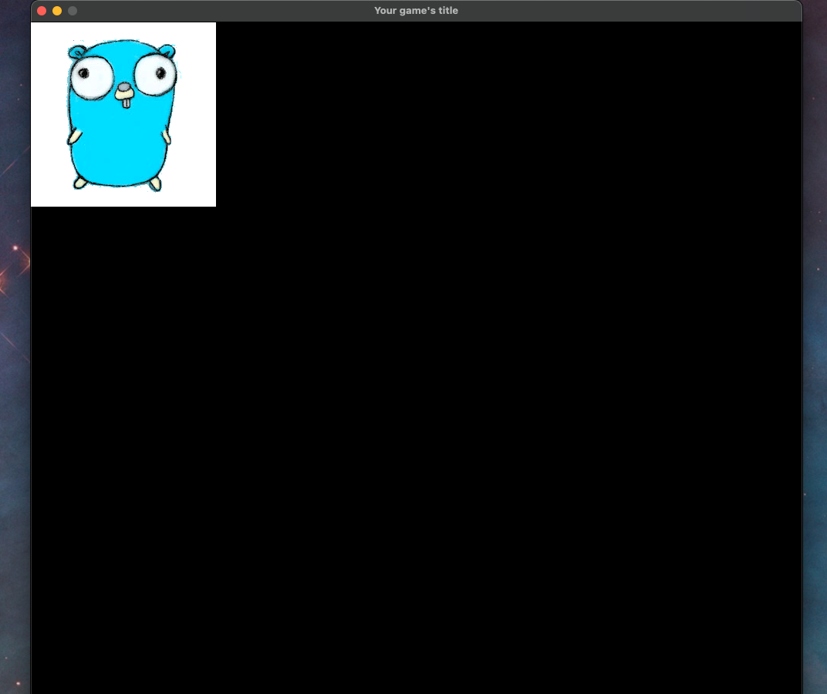
Learning Ebitengine
package main
import (
"image/color"
"log"
"github.com/hajimehoshi/ebiten/v2"
"github.com/hajimehoshi/ebiten/v2/ebitenutil"
)
var (
box *ebiten.Image
gopher *ebiten.Image
scaler *ebiten.DrawImageOptions
playerX float64
playerY float64
)
type Game struct{}
func (g *Game) Update() error {
if ebiten.IsKeyPressed(ebiten.KeyW) {
playerY = -4
} else if ebiten.IsKeyPressed(ebiten.KeyS) {
playerY = 4
} else {
playerY = 0
}
if ebiten.IsKeyPressed(ebiten.KeyA) {
playerX = -4
} else if ebiten.IsKeyPressed(ebiten.KeyD) {
playerX = 4
} else {
playerX = 0
}
return nil
}
func (g *Game) Draw(screen *ebiten.Image) {
scaler.GeoM.Translate(playerX, playerY)
screen.DrawImage(box, scaler)
box.DrawImage(gopher, nil)
}
func (g *Game) Layout(outsideWidth, outsideHeight int) (screenWidth, screenHeight int) {
return 1000, 1000
}
func main() {
var err error
scaler = &ebiten.DrawImageOptions{}
gopher, _, err = ebitenutil.NewImageFromFile("gopher.png")
if err != nil {
log.Fatal(err)
}
box = ebiten.NewImage(240, 240)
box.Fill(color.White)
game := &Game{}
ebiten.SetWindowSize(1000, 1000)
ebiten.SetWindowTitle("Your game's title")
if err := ebiten.RunGame(game); err != nil {
log.Fatal(err)
}
}
To get ready for my term 1 project, I learned how to use the Ebitengine engine.

Slide 13
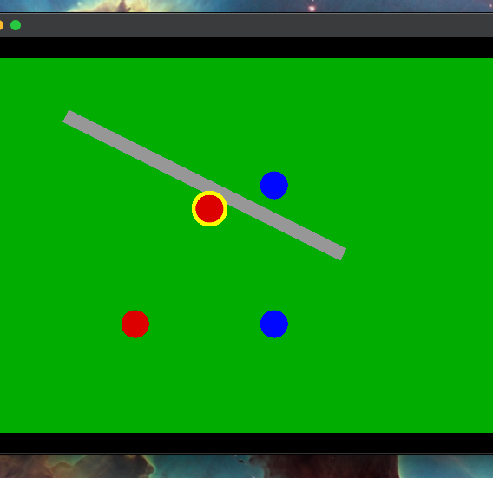
Final Project
For the final project, I ended up making a game where you could only move characters around with no collisions.

