Slide 1
Association Between Maternal Vitamin D Levels and Fetal Growth and Adiposity
A Systematic Review and Meta-Analysis Isabel O. A. & Audencio Victor PROSPERO: CRD42024590338

Slide 2
Background
• Vitamin D [25(OH)D] regulates calcium homeostasis, immune function, cell growth, and gene transcription
• Maternal 25(OH)D crosses the placenta and is essential for fetal skeletal development and growth
• Deficiency (< 50 nmol/L) affects up to 40–60% of pregnant women worldwide
• Fetal growth outcomes: SGA, FGR, biometry (FL, AC, BPD, HC), estimated fetal weight (EFW), adiposity
• Existing evidence is inconsistent due to heterogeneity in study design, VitD cutoffs, and analytical methods
• No comprehensive meta-analysis pooling both observational and RCT data on fetal growth and adiposity
2

Slide 3
Objective
• To synthesize the available evidence on the association between maternal
25(OH)D concentrations during pregnancy and fetal growth and adiposity
• Primary outcome: SGA / FGR (dichotomous)
• Secondary outcomes:
– Fetal biometry / EFW (dichotomous, OR)
– Fetal bone measurements (continuous, MD) from RCTs
– Fetal adiposity
3

Slide 4
Methods — Search Strategy & Eligibility
• PRISMA 2020 guidelines; registered at PROSPERO (CRD42024590338)
• Databases: PubMed, EMBASE, Scopus, LILACS, SciELO, Web of Science
• Search date: up to October 2024
• Inclusion: observational studies and RCTs in pregnant women with 25(OH)D measurement
and fetal growth/biometry/adiposity outcomes
• Exclusion: multiple pregnancies, reviews, editorials, conference abstracts
• PECOS: Population (pregnant women), Exposure (25(OH)D status),
Comparator (sufficient vs deficient), Outcome (fetal growth), Study (obs + RCT)
• Selection: two independent reviewers (AV, IOA); disagreements resolved by consensus
4

Slide 5
Methods — Statistical Analysis
• Dichotomous outcomes: Odds Ratio (OR) with inverse-variance weighting
ln(OR) = ln(a·d / b·c); SE = √(1/a + 1/b + 1/c + 1/d)
• Continuous outcomes (RCTs): Mean Difference (MD)
MD = X̄ₑ − X̄ᴄ; SE = √(s²ₑ/nₑ + s²ᴄ/nᴄ)
• Model selection: adaptive approach
Fixed-effects (Mantel–Haenszel) when I² < 50%
Random-effects (REML) when I² ≥ 50%
• Heterogeneity: Cochran’s Q statistic and I²
I² = [(Q − df) / Q] × 100%
• Publication bias: Egger’s regression, Begg’s rank test, Duval & Tweedie trim-and-fill
• Quality: JBI Critical Appraisal + NOS (observational); Cochrane RoB 2 (RCTs)
• Certainty of evidence: GRADE framework
Software: R (meta, metafor packages)
5

Slide 6
Methods — Key Formulas
Pooled OR (fixed-effects, inverse-variance):
ln(ORₚ) = Σ wᵢ · ln(ORᵢ) / Σ wᵢ , where wᵢ = 1 / SEᵢ²
Random-effects (DerSimonian–Laird / REML):
wᵢ* = 1 / (SEᵢ² + τ²)
τ² estimated via restricted maximum likelihood (REML)
Heterogeneity:
Q = Σ wᵢ(ln ORᵢ − ln ORₚ)² ~ χ²(k−1)
I² = max(0, (Q − (k−1)) / Q × 100%)
Risk Difference (clinical interpretation):
RD = p₀ × (OR − 1) / [1 + p₀ × (OR − 1)]
NNH = 1 / |RD|
Egger’s test: SNDᵢ = ln(ORᵢ) / SEᵢ regressed on precisionᵢ = 1/SEᵢ
6

Slide 7
Results — Study Selection
• Initial search: 3,135 records across 5 databases
• After duplicate removal: 3,412 screened (phase 1)
• Full-text assessed: 30 articles (phase 2)
• Included: 26 studies (24 observational + 2 RCTs)
• Total participants: 26,542
• Countries: 16 (Asia 46%, Europe 31%, America 15%, Africa 4%)
• Publication period: 2010–2025
• Meta-analysis (pooled): k = 4 (SGA/FGR) + k = 4 (Biometry/EFW)
• Narrative synthesis: remaining 18 studies
7

Slide 8
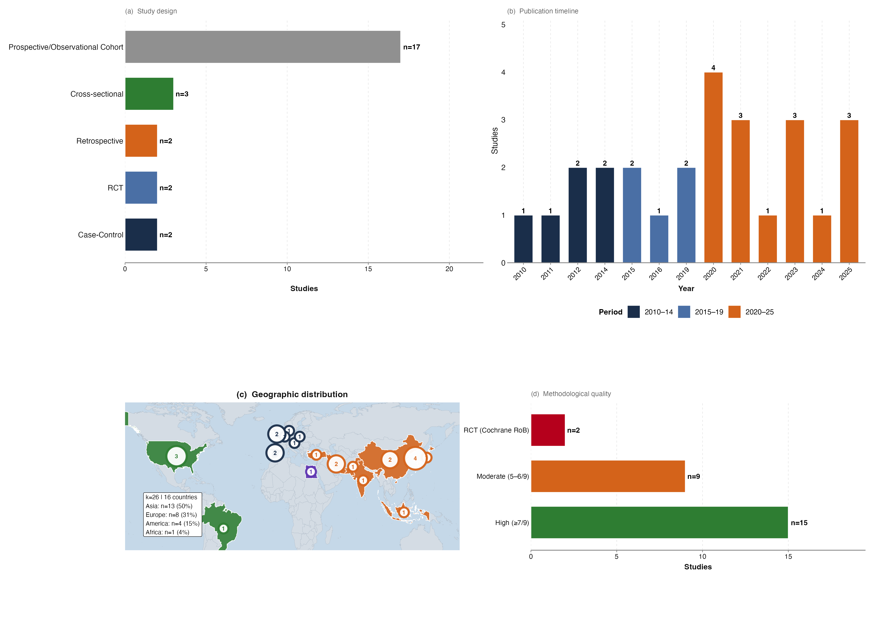
Results — Study Characteristics
8

Slide 9
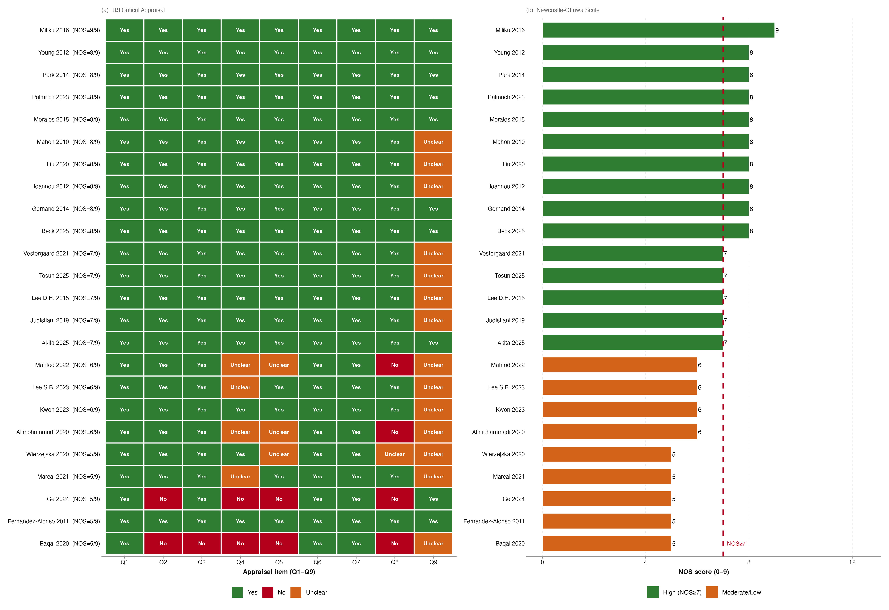
Results — Methodological Quality (JBI + NOS)
JBI Critical Appraisal (Q1–Q9) and Newcastle-Ottawa Scale for 24 observational studies.
9

Slide 10
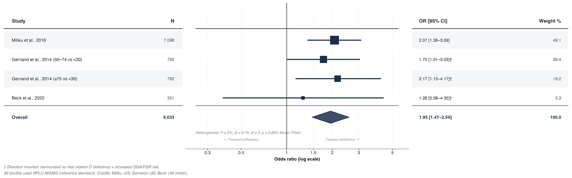
Results — Primary Meta-Analysis: SGA/FGR
Pooled OR = 1.95 (95% CI 1.47–2.59); I² = 0%; Fixed-effects model; k = 4, N = 9,033.
10

Slide 11
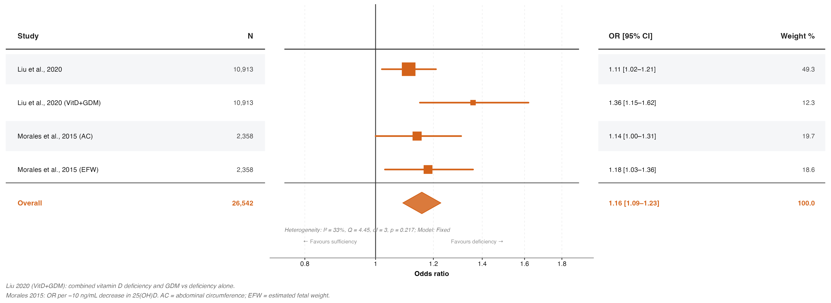
Results — Secondary Meta-Analysis: Biometry/EFW
Pooled OR = 1.16 (95% CI 1.09–1.23); I² = 33%; Fixed-effects model; k = 4, N = 26,542.
11

Slide 12
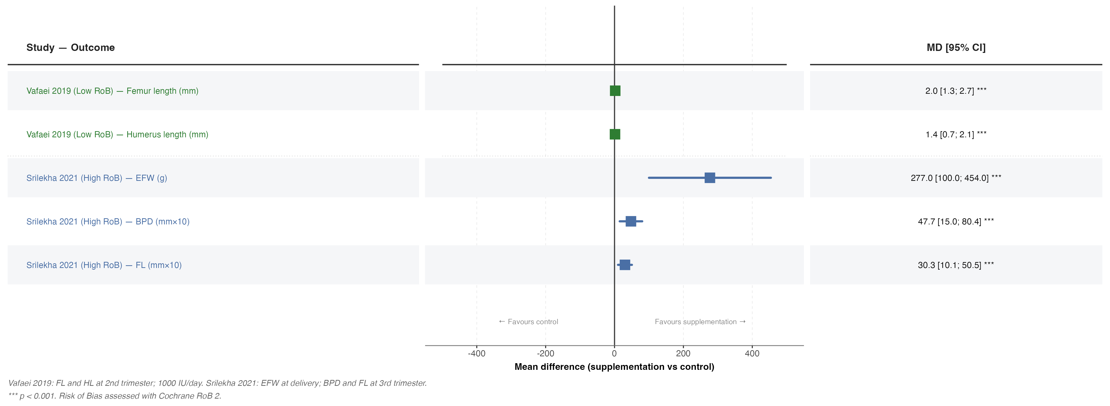
Results — RCT Continuous Outcomes (Mean Difference)
Vafaei 2019 (Low RoB): FL +1.98 mm, HL +1.39 mm. Srilekha 2021 (High RoB): EFW +277 g.
12

Slide 13
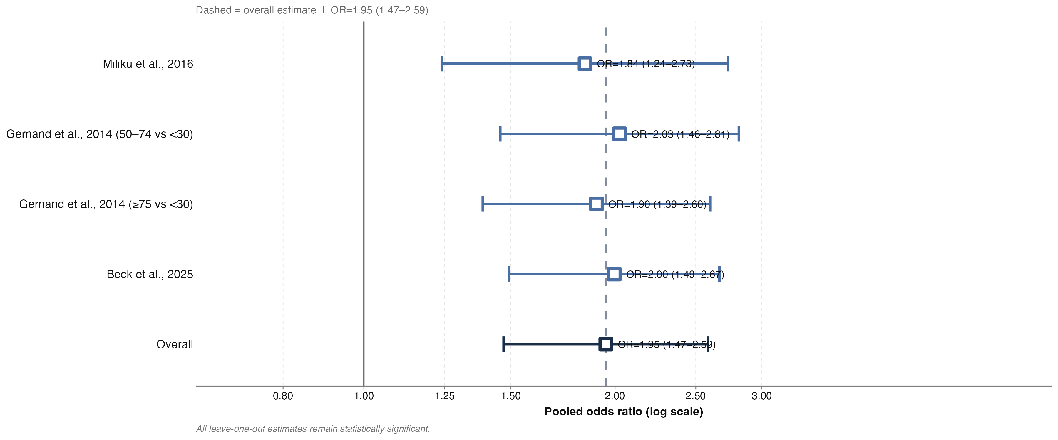
Results — Leave-One-Out Sensitivity Analysis
All LOO estimates remain statistically significant, confirming robustness.
13

Slide 14
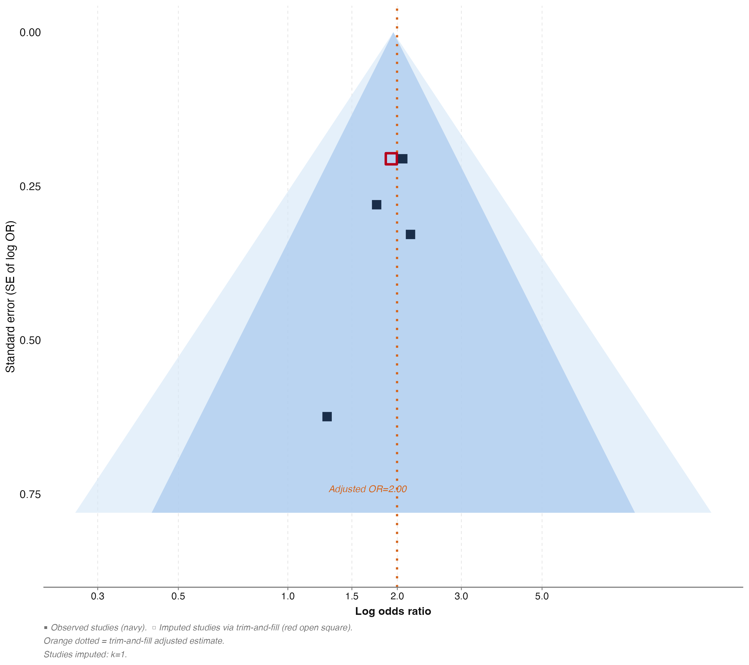
Results — Publication Bias (Funnel Plot & Trim-and-Fill)
Duval & Tweedie trim-and-fill analysis. Egger/Begg tests underpowered (k = 4).
14

Slide 15
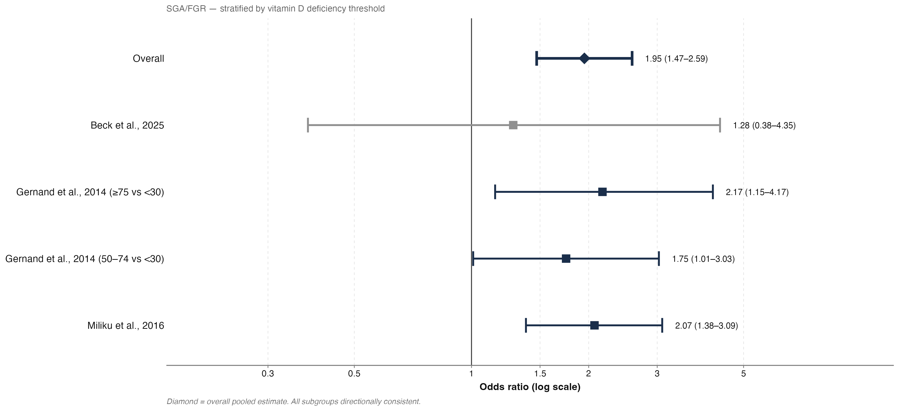
Results — Subgroup by Vitamin D Cutoff
All subgroups directionally consistent regardless of deficiency threshold.
15

Slide 16
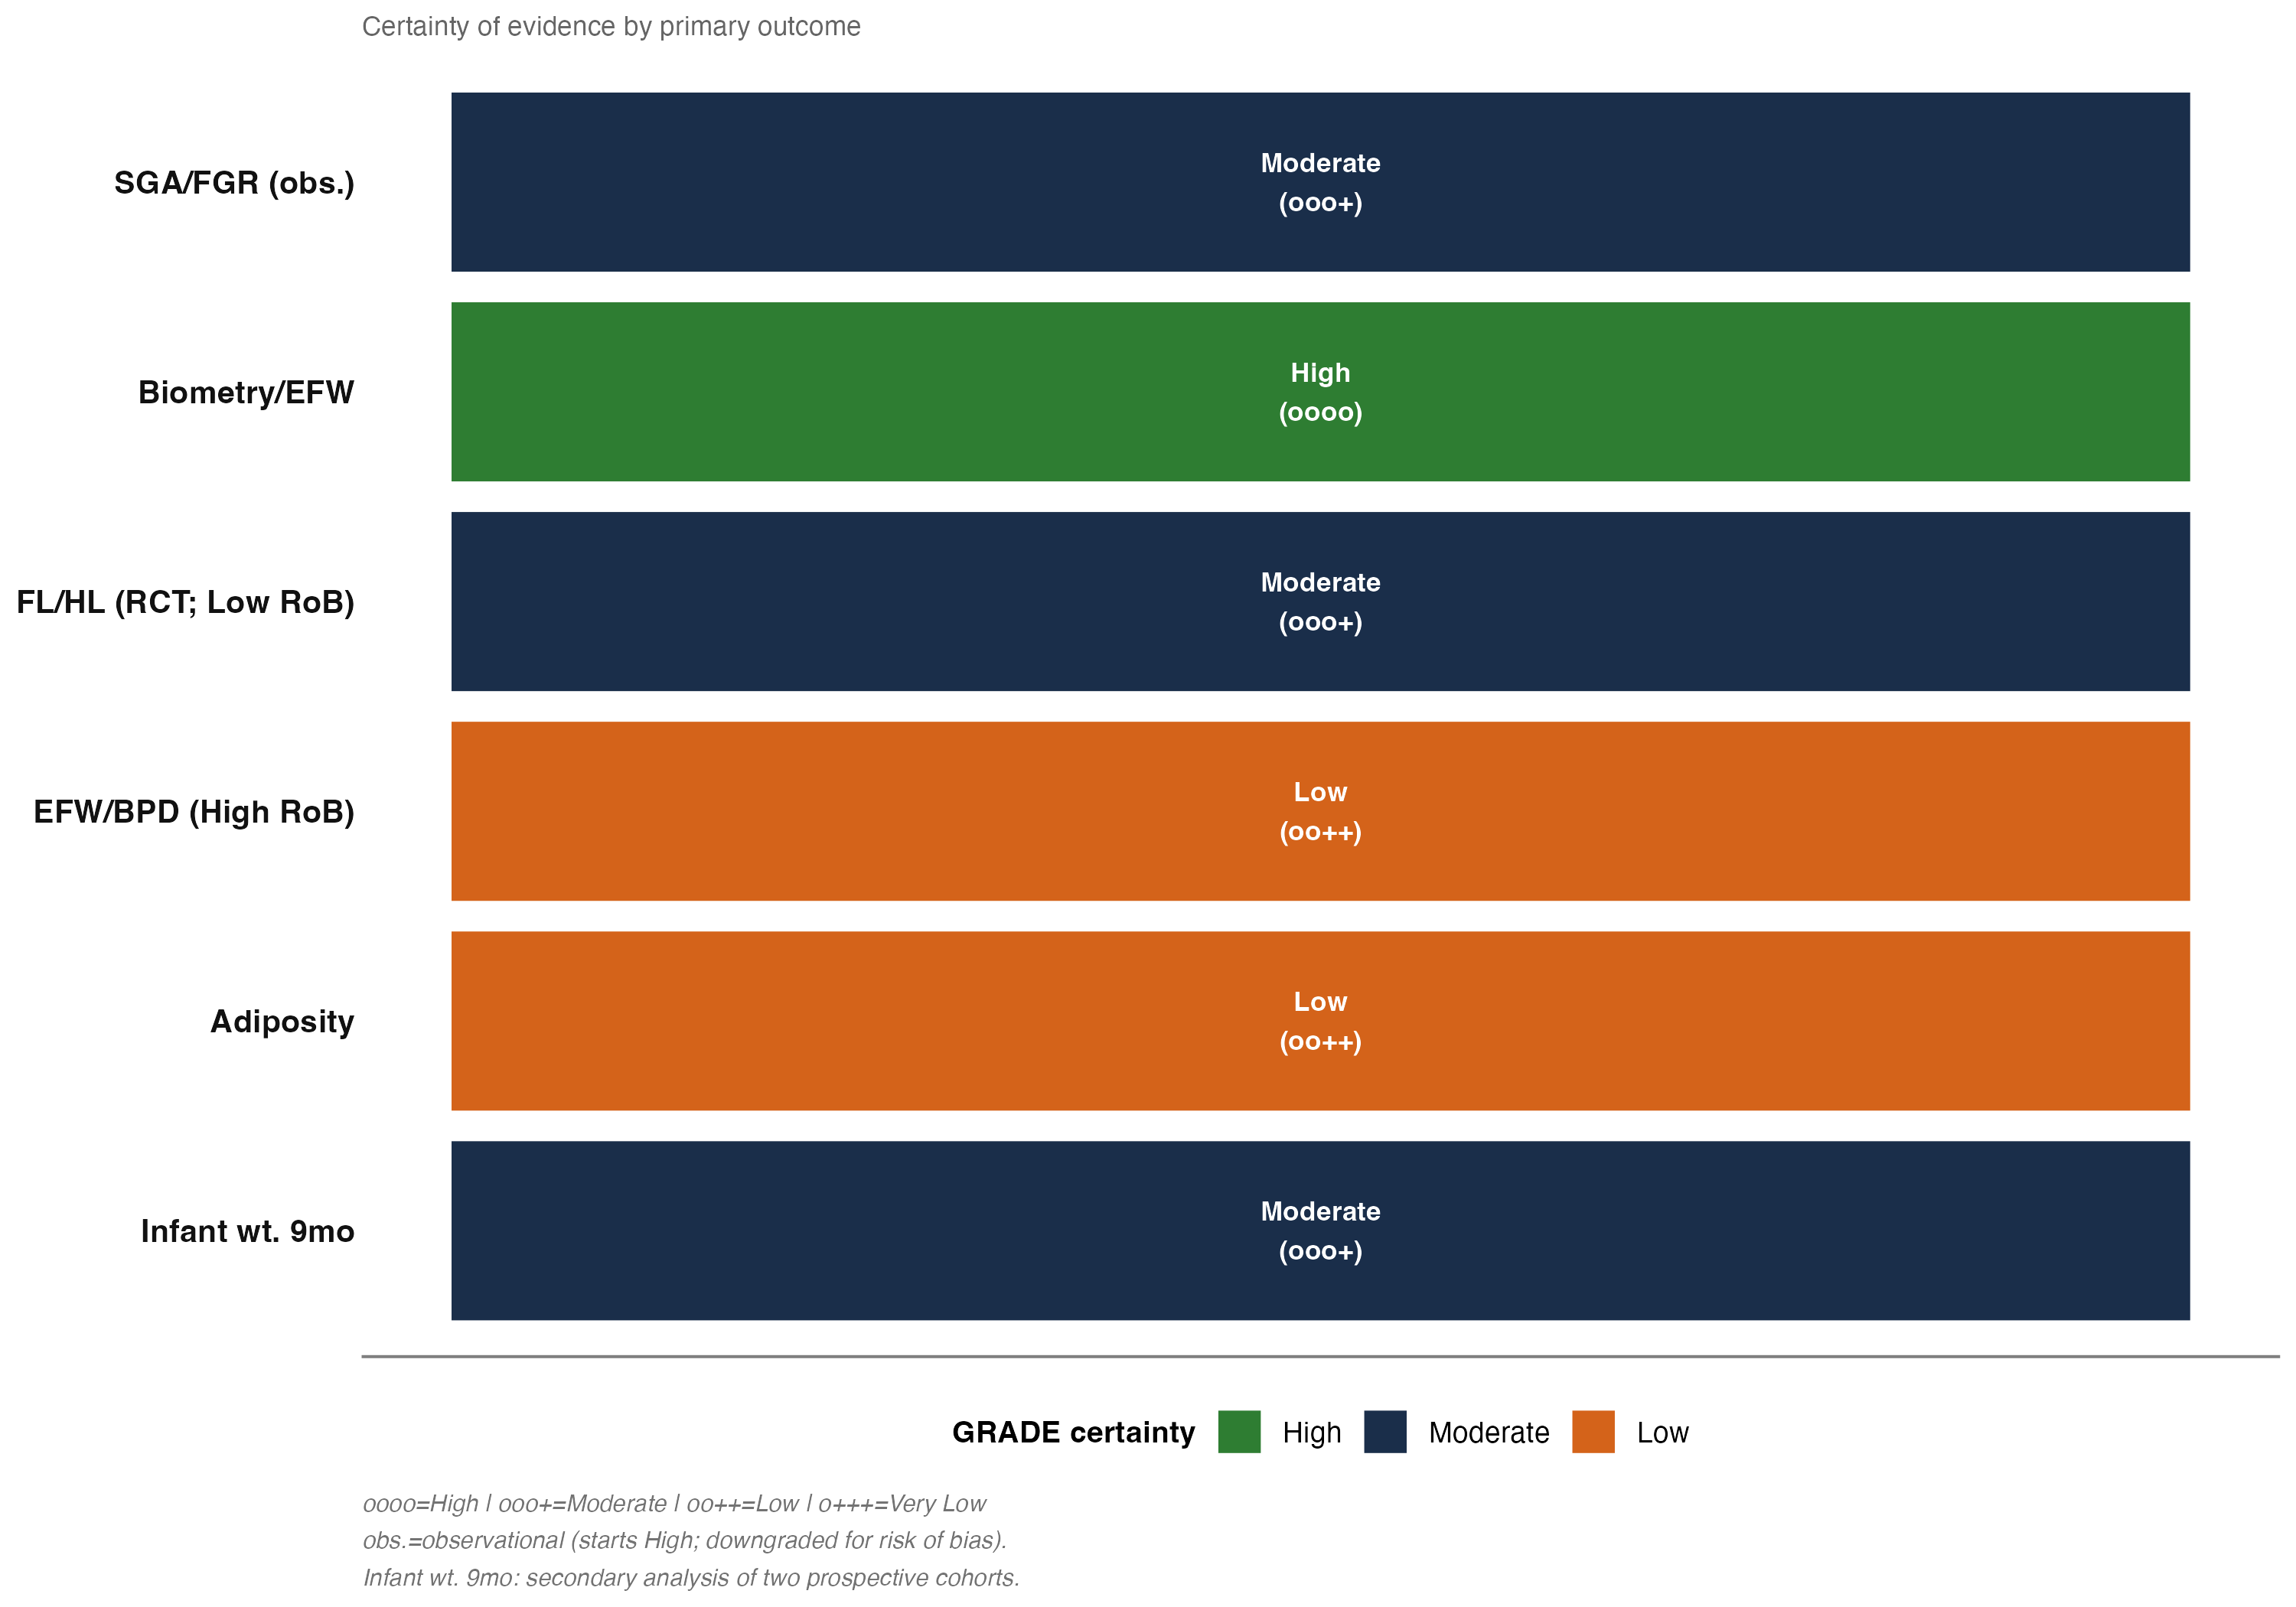
Results — GRADE Evidence Profile
Certainty: High (Biometry/EFW), Moderate (SGA/FGR, FL/HL, Infant wt.), Low (EFW/BPD RCT, Adiposity).
16

Slide 17
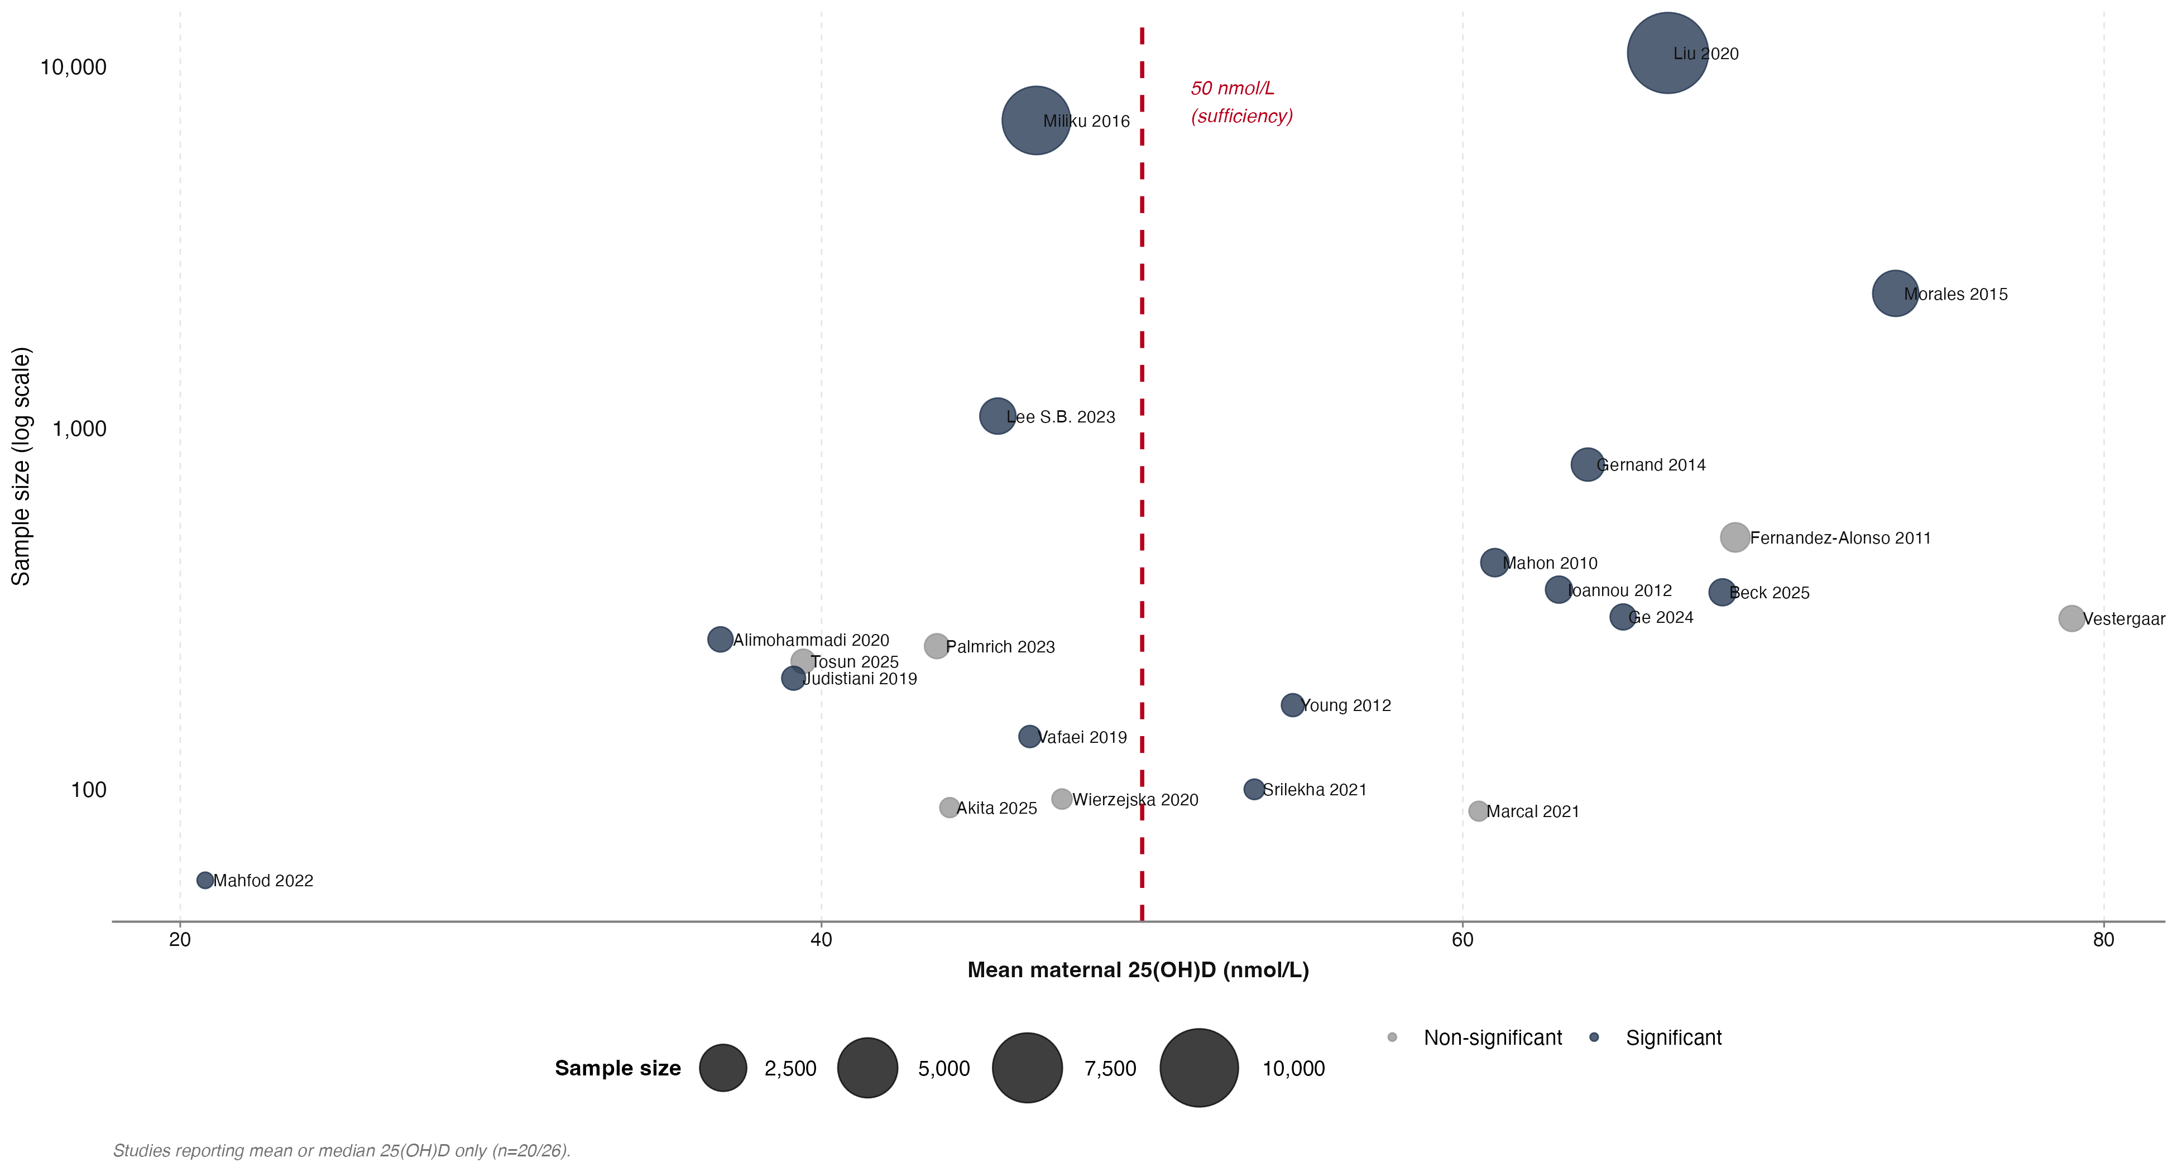
Results — 25(OH)D Concentration vs Sample Size
Studies below 50 nmol/L threshold more frequently reported significant associations.
17

Slide 18
Summary of Key Findings
• Maternal vitamin D deficiency is significantly associated with increased risk of SGA/FGR
OR = 1.95 (1.47–2.59); NNH = 14 (baseline SGA 8%)
• Deficiency also associated with altered fetal biometry/EFW
OR = 1.16 (1.09–1.23); GRADE: High certainty
• RCT evidence (limited): supplementation improves fetal bone length
FL: +1.98 mm (p < 0.001); HL: +1.39 mm (p < 0.001)
• Results robust across sensitivity analyses (LOO, subgroup, trim-and-fill)
• No significant association with fetal adiposity (k = 2; GRADE: Low)
• 15/26 studies (58%) reported significant associations with fetal growth
18

Slide 19
Strengths & Limitations
Strengths:
– Comprehensive search across 6 databases (3,135 records)
– Both observational and RCT evidence synthesized
– Adaptive model selection based on heterogeneity (I²)
– Multiple sensitivity analyses and GRADE assessment
– Dual quality tools (JBI + NOS for observational; RoB 2 for RCTs)
Limitations:
– Small number of poolable studies (k = 4 per analysis)
– Heterogeneity in VitD cutoffs and timing of measurement
– Only 2 RCTs available (1 with high risk of bias)
– Limited evidence on adiposity outcomes
– Residual confounding in observational studies
19

Slide 20
Conclusion
• Maternal vitamin D deficiency during pregnancy is consistently associated
with impaired fetal growth, particularly increased SGA/FGR risk (OR ≈ 2.0)
• Vitamin D supplementation in RCTs shows promising effects on fetal bone growth,
though evidence remains limited (k = 2)
• Clinical implication: screening and correcting vitamin D deficiency in pregnancy
may contribute to improved fetal growth outcomes
• Future research: large-scale RCTs with standardized protocols, consistent cutoffs,
and adiposity as a primary endpoint are needed
20

Slide 21
Thank You
audenciovictor@gmail.com https://github.com/Audency/maternal-vitamin-d-meta-analysis

