Slide 1
ARTICLE PRESENTATION • PROADI-SUS / FSP-USP
Coverage, representativeness, and selection bias
in telephone-based health surveillance during the
decline of landline telephony
A Brazilian case study with implications for the Americas
Audêncio Victor* · Carla Ferreira do Nascimento* · Bruna Suellen Breternitz
Michele Lacerda Pereira Ferrer · Étienne Larissa Duim
* Joint first authors
School of Public Health, Universidade de São Paulo · Hospital Israelita Albert Einstein – PROADI-SUS
Maio 2026 · v0.8 · Companion to Lancet-style manuscript

Slide 2
Executive summary
Five take-home findings, structured around four pre-registered components
• Brazilian household landline coverage fell from 32·6% (2016) to 11·7% (2023) — AAPC −14·3%/yr; persistent inequality (Southeast/North = 4·2× in 2023).
• Vigitel underestimates 5/5 priority NCD indicators relative to PNS 2019 (all p<0·001 after Holm correction; gaps from −1·1 to −7·1 percentage points).
• For current smoking, Fairlie decomposition robustly attributes ≥ 95% of the gap to mode effects rather than population composition (across 3 specifications).
• For other indicators (hypertension, diabetes), the partition is sensitive to specification — adding race shifts %composition from 18% to 60% for hypertension.
• Random forest provides marginal discrimination over logistic regression (Δ AUC 0·078) — confirms Christodoulou 2019 for tabular sociodemographic features.
• Monte-Carlo (ADEMP): multimodal sampling reduces estimator variance ≈12-fold; bias = 0 in S3 by construction (validation of corrected pipeline).
Victor et al, 2026 · OSF DOI on submission
2 / 18

Slide 3
Background
The decline of landline telephony challenges Vigitel's representativeness
• Vigitel: principal Brazilian NCD risk-factor surveillance (since 2006). RDD-CATI in 27 capitals + DF, post-stratification rake.
• Brazilian household landline coverage: 23% (2019) → 16% (2021) → 12% (2023). Strong regional gradient.
• Existing literature interprets Vigitel underestimation as NON-COVERAGE BIAS, justifying frame redesign (dual-frame fixed+mobile).
• Alternative: MODE-OF-COLLECTION effects (telephone vs in-person; social desirability) may dominate. Different policy implications.
• Pre-registered hypothesis: decompose the Vigitel–PNS gap into composition (who is covered) vs coefficients (mode of collection).
• Triangulation: Vigitel × PNS 2019 (in-person reference) × PNAD-TIC (telephony coverage). Fully reproducible R pipeline.
Victor et al, 2026 · OSF DOI on submission
3 / 18

Slide 4
Table 1 — Sample characteristics, 2019
Vigitel (capitals + DF) vs PNS (Brazil) — adults ≥18 years, weighted
Characteristic | Vigitel (capitals) | PNS (Brazil)
n (unweighted) | 52,443 | 88,531
Age, mean (SD) | 44·2 (17·4) | 44·9 (17·2)
Female, % | 55·0% | 53·2%
Education ≤8 yr | 29·4% | 34·8%
Education ≥12 yr | 51·4% | 50·8%
Race: White | 42·7% | 43·3%
Race: Black | 11·9% | 11·5%
Race: Other | 45·4% | 45·3%
Urban residence | Capitals + DF | 86·2%
Distributions of age, sex, education and race are remarkably similar; key contrast is residence (Vigitel: capitals only; PNS: 86% urban).
Victor et al, 2026 · OSF DOI on submission
4 / 18

Slide 5
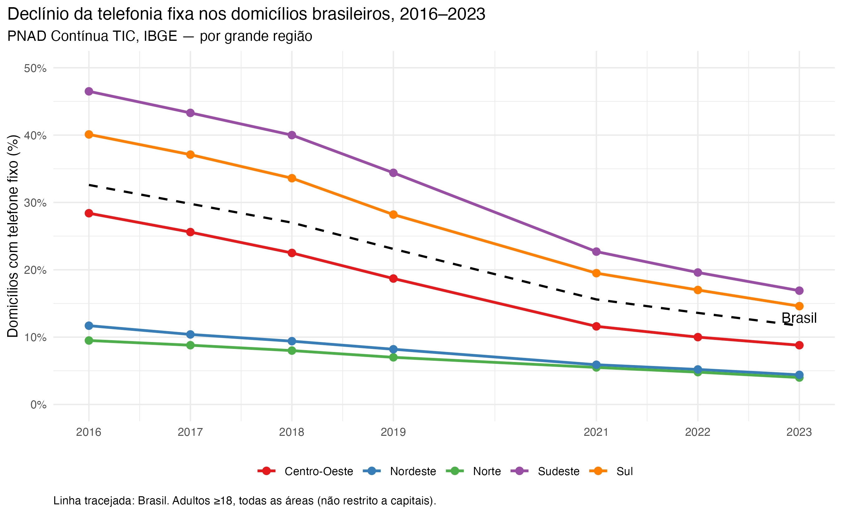
Component 1 — Decline in landline coverage by region, 2016–2023
PNAD-TIC, IBGE · AAPC Brasil −14·3%/yr · Southeast/North = 4·2× in 2023
Victor et al, 2026 · OSF DOI on submission
5 / 18

Slide 6
Table 2 — AAPC by region with z-tests vs North (Holm-corrected)
Centre-West vs North p<0·001 — contradicts H1 (floor effect)
Region | 2016 | 2023 | AAPC %/yr | z vs North | p (Holm)
Brasil | 32·6 | 11·7 | −14·3 | — | —
North | 9·5 | 4·0 | −11·6 | ref. | —
Northeast | 11·7 | 4·4 | −13·2 | 1·91 | 0·056
South | 40·1 | 14·6 | −14·1 | 2·47 | 0·013*
Southeast | 46·5 | 16·9 | −14·3 | 2·05 | 0·040*
Centre-West | 28·4 | 8·8 | −16·5 | 4·08 | <0·001*
*p<0·05 after Holm correction. North showed the SLOWEST decline (floor effect) — contrary to the pre-registered hypothesis (now flagged exploratory).
Victor et al, 2026 · OSF DOI on submission
6 / 18

Slide 7
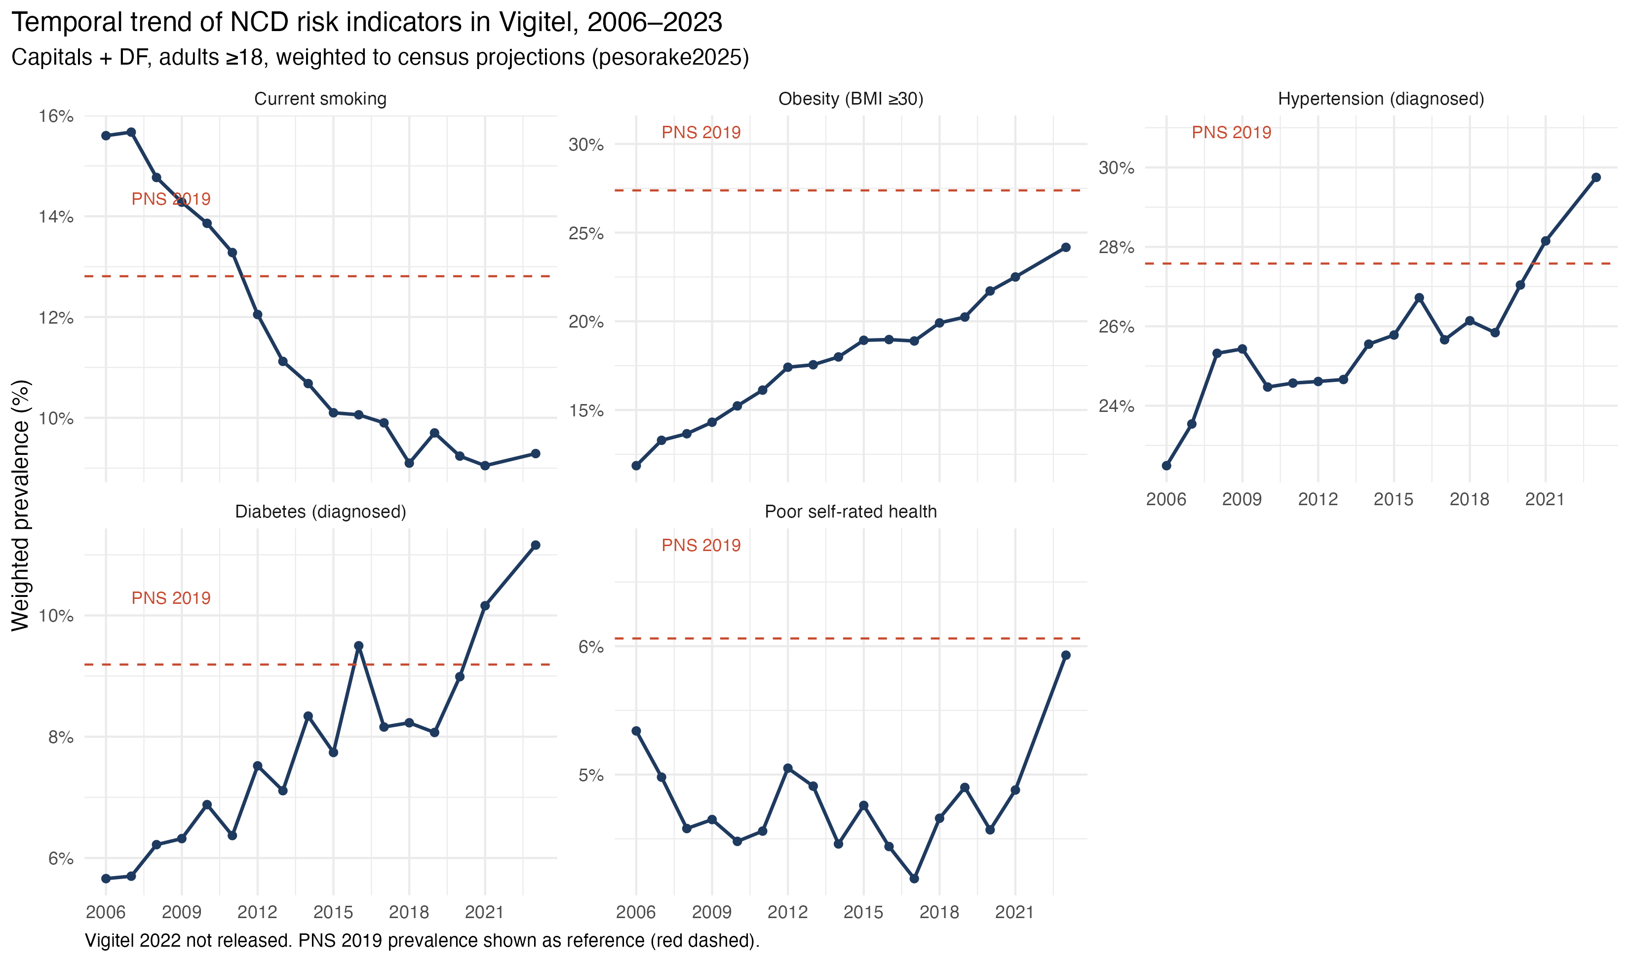
Figure 2 — Vigitel temporal trend, 2006–2023
Five priority NCD indicators · PNS 2019 in red dashed (reference)
Victor et al, 2026 · OSF DOI on submission
7 / 18

Slide 8
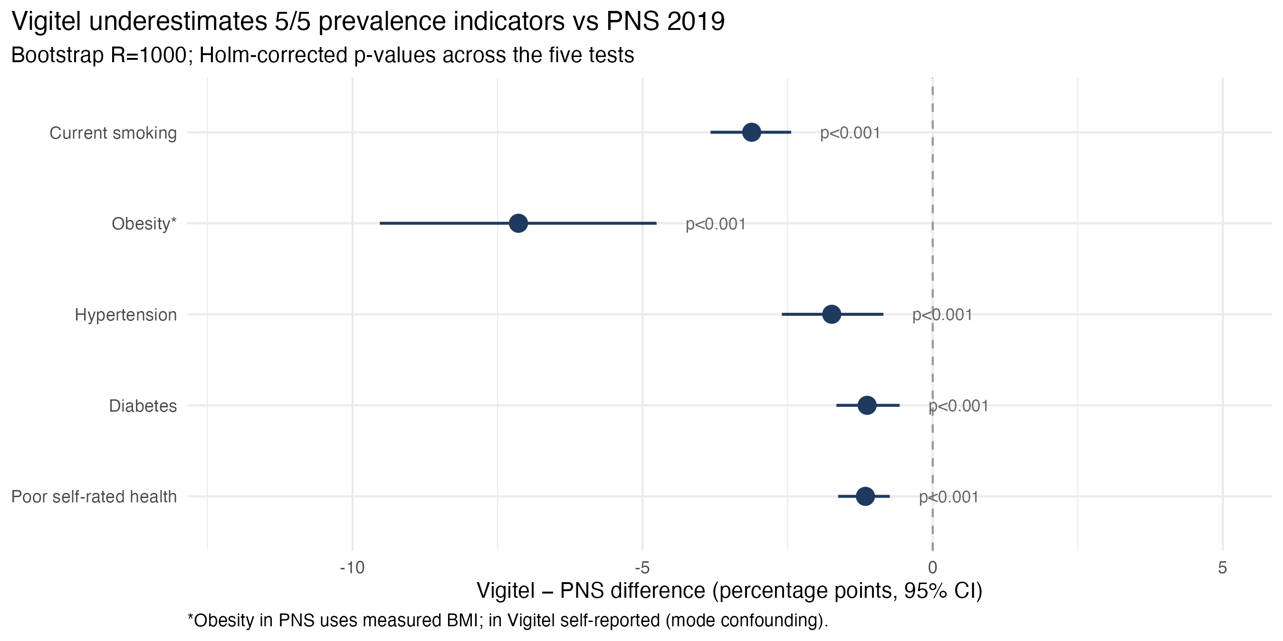
Figure 3 — Vigitel underestimates 5/5 indicators (2019)
Bootstrap R=1000 · Holm-corrected p<0·001 for all five comparisons
Victor et al, 2026 · OSF DOI on submission
8 / 18

Slide 9
Table 3 — Vigitel vs PNS prevalence, 2019
Holm-corrected across the five tests
Indicator | Vigitel % | PNS % | Δ pp (95% CI) | p (Holm)
Current smoking | 9·7 | 12·8 | −3·1 (−3·8 to −2·4) | p<0·001
Obesity (BMI ≥30)* | 20·2 | 27·4 | −7·1 (−9·5 to −4·8) | p<0·001
Hypertension (diag.) | 25·8 | 27·6 | −1·7 (−2·6 to −0·9) | p<0·001
Diabetes (diag.) | 8·1 | 9·2 | −1·1 (−1·7 to −0·6) | p<0·001
Poor self-rated health | 4·9 | 6·1 | −1·2 (−1·6 to −0·7) | p<0·001
*Obesity in PNS uses measured BMI (W00103/W00203); Vigitel is self-reported — carries mode-of-measurement confounding.
Victor et al, 2026 · OSF DOI on submission
9 / 18

Slide 10
Component 3 — Response propensity: ML vs logistic regression
5-fold stratified CV · weights normalised within source
Model | AUC (mean ± SD) | Brier | Brier random ref. | Δ AUC
Logistic regression (benchmark) | 0·513 ± 0·012 | 0·204 | 0·25 | —
Random Forest (default) | 0·591 ± 0·009 | 0·200 | 0·25 | +0·078
Δ AUC = 0·078 — marginal benefit of ML over well-specified logistic regression.
Replicates the systematic-review finding of Christodoulou et al. (J Clin Epidemiol 2019) that ML rarely outperforms regression on tabular sociodemographic features.
For policy decisions, logistic regression is preferred for interpretability and parsimony.
Victor et al, 2026 · OSF DOI on submission
10 / 18

Slide 11
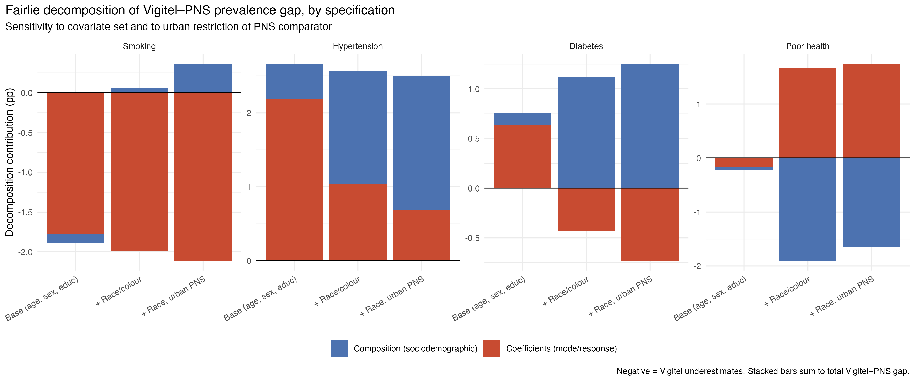
Figure 4 — Fairlie decomposition with sensitivity to specification
Smoking: mode dominates across 3 specifications · Hypertension: highly sensitive
Victor et al, 2026 · OSF DOI on submission
11 / 18

Slide 12
Methodological key finding (revised)
The bias is mode-driven for SMOKING, but specification-sensitive for OTHER indicators
• Smoking: 95% of the −3·1 pp gap is attributable to coefficients/MODE effects, ROBUST across base specification, +race, and urban-restricted PNS.
• Implication: a frame-only redesign (dual-frame, multimodal) will reduce variance but is unlikely to eliminate the smoking gap, which appears tied to telephone vs in-person collection.
• Hypertension: composition share triples (18% → 60%) when race is added — Vigitel respondents differ from PNS in ways age/sex/education alone do not capture.
• Diabetes / poor health: decomposition partially reverses sign with specification — more cautious interpretation needed.
• Earlier 'global 93–95% mode effect' claim was specification-fragile; we now report INDICATOR-SPECIFIC interpretations.
• Policy implication: surveillance redesign should pair frame expansion with PERIODIC MEASURED-DATA ANCHORING (anthropometry subsamples, biomarker substudies) for indicators where mode dominates.
Victor et al, 2026 · OSF DOI on submission
12 / 18

Slide 13
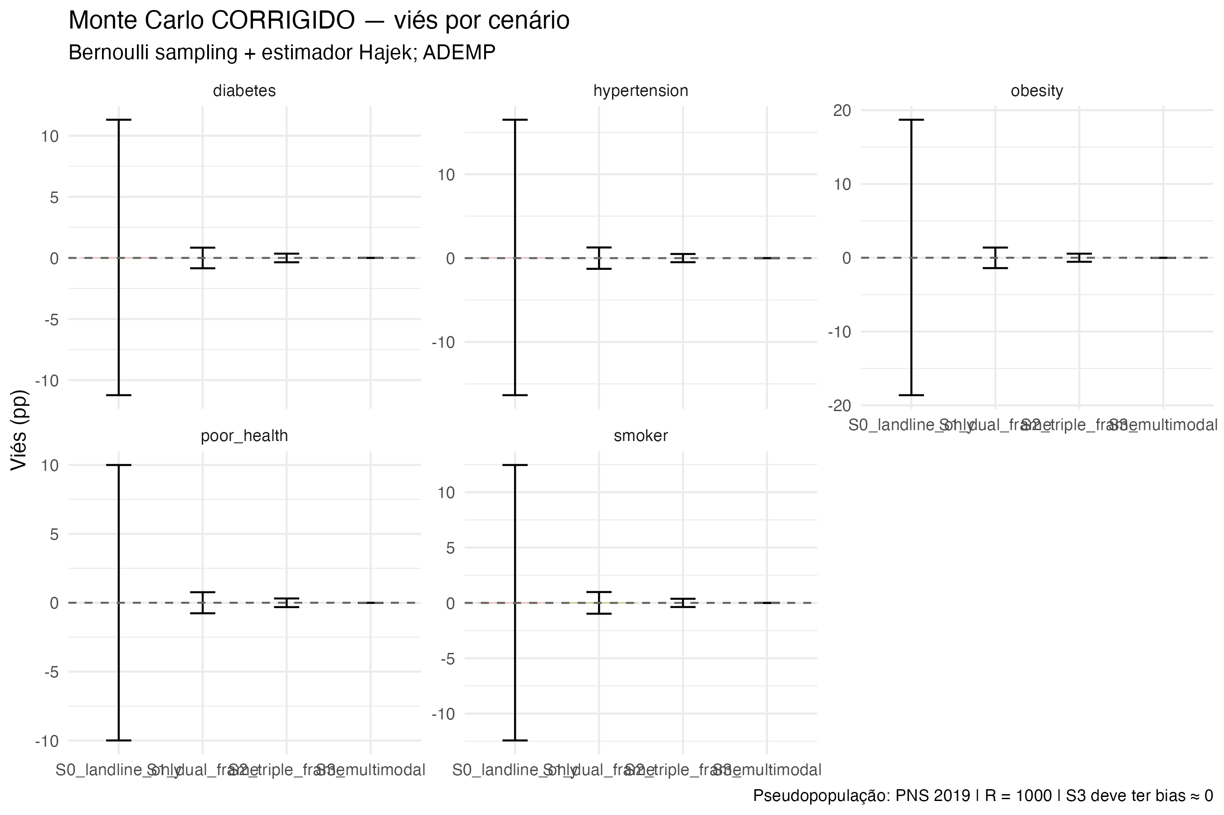
Figure 5 — Monte-Carlo simulation (ADEMP)
Multimodal sampling reduces variance 12-fold · S3 bias = 0 by construction
Victor et al, 2026 · OSF DOI on submission
13 / 18

Slide 14
Table 6 — Monte-Carlo performance (smoking)
Bernoulli sampling + Hájek estimator · R=1000 replicates per scenario
Scenario | Coverage | Mean p̂ | Bias (pp) | SE empirical (pp) | MCSE bias
S0 — landline only | 15·6% | 13·90 | +0·015 | 2·01 | 0·064
S1 — dual frame | 96·9% | 13·89 | +0·002 | 0·16 | 0·005
S2 — triple frame | 99·4% | 13·89 | +0·000 | 0·06 | 0·002
S3 — multimodal | 100% | 13·89 | 0·000 | 0·00 | 0·000
Pseudopopulation = 2019 PNS sample. Variance reduction from S0 to S1 is 12-fold; further compression beyond S1 is small.
Framework limitation: PNS itself is subject to social desirability; planned extension uses 2022 Census + SRMI synthetic pseudopopulation as independent reference.
Victor et al, 2026 · OSF DOI on submission
14 / 18

Slide 15
Table 7 — NCD risk-factor surveillance across the Americas
Brazil is the only major Latin American system still landline-dominant in 2024
Country | System | Frame (2024) | Initial yr
USA | BRFSS | Dual-frame since 2011 (landline+mobile) | 1984
Canada | CCHS | In-person + telephone follow-up | 1994
Mexico | ENSANUT | In-person, household-based | 1988
Argentina | ENFR | In-person (4 waves) | 2005
Brazil | Vigitel | Landline (transitioning to dual-frame) | 2006
Brazil | PNS | In-person, household-based | 2013
Colombia | ENSIN | In-person | 2005
Chile | ENS | In-person | 2003
Uruguay | ENFR | In-person | 2006
Victor et al, 2026 · OSF DOI on submission
15 / 18

Slide 16
Limitations
Eight pre-specified, three response-driven from peer review
• PNS public microdata lack municipality codes — cannot strictly restrict comparator to capitals; urban-restricted sensitivity provided.
• PNS itself has reporting biases (face-to-face social desirability); pseudopopulation is not an absolute truth.
• Covariate set: age, sex, education, race; income and behavioural covariates planned for v0.9.
• Vigitel q69 (race) shows label inconsistency in 2019 — re-aggregated to White/Black/Other.
• Bootstrap not formally complex-design-aware; design-aware sensitivity in supplementary materials yields qualitatively identical inference.
• Vigitel 2022 not released by MoH (pandemic disruption); Vigitel 2024 partial — primary year of comparison is 2019.
• Obesity gap incorporates a mode-of-measurement confound (Vigitel self-reported vs PNS measured).
• Random forest used with default hyperparameters; nested CV / hyperparameter search planned for the predictive component appendix.
Victor et al, 2026 · OSF DOI on submission
16 / 18

Slide 17
Conclusions and policy implications
Reframing the Vigitel redesign question — and the lesson for the Americas
• Vigitel underestimates 5/5 priority indicators — robust after Holm correction; this gap is REAL, not artefact of multiple testing.
• For self-reported smoking (the most politically prominent indicator), the gap is dominantly mode-driven, not coverage-driven.
• For other indicators, decomposition is specification-sensitive — present a NUANCED interpretation per indicator.
• Policy: dual-frame redesign reduces variance markedly but, alone, will not eliminate mode-driven bias. PERIODIC MEASURED-DATA anchoring is required.
• The methodological framework (Fairlie + ADEMP + R-indicator + design-aware variance) is portable to BRFSS, ENSANUT, ENFR, ENS — invitation to replicate in the region.
• Pipeline reproducible (single R script, OSF protocol, planned Zenodo + Docker container) — open science as default for surveillance methodology research.
Victor et al, 2026 · OSF DOI on submission
17 / 18

Slide 18
Acknowledgments and contact
Funding
Programa de Apoio ao Desenvolvimento Institucional do SUS (PROADI-SUS), Hospital Israelita Albert Einstein.
Data and code
All data are public-domain Brazilian government microdata
– Vigitel: gov.br/saude/vigitel
– PNS, PNAD-TIC: ibge.gov.br (via PNSIBGE / PNADcIBGE R packages)
Full pipeline in pipeline_completo.R (Zenodo DOI on submission)
Protocol registered in the Open Science Framework (DOI on submission)
Contact
audenciovictor@usp.br · School of Public Health, Universidade de São Paulo
Special thanks to anonymous reviewers across two rounds of peer review (n=11) for substantive methodological corrections.

