Slide 1
TEAM 3 PROJECT PRESENTATION
Karel Gutierrez, Audrey Romero, Eric Wimpee
Instructor: Alex Milevich

Slide 2
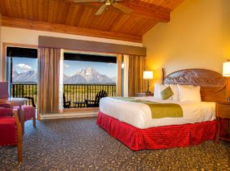

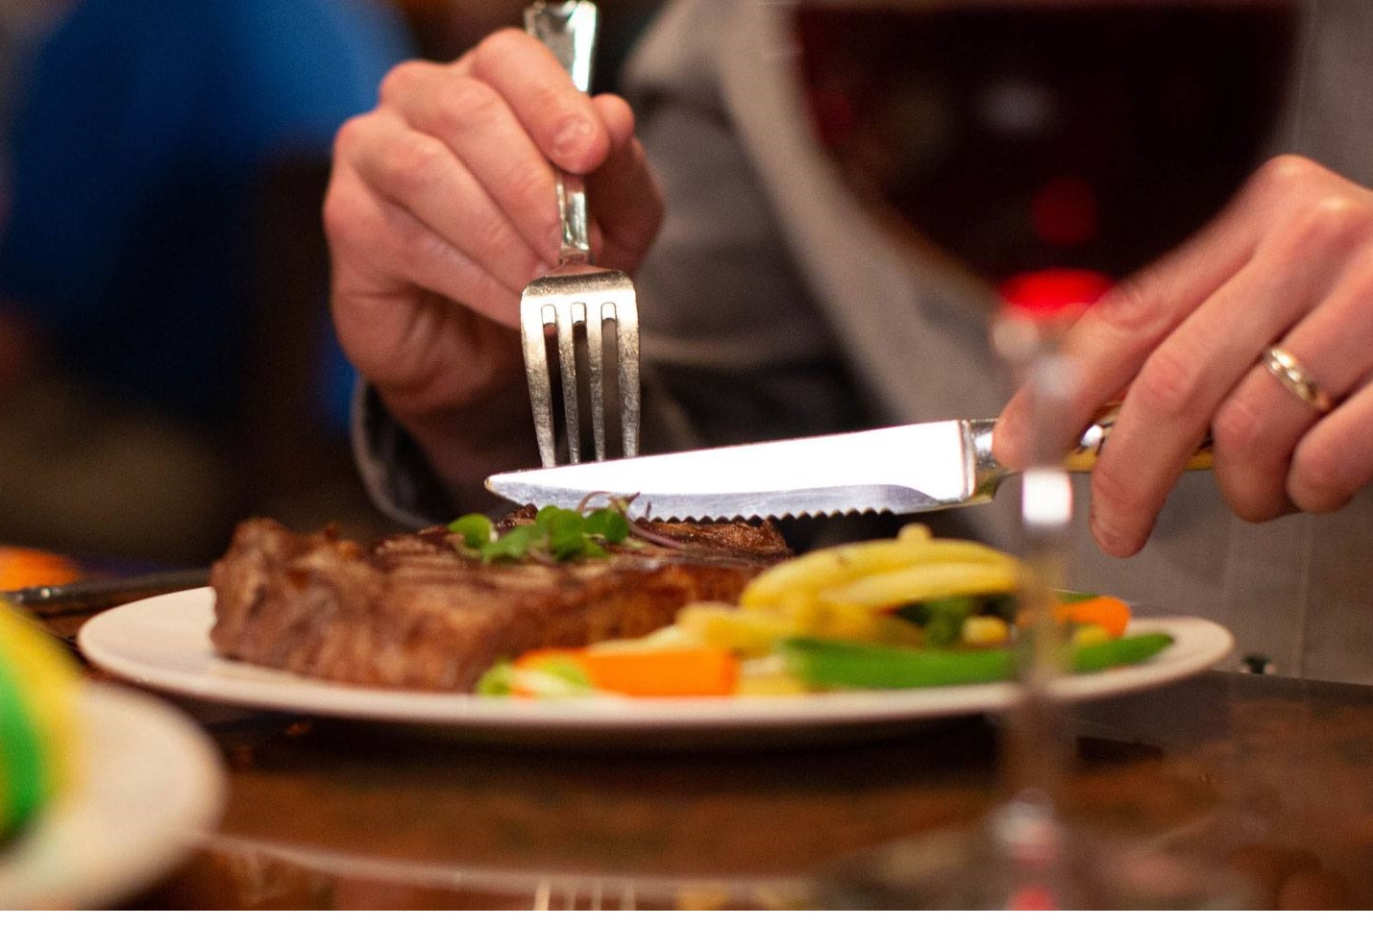
Expense Reimbursement System
Allows reimbursement for employees
Lodging
Travel
Food
Other

Slide 3


Expense Reimbursement System
Employee Login
Submit reimbursement ticket
Finance Manager Login
View and Approve/Deny all requests

Slide 4




Technologies Utilized
Spring Tool Suite ver. 3.9
Apache Tomcat ver. 9
GitHub
Java ver. 1.8

Slide 5



Technologies Utilized (continued)
JUnit ver. 5
JavaScript ver. 6
Oracle SQL Developer ver. 18.3

Slide 6
Programmer Roles
Karel Gutierrez:
DAO/DAO IMPL creation
Request Helper implementation
Audrey Romero:
DAO/DAO IMPL creation
Controller creation
Database construction
Repository management
Eric Wimpee:
Model construction
Servlet creation
Presentation production

Slide 7
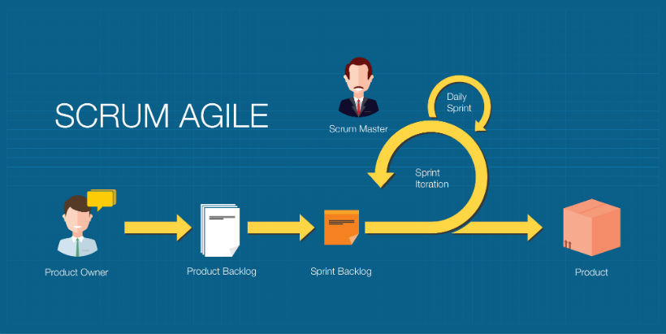
Methodologies
Agile
SCRUM:
SCRUM Master: Alex Milevich
SCRUM Team: Karel, Audrey, Eric
Test-Driven Development

Slide 8


Tech Demonstration

Slide 9

Thank you for your time!
Team3: Karel Gutierrez, Audrey Romero, Eric Wimpee

