Slide 1

Business Resource for the wine industry - Linking wine quality to its physicochemical properties
202a Stats Programming Project
Presented By: Liuli Chen Ankush Verma Cenlin He

Slide 2

Motivation
Wine is tasty
Almost 80% of US Population consumes wine
California accounts for 90% American wine production
Help the industry understand the factors affecting the wine quality

Slide 3
Dataset
Data source: UCI Database (https://archive.ics.uci.edu/ml/machine-learning-databases/wine-quality/)
Data: red & white vinho verde wine from Portugal
Number of samples: red wine (1599), white wine (4898)
Input variables (based on physicochemical lab tests):
-> fixed acidity -> volatile acidity -> citric acid
-> residual sugar -> chlorides -> free sulfur dioxide
-> total sulfur dioxide -> density -> pH
-> sulphate -> alcohol
Output variable (based on sensory data):
-> wine quality (score between 0 (bad) and 10 (good))
Notes:
Add wine source region

Slide 4
Methodology
Exploratory Data Analysis
Variable statistics, distribution and correlation analysis
Outlier removal
Multiple linear regression
Model evaluation (normal Q-Q, REC analysis, etc.)
Influential points
Generalized additive model with kernel regression
Model evaluation and comparison with multiple linear model

Slide 5
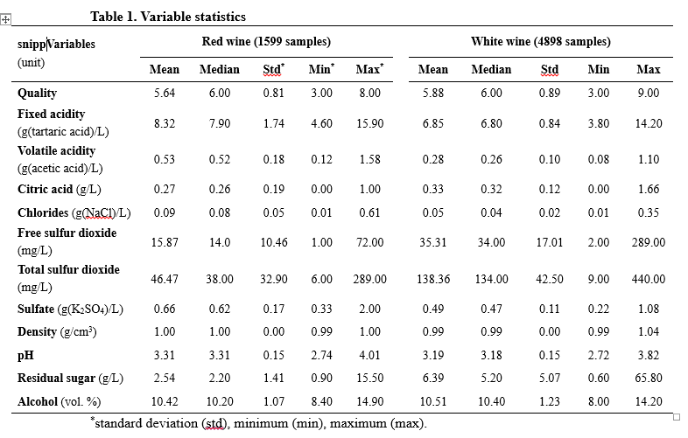
Exploratory Data Analysis

Slide 6
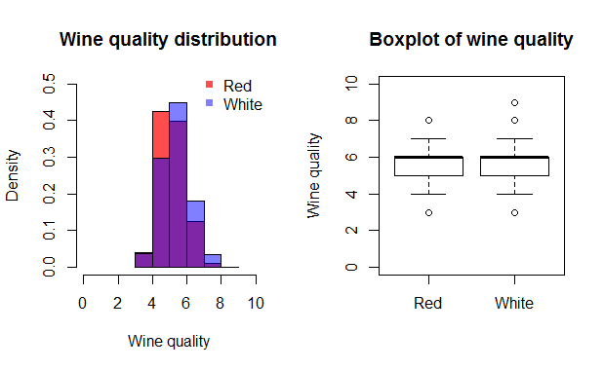
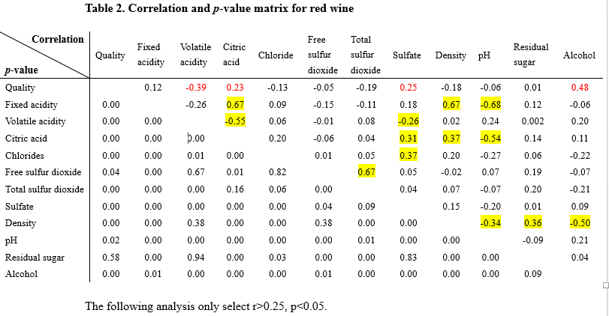
Exploratory Data Analysis
NOTE
White wine is quite different from red ones in correlation with these variables.
Correlations between input variables (marked by yellow):
e.g., Citric acid, Fixed acidity, Volatile acidity, and pH are correlated with each other, because they all reflect the acidity of wine to some extent.

Slide 7
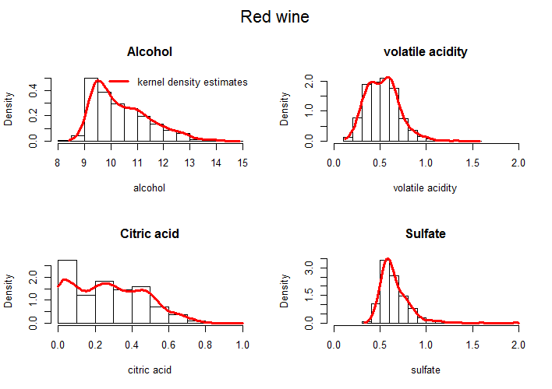
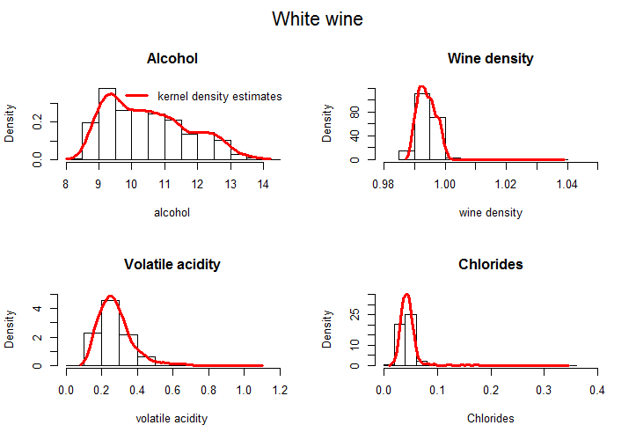
Kernel Density Estimation
Key Notes
4 important attributes for red & white wine are selected, which show the highest correlation with wine quality based on the preceding analysis.
The 4 key attributes (and the corresponding distribution) of white and red wine are different, which contributes to the different tastes of white and red wines

Slide 8
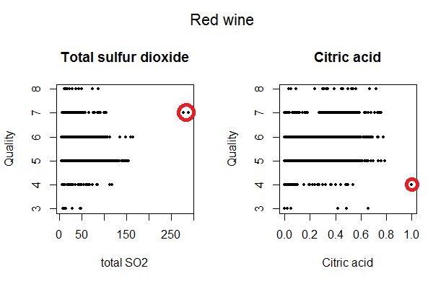
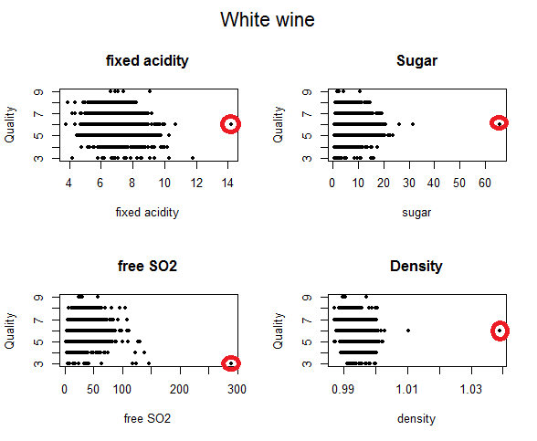
Outlier Removal
R²: 0.3567 -> 0.3644
R²: 0.2806 -> 0.2877

Slide 9
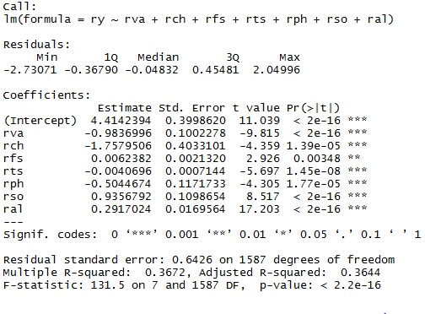
Results: Multiple Linear Regression
Red wine (R² = 0.36): alcohol, volatile acidity, free sulfur dioxide, pH, sulfate, chloride, total sulfur dioxide
White wine (R² = 0.29): alcohol, volatile acidity , free sulfur dioxide, pH, sulfate, fixed acidity, density, residual sugar

Slide 10
Error Analysis: Multiple Linear Regression

Slide 11
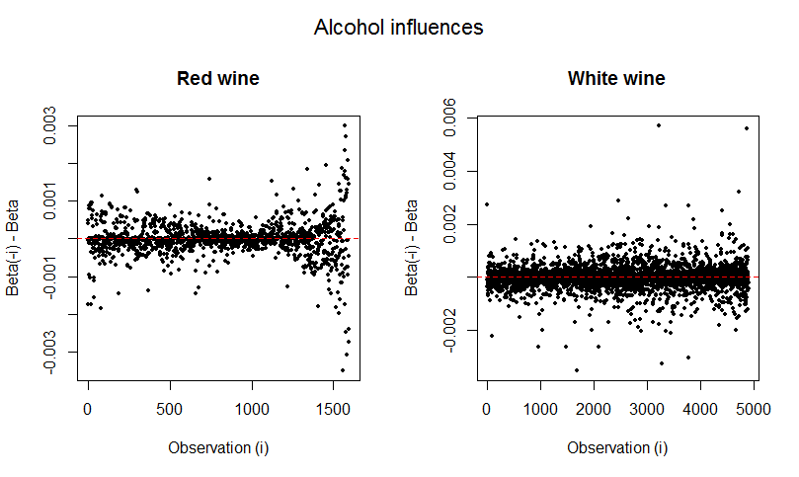
Influential Points

Slide 12
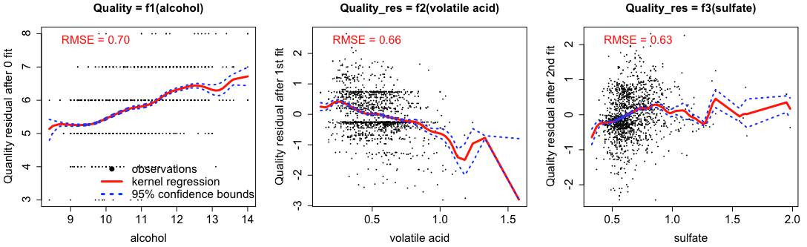
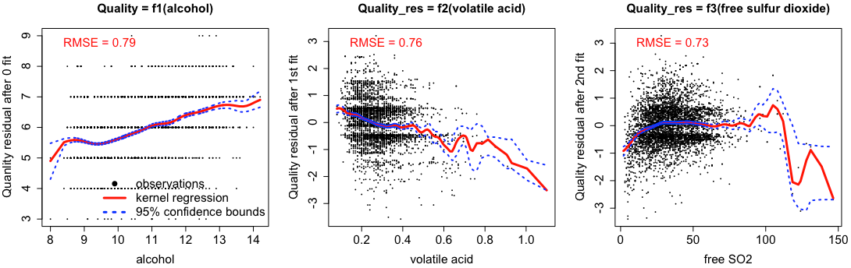
Generalized Additive Model with N-W kernel regression
Quality (Red wine) = f₁(alcohol) + f₂(volatile acidity) + f₃(sulfate) + f₄(chloride) + f₅(sugar) + f₆(pH)
Quality (White wine) = f₁(alcohol) + f₂(volatile acidity) + f₃(free SO2) + f₄(chloride) + f₅(sugar) + f₆(fixed acidity)

Slide 13
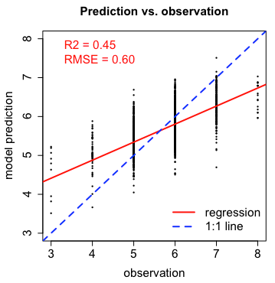
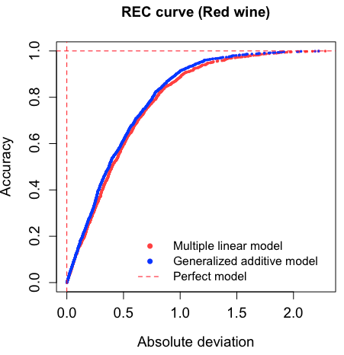
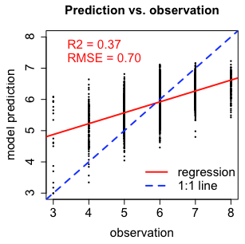
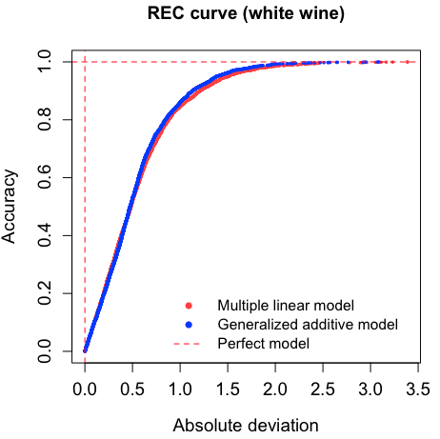
Model evaluations: Generalized Additive Model
Red wine: (for comparison: multiple linear regression: R² = 0.37, RMSE = 0.64)
White wine: (for comparison: multiple linear regression: R² = 0.29, RMSE = 0.75)

Slide 14
Implications and conclusions
We found that the amount of alcohol (+), volatile acidity (-), sulfate (+), free sulfur dioxide (+) and pH (-/+) have significant effects on both red and white wine quality.
Relatively high pH could increase the taste of white wine, but decrease the taste of red wine.
Sweetness (residual sugar) is more important for white wine (increase taste).
Density has a negative effects on white wine quality, probably reflecting the purity of wine (lower density -> higher alcohol fraction -> more pure -> more tasty)
Since these wine physicochemical properties can be controlled during wine production, our results could be helpful for the wine industry to produce more tasty wine.

Slide 15
Limitations & Future research
Missing variables like temperature, other chemical components
Outlier removal method
Limitation on analysis methods
Other analysis methods: SVM, neural network, cluster analysis
Using more variables if the data is available
Further studying some key factors (e.g. sugar, alcohol, pH, etc.) in more details.

Slide 16
THANK YOU

