Slide 1
Spoken Language Identification using Neural Network
Prepared under the guidance of
Dr. Shampa Chakraverty
by:
Aditya Jain 210/CO/13
Anmol Pandey 233/CO/13
Anmol Varshney 234/CO/13

Slide 2
Introduction
The problem of automatic language identification (LID) can be defined as the process of automatically identifying the language of a given spoken utterance.
LID can be used by speech recognition systems, multilingual translation systems or call-centers(e.g., emergency calls) routing.
Also LID can be used by intelligence and security, where the language identities of recorded messages need to be established before any information can be extracted.
Notes:
Problem and its use
Emergency mein quick response chaiye

Slide 3
Introduction
Our project aims at spoken language identification in speech audio samples using Deep Learning Models (DNNs).
We have used acoustic modelling for our LID system. Audio is divided into small chunks called frames and raw audio signal from each frame is transformed by applying the mel-frequency cepstrum.
The coefficients from this transformation called MFCCs are used as input to the acoustic model.
Notes:
How are we doing it
phonotactic and prosody bhi hote hai

Slide 4
Problem Statement
To construct efficient as well as effective Language Identification(LID) model using two stage Neural Network.
Notes:
Just read
Two stage being coarse and fine

Slide 5
Related Work
Notes:
Problem and its use

Slide 6
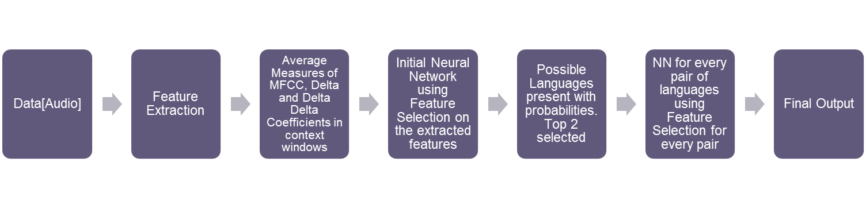
Our Proposal
Workflow of project
Notes:
Just brief talk about workflow

Slide 7
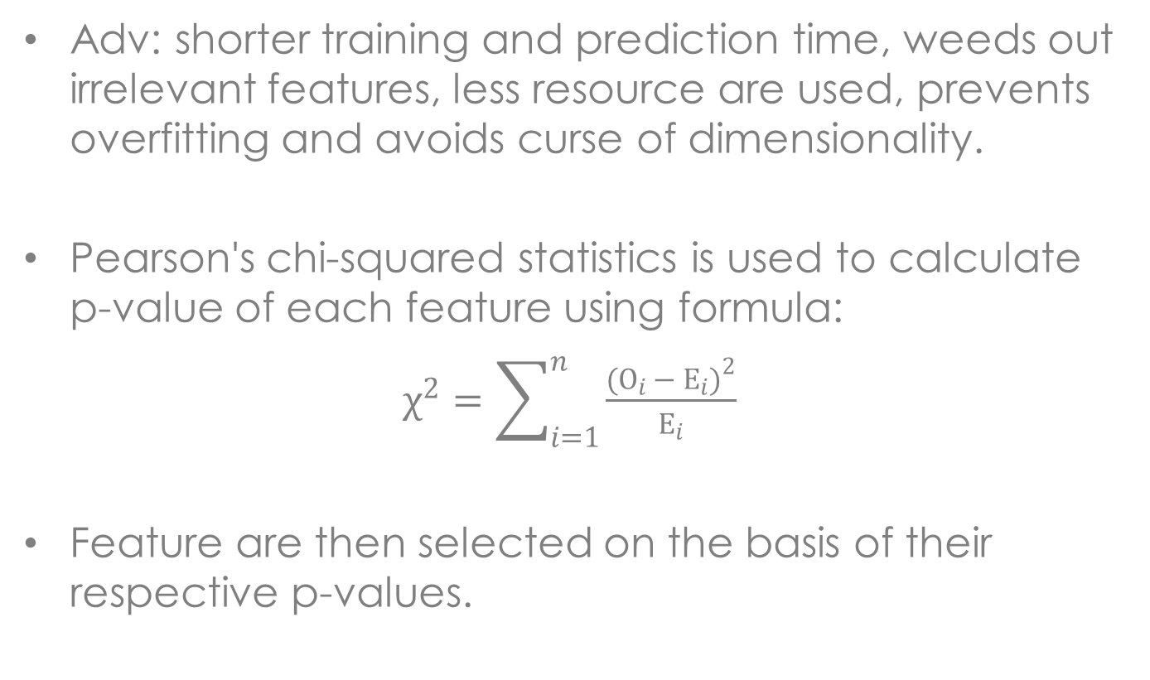
Feature Selection
Adv: shorter training and prediction time, weeds out irrelevant features, less resource are used, prevents overfitting and avoids curse of dimensionality.
Pearson's chi-squared statistics is used to calculate p-value of each feature using formula:
$χ^{2}=\sum_{i=1}^{n}{\frac{{(O_{i }− E_{i})}^{2}}{E_{i}}}$
Feature are then selected on the basis of their respective p-values.
Notes:
Problem and its use

Slide 8
Result
Notes:
Problem and its use

Slide 9
Real Time Analysis
Fast prediction time of hybrid model allowed us to do real time analysis of audio.
pyAudio was used as audio I/O library.
Thread were used to gather raw audio from source and pass that to our prediction model in chunks of 1 second.
Processing time for 1s audio sample was observed to be around 0.2s.
When using default device’s microphone as source result was observed to be not so accurate due to noise being high in audio samples.
Notes:
Problem and its use

Slide 10
Conclusion
Acoustic modelling together with DNN is powerful enough to identify languages.
Languages are better resolved when considered pairwise as a feature which is useful in distinguishing some languages was irrelevant for some pair of languages.
Our hybrid two stage classification model is definitely an imporvement over normal single stage classifier.
Notes:
Problem and its use

