Slide 1
Spoken Language Identification using Neural Network
Prepared under the guidance of
Dr. Shampa Chakraverty
by:
Aditya Jain 210/CO/13
Anmol Pandey 233/CO/13
Anmol Varshney 234/CO/13

Slide 2
Introduction
The problem of automatic language identification (LID) can be defined as the process of automatically identifying the language of a given spoken utterance.
LID can be used by speech recognition systems, multilingual translation systems or call-centers(e.g., emergency calls) routing.
Also LID can be used by intelligence and security, where the language identities of recorded messages need to be established before any information can be extracted.
Notes:
Problem and its use
Emergency mein quick response chaiye

Slide 3
Introduction
Our project aims at spoken language identification in speech audio samples using Deep Learning Models (DNNs).
We have used acoustic modelling for our LID system. Audio is divided into small chunks called frames and raw audio signal from each frame is transformed by applying the mel-frequency cepstrum.
The coefficients from this transformation called MFCCs are used as input to the acoustic model.
Notes:
How are we doing it
phonotactic and prosody bhi hote hai

Slide 4
Problem Statement
To construct efficient as well as effective Language Identification (LID) model using two stage Neural Network.
Notes:
Just read
Two stage being coarse and fine

Slide 5
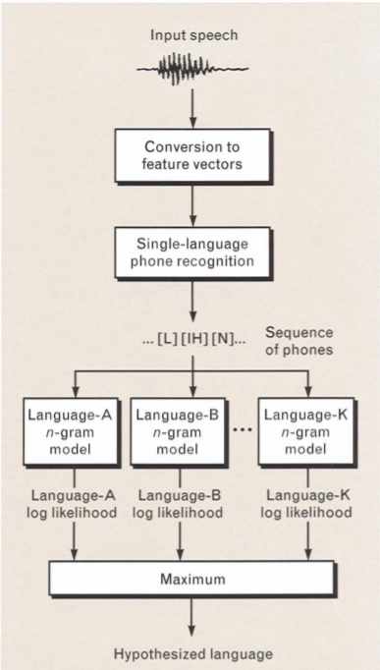
Related Work
MA Zeissman in Lincoln Laboratory^{[1]}
Uses PRLM (Phone Recognization followed by language modelling)
It consists of single language phone recognition followed by language modeling with an n-gram analyzer.
PRLM can be further extended to Parallel PRLM and Parallel Phone Recognition.
[1] M. Zissman, “Comparison of Four Approaches to Automatic Language Identification of Telephone Speech,” IEEE Trans. Acoust., Speech, Signal Processing, vol. 4,no. 1, pp. 31–44, 1996.

Slide 6
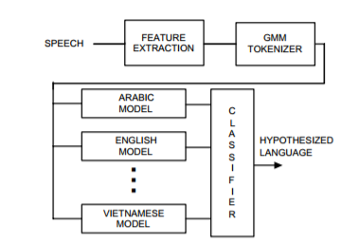
KshirodSarmah and UtpalBhattacharjee^{[2]}
GMM based Language Identification using MFCC and SDC Features
Pedro A. Torres-Carrasquillo^{[3]}
Language Identification using Gaussian Mixture Model Tokenization
[2] Kshirod Sarmah, “GMM based Language Identification using MFCC and SDC Features”, International Journal of Computer
Applications (0975 – 8887) Volume 85 – No 5, January 2014
[3] Pedro A. Torres-Carrasquillo, “Language Identification using Gaussian Mixture Model Tokenization”, Lincoln Laboratory,
Massachusetts Institute of Technology
Notes:
In this paper, a baseline system for the LID system in multilingual environments has been developed using GMM as a classifier and MFCC combined with Shifted-Delta-Cepstral (SDC) as front end processing feature vectors.

Slide 7
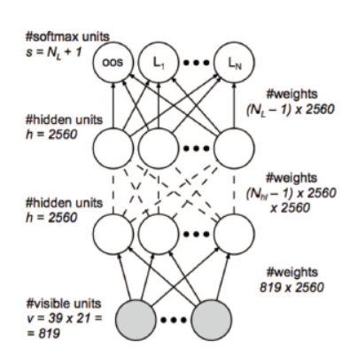
Julien De Mori^{[4]}
Presented and compared Support Vector Machine(SVM) based methods, Gaussian Mixture Model(GMM) based methods and Neural network.
Used Neural Network and Computing features for each 25ms frame.
Ignacio Lopez-Moreno^{[5]}
Automatic Language Identification Using Deep Neural Networks
Motivated by their recent success in acoustic modelling.
The proposed approach is compared to state-of-the-art i-vector based acoustic systems.
[4] Julien De Mori, “Spoken Language Classfication” , CS 229 – Machine Learning(Stanford)
[5] Ignacio Lopez-Moreno, “AUTOMATIC LANGUAGE IDENTIFICATION USING DEEP NEURAL NETWORKS”, 2014 IEEE
International Conference on Acoustic, Speech and Signal Processing (ICASSP),2014 (context windows)
Notes:
and then modeled each clip as a multivariate Gaussian distribution by computing the mean and variance of each feature across each clip
Averaging out any noise in the signal, as well as reducing the number of training examples, considerably decreasing computation time.

Slide 8
Our Proposal
We propose a hybrid neural network that consists of two levels.
An initial neural network gives the probability of the belongingness of data sample to all class of languages.
The second level, or the binary classifier finally outputs the class to which the data sample belongs amongst the best two sub-candidates.
The idea behind this hypothesis is the fact that different languages need different set of features to differentiate them.

Slide 9
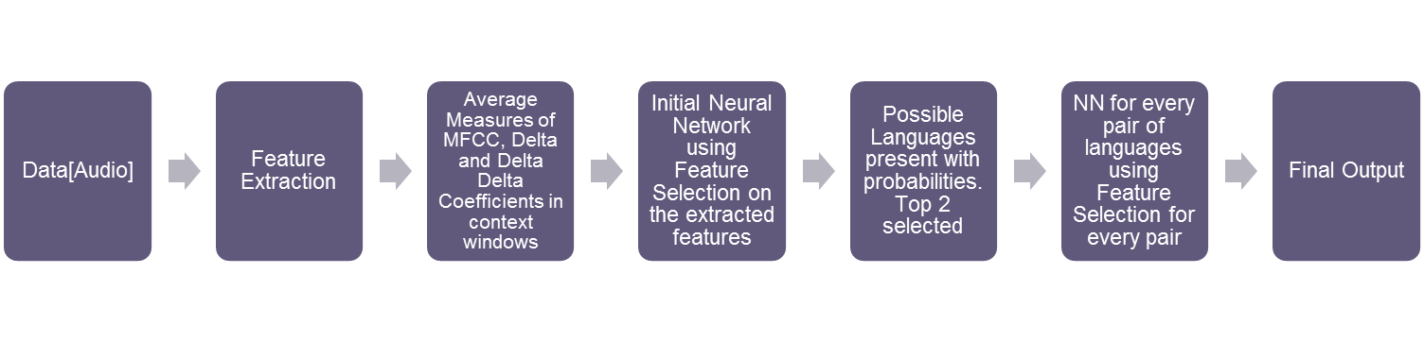
Experimental Setup
Workflow of project

Slide 10
Data Set
We obtained our language dataset from Audio Lingua.
The dataset includes 170 distinct speakers for each language.
The dataset is assumed to be clean. It is pre-processed and split to multiple equal sized (5 sec) audio samples.
One audio samples is treated as a single data point. This is done to average out any noise component in the speech.

Slide 11
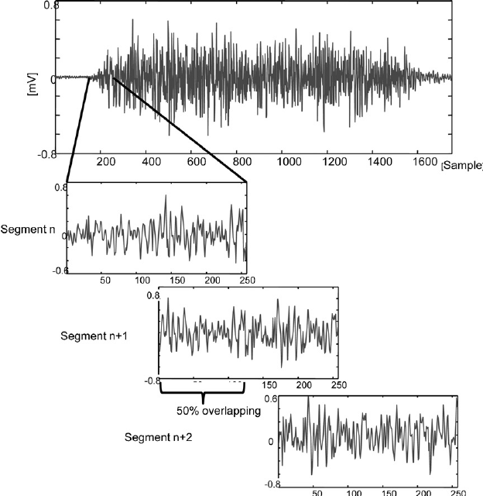
Feature Extraction
Audio Sample is divided into frames of 25ms(400 frames) with a window hop of 10ms(100 frames).
Sliding Window is used processing the audio sample.
This overlapping of windows prevents spectral loss that is caused by framing.
For each frame 13 mfcc features are calculated.
Using these mfcc features, delta mfcc, delta delta mfcc is calculated.
Sliding Window
Notes:
Why are delta and delta-delta mfcc used ?
Static mfcc features are representative of physical characteristics of vocal chord which is not enough to discriminate languages, hence we require temporal variation of mfcc.

Slide 12
Feature Vector
For each audio sample of 5 sec we obtain a long term averaged feature vector with 390 features.
These features include 13 MFCC+13 Delta MFCC+13 Delta Delta MFCC. Making a set of 39 sized feature vectors.
Such consecutive features are stacked to create context windows and the number of consecutive features used is called context window size. We used a context window size of 5.
Long term averaging is done by computing the mean and standard deviation over the entire duration giving a single feature vector of size of shape (1, 390)
39(mfcc + delta mfcc + delta delta mfcc) * 5 (context window size) * 2 (mean + standard deviation) = 390
When x such samples are taken out feature vector has a shape of (x, 390)

Slide 13
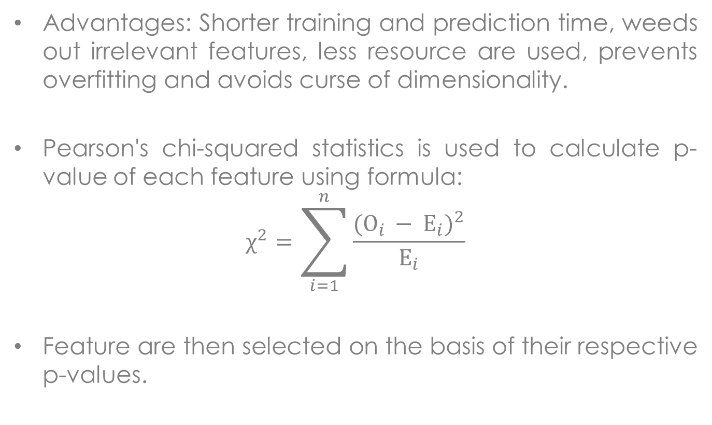
Feature Selection
Advantages: Shorter training and prediction time, weeds out irrelevant features, less resource are used, prevents overfitting and avoids curse of dimensionality.
Pearson's chi-squared statistics is used to calculate p-value of each feature using formula:
$$χ^{2}=\sum_{i=1}^{n}{\frac{{(O_{i }− E_{i})}^{2}}{E_{i}}}$$
Feature are then selected on the basis of their respective p-values.
Notes:
Less p-value means greater stat significance

Slide 14
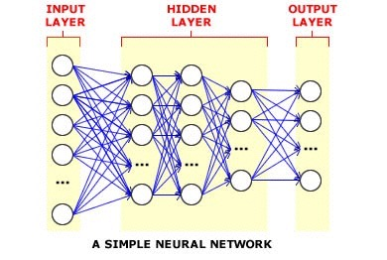
Deep Learning
Deep neural network is a feed-forward artificial neural network with multiple hidden units between input and output
Why Use Deep Neural Networks?
Ability to learn complicated feature representations and classifiers jointly
Learn much better models of data that lie on or near a non-linear manifold
Performance does not saturate with increase in training data
Surpass the performance of the other dominant paradigms
Notes:
Feed Forward, Neurons are used, Weights and Biases are changed to minimize cost function, Backpropagation used for output to input error propagation, Mini Batches used for better gradient calculation performance.

Slide 15
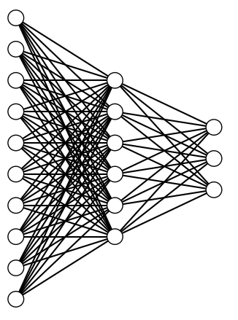
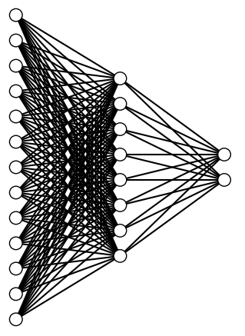
NN Architecture
Initial Neural Network
Binary Neural Network(s)
Representative Architecture
Representative Architecture
Common Parameters
Activation Function:
Hidden Layer : ReLU
Output Layer : Softmax
Regularizer : L1L2
Optimizer : Adadelta
Metric : Accuracy
Output Layer
Output Layer
Hidden Layer
Hidden Layer
Input Layer
Input Layer
Hidden Layers : 1 Input Dimension : Number of Selected Features : 180 Neurons
Hidden Layer : 12 Neurons
Output Layer : Number of Languages in set : 3 Neurons
Loss Function : Categorical Crossentropy
Hidden Layers : 1 Input Dimension : Number of Selected Features : 380 Neurons
Hidden Layer : 22 Neurons
Output Layer : 2 Neurons
Loss Function : Binary Crossentropy
Notes:
Categorical Crossentropy = Mistakes make learn faster like humans -1/n sum(y*logpi + (1-y)log(1-pi)) reLU = rectifier Linear Unit, max(0,x), less computation, leads to more convergence in many cases
Adadelta controls learning rate, makes initial choice of learning rate immaterial

Slide 16
Hybrid NN Model Training
Both Initial and Binary are using Keras Library which is a high-level neural networks library, written in Python, capable of running on top of either Tensor Flow or Theano and enables fast experimentation. It allows easy specification of the characteristics of the network.
The parameters associated with both NN’s were found through extensive testing.
The Initial NN is trained with audio speech samples for all languages and produces belongingness probability of the data sample to each class. It is used for classifying any number of languages in the set.
Binary NN(s) are trained with audio speech samples for all language pairs and is used for classifying two different languages.
Final output is produced by using the top 2 most probable languages and inputting them to the appropriate Binary Classifier from which the most probable language is selected.

Slide 17
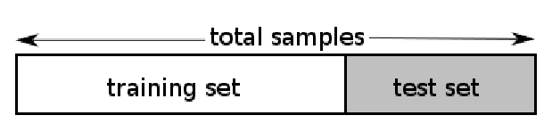
Testing
HoldOut Validation: The holdout method is the simplest kind of cross validation. The data set is separated into two sets, called the training set and the testing set. The function approximator fits a function using the training set only. Then the function approximator is asked to predict the output values for the data in the testing set (it has never seen these output values before).
In this type of validation, we set out 60% of the entire data for training and rest 30% for holdout test. The 30% test samples were independent of training samples, i.e. even the speakers were distinct in both the sample sets.
Notes:
Problem and its use. Accuracy based on this. Results depend on which data ends in test set. Dependent on division

Slide 18
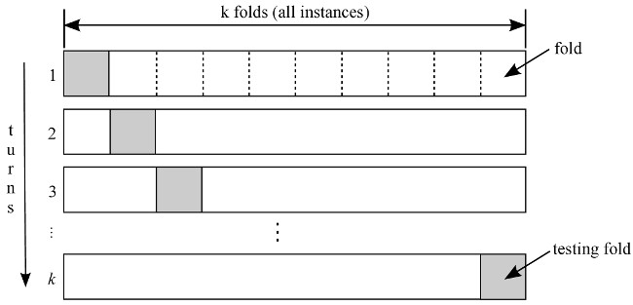
Testing
KFold Validation: K-fold cross validation is one way to improve over the holdout method. The data set is divided into k subsets, and the holdout method is repeated k times. Each time, one of the k subsets is used as the test set and the other k-1 subsets are put together to form a training set. Then the average error across all k trials is computed.
While doing K-Fold Validation we used k=10, thus the entire model had to be trained 10 times. The standard deviation and average accuracy is specified in the results section.
Notes:
Problem and its use

Slide 19
Results
Overall accuracy of the system using holdout validation technique
 | Chinese | French | German
Chinese | 160 | 23 | 53
French | 36 | 155 | 45
German | 25 | 41 | 170
Accuracy: 79.20%
Notes:
Actual Labels vs Predicted Labels 236 Test Files

Slide 20
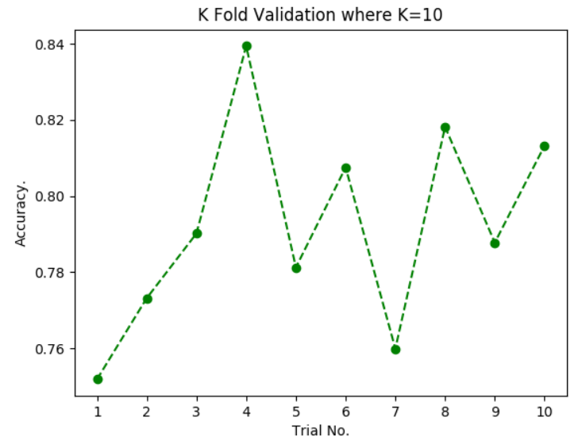
Results
Overall accuracy curve using KFold Validation Technique
Results of the K Fold Validation of the language detection system. The average accuracy is 79.22% and a low standard deviation of 2.59 in the percentage accuracy is indicative of a stable system.

Slide 21
Binary Classification Chinese vs French
 | Chinese | French
Chinese | 222 | 14
French | 11 | 225
Accuracy: 94.70%
Binary Classification German vs French
 | French | German
French | 225 | 11
German | 27 | 209
Accuracy: 91.95%
Binary Classification Chinese vs Germany
 | Chinese | German
Chinese | 192 | 44
German | 27 | 209
Accuracy: 84.96%

Slide 22
Results
Comparison of the language identification system with SGD Based Baseline Method
 | Baseline SGD Classifier | Hybrid Neural Network
Accuracy | 72.60% | 79.20%
Precision | 62.26% | 68.87%
Recall | 58.90% | 68.50%

Slide 23
Prediction Visualization through GUI
GUI was made to illustrate the functioning of the Hybrid Neural Network Model.
PyQt5 was used to design the GUI.
Allows the user to select any .mp3 file.
Provides frame wise language prediction for the audio sample.
Provides final language prediction for the audio sample.
Notes:
6s audio prediction, Final prediction considering whole audio also

Slide 24
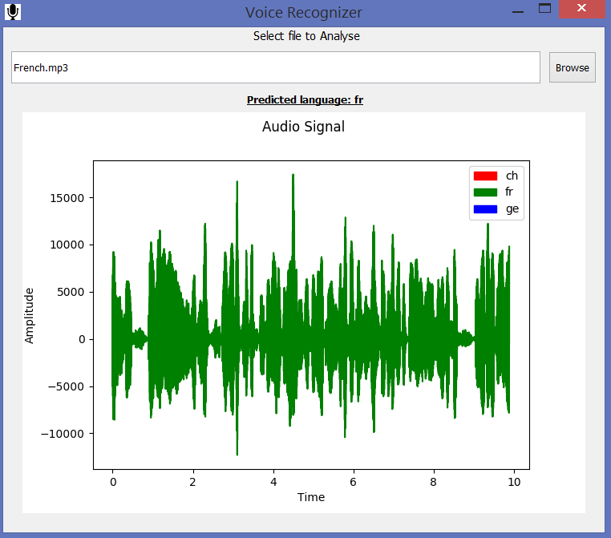
GUI Sample

Slide 25
Real Time Analysis
Fast prediction time of hybrid model allowed us to do real time analysis of audio.
pyAudio was used as audio I/O library.
Thread were used to gather raw audio from source and pass that to our prediction model in chunks of 1 second.
Processing time for 1s audio sample was observed to be around 0.2s.
When using default device’s microphone as source result was observed to be not so accurate due to noise being high in audio samples.

Slide 26
Conclusion
Acoustic modelling together with DNN is powerful enough to identify languages.
Languages are better resolved when considered pairwise as a feature which is useful in distinguishing some languages was irrelevant for some pair of languages.
Our hybrid two stage classification model is definitely an improvement over normal single stage classifier.

Slide 27
Future Work
Adding pre filter for noisy audio.
Using Shifted Delta Cepstral(SDC) features
Providing facility for incremental training.
Adding out of set option as possible output.
Improving real-time capabilities
Notes:
SDC: pseudo-prosodic feature, shifted delta op on acoustic feature

Slide 28
Thank You
谢谢 Merci Danke

