Slide 1
Spoken Language Identification using Neural Network
Prepared under the guidance of
Dr. Shampa Chakraverty
by:
Aditya Jain 210/CO/13
Anmol Pandey 233/CO/13
Anmol Varshney 234/CO/13

Slide 2
Introduction
The problem of automatic language identification (LID) can be defined as the process of automatically identifying the language of a given spoken utterance.
LID can be used by speech recognition systems, multilingual translation systems or call-centers(e.g., emergency calls) routing.
Also LID can be used by intelligence and security, where the language identities of recorded messages need to be established before any information can be extracted.
Notes:
Problem and its use
Emergency mein quick response chaiye

Slide 3
Introduction
Our project aims at spoken language identification in speech audio samples using Deep Learning Models (DNNs).
We have used acoustic modelling for our LID system. Audio is divided into small chunks called frames and raw audio signal from each frame is transformed by applying the mel-frequency cepstrum.
The coefficients from this transformation called MFCCs are used as input to the acoustic model.
Notes:
How are we doing it
phonotactic and prosody bhi hote hai

Slide 4
Problem Statement
To construct efficient as well as effective Language Identification(LID) model using two stage Neural Network.
Notes:
Just read
Two stage being coarse and fine

Slide 5
Our Proposal
We propose a hybrid neural network that consists of two level.
An initial neural network gives the probability of the belongingness of data sample to all class of languages.
The second level, or the binary classifier finally outputs the class to which the data sample belongs amongst the best two sub-candidates.
The idea behind this hypothesis is the fact that different languages need different set of features to differentiate them.

Slide 6
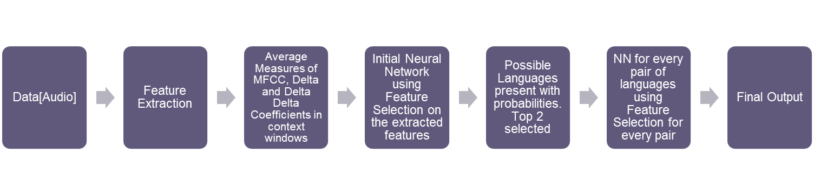
Experimental Setup
Workflow of project

Slide 7
Data Set
We obtained our language dataset from AudioLingua.
The dataset includes170 distinct speakers for each language.
The dataset is assumed to be clean. It is pre-processed and split to multiple equal sized (5 sec) audio samples.
One audio samples is treated as a single data point. This is done to average out any noise component in the speech.

Slide 8
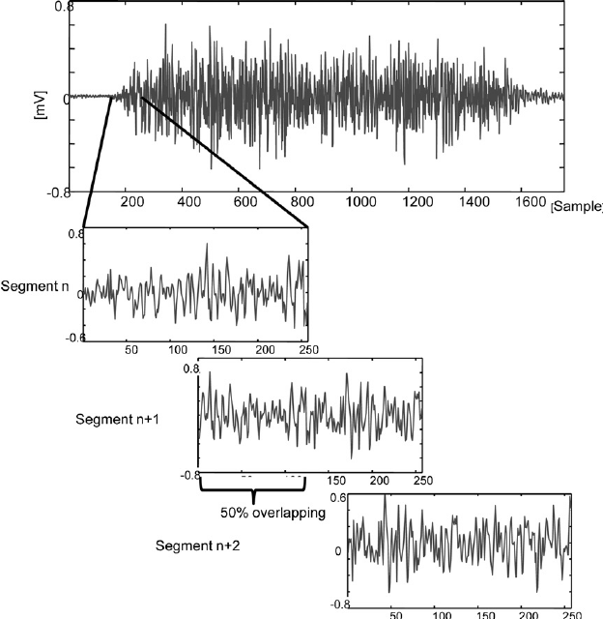
Feature Extraction
Audio Sample is divided into frames of 25ms(400 frames) with a window hop of 10ms(100 frames).
Hence this kind of overlapping prevents spectral loss that is caused by framing.
For each frame 13 mfcc features are calculated.
Using these mfcc features, delta mfcc, delta delta mfcc is calculated.
Notes:
Why are delta and delta-delta mfcc used ?
Static mfcc features are representative of physical characteristics of vocal chord which is not enough to discriminate languages, hence we require temporal variation of mfcc.

Slide 9
Feature Vector
For each audio sample of 5 sec we obtain a long term averaged feature vector with 390 features.
These features include 13 MFCC+13 Delta MFCC+13 Delta Delta MFCC. Making a set of 39 sized feature vector.
Such consecutive features are stacked to create context windows and the number of consecutive features used is called context window size. We used a context window size of 5.
Long term averaging is done and standard deviation is calculated for over entire duration giving a single feature vector of size of shape (390,1)
39(mfcc + delta mfcc+ delta-delta mfcc)*5(context window size)*2(mean + standard deviation)=390
When x such samples are taken out feature vector has a shape of (390,x)

Slide 10
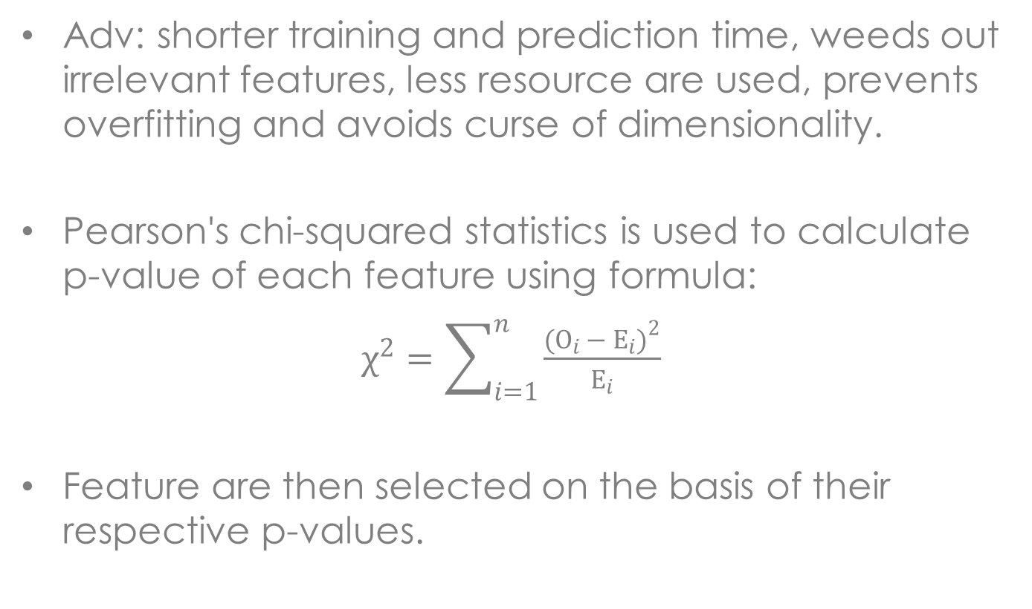
Feature Selection
Adv: shorter training and prediction time, weeds out irrelevant features, less resource are used, prevents overfitting and avoids curse of dimensionality.
Pearson's chi-squared statistics is used to calculate p-value of each feature using formula:
$χ^{2}=\sum_{i=1}^{n}{\frac{{(O_{i }− E_{i})}^{2}}{E_{i}}}$
Feature are then selected on the basis of their respective p-values.
Notes:
Less p-value means greater stat significance

Slide 11
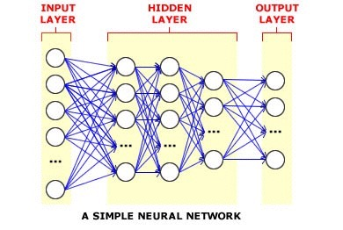
Deep Learning
Deep neural network is a feed-forward artificial neural network with multiple hidden units between input and output
Why Use Deep Neural Networks?
Ability to learn complicated feature representations and classifiers jointly
Learn much better models of data that lie on or near a non-linear manifold
Performance does not saturate with increase in training data
Surpass the performance of the other dominant paradigms

Slide 12
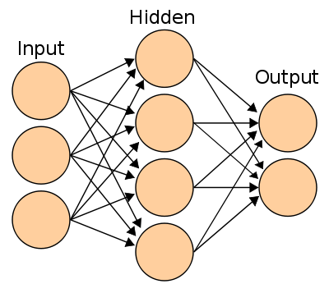
Training
Training Initial Neural Network
No of neurons in the Input Layers=No of features in input feature vector= 180
No of hidden layers=1
No of neuron in the hidden layers are fine tuned to give maximum accuracy= 12
No of neurons in output Layers=No of possible languages in the set=3
Activation Function used is ReLu
Ouput consists of softmax layer to give belongingness probability of the data sample to each class.
This neural network is trained for classifying any number of languages in the set.
Training Initial Neural Network
The architecture is same except the number of output layer=2, because it is a binary classifier.
Also neurons in the input layer are fined tune to 380.
The language corresponding to the neuron giving highest probability is selected as the predicted language.
This neural network is trained for classifying two different languages

Slide 13
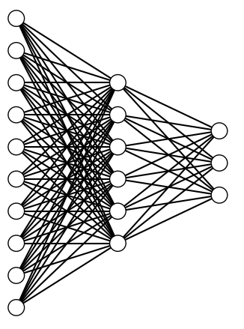
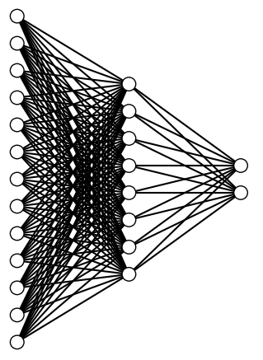
NN Architecture
Representative Architecture
Representative Architecture
Common Parameters
Activation Function:
Hidden Layer : ReLU
Output Layer : Softmax
Regularizer : L1L2
Optimizer : Adadelta
Metric : Accuracy
Output Layer
Output Layer
Hidden Layer
Hidden Layer
Input Layer
Input Layer
Initial Neural Network
Binary Neural Network(s)
Input Dimension : 180
Hidden Layer : 12
Output Layer : 3
Loss Function : Categorical Crossentropy
Input Dimension : 380
Hidden Layer : 22
Output Layer : 2
Loss Function : Binary Crossentropy
Notes:
reLU = rectifier Linear Unit
Adadelta controls learning rate

Slide 14
Hybrid NN Model
Both Initial and Binary are using Keras Library which is a high-level neural networks library, written in Python, capable of running on top of either Tensor Flow or Theano and enables fast experimentation. It allows easy specification of the characteristics of the network.
The Initial NN is trained with audio speech samples for all languages and produces the top 2 most probable language candidates.
Binary NN(s) are trained with audio speech samples for all language pairs.
Final output is produced by using the top 2 candidates and inputting them to the appropriate Binary Classifier.

Slide 15
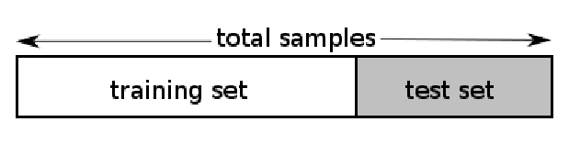
Testing
HoldOut Validation: The holdout method is the simplest kind of cross validation. The data set is separated into two sets, called the training set and the testing set. The function approximator fits a function using the training set only. Then the function approximator is asked to predict the output values for the data in the testing set (it has never seen these output values before).
In this type of validation, we set out 60% of the entire data for training and rest 30% for holdout test. The 30% test samples were independent of training samples, i.e. even the speakers were distinct in both the sample sets.
Notes:
Problem and its use

Slide 16
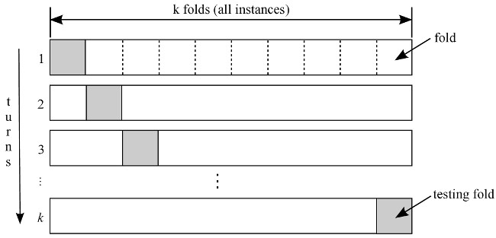
Testing
KFold Validation: K-fold cross validation is one way to improve over the holdout method. The data set is divided into k subsets, and the holdout method is repeated k times. Each time, one of the k subsets is used as the test set and the other k-1 subsets are put together to form a training set. Then the average error across all k trials is computed.
While doing K-Fold Validation we used k=10, thus the entire model had to be trained 10 times. The standard deviation and average accuracy is specified in the results section.
Notes:
Problem and its use

Slide 17
Results
Overall accuracy of the system using holdout validation technique
 | Chinese | French | German
Chinese | 160 | 23 | 53
French | 36 | 155 | 45
German | 25 | 41 | 170
Accuracy: 79.20%

Slide 18
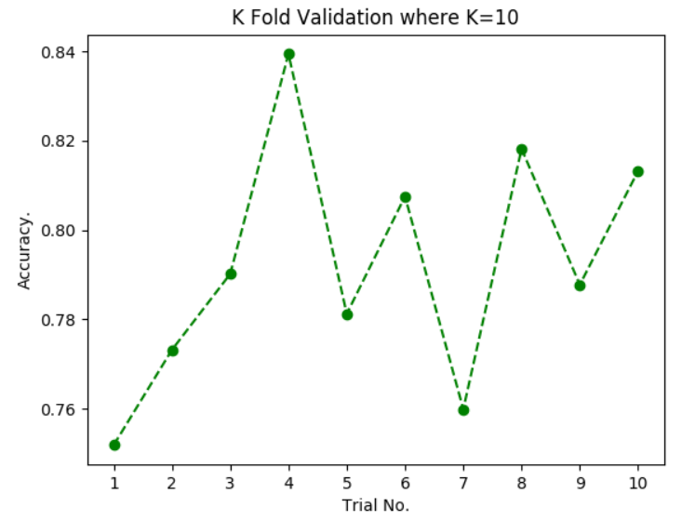
Results
Overall accuracy curve using KFold Validation Technique
Results of the K Fold Validation of the language detection system. The average accuracy is 79.22% and a low standard deviation of 2.59 in the percentage accuracy is indicative of a stable system.

Slide 19
Binary Classification Chinese vs French
 | Chinese | French
Chinese | 222 | 14
French | 11 | 225
Accuracy: 94.70%
Binary Classification German vs French
 | French | German
French | 225 | 11
German | 27 | 209
Accuracy: 91.95%
Binary Classification Chinese vs Germany
 | Chinese | German
Chinese | 192 | 44
German | 27 | 209
Accuracy: 84.96%

Slide 20
Results
Comparison of the language identification system with SVM Based Baseline Method
 | Baseline SGD Classifier | Hybrid Neural Network
Accuracy | 72.60% | 79.20%
Precision | 62.26% | 68.87%
Recall | 58.90% | 68.50%

Slide 21
Prediction Visualization through GUI
GUI was made to illustrate the functioning of the Hybrid Neural Network Model.
PyQt5 was used to design the GUI.
Allows the user to select any .mp3 file.
Provides frame wise language prediction for the audio sample.
Provides final language prediction for the audio sample.

Slide 22
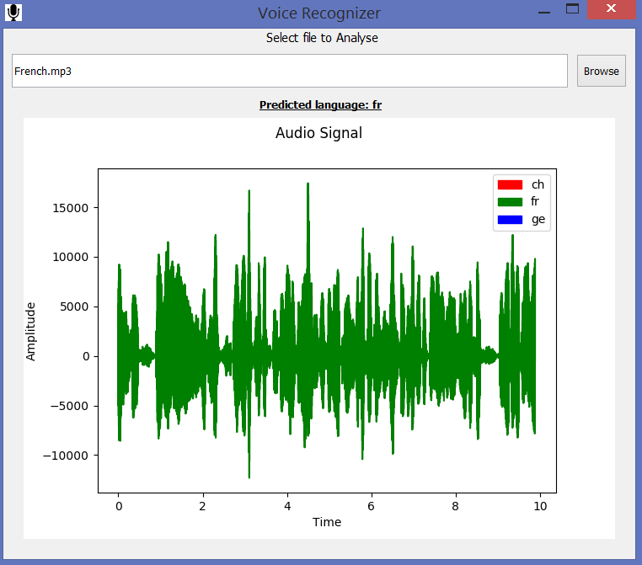
GUI Sample

Slide 23
Real Time Analysis
Fast prediction time of hybrid model allowed us to do real time analysis of audio.
pyAudio was used as audio I/O library.
Thread were used to gather raw audio from source and pass that to our prediction model in chunks of 1 second.
Processing time for 1s audio sample was observed to be around 0.2s.
When using default device’s microphone as source result was observed to be not so accurate due to noise being high in audio samples.

Slide 24
Conclusion
Acoustic modelling together with DNN is powerful enough to identify languages.
Languages are better resolved when considered pairwise as a feature which is useful in distinguishing some languages was irrelevant for some pair of languages.
Our hybrid two stage classification model is definitely an imporvement over normal single stage classifier.

