Slide 1
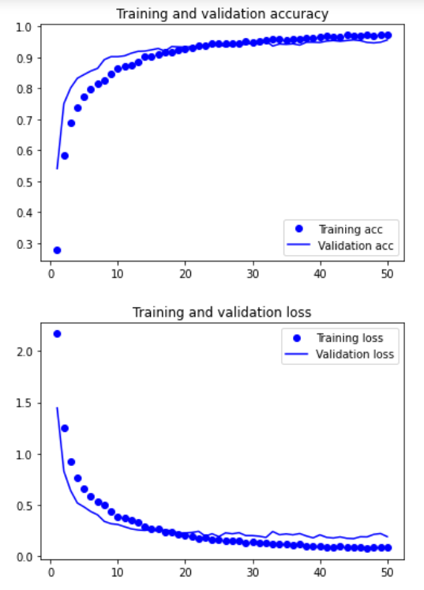
recordingTest.tflite
Train_acc=97.13%
Train_lose=8.21%
Val_acc=95.61%
Val_lose=18.99%
Test_acc=94.64%
Test_lose=23.53%

Slide 2
