Slide 1



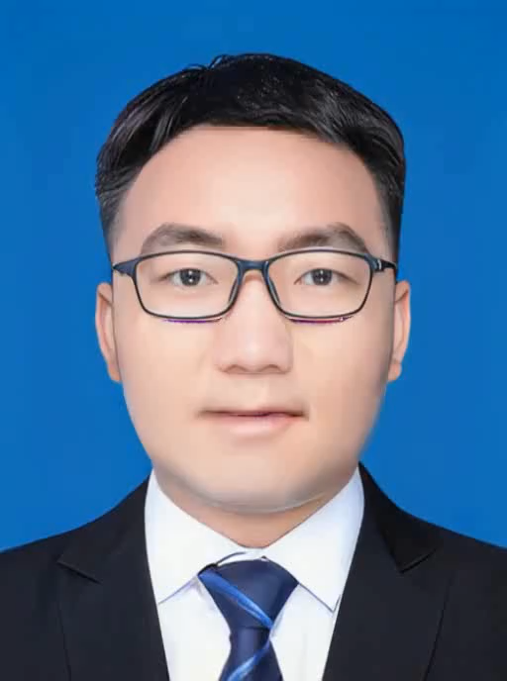
MetaSID: Singer Identification with Domain Adaptation for Metaverse
Xulong Zhang, Jianzong Wang, Ning Cheng, Jing Xiao
Ping An Technology (Shenzhen) Co., Ltd., China

Slide 2
Metaverse is coming

Slide 3

Thanks for your watching~

