Slide 1
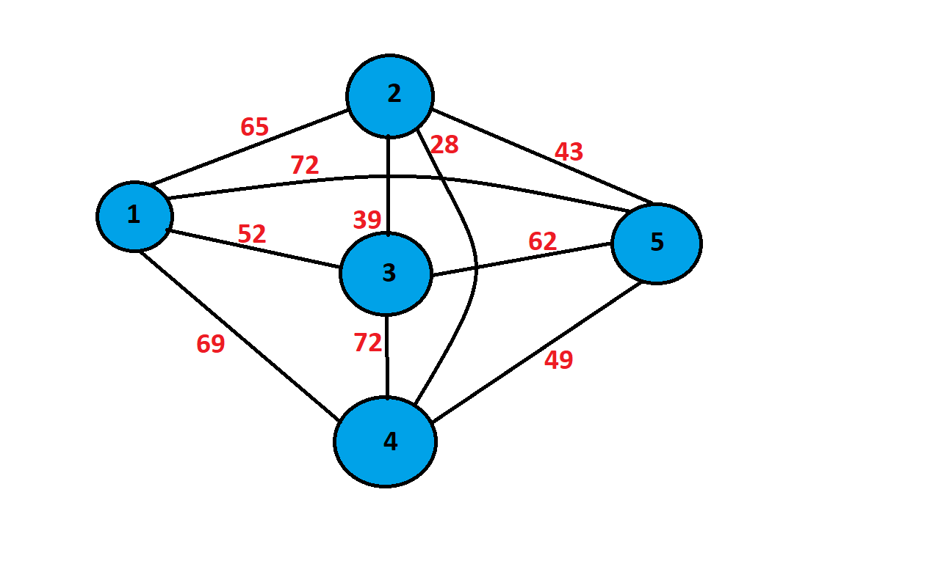
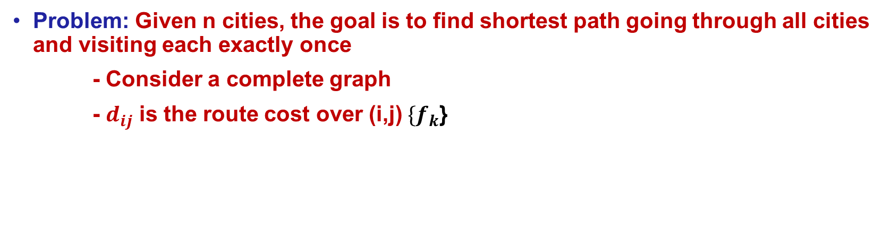
Travelling Salesman Problem
Problem: Given n cities, the goal is to find shortest path going through all cities and visiting each exactly once
- Consider a complete graph
- $d_{ij}$ is the route cost over (i,j) $\{f_{k}$}
Each ant builds its own tour from starting city
Each ant chooses a town to go to with a probability
Keep tabs on visit list of each ant
When tour completed, lay pheromone on each edge visited
Next city j after city i chosen according to probability rule

