Slide 1
AIMLCZG537/DSECLZG537 Information Retrieval
Dr. Maheswari Karthikeyan
Lecture2 : 03-12-2023

Slide 2
Lecture Outline
Boolean Retrieval
Inverted Index
Processing Boolean queries
Slides are from Introduction to Information Retrieval;Manning,Raghavan
http://nlp.stanford.edu/IR-book

Slide 3
An Example of IR problem
Example: Shakespeare
- Find all Shakespeare plays that contain the words
BRUTUS AND CAESAR AND NOT CALPURNIA

Slide 4
An Example of IR problem
One solution is Linear Scan of Document (Brute Force Approach)
• One could grep all of Shakespeare’s plays for BRUTUS and CAESAR, then strip out plays containing CALPURNIA
-- Similar to Unix command grep
• But this may not be the solution, because….
Slow for large data collection (e.g., the web, which contains billions or trillions of words)
Does not allow flexible matching operations (can’t search Brutus and Caesar in the same sentence)
Ranked retrieval (best documents to return)
• Instead, organize beforehand (Index the Documents)

Slide 5
Term-Document Incidence Matrix
Two dimensional: Terms and Documents
Matrix element (t, d) = 1 if term t appears in document d
1 if play contains word, 0 otherwise
Brutus AND Caesar but NOT Calpurnia

Slide 6
Sec. 1.1
Query Answer
Take the vectors for Brutus, Caesar and Calpurnia (complemented) ➔ bitwise AND.
110100 AND 110111 AND NOT 010000
110100 AND 110111 AND 101111 = 100100
Ans : Antony and Cleopatra, Hamlet

Slide 7
Query Answer

Slide 8
Query Answer
Query Results implies…..
Using the term vectors, we can only find whether the documents meet the query, but cannot find which parts of the documents meet the query.
Antony and Cleopatra, Act III, Scene ii
Agrippa [Aside to DOMITIUS ENOBARBUS]: Why, Enobarbus,
When Antony found Julius Caesar dead,
He cried almost to roaring; and he wept
When at Philippi he found Brutus slain.
Hamlet, Act III, Scene ii
Lord Polonius: I did enact Julius Caesar I was killed i' the
Capitol; Brutus killed me.

Slide 9
Term-Document Incidence Matrix
The incidence matrix is sparse
Term Vectors are of fixed length (size?)
Difficult to build for too big Document Corpus
Solution is to record only the things that occur.(Inverted Index)

Slide 10
Sec. 1.2
Inverted Index
Inverted Lists
Brutus
1
2
4
11
31
45
173
174
Caesar
1
2
4
5
6
16
57
132
Calpurnia
2
31
54
101

Slide 11
Inverted Index
Building an Inverted Index
For each term t, we must store a list of all documents that contain t.
Identify each by a docID, a document serial number
Sort according to docID
Instances of the same term are grouped and split into a dictionary and posting
Can be implemented using either singly linked lists or variable length arrays

Slide 12
Sec. 1.2
Inverted Index
Posting
Sorted by docID
Brutus
1
2
4
11
31
45
173
174
Caesar
1
2
4
5
6
16
57
132
Calpurnia
2
31
54
101
Dictionary
Postings
Notes:
Linked lists generally preferred to arrays
Dynamic space allocation
Insertion of terms into documents easy
Space overhead of pointers

Slide 13
Building Inverted Index
Collect the documents to be indexed:
Tokenize the text, turning each document into a list of tokens:
Friends, Romans, countrymen.
Friends
Romans
Countrymen

Slide 14
Building Inverted Index
Do linguistic pre-processing, producing a list of normalized tokens, which are the indexing terms
Index the documents that each term occurs in by creating an inverted index, consisting of a dictionary and postings.
friend
roman
countryman
friend
2
4
roman
1
2
countryman
13
16

Slide 15
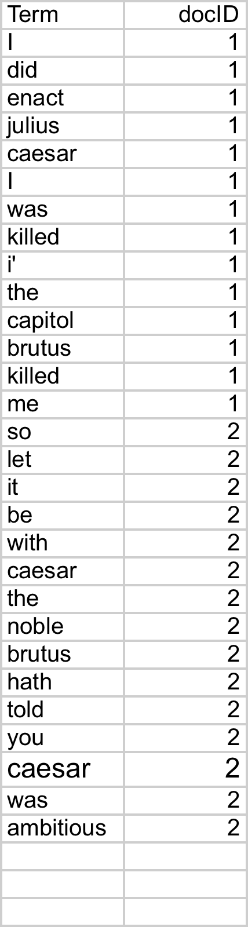
Sec. 1.2
Building Inverted Index
Sequence of (Modified token, Document ID) pairs.
Doc 1
Doc 2
I did enact Julius
Caesar I was killed
i' the Capitol;
Brutus killed me.
So let it be with
Caesar. The noble
Brutus hath told you
Caesar was ambitious

Slide 16
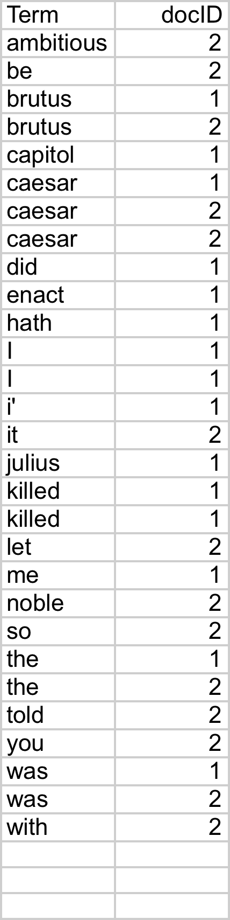
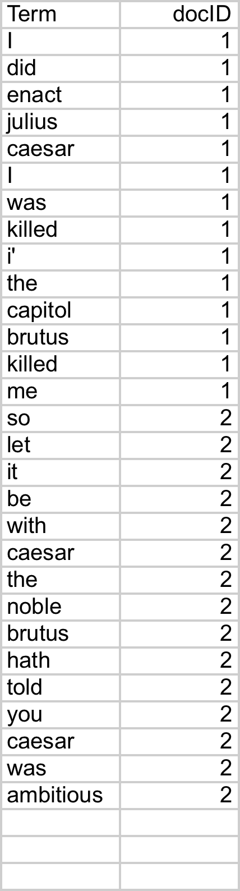
Sec. 1.2
Building Inverted Index
Sort by
Terms
docID

Slide 17
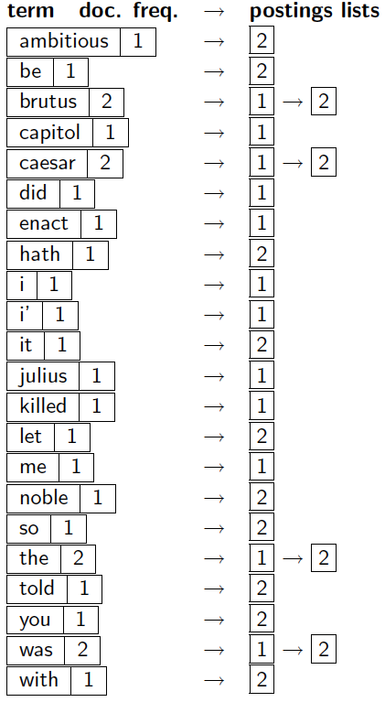
Sec. 1.2
Building Inverted Index
Multiple term entries in a single document are merged.
Split into Dictionary and Postings
Document frequency information is added.

Slide 18
Sec. 1.2
Building Inverted Index
Lists of docIDs
Terms and counts
Pointers

Slide 19
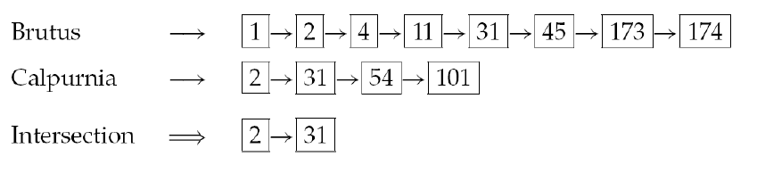
Processing Boolean Queries
Sec. 1.3
Consider the query: Brutus AND Calpurnia
Locate Brutus in the Dictionary
Retrieve its postings
Locate Calpurnia in the Dictionary
Retrieve its postings
Intersect the two postings lists

Slide 20
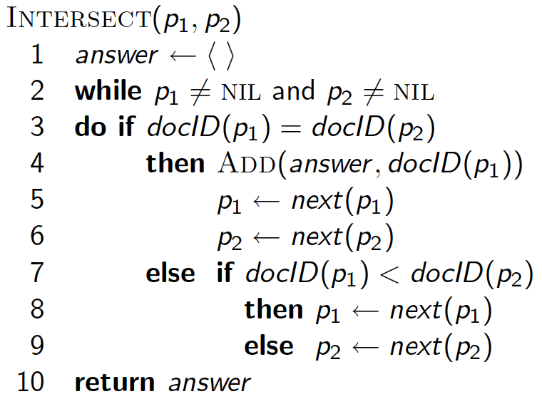
Intersecting two postings lists (a “merge” algorithm)
Time taken for Intersection?

Slide 21
Query optimization
Sec. 1.3
Consider a query that is an AND of n terms.
For each of the n terms, get its postings, then AND them together.
Query: Brutus AND Caesar AND Calpurnia
Brutus
2
4
8
16
32
64
128
Caesar
1
2
3
5
8
16
21
34
Calpurnia
13
16
21

Slide 22
Sec. 1.3
Query optimization
Process in order of increasing frequency:
start with smallest set, then keep cutting further.
Brutus
2
4
8
16
32
64
128
Caesar
1
2
3
5
8
16
21
34
Calpurnia
13
16
Execute the query as (Calpurnia AND Brutus) AND Caesar.

Slide 23
Sec. 1.3
Query optimization
(wind OR fire) AND (thunder OR lightning)
Get doc. frequencies for all terms
Estimate the size of each OR by the sum of its doc. freq.’s
Process in increasing order of OR sizes.

Slide 24
Example Problem 1
Consider these documents:
Doc 1 : breakthrough drug for schizophrenia
Doc 2 : new schizophrenia drug
Doc 3 : new approach for treatment of schizophrenia
Doc 4 : new hopes for schizophrenia patients
Draw the term-document incidence matrix for this document collection.
Draw the inverted index representation for this collection.

Slide 25
Example Problem 2
Recommend a query processing order for
(tangerine OR trees) AND (marmalade OR skies) AND (kaleidoscope OR eyes)
given the following postings list sizes:
Term Postings size
eyes 213312
kaleidoscope 87009
marmalade 107913
skies 271658
tangerine 46653
trees 316812

Slide 26
Boolean Model-Evaluation
Documents retrieved are Relevant to the information need
All relevant documents are retrieved?
Relevant docs
Retrieved docs

Slide 27
Boolean Model-Evaluation
Documents retrieved are Relevant to the information need
Are all documents retrieved are relevant?
Relevant docs
Retrieved docs

Slide 28
Boolean Model-Evaluation
Evaluation Measures
Precision
What fraction of the returned results are relevant to the information need?
Recall
What fraction of the relevant documents in the collection were returned by the system?
If A is the number of Relevant docs in the collection, C is the total documents retrieved and B is the relevant docs retrieved.
Precision =
Recall =

Slide 29
Boolean Model-Evaluation
Evaluation Measures
Precision
What fraction of the returned results are relevant to the information need?
Recall
What fraction of the relevant documents in the collection were returned by the system?
If A is the number of Relevant docs in the collection, C is the total documents retrieved and B is the relevant docs retrieved.
Precision = B/C
Recall = B/A

Slide 30
Example Problem 3
Consider the four terms, in order: park, mountain, trails, difficult. Assume that the query, in disjunctive normal form, DNF, is the following, where "OR" is the logical disjunction operator:
Q = (1,0,1,0) OR (0,1,1, 0) OR (1,1,1,0)
Can you give the description of the query ?
Document 1: "Loon park contains a lovely lake and is near Mystery mountain. It's not difficult to get to from the city."
Document 2: "The Mystery mountain area has many easy trails, but no difficult ones.“
What will be result of the query when applied to these documents?

