Slide 1
AIMLCZG537/DSECLZG537 Information Retrieval
Dr. Maheswari Karthikeyan
Lecture3 : 10-12-2023

Slide 2
Lecture Outline
Boolean Retrieval
Term vocabulary and Postings lists
Phrase Queries
Slides are from Introduction to Information Retrieval;Manning,Raghavan
http://nlp.stanford.edu/IR-book

Slide 3
Term Vocabulary & Postings List

Slide 4
Term Vocabulary & Postings List
Term vocabulary
Documents
Tokenization
Linguistic Pre-processing of tokens
Indexing
Postings
Faster merges: skip lists
Positional postings and phrase queries

Slide 5
Document delineation
Obtaining the character sequence in a document
Choosing a document unit
We need to deal with format and language of each document.
What format is it in? pdf, word, excel, html etc.
What language is it in?
What character set is in use?

Slide 6
Vocabulary of Terms
Tokenization
Stop words
Normalization
Stemming and Lemmatization

Slide 7
Tokenization
It is the task of chopping the document into pieces, called tokens, by removing unwanted characters
Example of tokenization:
Input: “Friends, Romans, Countrymen”
Output:
Tokens
Friends
Romans
Countrymen
Each such token is now a candidate for an index entry, after further processing.

Slide 8
Tokenization
Token: A token is an instance of a sequence of characters in a particular document that are grouped together as a useful semantic unit for processing
Type:. A type is the class of all tokens containing the same character sequence.
Term : A term is a (perhaps normalized) type that is included in the IR system’s dictionary.
“She was young the way an actual young person is young.”

Slide 9
Issues in Tokenization
What are the correct tokens to use?
Mr. O’Neill thinks that the boys’ stories about Chile’s capital aren’t amusing.
Language specific
Distinctive signature patterns

Slide 10
Issues in Tokenization
Hyphens
Hewlett‐Packard
Hewlett and Packard as two tokens?
state‐of‐the‐art:
co‐education
lowercase, lower‐case, lower case
White Space
San Francisco: one token or two?

Slide 11
Issues in Tokenization
Different character sequences
email addresses (jblack@mail.yahoo.com)
Web URLs (http://stuff.big.com/new/specials.html)
numeric IP addresses (142.32.48.231)
package tracking numbers (1Z9999W99845399981)
Often have embedded spaces
Older IR systems may not index numbers
But often very useful:
looking up error codes/stack traces on the web
Date of an email :Will often index “meta‐data” separately, Creation date, format, etc.

Slide 12
Issues in Tokenization
Tokenization: language issues
French
L'ensemble  one token or two?
L ? L’ ? Le ?
Want l’ensemble to match with un ensemble
German noun compounds are not segmented
Lebensversicherungsgesellschaftsangestellter
‘life insurance company employee’

Slide 13
Issues in Tokenization
Chinese and Japanese have no spaces between
words:
莎拉波娃现在居住在美国东南部的佛罗里达。
Not always guaranteed a unique tokenization
Further complicated in Japanese, with multiple alphabets intermingled
Dates/amounts in multiple formats
Arabic (or Hebrew) is basically written right to left, but with certain items like numbers written left to right
Words are separated, but letter forms within a word form complex ligatures

Slide 14
Vocabulary of Terms
Tokenization
Stop words
Normalization
Stemming and Lemmatization

Slide 15
Stop words
Stop words: common words, which are of little value in selecting documents, matching a user need
Stop words have little semantic content:
the, a, and, to, be
Stop list: the common words to be discarded while indexing
Sort the terms by collection frequency and then take the most frequent.
Collection frequency : the total number of times each term appears in the document collection.

Slide 16
Stop words
Issues in removing stop words
Some special query types are disproportionately affected
Phrase queries:
“King of Denmark”
“President of the United States”, President AND “United States
Various song titles, etc.:
“Let it be”, “To be or not to be”
“Relational” queries:
“flights to London”

Slide 17
Stop words
Issues in removing stop words
Standard use of quite large stop lists (200–300 terms) to very small stop lists (7–12 terms)
Good compression techniques means the space for including stop words in a system is very small
Good query optimization techniques means to pay little at query time for including stop words.

Slide 18
Vocabulary of Terms
Tokenization
Stop words
Normalization
Stemming and Lemmatization

Slide 19
Normalization
Token normalization is the process of canonicalizing tokens so that matches occur despite superficial differences in the character sequences of the tokens
We want to match U.S.A. and USA
Result is terms: a term is a (normalized) word type, which is an entry in the IR system dictionary
Standard way is to implicitly create equivalence classes, which are normally named after one member of the set
e.g.,
deleting periods to form a term
U.S.A., USA
deleting hyphens to form a term
anti-discriminatory, antidiscriminatory
An alternative to creating equivalence classes is to maintain relations between unnormalized tokens.

Slide 20
Normalization
Handling synonyms and homonyms
E.g., by hand-constructed equivalence classes
car = automobile color = colour
rewrite to form equivalence-class terms
When the document contains automobile, index it under car-automobile (and vice-versa)
Or expand a query
When the query contains automobile, look under car as well
Spelling mistakes
One approach is Soundex, which forms equivalence classes of words based on phonetic heuristics

Slide 21
Normalization
There is asymmetry in expansion
An example of where this may be useful
Enter: window Search: window, windows
Enter: windows Search: Windows, windows, window
Enter: Windows Search: Windows

Slide 22
Normalization
Accents and Diacritics
Case folding – True Casing
Reduce all letters to lower case
The simplest heuristic is to convert to lowercase words at the beginning of a sentence and all words occurring in a title that is all uppercase or in which most or all words are capitalized
exception: upper case in mid-sentence

Slide 23
Vocabulary of Terms
Tokenization
Stop words
Normalization
Stemming and Lemmatization

Slide 24
Stemming and Lemmatization
To reduce inflectional forms and sometimes derivationally related forms of a word to a common base form.
E.g.,
am, are, is → be
car, cars, car's, cars' → car
the boy's cars are different colors →
the boy car be different color

Slide 25
Stemming and Lemmatization
Stemming refers to a crude heuristic process that chops off the ends of words and removes the derivational affixes.
It commonly collapses derivationally related words.
Lemmatization refers to doing things properly with the use of a vocabulary and morphological analysis of words, normally aiming to remove inflectional endings only and to return the base or dictionary form of a word, which is known as the lemma.
It only collapses the different inflectional forms of a lemma.

Slide 26
Stemming
Sec. 2.2.4
Reduce terms to their “roots” before indexing
“Stemming” suggests crude affix chopping
language dependent
e.g., automate(s), automatic, automation all reduced to automat.
for example compressed
and compression are both
accepted as equivalent to
compress.
for exampl compress and
compress ar both accept
as equival to compress

Slide 27
Porter’s algorithm
Sec. 2.2.4
The most common algorithm for stemming English
Results suggest it’s at least as good as other stemming options
Algorithm
5 phases of reductions
phases applied sequentially
each phase has various conventions to select rules
sample convention: Of the rules in a compound command, select the one that applies to the longest suffix.

Slide 28
Sec. 2.2.4
Porter’s algorithm
sses → ss
ies → i
ational → ate
tional → tion
Weight of word sensitive rules
(m>1) EMENT →
replacement → replac
cement → cement
Notes:
careses
parties
separational -> separate
factional -> faction

Slide 29
Sec. 2.2.4
Other Stemmer Algorithms
Lovins stemmer
http://www.comp.lancs.ac.uk/computing/research/stemming/general/lovins.htm
Single-pass, longest suffix removal (about 250 rules)
Paice/Husk stemmer
Snowball

Slide 30
A comparison of three stemming algorithms on a sample text
Sample text: Such an analysis can reveal features that are not easily visible from the variations in the individual genes and can lead to a picture of expression that is more biologically transparent and accessible to interpretation
Lovins stemmer: such an analys can reve featur that ar not eas vis from th vari in th individu gen and can lead to a pictur of expres that is mor biolog transpar and acces to interpres
Porter stemmer: such an analysi can reveal featur that ar not easili visibl from the variat in the individu gene and can lead to a pictur of express that is more biolog transpar and access to interpret
Paice stemmer: such an analys can rev feat that are not easy vis from the vary in the individ gen and can lead to a pict of express that is mor biolog transp and access to interpret

Slide 31
Lemmatizer
Tool from Natural language Processing which does full morphological analysis to accurately identify the lemma for each word. Doing full morphological analysis produces at most very modest benefits for retrieval.

Slide 32
Sec. 2.2.4
Stemmer and Lemmatizer
The above methods embody transformations that are
Language-specific, and often
Application-specific
These are “plug-in” addenda to the indexing process
Both open source and commercial plug-ins are available for handling these.

Slide 33
Postings List
Postings
Faster merges: skip lists
Positional postings and phrase queries

Slide 34
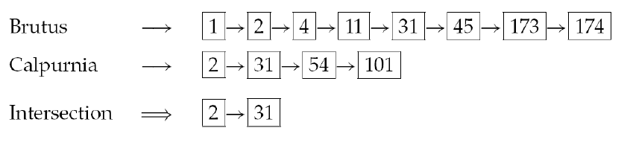
Faster postings list
Faster postings list intersection via skip pointers
ways to increase the efficiency of using postings lists
If the list lengths are m and n, the merge takes O(m+n)
operations.

Slide 35
Skip Pointers
Augmenting postings lists with skip pointers
Skip pointers are effectively shortcuts that allow us to avoid processing parts of the postings list that will not figure in the search results.
Where to place skip pointers ?
How to do efficient merging using skip pointers?

Slide 36
Sec. 2.3
Skip Pointers
41
128
Brutus
2
4
8
41
48
64
128
11
31
Caesar
1
2
3
8
11
17
21
31

Slide 37
Sec. 2.3
Skip Pointers
41
128
Brutus
2
4
8
41
48
64
128
11
31
Caesar
1
2
3
8
11
17
21
31
Suppose we’ve stepped through the lists until we process 8 on each list. We match it and advance.
We then have 41 and 11 on the lower. 11 is smaller
But the skip successor of 11 on the lower list is 31, so we can skip ahead past the intervening postings.

Slide 38
Postings lists intersection
with skip pointers.
IntersectWithSkips(p₁, p₂)
1 answer ← <>
2 while p₁ ≠ NIL and p₂ ≠ NIL
3 do if docID(p₁) = docID(p₂)
4 then ADD(answer, docID(p₁))
5 p₁ ← next(p₁)
6 p₂ ← next(p₂)
7 else if docID(p₁) < docID(p₂)
8 then if hasSkip(p₁) and (docID(skip(p₁)) ≤ docID(p₂))
9 then while hasSkip(p₁) and (docID(skip(p₁)) ≤ docID(p₂))
10 do p₁ ← skip(p₁)
11 else p₁ ← next(p₁)
12 else if hasSkip(p₂) and (docID(skip(p₂)) ≤ docID(p₁))
13 then while hasSkip(p₂) and (docID(skip(p₂)) ≤ docID(p₁))
14 do p₂ ← skip(p₂)
15 else p₂ ← next(p₂)
16 return answer

Slide 39
Where to place skips?
Sec. 2.3
Tradeoff:
More skips → shorter skip spans ⇒ more likely to skip. But lots of comparisons to skip pointers.
Fewer skips → few pointer comparison, but then long skip spans ⇒ few successful skips.

Slide 40
Placing skips
Sec. 2.3
Simple heuristic: for postings of length P, use √P evenly-spaced skip pointers.
Easy if the index is relatively static; harder if P keeps changing because of updates.

Slide 41
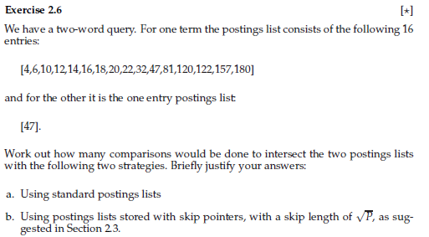
Exercise – Skip Pointers

Slide 42
Exercise – Skip Pointers Answer
using standard postings lists
Compare the elements from 4 thru 47 in the first list. So total number of comparisons without skip pointers is 11.
b) using postings lists stored with skip pointers, with a skip length of sqrt (P)
The length of the list is 16 . So sqrt (16) = 4.
The skip pointers will be at the elements 4, 14,22 and 120
Compare 4 and 47, as 4 is less than 47 and also skip pointer, compare the skip pointer 14 with 47, then 22 with 47 and 120 with 47. As 120 is greater than 47, compare the element next to 22 , ie 32 , then 47.
So total 6 comparisons are done with skip pointers.

Slide 43
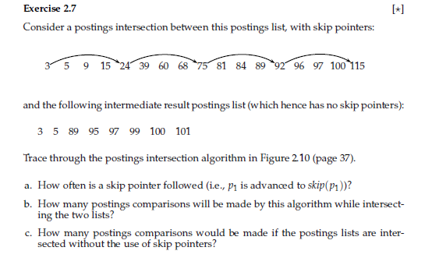
Exercise – Skip Pointers

Slide 44
Sec. 2.4
Positional postings and Phrase queries
Phrase queries
Want to be able to answer queries such as “Stanford University” – as a phrase
The sentence “I went to university at Stanford” is not a match
The sentence “The inventor Stanford Ovshinsky never went to university” is not a match
For this, it no longer suffices to store only
<term : docs> entries

Slide 45
Handling Phrase queries
Biword Indexes
Positional Indexes

Slide 46
Biword Indexes
Sec. 2.4.1
Index every consecutive pair of terms in the text as a phrase
For example, the text “Friends, Romans, Countrymen” would generate the biwords
friends romans
romans countrymen
Each of these biwords is now a dictionary term
Two-word phrase query-processing is now immediate.

Slide 47
Sec. 2.4.1
Biword indexes
Longer phrases are processed by breaking them.
stanford university palo alto can be broken into the Boolean query on biwords:
stanford university AND university palo AND palo alto
Without the docs, we cannot verify that the docs matching the above Boolean query do contain the phrase.

Slide 48
Extended biwords
Sec. 2.4.1
Parse the indexed text and perform part-of-speech-tagging (POST).
Bucket the terms into (say) Nouns (N) and articles/prepositions (X).
Call any string of terms of the form NX*N an extended biword.
Each such extended biword is now made a term in the dictionary.
Example: cost overruns on a power plant
N N X X N
Query processing: parse it into N’s and X’s
Segment query into extended biwords
“cost overruns” AND “overruns power” AND “power plant”
Better results can be obtained by using more precise part-of-speech patterns that define which extended biwords should be indexed.

Slide 49
Issues for biword indexes
Sec. 2.4.1
False positives
Index blowup due to bigger dictionary
Biword indexes are not the standard solution (for all biwords) but can be part of a compound strategy.

Slide 50
Positional indexes
Sec. 2.4.2
In the postings, store, for each term the position(s) in which tokens of it appear:
<term, number of docs containing term;
doc1: frequency of the term; position1, position2 … ;
doc2: frequency of the term; position1, position2 … ;
etc.>

Slide 51
Sec. 2.4.2
Positional indexes
to, 993427:
(1, 6: (7, 18, 33, 72, 86, 231);
2, 5: (1, 17, 74, 222, 255);
4, 5: (8, 16, 190, 429, 433);
5, 2: (363, 367);
7, 3: (13, 23, 191); . . . )
be, 178239:
(1, 2: (17, 25);
4, 5: (17, 191, 291, 430, 434);
5, 3: (14, 19, 101); . . . )

Slide 52
Sec. 2.4.2
Positional indexes
For phrase queries, we use a merge algorithm recursively at the document level
This requires more than just equality
Start with the least frequent term and then work, to further restrict the list of possible candidates
Need to check that their positions of appearance in the document are compatible with the phrase query being evaluated
This requires working out offsets between the words
Positional Index can also be used for Proximity Searches.

Slide 53
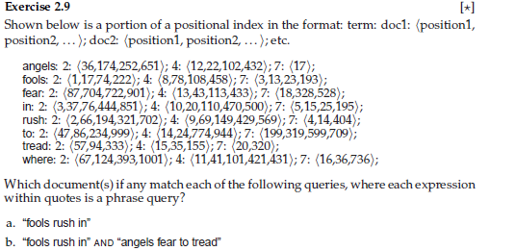
Exercise - Positional Indexes

Slide 54
Lecture Outline
Chapter 3: Dictionaries and Tolerant Retrieval
Dictionary Data Structures
Tolerant Retrieval
Slides are adapted from Introduction to Information Retrieval;Manning,Raghavan
http://nlp.stanford.edu/IR-book

Slide 55
Ch. 3
Dictionaries and Tolerant
Retrieval
Dictionary data structures
data structures that help the search for terms in the vocabulary in an inverted index.
Tolerant retrieval
techniques that are robust to typographical errors in the query, as well as alternative spellings.
Wild-card queries
Spelling correction
Phonetic correction

Slide 56
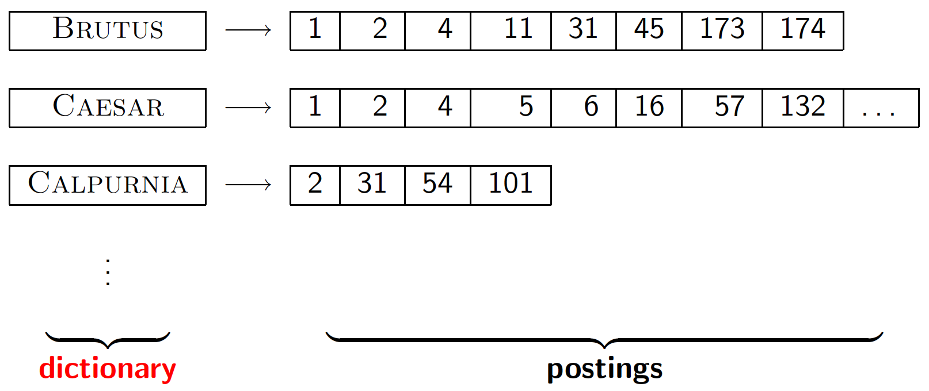
Search structures for dictionaries
Sec. 3.1
The dictionary stores the term vocabulary, document frequency, pointers to each postings list … in what data structure?

Slide 57
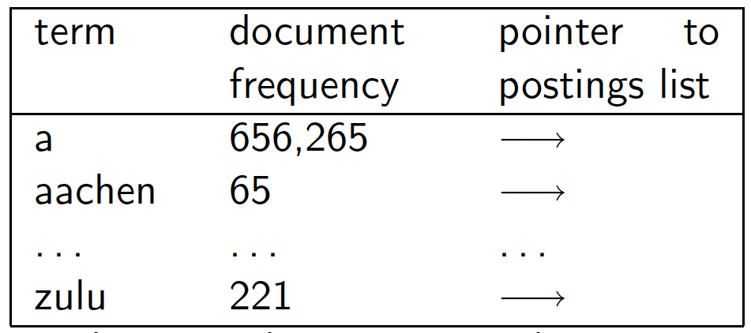
A simple dictionary
Sec. 3.1
An array of structures:
char[20] int Postings 20 bytes 4/8 bytes 4/8 bytes

Slide 58
Dictionary data structures
Sec. 3.1
Two main choices:
Hashtables
Trees
The choice of solution (hashing, or search trees) depends on:
No. of keys(Terms)
Keys remain static or dynamic
The relative frequencies with which various keys will be accessed.

Slide 59
Hashtables
Sec. 3.1
Each vocabulary term is hashed to an integer
Pros:
Lookup is faster than for a tree: O(1)
Cons:
No easy way to find minor variants:
judgment/judgement
No prefix search [tolerant retrieval]
If vocabulary keeps growing, need to occasionally do the expensive operation of rehashing everything

Slide 60
Tree: Binary Search Tree
Root
a-m
n-z
a-hu
hy-m
n-sh
si-z
huygens
sickle
zygot
aardvark

Slide 61
Tree: B-tree
Sec. 3.1
Definition: Every internal nodel has a number of children in the interval [a,b] where a, b are appropriate natural numbers, e.g., [2,4].
a-hu
n-z
hy-m

Slide 62
Trees
Sec. 3.1
Pros:
Solves the prefix problem (terms starting with hyp)
Cons:
Slower: O(log M) [and this requires balanced tree]
Rebalancing binary trees is expensive
But B-trees mitigate the rebalancing problem

Slide 63
Tolerant Retrieval
Wild-card queries
Spelling correction
Phonetic correction

Slide 64
Wild-card queries
Uncertain of the spelling of a query term (e.g., Sydney vs. Sidney, which leads to the wildcard query S*dney)
Seeking documents containing the variants (e.g., color vs. colour)
Seeking documents containing variants of a term that would be caught by stemming, but is unsure whether the search engine performs stemming (e.g., judicial vs. judiciary, leading to the wildcard query judicia*)
Uncertain of the correct rendition of a foreign word or phrase (e.g., the query Universit* Stuttgart).

Slide 65
Wild-card queries: *
Sec. 3.2
mon*: (trailing wildcard query) find all docs containing any word beginning with “mon”.
Easy with binary tree (or B-tree) lexicon: retrieve all words in range: mon ≤ w < moo (w is the set of terms which start with mon)

Slide 66
Wild-card queries: *
Sec. 3.2
*mon: (leading wildcard query) find words ending in “mon”:
Maintain an additional B-tree (reverse B-tree)
Reverse B-tree is one in which each root-to-leaf path of the B-tree corresponds to a term in the dictionary written backwards:
Can retrieve all words in range: nom ≤ w < non.

Slide 67
Wild-card queries: *
How can we handle *’s in the middle of query term?
co*tion
We could look up co* AND *tion in a B-tree and the reverse B-tree and intersect the two term sets
Expensive
The solution: transform wild-card queries so that the *’s occur at the end
This gives rise to the Permuterm Index.

Slide 68
Wildcard Query Processing
Permuterm indexes
K-gram indexes
Both techniques share a common strategy:
Express the given wildcard query q_{w} as a Boolean query Q on a specially constructed index, such that the answer to Q is a superset of the set of vocabulary terms matching q_{w.}
Then, we check each term in the answer to Q against q_{w}, discarding those vocabulary terms that do not match q_{w}

Slide 69
Permuterm indexes
Sec. 3.2.1
Introduce a special symbol $ into the character set, to mark the end of a term
For term hello, index under:
hello$, ello$h, llo$he, lo$hel, o$hell, $hello
where $ is a special symbol.

Slide 70
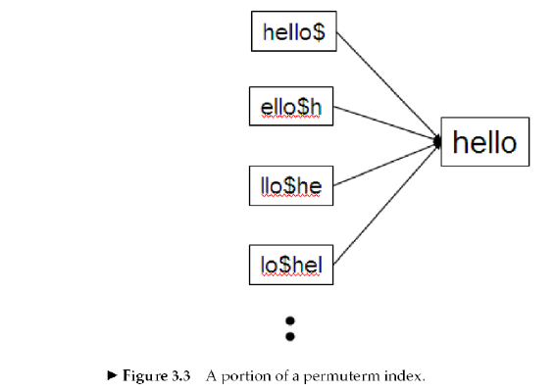
Permuterm indexes
Sec. 3.2.1
From the permuterm we can get the term and then from the standard index we can get the documents containing the term.

Slide 71
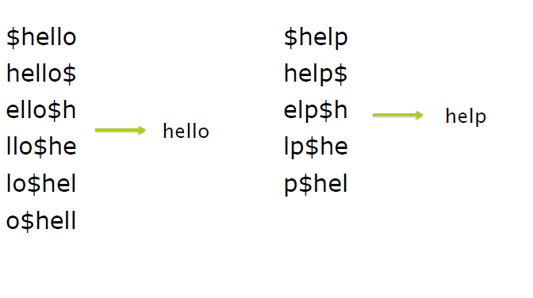
Permuterm indexes

Slide 72
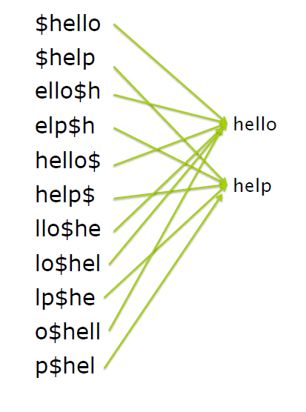
Permuterm indexes

Slide 73
Permuterm indexes
Consider the wildcard query m*n.
Rotate this wildcard query so that the * symbol appears at the end of the string after adding the $ symbol
Rotated wildcard query becomes n$m*
Look up this string in the permuterm index and get the terms
Search in the inverted index all the documents indexed by these terms

Slide 74
k-gram indexes
A k-gram is a sequence of k characters.
cas, ast and stl are all 3-grams occurring in the term castle.
The full set of 3-grams generated for castle is: $ca, cas, ast, stl, tle, le$
In a k-gram index, the dictionary contains all k-grams that occur in any term in the vocabulary
Each postings list points from a k-gram to all vocabulary terms containing that k-gram

Slide 75
Sec. 3.2.2
k-gram indexes
The k-gram index finds terms based on a query consisting of k-grams (here k=2).
$m
mace
madden
mo
among
amortize
on
along
among
Maintain a second inverted index from bigrams to dictionary terms that match each bigram.

Slide 76
k-gram indexes
Sec. 3.2.2
Query mon* can now be run as
$m AND mo AND on
Gets terms that match AND version of the wildcard query
But the enumerated term moon will also be retrieved (False Positive)
Must post-filter these terms against query
Surviving enumerated terms are then looked up in the term-document inverted index
Fast, space efficient.

Slide 77
Exercise - Permuterm Index

