Slide 1
AIMLCZG537/DSECLZG537 Information Retrieval
Dr. Maheswari Karthikeyan
Lecture4 : 17-12-2023

Slide 2
Lecture Outline
Chapter 3: Dictionaries and Tolerant Retrieval
Tolerant Retrieval
Slides are adapted from Introduction to Information Retrieval;Manning,Raghavan
http://nlp.stanford.edu/IR-book

Slide 3
Tolerant Retrieval
Techniques that are robust to typographical errors in the query, as well as alternative spellings.
Wild-card queries
Spelling correction
Phonetic correction

Slide 4
Wild-card queries
Uncertain of the spelling of a query term (e.g., Sydney vs. Sidney, which leads to the wildcard query S*dney)
Seeking documents containing the variants (e.g., color vs. colour)
Seeking documents containing variants of a term that would be caught by stemming, but is unsure whether the search engine performs stemming (e.g., judicial vs. judiciary, leading to the wildcard query judicia*)
Uncertain of the correct rendition of a foreign word or phrase (e.g., the query Universit* Stuttgart).

Slide 5
Wild-card queries: *
Sec. 3.2
mon*: (trailing wildcard query) find all docs containing any word beginning with “mon”.
Easy with binary tree (or B-tree) lexicon: retrieve all words in range: mon ≤ w < moo (w is the set of terms which start with mon)

Slide 6
Wild-card queries: *
Sec. 3.2
*mon: (leading wildcard query) find words ending in “mon”:
Maintain an additional B-tree (reverse B-tree)
Reverse B-tree is one in which each root-to-leaf path of the B-tree corresponds to a term in the dictionary written backwards:
Can retrieve all words in range: nom ≤ w < non.

Slide 7
Wild-card queries: *
How can we handle *’s in the middle of query term?
co*tion
We could look up co* AND *tion in a B-tree and the reverse B-tree and intersect the two term sets
Expensive
The solution: transform wild-card queries so that the *’s occur at the end
This gives rise to the Permuterm Index.

Slide 8
Wildcard Query Processing
Permuterm indexes
K-gram indexes
Both techniques share a common strategy:
Express the given wildcard query q_{w} as a Boolean query Q on a specially constructed index, such that the answer to Q is a superset of the set of vocabulary terms matching q_{w.}
Then, we check each term in the answer to Q against q_{w}, discarding those vocabulary terms that do not match q_{w}

Slide 9
Permuterm indexes
Sec. 3.2.1
Introduce a special symbol $ into the character set, to mark the end of a term
For term hello, index under:
hello$, ello$h, llo$he, lo$hel, o$hell, $hello
where $ is a special symbol.

Slide 10
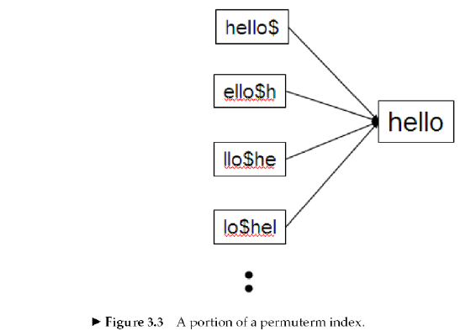
Permuterm indexes
Sec. 3.2.1
From the permuterm we can get the term and then from the standard index we can get the documents containing the term.

Slide 11
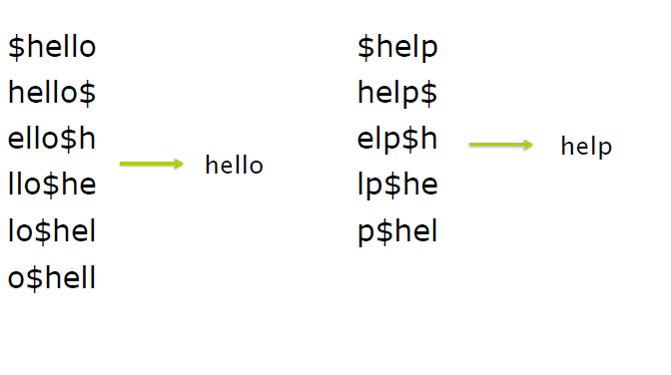
Permuterm indexes

Slide 12
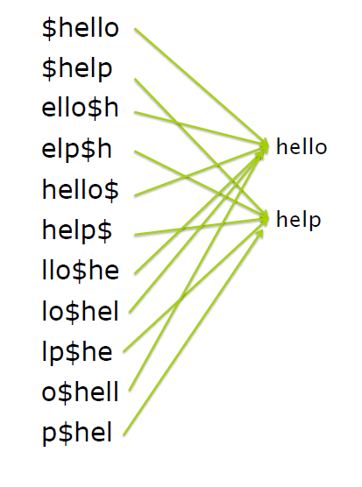
Permuterm indexes

Slide 13
Permuterm indexes
Consider the wildcard query m*n.
Rotate this wildcard query so that the * symbol appears at the end of the string after adding the $ symbol
Rotated wildcard query becomes n$m*
Look up this string in the permuterm index and get the terms
Search in the inverted index all the documents indexed by these terms

Slide 14
k-gram indexes
A k-gram is a sequence of k characters.
cas, ast and stl are all 3-grams occurring in the term castle.
The full set of 3-grams generated for castle is: $ca, cas, ast, stl, tle, le$
In a k-gram index, the dictionary contains all k-grams that occur in any term in the vocabulary
Each postings list points from a k-gram to all vocabulary terms containing that k-gram

Slide 15
Sec. 3.2.2
k-gram indexes
The k-gram index finds terms based on a query consisting of k-grams (here k=2).
$m
mace
madden
mo
among
amortize
on
along
among
Maintain a second inverted index from bigrams to dictionary terms that match each bigram.

Slide 16
k-gram indexes
Sec. 3.2.2
Query mon* can now be run as
$m AND mo AND on
Gets terms that match AND version of the wildcard query
But the enumerated term moon will also be retrieved (False Positive)
Must post-filter these terms against query
Surviving enumerated terms are then looked up in the term-document inverted index
Fast, space efficient.

Slide 17
Exercise - Permuterm Index

Slide 18
Tolerant Retrieval
Wild-card queries
Spelling correction
Phonetic correction

Slide 19
Spelling correction
Among the various alternative correct spellings for a mis-spelled query, choose the “nearest” one.
When two correctly spelled queries are tied (or nearly tied), select the one that is more common.
Two forms of Correction:
Isolated word
Check each word on its own for misspelling
Will not catch typos resulting in correctly spelled words
e.g., from → form
Context-sensitive
Look at surrounding words,
e.g., I flew form Heathrow to Narita

Slide 20
Isolated word correction
Sec. 3.3.2
Fundamental premise – there is a lexicon from which the correct spellings come
Two basic choices for this:
A standard lexicon such as
Webster’s English Dictionary
An “industry-specific” lexicon – hand-maintained
The lexicon of the indexed corpus
E.g., all words on the web
All names, acronyms etc.
(Including the mis-spellings)

Slide 21
Isolated word correction
Sec. 3.3.2
Given a lexicon and a character sequence Q, return the words in the lexicon closest to Q
Edit distance (Levenshtein distance)
Weighted edit distance
k-gram index

Slide 22
Edit distance
Sec. 3.3.3
Given two strings S₁ and S₂, the minimum number of operations to convert one to the other
Operations are typically character-level
Insert, Delete, Replace, (Transposition)
E.g., the edit distance from dof to dog is 1
From cat to act is 2 (Just 1 with transpose.)
from cat to dog is 3.
Dynamic programming technique is used for computing the edit distance

Slide 23
Levenshtein Distance: Algorithm
Note: To understand this algorithm, Dynamic programming design technique understanding is required.
The algorithm fills the entries in a matrix m whose two dimensions equals the length of the two strings, whose edit distances are being computed
The (i, j) entry of the matrix will hold the edit distance between the strings consisting of the first i characters of s1 and the first j characters of s2.

Slide 24
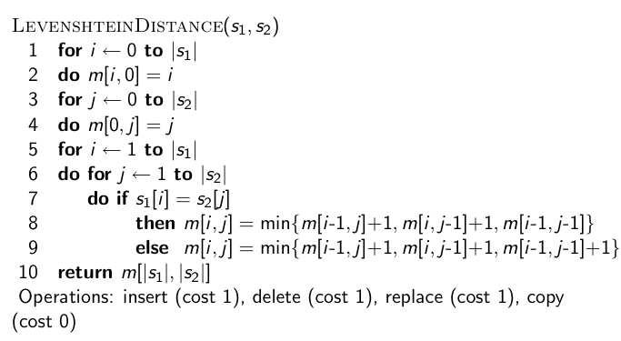
Levenshtein Distance: Algorithm
24

Slide 25
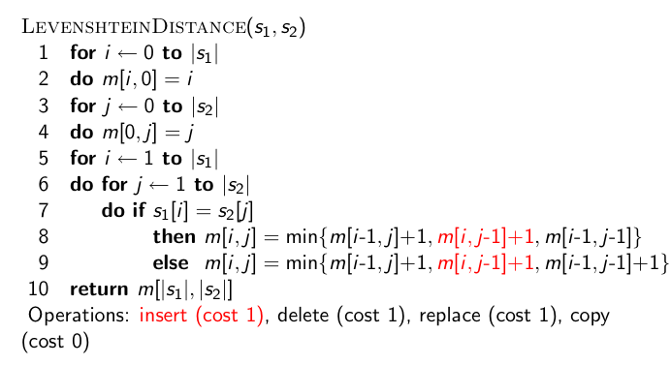
Levenshtein Distance: Algorithm
25

Slide 26
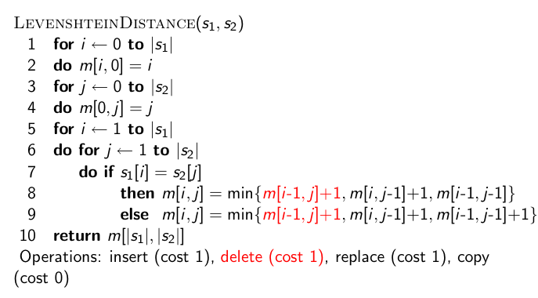
Levenshtein Distance: Algorithm
26

Slide 27
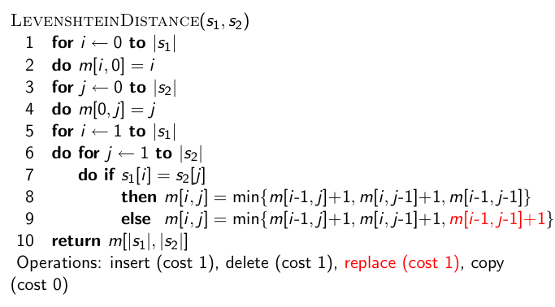
Levenshtein Distance: Algorithm
27

Slide 28
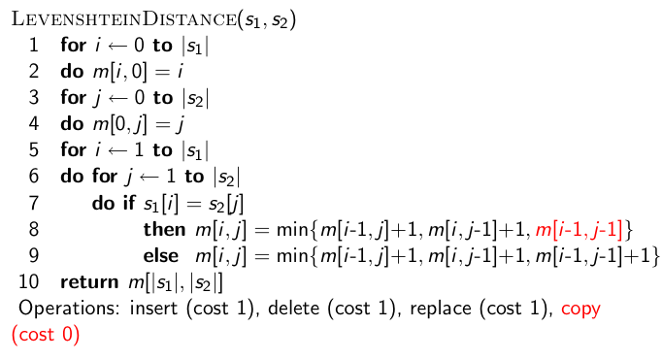
Levenshtein Distance: Algorithm
28

Slide 29
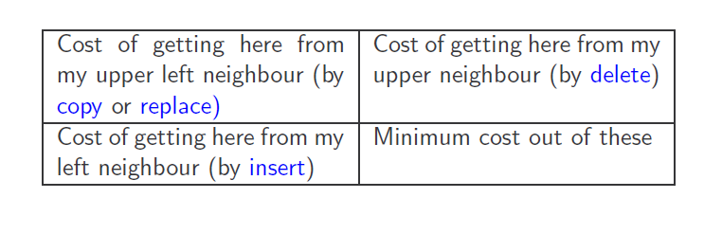
Each cell of Levenshtein matrix
29

Slide 30
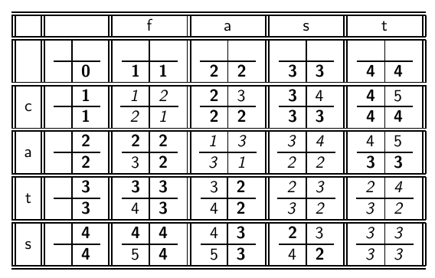
Levenshtein Distance: Example
30

Slide 31
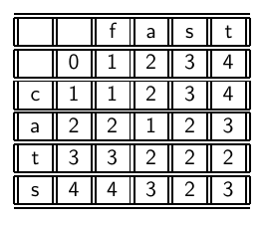
Levenshtein Distance: Example
31

Slide 32
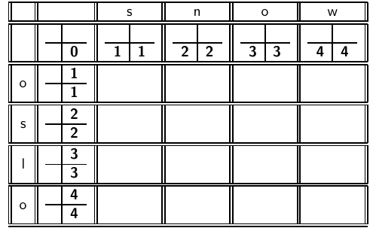
Levenshtein Distance: Example
32

Slide 33
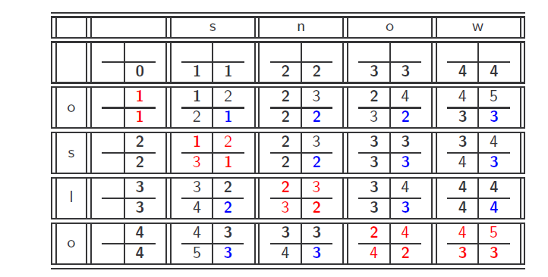
Levenshtein Distance: Example

Slide 34
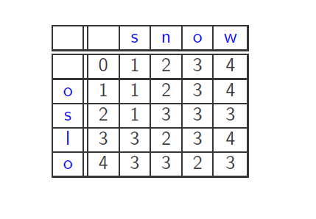
Levenshtein Distance: Example

Slide 35
Weighted edit distance
Sec. 3.3.3
Same as edit distance, but the weight of an operation depends on the character(s) involved
Meant to capture OCR or keyboard errors Example: m more likely to be mis-typed as n than as q
Therefore, replacing m by n is a smaller edit distance than by q
This may be formulated as a probability model
Requires weight matrix as input
Modify dynamic programming to handle weights

Slide 36
Using edit distances
Given query, first enumerate all character sequences within a preset edit distance (e.g., 2)
Intersect this set with list of “correct” words
Show terms you found to user as suggestions
Alternatively,
look up all possible corrections in the inverted index and return all docs -- slow
run with a single most likely correction

Slide 37
Sec. 3.3.4
Using edit distances
Given a (mis-spelled) query – do we compute its edit distance to every dictionary term?
Expensive and slow
Alternative?
One possibility is to use k-gram overlap.
to cut the set of candidate dictionary terms

Slide 38
k-gram index
Enumerate all the k‐grams in the query string as well as in the document
Use the k‐gram index to retrieve all terms matching any of the query k‐grams
Threshold by number of matching k‐grams
Example: bigram index, misspelled word boardroom as bordroom
Bigrams: bo, or, rd, dr, ro, oo, om
38

Slide 39
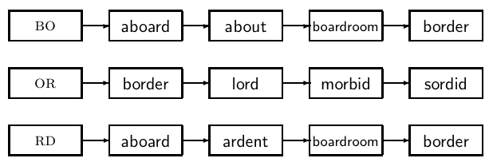
k-gram index
39

Slide 40
k-gram index
Example with trigrams
Suppose the text is November
Trigrams are nov, ove, vem, emb, mbe, ber.
The query is december
Trigrams are dec, ece, cem, emb, mbe, ber.
So 3 trigrams overlap (of 6 in each term)
normalized measure of overlap?

Slide 41
k-gram index
Jaccard coefficient
A commonly‐used measure of overlap
Let X and Y be two sets; then the J.C. is X ∩Y / X ∪Y
Equals 1 when X and Y have the same elements and zero when they are disjoint
X and Y don t’ have to be of the same size
Always assigns a number between 0 and 1
Now threshold to decide if you have a match
E.g., if J.C. > 0.8, declare a match

Slide 42
Context-sensitive spell correction
Take the Example : flew form munich
How can we correct form here?
One idea: hit-based spelling correction
Retrieve “correct” terms close to each query term for "flew form munich":
flea for flew, from for form, munch for munich
Now try all possible resulting phrases as queries with one word “fixed” at a time
Try query “flea form munich”
Try query “flew from munich”
Try query “flew form munch”
The correct query “flew from munich” has the most hits.
42

Slide 43
Context-sensitive spell correction
Another approach
Break phrase query into a conjunction of biwords.
Look for biwords that need only one term corrected.
Enumerate phrase matches and rank them.

Slide 44
Tolerant Retrieval
Wild-card queries
Spelling correction
Phonetic correction

Slide 45
Phonetic correction
Misspellings that arise because the user types a query that sounds like the target term
The main idea here is to generate, for each term, a “phonetic hash” so that similar-sounding terms hash to the same value
Algorithms for such phonetic hashing are collectively known as soundex algorithms.

Slide 46
Soundex
Sec. 3.4
Class of heuristics to expand a query into phonetic equivalents
Language specific – mainly for names
E.g., chebyshev → tchebycheff
Invented for the U.S. census … in 1918

Slide 47
Soundex – algorithm
Sec. 3.4
Turn every token to be indexed into a 4-character reduced form. Build an inverted index from these reduced forms to the original terms; call this the soundex index
Do the same with query terms
When the query calls for a soundex match, search this soundex index.

Slide 48
Soundex – algorithm
Sec. 3.4
Retain the first letter of the word.
Change all occurrences of the following letters to '0' (zero): 'A', E', 'I', 'O', 'U', 'H', 'W', 'Y'.
Change letters to digits as follows:
B, F, P, V → 1
C, G, J, K, Q, S, X, Z → 2
D,T → 3
L → 4
M, N → 5
R → 6

Slide 49
Sec. 3.4
Soundex – algorithm
Remove one out of each pair of consecutive digits.
Remove all zeros from the resulting string.
Pad the resulting string with trailing zeros and return the first four positions, which will be of the form <uppercase letter> <digit> <digit> <digit>.
E.g., Herman becomes H655.
What will be the soundex code for Hermann?

Slide 50
Soundex
Sec. 3.4
Soundex is the classic algorithm, provided by most databases (Oracle, Microsoft, …)
Not much useful for information retrieval
Okay for “high recall” tasks (e.g., Interpol), though biased to names of certain nationalities

