Slide 1
AIMLCZG537/DSECLZG537 Information Retrieval
Dr. Maheswari Karthikeyan
Lecture5 : 24-12-2023

Slide 2
Chapter 6
Vector Space Model
Slides are adapted from Introduction to Information Retrieval;Manning,Raghavan
http://nlp.stanford.edu/IR-book

Slide 3
Vector Space Model
Term frequency and weighting
The vector space model for scoring

Slide 4
Ranked retrieval
Ch. 6
Thus far, our queries have all been Boolean.
Documents either match or don’t.
Good for expert users with precise understanding of their needs and the collection.
Not good for the majority of users.
Most users are incapable of writing Boolean queries (or they are, but they think it’s too much work).
Most users don’t want to wade through 1000s of results.
This is particularly true of web search.

Slide 5
Ranked retrieval models
Rather than a set of documents satisfying a query expression, in ranked retrieval, the system returns an ordering over the (top) documents in the collection for a query
When a system produces a ranked result set,
The size of the result set is not an issue
Just show the top k ( ≈ 10) results
Don’t overwhelm the user

Slide 6
Ch. 6
Ranked retrieval models
Return in order the documents most likely to be useful to the searcher
How can we rank-order the documents in the collection with respect to a query?
Assign a score – say in [0, 1] – to each document
This score measures how well document and query “match”.

Slide 7
Query-document matching scores
Ch. 6
We need a way of assigning a score to a query/document pair
Let’s start with a one-term query
If the query term does not occur in the document: score should be 0
The more frequent the query term in the document, the higher the score (should be)
We will look at a number of alternatives for this.

Slide 8
Jaccard coefficient
Ch. 6
A commonly used measure of overlap of two sets A and B
jaccard(A,B) = |A ∩ B| / |A ∪ B|
jaccard(A,A) = 1
jaccard(A,B) = 0 if A ∩ B = 0
A and B don’t have to be the same size.
Always assigns a number between 0 and 1.

Slide 9
Jaccard coefficient
jaccard(A,B) = |A ∩ B| / |A ∪ B|
Larger the term overlap of the two sets A and B, the better.
Larger the proportion of term overlap with respect to the sizes of the sets A and B, the better.

Slide 10
Jaccard coefficient: Scoring example
What is the query-document match score that the Jaccard coefficient computes for each of the two documents below?
Query: ides of march
Document 1: caesar died in march
Document 2: the long march march
Document 3: the long march end april
Notes:
JC(1) = 1/6 JC(2) = 1/5

Slide 11
Issues with Jaccard for scoring
Ch. 6
It doesn’t consider term frequency (how many times a term occurs in a document)
Rare terms in a collection are more informative than frequent terms. Jaccard doesn’t consider this information
We need a more sophisticated way of normalizing the length of document

Slide 12
Term-document incidence matrix
Sec. 6.2
Each document is represented by a binary vector ∈ {0,1}^{|V|}

Slide 13
Term-document count matrices
Sec. 6.2
Consider the number of occurrences of a term in a document:
Each document is a count vector

Slide 14
Bag of words model
Vector representation doesn’t consider the ordering of words in a document
John is quicker than Mary and Mary is quicker than John have the same vectors
This is called the bag of words model.
In a sense, this is a step back: The positional index was able to distinguish these two documents.
We will look at “recovering” positional information later.
For now: bag of words model

Slide 15
Term frequency - tf
The term frequency tf_{t,d} of term t in document d is defined as the number of times that t occurs in d.
We want to use tf when computing query-document match scores.
Raw term frequency is not what we want:
A document with 10 occurrences of the term is more relevant than a document with 1 occurrence of the term.
But not 10 times more relevant.
Relevance does not increase proportionally with term frequency.

Slide 16
Example
Compute the Jaccard matching score and the tf matching score for the following query-document pairs.
q: [information on cars] d: “all you have ever wanted to know about cars”
q: [information on cars] d: “information on trucks, information on planes, information on trains”
q: [red cars and trucks] d: “cops stop red cars more often”

Slide 17
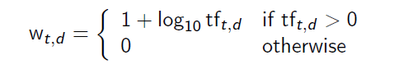
Log-frequency weighting
Sec. 6.2
The log frequency weight of term t in d is
tf_{t,d} → w_{t,d} :
0 → 0, 1 → 1, 2 → 1.3, 10 → 2, 1000 → 4, etc.
Score for a document-query pair: sum over terms t in both q and d:
The score is 0 if none of the query terms is present in the document.

Slide 18
Document Frequency
The document frequency is the number of documents in the collection that the term t occurs in.
Use the frequency of the term in the collection for weighting and ranking.

Slide 19
Collection vs. Document frequency
Sec. 6.2.1
The collection frequency of t is the number of occurrences of t in the collection, counting multiple occurrences.
Example:
Word | Collection frequency | Document frequency
insurance | 10440 | 3997
try | 10422 | 8760
Notes:
Why do you get these numbers?
Suggests df is better.

Slide 20
Document Frequency
Rare terms are more informative than frequent terms.
Consider a term in the query that is rare in the collection
(e.g., arachnocentric).
A document containing this term is very likely to be relevant.
We want high weights for rare terms like
arachnocentric

Slide 21
Document Frequency
Frequent terms are less informative than rare terms
Consider a term in the query that is frequent in the collection (e.g., good, increase, line)
A document containing this term is more likely to be relevant than a document that doesn’t
But words like good, increase and line are not sure indicators of relevance
For frequent terms like good, increase, and line, we want positive weights, but lower weights than the rare terms.

Slide 22
Document Frequency
Need high weights for rare terms like arachnocentric
Need low (positive) weights for frequent words like good, increase, and line
Can use the document frequency to factor this into computing the matching score.

Slide 23
idf weight
df_{t} is the document frequency, the number of documents that t occurs in.
df_{t} is an inverse measure of the informativeness of term t.
We define the idf weight of term t as follows:
i df_{t} = log ( N / df_{t} )
(N is the number of documents in the collection.)
idf_{t} is a measure of the informativeness of the term.

Slide 24
idf example
Sec. 6.2.1
suppose N = 1,000,000
term | df_{t} | idf_{t}
calpurnia | 1
animal | 100
sunday | 1,000
fly | 10,000
under | 100,000
the | 1,000,000
Notes:
6 4 3 2 1 0

Slide 25
Effect of idf on ranking
Does idf have an effect on ranking for one-term queries, like
iPhone
idf has no effect on ranking one term queries
idf affects the ranking of documents for queries with at least two terms
For the query capricious person, idf weighting makes occurrences of capricious count for much more in the final document ranking than occurrences of person.

Slide 26

tf-idf weighting
Sec. 6.2.2
The tf-idf weight of a term is the product of its tf weight and its idf weight.
Best known weighting scheme in information retrieval
Note: the “-” in tf-idf is a hyphen, not a minus sign.
Alternative names: tf.idf, tf x idf
Increases with the number of occurrences within a document (term frequency)
Increases with the rarity of the term in the collection (inverse document frequency)

Slide 27
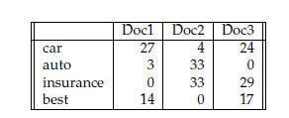
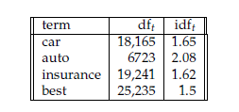
Example
Exercise 6.10
Consider the table of term frequencies for 3 documents denoted Doc1, Doc2, Doc3 in Figure 6.9. Compute the tf-idf weights for the terms car, auto, insurance, best, for each document, using the idf values from Figure 6.8.

Slide 28
tf – idf for (cars, doc1) = (1+log27) * 1.65 = 2.43 * 1.65 = 4
tf – idf for (cars, doc2) = (1+log 4) * 1.65 = 2.64
tf – idf for (cars, doc2) = (1+log 24) * 1.65 = 3.93
tf – idf score for term cars = 4+2.64+3.93= 10.57
Similar manner the scores for other terms has to be computed.

Slide 29
Example - Tf-idf scores
Tf-idf computation without taking logarithmic tf (raw tf value)
terms Doc1 Doc2 Doc3
----------------------------------------------
Car 44.55 6.6 39.6
Auto 6.24 68.64 0
Insurance 0 53.46 46.98
Best 21 0 25.5

Slide 30
Score for a document given a query

Slide 31
Binary → count → weight matrix
Each document is now represented by a real-valued vector of tf-idf weights ∈ R^{|V|}

Slide 32
Documents as Vectors
Each document is now represented by a real-valued vector of tf-idf weights ∈ R^{|V|}
It is a |V|-dimensional real-valued vector space.
Terms are axes of the space.
Documents are points or vectors in this space.
Very high-dimensional: tens of millions of dimensions when you apply this to web search engines
Each vector is very sparse - most entries are zero.

Slide 33
Queries as vectors
Key idea 1: Do the same for queries: represent them as vectors in the space
Key idea 2: Rank documents according to their proximity to the query in this space
proximity = similarity of vectors
proximity ≈ inverse of distance
How to quantify the similarity between the vectors?

Slide 34
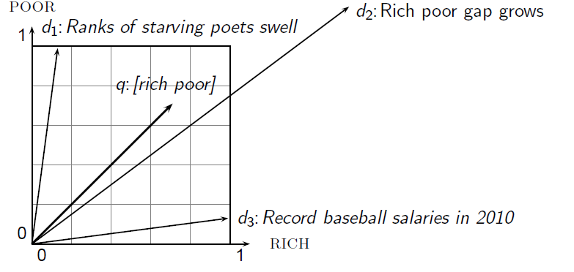
Similarity using distance(difference)
The Euclidean distance between q and d₂ is large even though the distribution of terms in the query q and the distribution of terms in the document d₂ are very similar.

Slide 35
Use angle instead of distance
Take a document d and append it to itself. Call this document d′.
“Semantically” d and d′ have the same content
The Euclidean distance between the two documents can be quite large
The angle between the two documents is 0, corresponding to maximal similarity.
Key idea: Rank documents according to angle with query.

Slide 36
From angles to cosines
The following two notions are equivalent.
Rank documents in increasing order of the angle between query and document
Rank documents in decreasing order of cosine angle between query and document
Cosine is a monotonically decreasing function for the interval [0º, 180º]

Slide 37
Cosine(query, document)
Dot product
q_{i} is the tf-idf weight of term i in the query
d_{i} is the tf-idf weight of term i in the document
cos(q,d) is the cosine similarity of q and d … or,
equivalently, the cosine of the angle between q and d.
Notes:
See Law of Cosines (Cosine Rule) wikipedia page

Slide 38
Cosine for length-normalized vectors
For length-normalized vectors, cosine similarity is simply the dot product (or scalar product):
for q, d length-normalized.

Slide 39
Length normalization
A vector can be (length-) normalized by dividing each of its components by its length – for this we use the L₂ norm:
Dividing a vector by its L₂ norm makes it a unit (length) vector.
Effect on the two documents d and d′ (d appended to itself) from earlier slide: they have identical vectors after length-normalization.
Long and short documents now have comparable weights

Slide 40
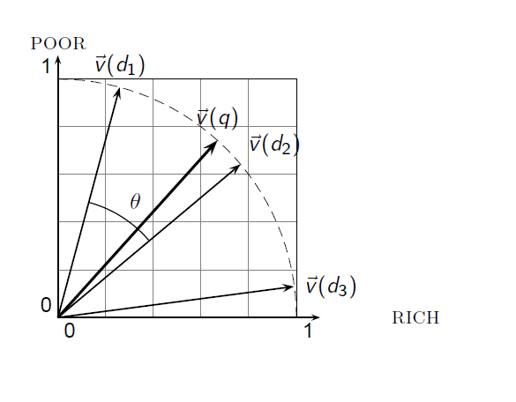
Cosine similarity

Slide 41
Cosine similarity among 3 documents
How similar are the novels?
SaS: Sense and Sensibility , PaP: Pride and Prejudice, and
WH: Wuthering Heights
term | SaS | PaP | WH
affection | 115 | 58 | 20
jealous | 10 | 7 | 11
gossip | 2 | 0 | 6
wuthering | 0 | 0 | 38
Term frequencies (counts)
Note: To simplify this example, we don’t do idf weighting.

Slide 42
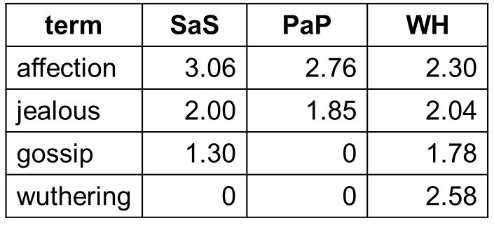
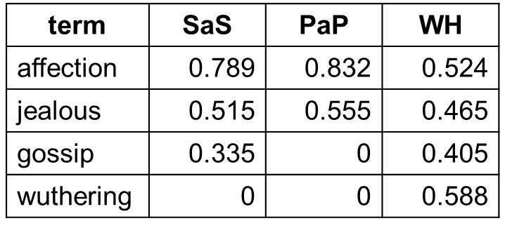
Cosine similarity among 3 documents
Log frequency weighting
After length normalization
cos(SaS,PaP) ≈
0.789 × 0.832 + 0.515 × 0.555 + 0.335 × 0.0 + 0.0 × 0.0
≈ 0.94
cos(SaS,WH) ≈ 0.79
cos(PaP,WH) ≈ 0.69

Slide 43
3.02^2 + 2^2 + 1.30^2
= SQRT(15.05) = 3.87
3.06/3.87 = 0.79

Slide 44
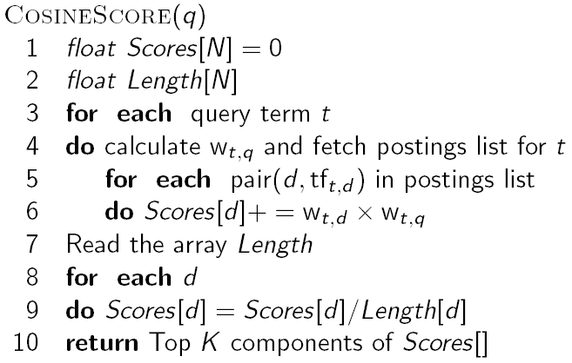
Computing cosine scores

Slide 45
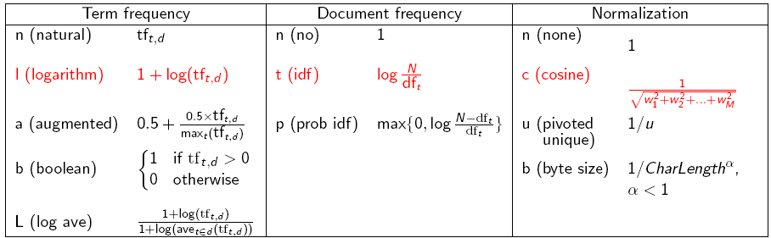
tf-idf weighting variants
Notes:
n default is just term frequency
ltc is best known form of weighting

Slide 46
Weighting may differ in queries vs. documents
We often use different weightings for queries and documents.
Notation: ddd.qqq
Example: lnc.ltn
document: logarithmic tf, no df weighting, cosine normalization
query: logarithmic tf, idf, no normalization
Example query: “best car insurance”
Example document: “car insurance auto insurance”

Slide 47
Example (lnc.ltn)
Query
Document
Word | tf-raw | tf-wt | df | idf | wt | tf-raw | tf-wt | wt | n’lize | product
auto
best
car
insurance

Slide 48
Example
Query
Document
Word | tf-raw | tf-wt | df | idf | wt | tf-raw | tf-wt | wt | n’lize | product
auto | 0 |  |  |  |  | 1
best | 1 |  |  |  |  | 0
car | 1 |  |  |  |  | 1
insurance | 1 |  |  |  |  | 2

Slide 49
Example
Query
Document
Word | tf-raw | tf-wt | df | idf | wt | tf-raw | tf-wt | wt | n’lize | product
auto | 0 | 0 |  |  |  | 1 | 1
best | 1 | 1 |  |  |  | 0 | 0
car | 1 | 1 |  |  |  | 1 | 1
insurance | 1 | 1 |  |  |  | 2 | 1.3

Slide 50
Example
Query
Document
Word | tf-raw | tf-wt | df | idf | wt | tf-raw | tf-wt | wt | n’lize | product
auto | 0 | 0 | 5000 |  |  | 1 | 1
best | 1 | 1 | 50000 |  |  | 0 | 0
car | 1 | 1 | 10000 |  |  | 1 | 1
insurance | 1 | 1 | 1000 |  |  | 2 | 1.3

Slide 51
Example
Query
Document
Word | tf-raw | tf-wt | df | idf | wt | tf-raw | tf-wt | wt | n’lize | product
auto | 0 | 0 | 5000 | 2.3 |  | 1 | 1
best | 1 | 1 | 50000 | 1.3 |  | 0 | 0
car | 1 | 1 | 10000 | 2.0 |  | 1 | 1
insurance | 1 | 1 | 1000 | 3.0 |  | 2 | 1.3

Slide 52
Example
Query
Document
Word | tf-raw | tf-wt | df | idf | wt | tf-raw | tf-wt | wt | n’lize | product
auto | 0 | 0 | 5000 | 2.3 | 0 | 1 | 1
best | 1 | 1 | 50000 | 1.3 | 1.3 | 0 | 0
car | 1 | 1 | 10000 | 2.0 | 2.0 | 1 | 1
insurance | 1 | 1 | 1000 | 3.0 | 3.0 | 2 | 1.3

Slide 53
Example
Doc length =
Query
Document
Word | tf-raw | tf-wt | df | idf | wt | tf-raw | tf-wt | wt | n’lize | product
auto | 0 | 0 | 5000 | 2.3 | 0 | 1 | 1 | 1
best | 1 | 1 | 50000 | 1.3 | 1.3 | 0 | 0 | 0
car | 1 | 1 | 10000 | 2.0 | 2.0 | 1 | 1 | 1
insurance | 1 | 1 | 1000 | 3.0 | 3.0 | 2 | 1.3 | 1.3

Slide 54
Example
Doc length =
Query
Document
Word | tf-raw | tf-wt | df | idf | wt | tf-raw | tf-wt | wt | n’lize | product
auto | 0 | 0 | 5000 | 2.3 | 0 | 1 | 1 | 1 | 0.52
best | 1 | 1 | 50000 | 1.3 | 1.3 | 0 | 0 | 0 | 0
car | 1 | 1 | 10000 | 2.0 | 2.0 | 1 | 1 | 1 | 0.52
insurance | 1 | 1 | 1000 | 3.0 | 3.0 | 2 | 1.3 | 1.3 | 0.68

Slide 55
Example
Doc length =
Query
Document
Word | tf-raw | tf-wt | df | idf | wt | tf-raw | tf-wt | wt | n’lize | product
auto | 0 | 0 | 5000 | 2.3 | 0 | 1 | 1 | 1 | 0.52 | 0
best | 1 | 1 | 50000 | 1.3 | 1.3 | 0 | 0 | 0 | 0 | 0
car | 1 | 1 | 10000 | 2.0 | 2.0 | 1 | 1 | 1 | 0.52 | 1.04
insurance | 1 | 1 | 1000 | 3.0 | 3.0 | 2 | 1.3 | 1.3 | 0.68 | 2.04
Final similarity score between query and document = 3.08

Slide 56
Example
Reconstruct the Table in the previous slides with the weighting as lnc.ltc
Word | tf-raw | tf-wt | df | idf | wt | n’lize | tf-raw | tf-wt | wt | n’lize | product
auto | 0 | 0 | 5000 | 2.3 | 0 | 0 | 1 | 1 | 1 | 0.52 | 0
best | 1 | 1 | 50000 | 1.3 | 1.3 | 0.34 | 0 | 0 | 0 | 0 | 0
car | 1 | 1 | 10000 | 2.0 | 2.0 | 0.52 | 1 | 1 | 1 | 0.52 | 0.27
insurance | 1 | 1 | 1000 | 3.0 | 3.0 | 0.78 | 2 | 1.3 | 1.3 | 0.68 | 0.53

Slide 57
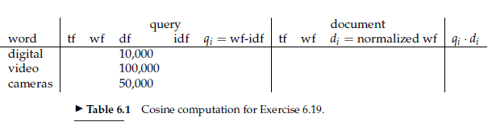
Exercise 6.19
Compute the vector space similarity between the query “digital cameras” and the document “digital cameras and video cameras” by filling out the empty columns in Table 6.1. Assume N = 10,000,000, logarithmic term weighting for query and document, idf weighting for the query only and cosine normalization for the document only. Treat and as a stop word. Enter term counts in the tf columns. What is the final similarity score?

Slide 58
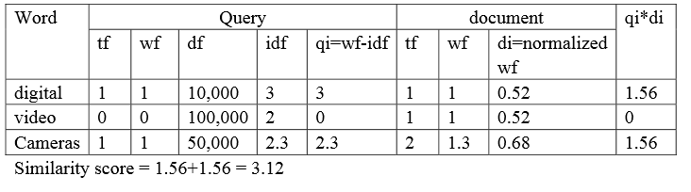
Exercise 6.19 – Solution

Slide 59
Summary – vector space ranking
Represent the query as a weighted tf-idf vector
Represent each document as a weighted tf-idf vector
Compute the cosine similarity score for the query vector and each document vector
Rank documents with respect to the query by score
Return the top K (e.g., K = 10) to the user

