Slide 1
AIMLCZG537/DSECLZG537 Information Retrieval
Dr. Maheswari Karthikeyan
Lecture6 : 31-12-2023

Slide 2
Index Compression
(T1, Chapter 5)
Slides are adapted from Introduction to Information Retrieval;Manning,Raghavan
http://nlp.stanford.edu/IR-book

Slide 3
Need for Compression
Use less disk space
Saves a little money
Keep more stuff in memory
Increases speed
Increase speed of data transfer from disk to memory
[read compressed data | decompress] is faster than [read uncompressed data]
Premise: Decompression algorithms are fast
True of the decompression algorithms we use

Slide 4
Why compression for inverted indexes?
Dictionary
Make it small enough to keep in main memory
Make it so small that you can keep some postings lists in main memory too
Postings file(s)
Reduce disk space needed
Decrease time needed to read postings lists from disk
Large search engines keep a significant part of the postings in memory.
Compression lets you keep more in memory
We will devise various IR-specific compression schemes

Slide 5
Reuters-RCV1:
Shakespeare’s collected works are not large enough to demonstrate scalable index construction algorithms.
Instead, we will use the Reuters RCV1 collection.
English newswire articles published in a 12-month period (1995/6)

Slide 6

A Reuters RCV1 Document

Slide 7
Reuters RCV1 Statistics
symbol statistic value
N documents 800,000
L avg. # tokens per doc 200
M terms (= word types) ~400,000
avg. # bytes per token 6
(incl. spaces/punct.)
avg. # bytes per token 4.5
(without spaces/punct.)
avg. # bytes per term 7.5
non-positional postings 100,000,000

Slide 8
Index parameters vs. what we index (details IIR Table 5.1)
Sec. 5.1
size of | word types (terms) |  |  | non-positional postings |  |  | positional postings
 | dictionary |  |  | non-positional index |  |  | positional index
 | Size (K) | ∆% | cumul % | Size (K) | ∆ % | cumul % | Size (K) | ∆ % | cumul %
Unfiltered | 484 |  |  | 109,971 |  |  | 197,879
No numbers | 474 | -2 | -2 | 100,680 | -8 | -8 | 179,158 | -9 | -9
Case folding | 392 | -17 | -19 | 96,969 | -3 | -12 | 179,158 | 0 | -9
30 stopwords | 391 | -0 | -19 | 83,390 | -14 | -24 | 121,858 | -31 | -38
150 stopwords | 391 | -0 | -19 | 67,002 | -30 | -39 | 94,517 | -47 | -52
stemming | 322 | -17 | -33 | 63,812 | -4 | -42 | 94,517 | 0 | -52

Slide 9
Lossless vs. lossy compression
Lossless compression: All information is preserved
What we mostly do in IR
Lossy compression: Discard some information
Several of the preprocessing steps can be viewed as lossy compression: case folding, stop words, stemming, number elimination.

Slide 10
Vocabulary vs. collection size
How big is the term vocabulary?
That is, how many distinct words are there?
Can we assume an upper bound?
Can’t : At least 70²⁰ = 10³⁷ different words of length 20
In practice, the vocabulary will keep growing with the collection size.
Notes:
Also - the calculation "At least 7020 = 1037 different words of length 20" seems like a bit of a gross overestimate (and in any case, might be more useful to say it's 2 raised to some power rather than 10 raised to the power 37)

Slide 11
Estimating the number of terms
Heaps’ law: M = kT^{b}
Estimates vocabulary size as a function of the collection size
M is the size of the vocabulary; T is the number of tokens in the collection,
Typical values: 30 ≤ k ≤ 100 and b ≈ 0.5
It is the simplest possible relationship between the two in log-log space
An empirical finding (“empirical law”)

Slide 12
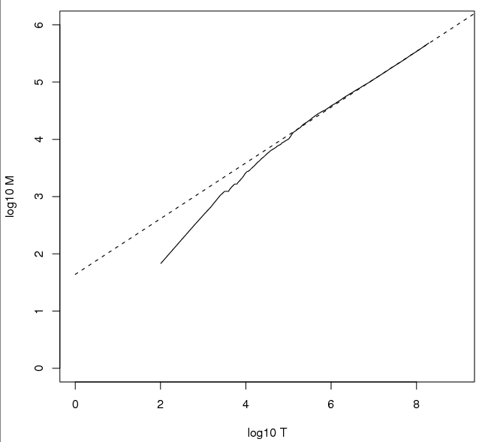
Heaps’ Law
Sec. 5.1
For RCV1, the dashed line log₁₀M = 0.49 log₁₀T + 1.64 is the best least squares fit.
Thus, M = 10^{1.64}T^{0.49} so k = 10^{1.64} ≈ 44 and b = 0.49.
Good empirical fit for Reuters RCV1 !
For first 1,000,020 tokens, law predicts 38,323 terms; actually, 38,365 terms

Slide 13
Estimating the number of terms
Heaps’ law suggests that
(i) the dictionary size continues to increase with more documents in the collection, rather than a maximum vocabulary size being reached
(ii) the size of the dictionary is quite large for large collections.

Slide 14
Zipf’s law:Modeling the distribution of terms
Heaps’ law gives the vocabulary size in collections
We also study the relative frequencies of terms
In natural language, there are a few very frequent terms and very many very rare terms
Zipf’s law: The ith most frequent term has frequency proportional to 1/i
cf_{i} ∝ 1/i
cf_{i} is collection frequency: the number of occurrences of the term t_{i} in the collection.

Slide 15
Zipf consequences
If the most frequent term (the) occurs cf₁ times
then the second most frequent term (of) occurs cf₁/2 times
the third most frequent term (and) occurs cf₁/3 times …
Equivalent: cf_{i} = K/i where K is a normalizing factor, so
log cf_{i} = log K - log i
Linear relationship between log cf_{i} and log i
Another power law relationship

Slide 16
Dictionary Compression

Slide 17
Dictionary storage
Array of fixed-width entries
~400,000 terms; 28 bytes/term = 11.2 MB.
Dictionary search
structure
20 bytes
4 bytes each

Slide 18
Dictionary storage
Most of the bytes in the Term column are wasted – we allot 20 bytes for 1 letter terms.
And we still can’t handle supercalifragilisticexpialidocious or hydrochlorofluorocarbons.
Written English averages ~4.5 characters/word.
Ave. dictionary word in English: ~8 characters
How do we use ~8 characters per dictionary term?
Short words dominate token counts but not type average.

Slide 19
Compressing the term list: Dictionary-as-a-String
Store dictionary as a (long) string of characters:
Pointer to next word shows end of current word
Hope to save up to 60% of dictionary space.
….systilesyzygeticsyzygialsyzygyszaibelyiteszczecinszomo….
Total string length =
400K x 8B = 3.2MB
Pointers resolve 3.2M
positions: log₂3.2M =
22bits = 3bytes

Slide 20
Space for dictionary as a string
4 bytes per term for Freq.
4 bytes per term for pointer to Postings.
3 bytes per term pointer
Avg. 8 bytes per term in term string
400K terms x 19 ⇒ 7.6 MB (against 11.2MB for fixed width)
⎫ Now avg. 11
⎬ bytes/term,
⎭ not 20.

Slide 21
Blocking
Store pointers to every kth term string.
Example below: k=4.
Need to store term lengths (1 extra byte)
….7systile9syzygetic8syzygial6syzygy11szaibelyite8szczecin9szomo….
⎫ Save 9 bytes
⎬ on 3
⎭ pointers.
Lose 4 bytes on
term lengths.

Slide 22
Net
Example for block size k = 4
Where we used 3 bytes/pointer without blocking
3 x 4 = 12 bytes,
now we use 3 + 4 = 7 bytes.
For k = 4, we save (k − 1) × 3 = 9 bytes for term pointers, but need an additional k = 4 bytes for term lengths.
The total space requirements for the dictionary of Reuters RCV1 are reduced by 5 bytes per four-term block, or a total of 400,000× 1/4× 5 = 0.5MB, bringing us down to 7.1 MB.
Saved another ~0.5MB. This reduces the size of the dictionary from 7.6 MB to 7.1 MB.
We can save more with larger k.

Slide 23
Exercise
Estimate the space usage (and savings compared to 7.6 MB) with blocking, for block sizes of k = 8 and 16.

Slide 24
Exercise
Estimate the space usage (and savings compared to 7.6 MB) with blocking, for block sizes of k = 8 and 16.
Solution:
K = 8
We will save :(8-1) * 3 = 21 bytes for term pointer
Need additional k =8 for term length so space reduced by 13 bytes per 8 term block
Total space reduced by= 400000 * 13 /8 = 0.65 MB
Total space : 7.6 – 0.65 = 6.95 MB
K=16
We will save :(16-1) * 3 = 45 bytes for term pointer
Need additional k=16 for term length so space reduced by 29 bytes per 16 term block
Total space reduced by= 400000 * 29 /16 = 0.725 MB
Total space : 7.6 – 0.725 = 6.875 MB

Slide 25
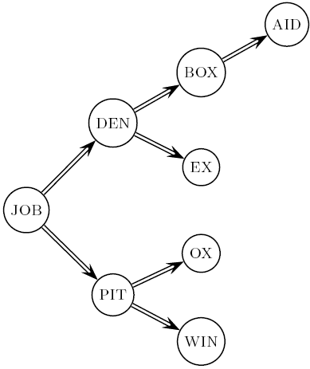
Dictionary search without blocking
Assuming each dictionary term equally likely in query (not really so in practice!), average number of comparisons = (1+2∙2+4∙3+4)/8 ~2.6

Slide 26
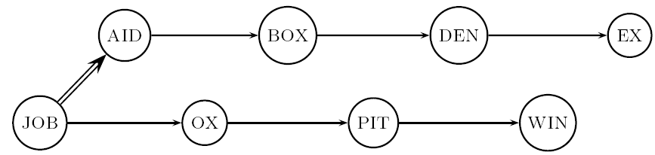
Dictionary search with blocking
Binary search down to 4-term block;
Then linear search through terms in block.
Blocks of 4 (binary tree), avg. = (1+2∙2+2∙3+2∙4+5)/8 = 3 compares

Slide 27
Front coding
Front-coding:
Sorted words commonly have long common prefix – store differences only
(for last k-1 in a block of k)
8automata8automate9automatic10automation
→8automat*a1◊e2◊ic3◊ion
Encodes automat
Subsequent terms
Begins to resemble general string compression.

Slide 28
RCV1 dictionary compression summary
Technique | Size in MB
Fixed width | 11.2
Dictionary-as-String with pointers to every term | 7.6
Also, blocking k = 4 | 7.1
Also, Blocking + front coding | 5.9

Slide 29
POSTINGS COMPRESSION

Slide 30
Postings compression
The postings file is much larger than the dictionary, factor of at least 10
Key Point : store each posting compactly
A posting for our purposes is a docID
For Reuters (800,000 documents), we would use 32 bits per docID, when using 4-byte integers
Alternatively, we can use log₂ 800,000 ≈ 20 bits per docID
Our goal: use far fewer than 20 bits per docID.

Slide 31
Postings: two conflicting forces
A term like arachnocentric occurs in maybe one doc out of a million – we would like to store this posting using log₂ 1M ~ 20 bits.
A term like the occurs in virtually every doc, so 20 bits/posting is too expensive.
Prefer 0/1 bitmap vector in this case

Slide 32
Postings file entry
We store the list of docs containing a term in increasing order of docID.
computer: 33,47,154,159,202 …
Consequence: it suffices to store gaps.
33,14,107,5,43 …
Hope: most gaps can be encoded/stored with far fewer than 20 bits.

Slide 33
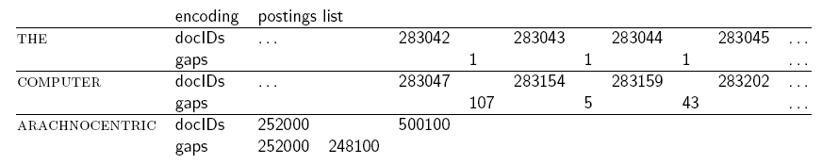
Three postings entries

Slide 34
Variable length encoding
Aim:
For arachnocentric, we will use ~20 bits/gap entry.
For the, we will use ~1 bit/gap entry.
If the average gap for a term is G, we want to use ~log₂G bits/gap entry.
Key challenge: encode every integer (gap) with about as few bits as needed for that integer.
This requires a variable length encoding
Variable length codes achieve this by using short codes for small numbers

Slide 35
Variable Byte (VB) codes
For a gap value G, we want to use close to the fewest bytes needed to hold log₂ G bits
Begin with one byte to store G and dedicate 1 bit in it to be a continuation bit c
If G ≤127, binary-encode it in the 7 available bits and set c =1
Else encode G’s lower-order 7 bits and then use additional bytes to encode the higher order bits using the same algorithm
At the end set the continuation bit of the last byte to 1 (c =1) – and for the other bytes c = 0.

Slide 36
Example
docIDs | 824 | 829 | 215406
gaps |  | 5 | 214577
VB code | 00000110 10111000 | 10000101 | 00001101 00001100 10110001
Postings stored as the byte concatenation
000001101011100010000101000011010000110010110001
Key property: VB-encoded postings are
uniquely prefix-decodable.
For a small gap (5), VB
uses a whole byte.

Slide 37
Exercise
What is the posting list that can be decoded from the variable byte-code
10001001 00000011 10000010 11111110 ?
What is the largest gap that can be encoded in 2 bytes using the variable-byte encoding ?

Slide 38
Exercise
What is the posting list that can be decoded from the variable byte-code
10001001 00000011 10000010 11111110 ?
9 386 126

Slide 39
RCV1 compression
Data structure | Size in MB
dictionary, fixed-width | 11.2
dictionary, term pointers into string | 7.6
with blocking, k = 4 | 7.1
with blocking & front coding | 5.9
collection (text, xml markup etc) | 3,600.0
collection (text) | 960.0
Term-doc incidence matrix | 40,000.0
postings, uncompressed (32-bit words) | 400.0
postings, uncompressed (20 bits) | 250.0
postings, variable byte encoded | 116.0
postings, γ−encoded | 101.0

Slide 40
Index construction
- T1, Chapter 4
Slides are adapted from Introduction to Information Retrieval;Manning,Raghavan
http://nlp.stanford.edu/IR-book

Slide 41
Chapter 4: Index construction
Hardware Basics
Blocked sort-based Indexing
Single pass in-memory indexing
Distributed and Dynamic indexing

Slide 42
Hardware Basics
When building an information retrieval (IR) system, many decisions are based on the characteristics of the computer hardware on which the system runs.
Access to data in memory is much faster than access to data on disk. - Caching
Disk seeks: No data is transferred from disk while the disk head is being positioned.
Transferring one large chunk of data from disk to memory is faster than transferring many small chunks.
Disk I/O is block‐based: Reading and writing of entire blocks (as opposed to smaller chunks).
Block sizes: 8KB to 256 KB.
Compressed data read
Servers used in IR systems typically have several gigabytes (GB) of main memory, sometimes tens of GB. Available disk space is several orders of magnitude larger

Slide 43
Blocked sort-based indexing
Reuters-RCV1:
Shakespeare’s collected works are not large enough to demonstrate scalable index construction algorithms.
Instead, we will use the Reuters RCV1 collection.
English newswire articles published in a 12-month period (1995/6)

Slide 44
A Reuters RCV1 Document

Slide 45
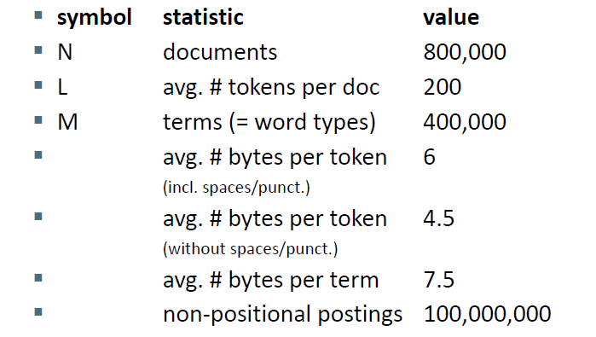
Reuters RCV1 Statistics

Slide 46
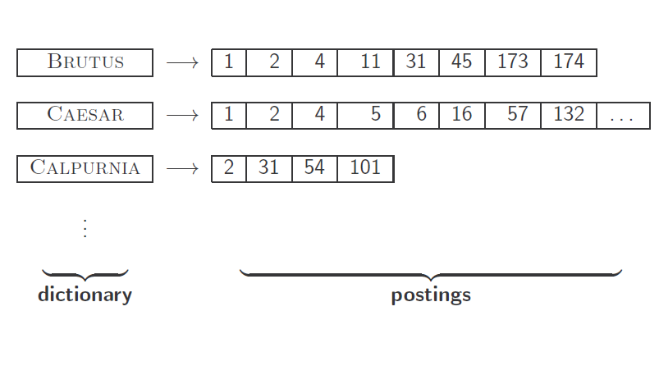
Inverted Index construction

Slide 47
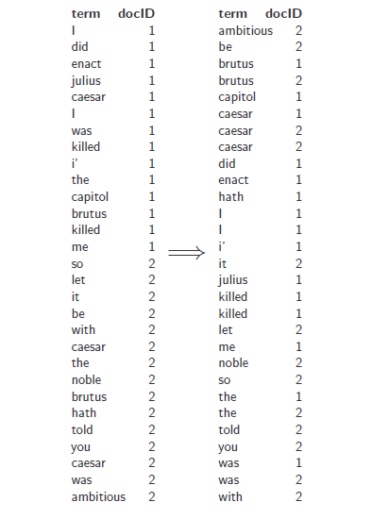
Inverted Index construction

Slide 48
Sort-based index construction
As we build index, we parse docs one at a time.
The final postings for any term are incomplete until the end.
But for large collections, we cannot keep all postings in memory and do the sort in-memory at the end
We cannot sort very large sets of records on disk either (too many disk seeks)
Need to store intermediate results on disk.
Need an external sorting algorithm.

Slide 49
Sort-based index construction
We must sort T = 100,000,000 non-positional postings.
Each posting has size 12 bytes (4+4+4: termID, docID, term frequency).
Define a block to consist of 10,000,000 such postings
Can easily fit that many postings into memory.
10 such blocks for RCV1.

Slide 50
Blocked sort-based indexing
(BSBI)
Segments the collection into parts of equal size
Sorts the termID – docID pair of each part in memory
Stores intermediate sorted results on disk
Merges all intermediate results into the final index.

Slide 51
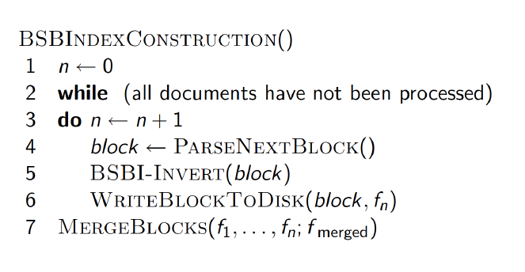
BSBI Index Construction Algorithm

Slide 52
BSBI Index Construction Algorithm
PARSENEXTBLOCK --- The algorithm parses documents into termID–docID pairs and accumulates the pairs in memory until a block of a fixed size is full
The block is then inverted and written to disk.
Inversion involves two steps. First, sort the termID–docID pairs. Next, collect all termID–docID pairs with the same termID into a postings list, where a posting is simply a docID.

Slide 53
MERGEBLOCKS - Example

Slide 54
BSBI Algorithm
Excellent scaling properties
We need a data structure in order to implement a term to termID mapping (which grows dynamically)
For very large collections, this data structure does not fit into memory
We would end up with a scalable, but very slow index construction method
More Scalable alternative is
Single‐pass in‐memory indexing (SPIMI)

Slide 55
Single‐Pass In‐Memory Indexing (SPIMI)
SPIMI uses terms instead of termIDs
Writes each block’s dictionary to disk
Starts a new dictionary for the next block
Can index collections of any size as long as there is enough disk space available.

Slide 56
Single‐Pass In‐Memory Indexing (SPIMI)

Slide 57
Single‐Pass In‐Memory Indexing (SPIMI)
Generate separate dictionaries for each block – no need to maintain term‐termID mapping across blocks
Eliminating expensive sorting
Compression makes SPIMI even more efficient.

Slide 58
Distributed Indexing
Data Collection is too big that index construction cannot be performed efficiently on a single machine
Especially for web-scale indexing it must use a distributed computing cluster.
Web search engines, therefore, use distributed indexing algorithms for index construction.
The result of the construction process is a distributed index that is partitioned across several machines – either according to term or according to document.

Slide 59
Distributed Indexing
We need large computer clusters to construct any reasonably sized web index.
Clustering is to solve large computing problems on cheap commodity machines or nodes that are built from standard parts (processor, memory, disk)
Individual machines are fault‐prone - Can unpredictably slow down or fail

Slide 60
Google data centers
Sec. 4.4
Google data centers mainly contain commodity machines.
Data centers are distributed around the world.
Estimate: a total of 1 million servers, 3 million processors/cores (Gartner 2007)
Estimate: Google installs 100,000 servers each quarter.
Based on expenditures of 200–250 million dollars per year
This would be 10% of the computing capacity of the world.

Slide 61
M45: Open Academic Cluster
Yahoo M45 cluster:
Datacenter in a Box (DiB)
1000 nodes, 4000 cores, 3TB RAM,
1.5PB disk
High bandwidth connection to Internet
Located on Yahoo campus
World’s top 50 supercomputer

Slide 62
Large scale computing
Challenges:
How do you distribute computation?
Distributed/parallel programming is hard
Machines fail
Map‐reduce addresses all the above
Google’s computational/data manipulation model
Elegant way to work with big data

Slide 63
Distributed Indexing
The distributed index construction method described is an application of MapReduce, a general architecture for distributed computing
MapReduce is designed for large computer clusters.

Slide 64
Distributed indexing
Sec. 4.4
Maintain a master machine directing the indexing job .
Break up indexing into sets of (parallel) tasks.
Master machine assigns/reassigns each task to an idle machine from a pool.

Slide 65
MapReduce
Two Phases:
Map and Reduce
split up the computing job into chunks that standard machines can process in a short time.
Steps in MapReduce Process:
The input data, is split into n splits where the size of the split is chosen to ensure that the work can be distributed evenly and efficiently
The map phase of MapReduce consists of mapping splits of the input data to key-value pairs.
Each split is a subset of documents (corresponding to blocks in BSBI/SPIMI)

Slide 66
Map Phase-Parsers
Sec. 4.4
Master assigns a split to an idle parser machine
Each parser writes its output to local intermediate files, the segment files
Parser writes pairs into j partitions
Each partition is for a range of terms’ first letters
(e.g., a-f, g-p, q-z) – here j = 3.
Each term partition thus corresponds to r segments files, where r is the number of parsers

Slide 67
Reduce phase - Inverters
Sec. 4.4
An inverter collects all (term,doc) pairs
(= postings) for one term-partition
Sorts and writes to postings lists.

Slide 68
Data flow
Sec. 4.4
assign
Master
assign
Postings
Parser
a-f
g-p
q-z
Inverter
a-f
Parser
a-f
g-p
q-z
Inverter
g-p
splits
Inverter
q-z
Parser
a-f
g-p
q-z
Map
phase
Reduce
phase
Segment files

Slide 69
MapReduce
Sec. 4.4
The index construction algorithm we just described is an instance of MapReduce
MapReduce (Dean and Ghemawat 2004) is a robust and conceptually simple framework for distributed computing without having to write code for the distribution part
They describe the Google indexing system (ca. 2002) as consisting of a number of phases, each implemented in MapReduce.

Slide 70
MapReduce
Sec. 4.4
Index construction was just one phase.
Another phase: transforming a term-partitioned index into a document-partitioned index.
Term-partitioned: one machine handles a subrange of terms
Document-partitioned: one machine handles a subrange of documents
Most search engines use a document-partitioned index, better load balancing, etc.

Slide 71
Schema for index construction in MapReduce
Sec. 4.4
Schema of map and reduce functions
map: input → list(k, v) reduce: (k,list(v)) → output
Instantiation of the schema for index construction
map: web collection → list(termID, docID)
reduce: (<termID1, list(docID)>, <termID2, list(docID)>, …)
→ (postings list1, postings list2, …)
Example for index construction
map: d2 : C died. d1 : C came, C c’ed. → (<C, d2>, <died,d2>, <C,d1>, <came,d1>, <C,d1>, <c’ed, d1>
reduce: (<C,(d2,d1,d1)>, <died,(d2)>, <came,(d1)>, <c’ed,(d1)>) → (<C,(d1:2,d2:1)>, <died,(d2:1)>, <came,(d1:1)>, <c’ed,(d1:1)>)

Slide 72
Dynamic Indexing
So far, we have assumed that the document collection is static, fine for collections that change infrequently or never (e.g., the Bible or Shakespeare).
Most collections are modified frequently with documents being added, deleted, and updated.
new terms need to be added to the dictionary,
postings lists need to be updated for existing terms.

Slide 73
Simplest approach
Sec. 4.5
Maintain “big” main index
New docs go into “small” auxiliary index
Search across both, merge results
Deletions
Invalidation bit-vector for deleted docs
Filter docs output on a search result by this invalidation bit-vector
Periodically, re-index into one main index

Slide 74
Issues with main and auxiliary indexes
Sec. 4.5
Problem of frequent merges
Poor performance during merge
Actually:
Merging of the auxiliary index into the main index is efficient if we keep a separate file for each postings list.
Merge is the same as a simple append.
But then we would need a lot of files – inefficient for O/S.
Assumption : The index is one big file.
In reality: Use a scheme somewhere in between (e.g., split very large postings lists, collect postings lists of length 1 in one file etc.)

Slide 75
Logarithmic merge
Sec. 4.5
Maintain a series of indexes, each twice as large as the previous one.
Keep smallest (Z₀) in memory
Larger ones (I₀, I₁, …) on disk
If Z₀ gets too big (> n), write to disk as I₀
or merge with I₀ (if I₀ already exists) as Z₁
Either write merge Z₁ to disk as I₁ (if no I₁)
Or merge with I₁ to form Z₂
etc.

Slide 76
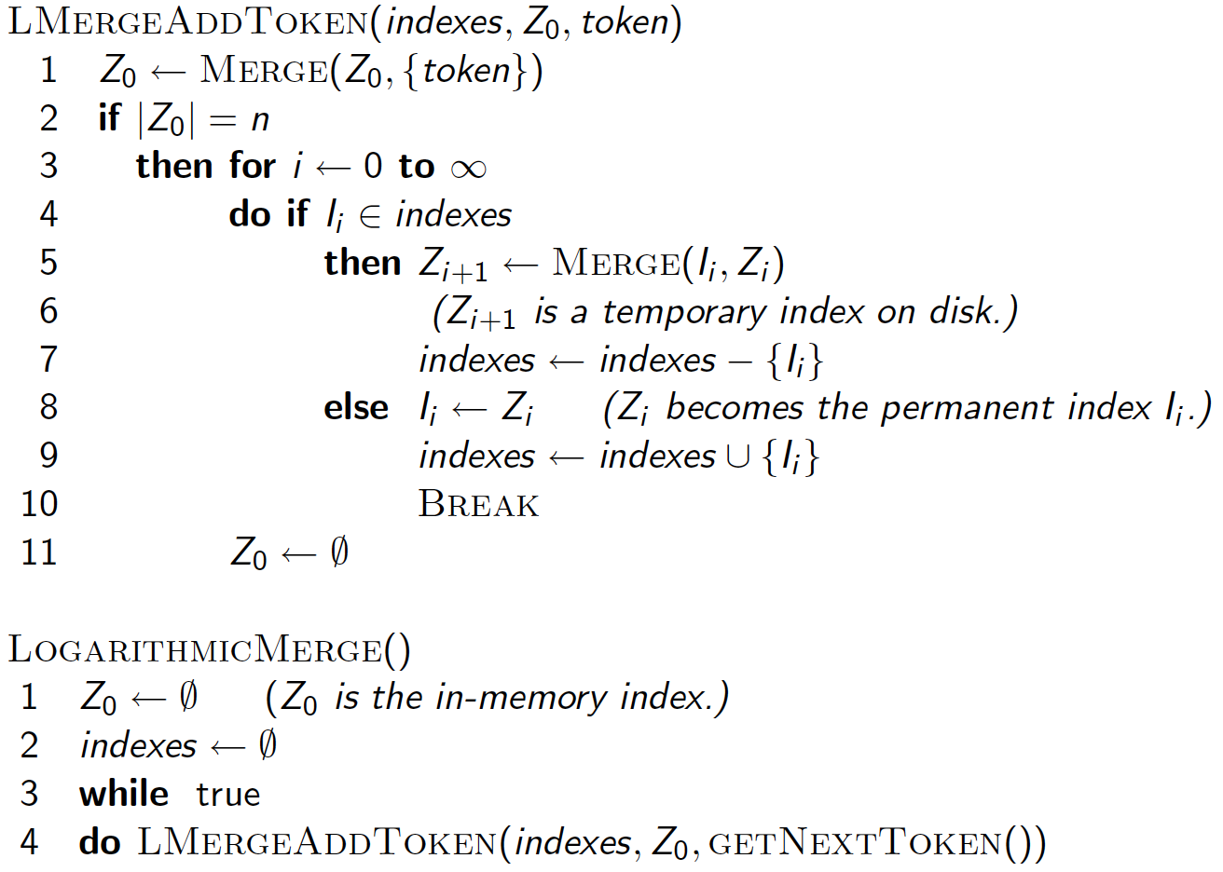
Sec. 4.5

Slide 77
Further issues with multiple indexes
Sec. 4.5
Collection-wide statistics are hard to maintain
E.g., when we spoke of spell-correction: which of several corrected alternatives do we present to the user?
We said, pick the one with the most hits
How do we maintain the top ones with multiple indexes and invalidation bit vectors?
One possibility: ignore everything but the main index for such ordering

Slide 78
Dynamic indexing at search engines
Sec. 4.5
All the large search engines now do dynamic indexing
Their indices have frequent incremental changes
News items, blogs, new topical web pages
But (sometimes/typically) they also periodically reconstruct the index from scratch
Query processing is then switched to the new index, and the old index is then deleted

Slide 79
Other sorts of indexes
Sec. 4.5
Positional indexes
Same sort of sorting problem … just larger
Building character n-gram indexes:
As text is parsed, enumerate n-grams.
For each n-gram, need pointers to all dictionary terms containing it – the “postings”.
Note that the same “postings entry” will arise repeatedly in parsing the docs – need efficient hashing to keep track of this.
E.g., that the trigram uou occurs in the term deciduous will be discovered on each text occurrence of deciduous
Only need to process each term once

