Slide 1

FLORIDA INTERNATIONAL UNIVERSITY
Chapman Graduate School of Business · Doctor of Business Administration
GEB 7365 · PROJECT PRESENTATION · INDIVIDUAL PROJECT
THE EVIDENCE IS MY OWN FAILED STUDY
Feasibility as a Parameter
334,976
When comparative research on narrow specialist
panel members screened
20
populations can and cannot be executed
eligible
4
usable responses
YASIR A. MALIK
About six per hundred thousand. Visible on the
panel's own interface before a dollar was spent.
Doctor of Business Administration · Cohort 8.14
Instructor: Prof. William Newburry · 19 September 2026
Yasir A. Malik · Cohort 8.14
GEB 7365 · Project Presentation · 19 September 2026
1
Notes:
[0:00 - 0:25] OPENING Block 1 of 6
>> DO NOT START WITH YOUR NAME. Start with the number.
SAY:
"I screened three hundred and thirty four thousand people."
... hold two full seconds. Look at one face. ...
"I got four."
"That is not bad luck. That is arithmetic, and every bit of it
was visible before I spent a cent."
ROADMAP:
"Five elements. The topic. The model. Five hypotheses and why each
one follows. How I would test it. And my evidence, which is that
failure."
>> CUE: stand still. Hands at your sides. The pause is the hook.
>> KEYWORD: arithmetic, not bad luck.

Slide 2
FLORIDA INTERNATIONAL UNIVERSITY
Chapman Graduate School of Business · Doctor of Business Administration
1
ELEMENT 1 · OVERALL RESEARCH TOPIC, AND WHY IT MATTERS
Comparative research has a requirement it never states as one
To compare a phenomenon across countries you must reach the same population in every country, at the same time, with an instrument
that means the same thing in each place.
WHEN THE POPULATION IS GENERAL
WHEN THE POPULATION IS RARE
The requirement is demanding but routine. Effort and money convert
into responses at a rate that differs by country and is always positive,
always improvable.
Conversion is governed by arithmetic fixed before the first contact.
That arithmetic does not add across borders. It compounds, and in one
direction only.
A FIELDWORK PROBLEM
A DESIGN PARAMETER
A design that is marginal in one country is not four times harder in four. It can be structurally impossible in four while remaining marginal in each one
separately.
Yasir A. Malik · Cohort 8.14
GEB 7365 · Project Presentation · 19 September 2026
2
Notes:
[0:25 - 1:15] OPENING Element 1
SAY:
"To compare something across countries you have to reach the same
people in every country, at the same time, with an instrument that
means the same thing in each place. Nobody writes that down as a
requirement. It just sits there."
"For a general population it is a fieldwork problem. Money and effort
turn into responses. The rate differs by country, but it is always
positive and always improvable."
"For a rare population it is not a fieldwork problem at all. It is
arithmetic that was fixed before the first contact. And it does not
add across borders. It compounds, in one direction."
>> CUE: point left box, then right box. Two gestures, no more.
>> KEYWORD: fieldwork problem on the left, design parameter on the right.

Slide 3
FLORIDA INTERNATIONAL UNIVERSITY
Chapman Graduate School of Business · Doctor of Business Administration
1
ELEMENT 1 · OVERALL RESEARCH TOPIC, AND WHY IT MATTERS
The gap, and the question
THE TOPIC
Reaching a narrow specialist professional population in several national frames at once.
THE RECEIVED WISDOM
Sampling difficulty is an execution problem. It belongs to budget and local partners, and it appears in print as a limitation paragraph.
THE GAP
Nobody has asked what happens when the population is rare. The quantities that decide it are observable before fielding, and they compound across frames.
THE RESEARCH QUESTION
Under what conditions is a comparative multi-country design on a narrow specialist population feasible at all, and where must a survey give way to another method?
THE CONTRIBUTION
To move sampling feasibility from the status of a LIMITATION to the status of a PARAMETER. A parameter is estimated before a design and constrains it. A limitation is
confessed after the design has failed.
WHO BENEFITS
Researchers designing comparative work · doctoral committees assessing feasibility · buyers of multi-country research
Yasir A. Malik · Cohort 8.14
GEB 7365 · Project Presentation · 19 September 2026
3
Notes:
[1:15 - 1:55] OPENING ends here Element 1
SAY:
"Received wisdom says sampling difficulty is an execution problem.
It belongs to budget and local partners, and it shows up in print as
a limitation paragraph at the end."
"The gap is that nobody asked what happens when the population is
rare. The quantities that decide it are observable before you field
anything."
THE QUESTION, read it slowly off the slide:
"Under what conditions is a comparative multi-country design on a
narrow specialist population feasible at all, and where must a survey
give way to another method?"
THE CONTRIBUTION, land this one:
"To move feasibility from a limitation to a parameter."
>> SIGNPOST OUT LOUD: "That is the topic. Now the model."
>> KEYWORD: parameter, not limitation.

Slide 4
FLORIDA INTERNATIONAL UNIVERSITY
Chapman Graduate School of Business · Doctor of Business Administration
2
ELEMENT 2 · THE STUDY MODEL
The model: four terms, four different levels
Reachable usable sample is a product, not a sum. Each term is decided at a different level, and attributing a failed frame to the country assigns to
one level what another produced.
FRAME SIZE
× PREVALENCE
× RESPONSE RATE
× SCREEN SURVIVAL
panel members
how rare the specialty is
who answers
who survives eligibility
POPULATION
INFRASTRUCTURE
INSTRUMENT
DESIGN
= REACHABLE USABLE SAMPLE
observable before a study is fielded, at no cost, on the panel's own interface
Yasir A. Malik · Cohort 8.14
GEB 7365 · Project Presentation · 19 September 2026
4
Notes:
[1:55 - 3:10] BODY 1 Element 2
SAY:
"Reachable usable sample is a product, not a sum. Four terms."
Walk them left to right, one breath each:
"Frame size. How many people the panel has.
Times prevalence. How rare the specialty is.
Times response rate. Who answers.
Times screen survival. Who gets through eligibility."
"And here is the part that matters. Each of those is decided at a
different level. Frame size is population. Prevalence is
infrastructure. Response is the instrument. Screen survival is my
own design. Blaming a failed country for all four assigns to one
level what another one produced."
"All four are readable on the panel's own interface, free, before
anyone commits a dollar. That is why it is a parameter."
>> CUE: four fingers, then close the hand on "product, not a sum."
>> KEYWORD: four terms, four different levels.

Slide 5
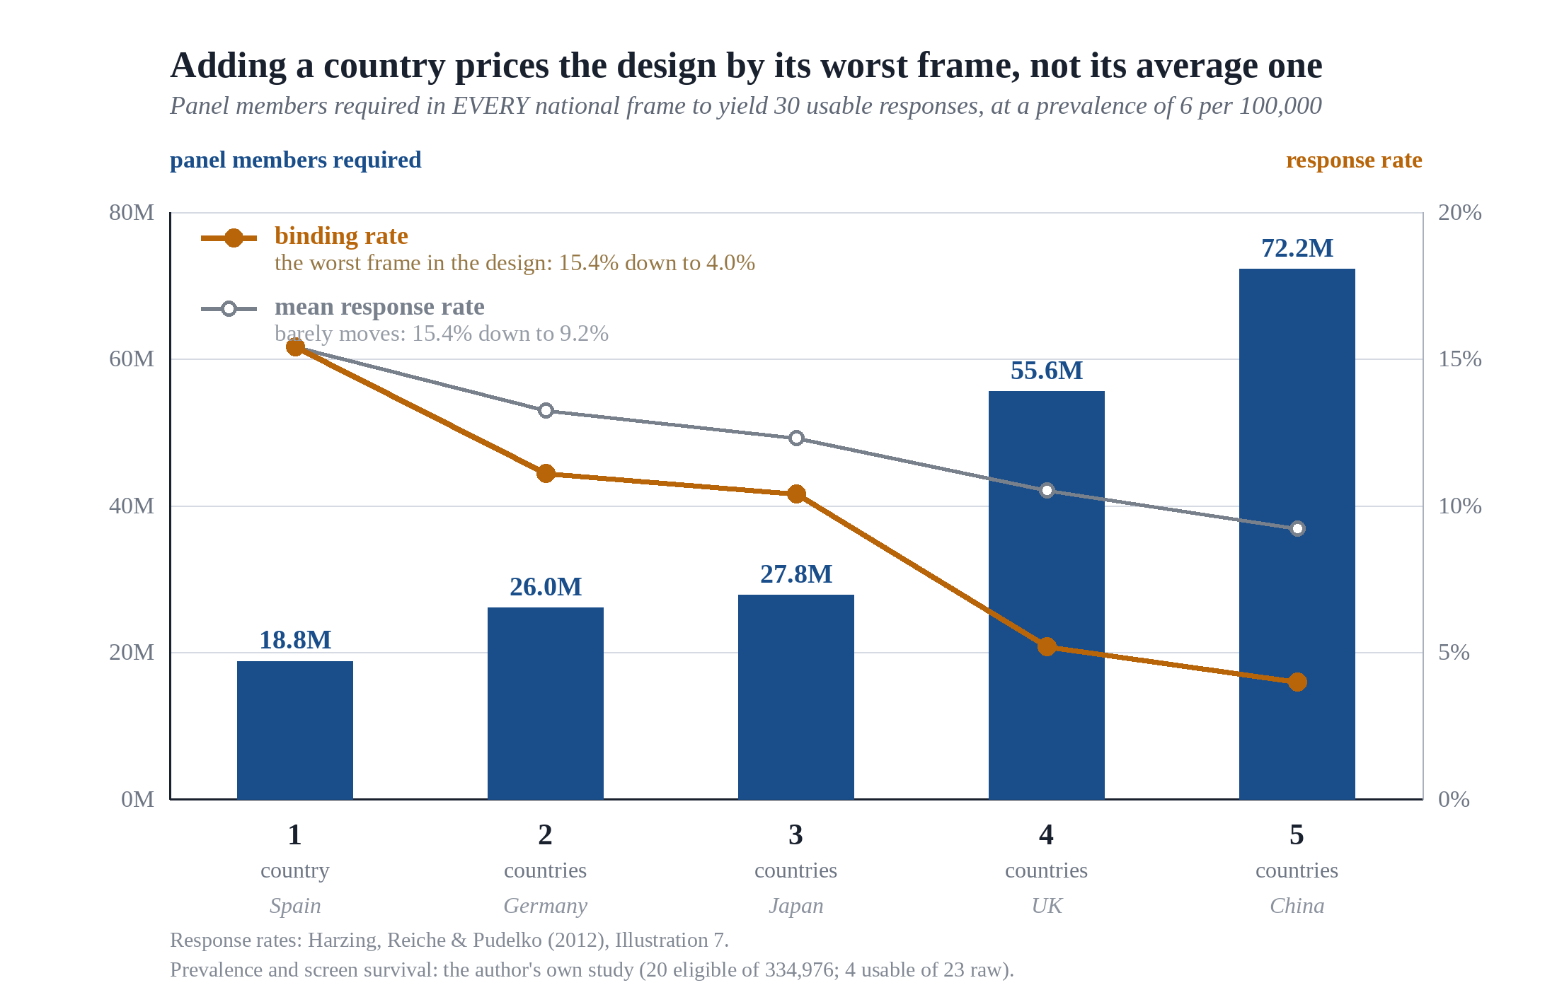
FLORIDA INTERNATIONAL UNIVERSITY
Chapman Graduate School of Business · Doctor of Business Administration
2
ELEMENT 2 · THE STUDY MODEL
The result that makes this a paper and not a complaint
ADD FOUR COUNTRIES
Mean response rate
15.4% → 9.2%
barely moves
Panel needed in EACH
18.8M → 72.2M
a factor of four
The design is priced by its worst frame, not its
average one. Reporting an overall response
rate reports the wrong statistic.
Yasir A. Malik · Cohort 8.14
GEB 7365 · Project Presentation · 19 September 2026
5
Notes:
[3:10 - 4:40] BODY 1 Element 2 *** THE CENTRAL SLIDE ***
>> ASK THE ROOM FIRST. Then wait. Do not answer your own question.
"How many of you have read a comparative paper that reported one
overall response rate?"
... wait for hands. Count them out loud if you like. ...
"That is the number I am telling you is wrong."
SAY:
"Add four countries to a design. The mean response rate barely moves,
fifteen point four down to nine point two. Looks survivable."
"But the panel you need in each frame goes from eighteen point eight
million to seventy two point two million. A factor of four."
"The design is priced by its worst frame, not its average one. An
average cannot satisfy a conjunction."
>> CUE: this is where you stand still. Do not walk.
>> KEYWORD: the average hides it, the worst frame decides it.
>> SIGNPOST: "That is the model. Now the hypotheses."

Slide 6
FLORIDA INTERNATIONAL UNIVERSITY
Chapman Graduate School of Business · Doctor of Business Administration
3
ELEMENT 3 · PRELIMINARY HYPOTHESES, AND THEIR JUSTIFICATION
Five hypotheses
EACH TAKES ITS LOGIC FROM ONE OF THIS WEEK'S FOUR PAPERS
H1
Joint feasibility is set by the least feasible frame, not the mean. Adding a country can only weakly
decrease it.
ANALYTIC · THE STRUCTURE OF A CONJUNCTION
H2
Specialist prevalence on a panel is higher inside the panel provider's home region.
RUGMAN & VERBEKE (2004)
H3
Studies described as cross-national achieve regionally concentrated coverage, more so as the
population narrows.
LOPEZ, KUNDU & CIRAVEGNA (2009)
H4
Mode explains more variance in response than country does.
MEYER, LI & SCHOTTER (2020)
H5
Standardization is negatively associated with response, worst in the frames that already bind.
ZENG ET AL. (2023)
Yasir A. Malik · Cohort 8.14
GEB 7365 · Project Presentation · 19 September 2026
6
Notes:
[4:40 - 5:20] BODY 2 Element 3
>> DO NOT READ ALL FIVE. Name them and move. You have a slide each
>> for the ones that matter.
SAY:
"Five hypotheses, and each one takes its logic from one of this
week's four papers, not from my own intuition."
"H1 is the binding frame. H2 and H3 come from regionalization.
H4 is level of analysis. H5 is standardization against response."
"I will take H1 on its own, then H2 and H3 together, then H4 and H5."
>> CUE: run your hand down the column once. Do not read the boxes.
>> KEYWORD: five hypotheses, four papers, one argument.

Slide 7
FLORIDA INTERNATIONAL UNIVERSITY
Chapman Graduate School of Business · Doctor of Business Administration
3
ELEMENT 3 · PRELIMINARY HYPOTHESES, AND THEIR JUSTIFICATION
H1 · A comparison is a conjunction, not an average
To say a relationship differs between Spain and China is to assert something about Spain and something about China. The assertion fails if
either component fails.
AN AVERAGE CANNOT SATISFY A CONJUNCTION
A design with one excellent frame and one hopeless frame has a respectable mean and no comparison. The requirement is set by the minimum.
Because a set's minimum can only fall or stay level when an element is added, every additional country weakly worsens the design and no
additional country can improve it.
Breadth is treated in comparative work as a virtue. It is purchased at a price that rises faster than the count of frames. A design covering more
countries has not become more ambitious. It has become more fragile.
Yasir A. Malik · Cohort 8.14
GEB 7365 · Project Presentation · 19 September 2026
7
Notes:
[5:20 - 6:10] BODY 2 Element 3 H1
SAY:
"To say a relationship differs between Spain and China is to assert
something about Spain AND something about China. That is a
conjunction. It fails if either half fails."
"So a design with one excellent frame and one hopeless frame has a
respectable mean and no comparison at all."
"And because a minimum can only fall or stay level when you add an
element, every extra country weakly worsens the design. No extra
country can improve it."
LAND IT:
"Breadth is treated as a virtue in comparative work. A design covering
more countries has not become more ambitious. It has become more
fragile."
>> CUE: two hands apart on "Spain AND China," then bring them together.
>> KEYWORD: a comparison is a conjunction, not an average.

Slide 8
FLORIDA INTERNATIONAL UNIVERSITY
Chapman Graduate School of Business · Doctor of Business Administration
3
ELEMENT 3 · PRELIMINARY HYPOTHESES, AND THEIR JUSTIFICATION
H2 and H3 · A research panel is a firm
Of the 380 largest multinationals with usable sales data, Rugman and Verbeke found 320 home-region oriented, averaging 80.3 percent of sales at
home. Nine were global. Their mechanism is specific: upstream advantages in technology travel, downstream advantages such as branding are
location-bound.
A research panel is a firm whose entire product is a downstream asset: its membership, and its standing with that membership. Survey software is a
commodity, so there is almost no upstream advantage to carry abroad. On their own account it should be MORE home-region bound than a
manufacturer, not less.
WHY IT BITES HARDER FOR SPECIALISTS
AND WHY THE SAMPLE COLLAPSES
A consumer panel is built by broad advertising anywhere. A panel of
experienced auditors is built through professional bodies whose reach is
national by construction.
Of 40 Costa Rican software firms, exactly one had exported from
inception to the market the founders called strategic. The rest sold to
neighbours. The category could not see the difference.
Yasir A. Malik · Cohort 8.14
GEB 7365 · Project Presentation · 19 September 2026
8
Notes:
[6:10 - 7:10] BODY 2 Element 3 H2 and H3
>> THIS IS THE SLIDE THAT MAKES IT INTERNATIONAL BUSINESS. Say so.
SAY:
"Rugman and Verbeke looked at the three hundred and eighty largest
multinationals with usable sales data. Three hundred and twenty were
home-region oriented, averaging eighty point three percent of sales
at home. Nine were global. Nine."
"Their mechanism is specific. Upstream advantages in technology
travel. Downstream advantages like branding are location-bound."
"Now apply that to a research panel. A panel is a firm whose entire
product is a downstream asset. Its membership, and its standing with
that membership. Survey software is a commodity, so there is almost
no upstream advantage to carry abroad."
"By their own logic a panel should be MORE home-region bound than a
manufacturer, not less."
"And it bites harder for specialists. A consumer panel is built by
broad advertising anywhere. A panel of experienced auditors is built
through professional bodies, and those are national by construction."
>> IF ASKED about the seven institutional types: say you are raising it
>> with the professor rather than quietly revising after the deadline.
>> KEYWORD: a panel is a firm, and its product is entirely downstream.

Slide 9
FLORIDA INTERNATIONAL UNIVERSITY
Chapman Graduate School of Business · Doctor of Business Administration
3
ELEMENT 3 · PRELIMINARY HYPOTHESES, AND THEIR JUSTIFICATION
H4 and H5 · Level of analysis, and the price of equivalence
H4 · MODE OVER COUNTRY
H5 · CONTROL AGAINST COORDINATION
Response is the outcome of an encounter between a person and a request.
Whether it arrives by telephone from a human being or by email from a
platform is a property of the instrument, not of the country.
Zeng and colleagues name standardization as one of four organizational
mechanisms, on the control side, against coordination by mutual
adjustment. They do NOT claim the two trade off. They say the
interaction is understudied.
Mode changes the cost of refusing. Country changes only the disposition
toward it.
Equivalence needs an identical instrument. Response needs adaptation of
length, channel, sponsorship and register. Proposing that these pull
against each other is my conjecture about a gap they name, not a finding I
am borrowing.
THE ONE DATUM
Harzing's 47% in Korea was telephone. It exceeds the entire country
spread in the same project by about five times. One observation is not
evidence. It is why this is worth testing.
A strong frame can afford the loss. A weak frame had no margin, and
under H1 the weak frames bind the design.
Yasir A. Malik · Cohort 8.14
GEB 7365 · Project Presentation · 19 September 2026
9
Notes:
[7:10 - 8:00] BODY 2 Element 3 H4 and H5
SAY H4:
"Response is what happens when a person meets a request. Whether that
request arrives by telephone from a human being or by email from a
platform is a property of the instrument, not of the country."
"Mode changes the cost of refusing. Country only changes the
disposition toward it."
"My one datum: Harzing's forty seven percent in Korea was telephone,
and it beats the entire country spread in the same project by about
five times. One observation is not evidence. It is why this is a
hypothesis and not a finding."
SAY H5, and be careful here:
"Zeng and colleagues name standardization as a control mechanism,
against coordination by mutual adjustment. They do NOT claim the two
trade off. They say the interaction is understudied."
"Proposing that equivalence and response pull against each other is my
conjecture about a gap they name. It is not a finding I am borrowing."
>> CUE: saying what is yours and what is theirs is the most credible
>> thing in the talk. Do not rush it.
>> SIGNPOST: "That is the why. Now how I would test it."

Slide 10
FLORIDA INTERNATIONAL UNIVERSITY
Chapman Graduate School of Business · Doctor of Business Administration
4
ELEMENT 4 · HOW I WOULD STUDY IT EMPIRICALLY · DATA SOURCES
What gets measured, and why it can be measured at all
Panel providers expose an audience-configuration interface that returns an estimated reachable count once screening criteria are entered, before any
commitment and at no cost. That is what makes feasibility a parameter rather than a limitation.
UNIT OF ANALYSIS
One occupation, on one panel provider, in one national frame
THE MATRIX
6+ occupations × 8+ national frames × 3+ providers ≈ 144 cells
PROVIDERS CHOSEN TO VARY
On home region, deliberately. H2 is unidentifiable otherwise
THE VALIDATING CASE
My own study. A model that cannot reproduce 334,976 → 20 → 4 is rejected
NO DATA HAVE BEEN COLLECTED FOR THIS PROJECT. THIS IS THE DESIGN, NOT A RESULT.
Yasir A. Malik · Cohort 8.14
GEB 7365 · Project Presentation · 19 September 2026
10
Notes:
[8:00 - 8:45] BODY 3 Element 4 data sources
SAY:
"Panel providers expose an audience-configuration interface. You enter
your screening criteria and it returns an estimated reachable count,
before any commitment, at no cost. That single fact is what makes
feasibility a parameter rather than a confession."
"The unit of analysis is one occupation, on one provider, in one
national frame. Six occupations by eight frames by three providers is
roughly a hundred and forty four cells."
"Providers are chosen to vary on home region, deliberately. H2 is
unidentifiable otherwise."
"And the validating case is my own study. A model that cannot
reproduce three hundred and thirty four thousand to twenty to four is
rejected."
>> SAY THE DISCLAIMER OUT LOUD, do not let them read it:
>> "No data has been collected for this project. This is the design."
>> KEYWORD: free, before commitment, on the vendor's own interface.

Slide 11
FLORIDA INTERNATIONAL UNIVERSITY
Chapman Graduate School of Business · Doctor of Business Administration
4
ELEMENT 4 · HOW I WOULD STUDY IT EMPIRICALLY · VARIABLE MEASURES
What gets measured, and how
DEPENDENT VARIABLE
Reachable usable sample = frame size x prevalence x response rate x screen survival
Source: the panel audience-configuration interface, read free before any commitment. Second DV for H4 and H5: achieved response rate, from published method sections
INDEPENDENT VARIABLES
VARIABLE
HOW MEASURED
WHERE THE DATA COMES FROM
H2
Region concordance
Binary, triad classification
Provider incorporation and HQ filings
H3
Coverage discrepancy
Stated minus achieved regional concentration
Method sections of published cross-national studies
H4
Mode
Categorical: phone, email, panel, in person
Method sections, coded by two readers
H5
Standardization index
Wording, length, incentive, sponsorship, protocol
Published instruments and appendices
CONTROLS
Prevalence · frame size · eligibility strictness, as the count of conjunctive screening criteria · incentive at PPP · field period · year
Yasir A. Malik · Cohort 8.14
GEB 7365 · Project Presentation · 19 September 2026
11
Notes:
[8:45 - 9:30] BODY 3 Element 4 variable measures
>> THIS SLIDE IS SCORED. The rubric asks for variable measures
>> explicitly. Walk the table, do not wave at it.
SAY:
"Dependent variable is the reachable usable sample, the product of the
four terms, read off the interface."
"Second dependent variable for H4 and H5 is the achieved response
rate, taken from published method sections."
"H2 is measured as region concordance, binary, against the triad,
from incorporation and headquarters filings."
"H3 is coverage discrepancy. Stated regional coverage minus achieved."
"H4 is mode, categorical, coded by two readers."
"H5 is a standardization index over wording, length, incentive,
sponsorship and protocol."
"Controls are prevalence, frame size, eligibility strictness as a
count of conjunctive screens, incentive at purchasing power parity,
field period and year."
>> CUE: one finger down the left column. Four beats.
>> KEYWORD: every measure has a named source. Nothing is assumed.

Slide 12
FLORIDA INTERNATIONAL UNIVERSITY
Chapman Graduate School of Business · Doctor of Business Administration
4
ELEMENT 4 · HOW I WOULD STUDY IT EMPIRICALLY · METHOD
Two different kinds of claim, two different treatments
H1 · ANALYTIC
H2 – H5 · INFERENTIAL
Established by demonstration and probed by sensitivity analysis across
the plausible range of prevalence, response and screen survival, reporting
the region of the parameter space where a comparative design stays
viable.
Hierarchical linear models. Cells nested in national frames, frames nested
in regions, random intercepts at frame and provider level.
The nesting is not a convenience. It is the structure Meyer and colleagues
argue must be modelled, and ignoring it attributes to countries the
variance that belongs to providers.
The claim is about the structure of a conjunction. It would not be made
more true by a p-value, and reporting one would present a deductive
result as an empirical one.
H5 IS SUPPORTED ONLY BY THE INTERACTION, NOT THE MAIN EFFECT
SOFTWARE
R, with lme4 for the hierarchical models and base R for the sensitivity analysis.
Stata as a cross-check on the multilevel estimates. All code and data versioned in git.
Yasir A. Malik · Cohort 8.14
GEB 7365 · Project Presentation · 19 September 2026
12
Notes:
[9:30 - 10:15] BODY 3 Element 4 method
SAY:
"Two different kinds of claim need two different treatments."
"H1 is analytic. It is established by demonstration and probed with a
sensitivity analysis across the plausible range, reporting the region
of the parameter space where a comparative design stays viable."
"I am deliberately not putting a p-value on H1. The claim is about the
structure of a conjunction. A p-value would present a deductive
result as an empirical one."
"H2 through H5 are inferential. Hierarchical linear models. Cells
nested in frames, frames nested in regions, random intercepts at
frame and provider level."
"The nesting is not a convenience. It is the structure Meyer and
colleagues argue has to be modelled, and ignoring it attributes to
countries the variance that belongs to providers, which is the exact
error this paper is about."
"H5 is supported only by the interaction, not the main effect."
"Software is R with lme4, Stata as a cross-check, everything versioned
in git."
>> KEYWORD: two kinds of claim, two treatments.

Slide 13
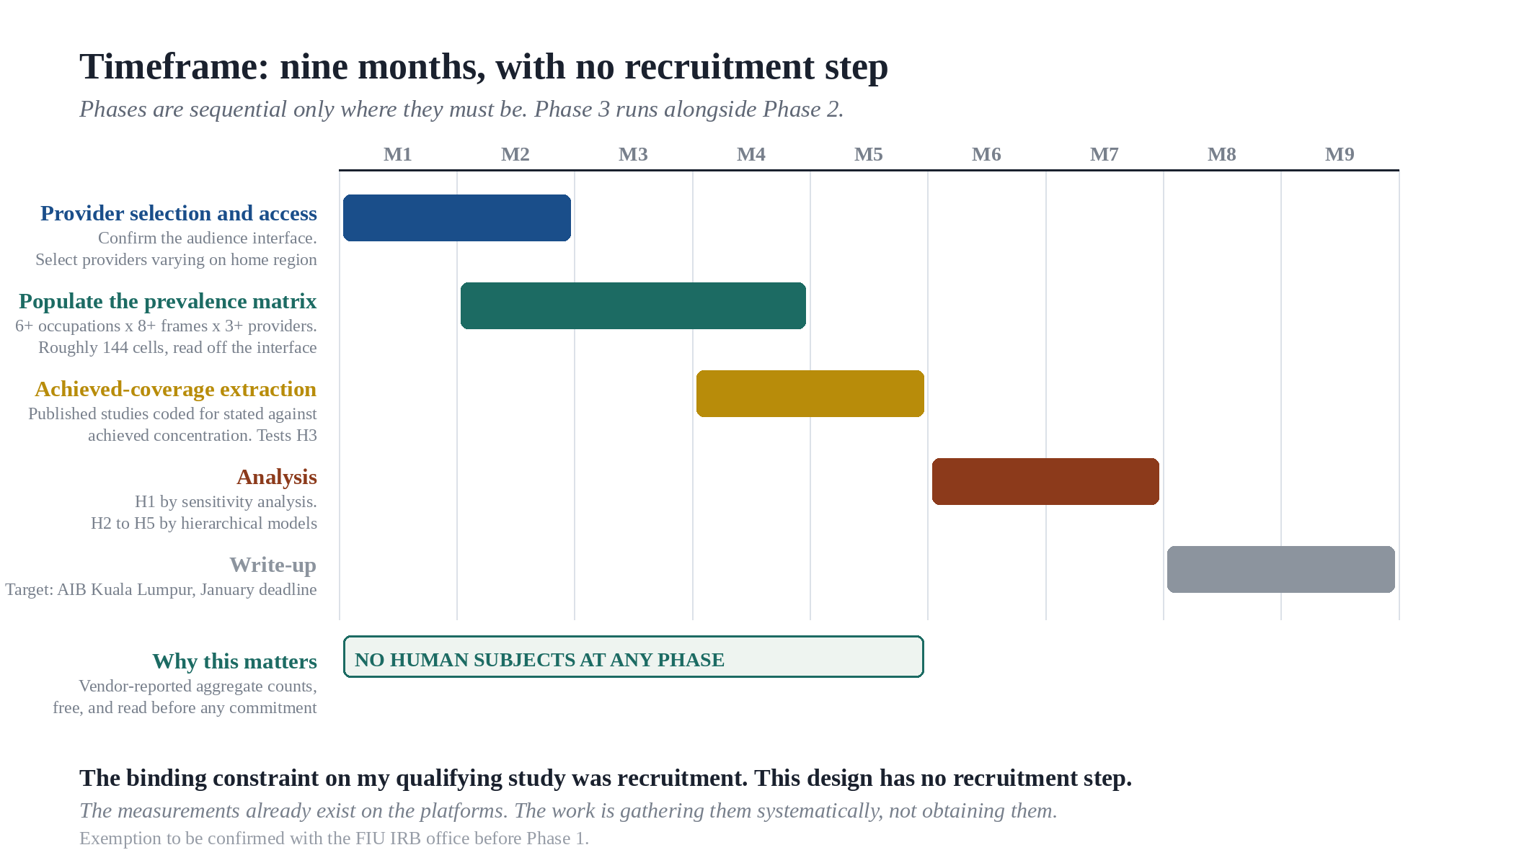
FLORIDA INTERNATIONAL UNIVERSITY
Chapman Graduate School of Business · Doctor of Business Administration
4
ELEMENT 4 · HOW I WOULD STUDY IT EMPIRICALLY · TIMEFRAME
Nine months, and no recruitment step
The constraint that ended my qualifying study was recruitment. This design has no recruitment step at all. The measurements already exist on the platforms,
so the work is gathering them systematically rather than obtaining them.
Yasir A. Malik · Cohort 8.14
GEB 7365 · Project Presentation · 19 September 2026
13
Notes:
[10:15 - 10:45] BODY 3 Element 4 timeframe
SAY:
"Nine months, four phases."
"And the thing I want you to notice is what is missing. There is no
recruitment step anywhere on this chart."
"The constraint that ended my qualifying study was recruitment. This
design does not have one. The measurements already exist on the
platforms. The work is gathering them systematically rather than
obtaining them."
"No human subjects at any phase. I still intend to confirm the
exemption with the IRB office before Phase 1 rather than assume it."
>> CUE: trace the timeline left to right once with a flat hand.
>> SIGNPOST: "That is the design. Now what I actually have."
>> KEYWORD: no recruitment step at all.

Slide 14
FLORIDA INTERNATIONAL UNIVERSITY
Chapman Graduate School of Business · Doctor of Business Administration
5
ELEMENT 5 · PRELIMINARY EVIDENCE
The evidence I have is my own failed study
No data has been collected for this project. What follows is from the qualifying study, which was designed to test something else and failed for the
reason this project is about.
WHAT HAPPENED
WHICH HYPOTHESES IT BEARS ON
334,976
Directly. It supplies the prevalence and screen-survival
terms the whole model runs on
H1
panel members screened against the eligibility criteria
Not yet. One provider, one home region. The comparison
H2 needs does not exist here
~20
H2
eligible
4
usable, of 23 raw starts
Weakly. My instrument was one mode, so mode could not
be separated from anything
H4
ABOUT SIX PER HUNDRED THOUSAND
This is one case, fully documented, and it is the reason the project exists. It is not evidence that the pattern generalises, which is what the design above is for.
Yasir A. Malik · Cohort 8.14
GEB 7365 · Project Presentation · 19 September 2026
14
Notes:
[10:45 - 11:40] EVIDENCE Element 5
>> SLOW DOWN. This is the most honest slide in the talk and honesty
>> is what gets remembered.
SAY:
"No data has been collected for this project. What I have is the
qualifying study, which was designed to test something else entirely
and failed for exactly the reason this project is about."
"Three hundred and thirty four thousand nine hundred and seventy six
panel members screened."
... pause ...
"About twenty eligible."
"Four usable, out of twenty three raw starts."
"That is about six per hundred thousand."
NOW SAY WHAT IT CANNOT DO:
"H1 it bears on directly. It supplies the prevalence and screen
survival terms the whole model runs on."
"H2 it says nothing about. One provider, one home region. The
comparison H2 needs does not exist in my data."
"H4 only weakly. My instrument was one mode, so mode could not be
separated from anything."
"This is one case, fully documented. It is not evidence that the
pattern generalises. That is what the design is for."
>> KEYWORD: say what your evidence cannot do.

Slide 15
FLORIDA INTERNATIONAL UNIVERSITY
Chapman Graduate School of Business · Doctor of Business Administration
BEFORE YOU ASK · THE LIMITS, STATED FIRST
What this model does not claim
Prevalence is held constant across countries
It almost certainly is not. No cross-national prevalence data for these populations exists, which is why obtaining it is the contribution rather than an assumption.
The response rates come from one study
One instrument, one period. Treating them as a general country characteristic would commit the level-of-analysis error the paper itself identifies.
Rates are treated as independent
They are not. Frames within a region share institutional conditions and will correlate.
Panel estimates are vendor-supplied and unaudited
They are the same numbers researchers already rely on, so this adds no new exposure, but estimated against achieved is a validation step not yet in the design.
Yasir A. Malik · Cohort 8.14
GEB 7365 · Project Presentation · 19 September 2026
15
Notes:
[11:40 - 12:20] EVIDENCE the limits, stated first
>> PUT THIS BEFORE THE Q AND A ON PURPOSE. Say that out loud.
SAY:
"I would rather state the limits than be handed them."
"One. Prevalence is held constant across countries in the model. It
almost certainly is not. No cross-national prevalence data for these
populations exists, which is why obtaining it is the contribution
rather than an assumption."
"Two. The response rates come from one study. One instrument, one
period. Treating them as a general country characteristic would
commit the very level-of-analysis error the paper identifies."
"Three. The rates are treated as independent and they are not. Frames
inside a region share institutional conditions and will correlate."
"Four. The panel estimates are vendor-supplied and unaudited. They are
the same numbers researchers already rely on, so this adds no new
exposure, but estimated against achieved is a validation step that is
not in the design yet, and it should be."
>> KEYWORD: the weakest part is the unit, and H1 being analytic.

Slide 16
FLORIDA INTERNATIONAL UNIVERSITY
Chapman Graduate School of Business · Doctor of Business Administration
THE CONTRIBUTION
A parameter is estimated before a design.
A limitation is confessed after it fails.
Comparative international business has treated who can be reached as a matter of execution.
For general populations that is harmless. For narrow specialist populations it is not, because
the arithmetic compounds across frames in one direction and is decided by the weakest frame
rather than the average one.
AND THE SECOND IMPLICATION
Where the arithmetic rules out a survey it
does not rule out the study. Twenty
reachable participants are a failed survey
and a well-powered phenomenological one.
The quantities are observable before a study is fielded. Making them part of the design, rather
than part of the confession, is a small change in practice and a substantial change in what the
field can claim to have compared.
THE THRESHOLD IS LOCATABLE IN ADVANCE
Yasir A. Malik · Cohort 8.14
GEB 7365 · Project Presentation · 19 September 2026
16
Notes:
[12:20 - 13:00] CLOSE Block 6 of 6
>> NO NEW MATERIAL. Return to the one message and stop.
SAY:
"A parameter is worked out before a design. A limitation is confessed
after it fails."
"Comparative international business has treated who can be reached as
a matter of execution. For general populations that is harmless. For
narrow specialist populations it is not, because the arithmetic
compounds in one direction and the weakest frame decides it."
"All of these numbers are visible before you field anything."
THE LAST SENTENCE. Land it and stop:
"Making them part of the design instead of part of the confession is a
small change in practice and a large change in what we can claim to
have compared."
AND THE SECOND IMPLICATION, if you have the time:
"Where the arithmetic rules out a survey, it does not rule out the
study. Twenty reachable participants are a failed survey and a well
powered phenomenological one."
>> STOP. Do not say "so, yeah, that's it." Say "Thank you. Questions."
>> KEYWORD: parameter before, limitation after.

