Slide 1

Welcome to International Business Theory and Practice (GEB 7365)
Dr. William Newburry
DBA Program
September 8/10, 2026

Slide 2
Today’s Plan of Action
Tips on Writing for Journals
Background on Common MNC Structures
Articles on how multinational corporations structure their international operations?

Slide 3
September 8 – 10 – Structuring the MNC
Rugman, A. M., & Verbeke, A. (2004). A perspective on regional and global strategies of multinational enterprises. Journal of International Business Studies, 35: 3–18.
Lopez, L. E., Kundu, S. K., & Ciravegna, L. (2009). Born global or born regional? Evidence from an exploratory study in the Costa Rican software industry. Journal of International Business Studies, 40: 1228–1238.
Meyer, K.E., Li, C. & Schotter, A.P.J. (2020). Managing the MNE subsidiary: Advancing a multi-level and dynamic research agenda. Journal of International Business Studies, 51: 538–576.
Zeng et al. (2023). Navigating MNE control and coordination: A critical review and directions for future research. Journal of International Business Studies, 54: 1599–1622.

Slide 4
September 18/19 (Residency) – Institutions and Culture
Deephouse, D., Newburry, W., & Soleimani, A. (2016). The importance of national contexts and institutions for cross-national differences in corporate reputation. Journal of World Business, 51: 463–473.
House, R., Javidan, M., Hanges, P., & Dorfman, P. (2002). Understanding cultures and implicity leadership theories across the globe: An introduction to project GLOBE. Journal of World Business, 37: 3-10.
Cuervo-Cazurra, A., Gaur, A. & Singh, D. (2019). Pro-market institutions and global strategy: The pendulum of pro-market reforms and reversals. Journal of International Business Studies, 50: 598–632.
Samiee et al. (2024). Research on country-of-origin perceptions: review, critical assessment, and the path forward. Journal of International Business Studies, 55: 285–302.
Fainshmidt, S., Judge, W.Q., Aguilera, R.V., & Smith, A. (2018). Varieties of institutional systems: A contextual taxonomy of understudied countries. Journal of World Business, 53: 307-322.

Slide 5
September 22/24 – Emerging Markets: What are They and Why are They Important?
Ramamurti, R. (2012). What is really different about emerging market multinationals? Global Strategy Journal, 2: 41-47.
Luo, Y., & Tung, R. L. (2007). International expansion of emerging market enterprises: A springboard perspective. Journal of International Business Studies, 38: 481–498.
Cuervo-Cazurra, A., & Genc, M. (2008). Transforming disadvantages into advantages: developing-country MNEs in the least developed countries. Journal of International Business Studies, 39: 957–979. -
Luo, Y., Zhang, H. & Bu, J. (2019). Developed country MNEs investing in developing economies: Progress and prospect. Journal of International Business Studies, 50: 633–667.

Slide 6
September 29/October 1 – Emerging Markets and their Impact on International Business Theories
Geleilate, J.-M. G., Magnusson, P., Parente, R. C. & Alvarado-Vargas, M.J. (2016). Home country institutional effects on the multinationality-performance relationship: A comparison between emerging and developed country multinationals. Journal of International Management, 22: 380-402.
Cuervo-Cazurra, A. (2012). How the analysis of developing country multinational companies helps advance theory: Solving the Goldilocks debate. Global Strategy Journal, 2: 153–167.
Newburry, N., Gardberg, N.A., & Sanchez, J.I. (2014). Employer attractiveness in Latin America: The association among foreignness, internationalization and talent recruitment. Journal of International Management, 20(3): 327–344.
Buckley et al. (2023). Following their predecessors’ journey? A review of EMNE studies and avenues for interdisciplinary inquiry. Journal of World Business, 58: 1-18.

Slide 7
October 6/8 – Nonmarket Strategies in International Business
Sun et al. (2021). Navigating cross-border institutional complexity: A review and assessment of multinational nonmarket strategy research. Journal of International Business Studies, 52: 1818-1853.
Caprar et al. (2022). Beyond “Doing as the Romans Do”: A review of research on countercultural business practices. Journal of International Business Studies, 53: 1449-1483.
Bruijn, K. (2024). MNE-civil society interactions: A systematic review and research agenda. Journal of International Business Studies, 55: 136-156.
Thams et al. (2025). Political ideology and the multinational enterprise: Broadening the epistemological lens. Journal of World Business, 60: 1-11.

Slide 8
Course Focus and Evaluation
Class Participation – 20%
Module-based Topic Area Summary and Presentation – 20%
Project:
Initial Project Idea (August 25/27) – 5%
Project Presentation (September 18/19) – 20%
Formal Project Report (October 7/9) – 30%
Peer Evaluation of Group (October 7/9) – 5%.

Slide 9
Class Participation
Quality Important
Attendance is not enough
Stronger discussion points are thoughtful, reference course/text constructs, directly address the focal issue, etc.
See evaluation rubric
Online Zoom Meetings
7:00 PM to 9:30 PM on the assigned date in course schedule, unless otherwise notified
If you know you will be missing, are shy, or just want to assure a higher participation grade, you can summarize articles and submit them (preferably in advance) to gain some credit.

Slide 10
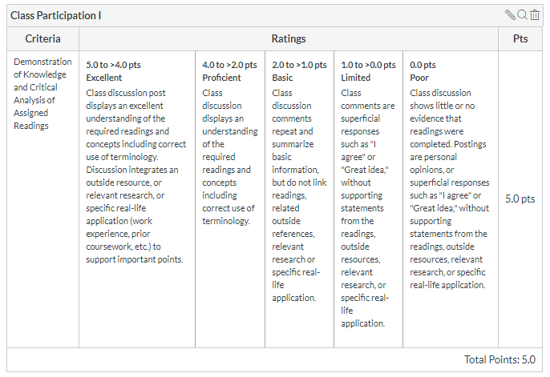
Class Participation Rubric

Slide 11
Missed Class or Extra Participation Credit
If you need to miss a class, you can partially make up attendance by writing up summaries of the articles we discussed that day.
Please try to keep these write-ups to no more than 2 pages (single spaced) each.
Focus the write-ups on the same content as the individual article summaries
Write-ups are due no later than the class period following the missed class. Please send via e-mail to: newburry@fiu.edu.
Missing more than one or two classes in the course will have a highly detrimental effect on your grade.
Newburry 2026 DBA International Business

Slide 12
Topic Area Written Analysis and Presentation
Everyone must summarize at least one research topic from the course.
This assignment will be submitted as both a written document (10 double-spaced pages maximum) combined with a short summary powerpoint presentation (up to 10 minutes maximum) to the class. Students will also be required to submit their powerpoint slides afterwards.
The topic analysis should focus on three components: 1) A summary of the major topic area findings, including but not limited to those within assigned course articles 2) A critical assessment of the topic area, including contributions, limitations and future extensions, and 3) Relation of the topic area to others examined in this course and prior courses in your DBA program.
I will let people request topic areas and inform everyone which ones they are assigned as soon as possible.
This assignment will be due the day before the topic area is discussed within class.

Slide 13
Research Project
Each student will be involved in a research project within the broadly-defined domain of international business during this course.
Topics can relate to any of the topics explicitly discussed during the course, along with many others.
Students may work on the project individually or in groups of up to four people.
Some important considerations:
Topic of interest to the group
Topic where you can make a theoretical contribution
Topic where you can potentially collect data (although actual data is note required for the project)
Please e-mail me your group selections (or choice to do the project individually) and topic area for approval prior to doing extensive work (newburry@fiu.edu).
Notes:
13

Slide 14
Project Presentation (September 18/19)
10-15 Minutes Per Individual/Group
Content Emphasized Over Presentation Style
Cover the Following Elements:
1) Research Topic and Importance
2) Study Model and Hypotheses
3) Justification of Hypotheses
4) Data Collection Plan
5) Empirical Analysis Plan
6) E-mail presentation to William Newburry by midnight the day before you present (Sept. 17/18). No changes to the slides will be permitted after this time.

Slide 15
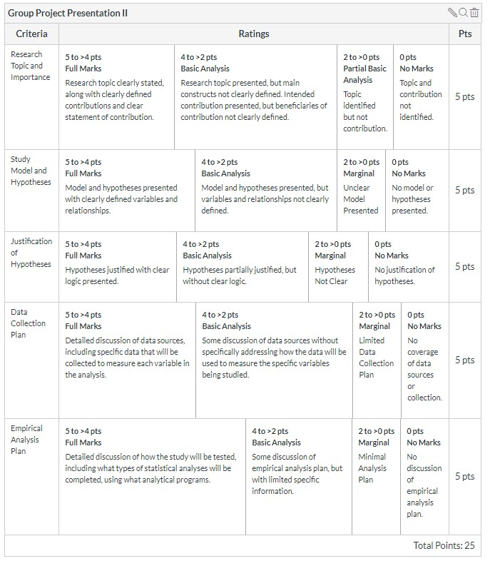
Project Presentation – Grading Expectations

Slide 16
Written Project Report (October 7/9)
30 pages maximum (inclusive)
Cover the Following Elements:
1) Research Topic and Importance
2) Study Model and Hypotheses
3) Justification of Hypotheses
4) Data Collection Plan
5) Empirical Analysis Plan
6) If you are able to gather some initial data to test your study hypotheses, what preliminary evidence can you provide regarding your hypothesized relationships?
Grading will follow the same rubric as Presentation 2

Slide 17
Example Paper Format
Introduction: 3 pages maximum
Literature Review: 5 pages
Hypotheses Development: 1+ page per hypothesis
Methodology: Length varies
Results: Not Needed for this paper
Discussion and Conclusions:
References, Tables and Figures

Slide 18
Introduction Section
Two pages maximum
Will Mitchell’s Four Sentence Conversation Starters:
The topic
The received wisdom about the topic
The gap between R/W and what we need to understand about the topic
The research question: How I propose to (at least start to) fill this gap
Establish your intended contribution and why it is interesting (see following slide)

Slide 19
Establish a Relevant Contribution (Adapted from Steve Tallman)
Being part of the conversation
Understanding the literature - the history of the conversation
Grounding in theory
Grounding in reality
Adding to the conversation
Innovation, new ideas for the conversation
Using existing theory to look at new phenomena
Looking at new theoretical ideas with familiar data

Slide 20
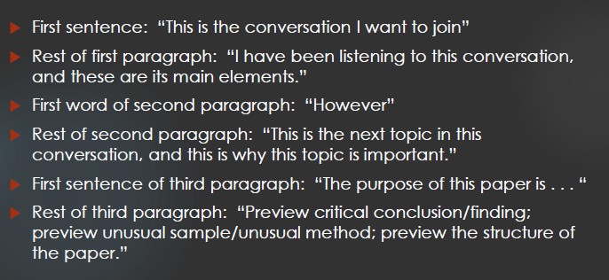
Example Approach from Jay Barney

Slide 21
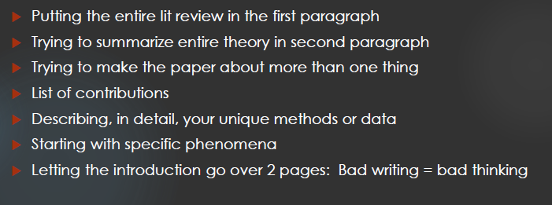
Common Errors in Introduction (From Jay Barney)
* Bill’s take/clarification: Should discuss contributions, just not only as a list.

Slide 22
Literature Review
Five pages
Cover main theories relevant to your contribution
Should relate to the conversation you identify in the introduction
Use this to establish a basic understanding of the background theories needed to develop your hypotheses

Slide 23
Hypotheses Section
About one page per hypothesis
Cover the theoretical logic justifying the hypothesis
“Why” A predicts B
Logic should be clear even without the citations
When using past research to justify, don’t just use findings to justify – need to discuss why the relationship should occur

Slide 24
Methodology Section
~ Five Pages (but depends on the methodology)
Study Context
Variable Measures
Dependent Variable
Independent Variables
Control Variables
If you are conducting a survey, the methodology should include results of tests to establish scale reliability, etc.
Statistical Method
What analyses you will conduct and why this is appropriate.

Slide 25
Results Section (not for this project)
Length will vary based on methodology
Start with a brief discussion of the correlation analysis and overall model fit.
Discuss each hypothesis result individually
Do NOT comment on results, only present them (commentary will occur in discussion)

Slide 26
Discussion and Conclusion (Discuss in terms of expected contributions for this project)
About five pages.
Open with a paragraph discussing the overall results.
Follow this with a paragraph each for each single hypothesis result
Discuss how the results add to the existing literature, being specific regarding studies that are built upon
Offer explanations for hypotheses that were not supported.
Next, include a subsection discussing your major contributions – both in terms of theory and empirical results.
Follow this with a subsection on managerial contributions and insights
Add a subsection on study limitations next.
End with a general concluding paragraph.

Slide 27
Additional Paper Elements
References
These should generally occur immediately after the main text
Everything cited in the text should be included here (and everything here should be cited in the text)
Tables and Figures
These are generally placed at the end of the manuscript with a note “Insert Figure X/Table X About Here” in the appropriate place in the main text.

Slide 28
Academy of International Business (AIB) 2027 Conferences
AIB-LAC – San Juan, Puerto Rico
Universidad Ana G. Méndez
March 3 – 5, 2027
https://lac.aib.world/2027-call-for-papers/
Paper Submission Deadline: September 30, 2026
Posters, Doctoral Consortium and Paper Development Workshops (PDWs) – Deadline: November 20, 2026

Slide 29
AIB 2027 Conferences
AIB – Kuala Lumpur, Malaysia
June 26 – 30, 2027
https://www.aib.world/events/2026/
Paper Submission Deadline: January TBD, 2027
Doctoral Consortium Deadline: TBD
Paper Development Workshop (PDW): TBD
Other Preconference Workshops will also be available.

Slide 30
Organizational Structure
Organizational structure: the formal arrangement of roles, responsibilities, and relationships within an organization
Organizational differentiation: the way in which different units and subunits within a firm are organized and assigned to work on different levels and kinds of tasks

Slide 31
Vertical Differentiation
Vertical differentiation: the way in which an organization balances centralized vs. decentralized decision-making alternatives [the locus of power]
Centralization: the degree to which high-level managers (usually above the country level) make decisions and then pass them down to lower levels for implementation
Decentralization: the degree to which lower-level managers (at or below the country level) make and implement important decisions
Usually, centralized decision-making is associated with an international or global strategy, decentralized decision-making with a multidomestic strategy, and a combination of the two with a transnational strategy.

Slide 32
Vertical Differentiation (Cont.)
The reason for choosing one type of decision-making authority over another is partly a function of attitude.
ethnocentric attitude: encourages an international or global firm to develop core competencies in its home country and then closely supervise their transfer and use abroad i.e., centralized decision-making
polycentric attitude: encourages a multidomestic firm to grant decision-making authority to foreign subsidiaries, i.e., decentralized decision-making
geocentric attitude: encourages a transnational firm to creatively balance the competing needs for centralized and decentralized decision-making in order to respond to both global and local pressures

Slide 33
Horizontal Differentiation
Horizontal differentiation: the way in which a firm is divided into discrete units and sub-units that are assigned responsibility for specialized tasks
• Horizontal differentiation describes the way in which a firm designs its formal structure in order to:
specify the total set of organizational tasks
logically divide those tasks into jobs, departments, subsidiaries, and/or divisions
assign authority and reporting relationships in ways that are designed to support the firm’s strategies
Traditionally MNEs have resolved these issues on the basis of function, type of business/product, geographic region, or some combination of the three.

Slide 34
Formal Organizational Structures

Slide 35
Domestic Functional + Export

Slide 36
Domestic Divisional + Export
CEO
Division A
Division B
Division C
Division D
Export
Department

Slide 37
Integration-Responsiveness Framework - International
HIGH
Transnational
strategy
Global strategy
Pressures towards Global Integration
International
strategy
Multi-domestic strategy
LOW
LOW
HIGH
Pressures towards Local Responsiveness

Slide 38
International Strategy
Low pressures for integration and low pressures for responsiveness
Use core competency or firm-specific advantage developed at home to enter foreign markets.
E.g., Krispy Kreme replicating their U.S. donut shops in Canada

Slide 39
International Division Structure
Corporate
Headquarters
International
Division
President
Product A
Division
Product B
Division
Region 1
Region 2
Production
Development
Marketing
etc...
Production
Development
Marketing
etc...

Slide 40
Anheuser-Busch

Slide 41
Organizational Structure

Slide 42
Integration-Responsiveness Framework – Multi-Domestic
HIGH
Transnational
strategy
Global strategy
Pressures towards Global Integration
International
strategy
Multi-domestic strategy
LOW
LOW
HIGH
Pressures towards Local Responsiveness

Slide 43
Multidomestic Strategy
High responsiveness pressures and low integration pressures
Strategic decisions affecting country markets are made by country subsidiaries
Product offerings and other key strategy dimensions differ across countries
Collection of relatively independent subsidiaries
E.g., AFLAC Insurance (due to different market demands)

Slide 44
Geographic Structure

Slide 45



AFLAC Organizational Structure
SUPPLEMENTAL INSURANCE
SUPPLIMENTAL INSUREANCE
LIFE INSURANCE
SUPPLEMENTAL INSURANCE
LIFE INSURANCE
SUPPLEMENTAL INSURANCE RIDER

Slide 46
Integration-Responsiveness Framework - Global
HIGH
Transnational
strategy
Global strategy
Pressures towards Global Integration
International
strategy
Multi-domestic strategy
LOW
LOW
HIGH
Pressures towards Local Responsiveness

Slide 47
Global Strategy
High integration pressures and low responsiveness pressures
Treats world as a single marketplace
Strives for global standardization of products and services
Centralization of strategic decision making, R&D, new product development
Strategic location of value chain activities, global sourcing, and global supply chains
Interdependence of country subsidiaries
E.g., Walt Disney Corporation (for consistent image) or Boeing (for economies of scale)

Slide 48
Global Functional Structure
R&D
Production
Marketing
Finance

Slide 49

Global Functional Design

Slide 50

MLB Organizational Structure is a simple Functional one...

Slide 51
Global Product Division Structure
Global Headquarters
Global Functions/
Corporate Support
Product 1
Division
Product 2
Division
Marketing
Manufacturing
Country 1
Country 2
Country 3
Product 3
Division

Slide 52
Structure of Reed-Elsevier
Notes:
52

Slide 53

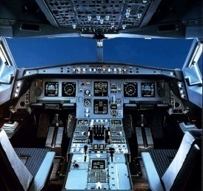

Thales Structure
THALES
Denis RANQUE
AEROSPACE
François LUREAU
GALILEO
Alain BORIES
AIR TRAFFIC MANAGEMENT
Michel MATHIEU
AVIONICS
François LUREAU
TRAINING AND SIMULATION
Stanislas GUERIN
THALES is the only company in the world to cover
all three aspects critical to air transport safety and security

Slide 54
Integration-Responsiveness Framework - Transnational
HIGH
Transnational
strategy
Global strategy
Pressures towards Global Integration
International
strategy
Multi-domestic strategy
LOW
LOW
HIGH
Pressures towards Local Responsiveness

Slide 55
Transnational Strategy
Both high integration pressures and high responsiveness pressures
Combines global-scale efficiencies with local responsiveness benefits
E.g., Star Alliance in Airline Industry

Slide 56
Global Matrix
Global Support
Functions
Global Headquarters
Product
Divisions
Regional
Groups
Functional
Services
Product 1
N. America
Marketing
Product 2
Europe
Research
Product 3
Asia-Pacific
Info. Systems

Slide 57
McDonnell Douglas Corporation (when I worked there)
Contracts &
Pricing
Engineering
Manufacturing
Quality
Assurance
F-15 U.S.
F-15 Japan
F-18
AV8-B

Slide 58
Ciba-Geigy Before Early 1990’s Reorganization
“Cube” – reporting lines based on three dimensions: geography, business and function
Geography
Business
Function

Slide 59
Stages of International Structure
Foreign
Product
Diversity
GLOBAL MATRIX
(OR “GRID”)
WORLDWIDE
PRODUCT
DIVISION
AREA
DIVISION
Alternative Paths
of Development
INTERNATIONAL
DIVISION
WORLDWIDE FUNCTIONAL
Foreign Sales as % of Total Sales

Slide 60
September 8 / 10 – Structuring the MNC
Rugman, A. M., & Verbeke, A. (2004). A perspective on regional and global strategies of multinational enterprises. Journal of International Business Studies, 35: 3–18.
Lopez, L. E., Kundu, S. K., & Ciravegna, L. (2009). Born global or born regional? Evidence from an exploratory study in the Costa Rican software industry. Journal of International Business Studies, 40: 1228–1238.
Meyer, K.E., Li, C. & Schotter, A.P.J. (2020). Managing the MNE subsidiary: Advancing a multi-level and dynamic research agenda. Journal of International Business Studies, 51: 538–576.
Zeng et al. (2023). Navigating MNE control and coordination: A critical review and directions for future research. Journal of International Business Studies, 54: 1599–1622.

Slide 61
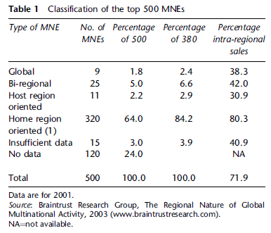
Rugman & Verbeke (2004). A perspective on regional and global strategies of multinational enterprises. Journal of International Business Studies, 35: 3–18.

Slide 62

Triad Power
Title of a 1985 book by Kenichi Ohmae who is a Japanese organizational theorist and management consultant.
Ohmae defined the triad as the geographic space consisting of the United States, the EU and Japan.
Commonalities included low macroeconomic growth, similar technological infrastructure, presence of large (capital and knowledge intensive) firms and relative homogenization of demand and protectionist pressures.

Slide 63
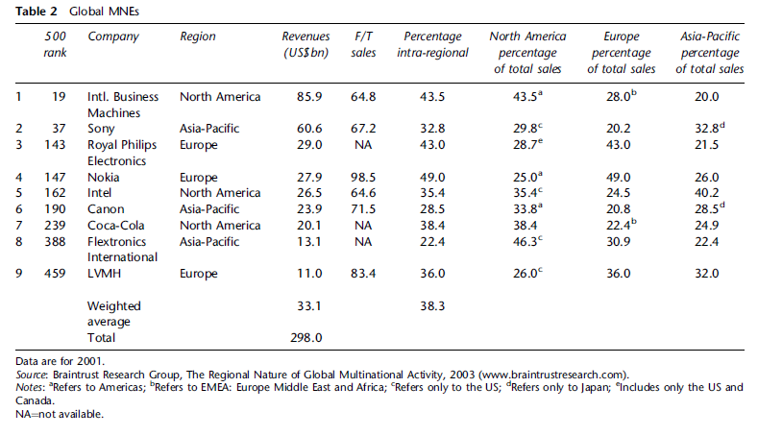
Rugman & Verbeke (2004). A perspective on regional and global strategies of multinational enterprises. Journal of International Business Studies, 35: 3–18.

Slide 64
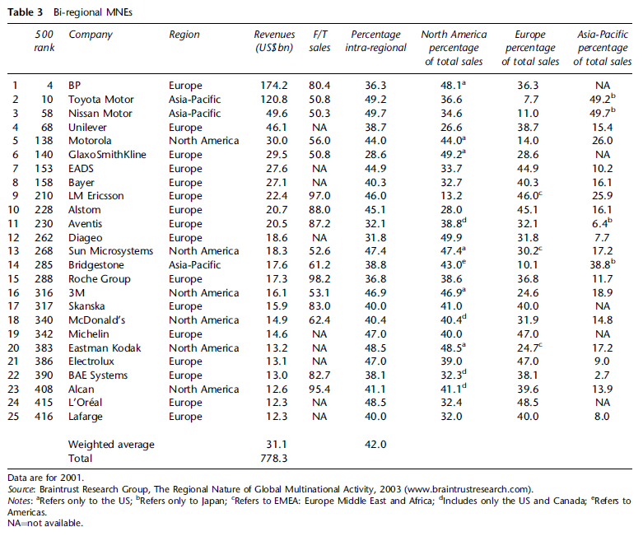
Rugman & Verbeke (2004). A perspective on regional and global strategies of multinational enterprises. Journal of International Business Studies, 35: 3–18. Table 3.

Slide 65
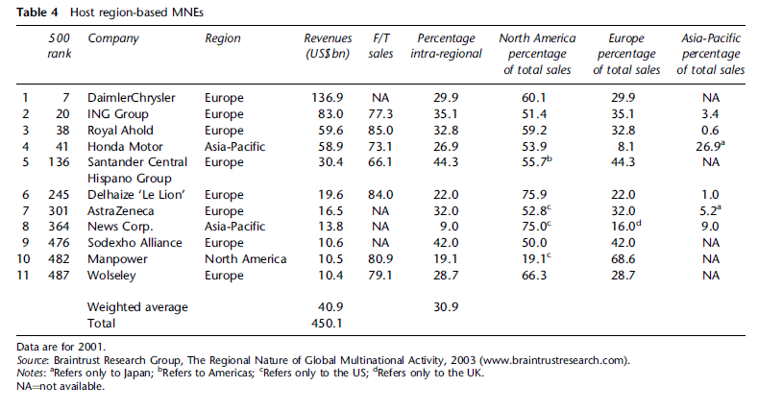
Rugman & Verbeke (2004). A perspective on regional and global strategies of multinational enterprises. Journal of International Business Studies, 35: 3–18. Table 4.

Slide 66
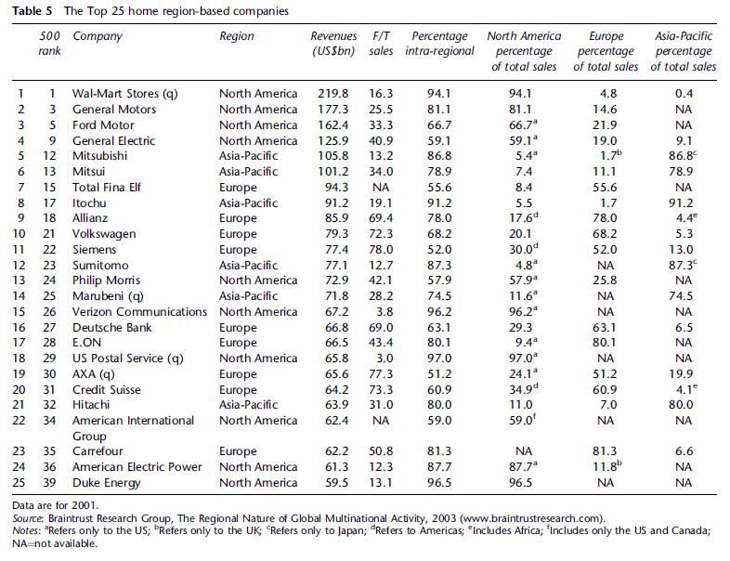
Rugman & Verbeke (2004). A perspective on regional and global strategies of multinational enterprises. Journal of International Business Studies, 35: 3–18. Table 5.

Slide 67
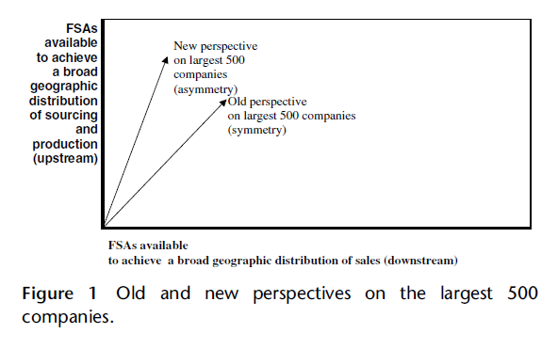
Rugman & Verbeke (2004). A perspective on regional and global strategies of multinational enterprises. Journal of International Business Studies, 35: 3–18. Figure 1.

Slide 68
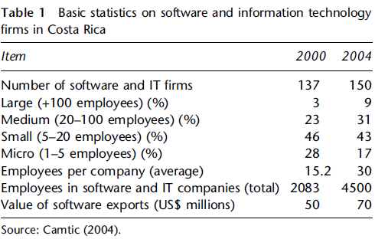
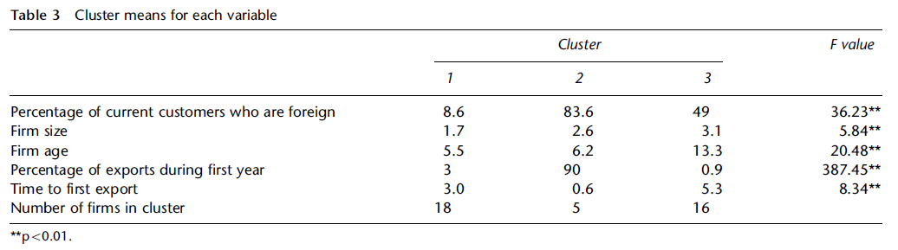
Lopez, Kundu, & Ciravegna (2009). Born global or born regional? Evidence from an exploratory study in the Costa Rican software industry. Journal of International Business Studies, 40: 1228–1238.

Slide 69
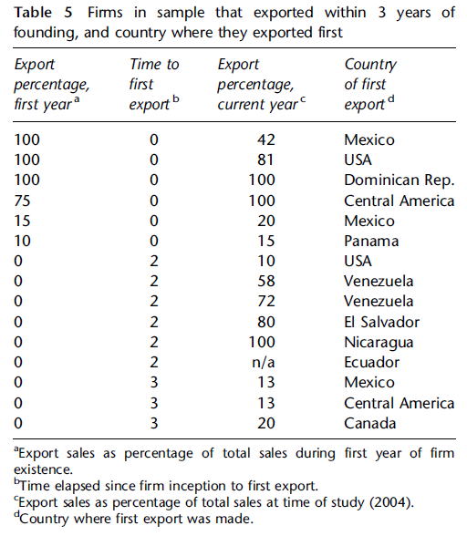
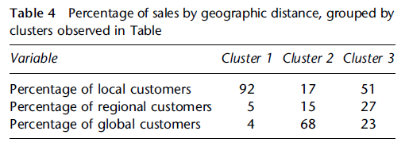
Lopez, Kundu, & Ciravegna (2009). Born global or born regional? Evidence from an exploratory study in the Costa Rican software industry. Journal of International Business Studies, 40: 1228–1238. Tables 4 and 5.

Slide 70
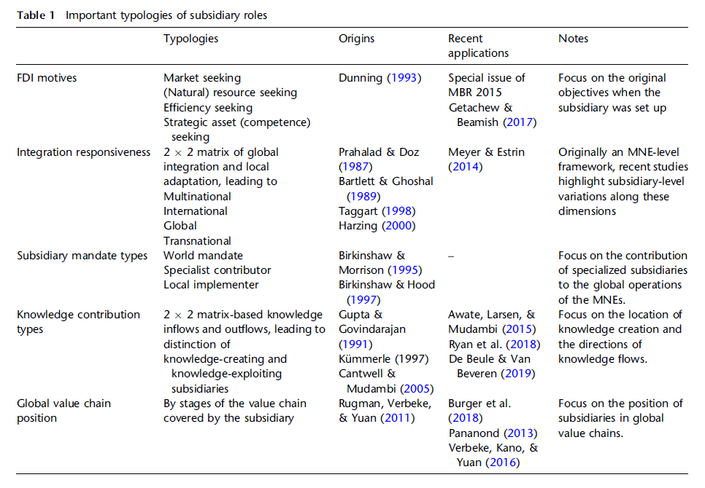
Meyer, K.E., Li, C. & Schotter, A.P.J. (2020). Managing the MNE subsidiary: Advancing a multi-level and dynamic research agenda. Journal of International Business Studies, 51: 538–576.

Slide 71
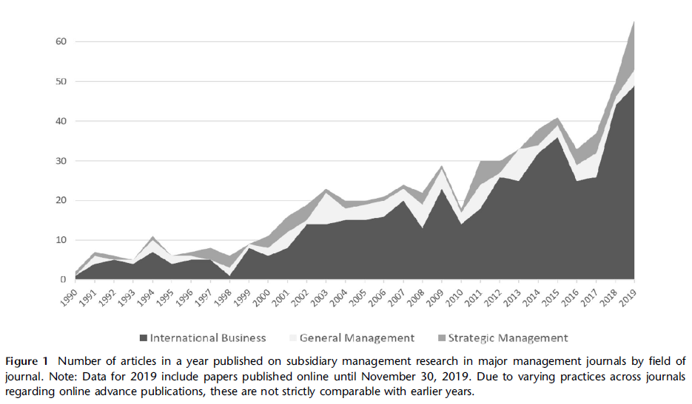
Meyer, K.E., Li, C. & Schotter, A.P.J. (2020). Managing the MNE subsidiary: Advancing a multi-level and dynamic research agenda. Journal of International Business Studies, 51: 538–576. Figure 1.

Slide 72
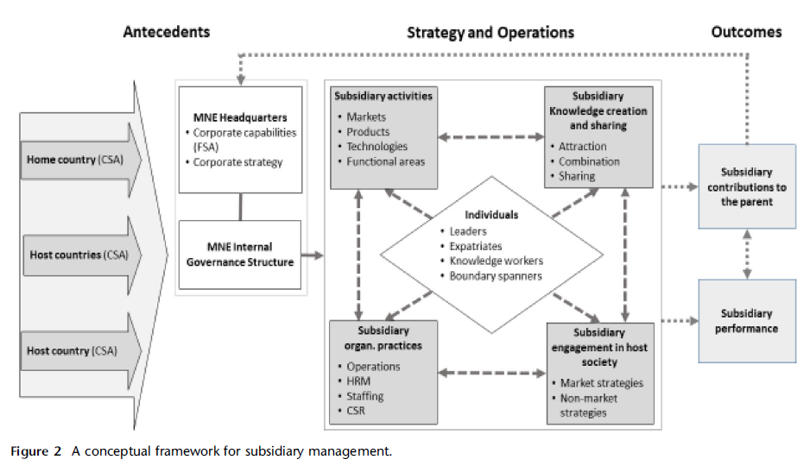
Meyer, K.E., Li, C. & Schotter, A.P.J. (2020). Managing the MNE subsidiary: Advancing a multi-level and dynamic research agenda. Journal of International Business Studies, 51: 538–576. Figure 2.

Slide 73
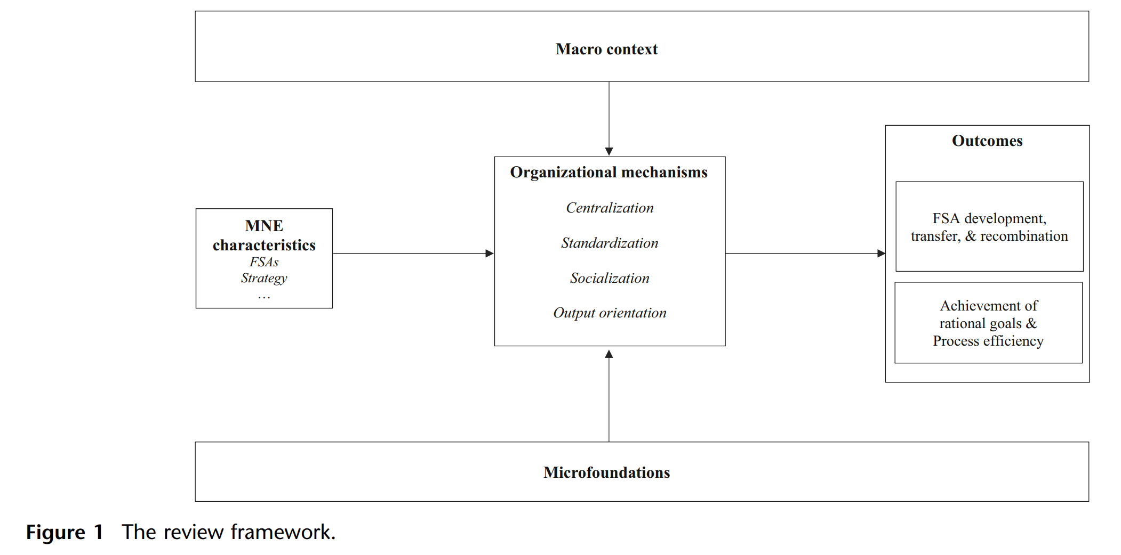
Zeng et al. (2023). Navigating MNE control and coordination: A critical review and directions for future research. Journal of International Business Studies, 54: 1599–1622.

Slide 74
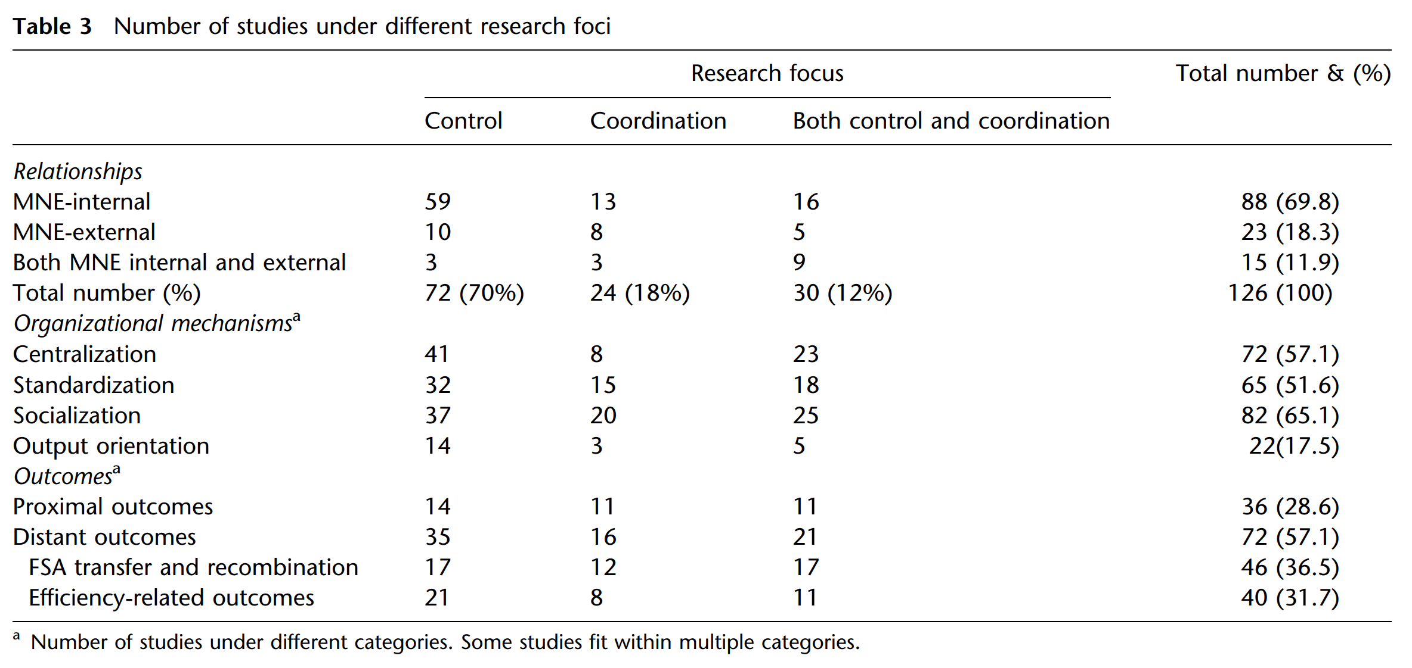
Zeng et al. (2023). Navigating MNE control and coordination: A critical review and directions for future research. Journal of International Business Studies, 54: 1599–1622. Table 3.

Slide 75
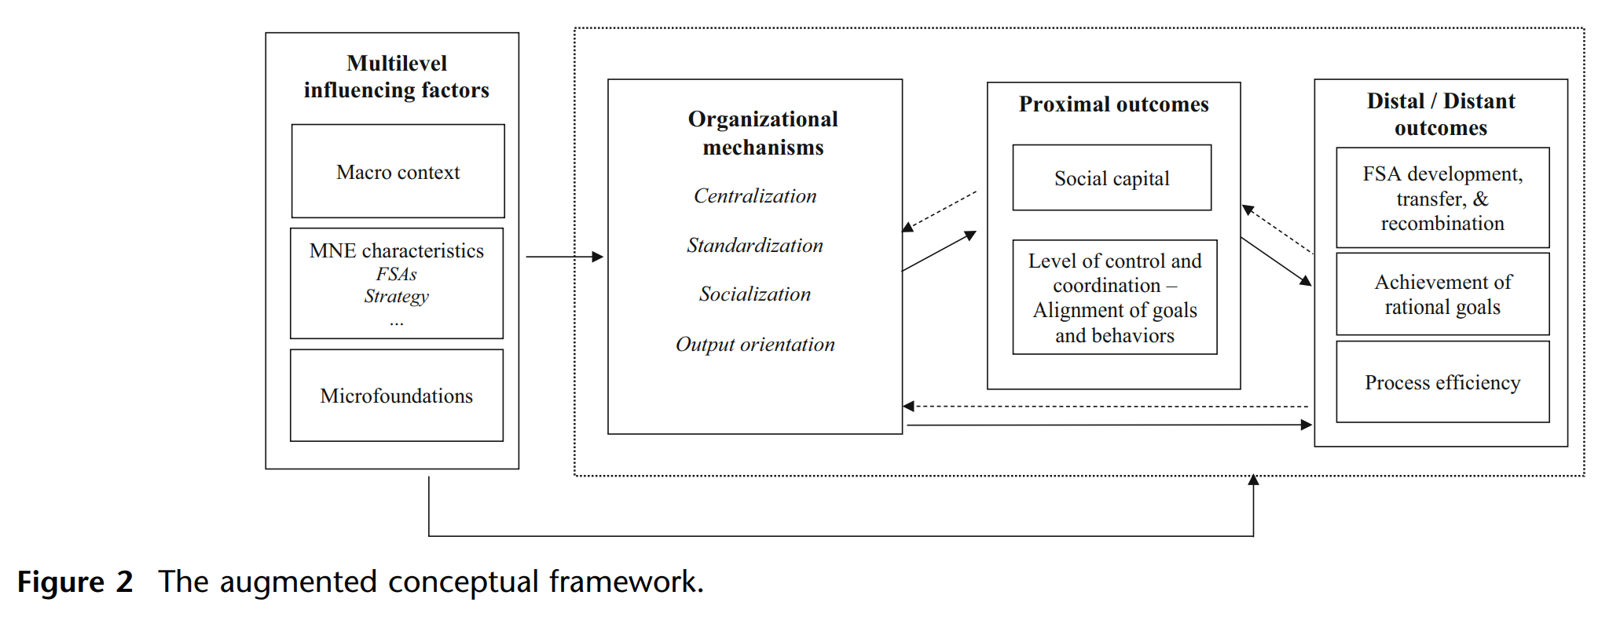
Zeng et al. (2023). Navigating MNE control and coordination: A critical review and directions for future research. Journal of International Business Studies, 54: 1599–1622. Figure 2.

Slide 76
Next Week: September 18/19 (Residency) – Institutions and Culture
Deephouse, D., Newburry, W., & Soleimani, A. (2016). The importance of national contexts and institutions for cross-national differences in corporate reputation. Journal of World Business, 51: 463–473.
House, R., Javidan, M., Hanges, P., & Dorfman, P. (2002). Understanding cultures and implicity leadership theories across the globe: An introduction to project GLOBE. Journal of World Business, 37: 3-10.
Cuervo-Cazurra, A., Gaur, A. & Singh, D. (2019). Pro-market institutions and global strategy: The pendulum of pro-market reforms and reversals. Journal of International Business Studies, 50: 598–632.
Samiee et al. (2024). Research on country-of-origin perceptions: review, critical assessment, and the path forward. Journal of International Business Studies, 55: 285–302.
Fainshmidt, S., Judge, W.Q., Aguilera, R.V., & Smith, A. (2018). Varieties of institutional systems: A contextual taxonomy of understudied countries. Journal of World Business, 53: 307-322.

