Slide 1
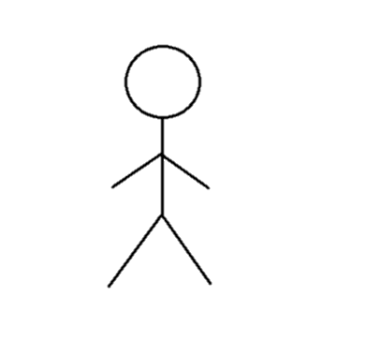
Player
:InputHandler
:MainMenu
signal(‘esc’)
keyPressed = isKeyDown(‘esc’)
[keyPressed] onKeyDown(‘esc’)
[openMenu] handler.openMenu()
menu opens
signal(‘s’)
highlightMenu = isKeyDown(‘s’)
[highlightMenu] onKeyDown(‘s’)
[highlightMenu] onSelect()
“Scores” tab highlighted
signal(‘etr’)
openMenu = isKeyDown(‘etr’)
[openMenu] onKeyDown(‘etr’)
[openMenu] handler.openMenu()
“Scores” menu opens

Slide 2
:InputHandler
Player
:InputHandler
:Entity
player
:PlayerBehavior
signal(‘1’)
keyPressed = isKeyDown(‘1’)
[keyPressed] onKeyDown(‘1’)
switchCharacter(‘rat’)
Character becomes rat
Character becomes rat
*[every frame] tickHealth()
player.health = player.health - 5
Health indicator decreases
Sees food
signal(‘w’)
keyPressed = isKeyDown(‘w’)
[keyPressed] onKeyDown(‘w’)
move()
Repeat until player is on top of food
Player moves
Player moves
signal(‘x’)
keyPressed = isKeyDown(‘x’)
[keyPressed] onKeyDown(‘x’)
eatFood()
boostHealth(100)
Health indicator increases
player.health = player.health + 100

Slide 3
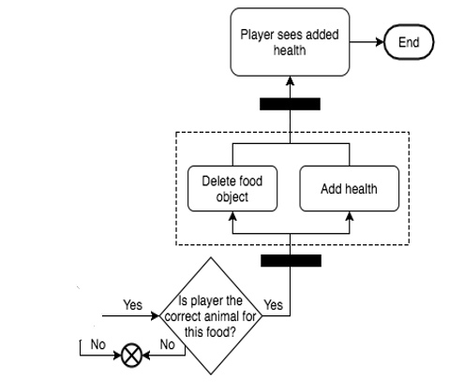
Start
UR-06: Eat food to regain health
Player presses 1, 2, or 3
Player sees decreasing health
Player moves to food
User
End
Player sees food
System
Switch active character to player’s selection
Player health begins to decrease with time
Is player colliding with food?

