Slide 1
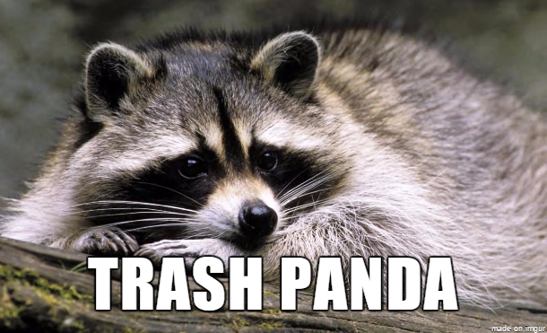
The Trash Panda Dilemma
Peter Gutenko, Tarah Peltz, Audrey Randall, Chance Roberts

Slide 2
Demo

Slide 3


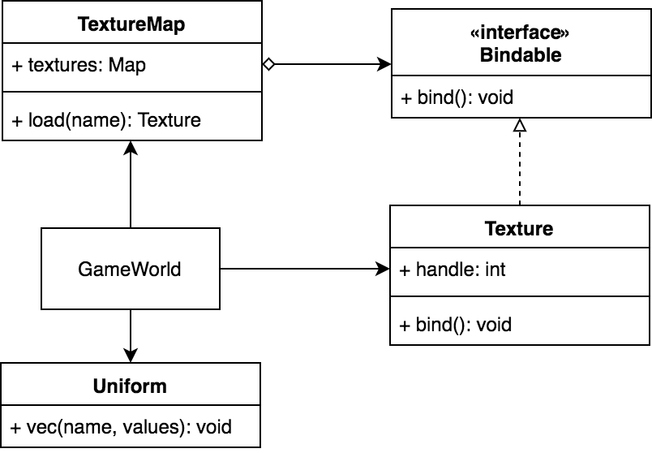
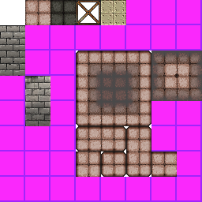
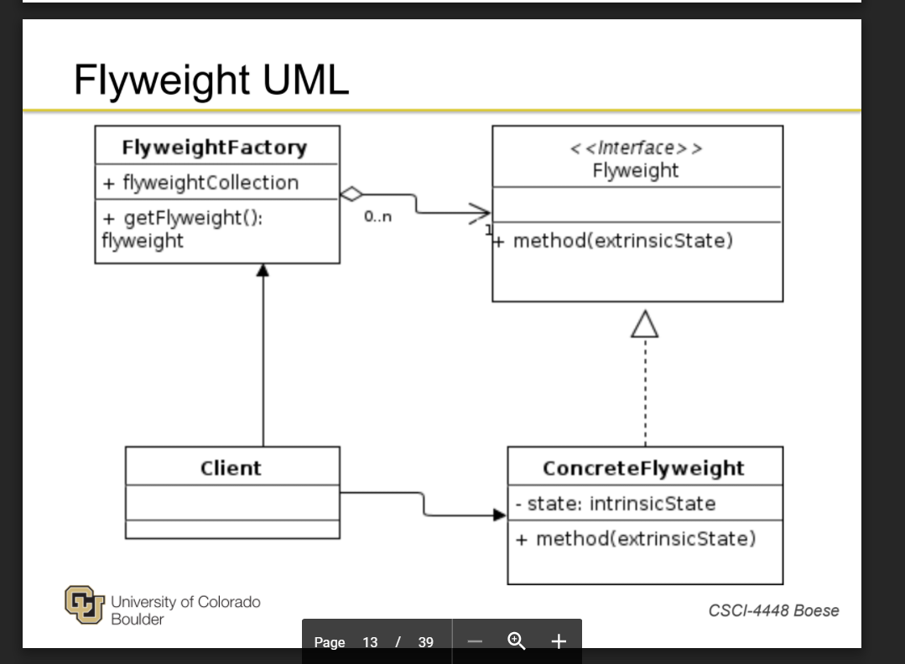
Flyweight
Notes:
TextureMap loads textures once, and maintains the handles OpenGL uses - textures for enemies and the world are tilesheets, only one texture is loaded, and you set uniform values for shaders (another part of OpenGL) to specify which frame to render - shaders use a similar model for flyweight

Slide 4
Factory
EntityFactory
-world: GameWorld
+EntityFactory(w: GameWorld)
+getEntity(type: EntityType): Entity
Entity (condensed)
-sprite: Sprite
-behavior: Behavior
-collider: Collider
+Entity(s: Sprite, b: Behavior, c: Collider)
+update(): void
+render(): void
EntityType
PLAYER COIN TILEMAP ENEMY HAT COSMETIC FOOD
Notes:
Allows us the flexibility to create whatever entities we need and however many we want
Can customize certain parts as well
Made expansion very simple (i.e. added hat and cosmetic)
When fundamentals changed (like sprite types) didn’t have to go to 8 different classes and change them

Slide 5
Strategy
CosmeticBehavior
EnemyBehavior
TestBehavior
HatBehavior
Behavior
Entity
FoodBehavior
PlayerBehavior
EnemyBehavior
CoinBehavior
Notes:
We encapsulated what varied in the behaviors of the entities

Slide 6
Singleton
<<enumeration>>
Key
~index : int
~Key(i : int)
YES NO UP DOWN LEFT RIGHT SPRINT BACKSPACE ENTER ESC
Input
-isNew: boolean[]
-isDown: boolean[]
+isKeyDown(k : Key) : boolean
+isKeyNew(k : Key) : boolean
+clearKeys() : void
+createKeyCallback() : void
-callbackAction(action : int, key : Key) : void
Notes:
Interesting part to talk about is how we could create a race condition if two inputs were generated and were not singletons.
Where is the default constructor??

Slide 7
No State! (gasp!)
Only two true states (menu and gameplay)
Came close to a state implementation in player behavior
The java-esque way to implement an array of function pointers without true pointers
Character Handler class would have added clutter when the “array of function pointers” was elegant on its own

Slide 8
State (What could have been)
PlayerBehavior
…
-charState: State
+swapCharState(s: State): void
...
State
...
+specialBehavior()
...
RacoonState
PossumState
RatState
...
+specialBehavior()
...
...
+specialBehavior()
...
...
+specialBehavior()
...

Slide 9
Menu System - MVC
MenuHandler
Manages input logic
MenuBehavior
Defines menu contents and actions
MenuRenderer
Renders the contents of a menu

