Slide 1
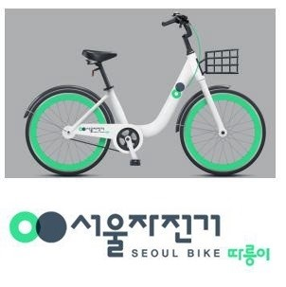
Python For Data Analysis Project
A project made by
CHMIEL Audrey and DONIER Marie ESILV A4 - DIA1

Slide 2

Table of contents
1. Introduction (the datasets, the features)
2. Importation of the dataset
3. Data Exploration
4. Data Cleaning
6. Data Visualization
7. Feature Engineering
8. Data Modeling
9. Flask API
10. Conclusion

Slide 3
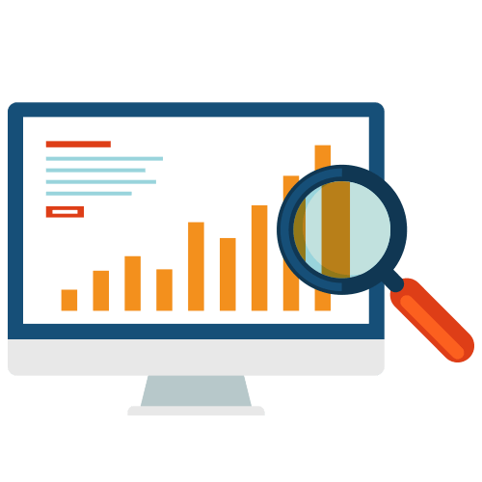
1. Introduction
During this project, we had to work on a dataset for estimating Seoul Bike rental demand based on a panel of time and meteorological criteria.
Our purpose is to visualize and understand the links between our target feature (‘Rented Bike Count’) and the other variables in order to build a model using machine learning methods to predict the amount of bike rented in the future according to the selected features.

Slide 4
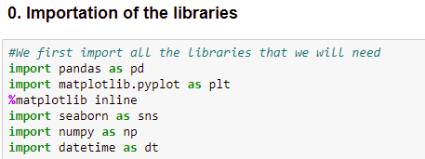
2. IMPORTATION OF THE DATASET
We first imported all the libraries we needed for our project (we kept adding more libraries to the code chunk throughout the project)
… and the dataset on our notebook

Slide 5
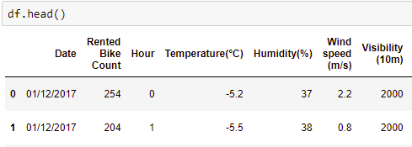

3. Data exploration
We then explored the features of our dataset:
14 features and 8760 records
The target value is ‘Rented Bike Count’
The features related to…
Time periods:
Date (from 01/12/2017 to 30/11/2018)
Hour
Seasons
Holiday
Functioning Day (FDay)
Weather criteria:
Temperature (Temp)
Humidity (Hum)
Wind speed (Wind)
Visibility (Vis)
Dew point temperature (Dew)
Solar Radiation (Solar)
Rainfall (Rain)
Snowfall (Snow)

Slide 6
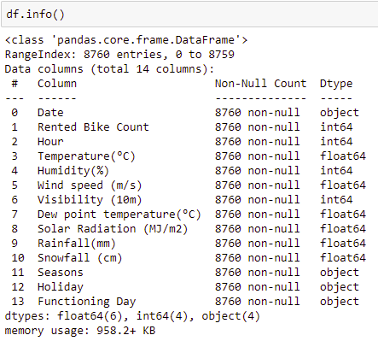
3. Data exploration
Luckily, our dataset did not contain any null value
Here are the types of each feature:
All the columns seem useful to our project, so we decided not to remove any.

Slide 7
4. Data cleaning
We abbreviated and renamed the columns
We checked if there were missing values (there was not)
We converted the datatype of ‘Date’ column from string to datetime

Slide 8
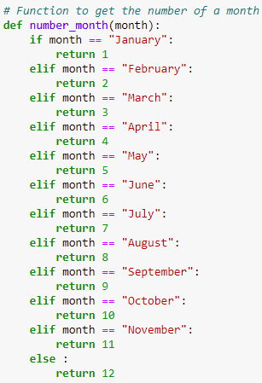

4. Data cleaning
Because we thought we lacked some time features, we finally added some useful columns to have a better insight of the model
‘Day_week’, a categorical variable to know the name of the day
‘Month’, a categorical variable to know the name of the month
‘Number_month’, a numeric value to know the number of each month, which we created with a function returning the number

Slide 9

4. Data VISUALIZATION
To understand the influence of the weather and the different periods of the year 2017-2018 on the number of rented bike in Seoul, we built several data visualization models especially thanks to the libraries Matplotlib and Seaborn.
We have split our visualizations in two parts:
4.1 Visualizations based on time variables
4.2 Visualizations based on weather variables

Slide 10
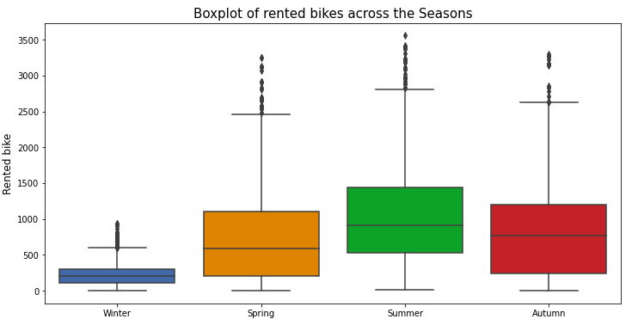
4.1 Visualizations based on time variables
We can see on this boxplot that bikes are usually more rented in Summer and are very less rented during Winter. The amount of bikes rented during Spring and Autumn seems equivalent, as the seasons do not really differ from each other

Slide 11
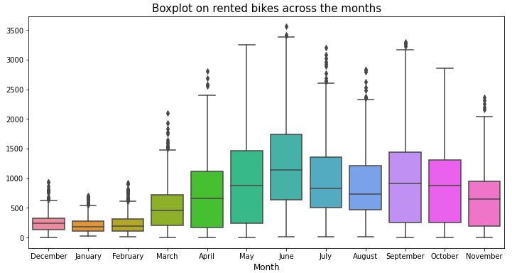
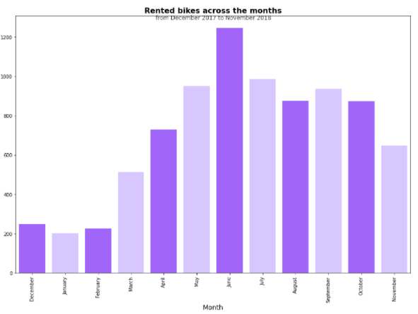
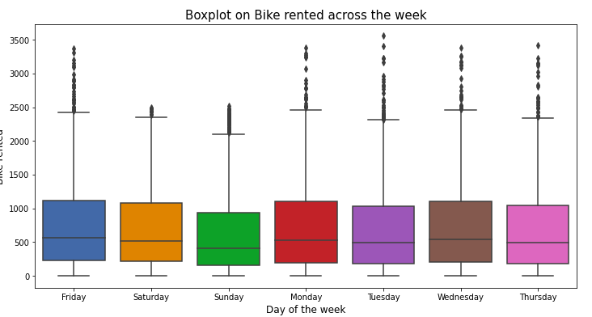
4.1 Visualizations based on time variables

