Slide 1

Python For Data Analysis Project
Seoul Bike Sharing Demand Data ANALYSIS
A project made by
CHMIEL Audrey and DONIER Marie ESILV A4 - DIA1

Slide 2

Table of contents
1. Introduction
2. Importation of the dataset
3. Data Exploration
4. Data Cleaning
5. Data Visualization
6. Dimensionality Reduction
7. Feature Engineering
8. Data Modeling
9. Flask API
10. Conclusion
CHMIEL Audrey and DONIER Marie ESILV A4 - DIA1

Slide 3

1. Introduction
During this project, we had to work on a dataset for estimating Seoul Bike rental demand based on a panel of time and meteorological criteria.
Our purpose is to visualize and understand the links between our target feature (‘Rented Bike Count’) and the other variables in order to build a model using machine learning methods to predict the amount of bike rented in the future according to the selected features.
CHMIEL Audrey and DONIER Marie ESILV A4 - DIA1

Slide 4
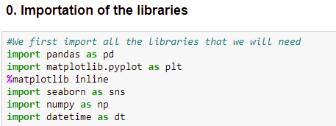
2. IMPORTATION OF THE DATASET
We first imported all the libraries we needed for our project (we kept adding more libraries to the code chunk throughout the project)
… and the dataset on our notebook
CHMIEL Audrey and DONIER Marie ESILV A4 - DIA1

Slide 5
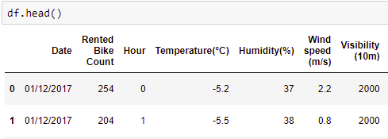

3. Data exploration
We then explored the features of our dataset:
14 features and 8760 records
The target value is ‘Rented Bike Count’
The features related to…
Time periods:
Date (from 01/12/2017 to 30/11/2018)
Hour
Seasons
Holiday
Functioning Day (FDay)
Weather criteria:
Temperature (Temp)
Humidity (Hum)
Wind speed (Wind)
Visibility (Vis)
Dew point temperature (Dew)
Solar Radiation (Solar)
Rainfall (Rain)
Snowfall (Snow)
CHMIEL Audrey and DONIER Marie ESILV A4 - DIA1

Slide 6
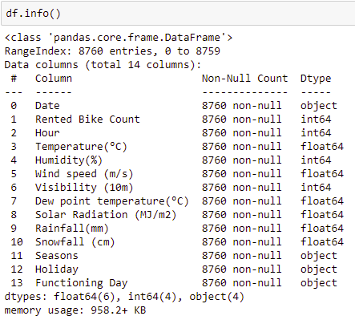
3. Data exploration
Luckily, our dataset did not contain any null value
Here are the types of each feature:
All the columns seem useful to our project, so we decided not to remove any.
CHMIEL Audrey and DONIER Marie ESILV A4 - DIA1

Slide 7
4. Data cleaning
We abbreviated and renamed the columns
We checked if there were missing values (there was not)
We converted the datatype of ‘Date’ column from string to datetime
CHMIEL Audrey and DONIER Marie ESILV A4 - DIA1

Slide 8
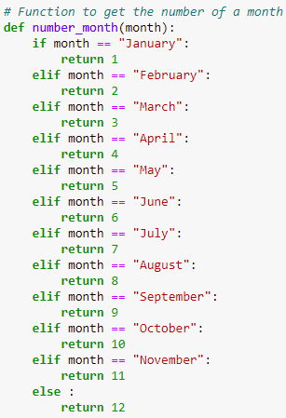

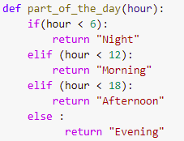
4. Data cleaning
Because we thought we lacked some time features, we finally added some useful columns to have a better insight of the model
‘Day_week’, a categorical variable to know the name of the day
‘Month’, a categorical variable to know the name of the month
‘Number_month’, a numeric value to know the number of each month, which we created with a function returning the number
‘Part_of_the_day’, a categorical feature returning moments of the day based on the hour.
CHMIEL Audrey and DONIER Marie ESILV A4 - DIA1

Slide 9

5. Data VISUALIZATION
To understand the influence of the weather and the different periods of the year 2017-2018 on the number of rented bike in Seoul, we built several data visualization models especially thanks to the libraries Matplotlib and Seaborn.
We have split our visualizations in two parts:
5.1 Visualizations based on time variables
5.2 Visualizations based on weather variables
CHMIEL Audrey and DONIER Marie ESILV A4 - DIA1

Slide 10
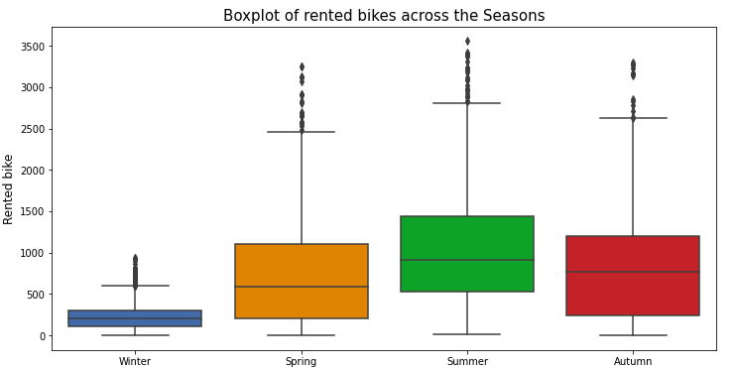
5.1 Visualizations based on time variables
Seasons
We can see on this boxplot that bikes are usually more rented in Summer and are very less rented during Winter.
The amount of bikes rented during Spring and Autumn seems equivalent, as the seasons do not really differ from each other.
As the box represents 50% of the data breakdown, we know that 500 to 1500 bikes are rented every hour in Seoul during the summer.
We also notice some outliers, as for some hours of the day, the demand of bikes is higher, no matter the season.
CHMIEL Audrey and DONIER Marie ESILV A4 - DIA1

Slide 11
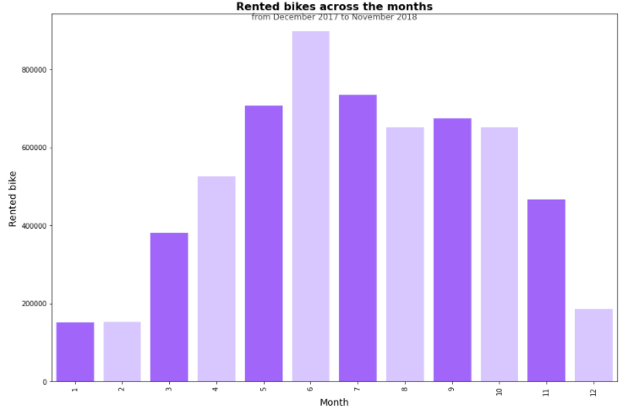
5.1 Visualizations based on time variables
Months
From this barplot:
Most bikes are rented in June, May, July, August, September and October (>600000 per month), so especially during Summer.
Less bikes are rented during January & February & December (<200000 per month), so especially during Winter.
Those months basically confirms the theory said before, that it is during Summer that bikes are most rented, where the weather is more warm.
CHMIEL Audrey and DONIER Marie ESILV A4 - DIA1

Slide 12
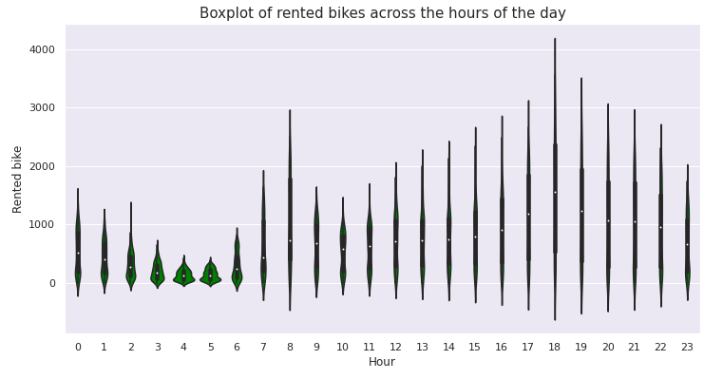
5.1 Visualizations based on time variables
Hours
As we can see on the violinplot, the bike is more used during the evening (especially near 6pm) and at 8am and is least used early in the morning (near 4/5am).
We could suppose that this could be explained because people commute during those hours and use bike to to do so.
CHMIEL Audrey and DONIER Marie ESILV A4 - DIA1

Slide 13
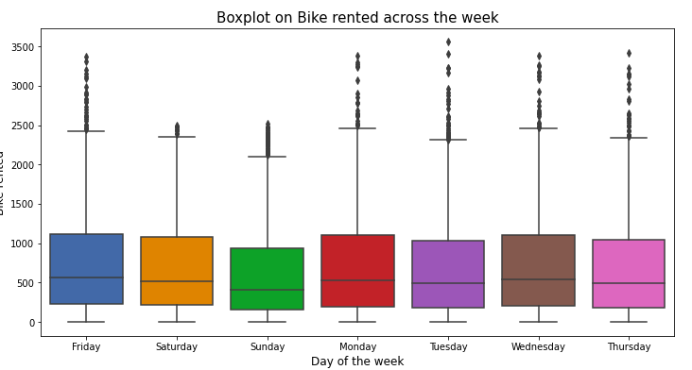
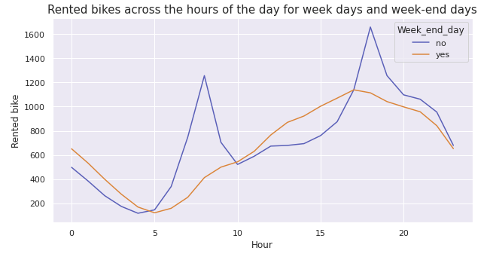
5.1 Visualizations based on time variables
Seasons
Week days / Week end
By looking on the median line of the boxplots, bike rented demand is slightly higher during the weekdays and especially on Monday, Wednesday and Friday than on Sunday.
This theory is confirm thanks to the distribution graph, showing 2 peaks throughout the day, illustrating commuting periods, for the weekdays blue curve and no such peaks for the weekend (Saturday & Sunday) orange curve.
So the feature ‘Holiday’ is therefore important for our future predictions.
CHMIEL Audrey and DONIER Marie ESILV A4 - DIA1

Slide 14
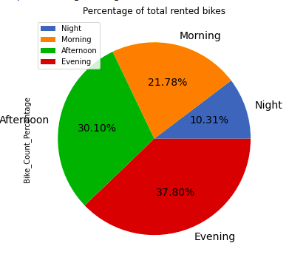
5.1 Visualizations based on time variables
Part of the day
From this pie-chart, we can see that bikes are most rented in the second half of the day (67.90%), i.e. in the afternoon and evening, confirming the results seen before.
Only 10.31% bikes are rented during the night, because we could safely assumed that most people sleep during this time period
CHMIEL Audrey and DONIER Marie ESILV A4 - DIA1

Slide 15
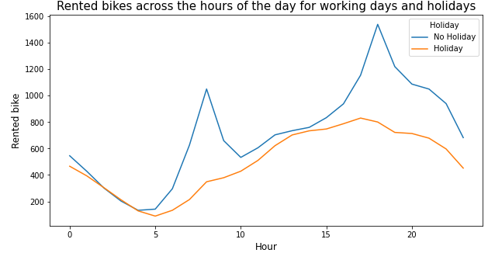
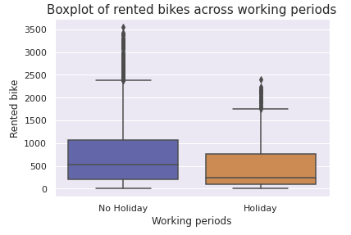
5.1 Visualizations based on time variables
Working / Holiday periods
We can see from this boxplot that the bikes are more rented during working days than on day off.
On the right graph, we notice two peaks illustrating the commuting movements observed previously, but during holidays they are very less noticeable because people no longer commute so they use less their bikes. Demand for bicycles increases fairly gradually throughout the day from 5am to 4pm-6pm.
CHMIEL Audrey and DONIER Marie ESILV A4 - DIA1

Slide 16
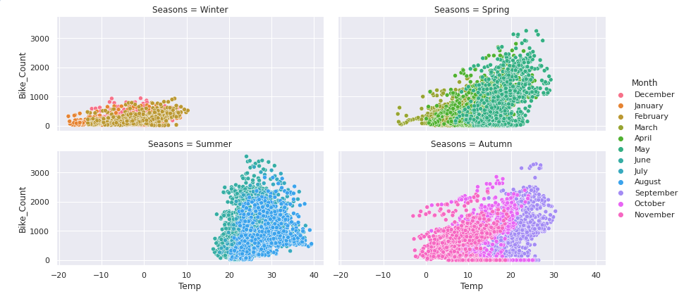
5.2 Visualizations based on Weather variables
The four scatter plots confirms the linked impact of the temperature and time period on the amount of bike rented.
Most bikes are rented when the weather is warm, from 15°C to 30°C, so especially during Summer
CHMIEL Audrey and DONIER Marie ESILV A4 - DIA1

Slide 17
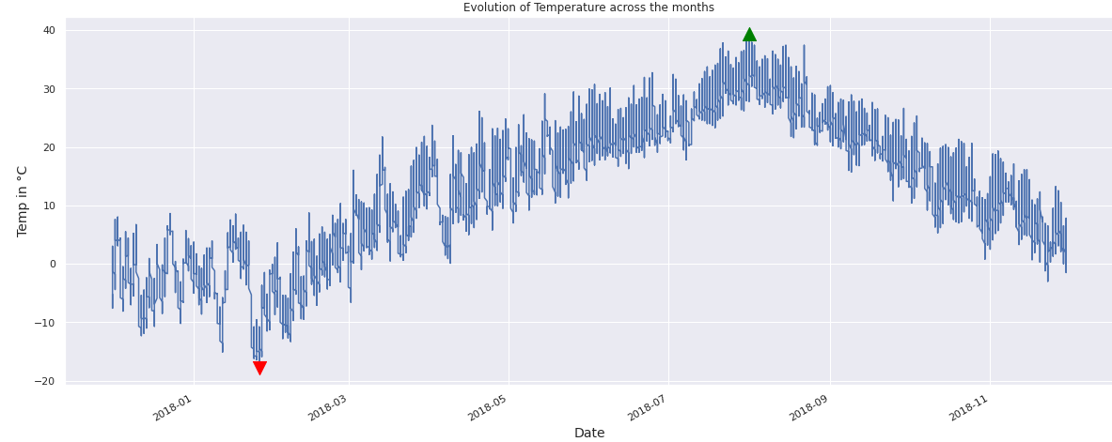
5.2 Visualizations based on Weather variables
Temperature across the months
We can see that the Seoul has more a cold temperate climate
High temperatures during Summer (20°C-40°C)
Cold temperatures during Winter (10°C to -20°C)
Lowest peak: 26/01/2018, -17.8°C
Highest peak: 01/08/2018, 39.4°C
CHMIEL Audrey and DONIER Marie ESILV A4 - DIA1

Slide 18
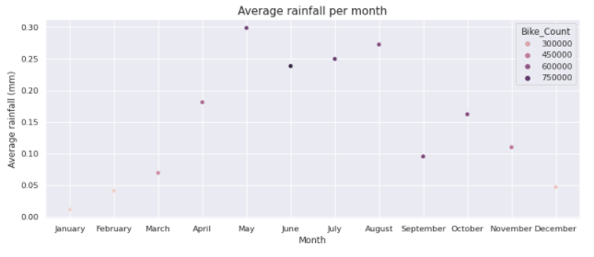
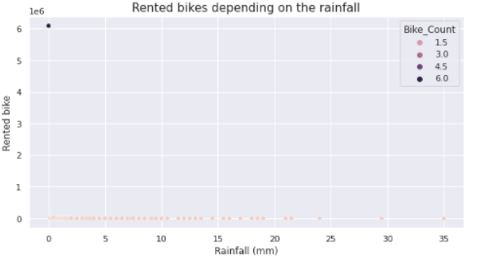
5.2 Visualizations based on Weather variables
Impact of other features on the target variable
We realized scatter plots for each meteorological features, to study the average impact of them on ‘Bike_Count’ per month. We concluded that:
Solar radiation, Dew point temperature, Wind and Visibility may have a strong influence on the target variable due to their variation
Humidity, Snowfall, Rainfall have less influence on ‘Bike_Count’, so in most of the cases, these weather factors do not stop people from riding their bike.
We noticed that Summer is the rainest season in Seoul.
CHMIEL Audrey and DONIER Marie ESILV A4 - DIA1

Slide 19
5. Visualizations Summary
To resume on time variables:
To resume on meteorological factors:
Most bikes are rented:
During Summer, especially in June
The demand increases from 5am to 4pm-6pm,.
Peak at 8am and 6pm, corresponding to commuting hours
During week days and work days than week end and holidays
All the features seem to have an impact on the target variable
Temperature has the highest influence on bike rented
Summer is the rainy season in Seoul but it does not influence bike rented
Solar radiation, Visibility, Dew point temperature and Wind have an influence on the target variable
Humidity, Rainfall and Snowfall do not seem to have an influence on the target variable.
CHMIEL Audrey and DONIER Marie ESILV A4 - DIA1

Slide 20
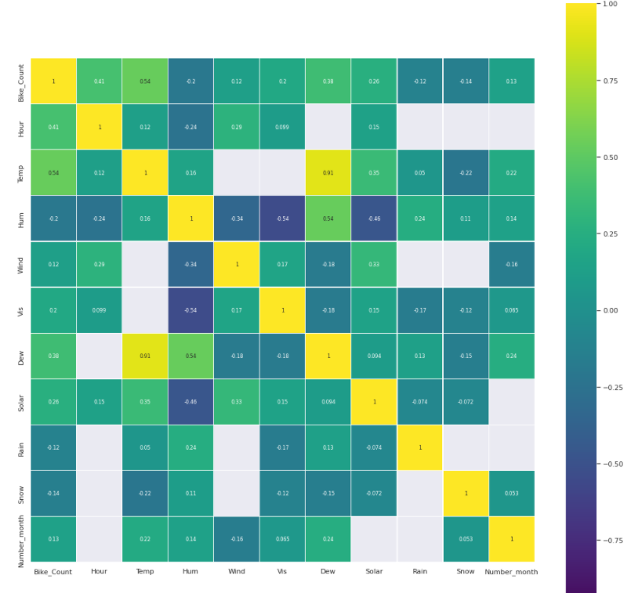
6. Dimensionality reduction
In order to verify our observations, we made a Correlation Matrix
The matrix confirms what was previously said:
Snow, Rain and Hum are not correlated with the target variable
Temp and Hour are strongly correlated with the target variable
Dew, Solar and Vis are slightly correlated with the target variable
We also carried a PCA analysis to have more precision on each variable based on the explained variance and we also found that Wind does not have a strong impact on ‘Bike_Count’
CHMIEL Audrey and DONIER Marie ESILV A4 - DIA1

Slide 21

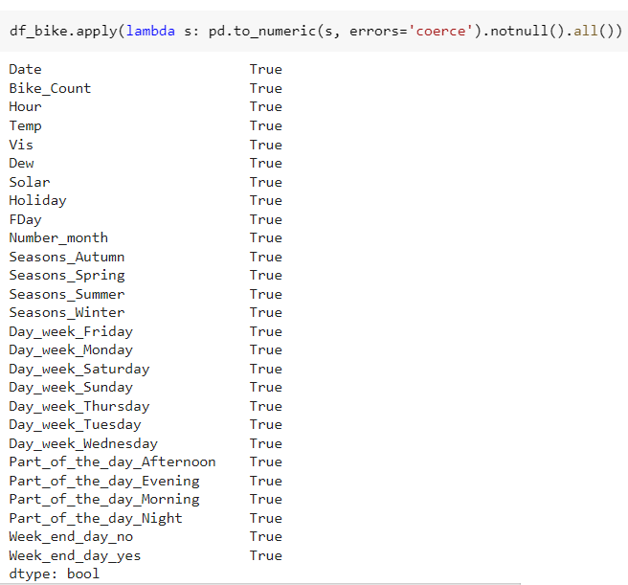

7. Feature Engineering
Now that we have selected the features to keep and to delete, we have to modify the dataset before creating our models. We have to select the useful columns and convert the categorical features into numerical values.
1- We remove the Windspeed, Rainfall, Snowfall and Humidity columns, keep the ‘Number_month’ column and delete the Month column (because they share the same informations)
2- We convert ‘Holiday’ and ‘Fday’ categorical values to binary values:
3- We convert the categorical features ‘Seasons’, ‘Day_week’, ‘Part_of_the_day’ and ‘Week_end_day’ to numeric values :
We convert the ‘Date’ column values to numeric values
Finally, we check if all values are numeric
CHMIEL Audrey and DONIER Marie ESILV A4 - DIA1

Slide 22

8. Data Modeling
Before creating our models, we split the data into a train and a test set.
And then, we scale the data.
We performed 9 different types of Regression models :
Linear Regression
Ridge Regression
Lasso Regression
Support Vector Machine Regression (SVR)
K-nearest neighbors algorithm for regression
Decision Tree
Random Forest
Gradient Boosting
Neural Network Regression
CHMIEL Audrey and DONIER Marie ESILV A4 - DIA1

Slide 23
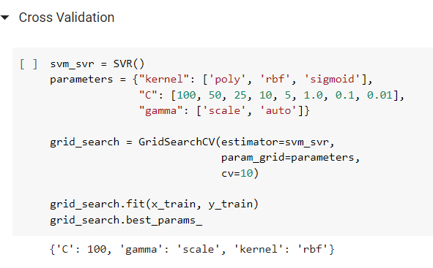
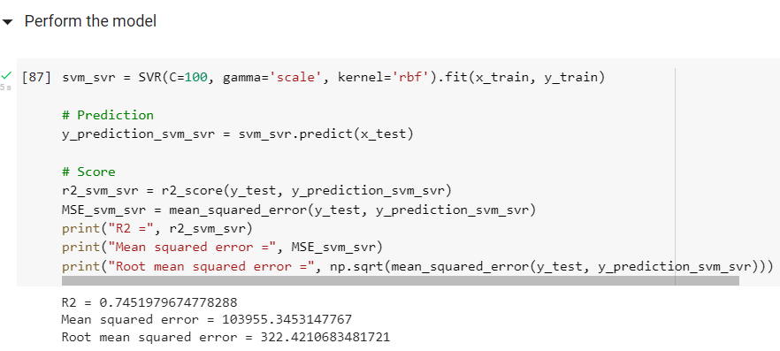
8. Data Modeling
For each model, we tried to change the hyper parameters and made a grid search to find the best ones. Then, we ran the model with those hyper parameters and printed the coefficient of determination R², the Mean Squared Error (MSE) and the Root Mean Squared Error (RMSE),
Here is an example with SVR model:
CHMIEL Audrey and DONIER Marie ESILV A4 - DIA1

Slide 24
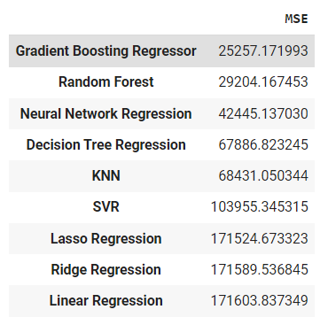
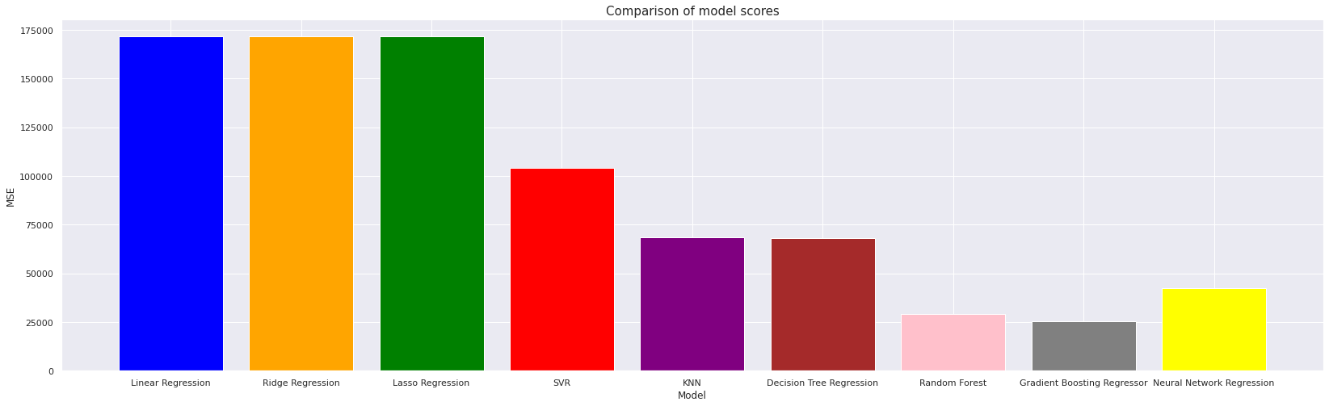
8. Data Modeling
After creating all our models, we compared the results.
To do so, we compared the value for the MSE :
MSE
CHMIEL Audrey and DONIER Marie ESILV A4 - DIA1

Slide 25
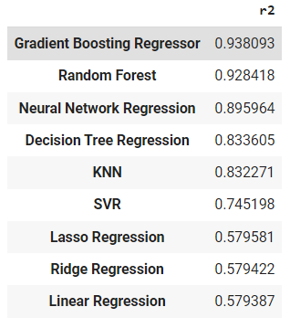
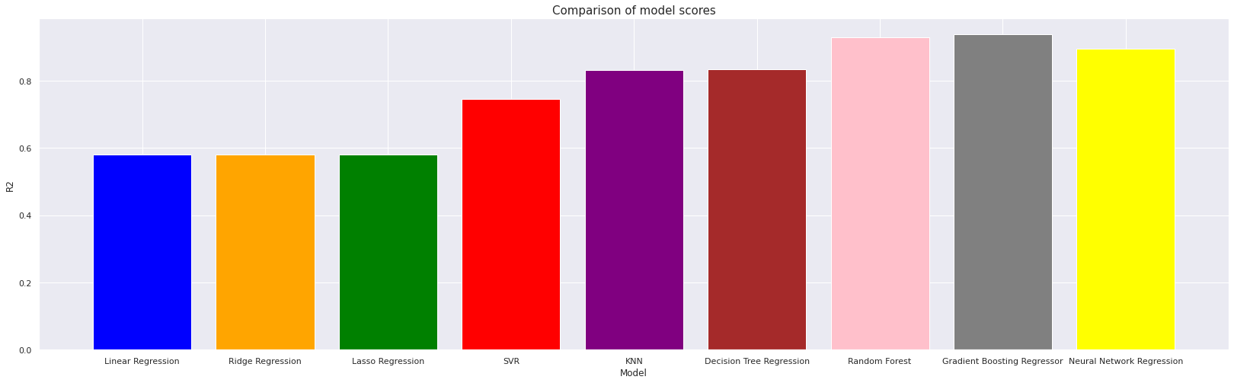
8. Data Modeling
And we compared the value for the R² :
R²
CHMIEL Audrey and DONIER Marie ESILV A4 - DIA1

Slide 26

8. Data Modeling
By looking at those comparisons, we can see that the best result is obtained with the Gradient Boosting Regressor model, because its MSE parameter is the lowest and its R² is the highest.
That’s why we decided to choose this type of model to make predictions.
In order to try to have a better result, we performed a gradient boosting regressor model with all features. Here are the obtained results :
We obtained a better score and decided to keep this model for the predictions,
CHMIEL Audrey and DONIER Marie ESILV A4 - DIA1

Slide 27

9. API - Flask
We had two choices of framework to transform our model into an API : Django and Flask.
We decided to choose Flask because Django is time-consuming, and it doesn’t really worth it for a one- or two-pages’ API. We didn’t need complicated structures for our API, as the user just need to fill in a form, a couple of information (just need to make a single POST request) to obtain the prediction.
To predict the rented bike count, we used the model (gradient boosting) obtained in the Notebook.
We used pickle to serialize the model. This enable us to access to the model without having to run the entire notebook, and to make predictions with our Flask API.
CHMIEL Audrey and DONIER Marie ESILV A4 - DIA1

Slide 28
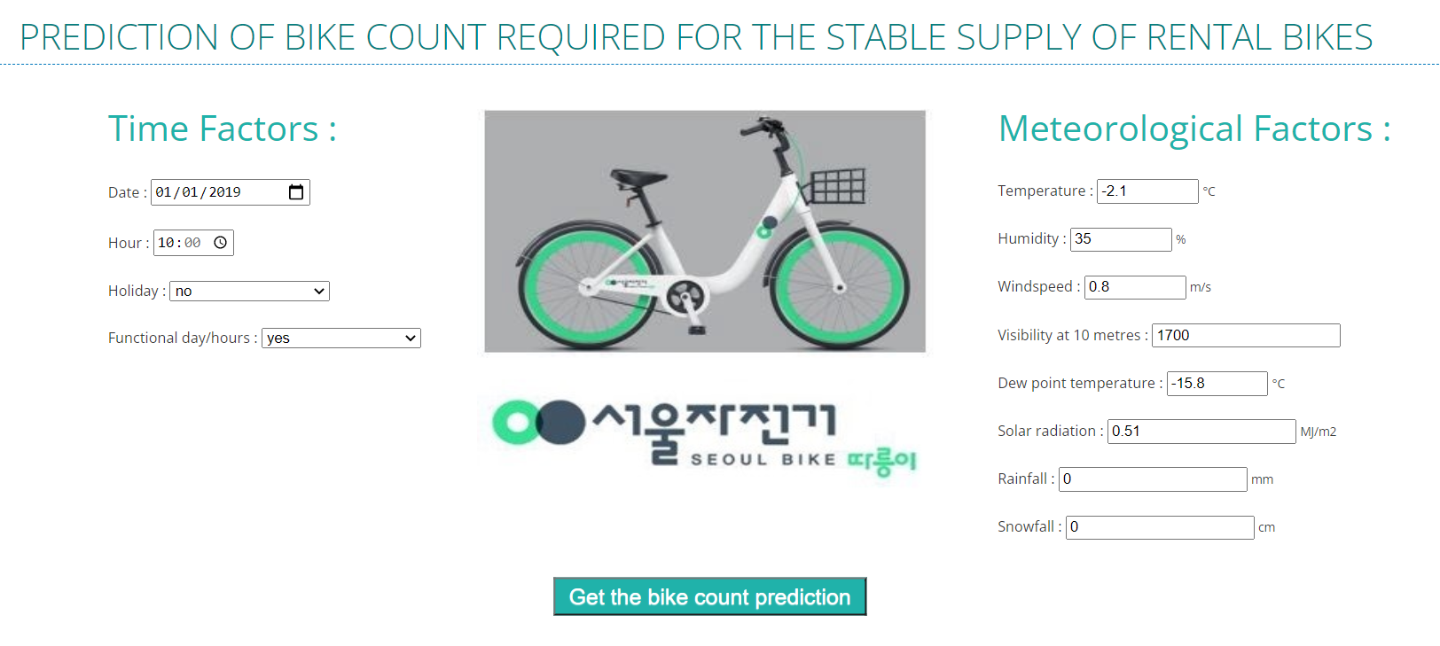
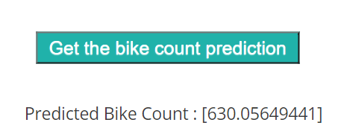
9. API - Flask
We created an .html template to present our solution.
Once the user has launched the API, all he has to do is fill in all the information requested and press the button at the bottom of the page to get the prediction. It will be displayed just below. He can then fill out the form again as many times as he wants to get more predictions.

Slide 29
10. Conclusion
Although it is possible to create a model with a good score and generate predictions, it is important to keep in mind that many parameters are related to the weather, which are relatively random and can vary a lot from year to year. As a result, predictions may be distorted by those weather factors.
In addition, we have in this dataset data ranging from 01.12.2017 to 30.11.2018, i.e. data for 1 year. We could have a better model if we had more data, for other years as well.
We are quite satisfied by the results of our work. With this project, we had the opportunity to work on a real case and with real data, which makes the study more interesting. We had the occasion to use the skills and knowledge we acquired with our Python and Machine Learning courses. But also learn how to expose our results on a web framework by learning to use Flask which allows to make APIs easily.
We had a real progression throughout the project, with an application of everything we learn during this course and even more thanks to our researches in order to seek for the best visualizations and models.
We have been able to study the dataset in detail, observe the influence of the different features, make visualizations of several types, interpret them and draw conclusions for the features to be used for the models to be built. We were able to use models we had seen in class but also discover new ones. And finally, after creating a performant model, we were able to present it through a nice interface by creating a flask application.
CHMIEL Audrey and DONIER Marie ESILV A4 - DIA1

