Slide 1
A Digital-Twin Multi-Agent Framework for Enterprise Cognitive Networking
ECNetBench and Leakage-Safe Multi-Seed Evaluation (ECN-v3)
Audrey Rah
Department of Electrical and Computer Engineering
University of Houston
August 2026
Final architecture: leakage-safe features · anchored fusion · TreeSHAP RCA T1 AUPRC 0.115 | RF 0.076 | v2 0.058 | Six frozen seeds | RF paired test non-significant

Slide 2
Agenda
• Motivation and research gap
• Contributions
• ECNetBench benchmark
• ECN-v3 architecture
• Leakage-safe evaluation protocol
• Experimental results and ablations
• Discussion, limitations, future work
• Architecture diagrams throughout
• Verified publication figures only
• Honest statistical reporting (n = 6)
• Reproducible repository artifacts
ECNetBench · Enterprise Cognitive Network (ECN-v3)
2 / 35

Slide 3
Motivation
Enterprise cognitive networking under continuous change
• Campus and data-center fabrics face continuous VLAN/ACL/EVPN/QoS and firmware change
• Operators need earlier anomaly detection, failure-horizon prediction, and explainable RCA
• Closed-loop remediation requires decision support—not opaque scores alone
• Progress is slowed by fragmented public resources and weak leakage protocols
ECNetBench · Enterprise Cognitive Network (ECN-v3)
3 / 35

Slide 4
Enterprise Networking Challenges
Class imbalance
~1% positives; ranking metrics required
Temporal leakage
Future telemetry must not enter features
Multi-modal ops
Counters, syslog, topology, config semantics
Explainability
RCA and healing must be operator-auditable
ECNetBench · Enterprise Cognitive Network (ECN-v3)
4 / 35

Slide 5
Research Gap
• Topology archives lack multi-modal telemetry and recovery labels
• Security corpora omit enterprise L2/L3 configuration semantics
• Few resources jointly expose detection, RCA, impact, and healing under temporal freeze
• Need: leakage-safe benchmark + complete cognitive NetOps pipeline + multi-seed statistics
ECNetBench · Enterprise Cognitive Network (ECN-v3)
5 / 35

Slide 6
Contributions
• ECNetBench: frozen multi-seed enterprise benchmark with leakage rules
• ECN-v3: Digital Twin + multi-agent detection–prediction–RCA–impact–healing decision support
• Evidence-selected T1 head: enriched features + anchored fusion (stacking is a negative ablation)
• TreeSHAP RCA and honest ablation / significance reporting (RF paired test non-significant)
• Reproducible package: checksums, relative paths, Overleaf + presentation sources
ECNetBench · Enterprise Cognitive Network (ECN-v3)
6 / 35

Slide 7
Literature Context (Summary)
• Network digital twins enable what-if analysis and safe change validation
• AIOps surveys emphasize imbalance, drift, and operational metrics beyond accuracy
• Strong tabular detectors (RF, boosting, logistic) remain competitive when features are informative
• Deep baselines include TabNet and true GraphSAGE; a historical GNN proxy (LightGBM) is reported separately
• ECNetBench fills the enterprise cognitive NetOps evaluation gap
ECNetBench · Enterprise Cognitive Network (ECN-v3)
7 / 35

Slide 8
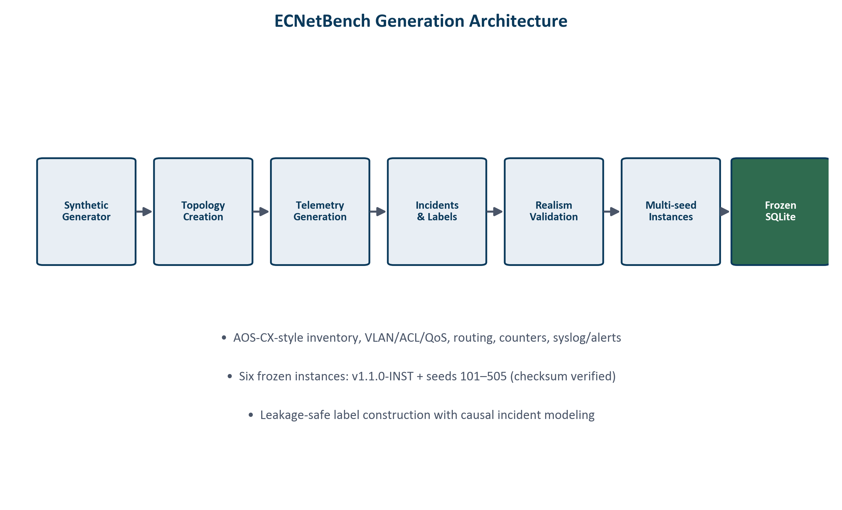
ECNetBench Benchmark
• Synthetic enterprise schema under AOS-CX-style assumptions
• 19 devices / 31 links (primary instance family)
• Tasks: T1 anomaly, T2 failure horizon, T3 RCA, T4 impact, healing decision support
• Six frozen instances: v1.1.0-INST + seeds 101–505
• Checksum-verified SQLite; read-only evaluation
ECNetBench · Enterprise Cognitive Network (ECN-v3)
8 / 35

Slide 9
Benchmark Generation Pipeline
ECNetBench · Enterprise Cognitive Network (ECN-v3)
9 / 35

Slide 10
Multi-Seed Evaluation
• Independent frozen instances reduce seed-specific overfitting claims
• Report mean ± 95% CI across n = 6
• Paired Wilcoxon + Cliff’s δ for proposed versus baselines
• n = 6 is underpowered—mean improvements reported with honest p-values
ECNetBench · Enterprise Cognitive Network (ECN-v3)
10 / 35

Slide 11
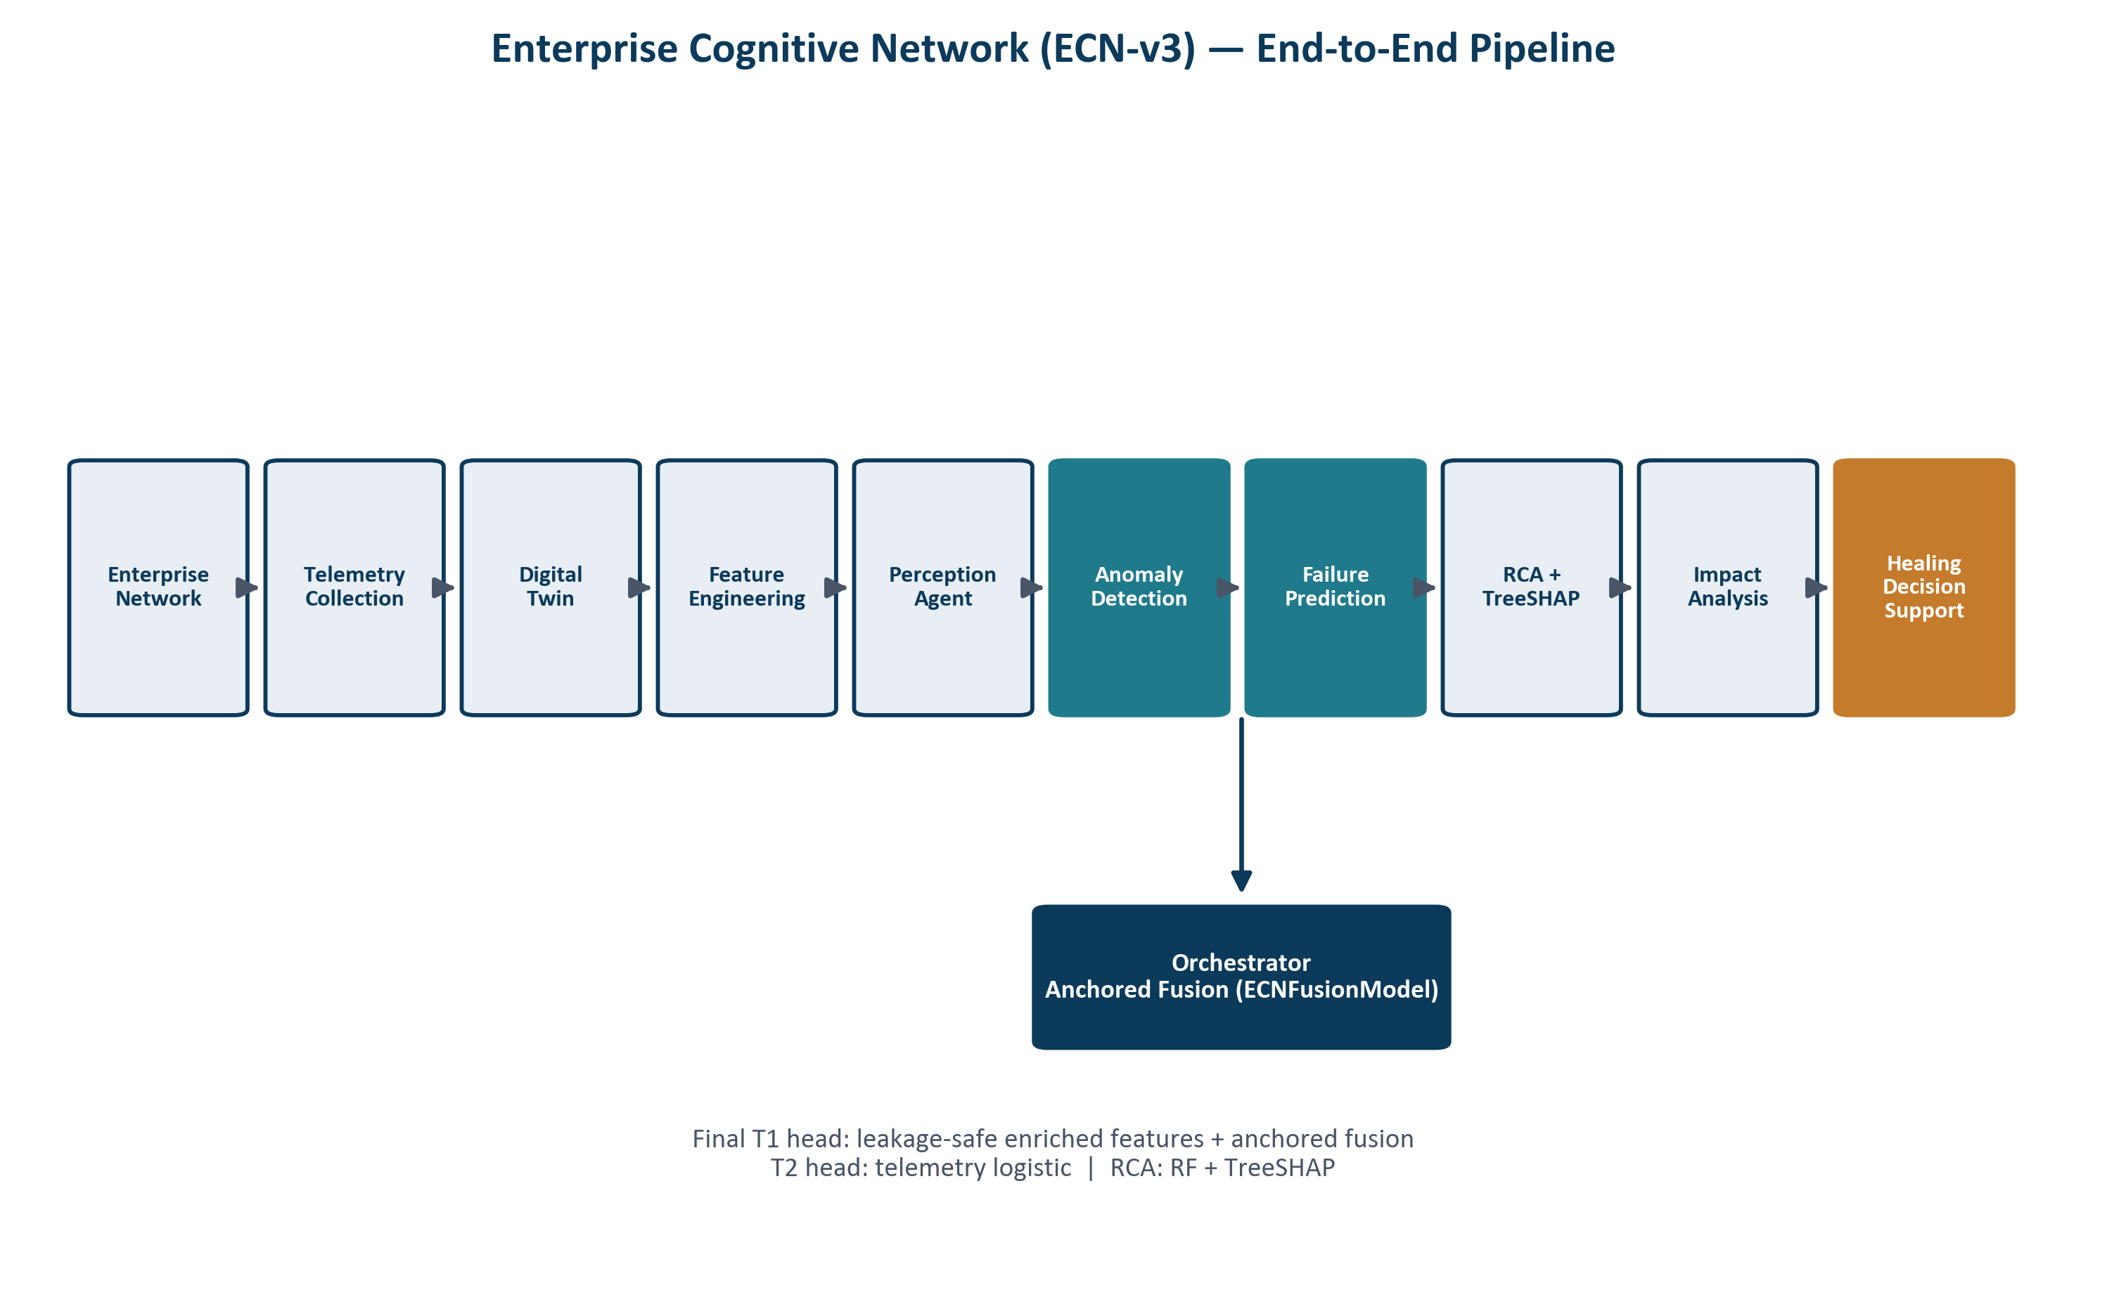
Complete ECN-v3 Architecture
ECNetBench · Enterprise Cognitive Network (ECN-v3)
11 / 35

Slide 12
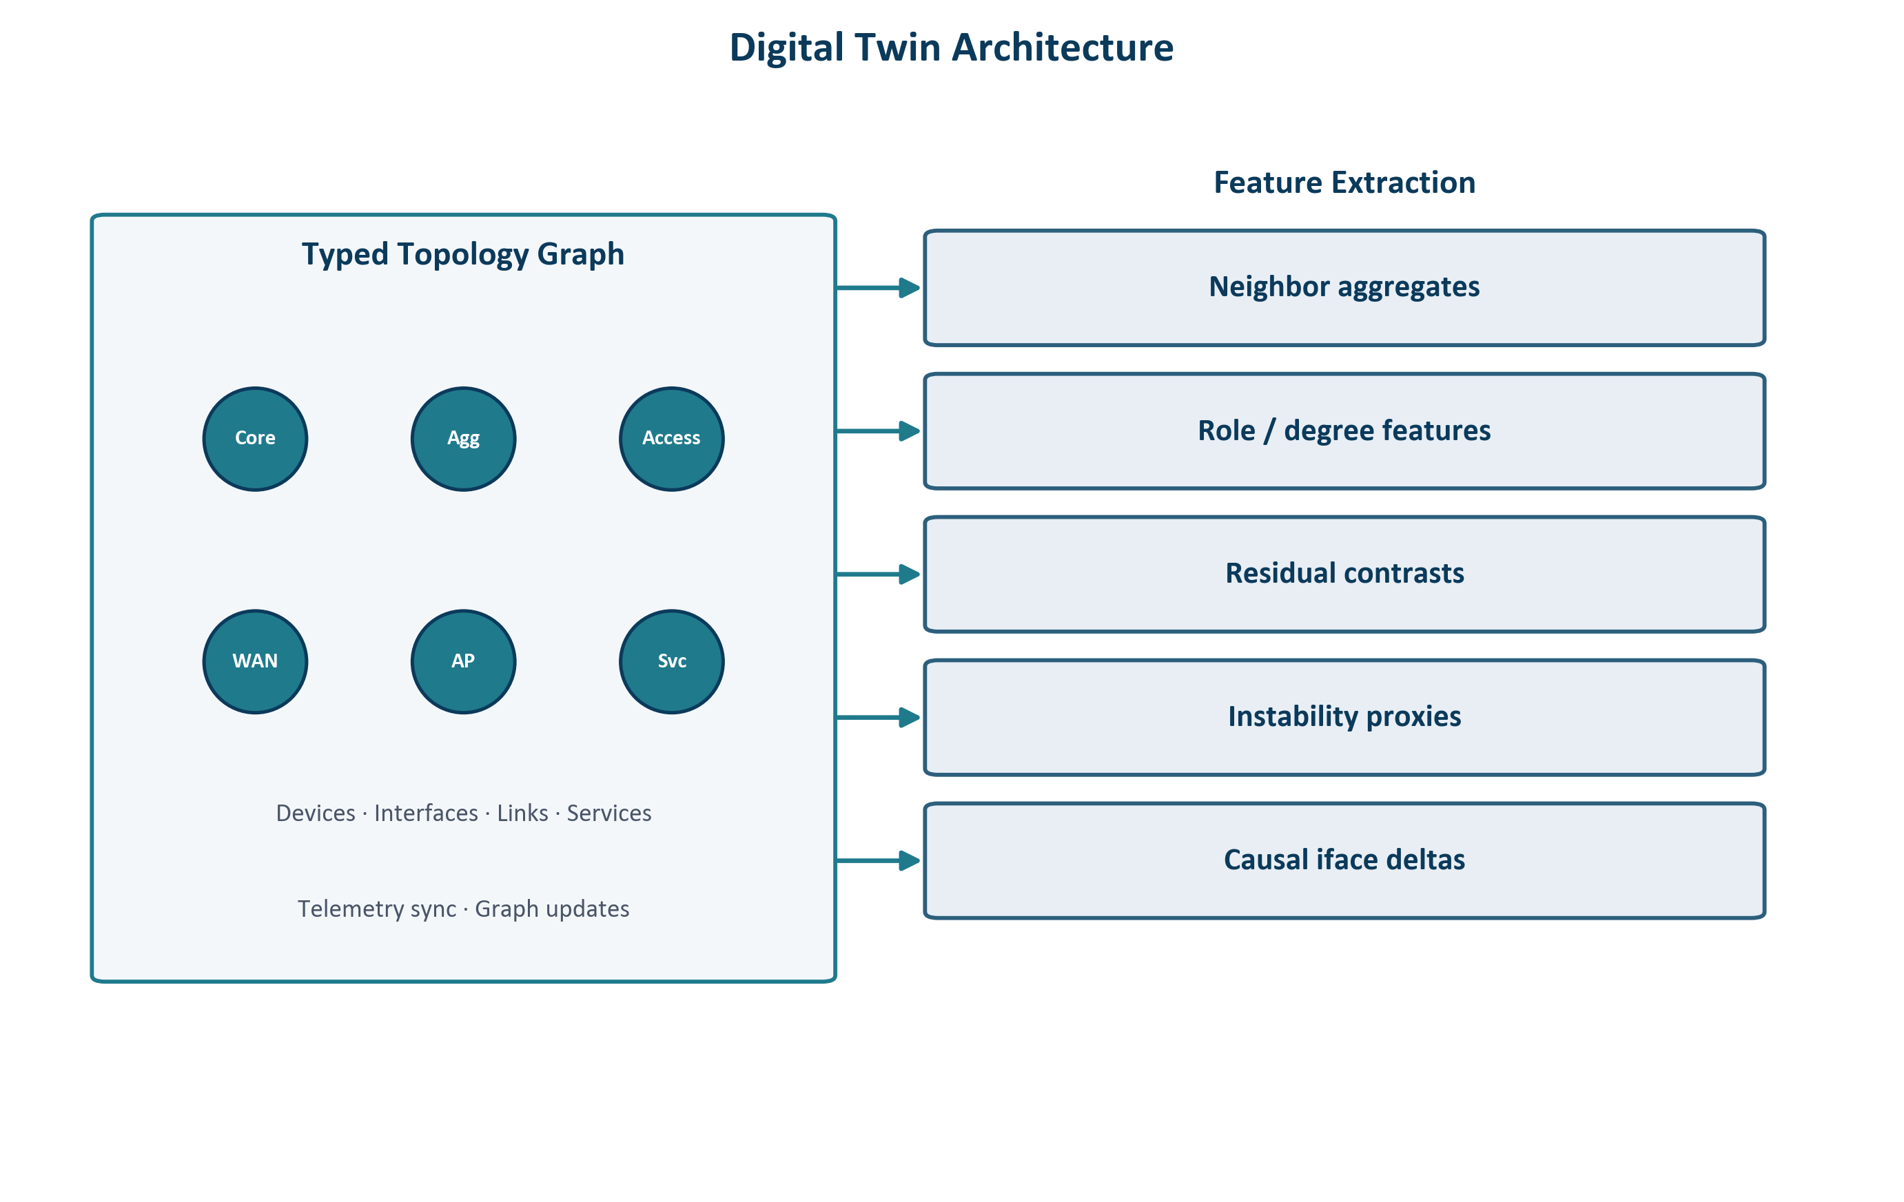
Digital Twin Architecture
ECNetBench · Enterprise Cognitive Network (ECN-v3)
12 / 35

Slide 13
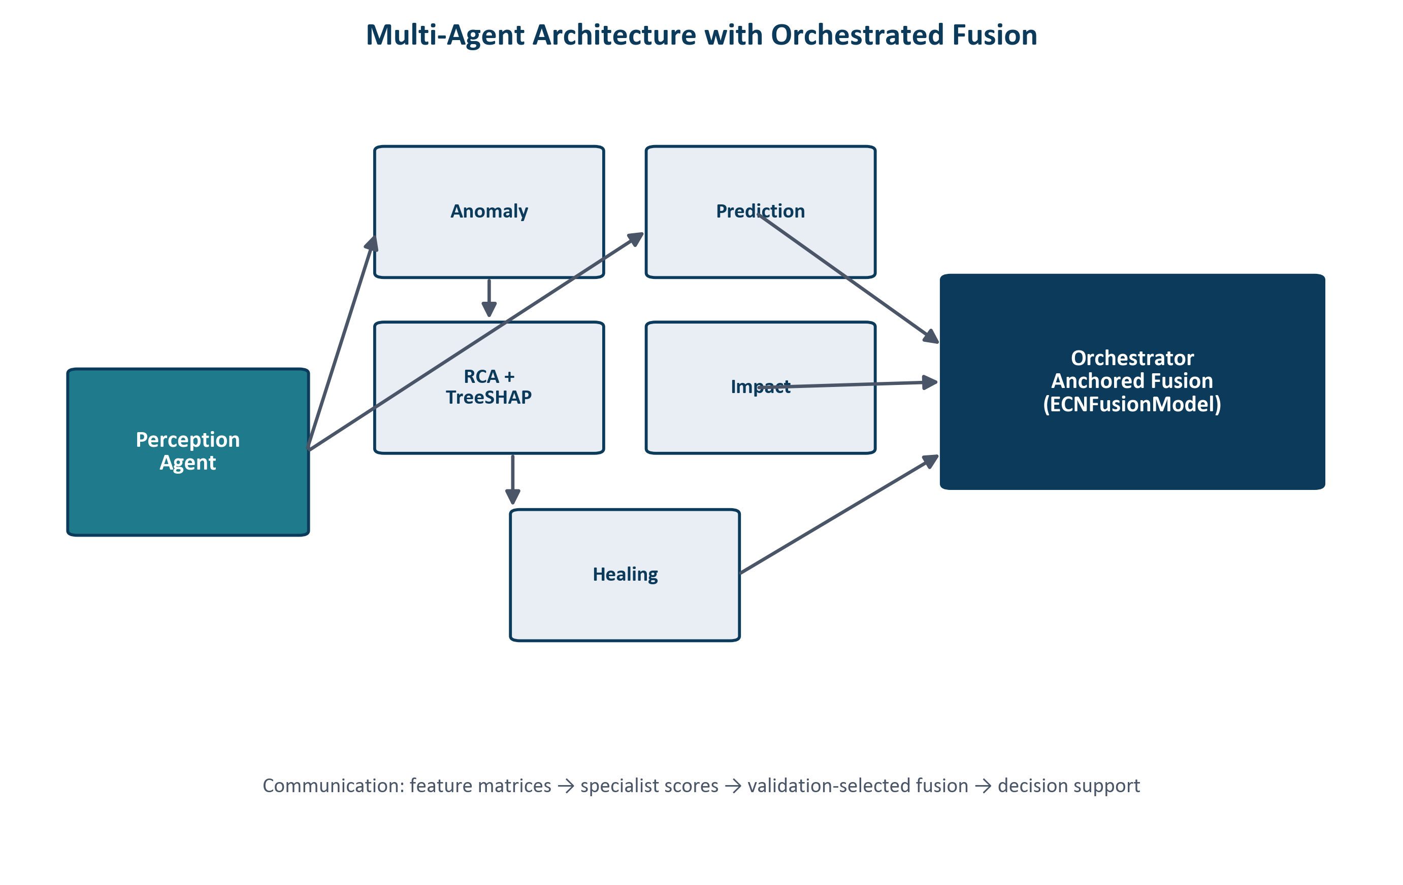
Multi-Agent Architecture
ECNetBench · Enterprise Cognitive Network (ECN-v3)
13 / 35

Slide 14
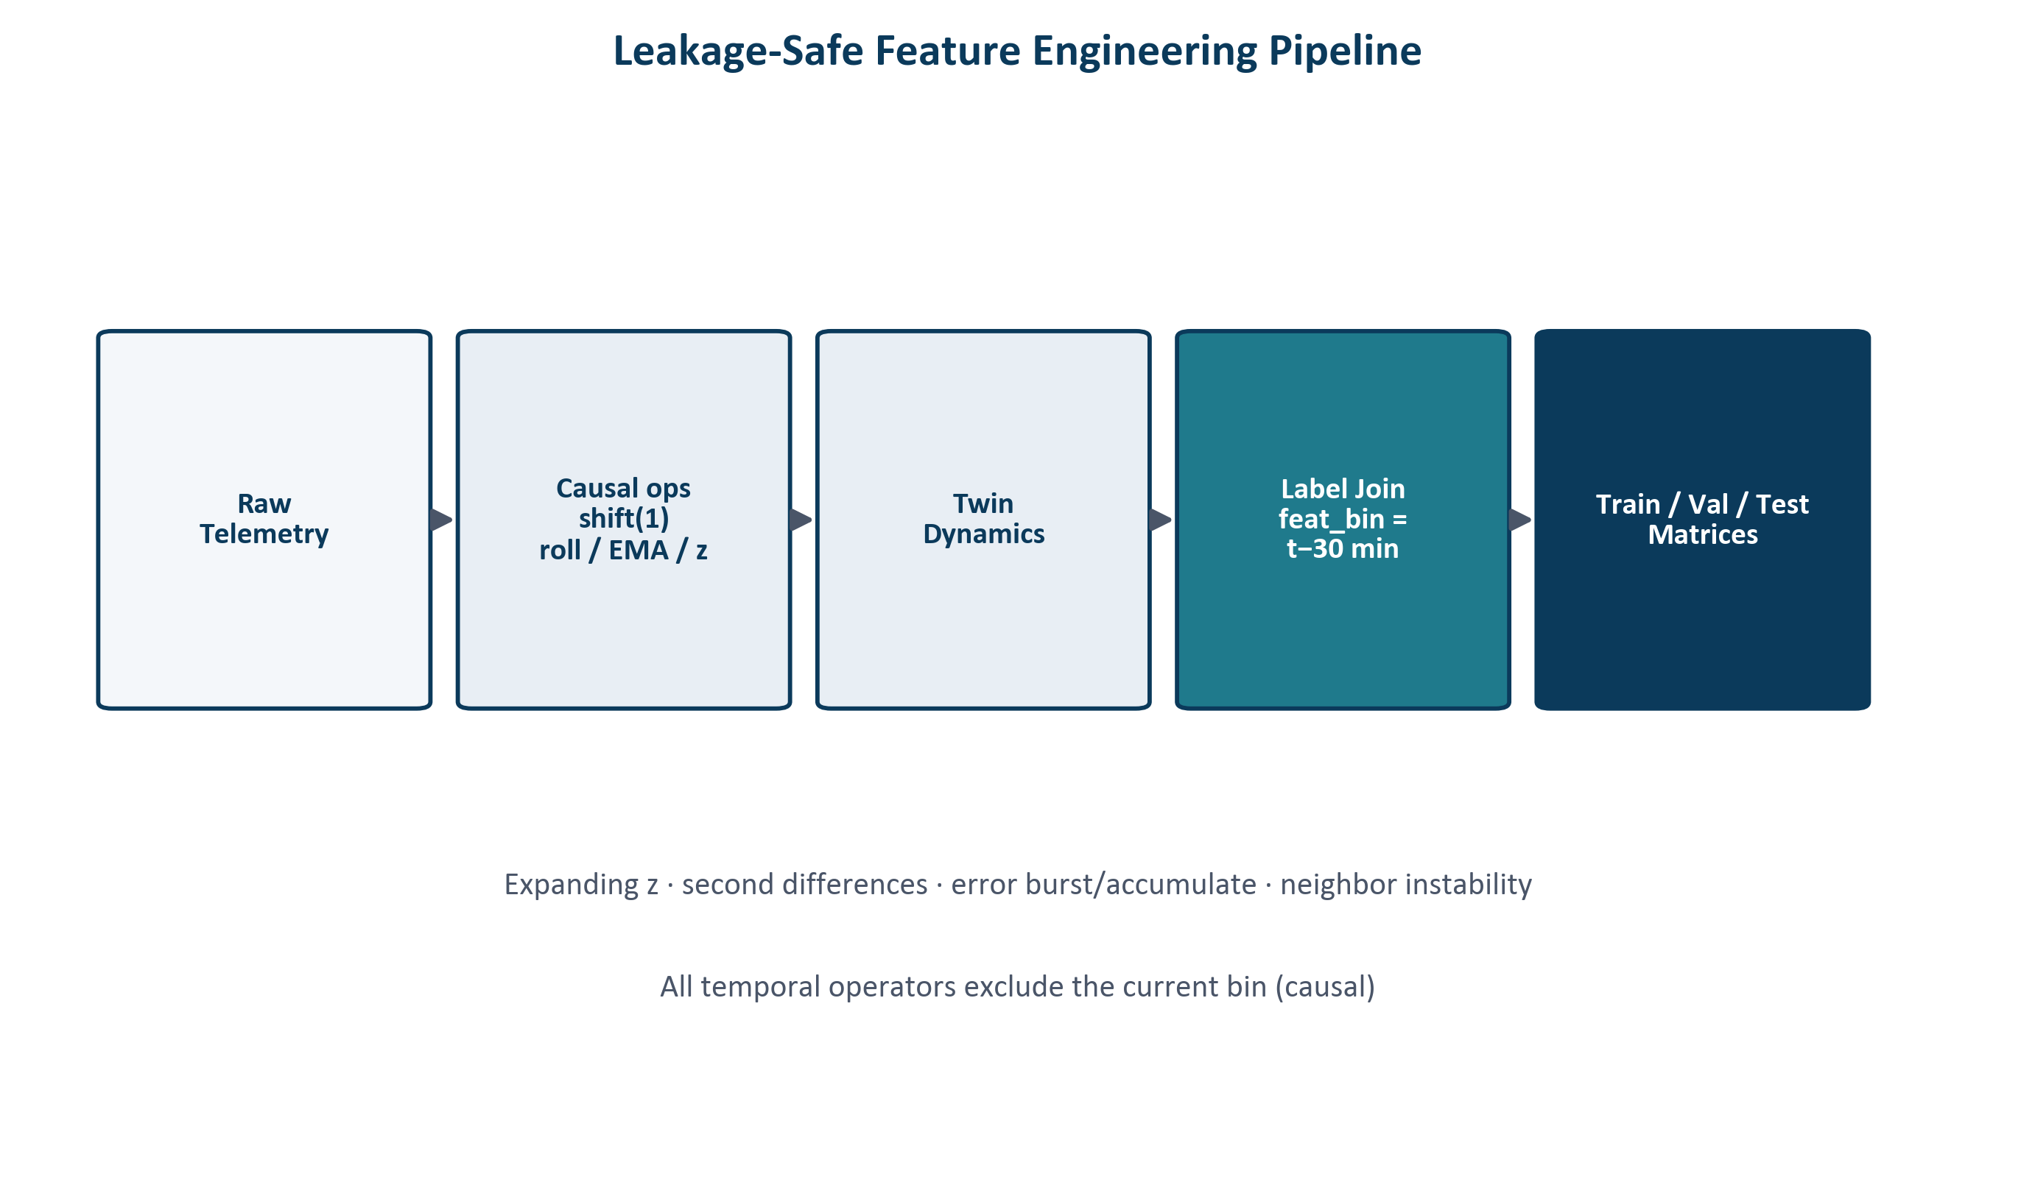
Feature Engineering Pipeline
ECNetBench · Enterprise Cognitive Network (ECN-v3)
14 / 35

Slide 15
Leakage-Safe Protocol
• Features join labels at a 30-minute decision-time offset (features strictly precede labels)
• Rolling / expanding / EMA operators exclude the current bin via a one-step causal shift
• Neighbor instability uses previous-bin aggregates only
• Classical baselines train on telemetry-only matrices; proposed T1 uses enriched twin+telem + anchored fusion
• Temporal 70/15/15 freeze and lag audits on all six frozen instances
ECNetBench · Enterprise Cognitive Network (ECN-v3)
15 / 35

Slide 16
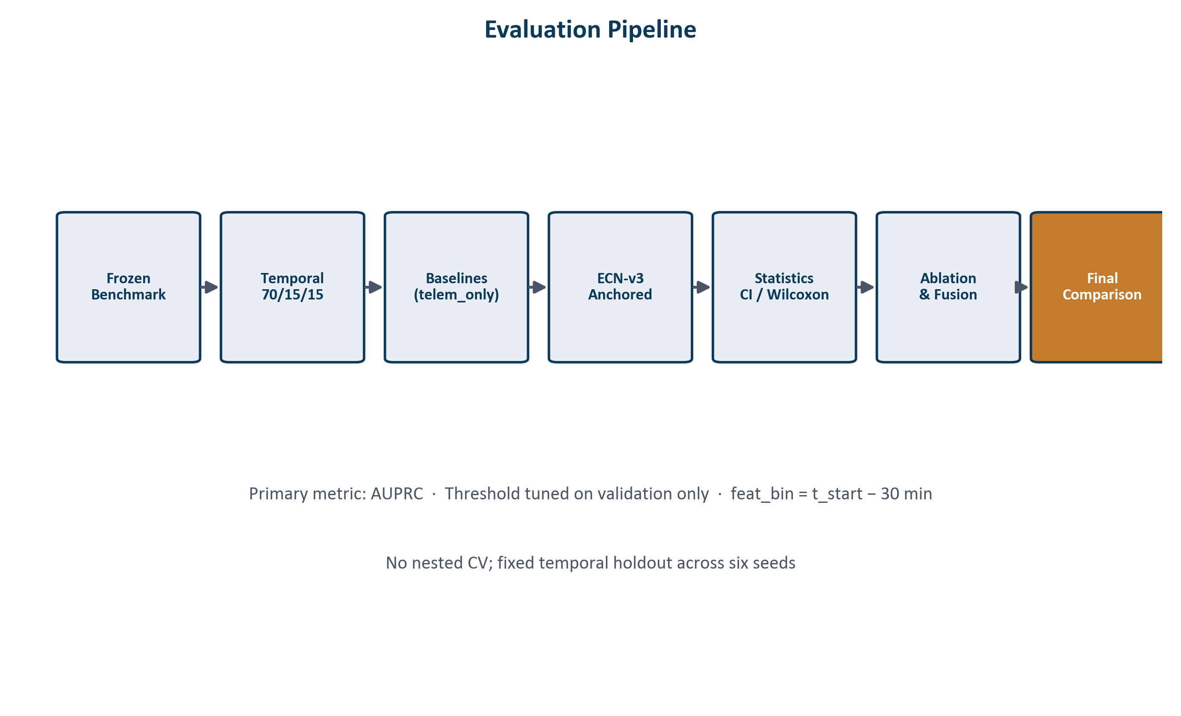
Temporal Evaluation Protocol
ECNetBench · Enterprise Cognitive Network (ECN-v3)
16 / 35

Slide 17
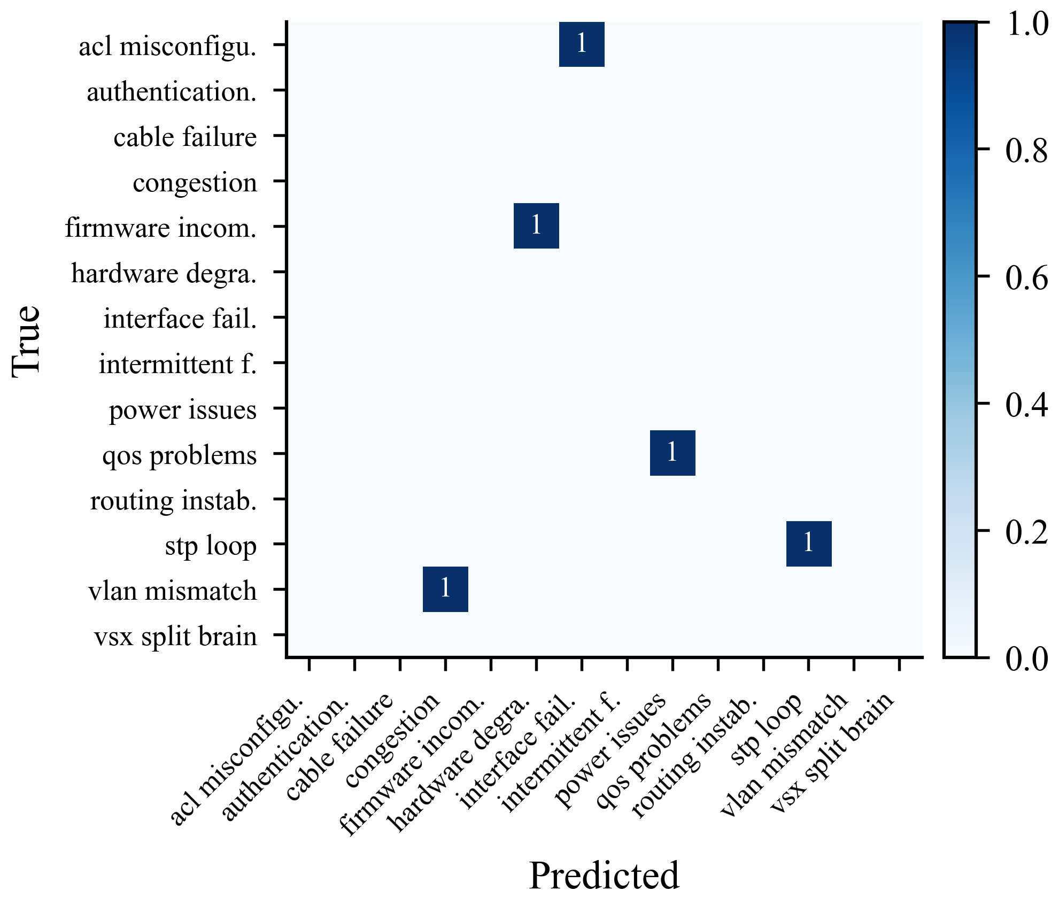
Explainable RCA
• Random-forest multiclass category model
• TreeSHAP attributions for operator-facing explanations
• Mean macro-F1 ≈ 0.254 across six seeds
• Supports triage—not claimed as solved RCA in production
ECNetBench · Enterprise Cognitive Network (ECN-v3)
17 / 35

Slide 18
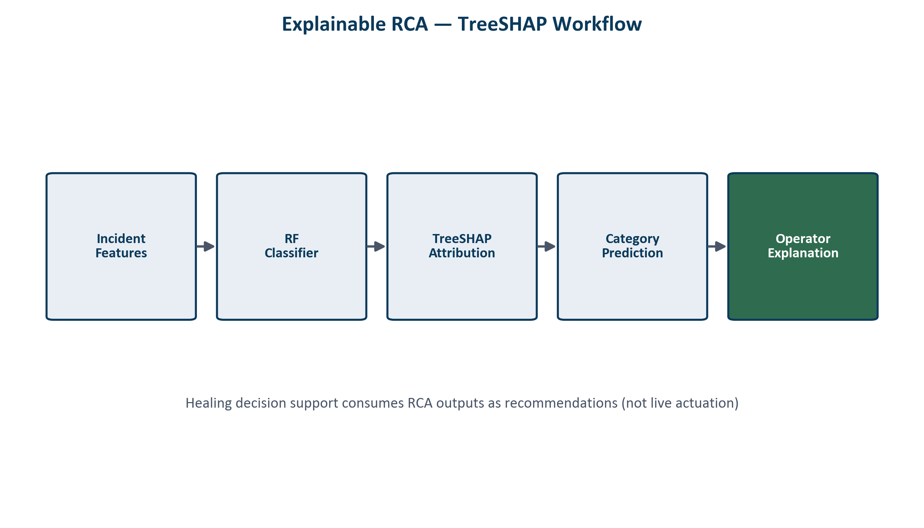
TreeSHAP Explanation Workflow
ECNetBench · Enterprise Cognitive Network (ECN-v3)
18 / 35

Slide 19
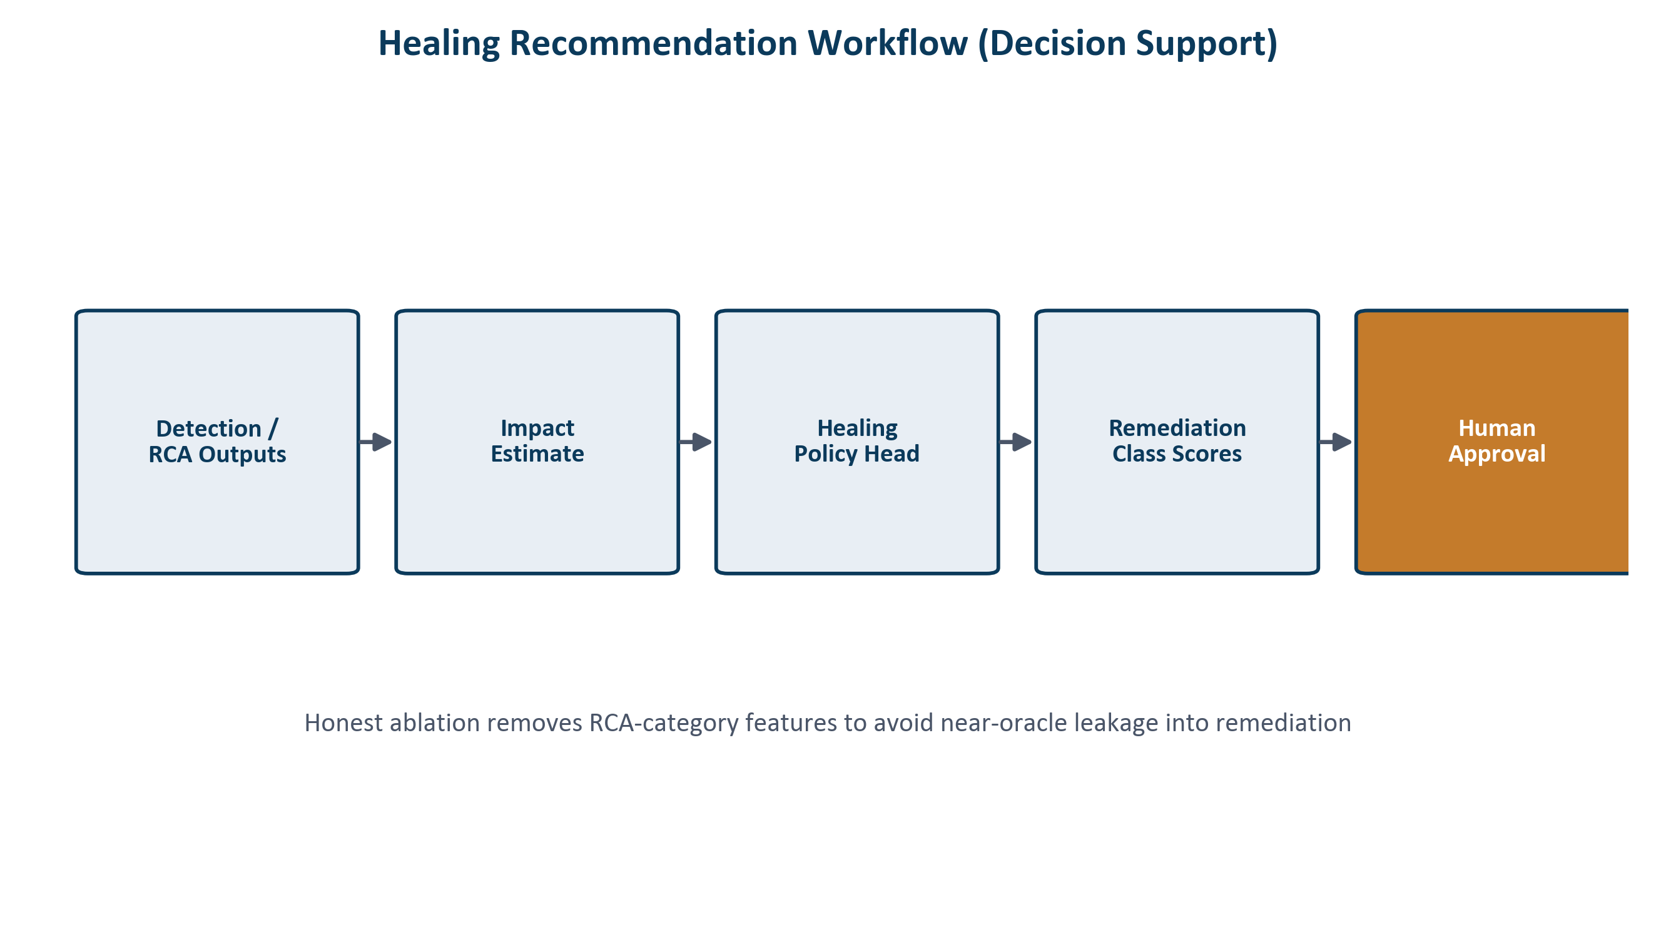
Healing Decision Support
Recommendations with human approval — not live autonomous switch actuation
ECNetBench · Enterprise Cognitive Network (ECN-v3)
19 / 35

Slide 20
Experimental Setup
• Six frozen ECNetBench instances (checksum verified)
• Temporal freeze 70% / 15% / 15%
• Primary metric: AUPRC (scores); thresholds on validation only
• Final T1: leakage-safe enriched features + anchored telemetry-first fusion
• T2 recommended operating head: telemetry logistic regression
• Healing evaluated as decision support (human approval), not physical actuation
ECNetBench · Enterprise Cognitive Network (ECN-v3)
20 / 35

Slide 21
Baselines
• Classical tabular: logistic regression, random forest, LightGBM, XGBoost, CatBoost, gradient boosting, balanced RF
• Classical detectors: Isolation Forest, EWMA, threshold rules, majority class
• Deep tabular: TabNet (telemetry-only)
• True GraphSAGE message-passing GNN over the Digital Twin adjacency
• Historical GNN proxy = LightGBM on a restricted feature subset (not message passing)
• Shared temporal enrichment; classical baselines use telemetry-only feature matrices
ECNetBench · Enterprise Cognitive Network (ECN-v3)
21 / 35

Slide 22
Deep Baselines vs Selected Heads
TabNet and true GraphSAGE do not overturn ECN-v3 / T2 selections
• ECN-v3 final T1 AUPRC 0.115 | RF 0.076
• TabNet T1 AUPRC 0.049 — trails ECN-v3 and RF
• True GraphSAGE T1 AUPRC 0.015 — message-passing baseline
• Historical GNN proxy (LightGBM) T1 AUPRC 0.034 — not message passing
• Recommended T2 head remains telem logistic (0.038); deep models also trail on T2
ECNetBench · Enterprise Cognitive Network (ECN-v3)
22 / 35

Slide 23
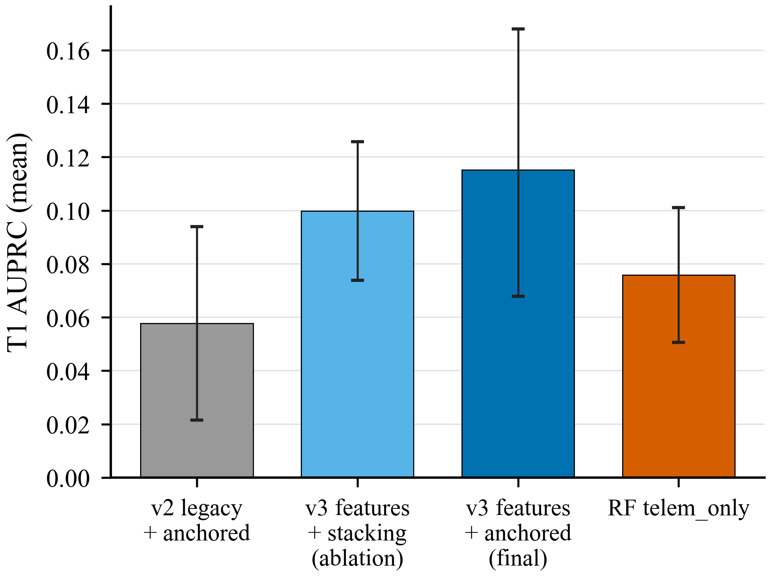
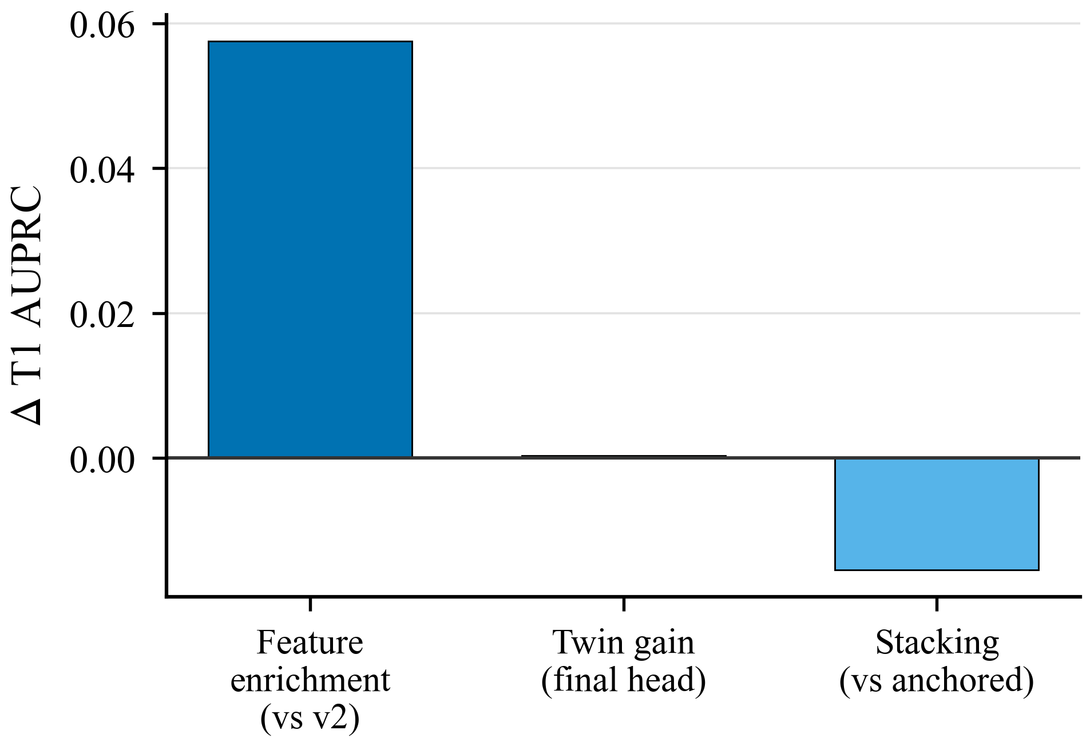
Ablation Studies
Feature enrichment dominates; stacking is a negative result
ECNetBench · Enterprise Cognitive Network (ECN-v3)
23 / 35

Slide 24
Statistical Validation
• Final T1 vs RF: Wilcoxon p = 0.688, Cliff δ = +0.389 (mean lift; not statistically significant)
• Final T1 vs stacking ablation: p = 0.375, δ = +0.111 (not significant)
• Final T1 vs logistic: p = 0.031, δ = +0.556 (exploratory under multiple comparisons)
• Bootstrap 95% CIs on seed means; n = 6 underpowered for many paired claims
• Do not claim statistically significant superiority over RF or stacking
ECNetBench · Enterprise Cognitive Network (ECN-v3)
24 / 35

Slide 25
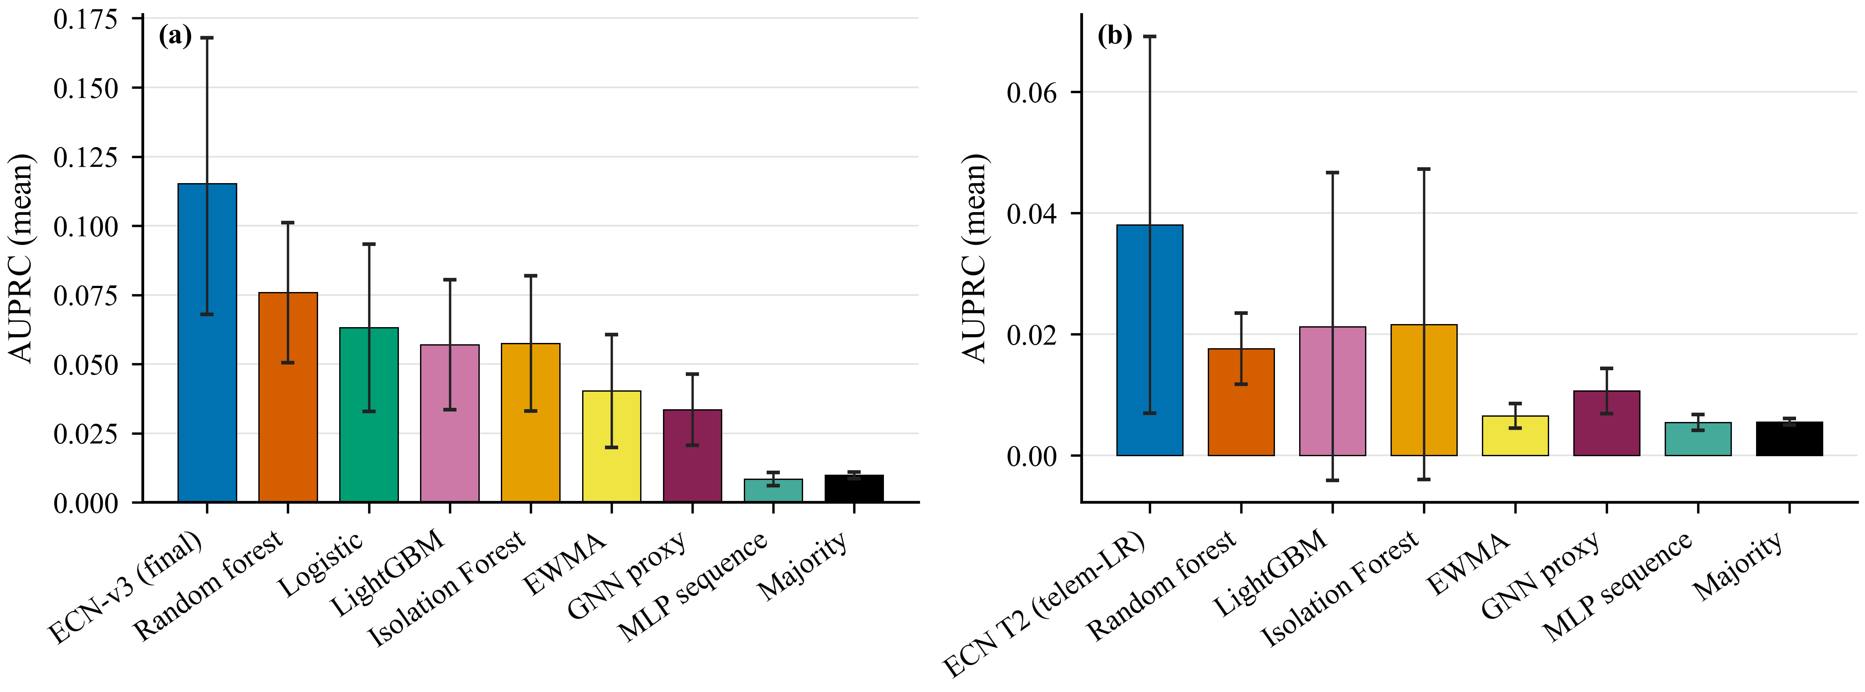
Main Quantitative Results
Verified six-seed means (publication figures)
ECNetBench · Enterprise Cognitive Network (ECN-v3)
25 / 35

Slide 26
Headline Numbers
Three-decimal manuscript convention; RF paired comparison non-significant
T1 ECN-v3 final (anchored)
0.115
T1 RF telem_only
0.076
T1 v2 legacy + anchored
0.058
T1 stacking ablation (negative)
0.100
T2 telem logistic (recommended)
0.038
Twin gain under final T1 head
+0.000
ECNetBench · Enterprise Cognitive Network (ECN-v3)
26 / 35

Slide 27
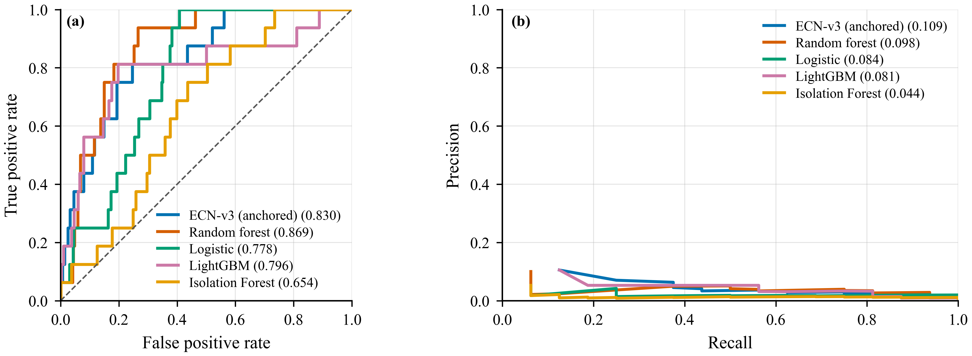
T1 ROC / Precision–Recall (Primary Instance)
ECNetBench · Enterprise Cognitive Network (ECN-v3)
27 / 35

Slide 28
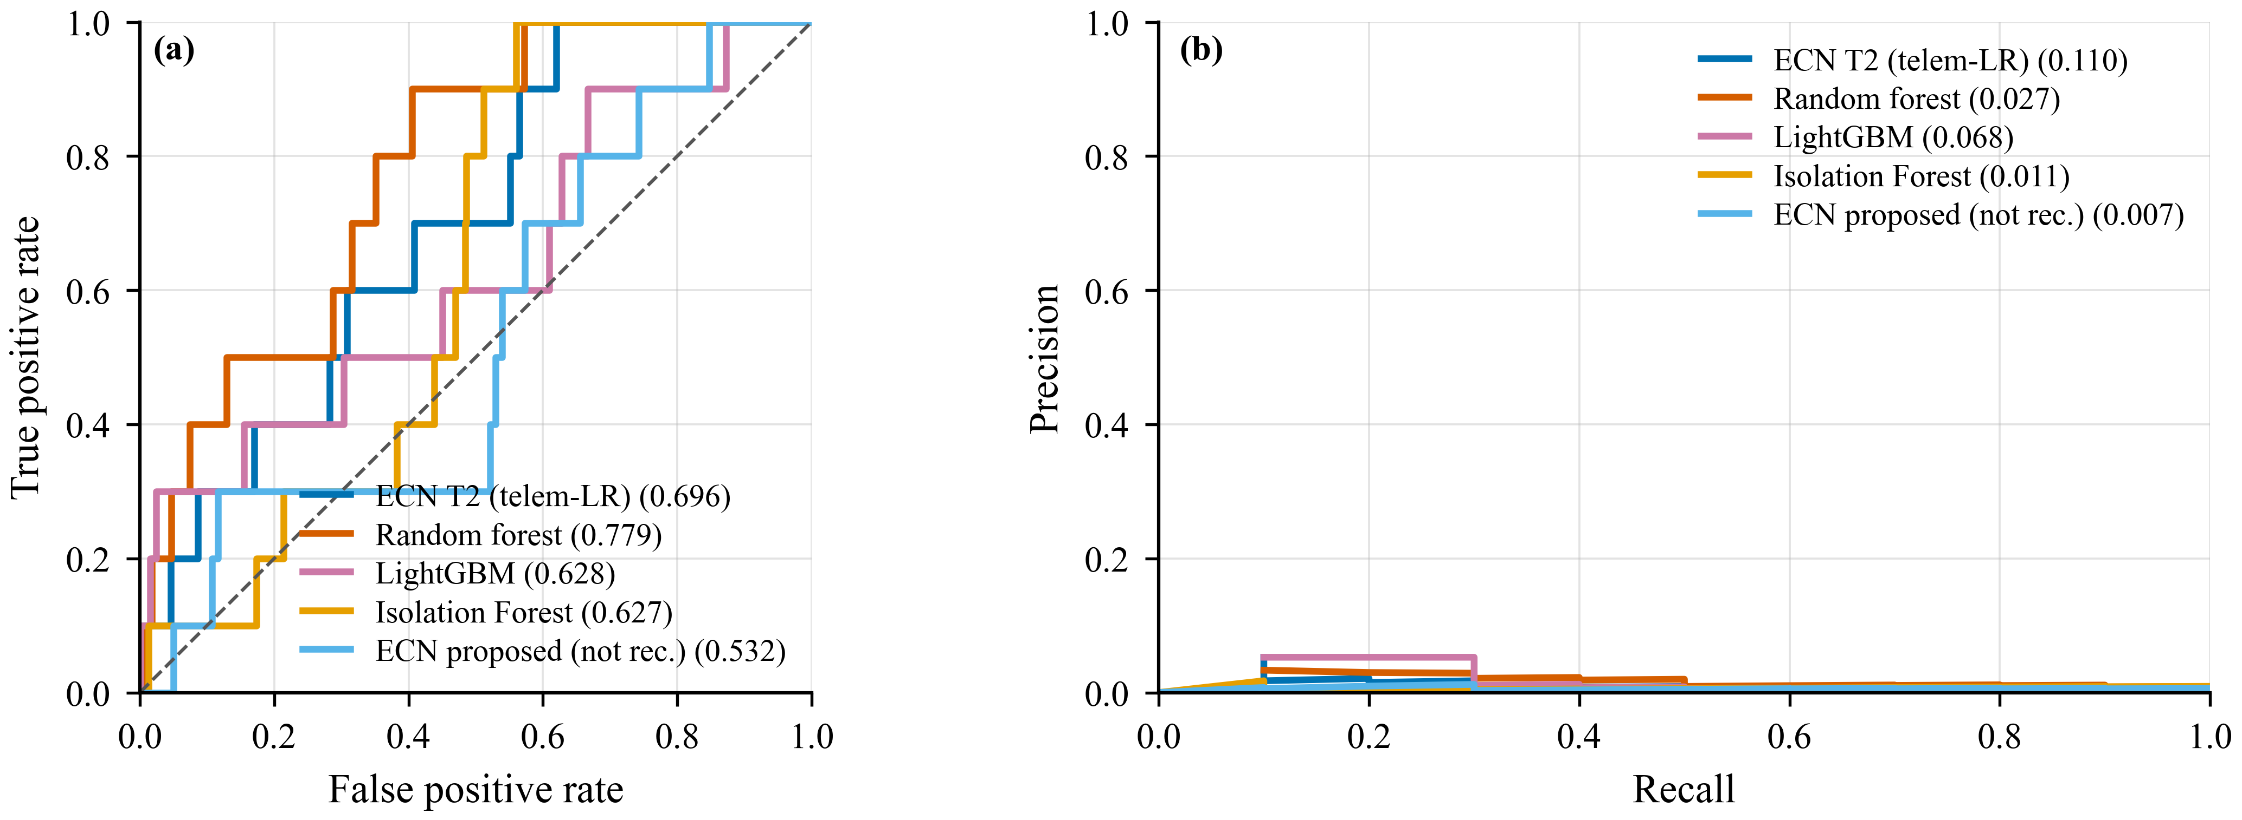
T2 ROC / Precision–Recall (Primary Instance)
ECNetBench · Enterprise Cognitive Network (ECN-v3)
28 / 35

Slide 29
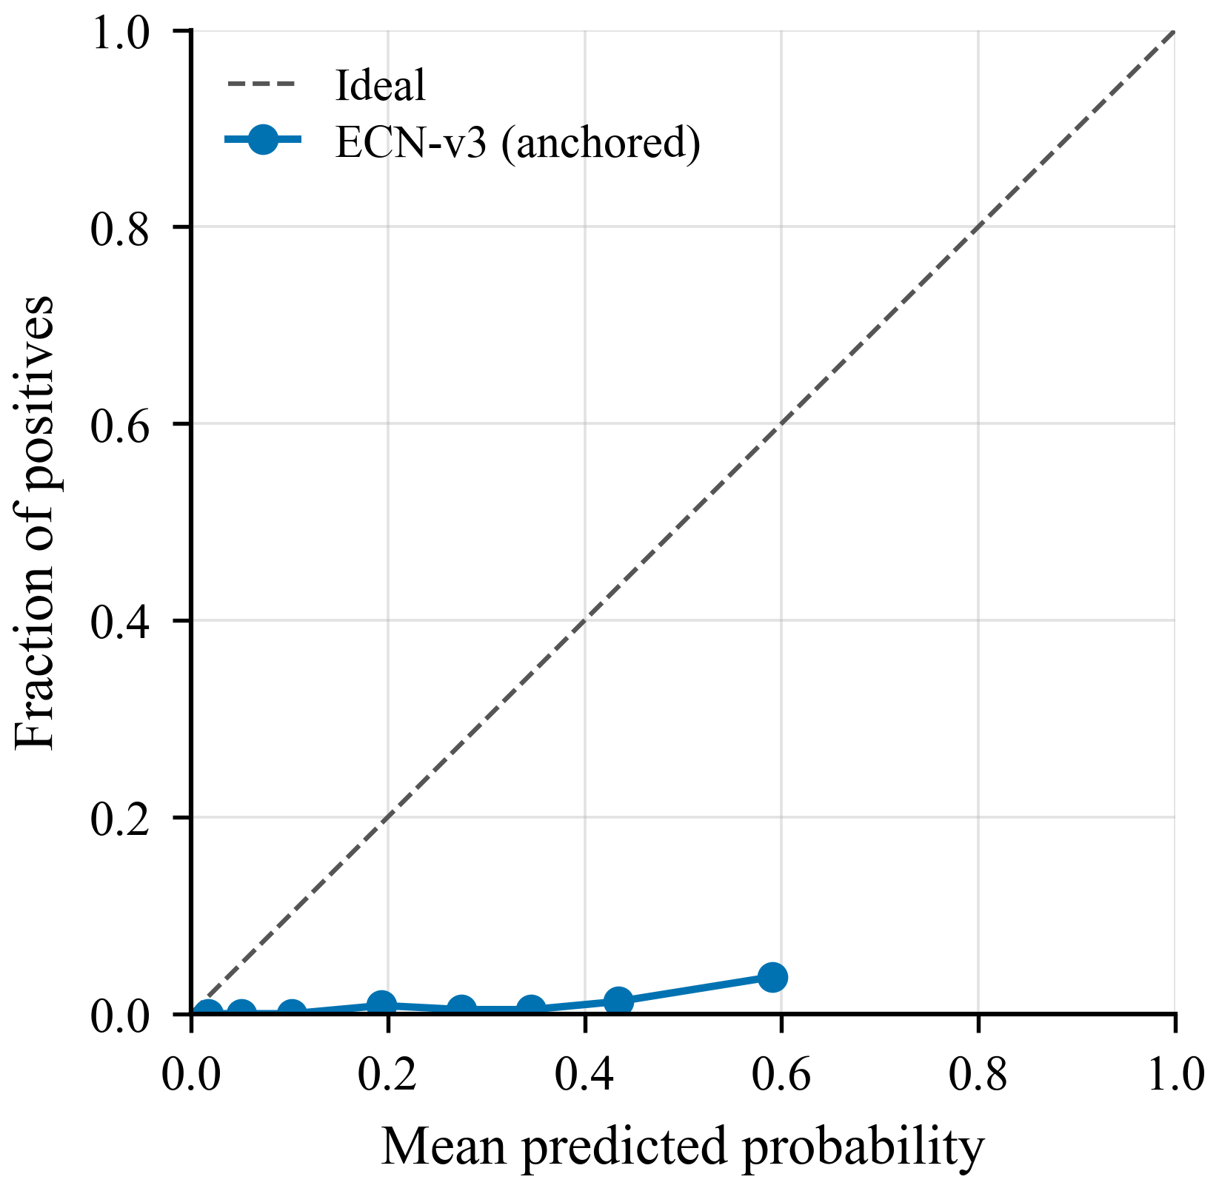
Calibration
Optional Beta for probability display; AUPRC uses scores
ECNetBench · Enterprise Cognitive Network (ECN-v3)
29 / 35

Slide 30
Discussion
• Leakage-safe feature enrichment is the primary T1 driver (+0.058 mean AUPRC vs v2)
• Anchored fusion preferred over stacking (higher mean AUPRC; stacking is a negative ablation)
• Mean T1 advantage vs RF is not statistically significant at n = 6 (p = 0.688)
• TabNet and true GraphSAGE do not overturn the selected T1 head
• T2 remains telem-logistic; twin gain under the final T1 head is near zero
• Value: reproducible benchmark + honest statistics—not universal detector dominance
ECNetBench · Enterprise Cognitive Network (ECN-v3)
30 / 35

Slide 31
Limitations
• Synthetic generator may over-structure causal chains (construct validity)
• n = 6 yields wide CIs and underpowered paired tests
• External validity requires production-trace evaluation beyond AOS-CX-style assumptions
• Healing with RCA-category features can be near-oracle—honest no-category ablations required
• No live autonomous deployment on physical AOS-CX switches; healing is decision support only
ECNetBench · Enterprise Cognitive Network (ECN-v3)
31 / 35

Slide 32
Future Work
• Larger topologies and longer traces
• Production-telemetry calibration studies
• Human-in-the-loop healing approval workflows
• Expanded multi-vendor schema realism mapping
ECNetBench · Enterprise Cognitive Network (ECN-v3)
32 / 35

Slide 33
Conclusion
• ECN-v3 final T1 AUPRC 0.115 is above RF 0.076 and v2 0.058 in mean (RF paired test non-significant)
• Stacking ablation 0.100 — negative result versus anchored fusion
• Recommended T2 head: telem logistic 0.038
• TabNet and true GraphSAGE do not outperform the selected T1 head
• Architecture: leakage-safe features + anchored fusion + TreeSHAP RCA + healing decision support
• Primary contribution: reproducible ECNetBench + complete cognitive NetOps pipeline
ECNetBench · Enterprise Cognitive Network (ECN-v3)
33 / 35

Slide 34
Reproducibility
• Repository: https://github.com/Audrey2023uh/Network-Multi-Agent
• Manuscript: paper/overleaf/
• Metrics: results/manuscript_ready_numbers.json
• Figures: paper/overleaf/figures/ (vector PDF + 600 dpi PNG)
• This deck: presentation/build_network_journal_presentation.py
ECNetBench · Enterprise Cognitive Network (ECN-v3)
34 / 35

Slide 35
Thank you
Questions and discussion

