Slide 1
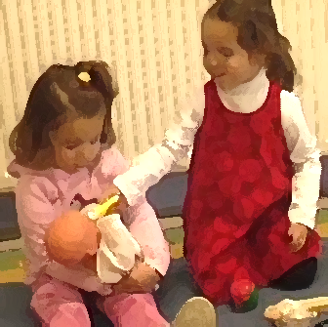
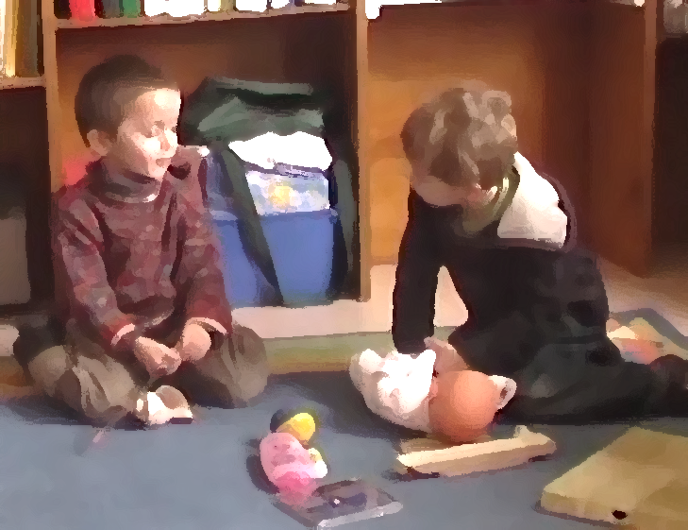
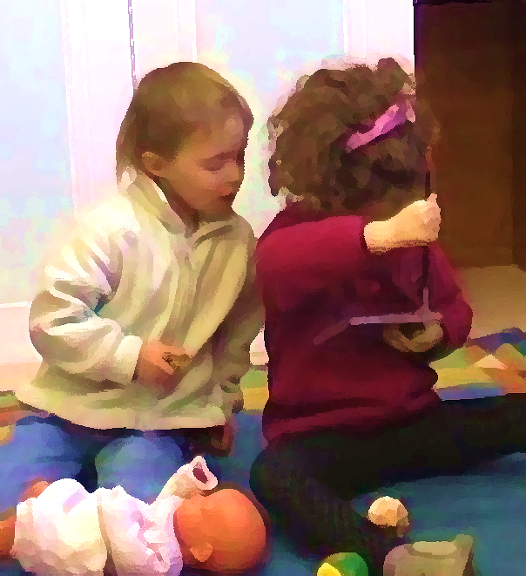




Audrey Barthélémy-Musso & Valérie Tartas k University of Toulouse II- France Octogone-ECCD Laboratory h European Conference of Developmental Psychology Lausanne – 2013, 4th september 2013
The development of social conventions and creativity:
how do 3 to 7 years-old children use objects during dyadic play ?

Slide 2

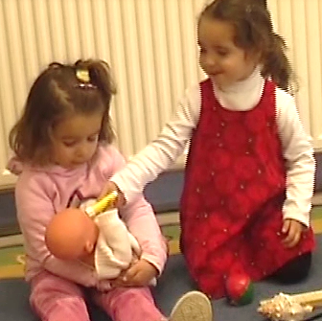
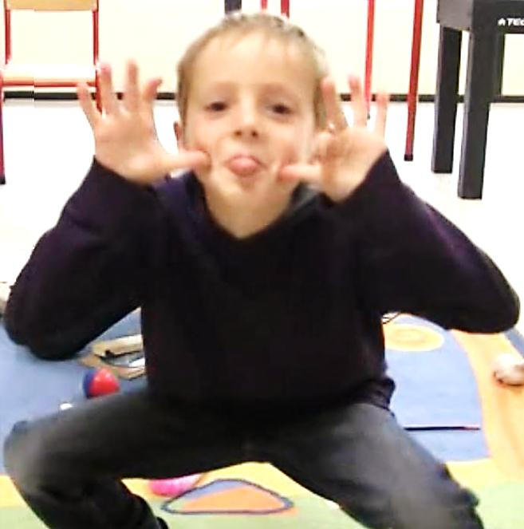
2. Three kinds of play
How do 3-to-7 year-old children construct and develop uses of objects in social contexts?
Three different contexts of social peer’s play
Interests for object substitutions
→ what kind of substitutions (shared conventions) do children create together in their play in function of their age?
Notes:
----- Notes de la réunion (29/08/13 21:38) -----
children's comprehension of object substitution produced by an adult

Slide 3
3. Few theoretical underpinnings
Production of substitutions is often considered as an individual skill and rarely as a social construction through triadic interactions (Moro & Rodriguez, 2005; Rodriguez & Moro, 2008)
Most studies focus on children’s comprehension of object substitutions produced by an adult
Bigham & Bourchier-Sutton (2008), Rakoczy (2006)
3 y.o. children still show difficulties to understand complex symbolic uses in communicative situations (Tomasello, Striano & Rochat, 1999) and very few studies are interested in this question after this age

Slide 4
Development of symbolic uses
Tomasello, Striano & Rochat (1999)
In child-adult interactions
Rakoczy (2006 )
Tomasello (2004)
No developement, Bigham & Bourchier-Sutton (2008)
12 month-olds
2 y.o.
3 y.o.
7 y.o.
Rodriguez & Palacios (2011)
Developement between 3-4 and 5-6 y.o., Barthélémy & Tartas (2009)
In child-adult-object interactions
Notes:
Dire : nous nous sommes appuyés sur les théories épigénétiques du développement pour élaborer les hypothèses de cette recherche.
1. Nous avons observés à partir de la théorie de l’apprentissage culturel par imitation de Tomasello que les enfants de 3 ans ont encore des difficultés à comprendre les usages symboliques correspondant à des usages détournés. Nous reprochons à cette approche de s’intéresser uniquement à la façon dont les enfants construisent des significations via le seul processus de l’imitation, réduisant les interactions expérimentales à la mise en place de démonstration par l’adulte, et limitant l’étendu des processus de co-construction impliqués dans les usages symboliques.
2. Au contraire, la théorie « pragmatique de l’objet » soutenue par Rodriguez et Moro (2008) s’intéresse à la construction des usages symboliques et des signes de manière plus globale, prenant en compte les dimensions sociales, cognitives et affectives dans ce processus. La méthode utilisée est un jeu libre dans lequel l’enfant joue avec l’un de ses parents et un objet choisi

Slide 5
4. General hypotheses
In peer’s play, children develop symbolic uses of objects increasing in complexity after 3 years-old. They share social rules about uses of objects relying on new abilities to coordinate different semiotic systems (language and object uses)
Play context influences symbolic uses productions : the objects uses and the children’s meaning making develop differently depending on the social instruction
Notes:
(we suppose that changing social purpose of the activity transforms the construction of social conventions)

Slide 6
5. Methodology
bout object use is developing.
We proposed 3 different kinds of play with the same objects at two same-age children
Free play
NO CONSTRAINT
Humoristic play
SOCIAL PURPOSE CONSTRAINT
Meal play
THEMATIC PURPOSE CONSTRAINT

Slide 7
5. Methodology
Common experimental design for the 3 plays
N = 288 children
96 diffe rent children (48 dyads) were recruited in each study
4 age groups of 3, 4, 5 and 7 years-old
Material : 10 familiar objects, 1 replica toy : a baby-doll
Passation at school : 10 minutes
All children were video recorded
We evaluated in shared play (in joint attention situation, only when children focused on the same objects)
(1) the number of substituted object uses
(2) the complexity of substituted object uses by examining verbal shared meanings
Notes:
----- Notes de la réunion (29/08/13 21:38) -----
ne pas mettre VI VD/ plutôt we examine the complexity of objects play (taht is to say the mean number of substituted uses of objects only during a shared play) and the complexity of social conventions (revoir ce qu il y a entre parenthèse car on ne comprend pas c'est la même chose que la VD antérieure)

Slide 8
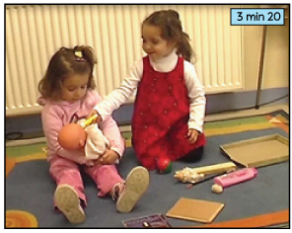
5. Methodology
Observation grid of subsituted uses of objects
Uses without verbalization
Verbalizations without use
The least complex
The most complex
Level 1
Level 2
Level 3
Level 4
Level 5
Level 6
Drink the glue
Here
Drink
Drink the baby bottle
The baby-bottle!
Without verbalization
With conventinal verbalization and incongruous nomination
With non specific verbalizations
With verbalization which emphasizes the actions
With verbalization which precises the identity of the represented object
With only verbal identification of the represented object, without use

Slide 9
6. Results : Free play (no constraint)
Mean number of substituted uses
No difference between age groups
Notes:
choix de la thématique, organisation du jeu autour d’un objet qui définit le thème

Slide 10
6. Results : Humoristic play (socio-pragmatic constraints)
Mean number of substituted uses
Difference existing between 5 and 7 y.o.

Slide 11
6. Results : Meal play (thematic constraints)
Mean number of substituted uses
Difference existing between 3, 4 y.o. and 7 y.o. children
Notes:
Jeu focalisé autour de l’objet poupon
Scénario développé : différence significative du type de scénario créé thème du nourrissage à 3 ans plus important qu’à 7 ans et inversement thème de la préparation du repas
Abandon de la thématique du jeu

Slide 12
6. Conclusion of results
In free play: whatever their age, children relied on conventional uses of objects to develop new substitutions (With the paintbrush, children use the bottle of shampoo as a paint bottle)
The conventional use of objects directed the children’s activity
In humoristic play, being able to make laugh his partner relies on a construction play whereas at 7 y.o, children use substitutions of objects in order to make laugh their partner
In meal play, 3 and 4 y.o. children develop other thematics in their play than the requested meal one.
After 5 y.o., the instruction directed the object uses and the pretend activity which in turns redirect the creation of new objects uses
Notes:
Necessity to explore precisely the creation of social conventions, how 3 to 7 y.o. children co-construct verbal shared meanings?
Necessity to explore precisely the creation of social conventions, how 3 to 7 y.o. children co-construct verbal shared meanings?
Social Conventions examined through substituted uses develop as a function of context and age

Slide 13
6. Results : Complexity of verbal shared meanings in free play
Mean number of substituted uses
* : p < .05
Legend of levels:
1 : without verbalization
2 : With conventinal verbalization and incongruous nomination
3 : With non specific verbalizations
4 : With verbalization which emphasize the actions
5 : With verbalization which specified identity of represented object
6 : With only verbal identification of the represented object, without use
Notes:
La plus grande part des substitutions co-construites par les enfants de 3 ans ne sont pas accompagnées de verbalisations, alors que les enfants de 4, 5 et 6 ans verbalisent davantage les substitutions qu’ils produisent.
Ce qui est remarquable néanmoins, les échanges des enfants de 7 ans sont plus précis, les substitutions sont mieux définies.
Les substitutions sont convenues à travers les actions menées plutôt qu’à travers leur définition précise. Le jeu produit est donc plus général et repose sur la verbalisation des actions, du cadre dans lequel sont substitués les objets

Slide 14
6. Results : Complexity of verbal shared meanings in humoristic play
Mean number of substituted uses
*
* : p < .05
*
Legend of levels:
1 : without verbalization
2 : With conventinal verbalization and incongruous nomination
3 : With non specific verbalizations
4 : With verbalization which emphasize the actions
5 : With verbalization which specified identity of represented object
6 : With only verbal identification of the represented object, without use
Notes:
choix de la thématique, organisation du jeu autour d’un objet qui définit le thème

Slide 15
6. Results : Complexity of verbal shared meanings in meal play
Mean number of substituted uses
* : p < .05
*
*
*
*
Legend of levels:
1 : without verbalization
2 : With conventinal verbalization and incongruous nomination
3 : With non specific verbalizations
4 : With verbalization which emphasize the actions
5 : With verbalization which specified identity of represented object
6 : With only verbal identification of the represented object, without use
Notes:
choix de la thématique, organisation du jeu autour d’un objet qui définit le thème

Slide 16
6. Conclusion of results
Substituted uses are increasingly complex with age even in the less constraining context (free play) : Children of 3 y.o. co-construct less verbal shared meanings than those of 7 y.o.
The more constraining is the task, the more youngest children are in difficulty to share verbal meanings about object’s substitution
=> Sharing of verbal meanings defines the play frame and is linked to a more important production of substitutions leading to co-creation of complex thematics
Notes:
choix de la thématique, organisation du jeu autour d’un objet qui définit le thème

Slide 17
7. General discussion (1/2)
INFLUENCES OF PLAY PURPOSE
Adult instructions imply different kinds of understanding : different kinds of symbolic uses production, of symbolic frame creation (fiction) and inter-comprehension
Inter-comprehension is very difficult in the thematic play :
3 and 4 y.o. children leave the meal play and develop thematics in which previous agreements are existing between the child (painting, nursing, toilet)
Notes:
choix de la thématique, organisation du jeu autour d’un objet qui définit le thème
When objects substitution porduction is provoked in peer’s interaction, task is really more complex than in free play where children can produce free substitution. This type of task show the important role of vrebal communication in convention creation. When adults scaffolds children in imagination play, they support verbal interaction frame of play and help children to enter in a play where they can not enter with a same age peer.

Slide 18
7. General discussion (2/2)
Verbal interactions about substitutions contributed to define the common goal, increasing the complexity of the substituted uses
Substitutions in social fiction play imply the coordination of :
production of object substitution
understanding of the other’s intentions in context
understanding and creating a frame for the play by producing appropriated substitutions
If 3 y.o. children coordinate these 3 levels (object, other and play frame) with an adult (Rakoczy, 2006), they have still difficulties in sharing and following the same common goal in peer’s play
Notes:
choix de la thématique, organisation du jeu autour d’un objet qui définit le thème
When objects substitution porduction is provoked in peer’s interaction, task is really more complex than in free play where children can produce free substitution. This type of task show the important role of vrebal communication in convention creation. When adults scaffolds children in imagination play, they support verbal interaction frame of play and help children to enter in a play where they can not enter with a same age peer.

Slide 19

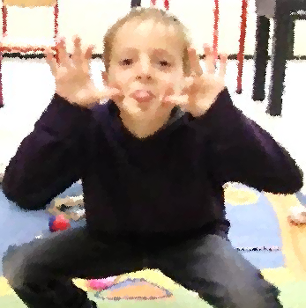

Thank you for your attention

Slide 20
3. Theoretical context
Development of PRODUCTION of object’s substitutions
Between 2 and 3 y.o :
Children followed the substitutions engaged by the adult from 2 y.o. They shared adult’s rules and became able to create new conventions, new substituted uses. They are increasingly creative (Rakoczy, 2006).
Between 3 and 5 y.o :
Children choose increasingly substituted objects corresponding to their action and not to represent the referent object (Copple, Cocking & Matthews, 1984) → They use objects increasingly different from the referent.
Between 3 and 8 y.o. :
In pretend play where the thematic is proposed by an adult, 3-4 y.o. had difficulties to exceed the level of « intentional use of objects » whereas 5-6 and 7-8 y.o do not (Barthélémy & Tartas, 2009).
Notes:
----- Notes de la réunion (29/08/13 21:38) -----
3. revoir le temps des verbes tout au passé
préciser sans doute le contexte du jeu dans between 3 and 8 y.o et met on inentional use of object ou conventional use of object
4. coordinate à corriger

