Slide 1
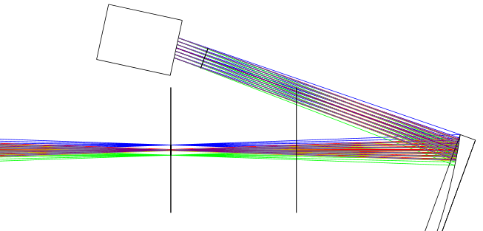
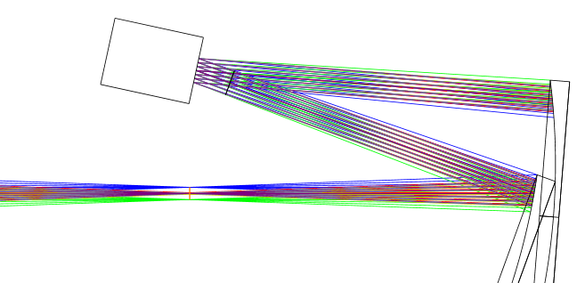
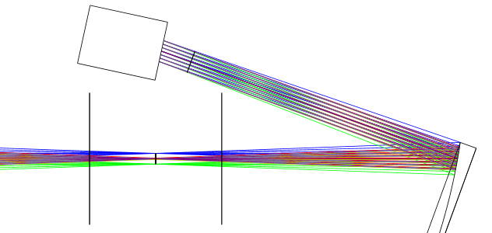
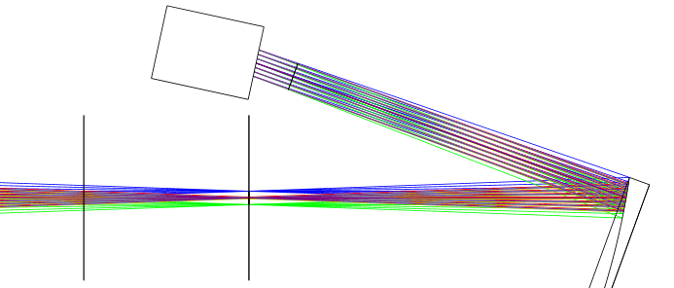
Début système AO
DM
DM
FoV
Telescope focal plane
Telescope focal plane
Sketch 1
200 mm
Sketch 2
DM
DM
FoV
FoV
Telescope focal plane
Telescope focal plane
Sketch 4
Sketch 3

Slide 2
DM
DM
FCL
Telescope focal plane
Telescope focal plane
Sketch 1
200 mm
Sketch 2
DM
DM
FCL
FCL
Telescope focal plane
Telescope focal plane
Sketch 4
Sketch 3

Slide 3
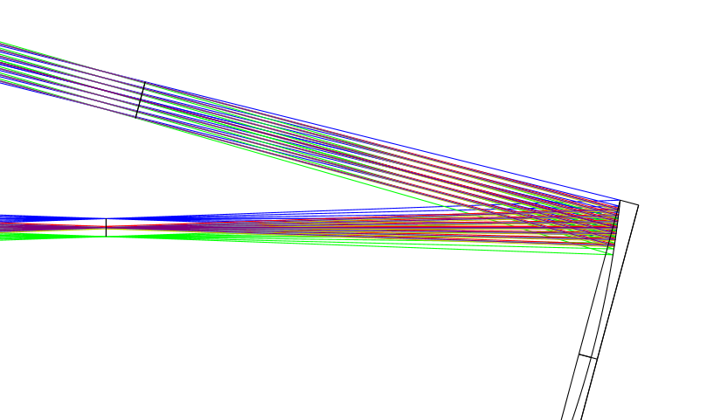
Pupil image
FCL
OAP0
θ= 15°
Telescope focal plane
(FoV = 1’)

Slide 4
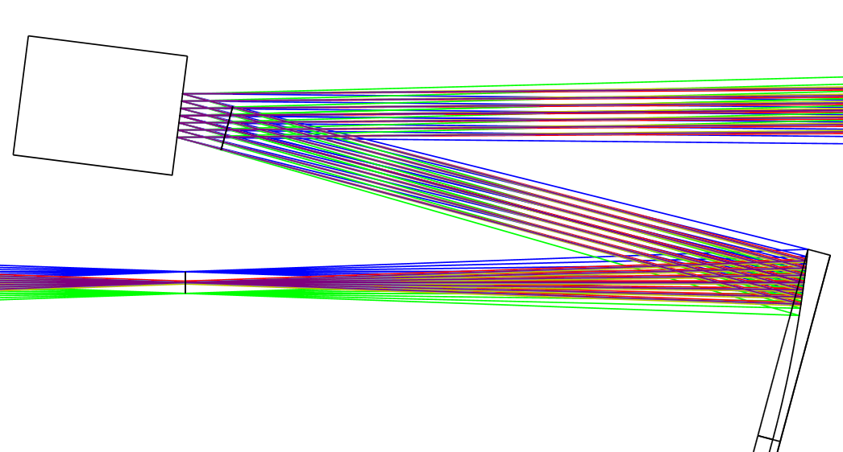
DM
2α
OAP0
θ= 15°
Telescope focal plane
(FoV = 1’)

Slide 5
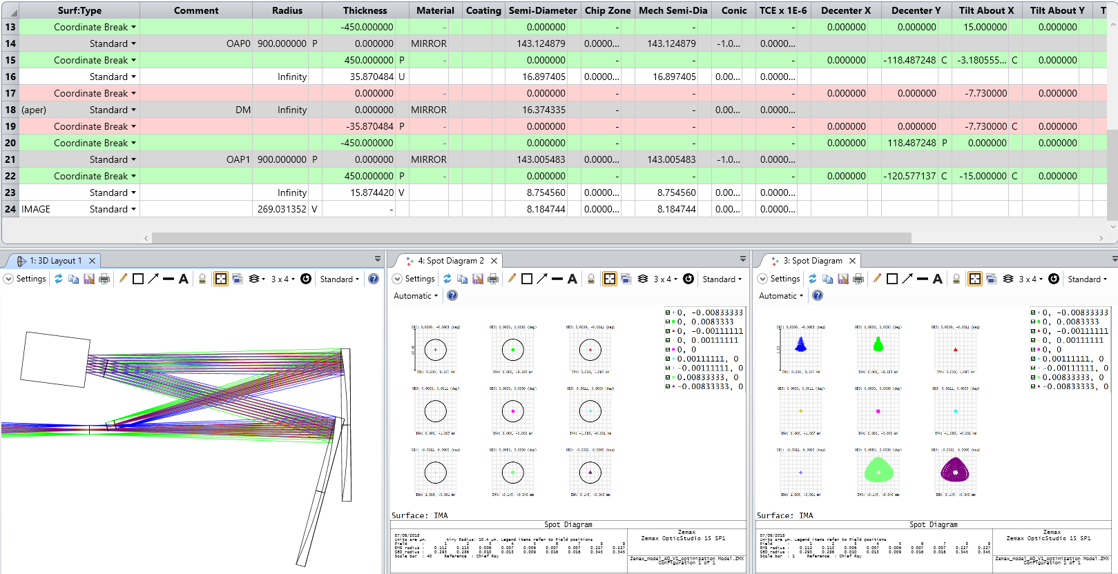

OAP1
DM
Telescope
focal plane
(FoV = 1’)
Intermediate
focal plane
(FoV = 1’)
OAP0
$$≈$$

Slide 6
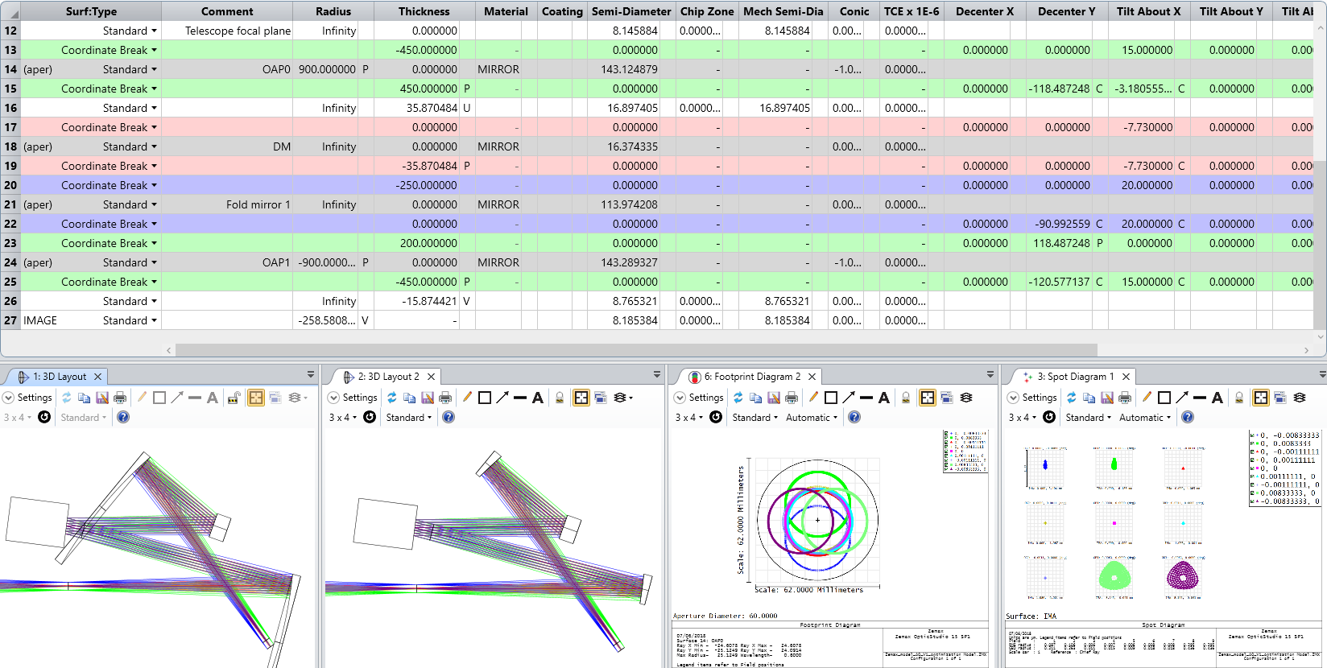
OAP1
OAP1
DM
Folding
mirror 1
DM
Folding
mirror 1
OAP0
OAP0
Telescope
focal plane
(FoV = 1’)
Telescope
focal plane
(FoV = 1’)
Intermediate
focal plane
(FoV = 1’)
Intermediate
focal plane
(FoV = 1’)

Slide 7
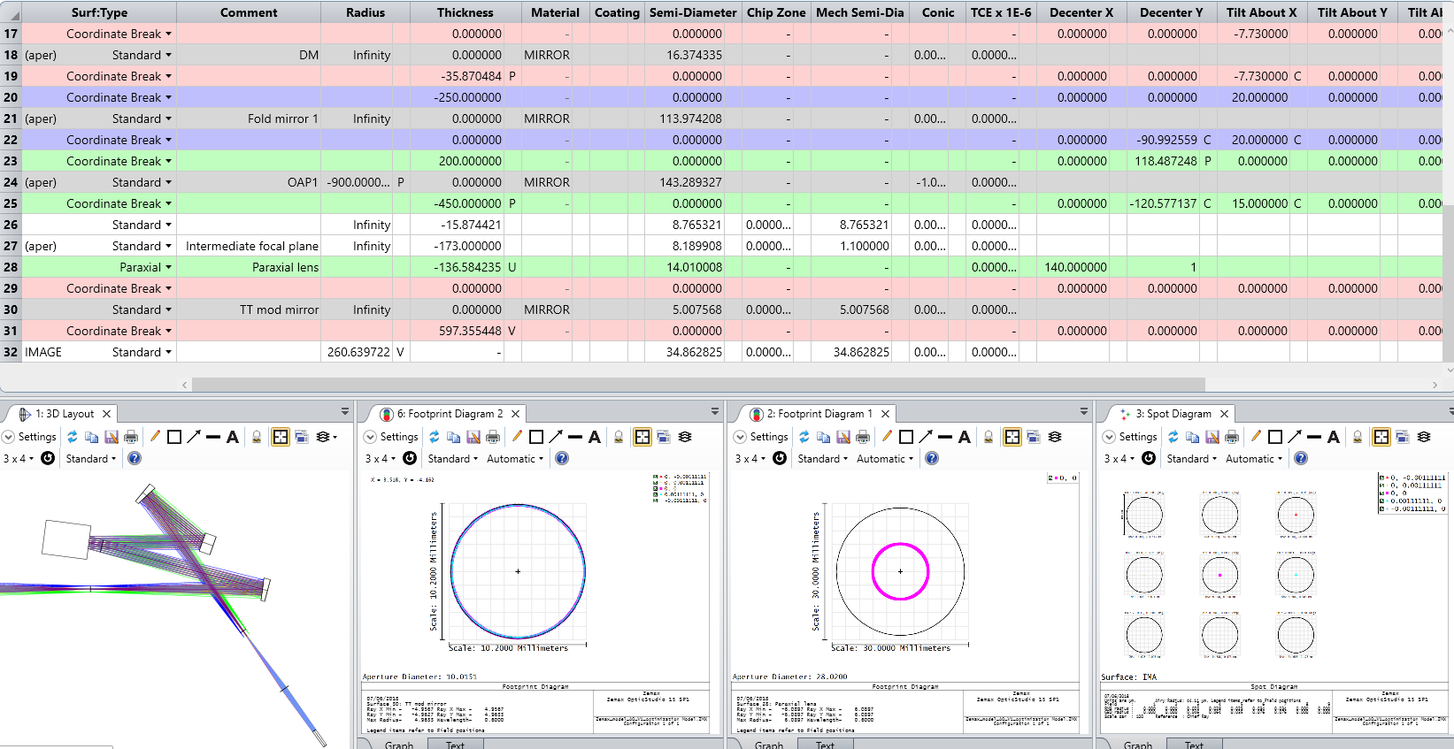


OAP1
DM
Folding
mirror 1
OAP0
Telescope
focal plane
(FoV = 1’)
Intermediate
focal plane
(FoV = 1’)
Paraxial lens
TT modulation
mirror

Slide 8
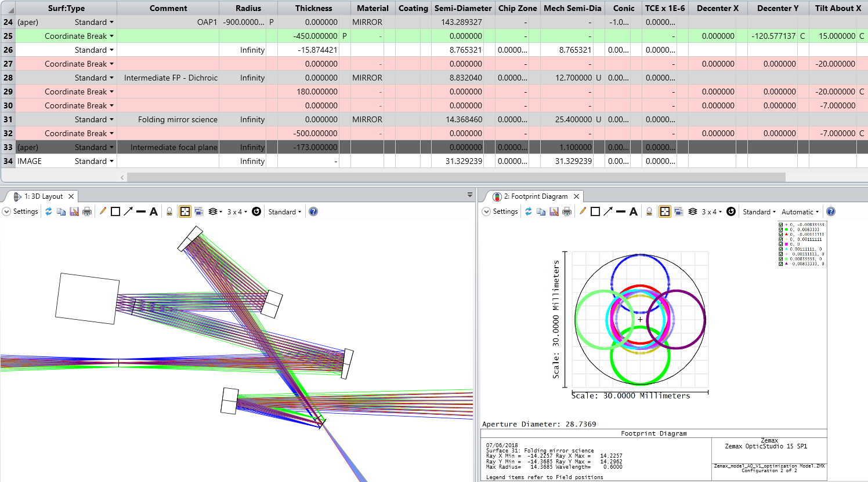

OAP1
DM
Folding
mirror 1
OAP0
Telescope
focal plane
(FoV = 1’)
Folding
mirror 2
Dichroic
membrane
Intermediate
focal plane
(FoV = 1’)
$$≈$$

Slide 9
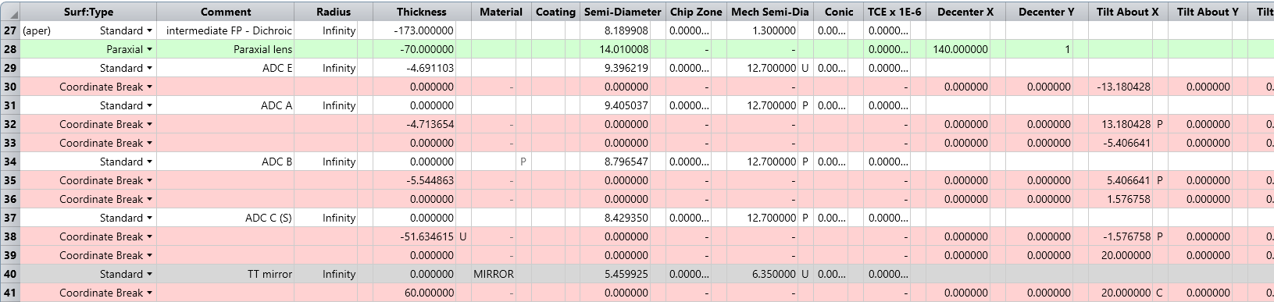
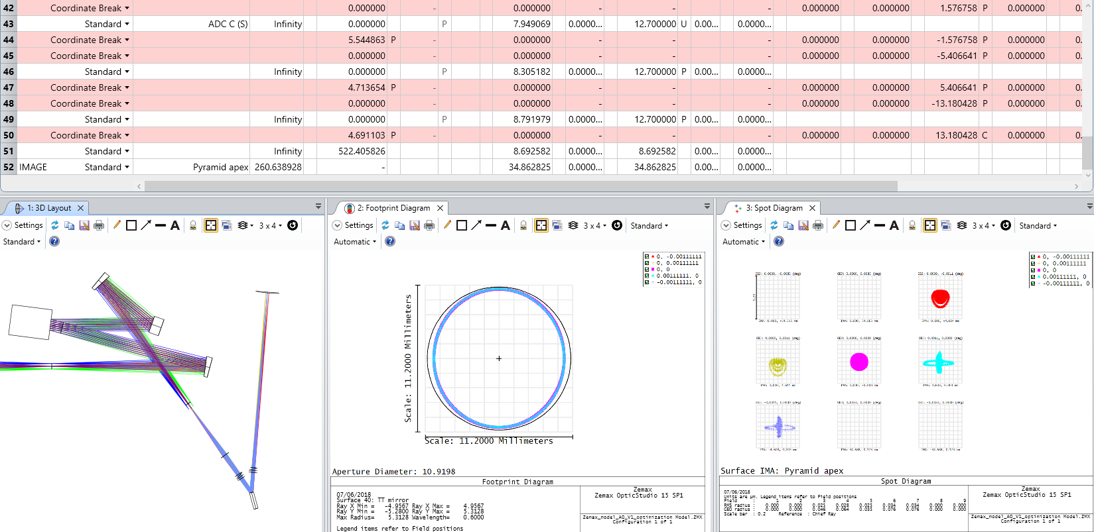


OAP1
Pyramid apex
DM
Folding
mirror 1
OAP0
Telescope
focal plane
(FoV = 1’)
Intermediate
focal plane
(FoV = 1’)
Paraxial lens
ADC
compound prism 2
ADC
compound prism 1
TT modulation
mirror

Slide 10
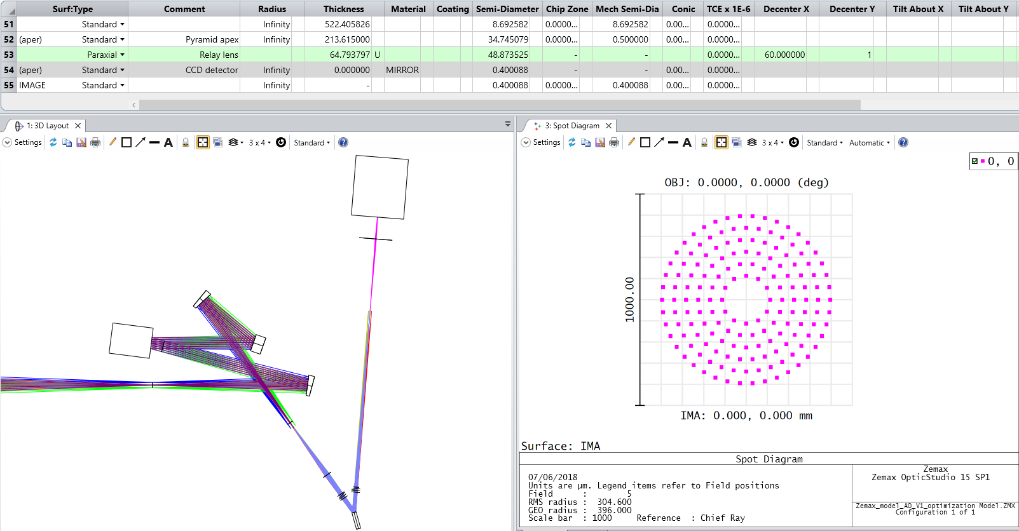
CCD
detector
Relay lens
OAP1
Pyramid apex
DM
Folding
mirror 1
OAP0
Telescope
focal plane
(FoV = 1’)
Intermediate
focal plane
(FoV = 1’)
Imaging lens
TT modulation
mirror

Slide 11
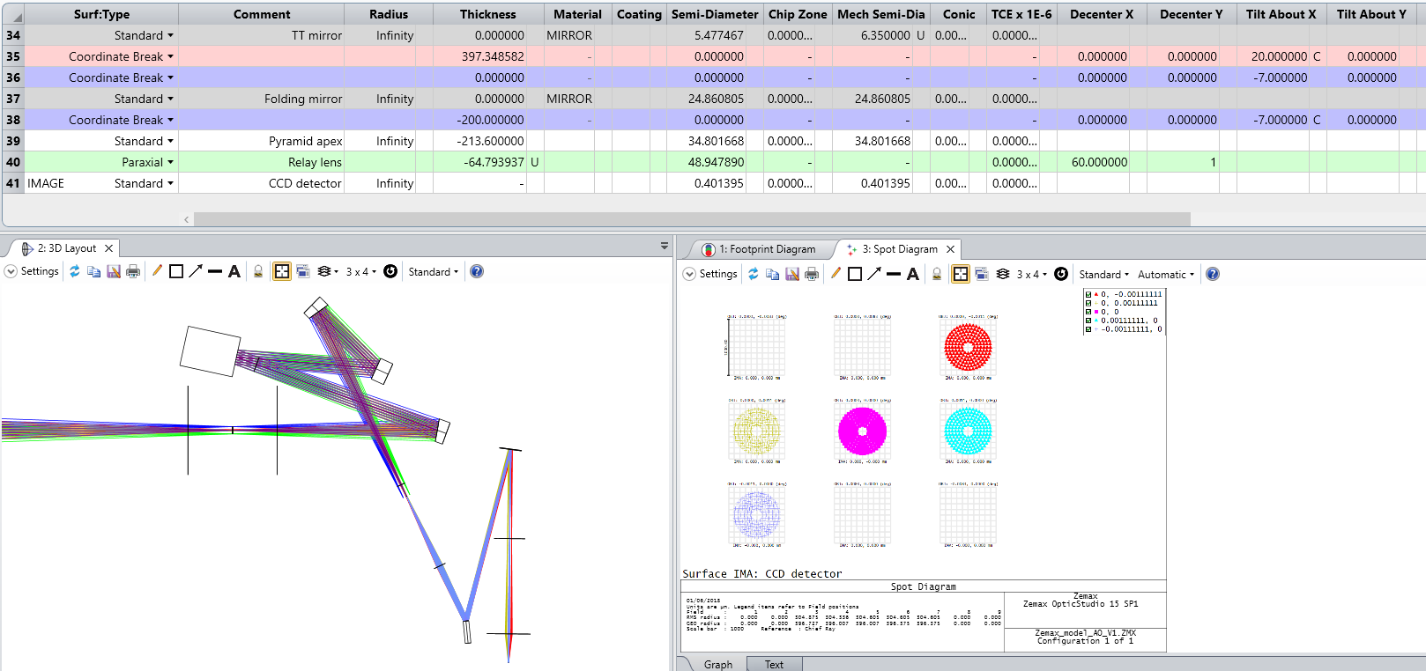
OAP1
DM
Folding
mirror 1
FCL
OAP0
Folding
mirror 2
Telescope
focal plane
(FoV = 1’)
Intermediate
focal plane
(FoV = 1’)
Pyramid apex
Paraxial lens
TT modulation
mirror
Relay lens
CCD detector

Slide 12
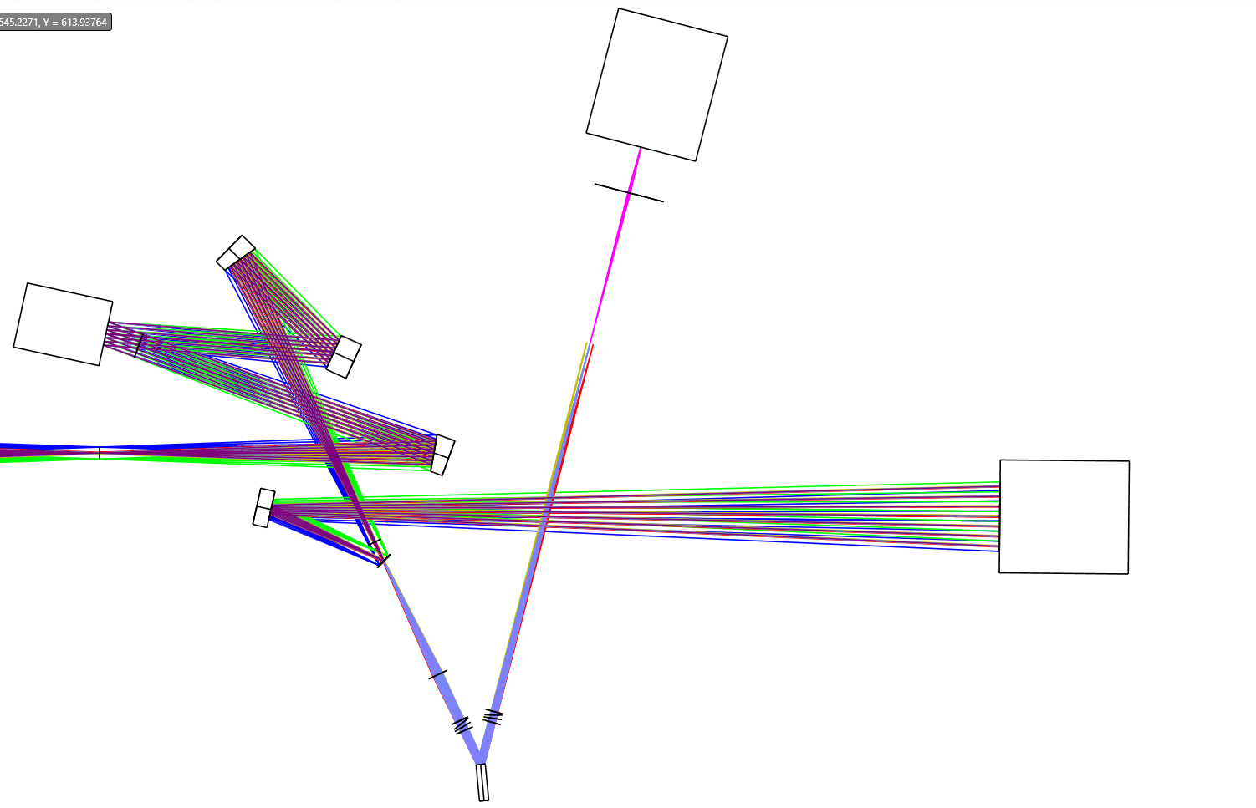
CCD
detector
Relay lens
OAP1
DM
Folding
mirror 1
Pyramid prisms
Telescope
focal plane
(FoV = 1’)
OAP0
To science
Folding
mirror 2
Dichroic mirror
@Intermediate
focal plane
(FoV = 1’)
Imaging lens
ADC
compound prism 2
ADC
compound prism 1
TT modulation
mirror
1 m

Slide 13
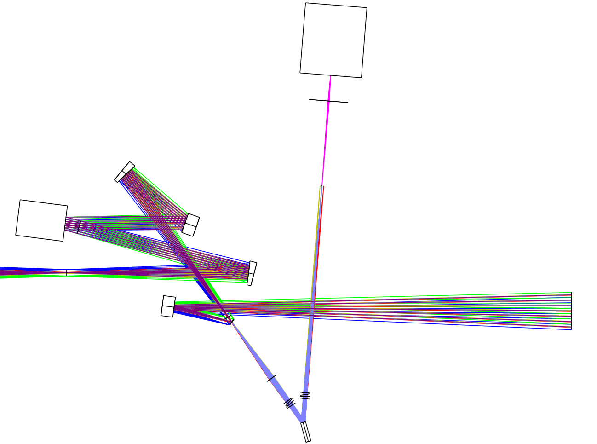
CCD
detector
Relay lens
OAP1
Pyramid prisms
DM
Folding
mirror 1
OAP0
To science
Telescope
focal plane
(FoV = 1’)
Folding
mirror 2
Dichroic mirror
@Intermediate
focal plane
(FoV = 1’)
Imaging lens
ADC
compound prism 2
ADC
compound prism 1
TT modulation
mirror
1 m

Slide 14
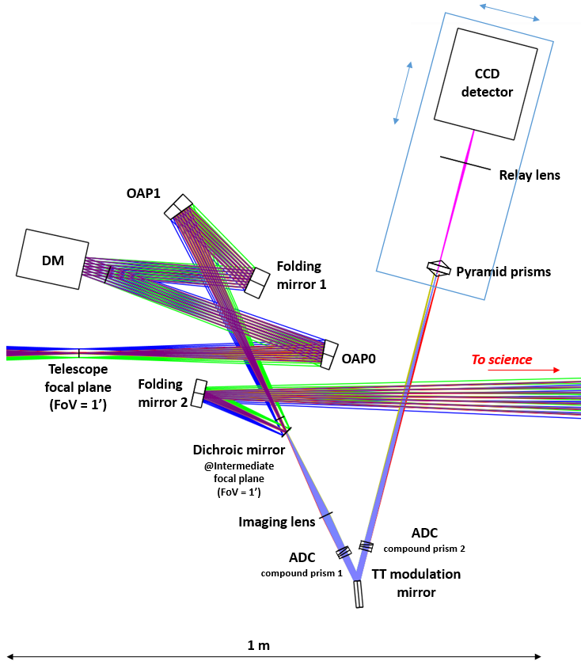
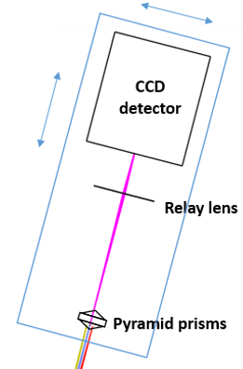

Slide 15
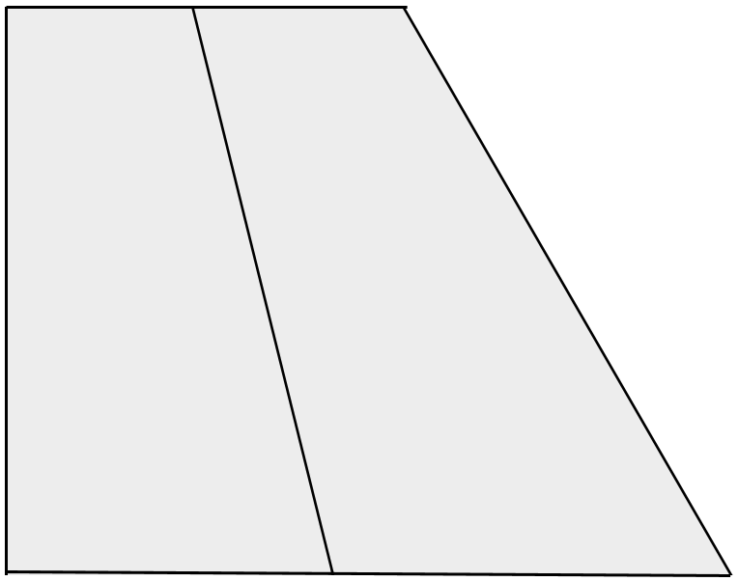
θ_{B}
θ_{B}
α_{E}
θ_{A}
θ_{A}
α₁
α₃
α₆
α₁₀
α₆
x
α₂
α₅
α₈
α₄
α₇
α₉
y
n_{A}
n_{B}
n_{B}
n_{A}

