Slide 1
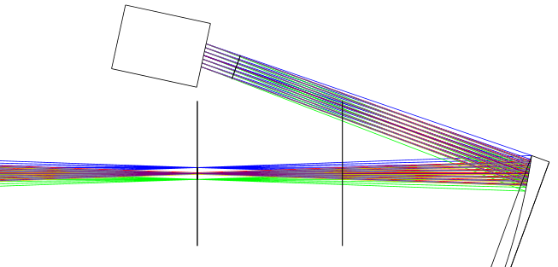
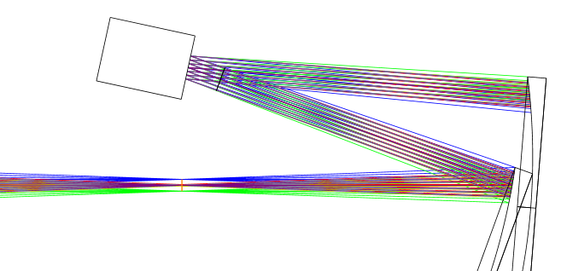
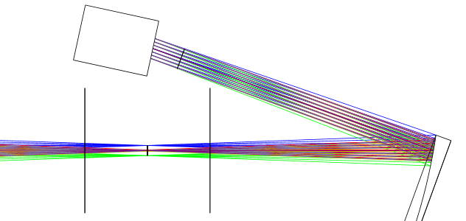
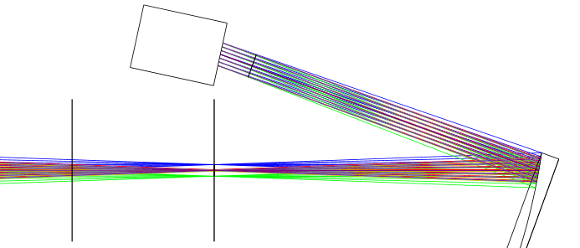
Début système AO
DM
DM
FoV
Telescope focal plane
Telescope focal plane
Sketch 1
200 mm
Sketch 2
DM
DM
FoV
FoV
Telescope focal plane
Telescope focal plane
Sketch 4
Sketch 3

