Slide 1
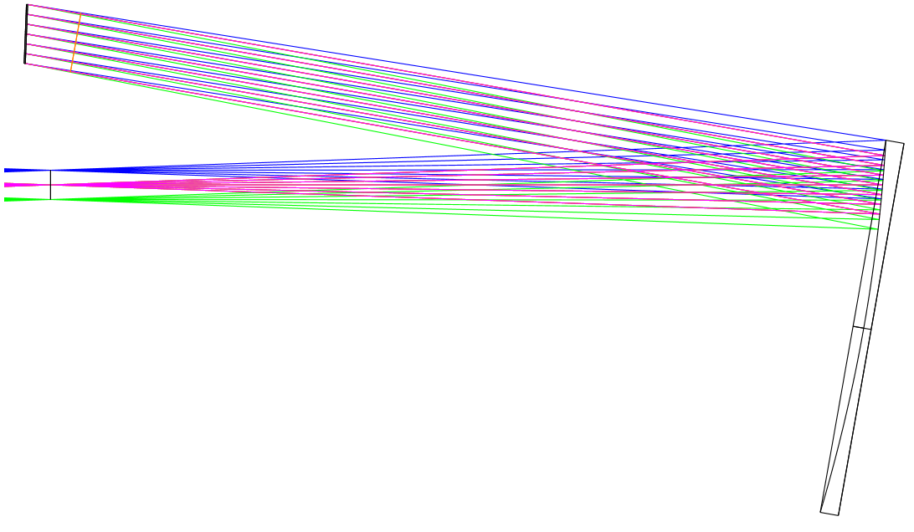
DM
α
Telescope
focal plane
(FoV = 1’)
θ
OAP0

Slide 2
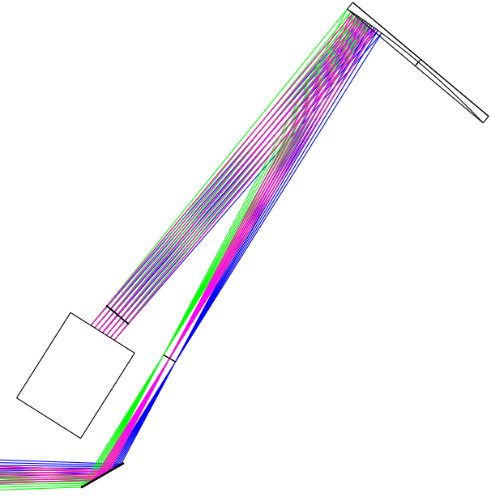
OAP0
Telescope
focal plane
(FoV = 1’)
DM
Folding mirror

Slide 3
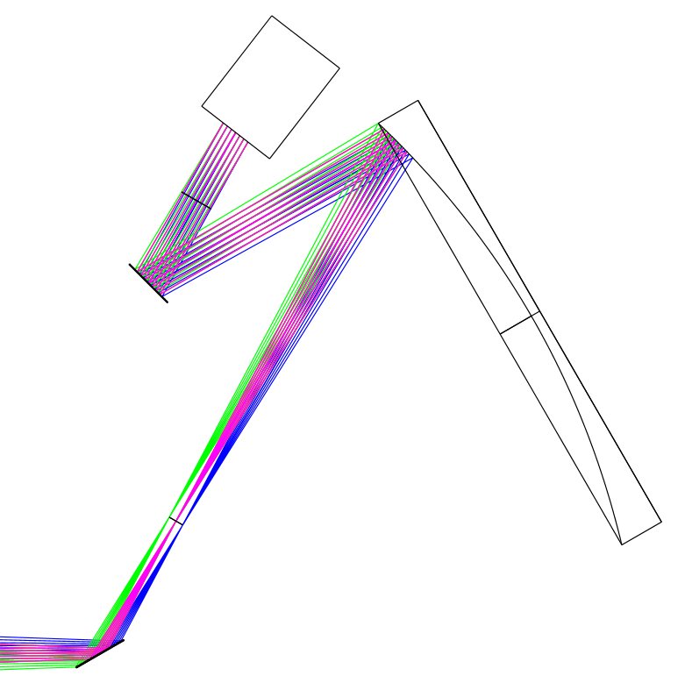
DM
OAP0
Fold mirror
Telescope
focal plane
(FoV = 1’)
Fold mirror

Slide 4
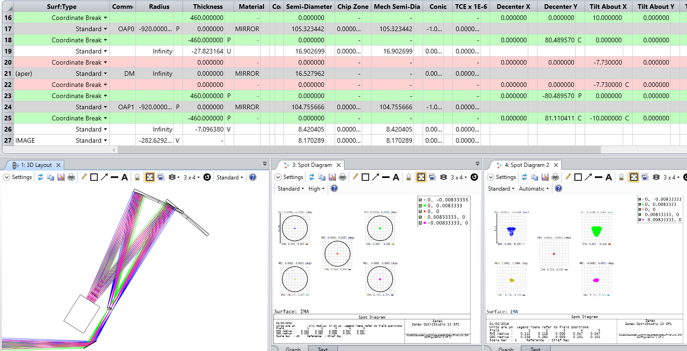

OAP1
OAP0
Telescope
focal plane
(FoV = 1’)
Intermediate
focal plane
(FoV = 1’)
DM
$$≈$$
Folding mirror

Slide 5
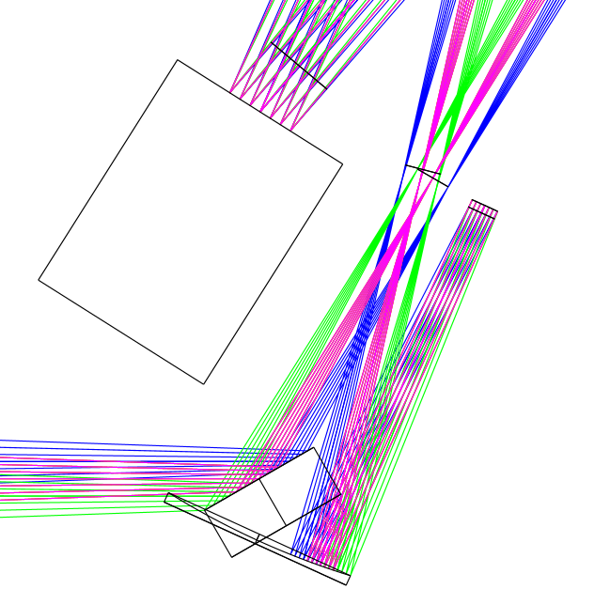
Intermediate
focal plane
TT modulation mirror
DM
Folding mirror
OAP2

Slide 6
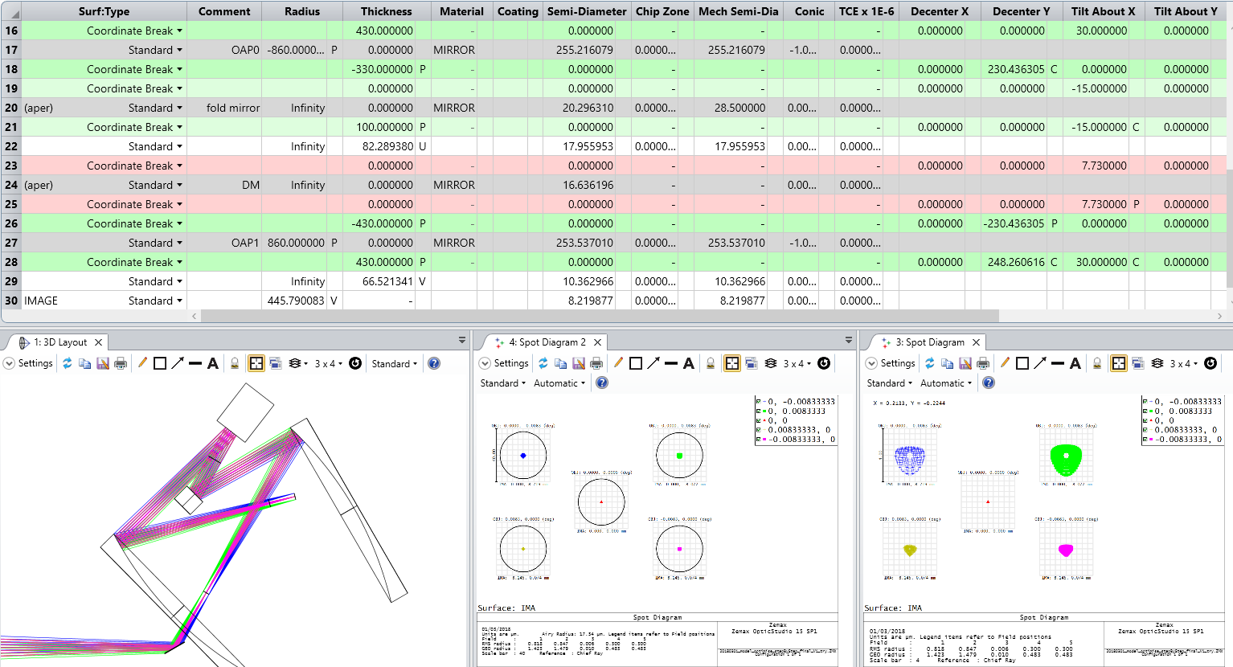
DM
OAP0
Fold mirror
Intermediate
focal plane
(FoV = 1’)
OAP1
Telescope
focal plane
(FoV = 1’)
Fold mirror

Slide 7
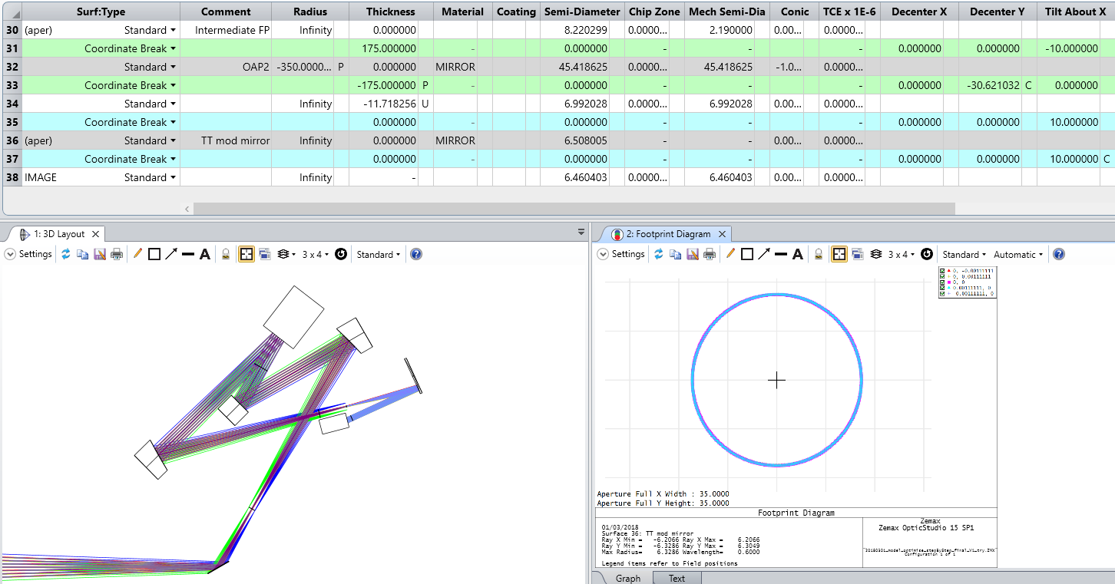
Intermediate
focal plane
(FoV stop = 8’’)
DM
OAP0
Fold mirror
OAP2
TT mod mirror
OAP1
Telescope
focal plane
(FoV = 1’)
Fold mirror

Slide 8
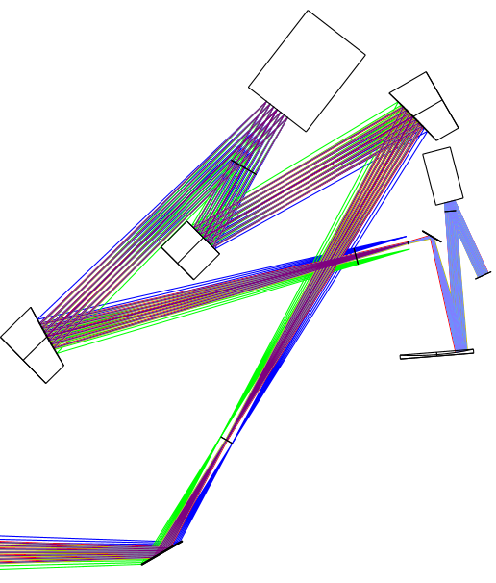
Intermediate
focal plane
(FoV stop = 8’’)
DM
OAP0
TT mod mirror
Fold mirror
To science…
Dichroic
OAP1
OAP2
Telescope
focal plane
(FoV = 1’)
Fold mirror

Slide 9
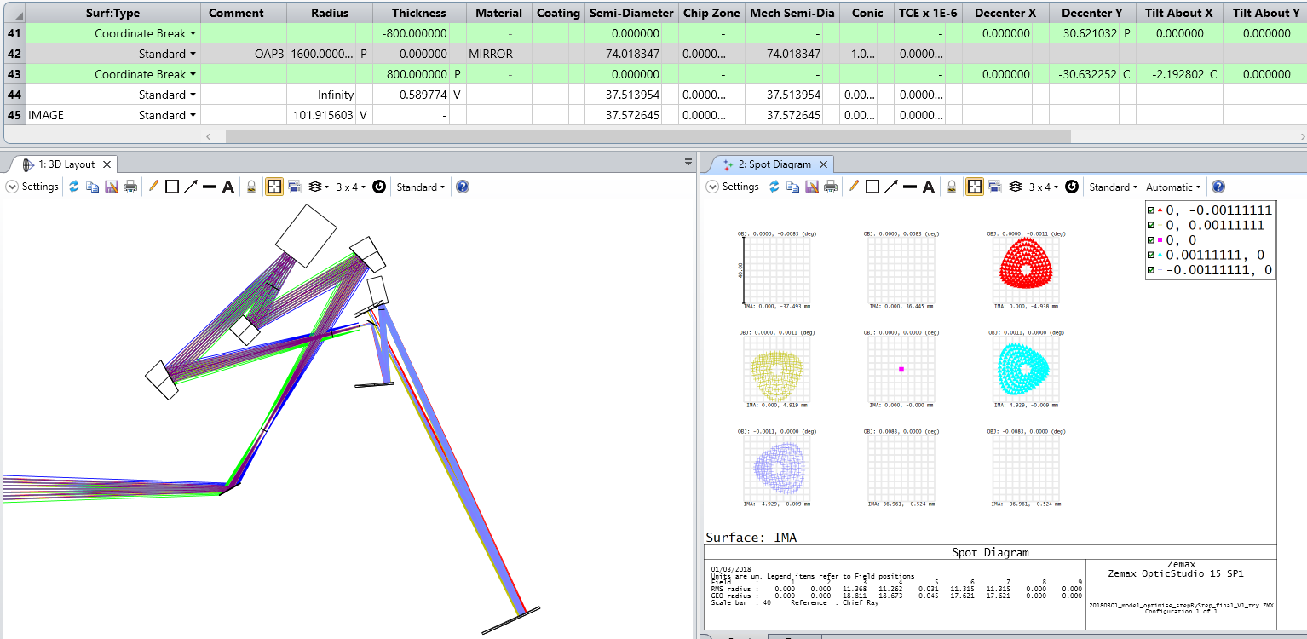
DM
OAP0
TT mod mirror
OAP1
OAP2
OAP3

Slide 10
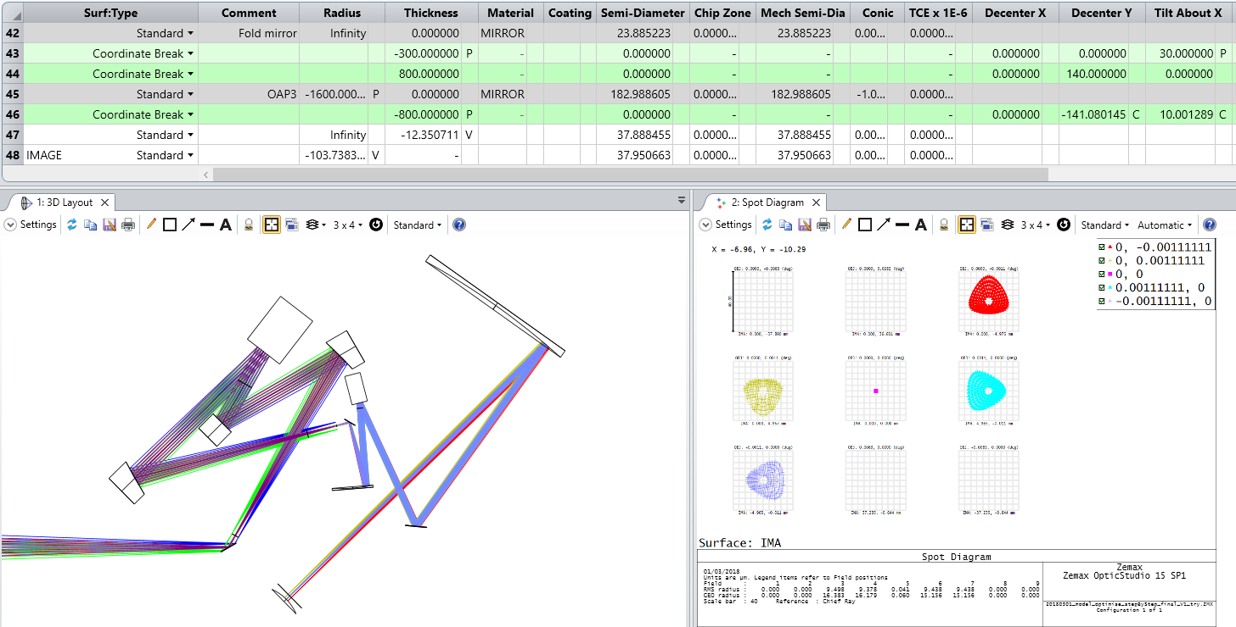
DM
OAP0
OAP3
TT mod mirror
OAP1
OAP2
Fold mirror

Slide 11
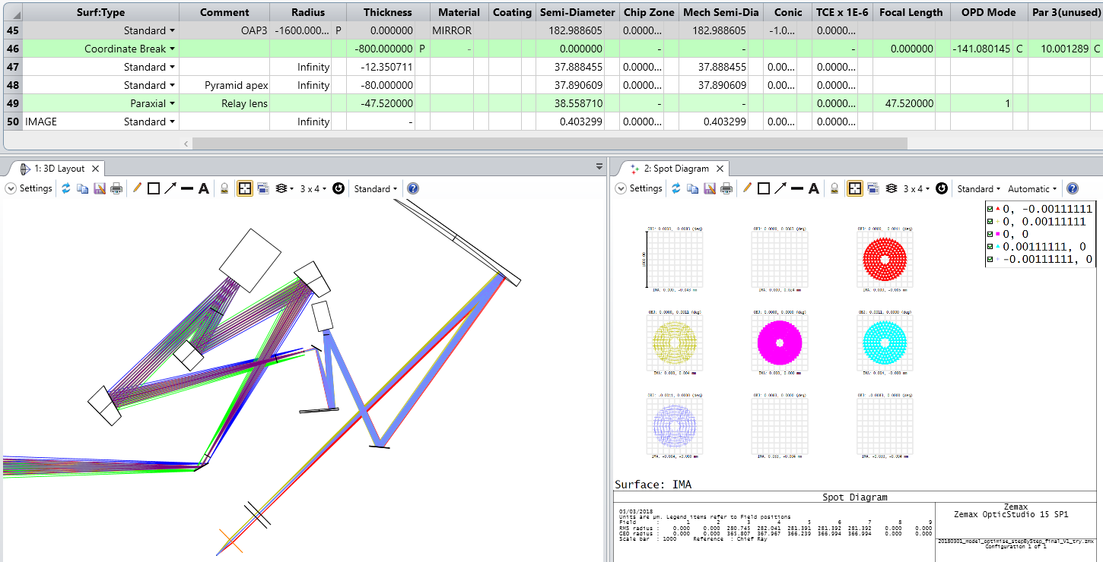
DM
OAP0
OAP3
TT mod mirror
OAP1
OAP2
Fold mirror
Pyramid
CCD
Relay lens

