Slide 1
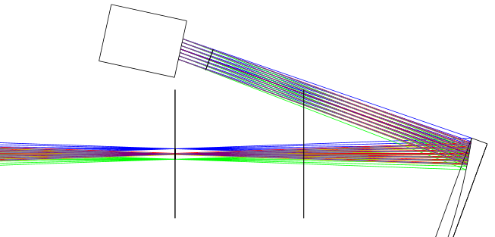
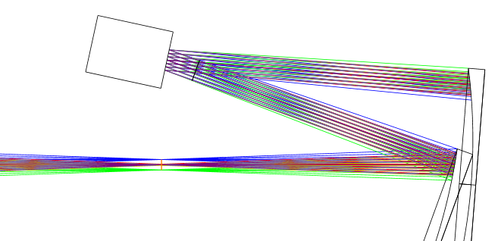
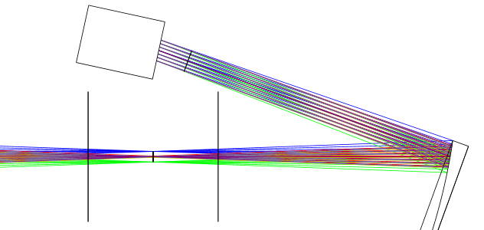
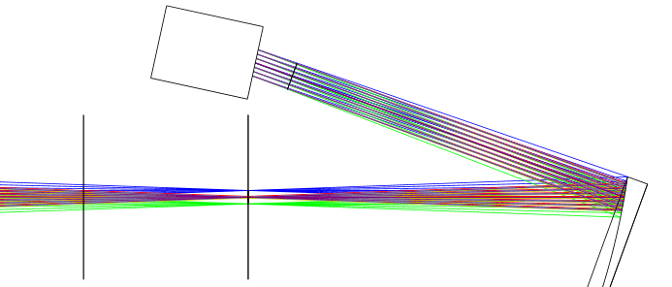
Début système AO
DM
DM
FoV
Telescope focal plane
Telescope focal plane
Sketch 1
200 mm
Sketch 2
DM
DM
FoV
FoV
Telescope focal plane
Telescope focal plane
Sketch 4
Sketch 3

Slide 2
DM
DM
FCL
Telescope focal plane
Telescope focal plane
Sketch 1
200 mm
Sketch 2
DM
DM
FCL
FCL
Telescope focal plane
Telescope focal plane
Sketch 4
Sketch 3

Slide 3
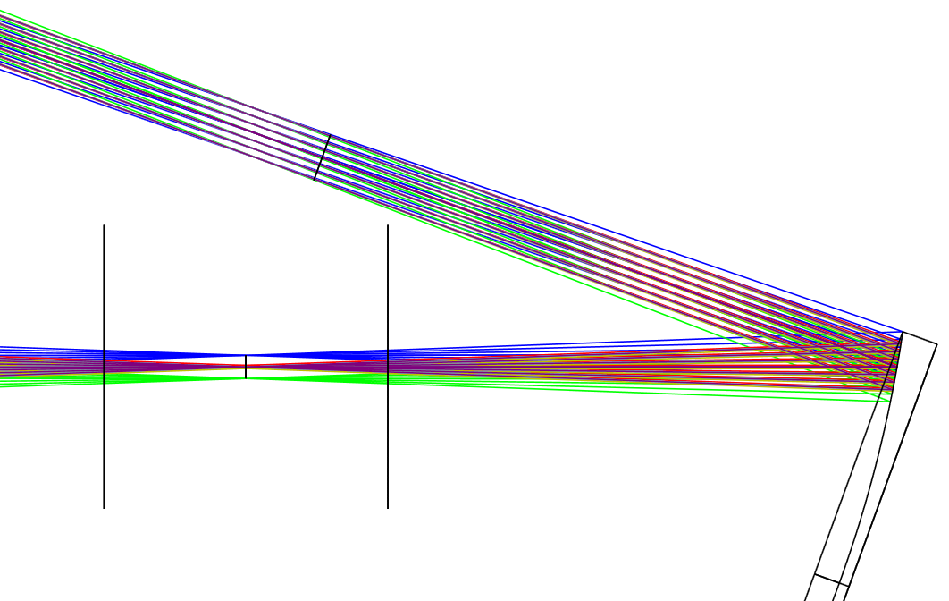
Pupil image
FCL
OAP0
θ= 20°
Telescope focal plane
(FoV = 1’)

Slide 4
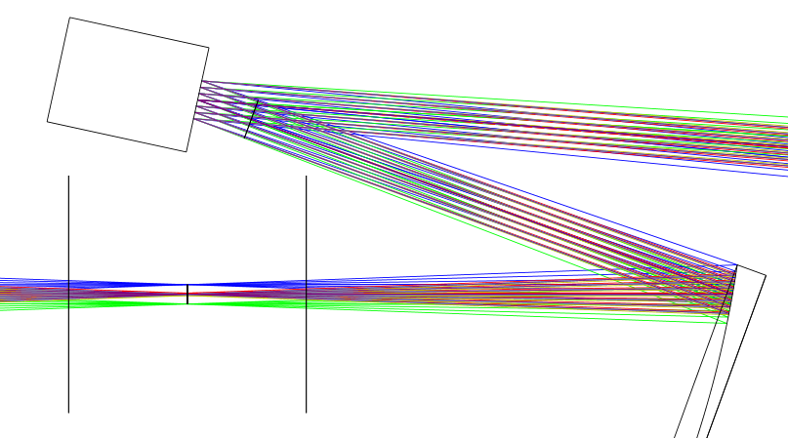
DM
2α
FCL
OAP0
θ= 20°
Telescope focal plane
(FoV = 1’)

Slide 5
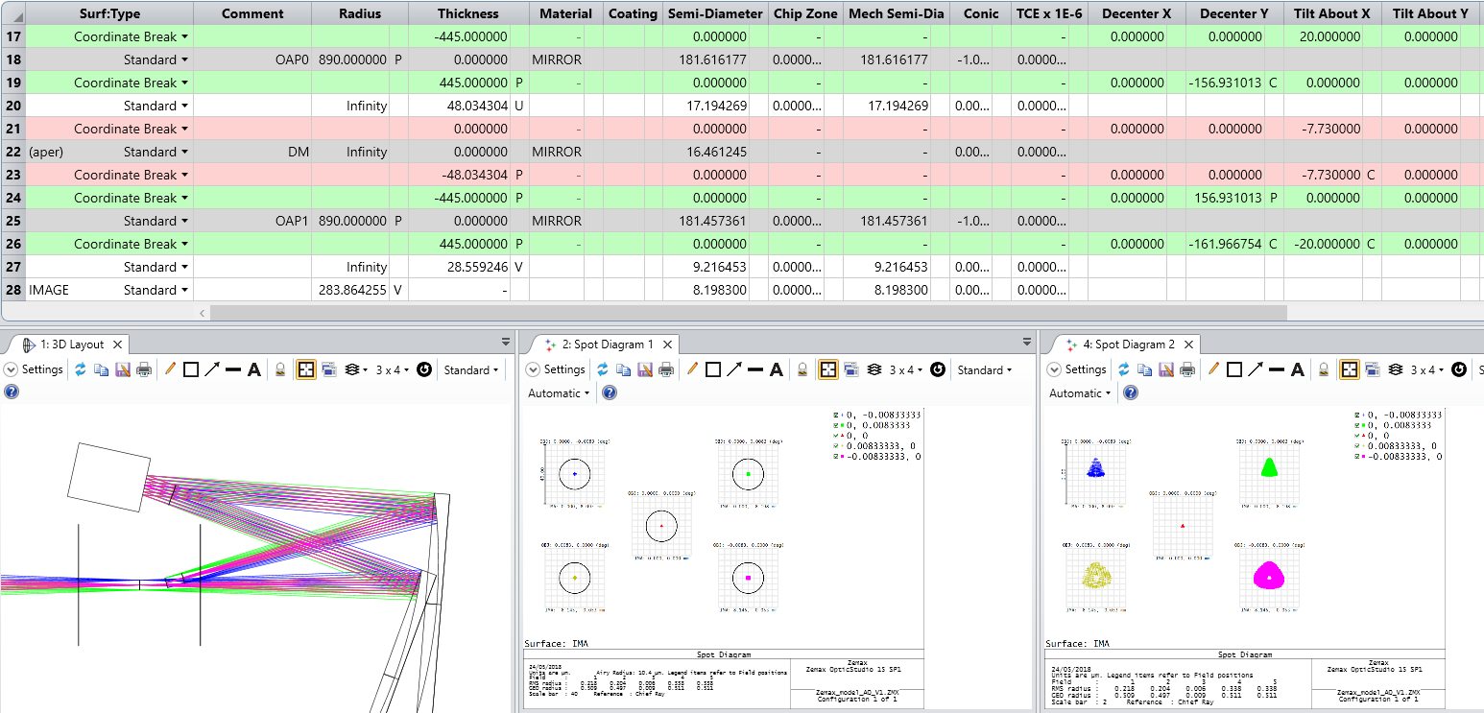

DM
OAP1
FCL
Telescope
focal plane
(FoV = 1’)
Intermediate
focal plane
(FoV = 1’)
OAP0
$$≈$$

Slide 6
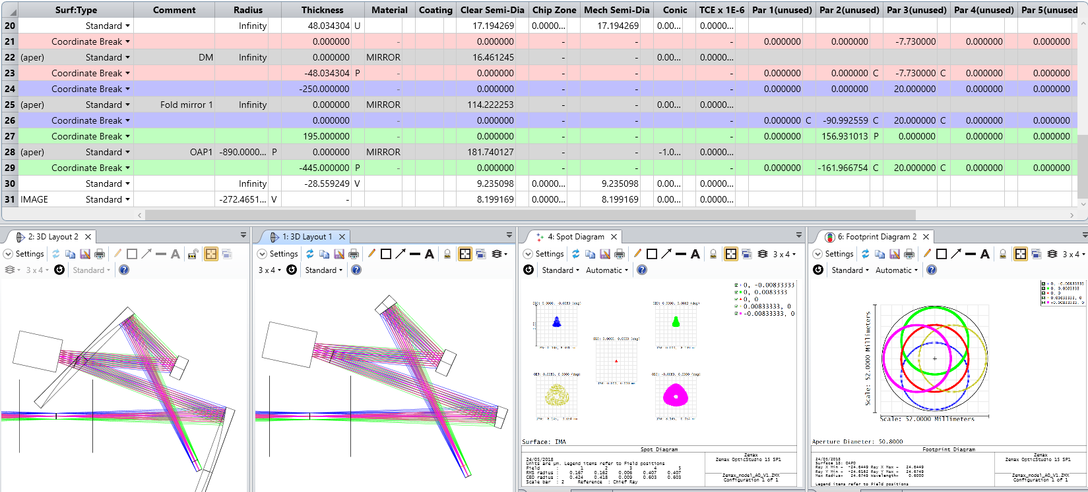
OAP1
OAP1
DM
Folding
mirror 1
DM
Folding
mirror 1
FCL
OAP0
FCL
OAP0
Telescope
focal plane
(FoV = 1’)
Telescope
focal plane
(FoV = 1’)
Intermediate
focal plane
(FoV = 1’)
Intermediate
focal plane
(FoV = 1’)

Slide 7
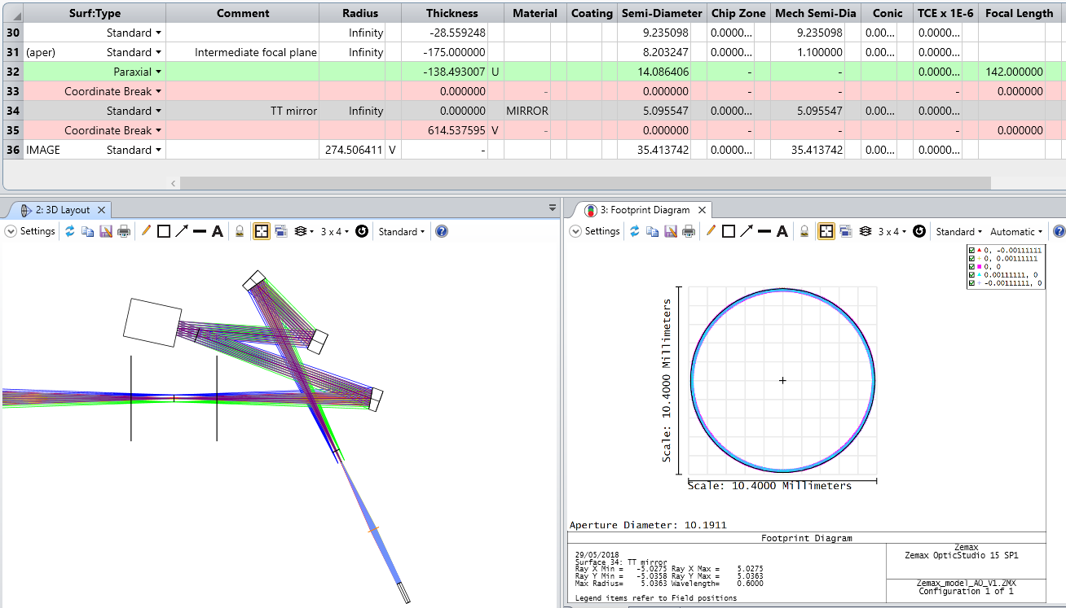
OAP1
DM
Folding
mirror 1
FCL
Telescope
focal plane
(FoV = 1’)
OAP0
Intermediate
focal plane
(FoV = 1’)
Paraxial lens
TT modulation
mirror

Slide 8
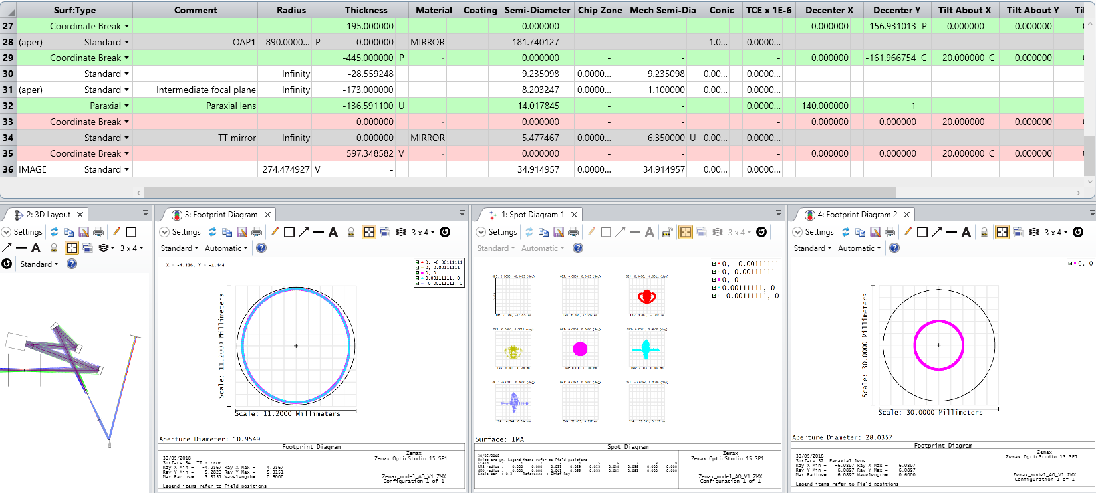


Slide 9
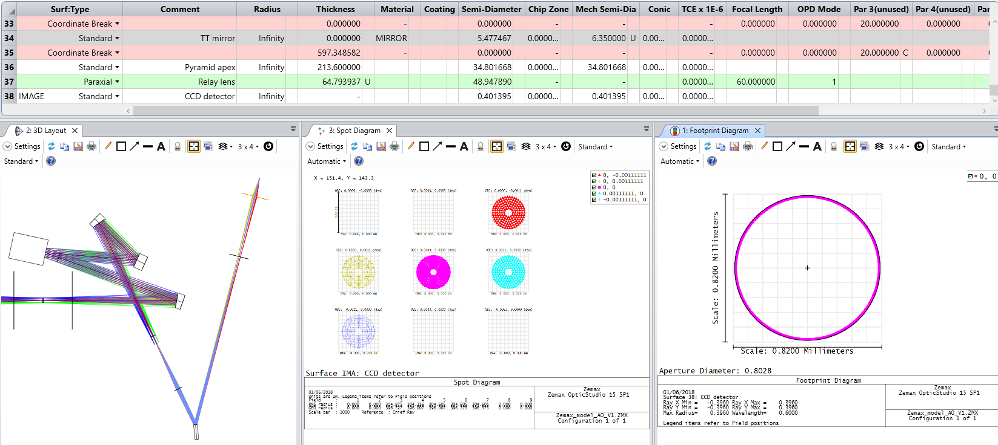

CCD detector
OAP1
Relay lens
DM
Folding
mirror 1
Pyramid apex
FCL
OAP0
Telescope
focal plane
(FoV = 1’)
Intermediate
focal plane
(FoV = 1’)
Paraxial lens
TT modulation
mirror

Slide 10
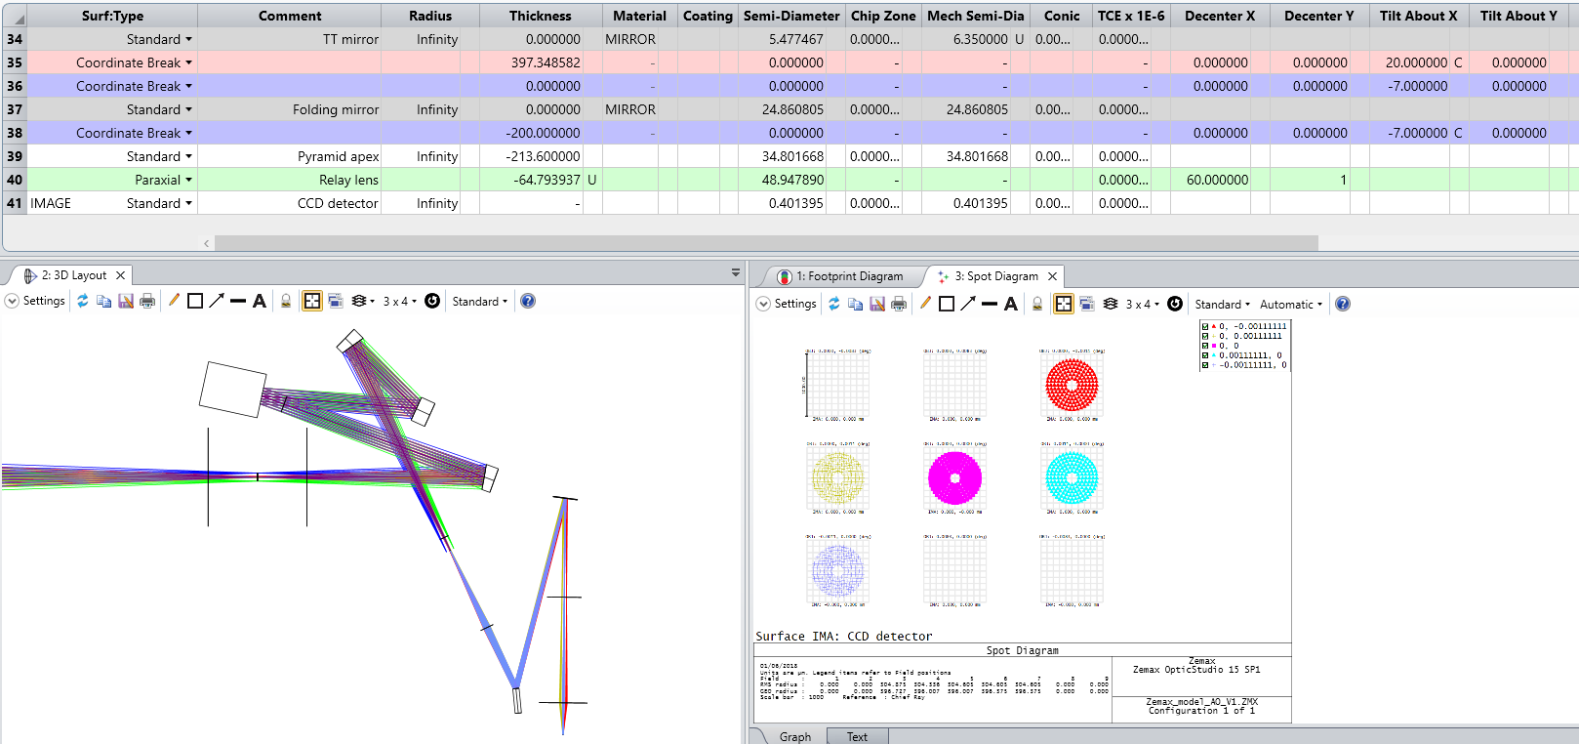
OAP1
DM
Folding
mirror 1
FCL
OAP0
Folding
mirror 2
Telescope
focal plane
(FoV = 1’)
Intermediate
focal plane
(FoV = 1’)
Pyramid apex
Paraxial lens
TT modulation
mirror
Relay lens
CCD detector

Slide 11
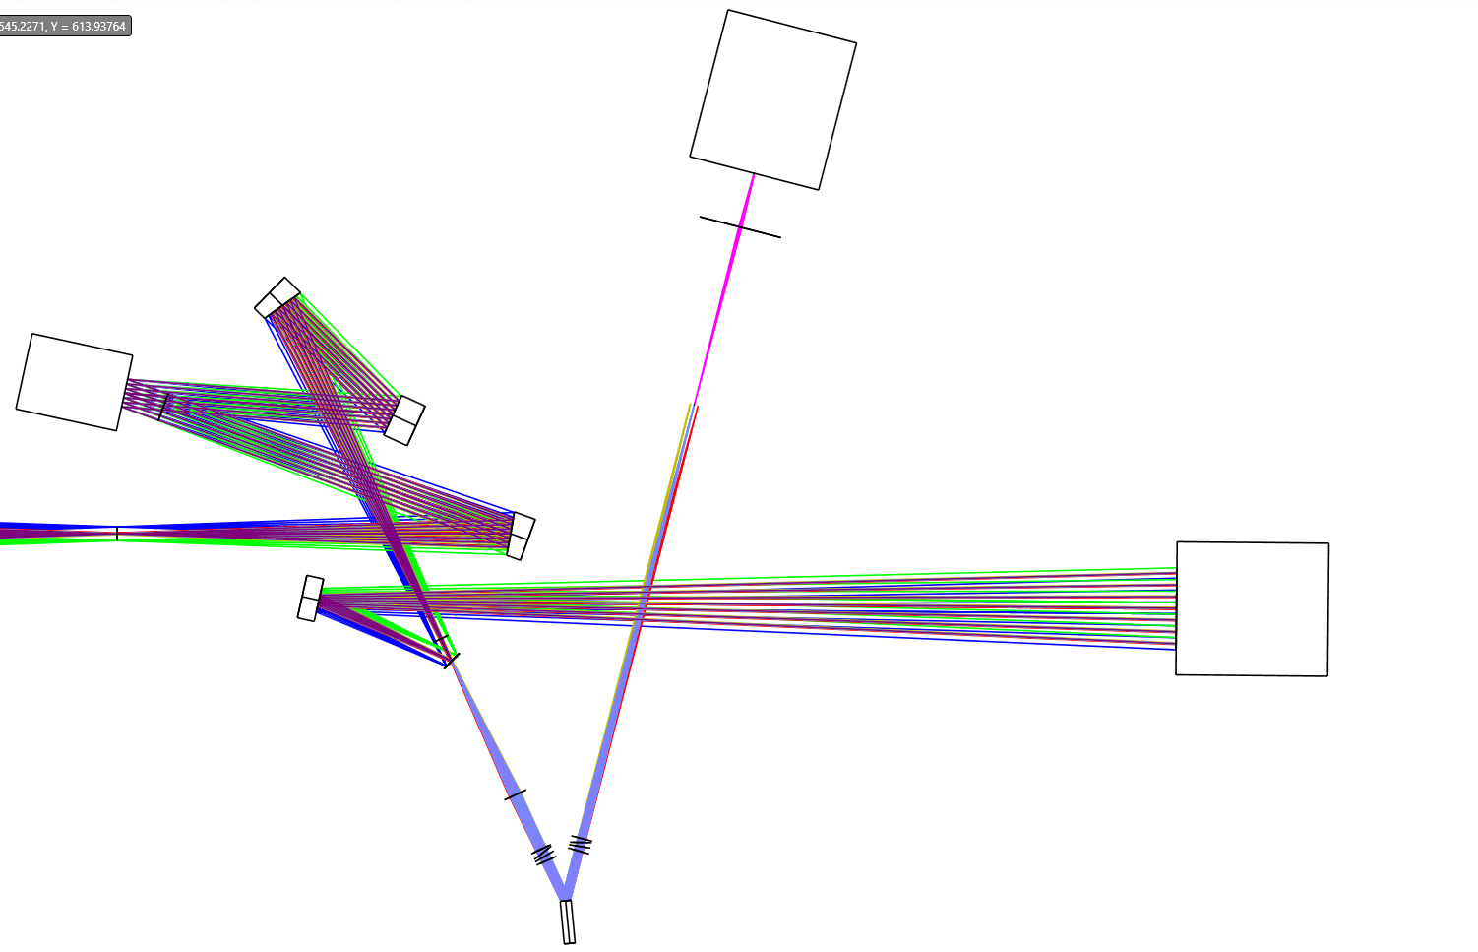
CCD
detector
Relay lens
OAP1
DM
Folding
mirror 1
Pyramid prisms
Telescope
focal plane
(FoV = 1’)
OAP0
To science
Folding
mirror 2
Dichroic mirror
@Intermediate
focal plane
(FoV = 1’)
Imaging lens
ADC
compound prism 2
ADC
compound prism 1
TT modulation
mirror
1 m

Slide 12
CCD
detector
Relay lens
OAP1
DM
Folding
mirror 1
Pyramid prisms
Telescope
focal plane
(FoV = 1’)
OAP0
To science
Folding
mirror 2
Dichroic mirror
@Intermediate
focal plane
(FoV = 1’)
Imaging lens
ADC
compound prism 2
ADC
compound prism 1
TT modulation
mirror
1 m

Slide 13
