Slide 1
Motrabin™
Audrey Lee
Anthony Yang
Larry Chang

Slide 2
Why motrabin™?
SUSTAINABILITY
Our product is designed to enforce correct recycling. Recycling is one of the best way to reduce waste. As we have seen everywhere around the world, the planet is tortured by hurricanes, wildfires and drought. The solid waste recycle and compost rate in US is only 35.2% in 2017 (USEPA, 2019). By correctly classifying waste into categories, more materials can be reused and thus reduce the waste produced during manufacture.
https://www.epa.gov/sites/production/files/2019-11/documents/2017_facts_and_figures_fact_sheet_final.pdf

Slide 3
About Our Product
The project starts with negotiating for a government regulation that requires all manufacturers to include a barcode on their unique products packages, which are encoded with recycle type and collected in a database that is accessible to our Motrabin™. Whenever the collection of barcode from manufacturers is not possible, the barcodes will be created manually in a large scale prior to the release of product.
Motrabin™ unit includes 3 separate bins, each takes one type of trash. Each bin has a lid that is by default closed. Motrabin™ is activated by user scanning the barcode on the package of commercial products. The lid will open for corresponding type of trash.

Slide 4
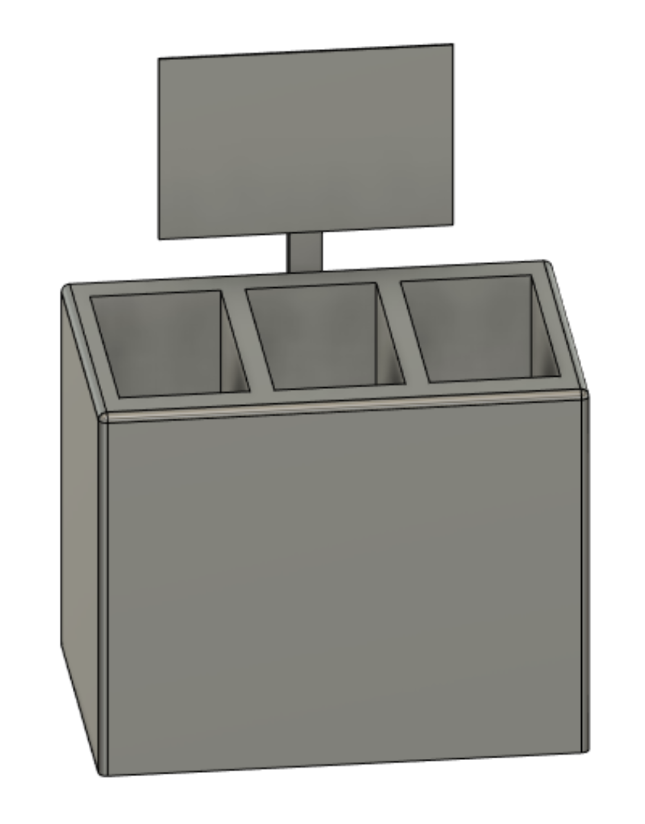
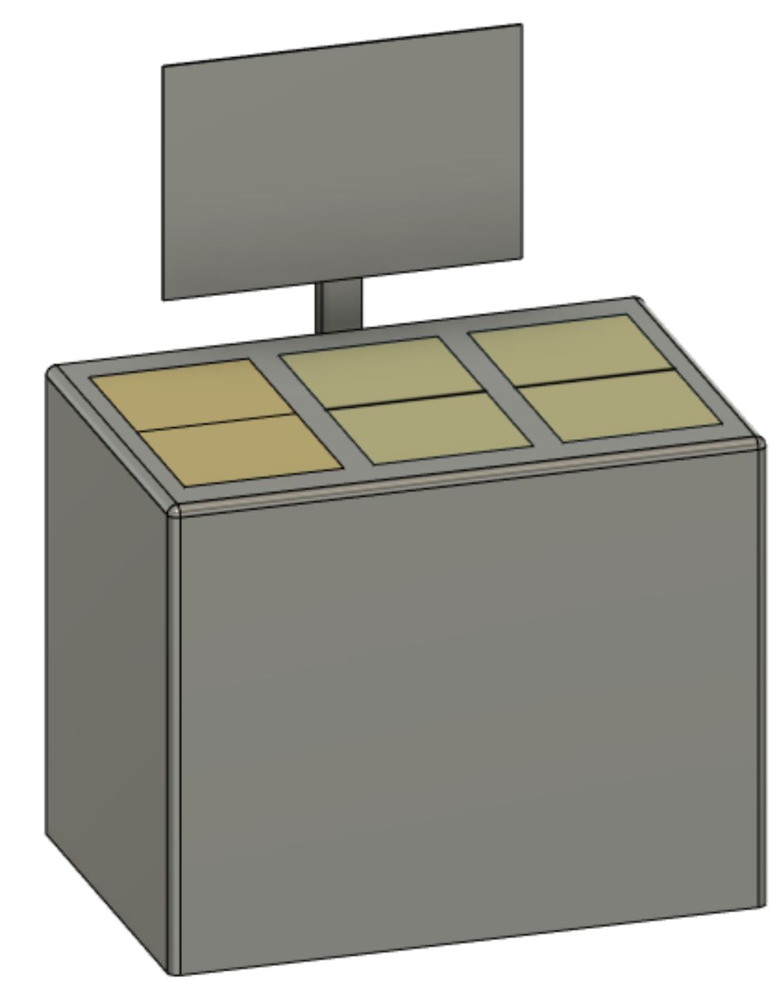
The Design

Slide 5
Demo

