Slide 1
E-Commerce
Exploratory Data Analysis

Slide 2
Age Group Below 36
The group that spends more on a product is the group under 36.
The group that patronizes more is the group under 36.
Recommendation
The social media should focus more on the age group that is below 36, since they purchase the most.

Slide 3
Income Levels
The age group below 36 have the most high-income level (275)
The age group 36 and above high-income level is 240
The age group below 36 middle-income level is 255
The age group 36 and above middle-income level is 230

Slide 4
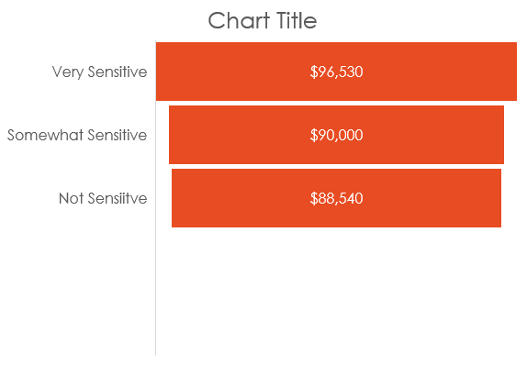
Customers’ Discount Sensitivity
Discount sensitive customers pay more when products are discounted.

Slide 5
High-income Earners and the Number of Discount Used

Slide 6
Shipping
Customers that purchase office supplies are most likely to use express shipping while animal feed uses standard shipping predominantly.
The peak shipping day is Tuesday.

Slide 7
Social Media Influence
Social media influence significantly affects the purchase amount.

Slide 8
Return Rate
Products with low ratings do not have a high return rate.
Travel and Leisure (flights) have the highest return rate.
Dissatisfied customers are not more likely to return products.

Slide 9
Recommendations
Use a high social media influence.
The social media should focus more on the age group that is below 36, since they purchase the most.
Discounts should be given more to middle income earners since they use it more than high income earners.

Slide 10
Thank you!

