Slide 1
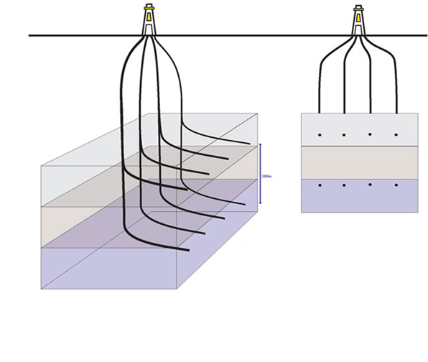
Variables
Response Variable = Oil EUR – Expected oil recovery over the life of the well
Continuous Input Variables
Geology
Porosity
Water saturation
Rock thickness
Depth
Gas-Oil ratio
Formation volume factor
Landing Zone
Well Spacing
Thickness
Lateral Length
Well spacing
Lateral Length
Frac Fluid Volume
Proppant volume

Slide 2
Machine Learning

