Slide 1
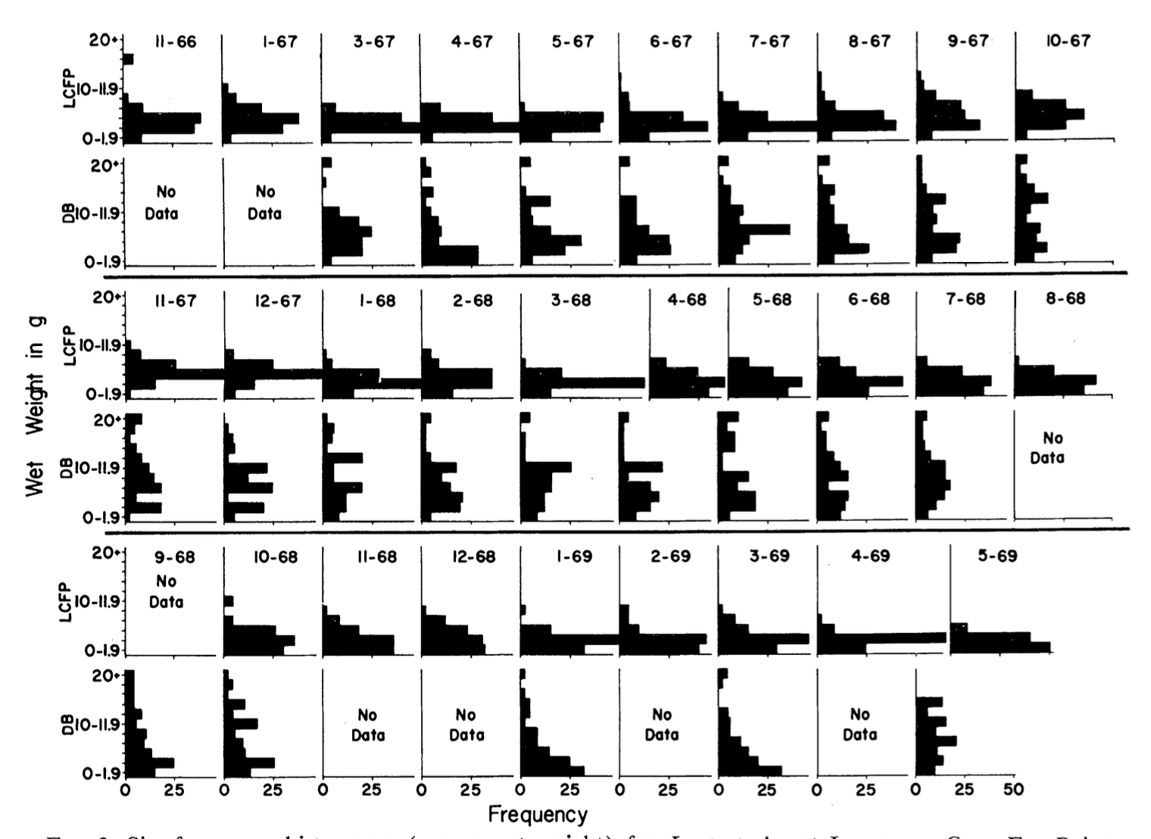
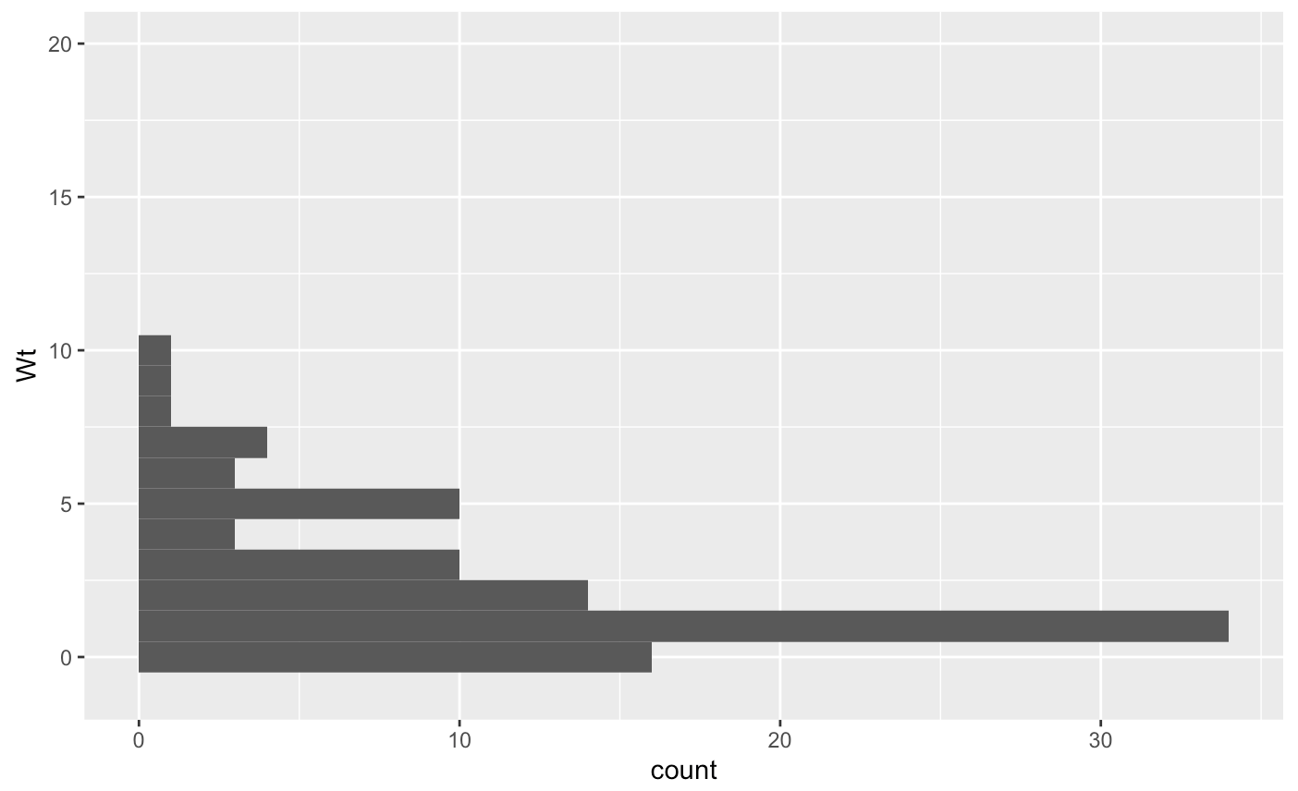
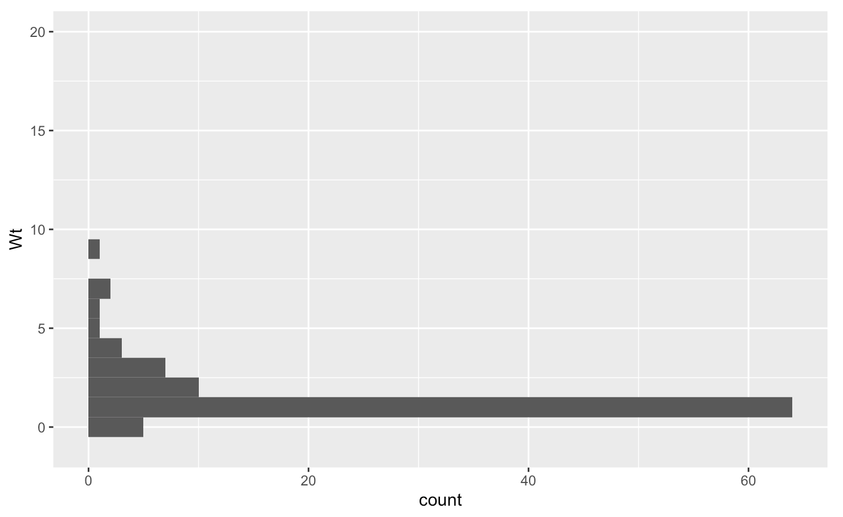
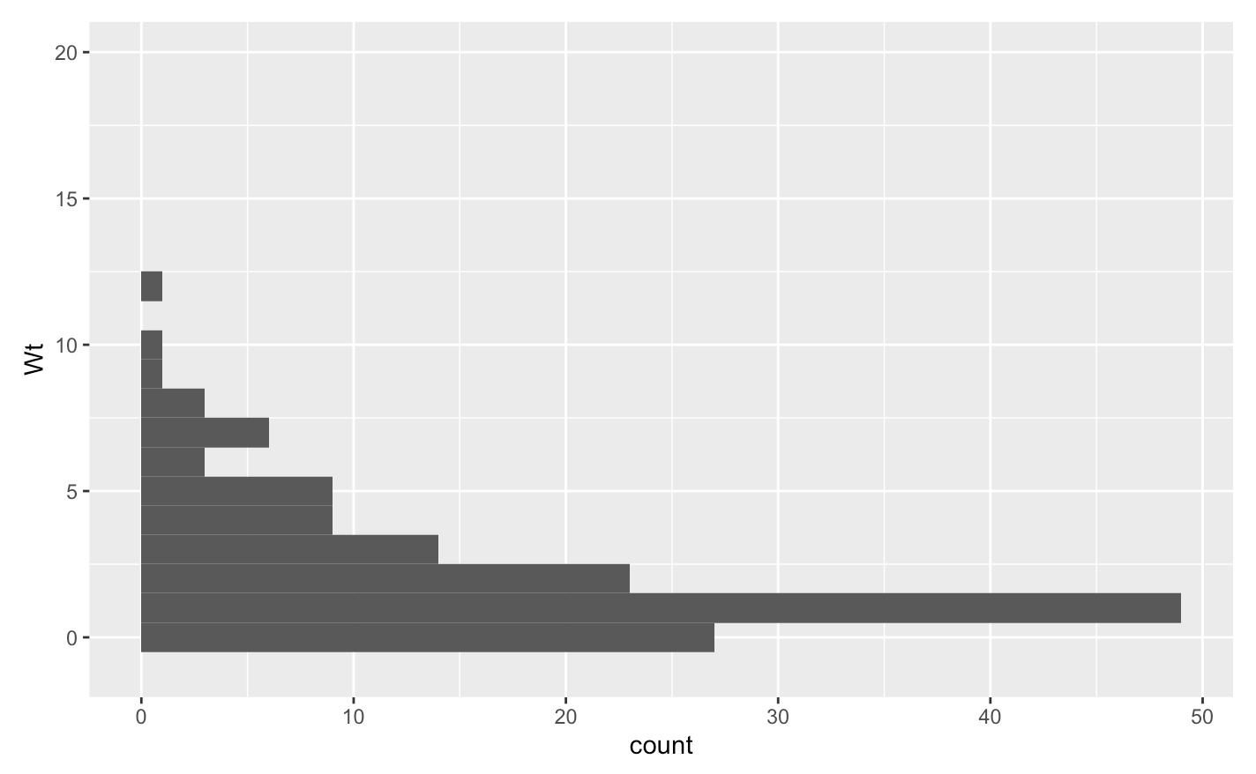
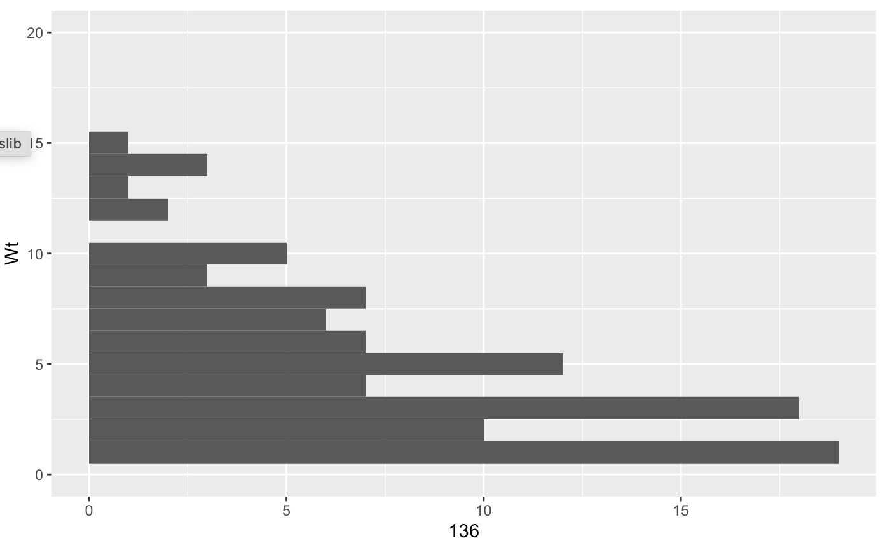
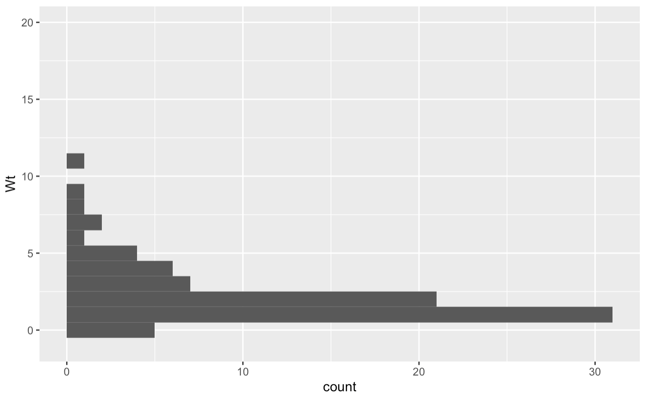
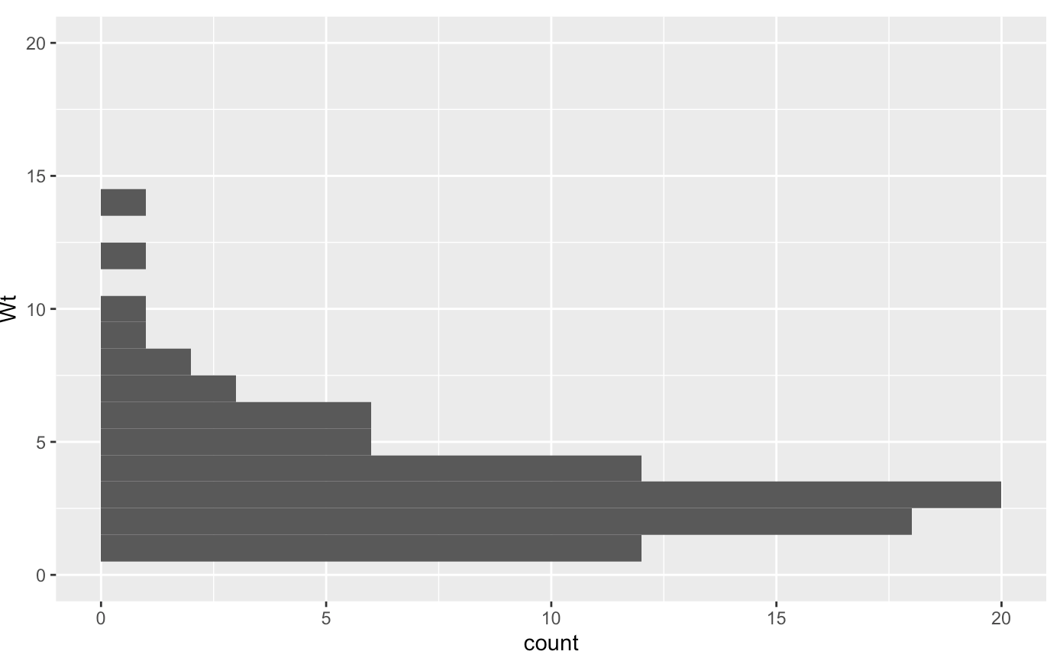
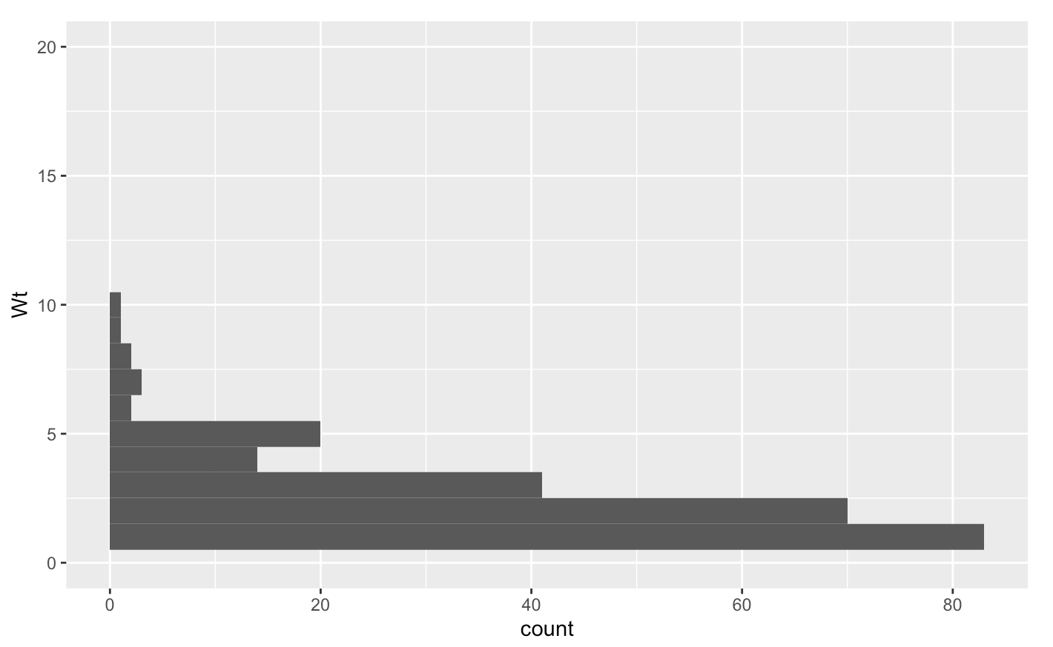
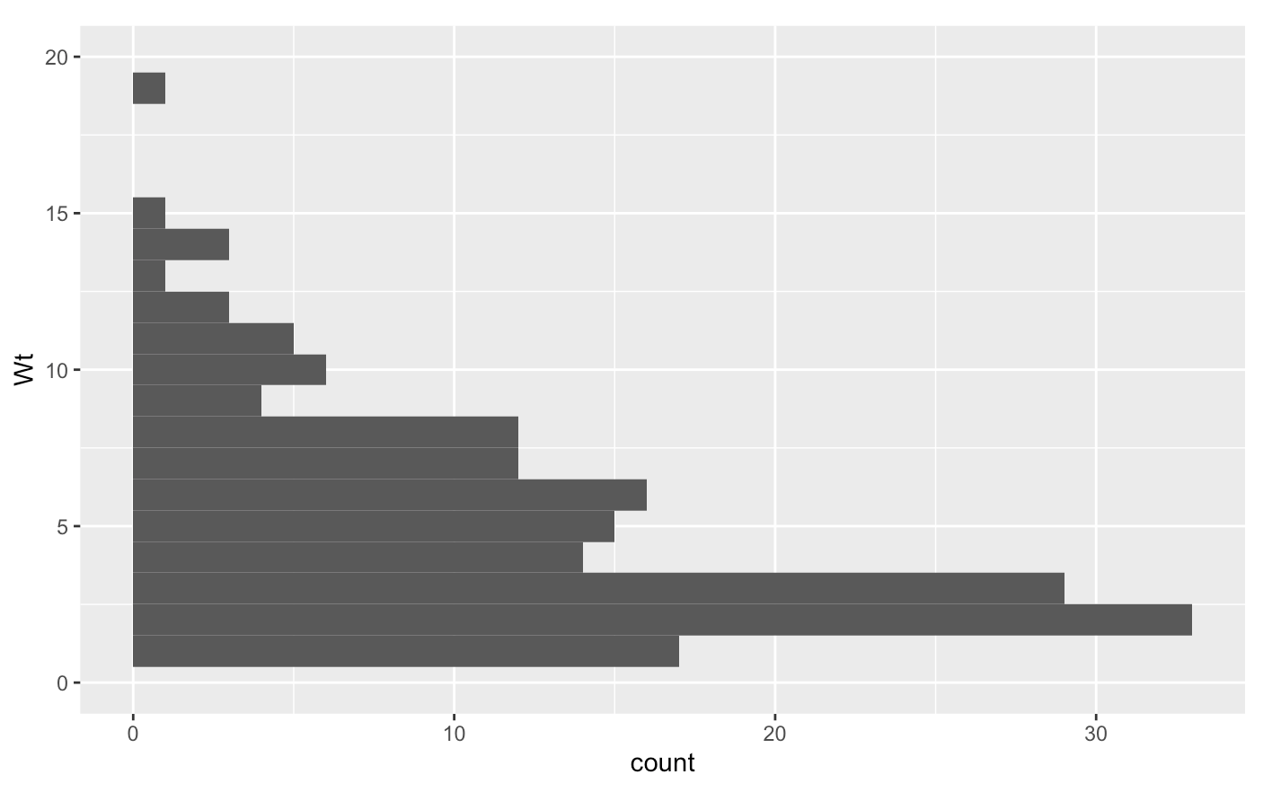
CP
RT
DB
SH
LCRA
PC
PPNP
PPSP

Slide 2
CP
Mean weight (g) = 2.35
Dens (/m^2) = 2.06
RT
Mean weight (g) = 1.60
Dens (/m^2) = 2.00
DB
Mean weight (g) = 2.30
Dens (/m^2) = 3.0
SH
Mean weight (g) = 4.88
Dens (/m^2) = 3.4
LCRA
Mean weight (g) = 2.26
Dens (/m^2) = 1.76
PC
Mean weight (g) = 3.58
Dens (/m^2) = 2.04
PPNP
Mean weight (g) = 2.09
Dens (/m^2) = 5.68
PPSP
Mean weight (g) = 4.77
Dens (/m^2) = 3.64

Slide 3
CP
Mean weight (g) = 2.35
Dens (/m^2) = 2.06
RT
Mean weight (g) = 1.60
Dens (/m^2) = 2.00
15 Pisaster
(Lots of Evasterias)
DB
Mean weight (g) = 2.30
Dens (/m^2) = 3.0
SH
Mean weight (g) = 4.88
Dens (/m^2) = 3.4
No Pisaster
LCRA
Mean weight (g) = 2.26
Dens (/m^2) = 1.76
>5 Pisaster
PC
Mean weight (g) = 3.58
Dens (/m^2) = 2.04
20 Pisaster
PPNP
Mean weight (g) = 2.09
Dens (/m^2) = 5.68
10 Pisaster
PPSP
Mean weight (g) = 4.77
Dens (/m^2) = 3.64
>20 Pisaster

