Slide 1
PHDL
Schematics Are Dead

Slide 2
Electronic SubSystem Development
A
A+
C-

Slide 3
Software Quality and Productivity
Increased Abstraction
High level language compilers
Structured design
OO Programming
UML, etc
Code Re-Use/Portability
Structured Design
OO
Open Source, Gnu, Linux, Posix, …
Revision Management
Subversion SVN
GIT
SourceForge.net, RepositoryHosting.com, Amazon EC2, The Cloud

Slide 4
Programmable Logic Quality and Productivity
Increased Abstraction
High level languages – VHDL, Verilog, System Verilog, System-C, JHDL, …
Structured design
Code Re-Use/Portability
Structured Design
OpenCores.Org, Amba, Wishbone, …
Revision Management
Subversion SVN
GIT
SourceForge.net, RepositoryHosting.com, Amazon EC2, The Cloud

Slide 5
Printed Circuit Design Quality and Productivity
Increased Abstraction – Blocked!
schematic methodology – very low level
Each pin on each chip must be handled separately.
Code Re-Use/Portability – Blocked!
proprietary file formats
No standards
You cannot even read my source without special software
Designs not portable even between versions of the same tools
In truth, graphical schematics are re-entered manually, over and over
Revision Management – Blocked!
Binary file formats
You never know what happened, just “File Changed”!

Slide 6
Design
Refactor
Step 1
Step 2
Step 3
Advance

Slide 7
PCB Software That Which Was Difficult is Now Easy That Which Was Easy is now Difficult
Physical Layout software has improved dramatically
Schematic software has worsened dramatically
Why?
Vendor Lock-In
Total Customer Dependency
Mentor controls us.
Mentor owns our IP.
Define
Connectivity
Netlist
Physical
Layout

Slide 8
Problems with Schematic Entry
Difficult to learn and relearn
High ratio of non-productive to productive activities.
Installation
Training
Retraining
Bug reporting
Tech support interaction
Incompatible with version control
Not suitable for important designs.
Graphical Tool for non-graphical problem
Maximizes number of manual tasks and opportunities for error.
Not abstract
Each pin must be handled individually
Don’t scale well to complex designs
Not under our control – Mentor Corporation owns us.
Buggy software
Not portable
Very Expensive
Very Slow
Very Error Prone
Inhumane

Slide 9
Schematic Capture productive vs. non-productive work

Slide 10
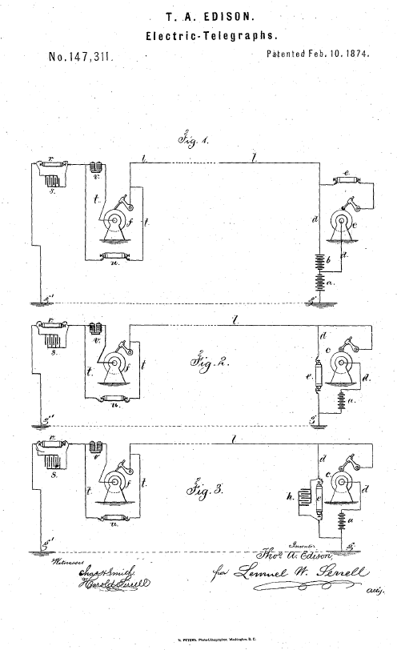
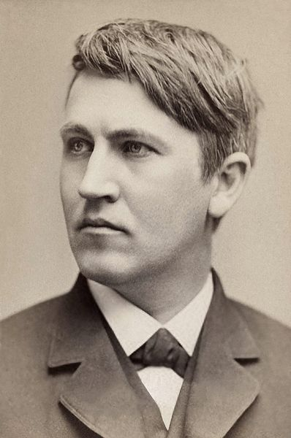
Schematics

Slide 11
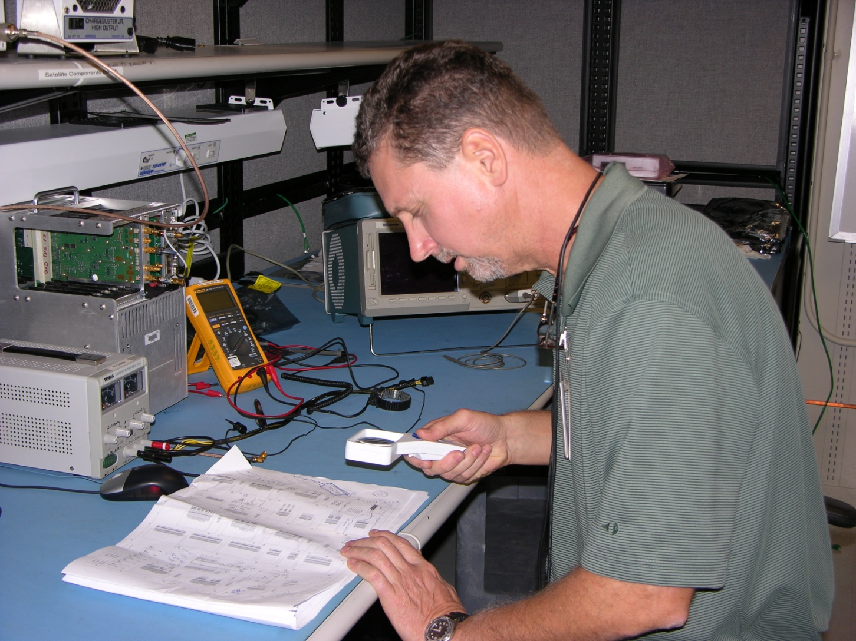
Schematics Don’t Scale Well

Slide 12
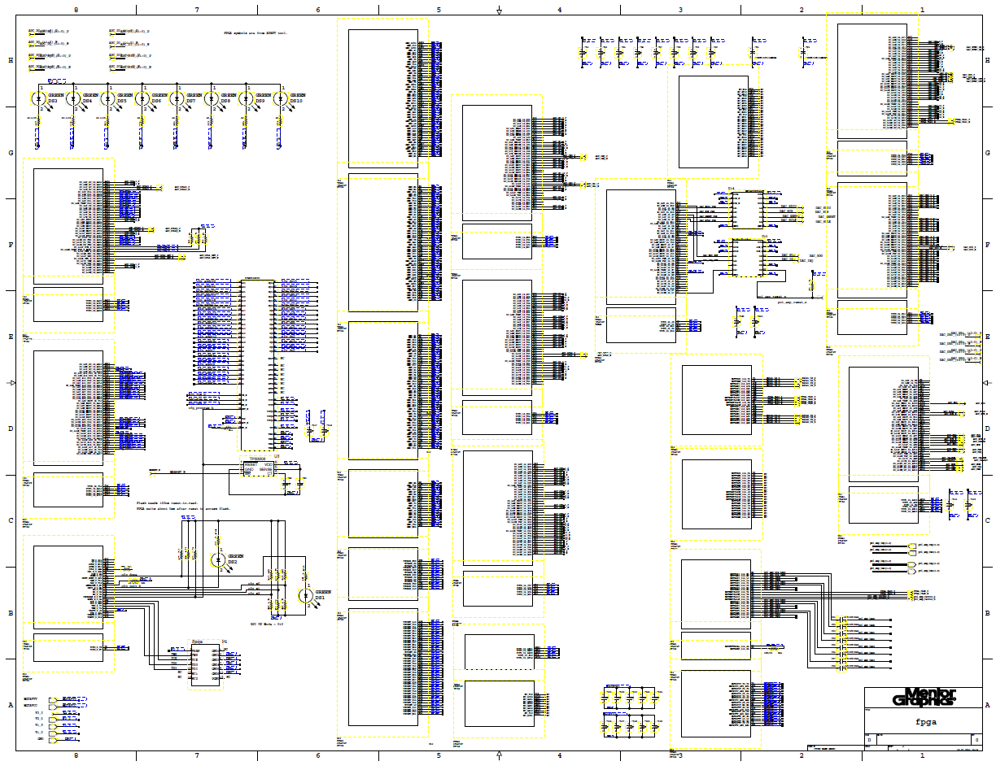
Schematics Don’t Scale Well

Slide 13
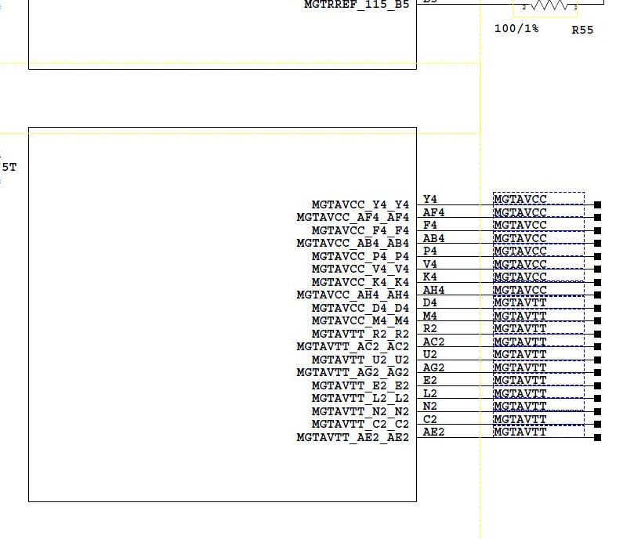
Typical Schematic Error

Slide 14
What is PHDL?
A super simple Hardware Description Language (HDL) for PCB connectivity definition.
An Application Specific Language (ASL).
Written by Brad Riching, Richard Black and Dr. Brent Nelson at BYU.
Sandia research contract funded by Steve Becker and Brett Remund.
Compiler is Java application – runs on all computers.
Uses Antlr parser generator for syntactical flexibility.
Free – Open Source project http://phdl.sourceforge.net/

Slide 15
PHDL Advantages (over schematic entry)
Create and maintain with any text editor. (Vim has context sensitive highlighting.)
Success promoting syntax - Reduces rate of design errors.
Compatible with version control.
No obstacles to re-use.
Provides abstraction of signals and components. (Soon will provide hierarchical design.)
Good error reporting and design rule checking at compile time.
Supports text-to-text auto-generation – Xilinx to PHDL converter exists.
Multiple output formats.
Easy to learn.
Minimizes typing, fiddling and fighting.
Java app – runs on all operating systems.
Open Source and free!

Slide 16
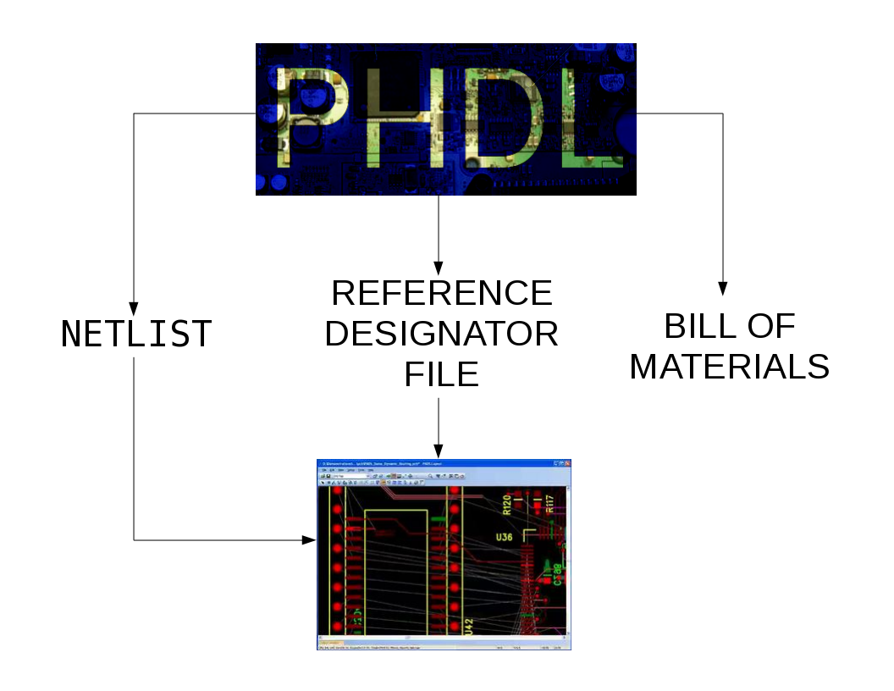

Slide 17
Connectivity Definition (two steps)
Define your components
Wire them up

Slide 18
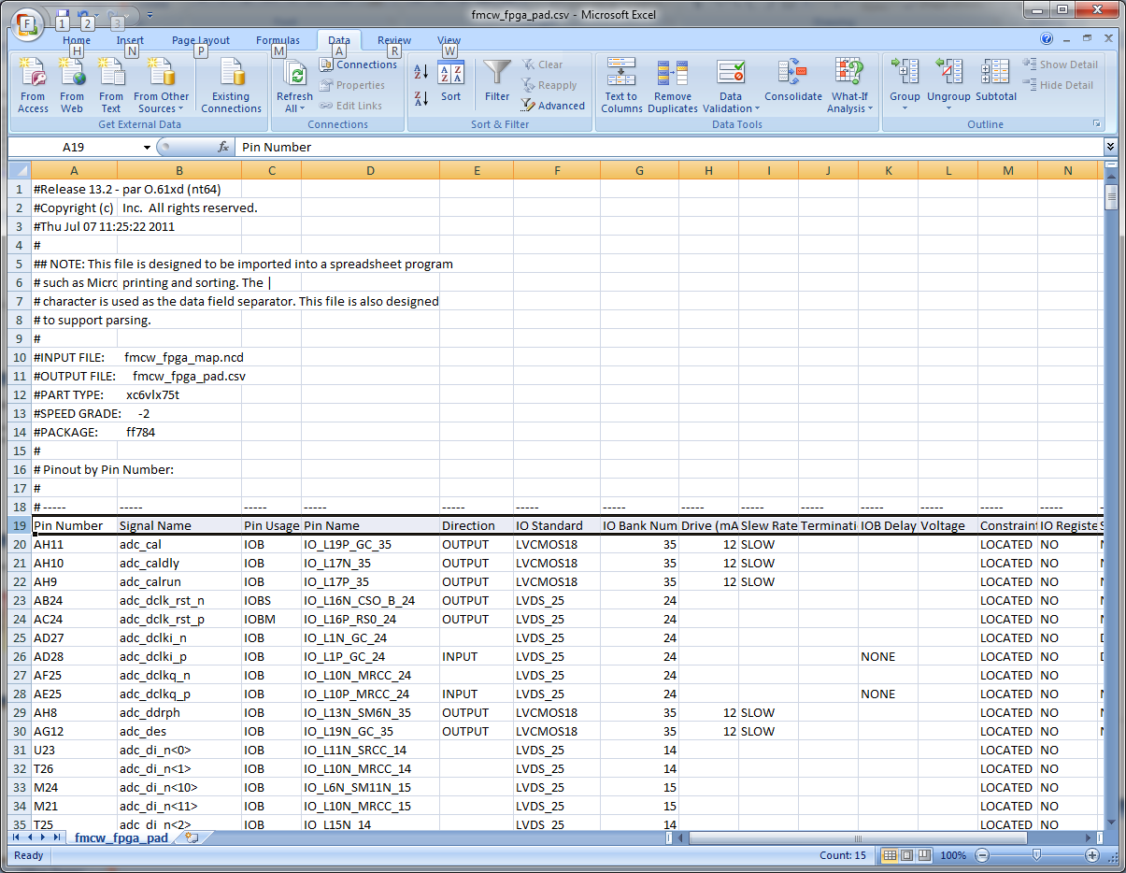
Automated FPGA Component Declaration

Slide 19
Component Declaration (auto-generated)
//PART TYPE = xc6vlx75t
//SPEED GRADE = -2
//PACKAGE = ff784
//INPUT FILE = fmcw_fpga_pad.csv
//Root Filename = fmcw_fpga
//Full Part Number = xc6vlx75t-2ff784
// Device declaration extracted from Xilinx fmcw_fpga_pad.csv
device fmcw_fpga is
attr refPrefix = "U";
attr pkg_type = "ff784";
attr mfgr = "XILINX";
attr partNumber = "xc6vlx75t-2ff784";
// User I/O pins.
pin adc_cal = {Y22};
pin adc_caldly = {T25};
pin adc_calrun = {T24};
pin adc_dclk_rst_n = {D11};
pin adc_dclk_rst_p = {E12};
pin adc_dclki_n = {AE10};
pin adc_dclki_p = {AF10};
pin adc_dclkq_n = {AE14};
pin adc_dclkq_p = {AD13};
pin adc_ddrph = {V24};
pin adc_des = {W22};
pin[11:0] adc_di_n = {J23,J27,AB7,AA10,A27,G16,J22,F12,G26,B28,E14,F24};
pin[11:0] adc_di_p = {K24,J26,AA7,Y10,A26,H16,J21,G12,G27,B27,E13,E25};
pin[11:0] adc_did_n = {Y9,D15,F17,K18,B13,D21,D12,F21,G21,B23,A25,J20};
pin[11:0] adc_did_p = {W8,E15,G17,K17,C14,E20,D13,F20,H20,B22,A24,K19};
pin[11:0] adc_dq_n = {C21,C11,C20,A22,E19,F25,K23,E27,A19,H15,E28,G24};
pin[11:0] adc_dq_p = {B21,B11,C19,A21,D20,F26,K22,F27,A20,J16,D28,H24};
pin[11:0] adc_dqd_n = {G9,D25,G19,H28,F19,E17,A12,B19,H18,D18,A16,J18};
pin[11:0] adc_dqd_p = {G8,E24,H19,G28,E18,D17,A11,B18,G18,C18,A15,J17};
…

Slide 20
Component Declaration (auto-generated)
…
pin DXP_0 = {T14};
pin[169:0] GND = {A1,A18,A2,A28,A6,A8,AA1,AA18,AA2,AA28,AA5,AA8,AB15,AB25,AB3,AB5,AC1,AC12,AC22,AC5,AC6,AD19,AD3,AD4,AD5,AD9,AE1,AE16,AE26,AE5,AE6,AF13,AF23,AF3,AF5,AG1,AG10,AG20,AG5,AH17,AH27,AH3,AH5,AH7,B15,B25,B3,B4,B6,C1,C12,C22,C5,D19,D3,D5,D9,E1,E16,E26,E5,E6,F13,F23,F3,F5,G1,G10,G2,G20,G5,H17,H27,H3,H4,H5,H7,J1,J14,J2,J24,J5,K11,K21,K3,K5,K6,L1,L10,L12,L14,L16,L18,L28,L5,L8,M11,M13,M15,M17,M25,M3,M5,M9,N1,N10,N12,N16,N18,N22,N5,N6,N8,P11,P15,P17,P19,P3,P7,P9,R1,R10,R12,R16,R18,R26,R5,R6,R7,R8,T11,T15,T17,T19,T23,T3,T4,T7,T9,U1,U10,U12,U14,U16,U18,U20,U5,U6,U7,U8,V11,V13,V15,V17,V27,V3,V5,V6,V7,V9,W1,W14,W2,W24,W5,W6,Y11,Y21,Y3,Y5};
pin HSWAPEN_0 = {N7};
pin INIT_B_0 = {M6};
pin M0_0 = {F6};
pin M1_0 = {D6};
pin M2_0 = {C6};
pin[9:0] MGTAVCC = {AB4,AF4,AH4,D4,F4,K4,M4,P4,V4,Y4};
pin[8:0] MGTAVTT = {AC2,AE2,AG2,C2,E2,L2,N2,R2,U2};
…
pin VN_0 = {R13};
pin VP_0 = {P14};
End device;
Powers and grounds are handled as
Single pins with associated pin
Number lists.

Slide 21
Power Connection (at component instantiation)
Design big_design is
net GND, +2V5, MGTAVCC, MGTAVTT;
…
Begin
Inst big_fpga of fmcw_fpga is refDes=“U1”;
…
…
GND = <GND>;
HSWAPEN_0 = +2V5;
INIT_B_0 = INIT_B_0;
M0_0 = GND;
M1_0 = +2V5;
M2_0 = GND;
MGTAVCC = <MGTAVCC>;
MGTAVTT = <MGTAVTT>;
…
…
End inst;
…
…
End design;
1 line power and ground
Connections are nearly impossible
To mess up.

Slide 22
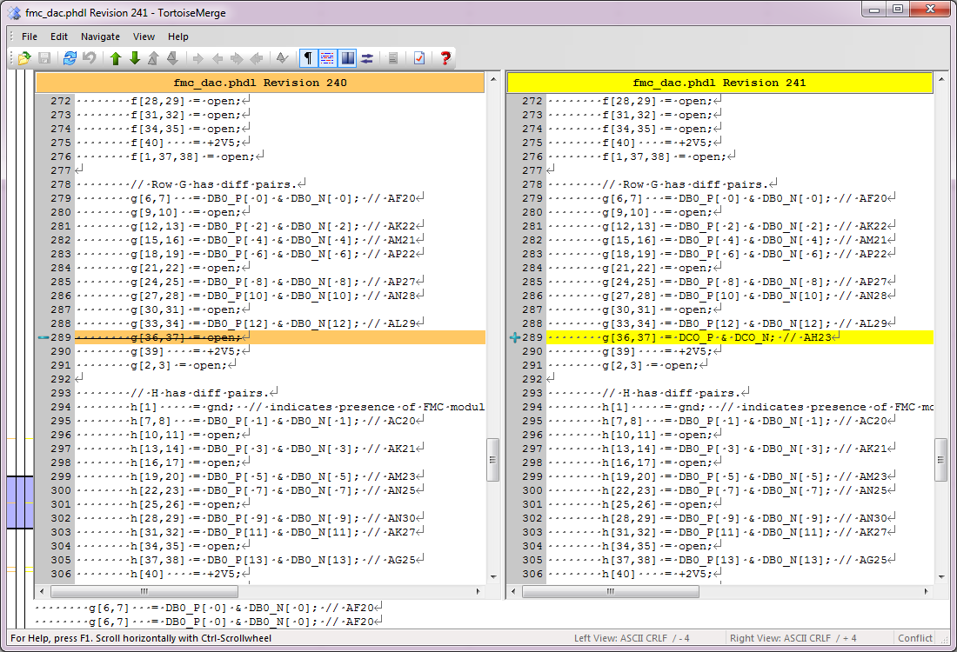
PHDL in Version Control

Slide 23
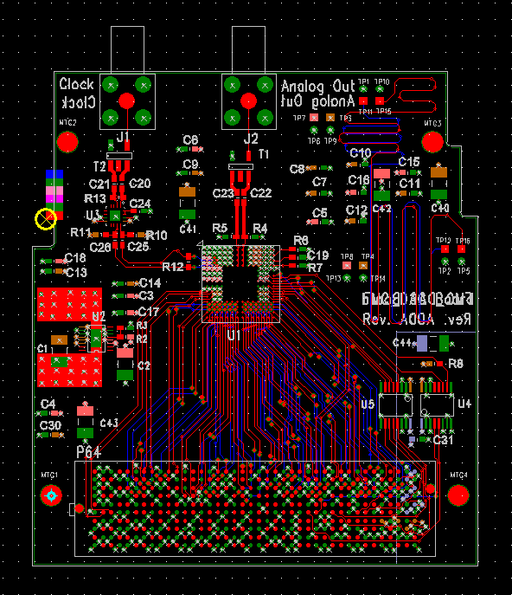
Example Design
2.5Gs/s DAC Board
FMC format (for ML605 carrier only)
Captured in PHDL
Physical layout in Mentor PADS

Slide 24
Device Declaration
// Analog Devices high speed DAC
device ad9739 is
attr refPrefix = "U";
attr refDes = "";
attr name = "";
attr value = "";
attr pkg_type = "ANALOG_DEVICES_BC-160-1";
attr mfgr = "Analog Devices";
attr PartNumber = "AD9739BBCZ";
attr cost = "70.00";
pin[1:8] VDDC = {C1, C2, D1, D2, E1, E2, E3, E4};
pin[1:14] VSSC = {A1, A2, A3, A4, A5, B1, B2, B3, B4, B5, C4, C5, D4, D5};
pin[1:8] VDDA = {A10, A11, B10, B11, C10, C11, D10, D11};
pin[1:8] VSSA = {A12, A13, B12, B13, C12, C13, D12, D13};
pin[1:18] VSSA_SHIELD = {A6, A9, B6, B9, C6, C9, D6, D9, F1, F2, F3, F4, E11, E12, E13, E14, F11, F12};
pin NC = {A14};
pin[1:4] IOUTN = {A7, B7, C7, D7};
pin[1:4] IOUTP = {A8, B8, C8, D8};
pin I120 = {B14};
pin VREF = {C14};
pin IPTAT = {D14};
pin DACCLK_N = {C3};
pin DACCLK_P = {D3};
pin IRQ = {F13};
pin RESET = {F14};
pin CS = {G13};
pin SDIO = {G14};
pin SCLK = {H13};
pin SDO = {H14};
pin[1:4] VDD33 = {J3,J4,J11,J12};
pin[1:6] VDD = {G1, G2, G3, G4, G11, G12};
pin[1:10] VSS = {H1, H2, H3, H4, H11, H12, K3, K4, K11, K12};
pin SYNC_OUT_P = {J1};
pin SYNC_OUT_N = {J2};
pin SYNC_IN_P = {K1};
pin SYNC_IN_N = {K2};
pin DCO_P = {J13};
pin DCO_N = {J14};
pin DCI_P = {K13};
pin DCI_N = {K14};
pin[13:0] DB1_P = {L14,L13,L12,L11,L10,L9,L8,L7,L6,L5,L4,L3,L2,L1};
pin[13:0] DB1_N = {M14,M13,M12,M11,M10,M9,M8,M7,M6,M5,M4,M3,M2,M1};
pin[13:0] DB0_P = {N14,N13,N12,N11,N10,N9,N8,N7,N6,N5,N4,N3,N2,N1};
pin[13:0] DB0_N = {P14,P13,P12,P11,P10,P9,P8,P7,P6,P5,P4,P3,P2,P1};
end device;

Slide 25
Device Instantiation
// This the fast DAC itself. Note how concisely the busses are connected.
inst fast_dac of ad9739 is refDes = "U1";
VDDC = <+1V8>;
VSSC = <gnd>;
VDDA = <+3V3>;
VSSA = <gnd>;
VSSA_SHIELD = <gnd>;
NC = open;
IOUTN = <IOUTN>;
IOUTP = <IOUTP>;
I120 = I120;
VREF = DAC_VREF;
IPTAT = IPTAT;
DACCLK_N = DACCLK_P; // clock polarity reversed for better routing.
DACCLK_P = DACCLK_N;
IRQ = IRQ;
RESET = RESET;
CS = SPI_CS;
SDIO = SPI_SDI;
SCLK = SPI_SCLK;
SDO = SPI_SDO;
VDD33 = <+3V3>;
VDD = <+1V8>;
VSS = <gnd>;
SYNC_OUT_P = SYNC_OUT_P;
SYNC_OUT_N = SYNC_OUT_N;
SYNC_IN_P = SYNC_IN_P;
SYNC_IN_N = SYNC_IN_N;
DCO_P = DCO_P;
DCO_N = DCO_N;
DCI_P = DCI_P;
DCI_N = DCI_N;
DB1_P = DB1_P;
DB1_N = DB1_N;
DB0_P = DB0_P;
DB0_N = DB0_N;
end inst

Slide 26
Include Statement and Signal Declaration
// This board design implments an FMC card that contains a wide-band
// DAC for the synthesis of radar waveforms. The FMC card is intended to
// be installed on a Xilinx ML605 evaluation board.
design fmc_dac is
// device definitions
include "devices.phdl";
// Power and ground nets.
net +3V3, +2V5, +1V8, 1V8_sense, gnd;
// net VDDC, VDDA;
// DAC Signals.
net IOUTP, IOUTN;
net[13:0] DB1_P, DB1_N, DB0_P, DB0_N;
net DACCLK_P, DACCLK_N, DCI_P, DCI_N, DCO_P, DCO_N, SYNC_IN_P, SYNC_IN_N, SYNC_OUT_P, SYNC_OUT_N;
net IRQ, RESET, SPI_CS, SPI_SCLK, SPI_SDO, SPI_SDI;
net IRQ_2V5, RESET_2V5, SPI_CS_2V5, SPI_SCLK_2V5, SPI_SDO_2V5, SPI_SDI_2V5;
net DAC_VREF, IPTAT, I120;
net analog_out;
// Clock signals.
net samp_clk_in, bal_clock_p, bal_clock_n, coup_clock_p, coup_clock_n;
net clock_buf_p, clock_buf_n;
net ADCLK914_Vref;
net out_coup_clock_p, out_coup_clock_n;
// Test signals.
net test_trace_bottom, test_trace_top;
begin
// This the fast DAC itself. Note how concisely the busses are connected.
inst fast_dac of ad9739 is refDes = "U1";
VDDC = <+1V8>

Slide 27
Dichotomy of Importance and Complexity
- PHDL
- PHDL
Importance
- Schematics
- PHDL
- PHDL
Complexity

Slide 28
To Do
Get the word out.
Sandia Presentation October 25th
Road Show – Santa Clara, Kuala Lumpur.
Hierarchical syntax (in progress).
Simplified looping syntax.
More output netlist formats including VHDL.

Slide 29
Special Thanks
Steve Becker - sponsorship
Brett Remund - sponsorship
Mike Knoll – sponsorship
Wes Landaker – tech consulting
Mike Gardner- tech consulting
Dr. Brent Nelson – technical leadership
Brad Riching – compiler design
Richard Black – compiler design
Many others – technical ideas

Slide 30
Conclusion
Electronics design is very important.
The way we do it now is very inefficient.
It is time to treat hardware design as IP.
PHDL provides an excellent alternative.
PHDL leverages quality and productivity techniques developed by the software industry.
PHDL is free and available today.
Get involved!
http://phdl.sourceforge.net/
For more info: pete@HDLGuy.com

