Slide 1
Arria II GX demo
Funbase first application
v5

Slide 2
Arria II GX demo architecture
PC / linux
PCIe phy
DDR2 dimm memory
Arria II GX board
FPGA
DDR2 HiPerf ctrl II (Altera)
PCIe controller (Altera)
MegaWizard
Avalon S
Avalon M
Avalon M
Avalon S
HIBI MEM DMA
Picture Manipulator
Video generator
PCIe to hibi 4x
Avalon2HIBI
HIBI wrapper
HIBI wrapper
HIBI wrapper
HIBI wrapper
HIBI network

Slide 3
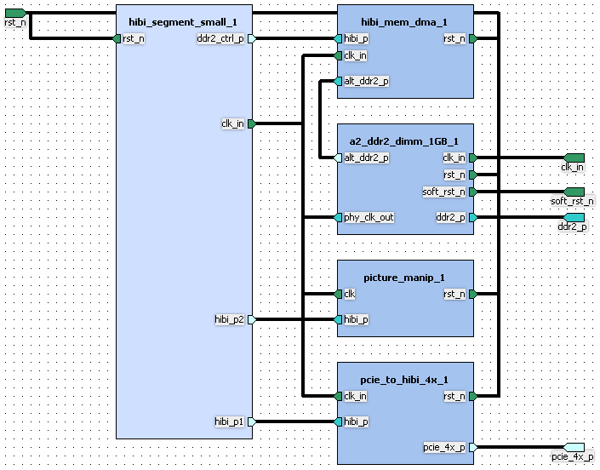
Kactus 2 diagram of A2GX

Slide 4
PCIe-to-HIBI bridge
HIBI-based system is seen as
memory mapped peripherals and
memory from Linux
Avalon2HIBI
Translates read/write operations from PCIe to a sequence of HIBI bus transactions
Translates PCIe memory space to HIBI-based system address space
Implemented as a SoPC subsystem
PCIe controller (Altera)
SoPC subsystem
Avalon M
Avalon S
Avalon2HIBI
Example system:

