Slide 1
Kactus 2 manual

Slide 2
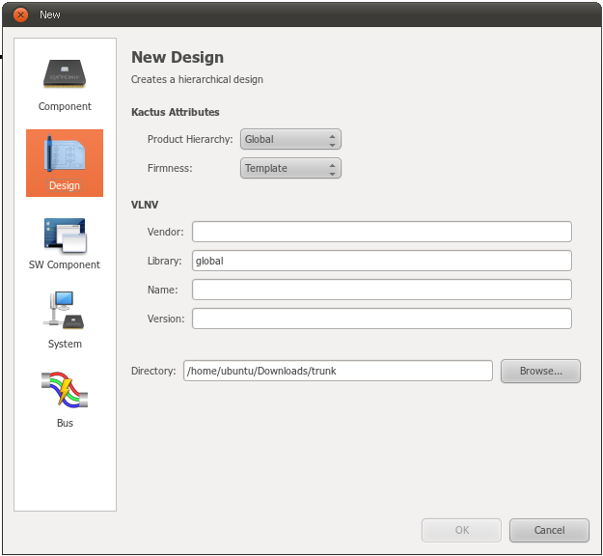
New dialog

Slide 3







Toolbar

Slide 4
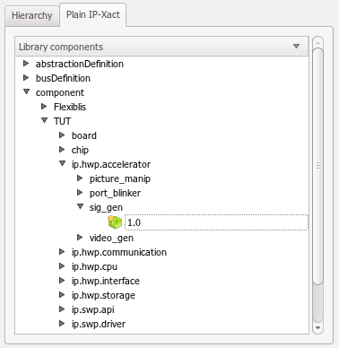
Sections

Slide 5
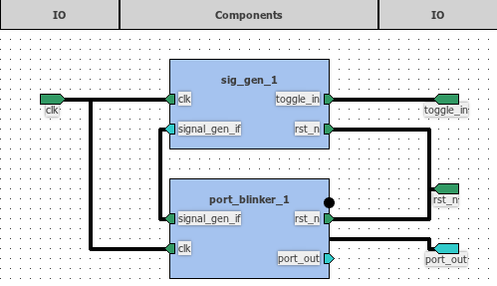
DE2 demo block diagram

