Slide 1


Framework for CAD/CAM/PDM Applications
the Synergy of STEP and JavaTM Technology
Lothar Klein,
LKSoftWare GmbH
http://www.lksoft.com
Java and all Java-based trademarks and logos are trademarks or registered trademarks of
Sun Microsystems, Inc. in the United States and other countries.
JSDAI is a trademark of LKSoftWare GmbH

Slide 2
SDAI Tutorial and the
J-SDAI implementation
Overview
  STEP description and implementation methods
  EXPRESS versus Java
Basic SDAI Functionality
Extended SDAI Functionality
Future SDAI Directions

Slide 3
Java history
1995/96: Java 1.0 released. It is a replacement for C++ !
1997: Major upgrade Java 1.1
1998: Sun is approved to submit Java as a Publicly Available Specification (PAS) at ISO JTC1.
1998: Swing -> Java 2 Platform (JDK 1.2)
an almost complete OS-interface
1999: Sun moves the standardization to ECMA,
but later it cancels this activities
2000: JDK 1.3, Split into several platforms
- Enterprise (Enterprise JavaBeans^{TM)}
- Standard
- Micro

Slide 4
What is JavaTM technology ?
Java 2 Platform, Standard Edition, actual Version 1.2.2
  Java Programming Language
  Java Virtual Machine, Platform independent
  Java 2 Platform API
    Swing (Windows API)
    Java Beans (reusable software components)
    Java 2D API
    JDBC, Database API for sql
    Security
    Network, Remote Method Invocation, CORBA/ IDL
Java Extensions
  Java 3D, JINI, Enterprise Java Beans (EJB), ...

Slide 5
STEP and associated Standards
ISO 10303-1x, 2x
Description and Implementation methods
ISO 10303-4x, 1xx, 5xx
Basic STEP Models
ISO 10303-2xx, 3xx
Applications Protocols (AP) and Tests (ATS)
ISO 13584, PLIB (Parts Library)
ISO 15926, OIL & GAS
ISO 15531, MANDATE
ISO 14649, NC programming

Slide 6
EXPRESS Standards
EXPRESS(-1): ISO 10303-11:1994
EXPRESS-G Graphical representation
EXPRESS-TC1/2 Technical Corrigendum
EXPRESS-Amendment
EXPRESS-X Maps and Views of Entities
EXPRESS-2 (behaviour, active processing of data due to events)

Slide 7
EXPRESS
information modeling language
used to define the data models of STEP
AIM: Application Integrated model
based on common integrated models
ARM: Application reference model

Slide 8
EXPRESS Data Types
primitive data type:
INTEGER, REAL (NUMBER), STRING, BINARY, BOOLEAN, LOGICAL
Entity data type and complex entity data type
constructed data type
enumeration data type
select data type
defined data type
aggregate data type
plus constraints (expressions, functions, procedures, rules)

Slide 9
EXPRESS-G

Slide 10
STEP Data Storage and Exchange
exchange by file, stream or similar
  EXPRESS-I (part12, outdated)
  Clear Text Encoding - "Physical File" - part21
  part28 (XML)
  vendor specific, e.g. J-SDAI binary format
active access through
  rational or object oriented data base
  SDAI
  vendor specific

Slide 11
Processing STEP Data, a classification
Internal representation does not reflect the EXPRESS structure. For data exchange information is mapped during export/import -> loss of information
Internal representation fits with with the EXPRESS structure. Entity instances and aggregates are represented as objects -> information is preserved
  Implementation directly based on EXPRESS
  SDAI conformant
  SDAI similar, but not conformant

Slide 12
Dependencies of the STEP
Description and Implementation Methods
SDAI_dictionary
_schema
Compiler
EXPRESS
Generator
Import
SDAI
Part21
Export

Slide 13
Standard Data Access Interface
(SDAI, ISO 10303-22)
Abstract Application Programming Interface (API) for STEP data
Programming Language bindings to
  C++ ISO 10303-23
  C ISO 10303-24
  Fortran (canceled) ISO 10303-25
  IDL (to be canceled) ISO 10303-26
  complete Java ISO 10303-27
  lightweight Java ISO 10303-29

Slide 14
Java programming language binding to the SDAI with Internet/Intranet extensions
To be published as
Technical Specifications (TS)
Split into 2 documents
  ISO 10303-27: complete
  ISO 10303-29: lightweight + EJB

Slide 15
Installation overview (1)
Till now only manual installation
J-SDAI runs with Java 1.1, but we recommend to use Java 1.2 (Java 2 platform). In future we will move to JDK 1.3 for better complex type support (alternatively)
J-SDAI is an extension of the Java platform. As such its components are installed in the special "ext" directory.
c:\jdk1.2.2\jre\lib\ext
Tip: When following the default installation of JDK1.2.2, two ext directories are created, one for compilation and one for usual prgram execution.
During the installing JDK 1.2.2 adjust the Java runtime system to "c:\jdk1.2.2\jre"

Slide 16
Installation overview (1)
No classpath needed ! Files to install:
jsdai.properties
jsdai_m.jar
jsdai_lib.jar
Repository directory
c:\sdairepositories
Applications:
jsdaix_ap203book.jar, jsdaix_look_feel.jar, jsdaix_view3d.jar

Slide 17
package structure
jsdai.lang main session
Java classes and interfaces for EXPRESS
  jsdai.dictionary dictionary schema
  jsdai.mapping mapping schema
  jsdai.SXxx application schema xxx
jsdai.util SdaiTerm, SdaiEdit
jsdai.bean session beans
jsdaix.view3d 3D-viewer bean
jsdaix.pdm_beans PDM (p41) beans
jsdaix.look_feel special L&F
jsdaix.ap203book AP203 application

Slide 18
J-SDAI implementation facts
100% pure Java =
all written in Java + platform neutral
All pointers (Java references) for fast access
  bi-directional between model and entity-instance
  bi-directional for explicit attribute (implicit inverse attributes)
  direct link form application level to meta level
compact and specialized binary format for
  persistent storage in repository
  and internet access
In parallel late- and early-binding access for entity type, attributes and aggregates

Slide 19
Topics: Basic SDAI Functionality
Java representation of entities
Management classes
Reading and writing part21 files
Handling of inverse relations
examples
Transaction
The role of SchemaInstance
Validation
AP-Interoperability, usage of common data between several APs.
late-binding and the SDAI_dictionary_schema

Slide 20
Entity, Entity Instance, Complex
The terms Entity and Entity-Instance are not very precise. Complex Entity is even miss-leading.
Entity Data Types are defined in an EXPRESS schema
Complex Entity Data Types
  generated by an algorithm for a given EXPRESS schema (ABSTRACT, AND, ONEOF, ANDOR)
  have one or several leave Entity Data Types,
  the later one is often called a Complex Entity
  can be instantiated
Partial Complex Entity Data Types are incomplete Complex Entity Data Types. They exist only in EXPRESS but not in SDAI or Part21.

Slide 21
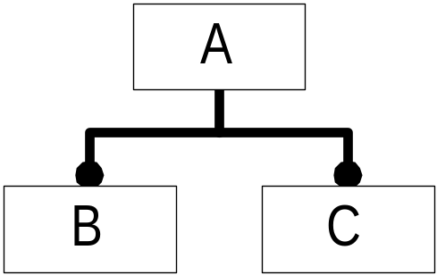
Entity Data Types:
Complex Entity Data Types:
Partial
A
A&B
A&C
A&B&C
B&C
A
A
A
A
B
B
B
C
C
C
Only complex entity data types can be instantiated

Slide 22
Complex Entity Data Types number of Leave Entity Data Types:
1
1
1
2
A
A&B
A&C
A&B&C
A
A
A
A
B
B
C
C
#1=A(...);
#2=B(...)
#3=C(...);
#4=(A(...)B(...)C(...));

Slide 23
Entity Mapping to Java (early binding)
Entity Data Types are represented by
Java Interfaces with prefix "E", e.g. "EXxx"
Complex Entity Data Types are represented by
Java Classes with prefix "C", e.g. "CXxx"
Multiple leave entity data types are separated by "&"
Aggregates of Entity Data Types are represented by
Java Classes with prefix "A", e.g. "AXxx"
CA
CB
CC
CB&C
EA
EA
EA
EA
EB
EB
EC
EC

Slide 24
Entity Mapping to Java (late binding)
All Entity Data Types and Complex Entity Data Types are represented by the Java Interface EEntity
All Aggregates of Entity Data Types are represented by the Java class AEntity
Linking of early and late binding is realized by:
EEntity is directly or indirectly extended by every early binding Entity Interface
public interface EXxx extends EEntity {...}
public interface EYyy extends EXxx {...}
AEntity is directly interfaced by every early binding Aggregate Class
public class AXxx extends AEntity {...}

Slide 25
Logical and Enumerations
LOGICAL and early binding enumerations:
public final class ELogical {
// unset == 0;
public static final int FALSE = 1;
public static final int TRUE = 2;
public static final int UNKNOWN = 3;
public static final String values[] = {"FALSE", "TRUE",
"UNKNOWN"};
private ELogical( ); // no instances are allowed
public static int toInt(String str);
public static String toString(int value);
}

Slide 26
Short form
EXPRESS schemas
Java package with
interfaces and classes
J-SDAI
EXPRESS
-Compiler
Short names
Dictionary data,
based on the
SDAI_dictionary_schema
Long form
EXPRESS schemas

Slide 27
J-SDAI Libarary
file: jsdai_lib.jar (~8.5 MBytes)
IR-schemas: 49
AIC-schemas: 19
PLIB schemas: 2 (soon more)
AP-AIM schemas: 9
AP-ARM schemas: 3 (210, 212, 214)
Mapping Information: 2 (210, 214)
one special "schema" for cross-mixed
Complex Entity Data Types
some test and meta-schemas

Slide 28
Main Management Objects
SdaiSession
root from which every SDAI activity starts from
SdaiRepository
physical storage space for SchemaInstances and SdaiModels
SchemaInstance
logical grouping of models to define a valid population of an express schema
SdaiModel
grouping of entity instances based on one express schema

Slide 29
Auxiliary Management Objects
Implementation
provides runtime information of the implementation
SdaiTransaction
controls simultaneous updating of changes
prevents multiple clients from each other
EntityExtent
auxiliary, easy accessing entity instances
SdaiException
thrown in case of error conditions

Slide 30
Repo A
Repo B
SI BX, Schema X
SI AX, Schema X
SI BY, Schema Y
Model A1,
Model B1,
Schema X
Schema X
Model A2,
Model B1,
Schema X
Schema Y

Slide 31
AP203
...
Applications
Book
Reusable
3D-
PDM
3D-
Software
...
Viewer
Bean
Component
(Beans)
SDAI (Part 22+27)
Extensions
API
RO
RW
RO
Implementation
Opr
JSdaiServer
SdaiSession
external
dictionary
application
part21-files
repo
+map data
data

Slide 32
Core SDAI Structure
SDAI_session_schema
jsdai.lang
SdaiSession
(simplified)
servers S[1:?]
SdaiRepository
SDAI_dictionary_schema
jsdai.dictionary
native_schema
SchemaInstance
associated_models S[0:?]
ESchema_definition
SdaiModel
underlying_schema
parent_schema
(INV) instances
owning_model
EEntity_definition
EEntity
late
binding
EAttribute
ECartesian_point
...
EProduct
early
binding
An application schema

Slide 33
class SdaiException (1)
Extends java.lang.Exception
Thrown by every SDAI operation
Handling of error conditions
getErrorId(): IDs defined for every case, e.g:
/** Repository is not open */
static int RP_NOPN = xx; ...
getErrorDescription() - some explanations
getErrorBase() - the object causing this error
getUnderlyingError(), e.g. file I/O or memory

Slide 34
class SdaiException (2)
Typical usage:
try {
// ... some J-SDAI operations
// ... "
} catch (SdaiException e) {
e.printStackTrace();
int id = e.getErrorId();
String desc = e.getErrorDescription();
Object base = e.getErrorBase();
Exception exc = e.getUnderlyingError();
...
}

Slide 35
class SdaiSession
Lothar:
openSession() is a static method but closeSession() not.
Beginning and ending an SDAI application
SdaiSession session =
SdaiSession.openSession();
....
session.closeSession();
after closing the session object becomes invalid.
Only one SdaiSession object at a time
SdaiSession session =
SdaiSession.getSession();

Slide 36
SdaiSession - Exceptions
SS_NAVL: Session not available
The implementation cannot open a session
SS_NOPN: Session is not open
Access to an SDAI object is possible only when the session is open
SS_OPN : Session open
An attempt was made to open a session while a session was still open

Slide 37
SdaiSession - LogWriter
Used to write out warnings, debug messages, measure times etc.
static
java.io.PrintWriter getLogWriter();
static void
setLogWriter(java.io.PrintWriter out);
Using the logWriter from an application:
s.println("My test message");

Slide 38
class SdaiImplementation
Informs about the name, version and features of the SDAI implementation
Access through SdaiSession
Implementation imp =
session.getImplementation();
Include most information of the
Protocol Implementation Conformance Statement (PICS)

Slide 39
SdaiImplementation (SdaiTerm)
C:\LKSoft\current>java jsdai.util.SdaiTerm
:so
:si
----------- Implementation -------------
name: J-SDAI MULTIPLE
level: Version 2.0 (Build 200, 2000-01-24)
sdai_version: { iso standard 10303 part(22) version(0) }
binding_version: { iso standard 10303 part(27) version(0) }
implementation_class: 5
transaction_level: 3
expression_level: 1
domain_equivalence_level: 2
:q

Slide 40
Levels of Transaction
Level 1 : No transaction
Level 2 : SDAI-Model based transaction
Level 3 : full transaction (J-SDAI)

Slide 41
Levels of Expression Evaluation
Level 1 : No evaluation
Level 2 : Simple evaluation (J-SDAI)
Level 3 : Complex Evaluation
Level 4 : Complete Evaluation

Slide 42
Levels of domain equivalence support
Level 1 : No domain equivalence
Level 2 : Domain equivalence support

Slide 43
Levels not relevant for the
Java bindings to the SDAI
Level of session event recording support -
replaced by the Java Exception mechanism
Level of SCOPE support
deprecated in implementation methods
(SDAI, part21)

Slide 44
Implementation Limits - 1
Q: What is the basis for setting the time?
A: The Java system time which is based on the underlying host, see class
java.lang.System.currentTimeMillis()
Q: What is the maximum number of repositories that may exist within an SDAI session?
A: No limit
Q: What is the maximum number of SDAI-models that may exist within a repository?
A: No limit

Slide 45
Implementation Limits - 2
What is the maximum length of EXPRESS STRING that is supported?
A: 64K due to Java serialization
Q: What is the maximum length of EXPRESS BINARY that is supported?
A: No limit
Q: What is the limit of EXPRESS REAL precision that is supported?
A1: The Java type double has about 14 decimal digits precision, see IEEE 754-1985.
A2: Arbitrary precision by java.util.BigDecimal. Not implemented in current version (late binding only)

Slide 46
Implementation Limits - 3
Q: What is the maximum number of elements that may appear in a variable sized aggregate instance?
A: No limit
Q: What is the maximum number of index positions that may appear in an array instance?
A: No limit
Q: If domain equivalence is supported, what method for declaring it in the data dictionary is supported?
A: Direct usage of EXPRESS short forms

Slide 47
SdaiSession ~> SdaiTransaction
Start either ReadOnly or ReadWrite Transaction
SdaiTransaction t = session.
startTransactionReadOnlyAccess()
SdaiTransaction t = session.
startTransactionReadWriteAccess()
Only one transaction at a time
Accessing the active transaction
if (session.testActiveTransaction()){
t = session.getActiveTransaction();
}

Slide 48
SdaiTransaction - operations
Checking the actual state
switch(t.getMode()) {
case SdaiTransaction.NO_ACCESS: ...
case SdaiTransaction.READ_ONLY: ...
case SdaiTransaction.READ_WRITE: ...}
Aborting the transaction
t.abort();
t.endTransactionAccessAbort();
Committing the transaction
t.commit();
t.endTransactionAccessCommit()

Slide 49
SdaiTransaction - Pending changes
Checking if a modification is pending on
for the whole SdaiSession
if (session.isModified()) { ... }
for a single SdaiRepository and all its models
if (repo.isModified()) { ... }
for a single SdaiModel only
if (model.isModified()) { ... }

Slide 50
SdaiTransaction - Example
SdaiSession s = SdaiSession.openSession();
SdaiTransaction t = s.startTransactionReadOnlyAccess();
// ... read some data
while (...) {
// modify/create data ...
if (s.isModified()) {
t.commit();
} else {
t.abort();
// ... re-read the previous data
}
}
t.endTransactionAccessAbort();
session.closeSession();

Slide 51
SdaiTransaction - Exceptions
TR_EXS : Transaction exists
TR_NEXS : Transaction does not exist
TR_NRW : Transaction not read-write
TR_EAB : Transaction ended abnormally
TR_NAVL : Transaction currently not available

Slide 52
SdaiSession ~> SdaiRepository
Accessing repositories from SdaiSession
ASdaiRepository ar = s.getKnownServers();
ASdaiRepository ar = s.getActiveServers();
SdaiRepository r = ar.getByIndex(5);
A repository is either open (active) or close
if (!r.isActive()) {
r.openRepository();
}
...
if (r.isActive()) {
r.closeRepository();
}

Slide 53
Basic SDAI Structure without Network support
ISO 10303-22
Session
known_servers
S[1:*]
Repository
Persistent
storage
Model
Entity Instance

Slide 54
Extended SDAI with Network support
Client Session
Server Session
Network
connection
known_servers
S[1:*]
Repository
Repository
Persistent
storage
Model
Model
Entity Instance
Entity Instance

Slide 55
Requirements for the Network Protocol
easy to establish (firewall, ...)
=> bi-directional Java streams, based on TCP/IP ports
suitable for SDAI operations
  transferring all entity instances take too long
  transferring single entity instances on request is too slow (100ms delay each)
  => transferring a whole SDAI model at a time
fast loading process
=> optimized arrangement, not like part21 or Java serialization
=> compact (not compressed) binary encoding
Support references between entity instances
  within the same Model
  within the same Repository but different Models
  within different Repositories
Support references between entity instances with different
underlying EXPRESS schemas.

Slide 56
Dynamic SdaiRepository (1)
In the SDAI standard the known repositories are static,
they cannot change while a Session is open.
In the extended SDAI repositories become dynamic objects.
For this new operations are introduced:
- Create Repository
- Delete Repository
- Link Repository
- Unlink Repository
In addition to name Repositories got a location attribute.
During SDAI operations it may happen that a Repository is
“known”, but not its location. So it can’t be opened.

Slide 57
Dynamic SdaiRepository (2)
Access name and location
String name = r.getName();
String location = r.getLocation();
Linking remote/external repositories,
explicit and implicit
r = s.linkRepository("name","location");
r.unlinkRepository();
Create and Delete repositories
r = s.createRepository("name","location");
r = s.importClearTextEncoding("name",
"source_location","destination_location");
r.deleteRepository()

Slide 58
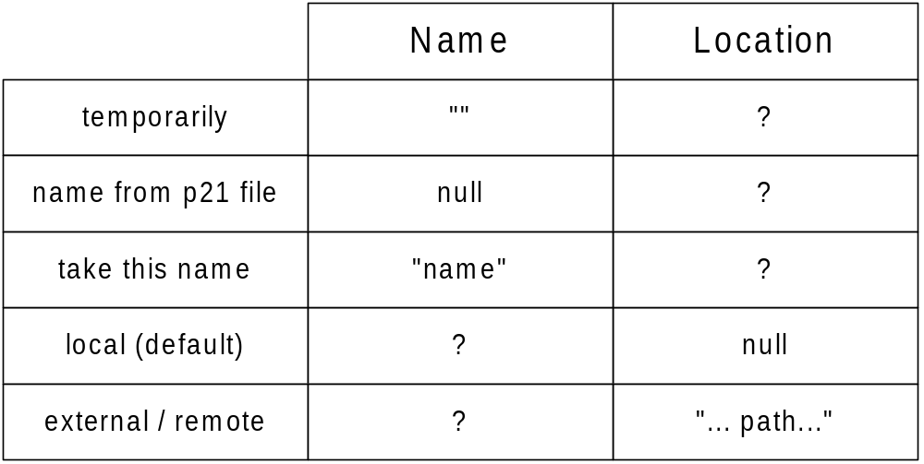
Dynamic SdaiRepository (3)

Slide 59
Working with simple repository names:
Import into a temporarily local repository:
importClearTextEncoding("", "source-path", null)
Take the repo-name from the part21 FILE_NAME:
importClearTextEncoding(null, "source-path", null)
Specify name and location (external and remote):
createRepository("MyRepo", "c:\myrepos") createRepository("MyRepo", "//guest:passwd@192.123.22.11:1050")
createRepository("MyRepo", "//user:passwd@server.lksoft.de")
Working with global unique repository names:
Repository is a part of a domain:
createRepository("//server.lksoft.de/MyRepo", user:passwd)
In future:
createRepository("//testrep.server.lksoft.de", user:passwd)

Slide 60
Which remote repositories are available on a remote location?
A_string as =
s.remoteRepositories("//user:passwd@server.lksoft.de");
for (int i = 0; i < as.getMemberCount(); i++) {
System.out.println(as.getByIndex(i);
}

Slide 61
SdaiRepository - Exceptions
RP_OPN : Repository open
RP_NOPN : Repository is not open
RP_DUP : Repository duplicate
RP_LOCK : Repository locked by another user
RP_NAVL : Repository currently not available
RP_NEXS : Repository does not exist
RP_RO : Repository is read-only
LC_NVLD : Location invalid

Slide 62
SdaiRepository ~> SchemaInstance
A repository stores SchemaInstances
ASchemaInstance asi = r.getSchemas();
SchemaInstance si = asi.getByIndex(n);
A SchemaInstance is stored within a repository
SdaiRepository r = si.getRepository();
Creation and deletion of SchemaInstances
ESchema_definition sd = ...;
si = r.createSchemaInstance("name", sd);
si = r.createSchemaInstance
("name", SAutomotive_design.class);
si.delete();

Slide 63
class SchemaInstance (1)
The name is unique within the repository
String name = si.getName();
si.rename("NewSchemaInstanceName");
A SchemaInstance is based on a schema
ESchema_definition sd = si.getNativeSchema();
String schema = si.getNativeSchemaString();

Slide 64
class SchemaInstance (2)
Valid population defined by collection of models
ASdaiModel am = si.getAssociatedModels() ;
associated models may be in the same or in different repositories
si.addSdaiModel(model1);
si.removeSdaiModel(model2);
associated models may be based on the same or on different schemas, but domain_equivalent schemas.

Slide 65
SchemaInstance - Validation
Uniqueness Validation
int validateUniquenessRule(EUniqueness_rule rule, AEntity err)
int validateUniquenessRule(String rule, AEntity err)
Global rule Validation
int validateGlobalRule(EGlobal_rule rule, AEntity err)
int validateGlobalRule(String rule, AEntity err)
Validate Reference Domain
int validateInstanceReferenceDomain(AEntity err)
CompleteValidation, updates validation info
int validateSchemaInstance()

Slide 66
SchemaInstance - Information
Validation Information,
set by validateSchemaInstance()
String date = si.getValidationDate();
int level = si.getValidationLevel();//0-7
boolean result = si.getValidationResult();
boolean actual = si.isValidationCurrent();
Change Information
if (si.testChangeDate()) {
String date = si.getChangeDate();
}

Slide 67
Pre-Defined SchemaInstances
Dictionary SchemaInstance with all dictionary models
if (s.testDataDictionary()) {
SchemaInstance si =
s.getDataDictionary();
}
Mapping SchemaInstance with all dictionary and mapping models
if (s.testDataMapping()) {
SchemaInstance si = s.getDataMapping();
}

Slide 68
SchemaInstance - Exceptions
SI_DUP : Schema instance duplicate
Name must be unique within SdaiRepository
SI_NEXS : Schema instance does not exist
e.g. SI deleted or repository closed
SI_LOCK : Schema instance locked
Another application is going to modify the SI on a remote repository.

Slide 69
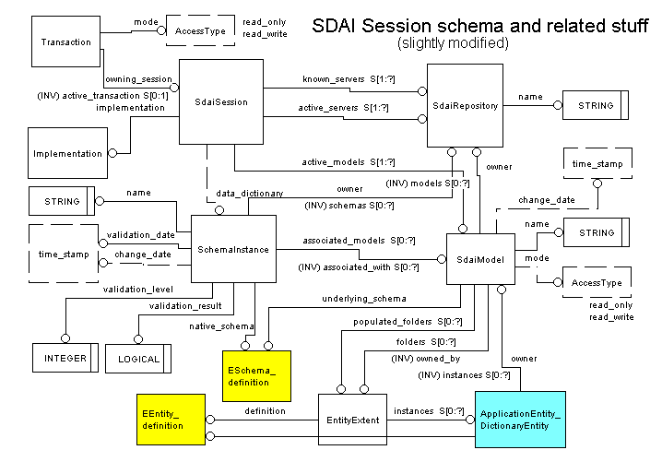

Slide 70
SdaiRepository ~> SdaiModel
SdaiModels are stored in repositories:
ASdaiModel am = r.getModels();
SdaiModel m = am.getByIndex(n);
An SdaiModel is stored within a repository
SdaiRepository r = m.getRepository();
Creation and deletion of SdaiModels
ESchema_definition sd = ...;
m = r.createSdaiModel("name", sd);
m = r. createSdaiModel
("name", SConfig_control_design.class);
m.renameSdaiModel("newName"); // critical!
m.deleteSdaiModel();

Slide 71
SdaiModel - Exceptions
MO_DUP : SDAI-model duplicate
MO_NEXS : SDAI-model does not exist
MO_NVLD : SDAI-model invalid
MO_NDEQ : SDAI-model not domain equivalent
MO_LOCK : Model locked by another user

Slide 72
SdaiModel - Header (1)
The header information is always accessible from a model, no matter if RW, RO access is started or not.
String name = m.getName();
SdaiRepository r = m.getRepository();
ESchema_definition schema =
m.getUnderlyingSchema();
ESchema_definition schema =
m.getDefinedSchema();
ASchemaInstance as = m.getAssociatedWith();
if (m.testChangeDate()) {
String date = m.getChangeDate();
long date = m.getChangeDateLong();
}
alternative: if (m.isModified()) {... }

Slide 73
SdaiModel - Header (2)
The attributes language and context are added to fully support the part21 Amendment
String lang = m.getDefaultLanguage();
m.setDefaultLanguage("ger", true);
A_string as = m.getContextIdentifiers();
m.putContextIdentifiers(A_string value,
boolean all)

Slide 74
SdaiModel - Access Mode
State of access mode
switch(m.getMode()) {
case SdaiModel.NO_ACCESS: ...
case SdaiModel.READ_ONLY: ...
case SdaiModel.READ_WRITE: ... }
Start either RO or RW access
m.startReadOnlyAccess( );
m.startReadWriteAccess( );
Change access mode between RO and RW
m.promoteSdaiModelToRW( );
m.reduceSdaiModelToRO( ); // transaction !
End access mode, take care of transaction !
m.endReadOnlyAccess( );
m.endReadWriteAccess( ); // transaction !
ASdaiModel am = s. getActiveModels();

Slide 75
SdaiModel - Access Mode Exceptions
MX_NDEF : SDAI-model access not defined
MX_NRW : SDAI-model access not read-write
MX_RO : SDAI-model access read-only
MX_RW : SDAI-model access read-write

Slide 76
SdaiModel - Contents (1)
Accessing all instances of all types
int count = m.getInstanceCount();
AEntity ae = m.getInstances();
Accessing all instances of a given
entity data types (including subtypes)
  Early binding:
  int count = m.getInstanceCount(EXxx.class);
  AXxx ax = (AXxx) m.getInstances(EXxx.class);
  Late binding:
  EEntity_definition ed = ...; // xxx
  int count = m.getInstanceCount(ed);
  AXxx ax = (AXxx) m.getInstances(ed);

Slide 77
SdaiModel - Contents (2)
Accessing all instances of a given
complex entity data type (no subtypes)
  Early binding:
  int count =
  m.getExactInstanceCount(CXxx.class);
  AXxx ax =
  (AXxx) m.getExactInstances(CXxx.class);
  Late Binding:
  EEntity_definition ed = ...; // xxx
  int count = m.getExactInstanceCount(ed);
  AXxx ax = (AXxx) m.getExactInstances(ed);

Slide 78
SdaiModel -> EntityExtent
EntityExtent helps to access entity instances of a given
Entity Data Type. Only auxiliary purpose.
Either get all or only the non-empty EntityExtents
AEntityExtent aee = m.getFolders();
AEntityExtent aee = m.
getPopulatedFolders();
EntityExtent ee = aee.getByIndex(3);
Attributes: definition, owner and instances
EEntity_definition ed = ee.getDefinition();
String name = ee.getDefinitionString();
SdaiModel m = ee.getOwnedBy();
AEntity ae = ee.getInstances();
AXxx ae = (AXxx) ee.getInstances();

Slide 79
SdaiModel ~> Entity Instances (1)
An Entity Instance exist only within an owning SdaiModel
Late binding creation
EEntity_definition ed =
m.getEntityDefinition("product");
EEntity p1 = m.createEntityInstance(ed);
Early binding creation
EProduct p1 = (EProduct)
m.createEntityInstance(CProduct.class);
The owning model is always available
Model m1 = p1.findEntityInstanceSdaiModel();
Delete also removes all references from active model
p1.deleteApplicationInstance();

Slide 80
SdaiModel ~> Entity Instances (2)
Create a copy of an entity instance within the same or another model. All references remain on the original instance only.
EEntity p1 = m.copyApplicationInstance(p);
Moving an instance to another model and/or changing
the type (late and early).
Within the same repo the persistent name is preserved.
References from active models are maintained
EEntity pNew
= m.substituteInstance(pOld);
= m.substituteInstance(pOld, ed);
= m.substituteInstance(pOld, CXxx.class);

Slide 81
Domain (1)
A valid valid population of entity instances is defined by a SchemaInstance and its associated SdaiModels.
Some operations need to know the domain where to search/access related instances. Depending on the application the domain may be defined for several SchemaInstances or only part of it. Within J-SDAI the domain is defined as an aggregate of SdaiModel (ASdaiModel).
get inverse attribute
usedin (late and early)
findEntityInstanceUsedin
findEntityInstanceUsers
findInstanceRoles
all mapping operations

Slide 82
Domain (2)
Create a non-persistent Aggregate and add the desired SdaiModels
ASdaiModel domain = new ASdaiModel();
domain.addByIndex(model1);
Access the domain from a single SchemaInstance
SchemaInstance si = ...;
domain = si.getAssociatedModels();
Access the common domain of several SchemaInstances (set)
ASchemaInstance asi = ...;
domain = asi.getAssociatedModels();

Slide 83
Attribute Access
Operations to access the attributes of entity instance, available in late binding and in early binding
test attribute
does the attribute have a value or is it unset?
If it is set what is the type - important for select types
get attribute
retrieves the actual value, either simple, entity instance or aggregate
set attribute
only for simple and entity instance values. Not for aggregates
create
only for attributes of aggregation type. The aggregates are create in place and cannot be assigned.
unset attribute
Makes test attribute to return unset. This is also if aggregate. You can't use set attribute for unset values.

Slide 84
Reading Attribute Value (late)
Testing and accessing attributes
EDefined_type[] select = ...;
EAttribute attr = ...;
int iType = p.testAttribute(attr, select);
switch (iType) {
case 0: ... // unset
case 1: Object o = p.get_object(attr); ...;
case 2: int i = p.get_int(attr);...
case 3: double r = p.get_double(attr);... }
For inverse attributes the domain where to search must be given. If null domain is local SdaiModel only.
EInverse_attribute ia = ... ;
ASdaiModel domain = ... ;
AEntity inverses = get_inverse(ia, domain);

Slide 85
Writing Explicit Attribute Values (late)
Overloaded methods for double, int, Object,
p.set(attr1, 5.7, select);
p.set(attr2, 123, select);
p.set(attr3, "xxx", select);
p.set(attr4, entity, select);
Aggregates can never be set, they are only created in place. Only one usage of aggregates!
Aggregate a =
p.createAggregate(attr5, select);
Every explicit (mandatory) attribute can be unset
p.unsetAttributeValue(attr1);
Derived and inverse attributes are read-only,
also explicit attributes redeclared as derived

Slide 86
Early Binding Attribute Access (1)
The attribtute name is part of the access methods.
The first parameter specifies the type of the Java Interface; this allows to solve name conflicts, always null + casting.
Methods for test, get, set/create, unset, usedin, attribute:
public interface EAlpha extends EEntity {
boolean testA1(EAlpha type);
EKappa getA1(EAlpha type);
void setA1(EAlpha type, EKappa value);
void unsetA1(EAlpha type); ... }
public class CAlpha implements EAlpha { ...
static int usedinA1(EAlpha type, EKappa p,
ASdaiModel domain, AEntity result);
static EAttribute attributeA1(EAlpha type);}
public interface ESigma extends EEntity {
AIota createS0(ESigma type); ... }

Slide 87
Early Binding Attribute Access (2)
In case that the attribute is of a select type additional parameters are added to distinguish overloaded methods for different value types
The approach is similar to the part21 solution
The select cases are numbered. The test method returns the actual type (0-unset, 1-entity, 2, 3...).
no parameter for simple entity types (== 1)
for Defined Data Type this type is added (select1)
several parameter for nested selecting of
Defined Data Types (select2, select3 ...)
Overloaded methods for get, set/create

Slide 88
Early Binding Attribute Access (3)
public interface EEpsilon extends EEntity {
// constants and methods for SELECT attribute: e1
int sE1Phi = 2;
int sE1Psi = 3;
int sE1Chi = 4;
int sE1Tau = 5;
int sE1Xi = 6;
int sE1Pie = 7;
int testE1(EEpsilon type);
EEntity getE1(EEpsilon type) ; // case 1
AEntity getE1(EEpsilon type, EPhi node1); // case 2
AaEntity getE1(EEpsilon type, EPsi node1); // case 3
A_double getE1(EEpsilon type, EChi node1); // case 4
int getE1(EEpsilon type, ETau node1); // case 5
int getE1(EEpsilon type, EXi node1); // case 6
int getE1(EEpsilon type, EPie node1); // case 7 ... }

Slide 89
Diverse Entity Instance Operations
Finding the EAttribute definition (dictionary)
EAttribute ea =
p.getAttributeDefinition("attr1");
Population dependent Bound of a
REAL, INTEGER, or BINARY value
int bound = p.getAttributeValueBound(ea) ;
Instance comparison
if (p1 == p2) {...}
Value comparison as defined in EXPRESS (logical)
int i = p1.compareValues(p2);
flat value comparison (non-recursive, shallow)
if (p1.compareValuesBoolean(p2)) {...}

Slide 90
Instance Identifiers / Persistent Label
Every entity instance has an unchangeable persistent label which is assigned during its creation
String label = p.getPersistentLabel();
J-SDAI use part21 type instance identifiers for this:
"#" + positive 63 bit number, e.g. "#1234"
J-SDAI ensures that a persistent label is used only once within a repository.
Finding an entity instance within a repository
EEntity p = r.getSessionIdentifier("#1234");
Some strings
String descr = p.getDescription();
String part21Line = p.toString();

Slide 91
Entity Type (1)
Does an entity instance contain a Entity Data Type?
EEntity_definition ed = ...;
if (p.isKindOf(ed)) {...}
if (p instanceof ECartesian_point.class){}
Is an entity instance exactly of a particular type?
if (p.isInstanceOf(ed)) {...}
if (p.getClass()== CCartesian_point.class){}
Accessing the Complex Entity Data Type
EEntity_definition ed = p.getInstanceType();
Class c = p.getClass();
Find the named_tpes, like EXPRESS TypeOf operation
ANamed_type result = ...;
p.findInstanceDataTypes(result);

Slide 92
Entity Type (2)
For entity instances of the dictionary type
EEntity_definition p1, p2;
Checking if one is a subtype of the other
if (p1.isSubtypeOf(p2)) {...}
Are entities from different schema equivalent
if (p1.isDomainEquivalentWith(p2) {...}
No supported by SDAI because short-form solution
Creation of new Complex Entity Data Types
ESchema_definition sd = ...;
AEntity_definition aed = ...;
EEntity_definition ed =
s.getComplexEntityDefinition(aed,sd);
Class ac[] = { EBbb.class, ECcc.class };
Class c = s.getComplexEntityDefinition(ac);

Slide 93
Relating Entity Instances with App. Data
While a model is active, it's entity instances can be associated with application specific data of any kind.
The application is responsible for the data, not J-SDAI. The association is lost when access ends.
Object o = ... ; // from Application
p.setTemp(o);
...
Object o = p.getTemp()
A common place to exchange entity instances
AEntity ai = s. getClipboard();
Applications can clear, add, remove instances

Slide 94
Related instances
Find all referencing instances within a domain
ASdaiModel domain = ...;
AEntity users = new AEntity();
p.findEntityInstanceUsers(domain, users);
Find all referencing instances of a particular role within a domain
EAttribute role = ...;
p.findEntityInstanceUsedin(role,domain,users);
Find all roles by which this instance is referenced
AAttribute result = ...;
p.findInstanceRoles(domain, result);

Slide 95
Entity Instance Validation
Validation of the attributes and rules of a entity instance
validateWhereRule(EWhere_rule rule)
validateRequiredExplicitAttributesAssigned(AAttribute nonConf)
validateExplicitAttributesReferences(AAttribute nonConf)
validateInverseAttributes(AAttribute nonConf)
validateAggregatesSize(AAttribute nonConf)
validateAggregatesUniqueness(AAttribute nonConf)
validateArrayNotOptional(AAttribute nonConf)
validateStringWidth(AAttribute nonConf)
validateRealPrecision(AAttribute nonConf)
validateBinaryWidth(AAttribute nonConf)

Slide 96
Aggregate Interface and Classes
One fits all: SET, BAG, LIST or ARRAY
Interface implemented by all aggregate classes except
ASdaiRepository
ASchemaInstance
ASdaiModel
AEntityExtent
Single (A) and nested Aggregates (Aa...a)
Specialized aggregates for primitive types
A_binary, Aa_binary, Aaa_binary,
A_boolean, Aa_boolean, Aaa_boolean,
A_double, Aa_double, Aaa_double,
A_enumeration, Aa_enumeration, Aaa_enumeration
A_integer, Aa_integer, Aaa_integer,
A_string, Aa_string, Aaa_string

Slide 97
Early Binding Aggregate classes
For all Entity Data Types XXX
single: AXxx
nested as needed: AaXxx, AaaXxx ...
For some Select Data Types (as needed) SSS
single: ASss
in extreme cases also nested: AaSss
Accessing members of different type by overloaded methods, similar to part21 encoding
(see select for early binding attribute access)

Slide 98
Iterating and indexing Aggregates
The members of an aggregate can be accessed either by an iterator or by index:
RO and RW access with SdaiIterator
SdaiIterator iter = agg.createIterator();
value = agg.getCurrentMember(iter);
RO access by index for all types, RW only for LIST and ARRAY.
value = agg.getByIndex(5);

Slide 99
Aggregate creation
Entity instance attribute (late and early)
Aggregate a =
p.createAggregate(attr5, select);
AXxx = p.createAttrib1(null);
Nested Aggregates
createAggregateAsCurrentMember
createAggregateAfter
createAggregateBefore
createAggregateByIndex
addAggregateByIndex
createAggregateUnordered
User aggregates (Non Persistent Lists)
AXxx ax = new AXxx();
ASdaiModel am = new ASdaiModel();

Slide 100
Aggregate Access Rights
Session aggregates are RO. See the special operations to modify them. Exception when creates with new.
ASdaiRepository, ASchemaInstance,
ASdaiModel, AEntityExtent,
SdaiModel.getInstances(...);
SdaiModel.getExactInstances(...);
EntityExtent.getInstances();
All data in the special "SystemRepository" repository containing dictionary and mapping data is read-only
Aggregates in application data is RW if RW-transaction and RW model access is started
Non Persistent List aggregates are always RW

Slide 101
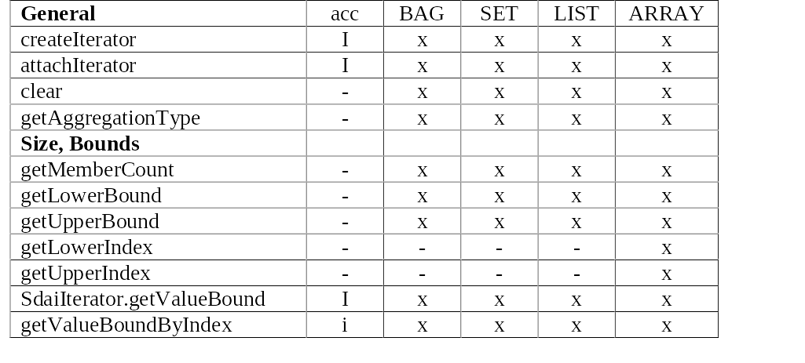
Aggregate: General and Bounds

Slide 102
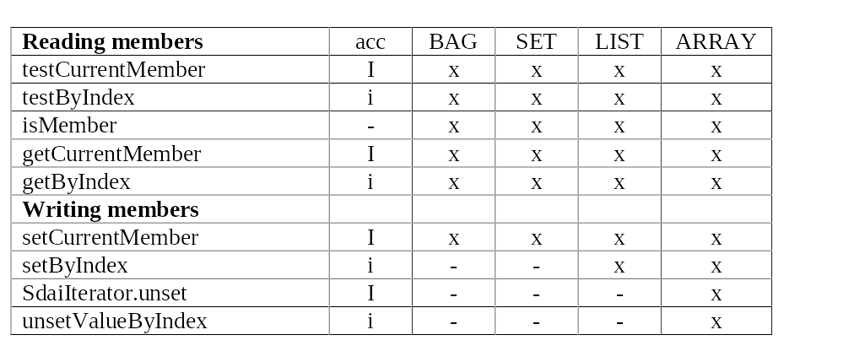
Aggregate: Reading and Writing members

Slide 103
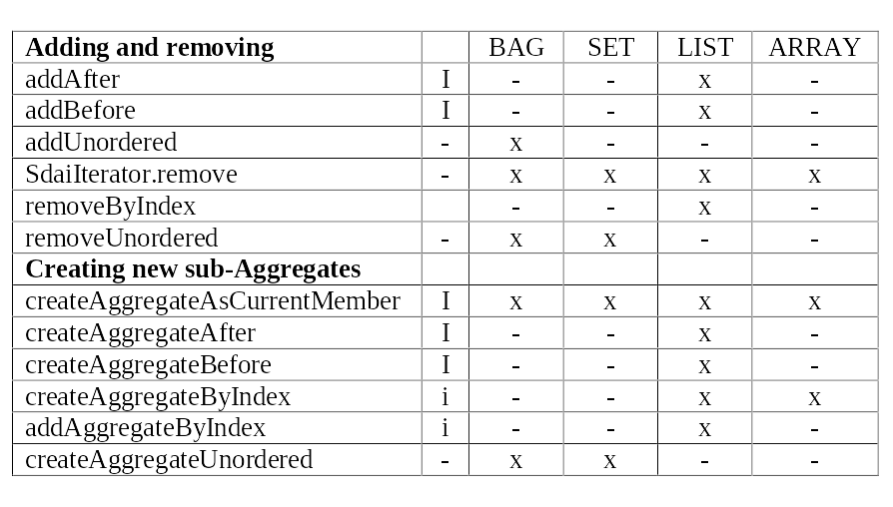
Aggregate: add, remove, create members

Slide 104
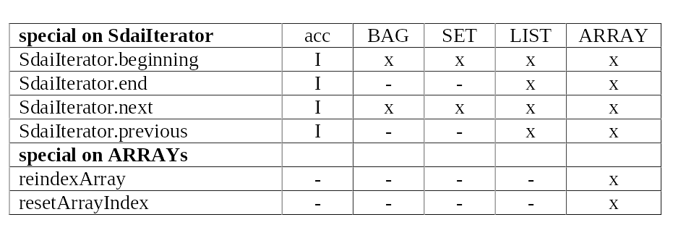
Aggregate: special

Slide 105
Query
Source where to search
- SdaiRepository
- SchemaInstance
- SdaiModel
- ASdaiModel
Expression
spec: attribute.name, {...}
operator: =, <=, =>, <, >, :=:, :<>:, IN, LIKE
value or UNSET
Result added to AEntity, return count
Not implemented in J-SDAI 2.0

Slide 106
Import / Export of ISO 10303-21
Clear Text Encoding of the Exchange Structure
Technical Corrigendum (TC1) fix select bug.
Amendment extends for multiple data sections.
Originally part21 and SDAI are not related
The complete Java Binding defines a mapping based on SdaiRepository. A mapping to SchemaInstance would also be a good alternative.
SDAI is more powerful. Import is always possible but export is restricted because of:
  missing schema_instance (domain, validation)
  references into other repositories

Slide 107
Mapping between part21 and SDAI
complete Exchange Structure SdaiRepository
FILE_NAME SdaiRepository.name
Data-Section SdaiModel
instance identifier Persistent Label

Slide 108
Repository / part21 attributes
ENTITY file_description;
description : LIST [1:?] OF STRING (256) ; -> description
implementation_level : STRING (256) ; -> "2.1" or "3.1"
END_ENTITY;
ENTITY file_name;
name : STRING (256) ; -> name
time_stamp : STRING (256) ; -> timeStamp
author : LIST [ 1 : ? ] OF STRING (256) ; -> author
organization : LIST[ 1 : ? ] OF STRING (256) ; -> organization
preprocessor_version : STRING (256) ; -> preProcessorVersion
originating_system : STRING (256) ; -> originatingSystem
authorization : STRING (256) ; -> authorization
END_ENTITY;

Slide 109
Repository / part21 attributes
String getAuthorization()
setAuthorization(java.lang.String value)
A_string getAuthor()
A_string getDescription()
A_string getOrganization()
String getOriginating_system()
setOriginating_system(java.lang.String value)
String getPreprocessor_version()
setPreprocessor_version(java.lang.String value)
suppressShortNames(), allowShortNames()

Slide 110


SDAI_dictionary_schema: Principles
Meta model and data:
#10=SCHEMA_DEFINITION('test_schema',...);
#20=ENTITY_DEFINITION('A', ..., #10, ...);
#30=ENTITY_DEFINITION('B', ..., #10, ...);
#40=ATTRIBUTE('x', ..., #30, ...);
Application model (test_schema) and data:
#80=A( );
#90=B(#80),

Slide 111
SDAI_dictionary_schema: Overview
Semantic Meta model of the EXPRESS language
Alternative representation of EXPRESS schemas.
The SDAI_dictionary_data itself can be represented as a population of the SDAI_dictionary_schema.
It is a kernel part of J-SDAI in package jsdai.dictionary
Basis for Late Binding entity and attribute access.
In J-SDAI the SDAI_dictionary_schema is slightly modified for explicit support of short form schemas.
The SDAI_dictionary_schema will probably be substituted by a unified Semantic Meta Model for EXPRESS when available.

Slide 112
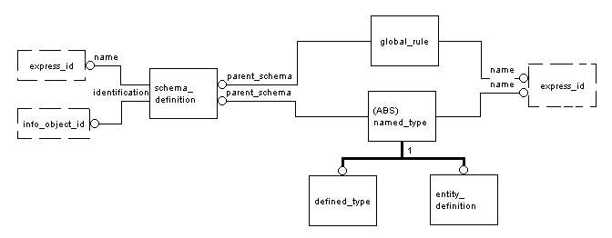
SDAI_dictionary_schema: Original
entity_definitions cannot be explicitly interfaced into other schemas

Slide 113
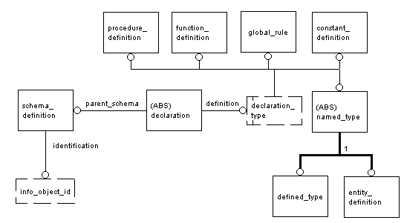
SDAI_dictionary_schema: Modified

Slide 114
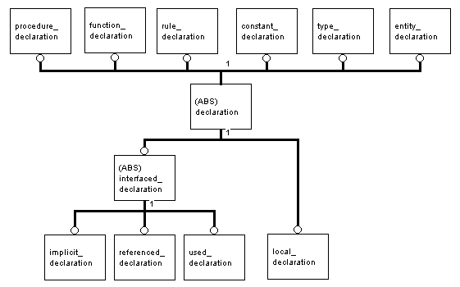
SDAI_dictionary_schema: Declarations

Slide 115
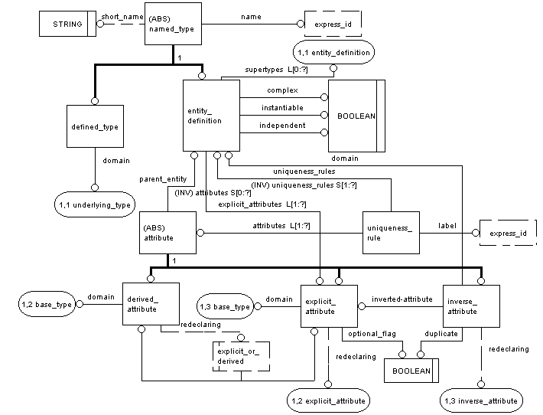

Slide 116
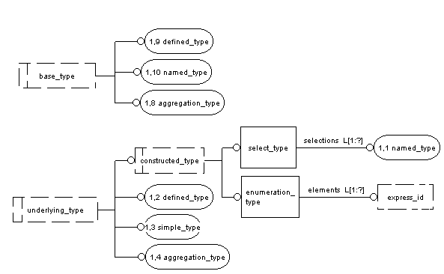

Slide 117
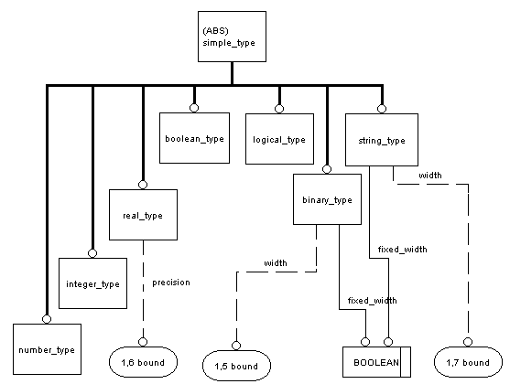

Slide 118
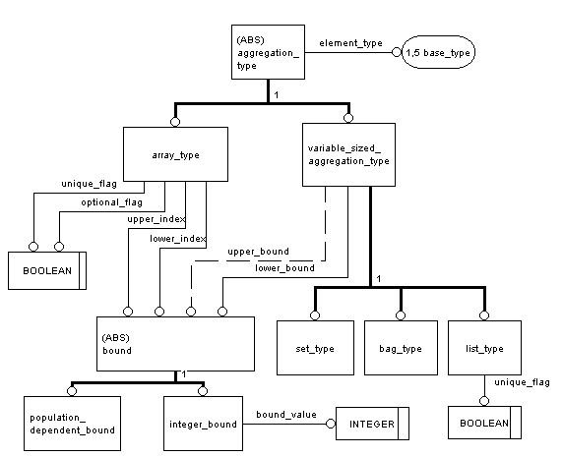

Slide 119
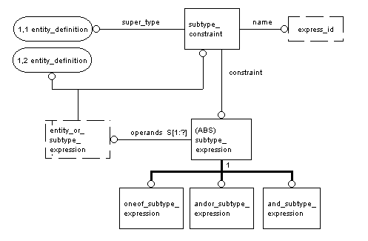

Slide 120
SDAI_dictionary_schema: Summery
It fulfills the primary needs of SDAI (late binding)
Added "declaration" entities allows full short form support, needed for interoperable schemas
Added sub-super type constraints
(compatible to E-Amendment)
It lacks modeling of
  expressions, statements, constants and variables
  needed for the body of functions and procedures
  splitting of entity data type and
  complex entity data type
  simple types should be represented as constant instances, not as entities.

Slide 121
Structure of STEP Application Protocols
Mapping Extensions of J-SDAI
SDAI, part21
ARM
Mapping
AIM
Table

Slide 122
Mapping Schema and
Mapping Operations, History
The mapping extensions of the SDAI_dictionary_schema and associated operators
  WG11/N050 SDAI Mapping Schema
  WG11/N051 SDAI Mapping Schemas II
  WG11/N068 Requirements for the next version of SDAI
  WG11/N075 Mapping Operations for the SDAI
Data conversion: AIM <=> ARM <=> EPISTLE
but not: AIM <=> EPISTLE

Slide 123
Dependencies of the STEP
Description and Implementation Methods
SDAI_dictionary
_schema
Compiler
EXPRESS
Generator
Import
SDAI
Part21
Export

Slide 124
SDAI_dictionary
_schema
+
mapping_schema
Compiler
EXPRESS
+ Mapping
Generator
SDAI +
Mapping operation
Import
Part21
Export

Slide 125
Mapping Table
Compiler
Mapping
Table
(ASCII)
Mapping
AIM
ARM
dictionary_ +
mapping_schema
Compile
EXPRESS (X,2)
+ Mapping
ARM
Generate
AIM
Generate
HTML -
Documentation
Combined
ARM + AIM
+ Mapping
SDAI +
Mapping operation
Import
Part21
Export
ARM <=> AIM converter

Slide 126
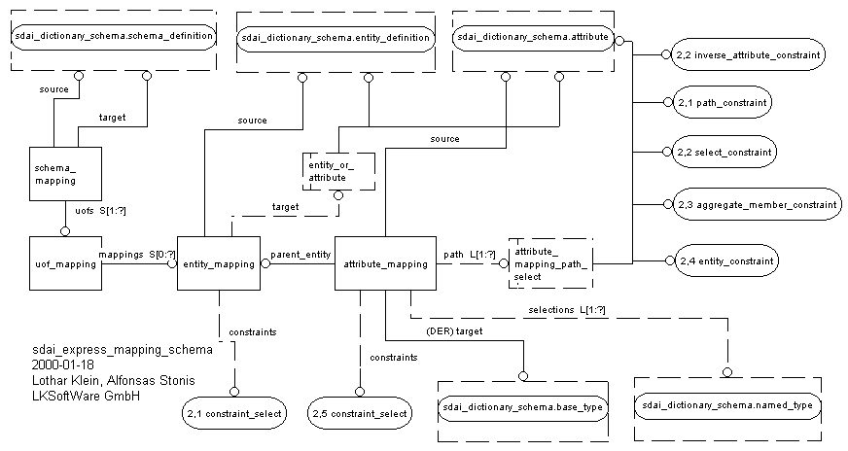

Slide 127
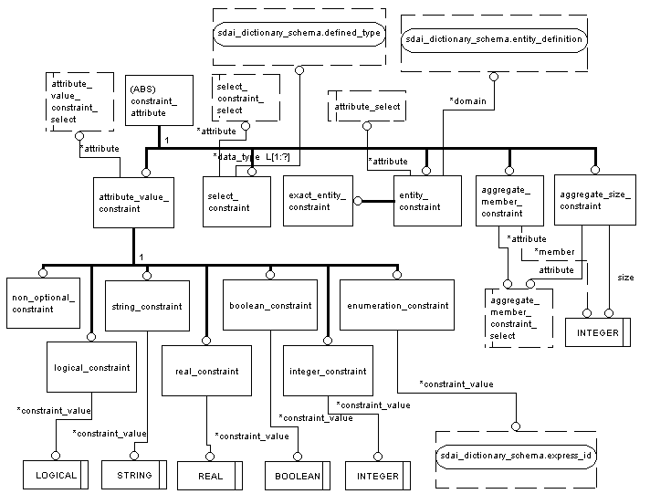

Slide 128
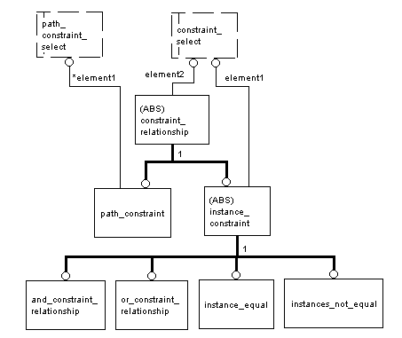

Slide 129
Mapping Operations (1)
Allow to work on AIM instances with ARM types
Require dictionary data for ARM, AIM and mapping data => late-binding
(Early binding also possible, but many classes and code)
Read operations:
  find instances which fits to a given ARM type
  test if instance fits to an ARM type
  test ARM attribute
  get ARM value
Write operations:
  create AIM instances for ARM type
  set/unset ARM attribute values on AIM instance
Mapping methods are defined in SdaiModel and EEntity

Slide 130
Mapping Operations (2)
Take care of all constraints in the reference path.
User can ignore the reference path column.
Define a higher level API on top of the lower level SDAI
User need to know only column 1 -Application element-
and 2 -AIM element-.
Are limited to the quality of the Mapping Tables
The read-operations (AIM to ARM) find all solutions, either 0, 1 or many. Often not only one solution.
Extensions are needed to cover Conformance Classes and top - entities from where to start searching; e.g. product_concept

Slide 131
Mapping Operations (3)
Example for testing and accessing ARM
EAttribute armAttribute = ...;
ASdaiModel dataDomain = ...;
ASdaiModel mappingDomain = ...;
AAttribute_mapping attAlternatives =
p.testSourceAttribute(armAttribute,
dataDomain, mappingDomain);
if (attAlternatives != null) {
Object o =
p.getMappedAttribute(armAttribute,
dataDomain, mappingDomain);
}

Slide 132
Memory Limitations
J-SDAI stores the persistent information of repositories and models on disk
The contents of a closed repository is stored on disk only.
The contents of an in-active SdaiModel (no RO/RW access) is also stored on disk only.
When opening a repository its models and SchemaInstances are loaded into RAM
When activating a model in RO or RW access mode its entity instances are loaded into RAM

Slide 133
Memory (2)
The available RAM limits the number of available entity instances at a time. Consequences for practical works:
Don't make SdaiModels too big. Several of them should always fit into RAM
De-active models when not needed (end access)
General, don't keep pointers to objects you don't need:
  set them to null when no longer needed
  minimize data fields in classes - define as many fields as possible in methods (stack)

Slide 134
Memory (2)
A 128 MByte machine can typically handle 250,000 entity instances or more simultaneously.
This is sufficient for many applications. The problem is more that the STEP-APs and IRs give no guidance how to use SdaiModels (devide and conquer)
e.g. an A-BREP into one model

Slide 135
SdaiEvent and -Listeners (1)
Applications may want to be informed if an SDAI object is changed either through local activities or from remote actions.
Objects of class SdaiEvent inform on changes
SDAI classes implementing the interface SdaiEvenSource can send out SdaiEvents
Application classes implementing SdaiListener can receive SdaiEvents when having registered at SdaiEventSources as listener.

Slide 136
SdaiEvent and -Listeners (2)
Currently (J-SDAI 2.0) the interface SdaiEvenSource is implemented by:
EEntity the basis for all application and dictionary instances
SdaiRepository
For future versions we plan to have SdaiEventSource also implemented by:
All kind of Aggregates
SdaiModel
SchemaInstance

Slide 137
SdaiEvent and -Listeners (3)
SdaiEvent inform on these modifications:
ATTRIBUTE_MODIFIED
INVALID
MEMBER_ADD
MEMEBER_REMOVE
SERVER_DATA_CHANGED
Other SdaiEvent types may be considered for the future
SdaiEvent and SdaiListener define an information system on pur SDAI basis - it is on persistend data. It can be a replacement for other Java APIs such as InfoBus for this specific purpose

Slide 138
Other possible part27 implementations
Dynamic loading of only the needed entity instances from disk/network
handling unlimited number of entity instances
Implementation cannot know which data will be needed. Therefor entity instances are only loaded on request, e.g. with get attribute methods. This will significantly slow down
Operations like SdaiModel.getInstances or EntityExtent.getInstances are not useful. How to start initially (-> query)
For every get Attribute access if is checked if this instance is already loaded

Slide 139
EXPRESS support for Modularization and it’s usage in STEP today
EXPRESS supports modular data modeling by interfacing elements from other schemas
into a local one. Elements are interfaced either
  explicitly with REFERENCE FROM or USE FROM or
  implicitly when used by explicitly interfaced elements.
Within the context of a schema only locally declared entities or entities interfaced
with USE FROM can be individually instantiated. Instances of entities which are interfaced
either implicitly or with REFERENCE FROM are only allowed if they are referenced
from locally defined or USE FROM entity instances.
Today STEP consists of 66 schemas in the Integrated Resources (IR) and
Application Interpreted Construct (AIC). While the IR schemas interfaces elements from
other IRs with REFERENCE FROM the AIC do this with USE FROM.
Every Application protocols (AP) have a short form and a long form schema.
The short form schema interfaces elements from the integrated and interpreted
schemas with USE FROM. In the long form schema all interfaced elements are resolved in
one global schema. So far STEP implementations are based on the
long-form schemas.
For AP-interoperability and for component based programming (beans)
the usage of the AP short form is essential !

Slide 140
application_context_schema
product_context
REFERENCE FROM
product
product_definition_schema
product_definition_formation
REFERENCE FROM
product_definition
product_property_definition_schema
product_definition_shape
REFERENCE FROM
product_property_representation_schema
shape_definition_representation
REFERENCE FROM
representation-schema
shape_representation
AIC 514
advanced_brep_shape_representation
USE FROM
AIC511
advanced_face
USE FROM
geometry_schema
topology_schema
geometric_model_schema
cartesian_point

Slide 141
Problems with short form implementation
The proposed p21 amendment allows more than one Data-Section.
A Data-Section in a p21 file or an SdaiModel is based on one EXPRESS schema.
The Data-Section /SdaiModel can contain only instances of entities defined in its
underlying schema or of interfaced entities. What to do with AP specific subtypes?
Exclude them from AP interoperability
Use CONNOTATIONAL subtypes (Express V2)
allow foreign subtypes in Data-Section / SdaiModel
How many instances shall a Data-Section / SdaiModel contain?
E.g. for the application_context_schema typically only 4 instances are needed.
But with too few instances the overhead of having a separate Data-Section / SdaiModel is too big.
A complete assembled product with all shapes can easily consists of several millions of instances.
There is a practical upper limit of less than one million instances for an SdaiModel.
Otherwise working on repositories with billions of instances, referencing each other
will be hard to implement and inefficient. (Optimal less than 100,000 instances per SdaiModel)
Guidelines are needed for practical / typical sizes of Data Sections / SdaiModels.
Are Data-Sections / SdaiModel needed for every schema or only for the major ones?
Guidelines are needed for which schemas to use,
e.g. AIC schemas and product_property_representation_schema,
but probably not application_context_schema

Slide 142
Some hot topics from our perspective
Implementations based on EXPRESS short forms:
It makes us a lot of work to get mating sets of all the
EXPRESS schemas - and we have to update the old
APs (203) for the AICs ourselves.
Identifying the possible complex entity data types
with several leaves. These are those which require
external mapping in a part21 file.
Today's STEP schemas allow an astronomic big
number of those complexes - but only a few are
really relevant and are supported by applications.
Making mapping tables (clause 5.1 of APs) and
conformance classes (4.1 of APs) computer readable.

Slide 143
Topics: Future SDAI Directions
Effects of the EXPRESS Amendment and EXPRESS-2 on SDAI
How the EXPRESS-2 semantic Meta-model will influence the SDAI_dictionary_schema
PLIB 32, the Geometric Programming interface for Java
How SDAI may support Parametrics
What SDAI can do for the special needs of handling life cycle information as defined in STEP-AP221, ISO 15926, EPISTLE

