Slide 1

CS 501 – Introduction to JAVA Programing
Lecture 2 – Elementary Programming, Selections

Slide 2
Elementary Programming
To learn
how to solve practical problems programmatically.
to learn Java primitive data types and related subjects, such as variables, constants, data types, operators, expressions, and input and output.

Slide 3
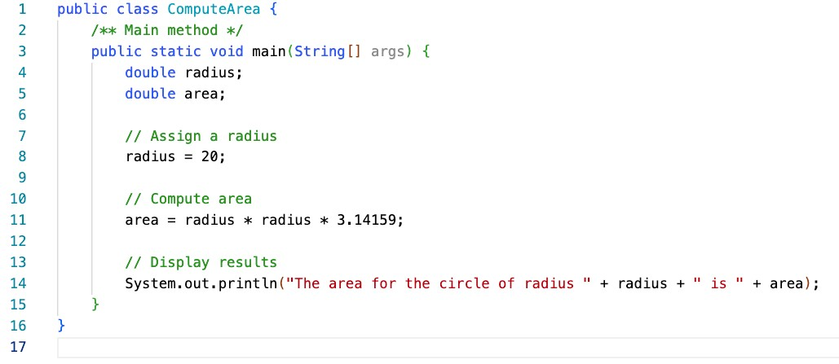
Example – Area of Circle

Slide 4
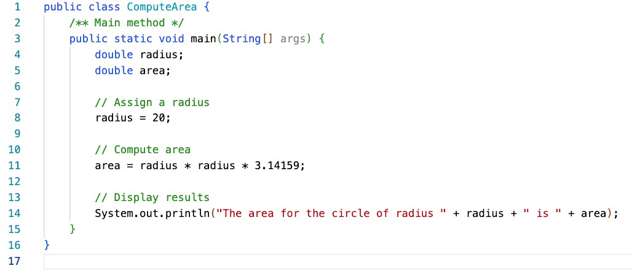
Example – Area of Circle
Allocate memory for radius and area.
No values

Slide 5
Example – Area of Circle
Assign 20 to radius:
Area: No values

Slide 6
Example – Area of Circle
Computes the area using assigned radius
Switch to code – ComputeArea

Slide 7
File Headers – Automate for Labs/Assignments
File -> Settings -> Editor -> File and Code Templates -> Includes -> File Header
/**
* @author: ${USER}
* @class: CS501 Intro to Java
* @description:
* @date: ${DATE}, ${DAY_NAME_FULL}
**/

Slide 8
Imports
Bring classes and interfaces from other packages into our file. Syntax:
import package.name.Class; // Import a single class
import package.name.*; // Import all classes from a package
To get started with inputs, we will be importing the Scanner class.
import java.util.Scanner;
Switch to code - Greetings

Slide 9
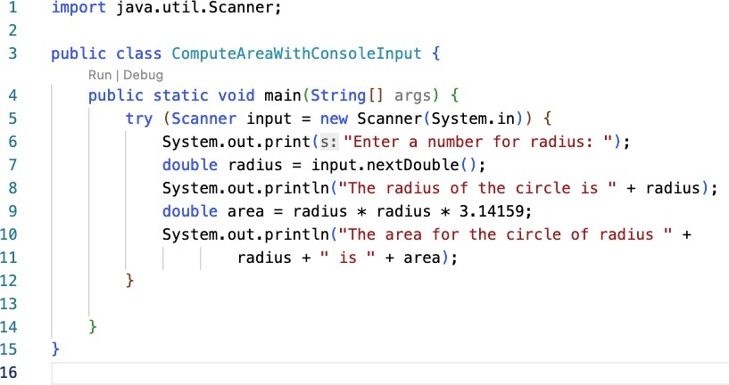
Example – Reading Input from the Console
Explicit Import.
Alternatively, it can be replaced with java.util.*; Generally discouraged!

Slide 10
Example – Reading Input from the Console
Create a Scanner object, note the use of new

Slide 11
Example – Reading Input from the Console
Use the method nextDouble() to obtain a double value.
Switch to code - ComputeAreaWithConsoleInput

Slide 12
Identifiers – Variable/Class Names
Identifiers are the names that identify the elements such as classes, methods, and variables in the program.
An identifier is a sequence of characters that consist of letters, digits, underscores (_), and dollar signs ($).
An identifier must start with a letter, an underscore (_), or a dollar sign ($). It cannot start with a digit.
An identifier cannot be a reserved word. (See Appendix A, “Java Keywords,” for a list of reserved words).
Common reserved words: assert, case, catch, char, continue, do, double, else, final, for, if, import, int, package, private, public, return, static, switch, this, void, while
An identifier cannot be true, false, or null.
An identifier can be of any length.
Examples of illegal identifiers:
2A, d+4

Slide 13
Variables
Variables are used to represent values that may be changed in the program, e.g., radius, area
Variable declaration tells the compiler to allocate appropriate memory space for the variable based on its data type.
The syntax for variable declaration is in the order of datatype and the name. For example,
int x;
x = 1;
// Declare x to be an
// integer variable;
// Assign 1 to x;
int x = 1;
int x = 5 + 2; // Assign the value for the
// expression to x
double radius = 1.4; char a = ‘A’;
double radius; // Declare radius to
// be a double variable; radius = 1.0; // Assign 1.0 to radius;
char a;
a = 'A';
// Declare a to be a
// character variable;
// Assign 'A' to a;

Slide 14
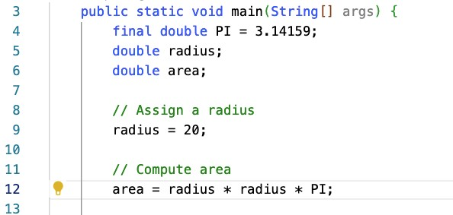
Named Constants
A named constant is an identifier that represents a permanent value.
The named constant declaration can be done as
final datatype CONSTANTNAME = VALUE;
final double PI = 3.14159;
final int SIZE = 3;

Slide 15
Naming Conventions
Choose meaningful and descriptive names.
Variables and method names:
Use lowercase. If the name consists of several words, concatenate all in one, use lowercase for the first word, and capitalize the first letter of each subsequent word in the name. For example, the variables radius and area, and the method computeArea.
Class names:
Capitalize the first letter of each word in the name. For example, the class name ComputeArea.
Constants:
Capitalize all letters in constants, and use underscores to connect words. For example, the constant PI and MAX_VALUE

Slide 16
Numerical Data Types and Operations
Name | Range | Storage Size
byte | –2⁷ to 2⁷ – 1 (-128 to 127) | 8-bit signed
short | –2¹⁵ to 2¹⁵ – 1 (-32768 to 32767) | 16-bit signed
int | –2³¹ to 2³¹ – 1 (-2147483648 to 2147483647) | 32-bit signed
long | –2⁶³ to 2⁶³ – 1 (i.e., -9223372036854775808 to 9223372036854775807) | 64-bit signed
float | Negative range: | 32-bit IEEE 754
-3.4028235E+38 to -1.4E-45
Positive range:
1.4E-45 to 3.4028235E+38
Negative range:
-1.7976931348623157E+308 to -4.9E-324
double
64-bit IEEE 754
Positive range:
4.9E-324 to 1.7976931348623157E+308

Slide 17
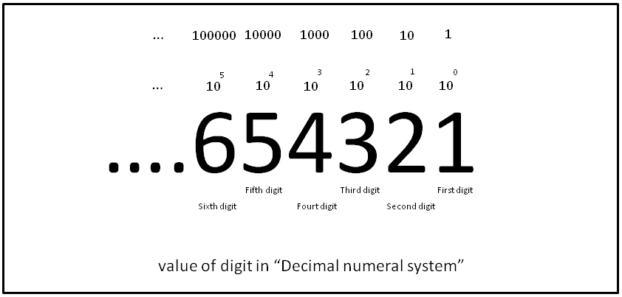
Quick Lesson on Binary!
It’s the same thing as decimal, but with a base of 2. This means we only need two characters: 0 and 1.
https://en.wikipedia.org/wiki/Decimal

Slide 18
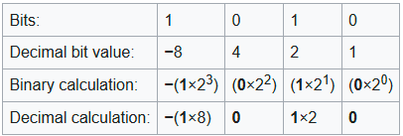
How do we represent negative numbers? Two’s Complement
Make the first bit (most significant bit) negative!
This is why for n bits we see ranges that have exponents of 2^{n}-1.
The rest of the bits are still positive. -6 can be represented as 1010.
https://en.wikipedia.org/wiki/Two%27s_complement

Slide 19
Going from Positive to Negative – Two’s Complement
Flip the positive number’s bits and add one (ignore overflow) to get the negative equivalent.
0110 -> 1001 + 1 = 1010 0000 -> 1111 + 1 = 0000 0111 -> 1000 + 1 = 1001
6 -7 -6 0 -1 0 7 -8 -7
1010 -> 0101 + 1 = 0110 0001 -> 1110 + 1 = 1111 1001 -> 0110 + 1 = 0111
-6 5 6 1 -2 -1 -7 6 7
https://en.wikipedia.org/wiki/Two%27s_complement

Slide 20
How do we store fractions? - Simplified
Same as in decimal: 12.5 -> 1100.1 5.8 -> 101.1100110011…
Full details: IEEE 754, Example: https://www.youtube.com/watch?v=8afbTaA-gOQ

Slide 21
Numerical Data Types and Operations
Scanner input = new Scanner(System.in); int value = input.nextInt();
Method Description
nextByte() nextShort() nextInt() nextLong() nextFloat() nextDouble()
reads an integer of the byte type. reads an integer of the short type. reads an integer of the int type. reads an integer of the long type. reads a number of the float type. reads a number of the double type.

Slide 22
Numerical Data Types and Operations
Name
Meaning
Example
Result
+
Addition
34 + 1
35
-
Subtraction
34.0 – 0.1
33.9
*
Multiplication
300 * 30
9000
/
Division
1.0 / 2.0
0.5
If both variables are integer, 1 / 2 = 0.
%
Remainder
20 % 3
2

Slide 23
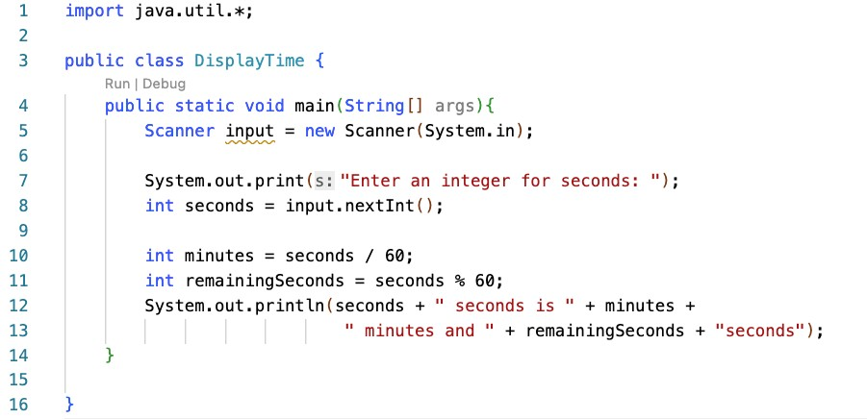
Example: % Operator
Create a scanner

Slide 24
Example: % Operator
Read an integer seconds
If input is 500, seconds=500

Slide 25
Example: % Operator
500 / 60 = 8
500 % 60 = 20
Switch to code – DisplayTime

Slide 26
Example: % Operator
Suppose today is Saturday and you and your friends are going to meet in 10 days. What day is in 10 days?
Saturday is the 6th day in a week
A week has 7 days
(6 + 10) % 7 is 2
The 2nd day in a week is Tuesday
After 10 days

Slide 27

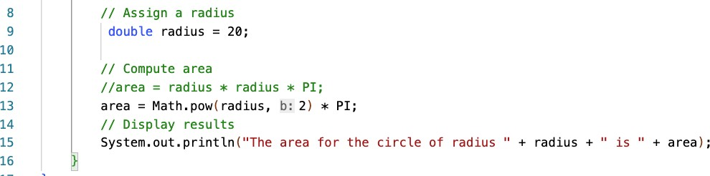
Exponent Operation
Math.pow(a,b) were a is the base and b is the exponent.

Slide 28
Literals
A literal is a constant value that appears directly in the program.

Slide 29
Literals - Integer
An integer literal can be assigned to an integer variable as long as it can fit into the variable. A compilation error would occur if the literal were too large for the variable to hold.
The statement byte b = 1000₁₀ would cause a compilation error,
because 1000 cannot be stored in a variable of the byte type.
An integer literal is assumed to be of the int type, whose value is between -2³¹ (-2147483648) to 2³¹–1 (2147483647).
To denote an integer literal of the long type, append it with the letter L or l. L is preferred because l (lowercase L) can easily be confused with 1 (the digit one).

Slide 30
Literals – Floating-Point
Floating-point literals are written with a decimal point.
By default, a floating-point literal is treated as a double type value.
5.0 is considered a double value, not a float value.
Can make a number a float by appending the letter f or F, and make a number a double by appending the letter d or D.
use 100.2f or 100.2F for a float number
100.2d or 100.2D for a double number.
System.out.println("1.0 / 3.0 is " + 1.0 / 3.0);
displays 1.0 / 3.0 is 0.3333333333333333
16 digits
System.out.println("1.0F / 3.0F is " + 1.0F / 3.0F);
displays 1.0F / 3.0F is 0.33333334
7 digits

Slide 31
Scientific Notation
Floating-point literals can also be specified in scientific notation.
E (or e) represents an exponent and it can be either in lowercase or uppercase.
o 1.23456e+2, same as 1.23456e2, is equivalent to 123.456.
o 1.23456e-2 is equivalent to 0.0123456.

Slide 32
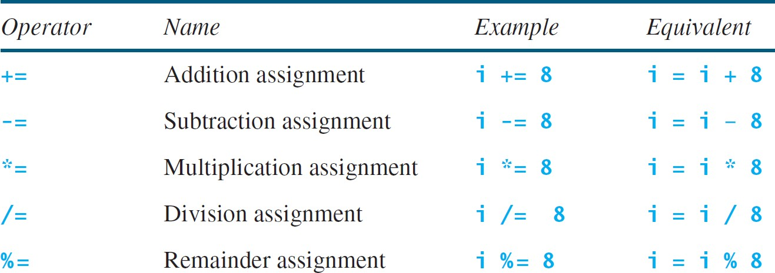
Augmented Assignment Operators

Slide 33
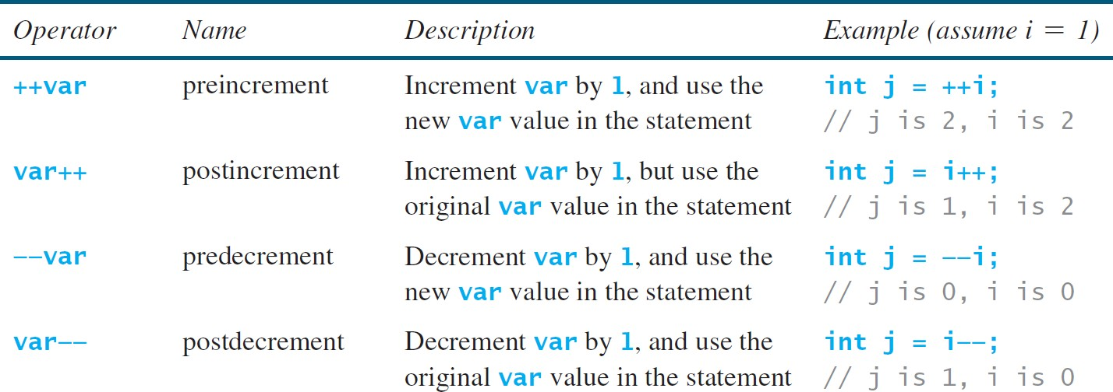
Increment and Decrement Operators
int i = 10;
int newNum = 10 * i++;
Same effect as
int newNum = 10 * i; i = i + 1;
int i = 10;
int newNum = 10 * (++i);
Same effect as
i = i + 1;
int newNum = 10 * i;

Slide 34
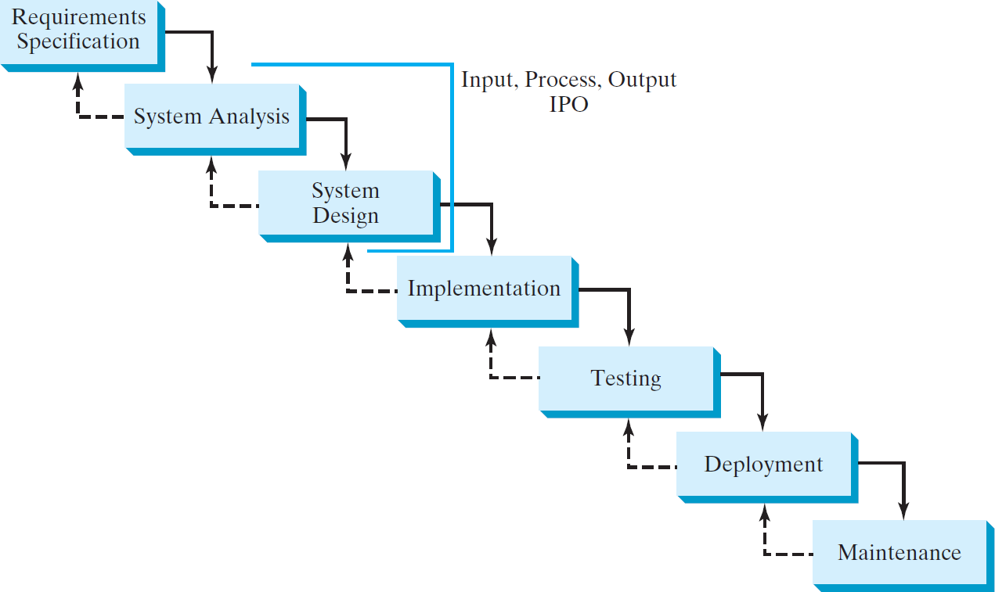
Software Development Process

Slide 35
boolean Data Type, Values, and Expressions
Often in a program you need to compare two values, such as whether i is greater than j.
Java provides six comparison operators (also known as relational operators) that can be used to compare two values.
The result of the comparison is a Boolean value: true or false.
boolean b = (1 > 2);

Slide 36
boolean Data Type, Values, and Expressions
Java Operator | Mathematics Symbol | Name | Example (radius is 5) | Result
< | < | less than | radius < 0 | false
<= | ≤ | less than or equal to | radius <= 0 | false
> | > | greater than | radius > 0 | true
>= | ≥ | greater than or equal to | radius >= 0 | true
== | = | equal to | radius == 0 | false
!= | ≠ | not equal to | radius != 0 | true

Slide 37
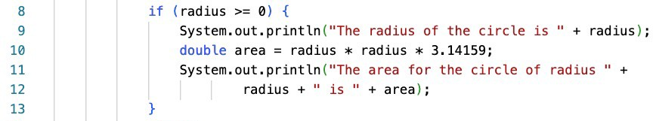
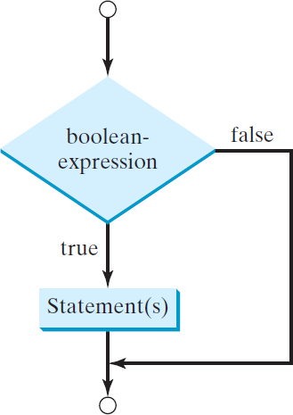
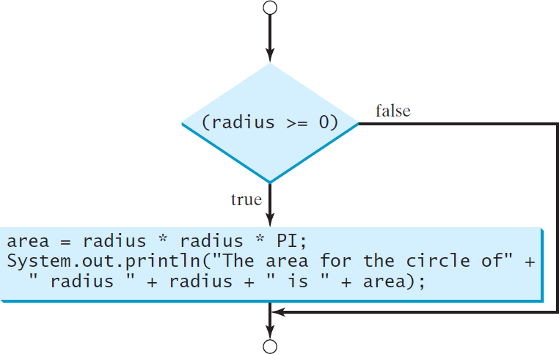
if Statements
if (boolean-expression) { statement(s);
}

Slide 38
if Statements
if ( i > 0 ) {
System.out.println( "i is positive " );
}
Perfect
if (i > 0 )
System.out.println( "i is positive " );
Works – use with caution, only 1 line lies inside the if statement
if i > 0 {
System.out.println( "i is positive " );
}
Breaks – we need parentheses () around the condition.

Slide 39
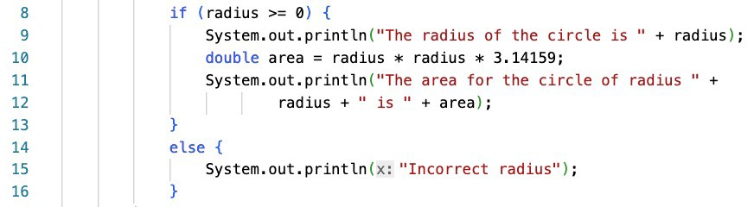
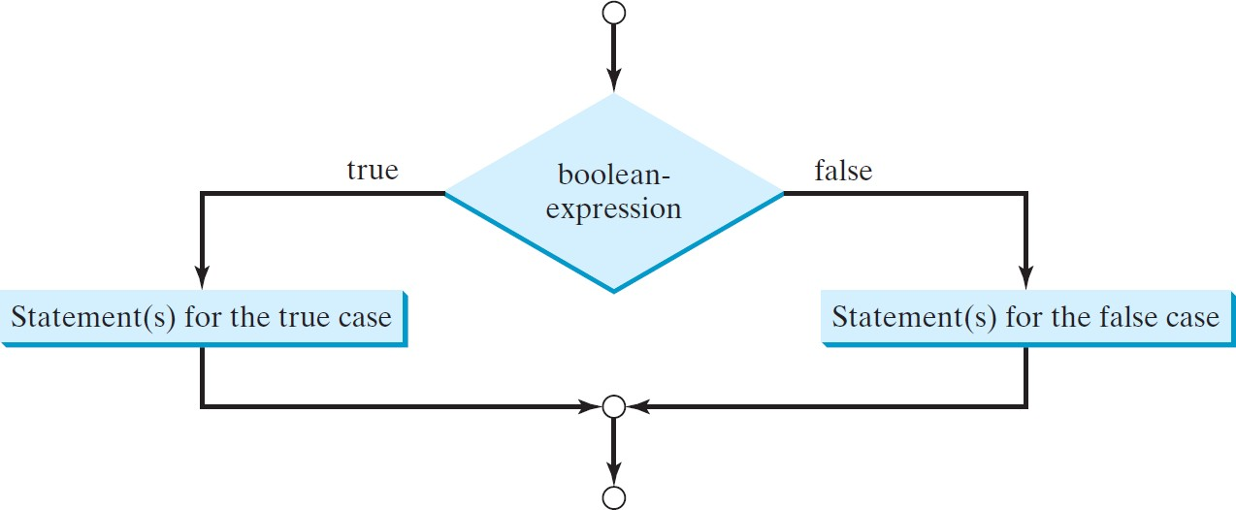
if Statements
if (boolean-expression) { statement(s)-for-the-true-case;
}
else {
statement(s)-for-the-false-case;
}

Slide 40
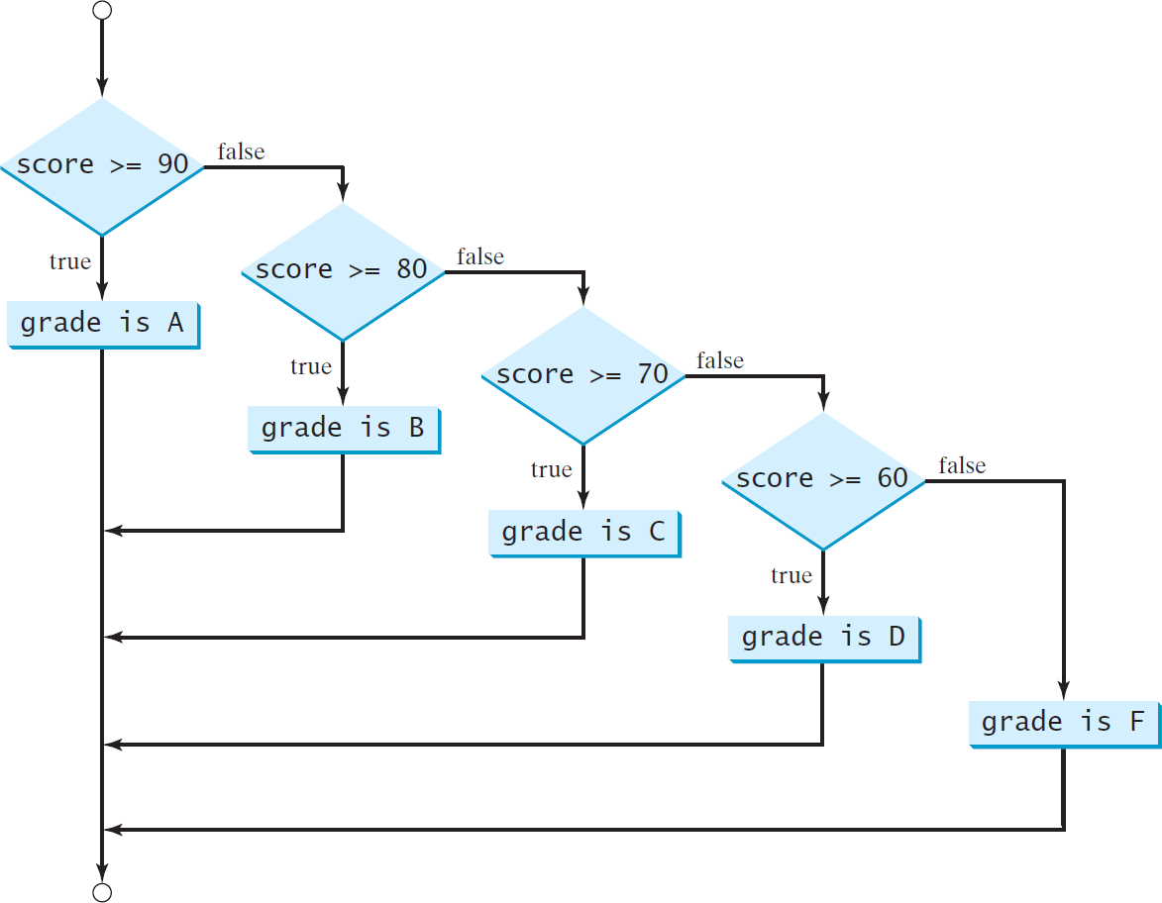
if Statements
Notice it is strictest condition first
Switch to code – ClassScore

Slide 41

if Statements
if (score >= 90.0) System.out.print("A");
else
if (score >= 80.0) System.out.print("B");
else
if (score >= 70.0) System.out.print("C");
else
if (score >= 60.0) System.out.print("D");
else
System.out.print("F");
if (score >= 90.0) System.out.print("A");
else if (score >= 80.0)
System.out.print("B");
else if (score >= 70.0) System.out.print("C");
else if (score >= 60.0) System.out.print("D");
else
System.out.print("F");
Equivalent
This is better
(a)
(b)
The else clause matches the most recent if clause in the same block.

Slide 42
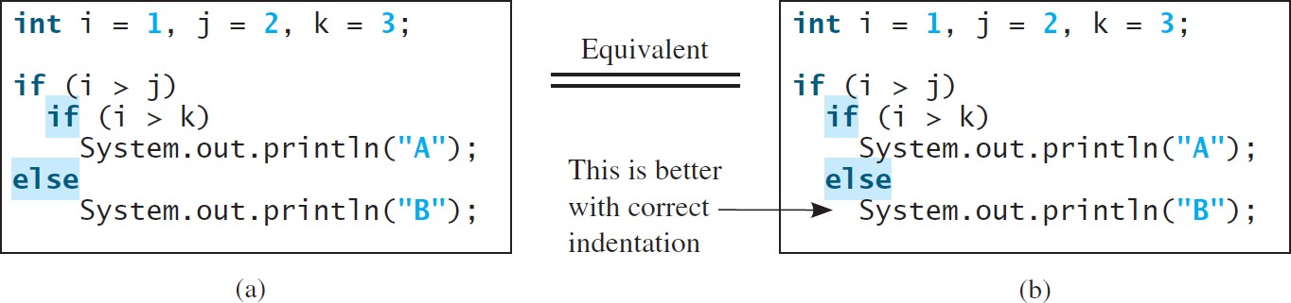
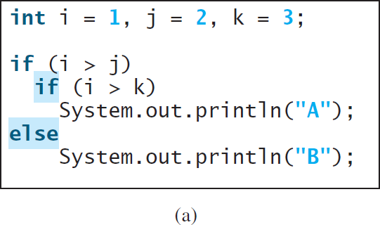
if Statements
To force the else clause to match the first if clause, you must add a pair of braces.
{
}

Slide 43
Logical Operators
Operator | Name | Description
! | not | logical negation
&& | and | logical conjunction
|| | or | logical disjunction
^ | exclusive or | logical exclusion

Slide 44
Logical Operators
p | !p | Example (assume age = 24, weight = 140)
true | false | !(age > 18) is false, because (age > 18) is true.
false | true | !(weight == 150) is true, because (weight == 150) is false.

Slide 45
Logical Operators
p₁ | p₂ | p₁ && p₂ | Example (assume age = 24, weight = 140)
false | false | false | (age <= 18) && (weight < 140) is false, because both conditions are both false.
false | true | false
true | false | false | (age > 18) && (weight > 140) is false, because (weight > 140) is false.
true | true | true | (age > 18) && (weight >= 140) is true, because both (age > 18) and (weight >= 140) are true.

Slide 46
Logical Operators
p₁ | p₂ | p₁ || p₂ | Example (assume age = 24, weihgt = 140)
false | false | false
false | true | true | (age > 34) || (weight <= 140) is true, because (age > 34) is false, but (weight <= 140) is true.
true | false | true | (age > 14) || (weight >= 150) is false, because (age > 14) is true.
true | true | true

Slide 47
Logical Operators
p₁ | p₂ | p₁ ^ p₂ | Example (assume age = 24, weight = 140)
false | false | false | (age > 34) ^ (weight > 140) is true, because (age > 34) is false and (weight > 140) is false.
false | true | true | (age > 34) ^ (weight >= 140) is true, because (age > 34) is false but (weight >= 140) is true.
true | false | true | (age > 14) ^ (weight > 140) is true, because (age > 14) is true and (weight > 140) is false.
true | true | false

Slide 48
Logical Operators - Example
Here is a program that checks whether a number is divisible by 2 and 3, whether a number is divisible by 2 or 3, and whether a number is divisible by 2 or 3 but not both:
System.out.println("Is " + number + " divisible by 2 and 3? " +
((number % 2 == 0) && (number % 3 == 0)));
System.out.println("Is " + number + " divisible by 2 or 3? " + ((number % 2 == 0) || (number % 3 == 0)));
System.out.println("Is " + number + " divisible by 2 or 3, but not both? " + ((number % 2 == 0) ^ (number % 3 == 0)));

Slide 49
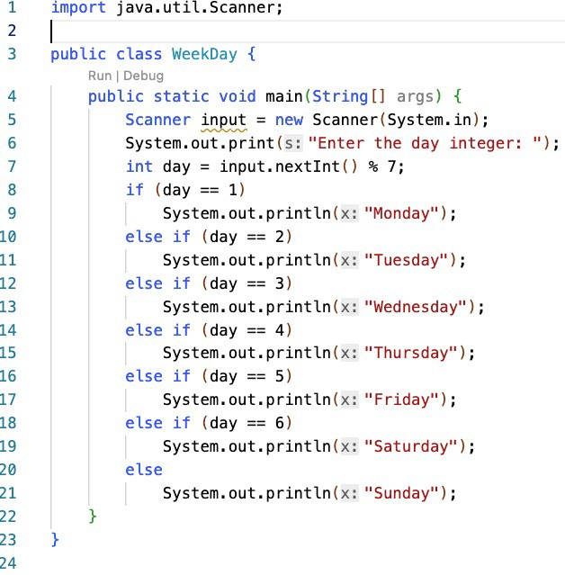
switch Statements
Switch to code – WeekDay

Slide 50
switch Statements
The switch-expression must yield a value of char, byte, short, or int type and must always be enclosed in parentheses.
The value1, ..., and valueN must have the same data type as the value of the switch-expression.
The resulting statements in the case statement are executed when the value in the case statement matches the value of the switch-expression.
o Note that value1, ..., and valueN are constant expressions, meaning that they cannot contain variables in the expression, such as 1 + x.
switch (switch-expression) { case value1: statement(s)1;
break;
case value2: statement(s)2; break;
…
case valueN: statement(s)N; break;
default: statement(s)-for-default;
}
Switch to code – WeekDaySwitch

Slide 51
switch Statements
The keyword break is optional, but it should be used at the end of each case in order to terminate the remainder of the switch statement.
If the break statement is not present, the next case statement will be
executed.
switch (switch-expression) { case value1: statement(s)1;
break;
case value2: statement(s)2; break;
…
case valueN: statement(s)N; break;
default: statement(s)-for-default;
}
The default case, which is optional,
can be used to perform actions when none of the specified cases matches the switch-expression.
When the value in a case statement matches the value of the switch-expression, the statements starting from this case are executed until either a break statement or the end of the switch statement is reached.

Slide 52
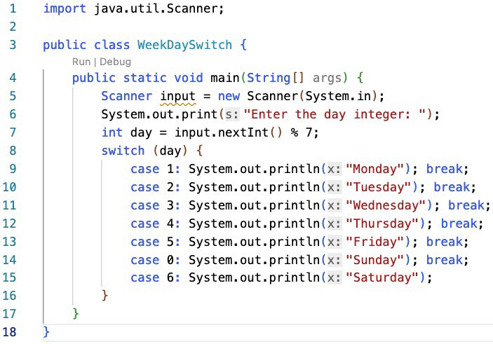
switch Statements

Slide 53
Conditional Operators
if (x > 0)
y = 1
else
y = -1;
y = (x > 0) ? 1 : -1;
(boolean-condition) ? expressionIfTrue : expressionIfFalse

Slide 54
Conditional Operators
if (num % 2 == 0) System.out.println(num + “is even”);
else
System.out.println(num + “is odd”);
System.out.println(
(num % 2 == 0)? num + “is even” : num + “is odd”);

Slide 55
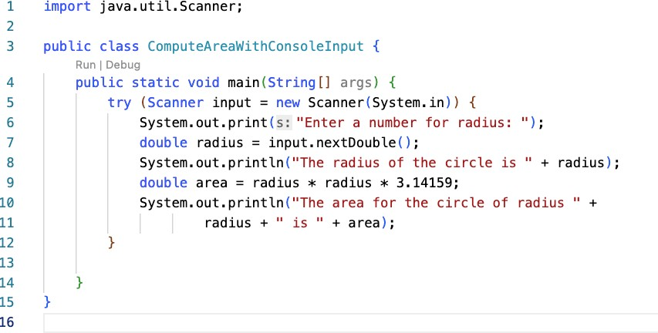
Try – To manage resources, or protect against error
Note: We also use try on something that has the possibility of breaking in order to catch its exception.
Switch to code – TryDividingByZero

Slide 56
Numeric Type Conversion
When performing a binary operation involving two operands of different types, Java automatically converts the operand based on the following rules:
If one of the operands is double, the other is converted into double.
Otherwise, if one of the operands is float, the other is converted into float.
Otherwise, if one of the operands is long, the other is converted into long.
Otherwise, both operands are converted into int.
In Java, an augmented expression of the form x1 op= x2 is implemented as x1 = (T)(x1 op x2), where T is the type for x1. Therefore, the following code is correct.
Implicit casting
double d = 3; (type widening)
int sum = 0;
sum += 4.5; // sum becomes 4 after this statement
sum += 4.5 is equivalent to sum = (int)(sum + 4.5).
Explicit casting
int i = (int)3.0; (type narrowing)
int i = (int)3.9; (Fraction part is truncated)
What is wrong? int x = 5 / 2.0;
Switch to code – TypeConversions

Slide 57
Operator Precedence
1. var++, var--
2. +, - (Unary plus and minus), ++var,--var
(type) Casting
! (Not)
*, /, % (Multiplication, division, and remainder)
6. +, - (Binary addition and subtraction)
7. <, <=, >, >= (Relational operators)
8. ==, !=; (Equality)
^ (Exclusive OR)
&& (Conditional AND) Short-circuit AND
|| (Conditional OR) Short-circuit OR
12. =, +=, -=, *=, /=, %= (Assignment operator)

Slide 58
Operator Precedence and Associativity
The expression in the parentheses is evaluated first. (Parentheses can be nested, in which case the expression in the inner parentheses is executed first.)
When evaluating an expression without parentheses, the operators are applied according to the precedence rule and the associativity rule.
If operators with the same precedence are next to each other, their associativity determines the order of evaluation.
All binary operators except assignment operators are left-associative.
Assignment operators are right-associative. Therefore, the expression
a – b + c – d is equivalent to ((a – b) + c) – d
a = b += c = 5 is equivalent to a = (b += (c = 5))

Slide 59
Operator Precedence and Associativity - Example
Applying the operator precedence and associativity rule, the expression 3 + 4 * 4 > 5 * (4 + 3) - 1 is evaluated as follows:
3 + 4 * 4 > 5 * (4 + 3) - 1
inside parentheses first
3 + 4 * 4 > 5 * 7 – 1
multiplication
3 + 16 > 5 * 7 – 1
multiplication
3 + 16 > 35 – 1
addition
19 > 35 – 1
subtraction
19 > 34
greater than
false

Slide 60
Conclusion
From the ComputeArea program, we learned
How to handle variables
How to solve problems using operators and methods
How to control the condition if necessary (e.g., if statement)
From the WeekDay program, we learned
How to write the algorithm simpler using switch statement
We discussed the use of logical operators to make the conditional statement simpler (in a single line statement).
We discussed the precedence of operators in the problems.

