Slide 1

CS 501 – Introduction to JAVA Programing
Lecture 5 – Methods
Lecture 6 – 1-D Array
Lecture 7 – M-D Array

Slide 2
7.0 Motivation
The following table that describes the distances between the cities can be represented using a two-dimensional array.
Distance Table (in miles)
 | Chicago | Boston | New York | Atlanta | Miami | Dallas | Houston
Chicago | 0 | 983 | 787 | 714 | 1375 | 967 | 1087
Boston | 983 | 0 | 214 | 1102 | 1763 | 1723 | 1842
New York | 787 | 214 | 0 | 888 | 1549 | 1548 | 1627
Atlanta | 714 | 1102 | 888 | 0 | 661 | 781 | 810
Miami 1375 |  | 1763 | 1549 | 661 | 0 | 1426 | 1187
Dallas 967 |  | 1723 | 1548 | 781 | 1426 | 0 | 239
Houston ¹⁰⁸⁷ |  | 1842 | 1627 | 810 | 1187 | 239 | 0

Slide 3
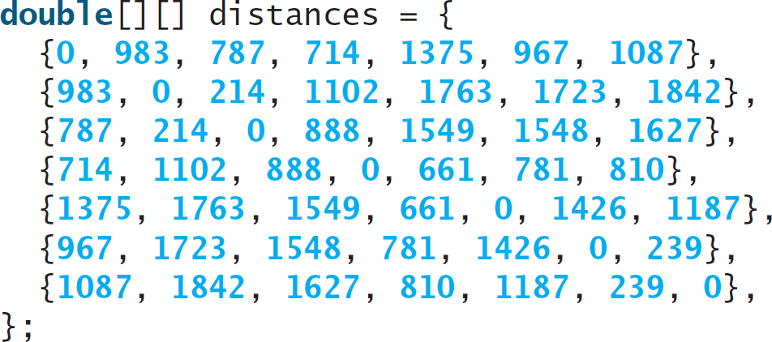
7.0 Motivation

Slide 4
7.1. 2-D Array
// Declare array ref var dataType[][] refVar;
// Create array and assign its reference to variable refVar = new dataType[10][10];
// Combine declaration and creation in one statement dataType[][] refVar = new dataType[10][10];
// Alternative syntax
dataType refVar[][] = new dataType[10][10];

Slide 5
7.1. 2-D Array
int[][] matrix = new int[10][10];
int matrix[][] = new int[10][10]; matrix[0][0] = 3;
for (int i = 0; i < matrix.length; i++)
for (int j = 0; j < matrix[i].length; j++) matrix[i][j] = (int)(Math.random() * 1000);
double[][] x;

Slide 6
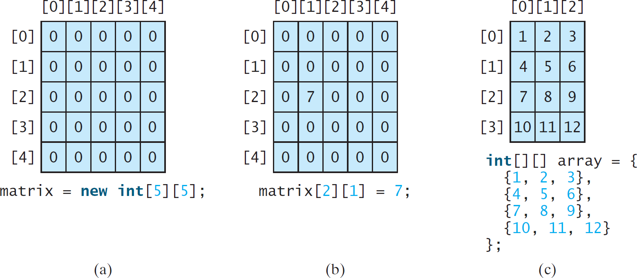
7.1. 2-D Array
matrix.length? 5
matrix[0].length? 5
array.length? 4
array[0].length? 3

Slide 7
7.1. 2-D Array
You can also use an array initializer to declare, create and initialize a two-dimensional array.
int[][] array = {
{1, 2, 3},
{4, 5, 6},
{7, 8, 9},
{10, 11, 12}
};
 | int[][] array | = | new int[4][3];
 | array[0][0] = | 1; | array[0][1] = | 2; | array[0][2] | = | 3;
 | array[1][0] = | 4; | array[1][1] = | 5; | array[1][2] | = | 6;
 | array[2][0] = array[3][0] = | 7; array[2][1] = 8; array[2][2] = 10; array[3][1] = 11; array[3][2] |  |  |  |  | 9; = 12;

Slide 8
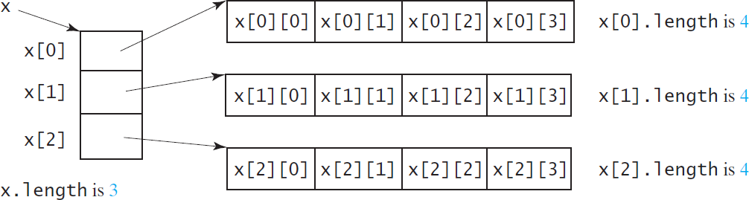
7.1. 2-D Array
int[][] x = new int[3][4];

Slide 9
7.1. 2-D Array
int[][] array = {
{1, 2, 3},
{4, 5, 6},
{7, 8, 9},
{10, 11, 12}
};
array.length array[0].length array[1].length array[2].length array[3].length
array[4].length
ArrayIndexOutOfBoundsException

Slide 10
7.1. 2-D Array
Each row in a two-dimensional array is itself an array. So, the rows can have different lengths. Such an array is known as a jagged array.
int[][] matrix = {
{1, 2, 3, 4, 5},
{2, 3, 4, 5},
{3, 4, 5},
{4, 5},
{5}
};
matrix.length is 5
matrix[0].length is 5
matrix[1].length is 4
matrix[2].length is 3
matrix[3].length is 2
matrix[4].length is 1

Slide 11
7.2. Processing Two-Dimensional Arrays
See the examples in the text.
(Initializing arrays with input values)
(Printing arrays)
(Summing all elements)
(Summing all elements by column)
(Which row has the largest sum)
(Finding the smallest index of the largest element)
(Random shuffling)

Slide 12
7.2. Processing Two-Dimensional Arrays
Initializing arrays with input values
java.util.Scanner input = new Scanner(System.in); System.out.println("Enter " + matrix.length + " rows and " +
matrix[0].length + " columns: ");
for (int row = 0; row < matrix.length; row++) {
for (int column = 0; column < matrix[row].length; column++) { matrix[row][column] = input.nextInt();
}
}

Slide 13
7.2. Processing Two-Dimensional Arrays
Initializing arrays with random values
for (int row = 0; row < matrix.length; row++) {
for (int column = 0; column < matrix[row].length; column++) { matrix[row][column] = (int)(Math.random() * 100);
}
}
Printing arrays
for (int row = 0; row < matrix.length; row++) {
for (int column = 0; column < matrix[row].length; column++)
{
System.out.print(matrix[row][column] + " ");
}
System.out.println();
}

Slide 14
7.2. Processing Two-Dimensional Arrays
Summing all elements
for (int column = 0; column < matrix[row].length; column++)
{
total += matrix[row][column];
}
}
int | total | = | 0;
for | (int | row | = | 0; | row | < | matrix.length; | row++) | {

Slide 15
7.2. Processing Two-Dimensional Arrays
Random shuffling
for (int i = 0; i < matrix.length; i++) {
for (int j = 0; j < matrix[i].length; j++) { int i1 = (int)(Math.random() * matrix.length);
int j1 = (int)(Math.random() * matrix[i].length);
// Swap matrix[i][j] with matrix[i1][j1] int temp = matrix[i][j];
matrix[i][j] = matrix[i1][j1];
matrix[i1][j1] = temp;
}
}

Slide 16
7.3. Passing 2-D Arrays to Methods
Get Array getArray Method
Pass Array sum Method

Slide 17
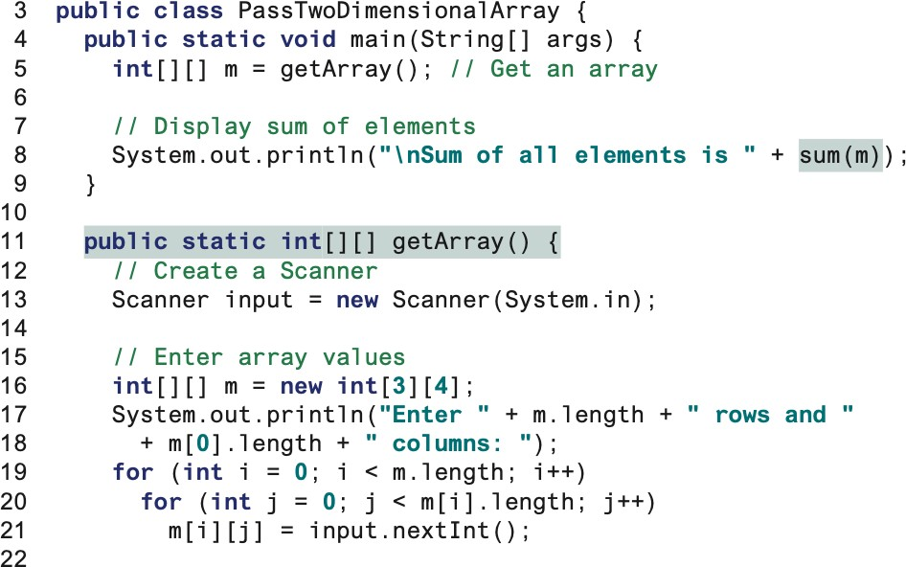

7.3. Passing 2-D Arrays to Methods

Slide 18
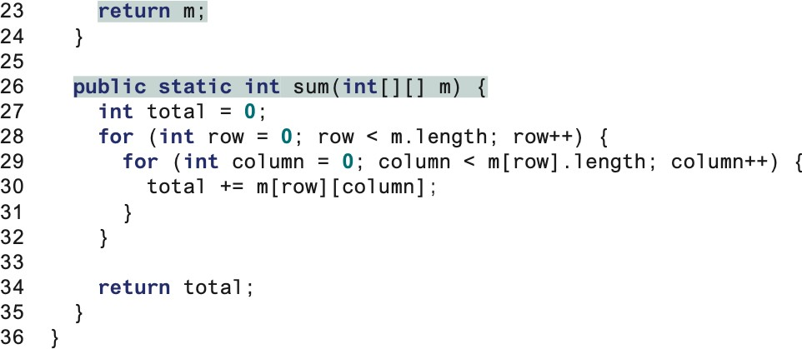
7.3. Passing 2-D Arrays to Methods
Switch to Code - MultiplicationTable

Slide 19
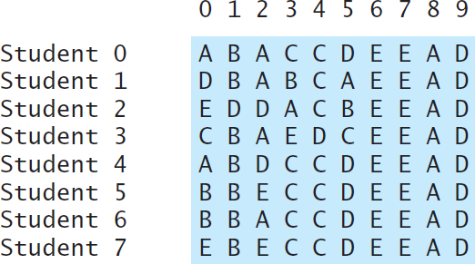
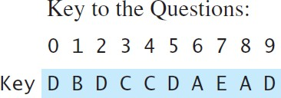
7.4. Problem: Grading Multiple-Choice Test
Objective: write a program that grades multiple-choice test.
Students’ answer

Slide 20
7.4. Problem: Grading Multiple-Choice Test
Objective: write a program that grades multiple-choice test.
Answer Array Key array
Print the correct count per student
Compare with key

Slide 21
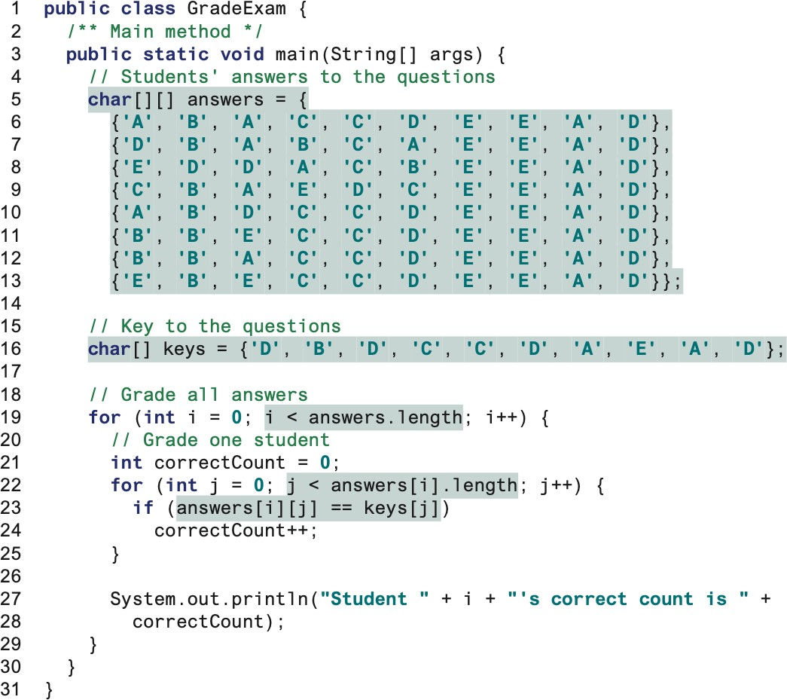
7.4. Problem: Grading Multiple-Choice Test

Slide 22
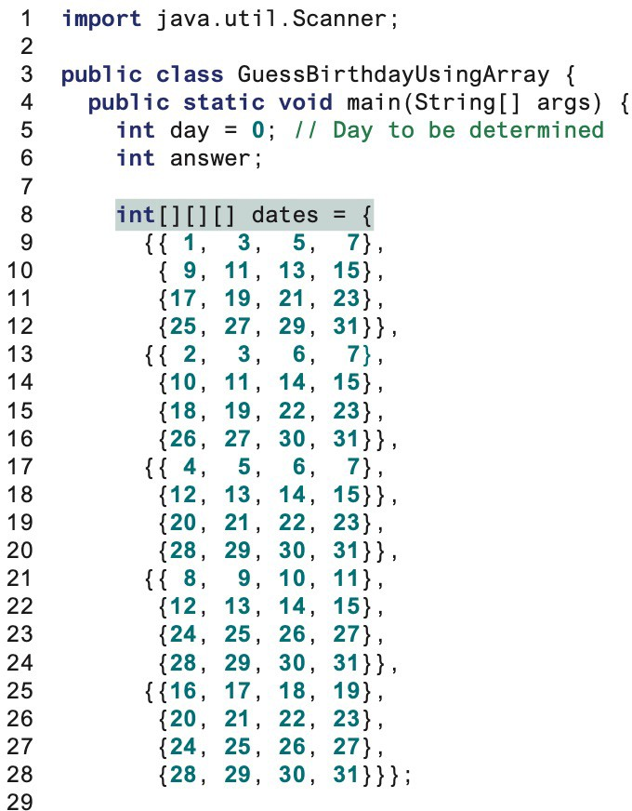
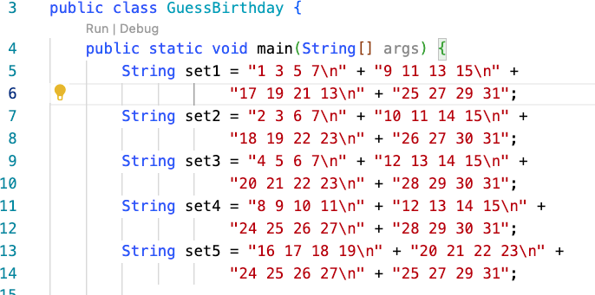
7.5 Multidimensional Arrays
5 sets of 4 by 4 Matrix

Slide 23
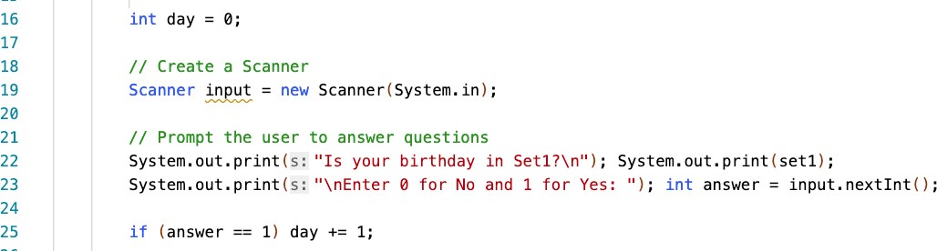
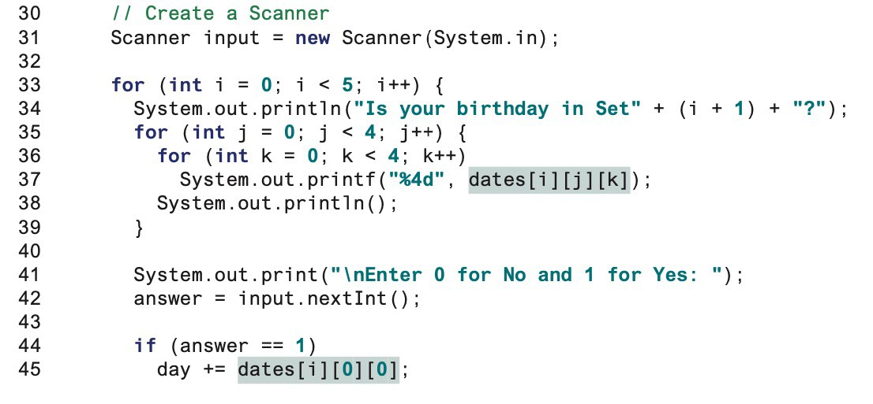
7.5 Multidimensional Arrays
Prints the set
Sum the first number of each set.
Lecture 7 - M-D Array
23

