Slide 1
Lecture 15 Recursion

Slide 2
Characteristics of Recursion
All recursive methods have the following characteristics:
□The method is implemented using a conditional statement
that leads to different cases.
□One or more base cases (the simplest case) are used to stop the recursion.
□Every recursive call reduces the original problem, bringing it increasingly closer to a base case until it becomes that case.

Slide 3
Problem Solving Using Recursion
nPrintln(“Welcome”, n);
one is to print the message one time and the other is to print the message for n-1 times.
The second problem is the same as the original problem with a smaller size.
The base case for the problem is n==0. You can solve this problem using recursion as follows:
public static void nPrintln(String message, int n) {
if (n >= 1) { System.out.println(message);
nPrintln(message, n - 1);
} // The base case is n < 1
}

Slide 4
Problem Solving Using Recursion
In general, to solve a problem using recursion, you
break it into subproblems.
If a subproblem resembles the original problem, you can apply the same approach to solve the subproblems recursively.
A subproblem is almost the same as the original problem in nature with a smaller size.

Slide 5
Computing Factorial
Mathematic notation: n! = n * (n-1)!, n > 0 0! = 1
Function:
factorial(0) = 1;
factorial(n) = n*factorial(n-1); n > 0
ComputeFactorial

Slide 6
Computing Factorial
factorial(0) = 1;
factorial(4) = 4 * factorial(3)
= 4 * (3 * factorial(2))
factorial(n) = n*factorial(n-1);
= 4 * (3 * (2 * factorial(1)))
= 4 * (3 * ( 2 * (1 * factorial(0))))
= 4 * (3 * ( 2 * ( 1 * 1))))
= 4 * (3 * ( 2 * 1))
= 4 * (3 * 2)
= 4 * (6)
= 24

Slide 7
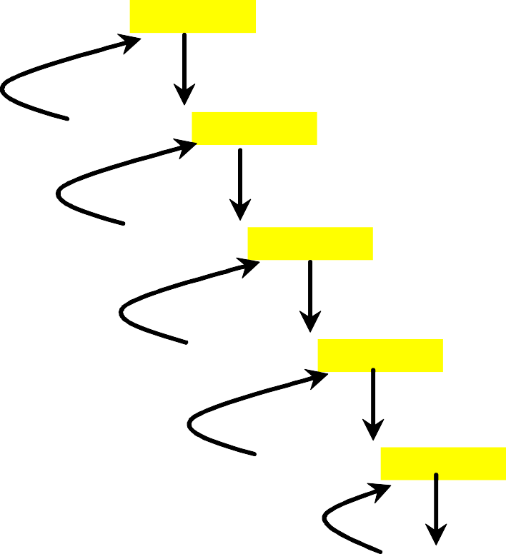
animation
Trace Recursive factorial
returns factorial(4)
factorial(4)
Step 0: executes factorial(4)
Step 9: return 24
return 4 * factorial(3)
Step 8: return 6
Step 1: executes factorial(3)
return 3 * factorial(2)
Step 2: executes factorial(2)
Stack
Space Required for factorial(4)
Main method
Step 7: return 2
return 2 * factorial(1)
Step 6: return 1
Step 3: executes factorial(1)
return 1 * factorial(0)
Step 5: return 1
Step 4: executes factorial(0)
return 1

Slide 8
factorial(4) Stack Trace
1 | Space Required for factorial(4)
2 | Space Required for factorial(3)
 | Space Required for factorial(4)
3 | Space Required for factorial(2)
 | Space Required for factorial(3)
 | Space Required for factorial(4)
4 | Space Required for factorial(1)
 | Space Required for factorial(2)
 | Space Required for factorial(3)
 | Space Required for factorial(4)
5 | Space Required for factorial(0)
 | Space Required for factorial(1)
 | Space Required for factorial(2)
 | Space Required for factorial(3)
 | Space Required for factorial(4)
6 | Space Required for factorial(1)
 | Space Required for factorial(2)
 | Space Required for factorial(3)
 | Space Required for factorial(4)
7 | Space Required for factorial(2)
 | Space Required for factorial(3)
 | Space Required for factorial(4)
8 | Space Required for factorial(3)
 | Space Required for factorial(4)
9 | Space Required for factorial(4)

Slide 9
ComputeFactorial
public class ComputeFactorial {
/** Main method */
public static void main(String[] args) {
// Create a Scanner
Scanner input = new Scanner(System.in); System.out.print("Enter a non-negative integer: "); int n = input.nextInt();
// Display factorial
System.out.println("Factorial of " + n + " is " + factorial(n));
}
/** Return the factorial for a specified number */
public static long factorial(int n) {…}
}

Slide 10
ComputeFactorial
public class ComputeFactorial {
/** Main method */
public static void main(String[] args) {
// Create a Scanner
// Display factorial
System.out.println("Factorial of " + n + " is " + factorial(n));
}
/** Return the factorial for a specified number */
public static long factorial(int n) {
if (n == 0) // Base case
return 1; else
return n * factorial(n - 1); // Recursive call
}
}

Slide 11
Fibonacci Numbers
Fibonacci series: 0 1 1 2 3 5 8 13 21 34 55 89…
indices: 0 1 2 3 4 5 6 7 8 9 10 11
fib(0) = 0;
fib(1) = 1;
fib(index) = fib(index -1) + fib(index -2); index >=2
fib(3) = fib(2) + fib(1) = (fib(1) + fib(0)) + fib(1) =
(1 + 0) +fib(1) = 1 + fib(1) =
1 + 1 = 2
ComputeFibonacci

Slide 12
ComputeFibonacci
public class ComputeFibonacci {
/** Main method */
public static void main(String args[]) {
// Create a Scanner
Scanner input = new Scanner(System.in); System.out.print("Enter an index for the Fibonacci number: "); int index = input.nextInt();
// Find and display the Fibonacci number
System.out.println(
"Fibonacci number at index " + index + " is " + fib(index));
}
/** The method for finding the Fibonacci number */
public static long fib(long index) { … }
}

Slide 13
ComputeFibonacci
public static long fib(long index) { if (index == 0) // Base case return 0;
else if (index == 1) // Base case
return 1;
else // Reduction and recursive calls
return fib(index - 1) + fib(index - 2);
}

Slide 14
Fibonnaci Numbers, cont.
fib(4)
17: return fib(4)
0: call fib(4)
return fib(3) + fib(2)
11: call fib(2)
10: return fib(3)
1: call fib(3)
16: return fib(2)
return fib(2) + fib(1)
return | fib(1) | + | fib(0)
7: return fib(2)
8: call fib(1)
13: return fib(1)
14: return fib(0)
2: call fib(2)
12: call fib(1)
return fib(1) + fib(0)
9: return fib(1)
return 1
return 1
15: return fib(0)
return 0
4: return fib(1)
5: call fib(0)
3: call fib(1)
return 1
6: return fib(0)
return 0

Slide 15
Recursive Helper Methods
Sometimes you can find a solution by defining a recursive method to a problem similar to the original problem.
This new method is called a recursive helper method.
The original method can be solved by invoking the recursive helper method.

Slide 16
The palindrome problem
A string is a palindrome if it reads the same from the left and from the right.
□Subproblems
Check whether the first character and the last character of the string are equal.
Ignore the two end characters and check whether the rest of the substring is a palindrome.
□Same as the original problem, but smaller in size (i.e., reduction)
□Base cases
The two end characters are not the same.
The string size is 0 or 1.

Slide 17
The palindrome problem
Without a recursive helper method:
Public static Boolean isPalindrome(String s) { if (s.length() <= 1) {
return true; //base case
}
else if (s.charAt(0) != s.charAt(s.length() – 1)) { return false; //base case
}
else {
// Reduction and recursive call
return isPalindrome(s.substring(1, s.length() – 1));
}
}
Inefficiently creates a new string for every recursive call.
To avoid creating new strings, use a helper method.

Slide 18
RecursivePalindromeUsingSubstring
public class RecursivePalindrome {
public static boolean isPalindrome(String s) { … }
public static boolean isPalindrome(String s, int low, int high) { … } public static void main(String[] args) {
System.out.println("Is moon a palindrome? " + isPalindrome("moon")); System.out.println("Is noon a palindrome? " + isPalindrome("noon")); System.out.println("Is a a palindrome? " + isPalindrome("a")); System.out.println("Is aba a palindrome? " + isPalindrome("aba")); System.out.println("Is ab a palindrome? " + isPalindrome("ab"));
}
}

Slide 19
RecursivePalindromeUsingSubstring
public class RecursivePalindrome {
public static boolean isPalindrome(String s) { return isPalindrome(s, 0, s.length() - 1);
}
public static boolean isPalindrome(String s, int low, int high) { if (high <= low) // Base case
return true;
else if (s.charAt(low) != s.charAt(high)) // Base case
return false;
else
return isPalindrome(s, low + 1, high - 1);
}
public static void main(String[] args) {
System.out.println("Is moon a palindrome? " + isPalindrome("moon")); System.out.println("Is noon a palindrome? " + isPalindrome("noon")); System.out.println("Is a a palindrome? " + isPalindrome("a")); System.out.println("Is aba a palindrome? " + isPalindrome("aba")); System.out.println("Is ab a palindrome? " + isPalindrome("ab"));
}
}

Slide 20
Recursive Selection Sort
Find the smallest number in the list and swaps it with the first number. A=[2,1,3,1,2,5,2,-1,0]
Ignore the first number and sort the remaining smaller list recursively.
RecursiveSelectionSort

Slide 21
RecursiveSelectionSort
public class RecursiveSelectionSort { public static void sort(double[] list) {
// Sort the entire list
…
}
public static void sort(double[] list, int low, int high) { if (low < high) {
// Find the smallest number and its index in list(low .. high)
int indexOfMin = low; double min = list[low];
for (int i = low + 1; i <= high; i++) {
…
}
}
// Swap the smallest in list(low .. high) with list(low)
list[indexOfMin] = list[low]; list[low] = min;
// Sort the remaining list(low+1 .. high)
…
}
}

Slide 22
RecursiveSelectionSort
public static void main(String[] args) { double[] list = {2, 1, 3, 1, 2, 5, 2, -1, 0};
sort(list);
for (int i = 0; i < list.length; i++) System.out.print(list[i] + " ");
}

Slide 23
RecursiveSelectionSort
public class RecursiveSelectionSort { public static void sort(double[] list) {
sort(list, 0, list.length - 1); // Sort the entire list
}
public static void sort(double[] list, int low, int high) { if (low < high) {
// Find the smallest number and its index in list(low .. high)
int indexOfMin = low; double min = list[low];
for (int i = low + 1; i <= high; i++) { if (list[i] < min) {
min = list[i]; indexOfMin = i;
}
}
// Swap the smallest in list(low .. high) with list(low)
list[indexOfMin] = list[low]; list[low] = min;
// Sort the remaining list(low+1 .. high) sort(list, low + 1, high);
}
}

Slide 24
Recursive Binary Search
Case 1: If the key is less than the middle element, recursively search the key in the first half of the array.
Case 2: If the key is equal to the middle element, the search ends with a match.
Case 3: If the key is greater than the middle element, recursively search the key in the second half of the array.
RecursiveBinarySearch

Slide 25
RecursiveBinarySearch
public class RecursiveBinarySearch {
public static int recursiveBinarySearch(int[] list, int key) { int low = 0;
int high = list.length - 1;
return recursiveBinarySearch(list, key, low, high);
}
public static int recursiveBinarySearch(int[] list, int key, int low, int high) {
// The list has been exhausted without a match
if (low > high) return -low - 1;
int mid = (low + high) / 2; complete the cases
}
}

Slide 26
RecursiveBinarySearch
public class RecursiveBinarySearch {
public static int recursiveBinarySearch(int[] list, int key) { int low = 0;
int high = list.length - 1;
return recursiveBinarySearch(list, key, low, high);
}
public static int recursiveBinarySearch(int[] list, int key, int low, int high) {
// The list has been exhausted without a match
if (low > high) return -low - 1;
int mid = (low + high) / 2; if (key < list[mid])
return recursiveBinarySearch(list, key, low, mid - 1); else if (key == list[mid])
return mid; else
return recursiveBinarySearch(list, key, mid + 1, high);
}
}

Slide 27
Tower of Hanoi
There are n disks labeled 1, 2, 3, . . ., n, and three towers labeled A, B, and C.
All the disks are initially placed on tower A.
No disk can be on top of a smaller disk at any time.
Only one disk can be moved at a time, and it must be the top disk on the tower.

Slide 28
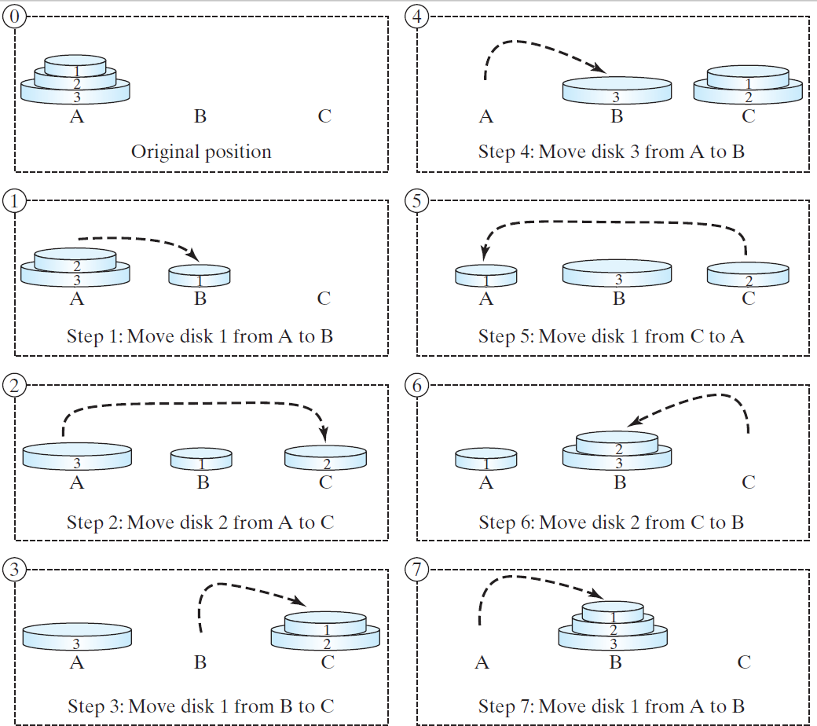
Tower of Hanoi

Slide 29
Tower of Hanoi Animation
animation
https://liveexample.pearsoncmg.com/dsanimation/TowerO fHanoi.html

Slide 30
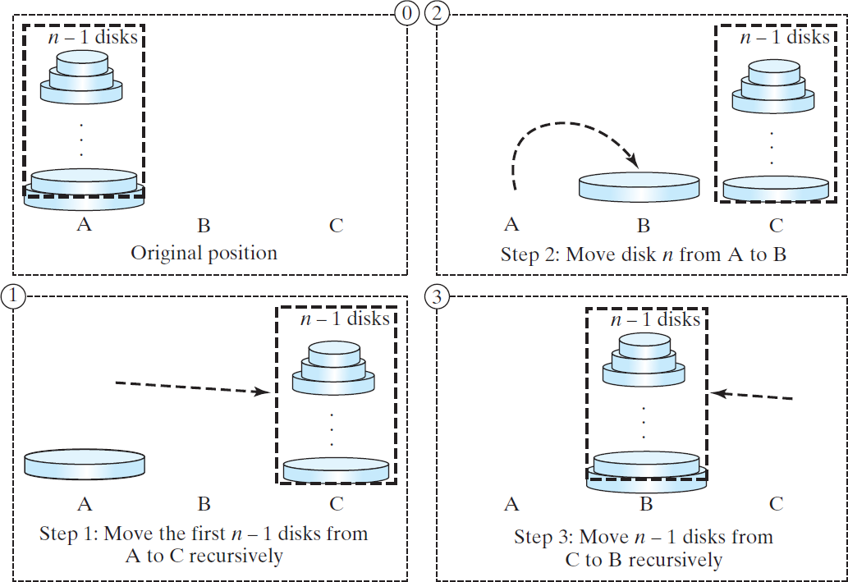
Solution to Tower of Hanoi
□ The Tower of Hanoi problem can be decomposed into three subproblems.

Slide 31
Solution to Tower of Hanoi
Move the first n - 1 disks from A to C with the assistance of tower B.
Move disk n from A to B.
Move n - 1 disks from C to B with the assistance of tower A.
TowerOfHanoi
public class TowersOfHanoi {
/** Main method */
public static void main(String[] args) { Scanner input = new Scanner(System.in); System.out.print("Enter number of disks: "); int n = input.nextInt(); System.out.println("The moves are:"); moveDisks(n, 'A', 'B', 'C’);
}

Slide 32
Solution to Tower of Hanoi
/** The method for finding the solution to move n disks from fromTower to toTower with auxTower */ public static void moveDisks(int n, char fromTower, char toTower, char auxTower) { if (n == 1) // Stopping condition
System.out.println("Move disk " + n + " from " + fromTower + " to " + toTower);
else {
moveDisks(n - 1, fromTower, auxTower, toTower);
System.out.println("Move disk " + n + " from " + fromTower + " to " + toTower);
moveDisks(n - 1, auxTower, toTower, fromTower);
}
}
}

Slide 33
Fractals
□A fractal is a geometrical figure just like triangles, circles, and rectangles, but fractals can be divided into parts, each of which is a reduced-size copy of the whole.
□There are many interesting examples of fractals.
□This section introduces a simple fractal, called Sierpinski triangle, named after a famous Polish mathematician.

Slide 34
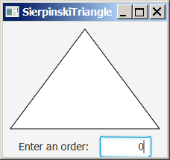
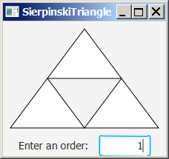
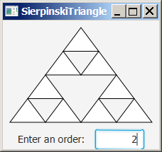
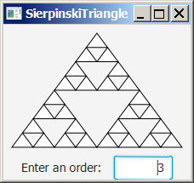
Sierpinski Triangle
It begins with an equilateral triangle, which is considered to be the Sierpinski fractal of order (or level) 0, as shown in Figure (a).
Connect the midpoints of the sides of the triangle of order 0 to create a Sierpinski triangle of order 1, as shown in Figure (b).
Leave the center triangle intact. Connect the midpoints of the sides of the three other triangles to create a Sierpinski of order 2, as shown in Figure (c).
You can repeat the same process recursively to create a Sierpinski triangle of order 3, 4, ..., and so on, as shown in Figure (d).

Slide 35
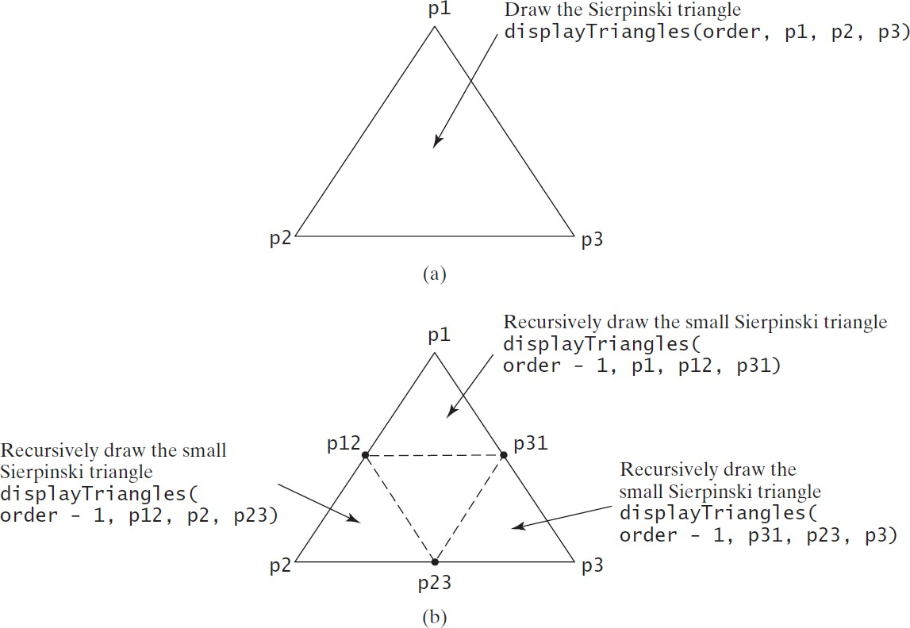
Sierpinski Triangle Solution
SierpinskiTriangle

Slide 36
Sierpinski Triangle Solution
private void displayTriangles(int order, Point2D p1, Point2D p2, Point2D p3) {
if (order == 0) {
// Draw a triangle to connect three points
Polygon triangle = new Polygon();
triangle.getPoints().addAll(p1.getX(), p1.getY(), p2.getX(), p2.getY(), p3.getX(), p3.getY()); triangle.setStroke(Color.BLACK);
triangle.setFill(Color.WHITE);
this.getChildren().add(triangle);
}
else {
// Get the midpoint on each edge in the triangle
Point2D p12 = p1.midpoint(p2); Point2D p23 = p2.midpoint(p3); Point2D p31 = p3.midpoint(p1);
// Recursively display three triangles displayTriangles(order - 1, p1, p12, p31); displayTriangles(order - 1, p12, p2, p23); displayTriangles(order - 1, p31, p23, p3);
}
}

Slide 37
Tail Recursion
A recursive method is said to be tail recursive if there are no pending operations to be performed on return from a recursive call.
A tail-recursive method is more efficient than a nontail- recursive method
Compilers can optimize to reduce stack size
Non-tail recursive: ComputeFactorial
Tail recursive: ComputeFactorialTailRecursion

Slide 38
Tail Recursion
public static long fib(long index) { if (index == 0) // Base case return 0;
else if (index == 1) // Base case
return 1;
else // Reduction and recursive calls
return fib(index - 1) + fib(index - 2);
}
private static long factorial(int n, int result) {
if (n == 0) return result; else
return factorial(n - 1, n * result); // Recursive call
}

Slide 39
Recursion vs. Iteration
□Recursion is an alternative form of program control. It is essentially repetition without a loop.
□Recursion bears substantial overhead.
□Each time the program calls a method, the system
must assign space for all of the method’s local variables and parameters.
□This can consume considerable memory and requires extra time to manage the additional space.

Slide 40
Recursion vs. Iteration
□Recursive algorithms can be replaced with non- recursive counterparts
□If performance is a concern, then avoid using recursion
□However, some problems are inherently recursive, and difficult to solve without using recursion.
□ Use whichever approach can best develop an
intuitive solution that naturally mirrors the problem.
□If an iterative solution is obvious, then use it.

Slide 41
Lecture 16: Lists, Stacks, Queues, and
Priority Queues

Slide 42
What is Data Structure?
A data structure is a collection of data organized in some fashion.
The structure not only stores data, but also supports operations for accessing and manipulating the data.

Slide 43
Java Collection Framework hierarchy
A collection is a container object that holds a group of objects, often referred to as elements.
The Java Collections Framework supports two types of collections:
One, for storing a collection , is simply called collection.
The other, for storing key/value pairs, is called a map.

Slide 44
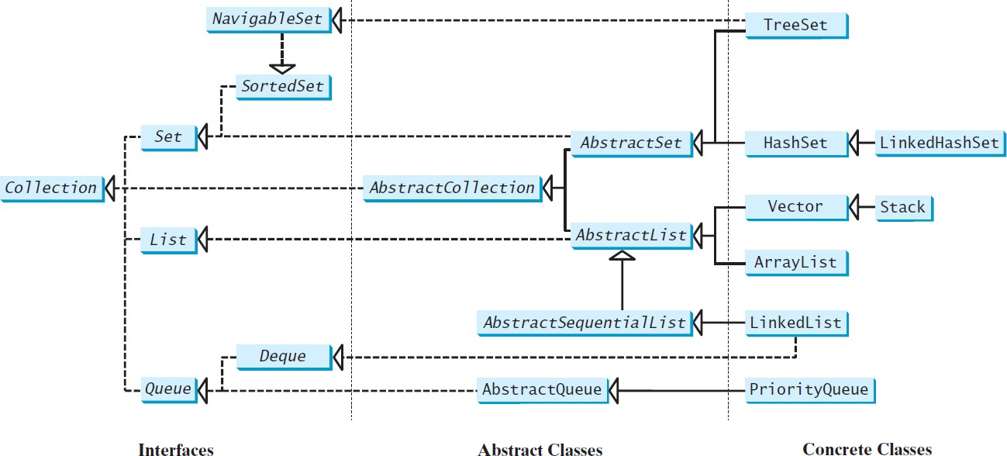
Java Collection Framework hierarchy
Set and List are subinterfaces of Collection.

Slide 45
The Collection Interface
Returns an iterator for the elements in this collection. Performs an action for each element in this iterator.
«interface»
java.lang.Iterable<E>
+iterator(): Iterator<E>
+forEach(action: Consumer<? super E>): default void
The Collection interface is for manipulating a collection of objects.
Adds a new element e to this collection.
Adds all the elements in the collection c to this collection.
Removes all the elements from this collection. Returns true if this collection contains the element o.
Returns true if this collection contains all the elements in c. Returns true if this collection contains no elements.
Removes the element o from this collection.
Removes all the elements in c from this collection.
Retains the elements that are both in c and in this collection.
«interface»
java.util.Collection<E>
+add(e: E): boolean
+addAll(c: Collection<? extends E>): boolean
+clear(): void
+contains(o: Object): boolean
+containsAll(c: Collection<?>):boolean
+isEmpty(): boolean
+remove(o: Object): boolean
+removeAll(c: Collection<?>): boolean
+retainAll(c: Collection<?>): boolean
+size(): int
+toArray(): Object[]
+stream(): Stream default
Returns the number of elements in this collection.
Returns an array of Object for the elements in this collection. Returns a stream from this collection (covered in Ch 30).
Returns a parallel stream from this collection (covered in Ch 30).
UML Diagram
«interface»
java.util.Iterator<E>
TestCollection
+hasNext(): boolean
+next(): E
+remove(): void
Returns true if this iterator has more elements to traverse. Returns the next element from this iterator.
Removes the last element obtained using the next method.

Slide 46
TestCollection
Create an ArrayList “collection1” with four cities: New York, Atlanta, Dallas, and Madison and print out collection1
ArrayList<String> collection1 = new ArrayList<>();
Test if Dallas is in collection1 using contains() method.
Use remove() to remove Dallas from collection1 and print the length of collection1 using size().
public class TestCollection {
public static void main(String[] args) {
ArrayList<String> collection1 = new ArrayList<>(); collection1.add("New York"); collection1.add("Atlanta"); collection1.add("Dallas"); collection1.add("Madison");
System.out.println(collection1);
System.out.println("\nIs Dallas in collection1? ” + collection1.contains("Dallas")); collection1.remove("Dallas");
System.out.println("\n" + collection1.size() + " cities are in collection1 now");

Slide 47
TestCollection
Create an interface“collection2” with four cities: Seattle, Portland, Los Angles, and Atlanta as following:
Collection<string> collection2 = new ArrayList<>( );
Clone collection1 to a new ArrayList and name it c1: ArrayList<String> c1 = (ArrayList<String>)(collection1.clone());
Add all cities in collection2 to c1 using addAll( ).
Print c1.
Collection<String> collection2 = new ArrayList<>(); collection2.add("Seattle"); collection2.add("Portland"); collection2.add("Los Angles"); collection2.add("Atlanta");
ArrayList<String> c1 = (ArrayList<String>)(collection1.clone()); c1.addAll(collection2);
System.out.println("\nCities in collection1 or collection2: ");
System.out.println(c1);

Slide 48
TestCollection
Re-clone collection1 to the ArrayList c1.
Use retainAll() to retain collection2 to c1 and print c1 to find the
mutual city(ies).
Re-clone collection1 to c1.
Use removeAll() to remove cities in collection2 in c1 and print
c1.
ArrayList<String> c1 = (ArrayList<String>)(collection1.clone()); c1.retainAll(collection2);
c1 = (ArrayList<String>)(
System.out.print("\nCities in collection1 and collection2: "); System.out.println(c1);
c1 = (ArrayList<String>)(collection1.clone()); c1.removeAll(collection2);
System.out.print("\nCities in collection1, but not in 2: "); System.out.println(c1);

Slide 49
Iterators
Iterator is a classic design pattern for walking through a data structure without having to expose the details of how data is stored in the data structure.
Iterator interface provides a uniform way to traverse elements in various type of collections.
Iterator() method returns an instance of Iterator.
next() method accesses the elements sequentially in the collection.
hasNext() method checks whether there are more elements in the iterator.
remove() method removes the last element returned by the iterator.
TestIterator

Slide 50
TestIterator
Complete the program:
The collection obtains the iterator..
The iterator traverses all the strings in the list and displays the strings in uppercase.
While-loop iterates until the iterator has new elements.
Use toUpperCase() to capitalize letters.
Collection<String> collection = new ArrayList<>(); collection.add("New York"); collection.add("Atlanta"); collection.add("Dallas"); collection.add("Madison");
Iterator<String> iterator = collection.iterator(); while (iterator.hasNext()) {
System.out.print(iterator.next().toUpperCase() + " ");
}
System.out.println();

Slide 51
Using the forEach Method
Java 8 added a new forEach method in the Iterable
interface.
It functions like a foreach loop.
The method takes an argument for specifying the action.
Lambda expression example:
collection.forEach(e -> action);
TestForEach

Slide 52
TestForEach
Complete the program:
1. Print elements in collection using ForEach() method after
capitalizing letters.
Collection<String> collection = new ArrayList<>(); collection.add("New York"); collection.add("Atlanta"); collection.add("Dallas"); collection.add("Madison");
collection.forEach(e -> System.out.print(e.toUpperCase() + " "));

