Slide 1

CS 501 – Introduction to JAVA Programing
Mathematical Functions, Characters, and Strings
Loops

Slide 2

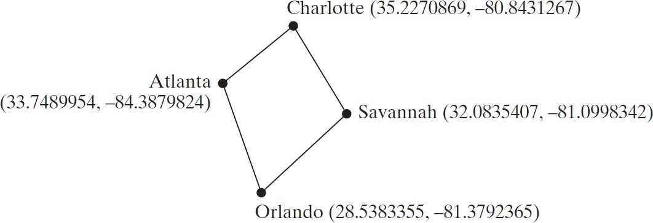
3.1. Motivations
Suppose you need to estimate the area enclosed by four cities, given the GPS locations (latitude and longitude) of these cities, as shown in the following diagram.
How would you write a program to solve this problem?

Slide 3
3.3. Mathematical Functions
Java provides many useful methods in the Math class for performing common mathematical functions.
Class constants:
PI
E
Class methods:
Trigonometric Methods
Exponent Methods
Rounding Methods
min, max, abs, and random Methods

Slide 4
3.3.1.Trigonometric Methods
sin(double a)
cos(double a)
tan(double a)
acos(double a)
asin(double a)
atan(double a)
Examples:
Math.sin(0) returns 0.0
Math.sin(Math.PI | / | 6) | returns | 0.5
Math.sin(Math.PI | / | 2) | returns | 1.0
Math.cos(0) returns 1.0 Math.cos(Math.PI / 6) returns |  |  |  | 0.866
Math.cos(Math.PI | / | 2) | returns | 0
Unit Conversion:
𝜋 = 180°
𝜃 rad = 𝜃 ° × 𝜋⁄180°
𝜃 ° = 𝜃 rad ×180°/𝜋
Degrees to Radians: toRadians()
Radians to Degrees: toDegrees()

Slide 5
3.3.2. Exponent Methods
exp(double a): Returns e raised to the power of a.
log(double a): Returns the natural logarithm of a.
log10(double a):Returns the 10-based logarithm of a.
pow(double a, double b):Returns a raised to the power of b.
sqrt(double a):Returns the square root of a.
Examples:
𝒆^{𝟏}: Math.exp(1) returns 2.71
𝒍𝒏 𝟐. 𝟕𝟏 : Math.log(2.71) returns 1.0
𝟐^{𝟑}: Math.pow(2, 3) returns 8.0
𝟑^{𝟐}: Math.pow(3, 2) returns 9.0
𝟑. 𝟓^{𝟐.𝟓}: Math.pow(3.5, 2.5) returns 22.91765
𝟐: Math.sqrt(4) returns 2.0
𝟑. 𝟐𝟒: Math.sqrt(10.5) returns 3.24

Slide 6
3.3.3. Rounding Methods
double ceil(double x)
x rounded up to its nearest integer. This integer is returned as a double value.
double floor(double x)
x is rounded down to its nearest integer. This integer is returned as a double value.
double rint(double x)
x is rounded to its nearest integer. If x is equally close to two integers, the even one is returned as a double.
int round(float x)
Return (int)Math.floor(x+0.5) if x is a float.
long round(double x)
Return (long)Math.floor(x+0.5) if x is a double.

Slide 7
3.3.3. Rounding Methods Examples
Math.ceil(2.1) returns 3.0
Math.ceil(2.0) returns 2.0
Math.ceil(-2.0) | returns | –2.0
Math.ceil(-2.1) | returns | -2.0
Math.floor(2.1) | returns | 2.0
Math.floor(2.0) | returns | 2.0
Math.floor(-2.0) returns –2.0
Math.floor(-2.1) returns -3.0
Math.rint(2.1) returns 2.0
Math.rint(2.0) returns 2.0
Math.rint(-2.0) returns –2.0
Math.rint(-2.1) returns -2.0
Math.rint(2.5) returns 2.0
Math.rint(-2.5) returns -2.0
Math.round(2.6f) returns 3
Math.round(2.0) returns 2
Math.round(-2.0f) returns -2
Math.round(-2.6) returns -3

Slide 8
3.3.4. min, max, and abs
Examples:
max(a, b) and min(a, b)
Returns the maximum or minimum of two parameters.
abs(a)
Returns the absolute value of the parameter.
random()
Returns a random double value in the range [0.0, 1.0).
Math.max(2, 3) returns 3
Math.max(2.5, 3) returns 3.0
Math.min(2.5, 3.6) returns 2.5
Math.abs(-2) returns 2
Math.abs(-2.1) returns 2.1

Slide 9
3.3.5. The random Method
Generates a random double value greater than or equal to 0.0 and less than 1.0 (0
<= Math.random() < 1.0).
Examples:
(int)(Math.random() * 10)
Returns a random integer between 0 and 9.
Returns a random integer between 50 and 99.
50 + (int)(Math.random() * 50)
In general,
a + Math.random() * b
Returns a random number between a and a + b, excluding a + b.
Switch to code – Random

Slide 10
3.3.6. Case Study: Computing Angles of a Triangle
x2, y2
a
B
c
C
A
x3, y3
b
x1, y1
Write a program that prompts the user to enter the x- and y-coordinates of the three corner points in a triangle and then displays the triangle’s angles.
𝑎& − 𝑏& − 𝑐&
𝐴 = acos
−2𝑏𝑐
𝑏& − 𝑎& − 𝑐&
𝑎 = 𝑥 − 𝑥 ! + 𝑦 − 𝑦
𝑏 =
𝑐 =
!
! " ! "
𝑥# − 𝑥" ! + 𝑦# − 𝑦" !
𝑥# − 𝑥! ! + 𝑦# − 𝑦! !
𝐵 = acos
−2𝑎𝑐
𝑐& − 𝑎& − 𝑏&
𝐶 = acos
−2𝑎𝑏

Slide 11
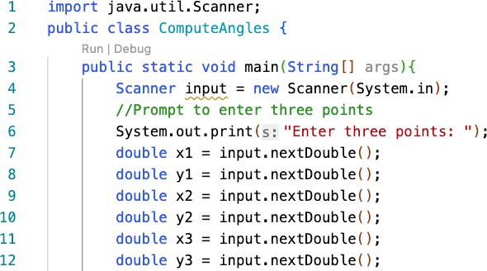
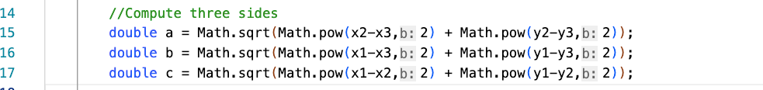
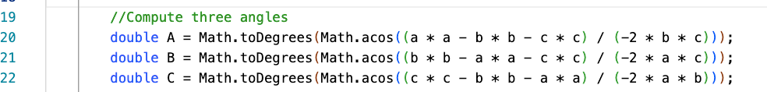
3.3.6. Case Study: Computing Angles of a Triangle
Switch to code – ComputeAngles

Slide 12
3.4. Character Data Type
Four hexadecimal digits.
char letter = 'A'; (ASCII) char numChar = '4'; (ASCII)
char letter = '\u0041'; (Unicode) char numChar = '\u0034'; (Unicode)
NOTE: The increment and decrement operators can also be used on char variables to get the next or preceding Unicode character. For example, the following statements display character b.
char ch = 'a';
System.out.println(++ch);
Notes:
Talk about hexadecimal, octal, quaternary

Slide 13
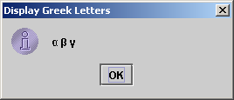
3.4.1. Unicode Format
Java characters use Unicode, a 16-bit encoding scheme established by the Unicode Consortium to support the interchange, processing, and display of written texts in the world’s diverse languages.
Unicode takes two bytes, preceded by \u, expressed in four hexadecimal numbers that run from '\u0000' to '\uFFFF'. So, Unicode can represent 65535 + 1 characters.
Unicode \u03b1 \u03b2 \u03b3 for three Greek letters

Slide 14
3.4.1. Unicode Format
Most computers use ASCII (American Standard Code for Information Interchange)
an 8-bit encoding scheme
Unicode includes ASCII for the 128 ASCII characters:
all upper and lower letters, digits, punctuations, control characters
Characters | Code Value | in Decimal | Unicode Value
'0' to '9' | 48 to 57 |  | \u0030 to \u0039
'A' to 'Z' 'a' to 'z' | 65 to 90 97 to 122 |  | \u0041 to \u005A \u0061 to \u007A

Slide 15
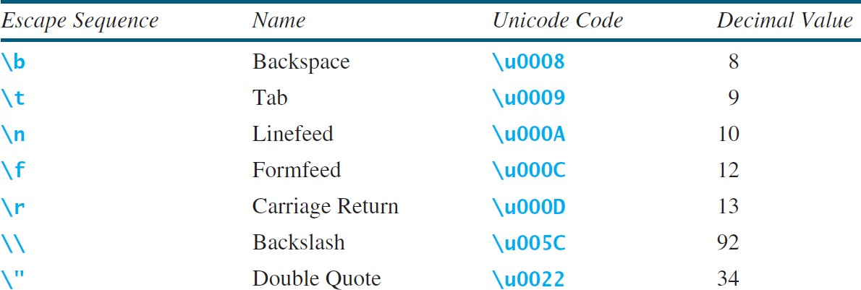
3.4.2. Escape Sequences for Special Characters

Slide 16
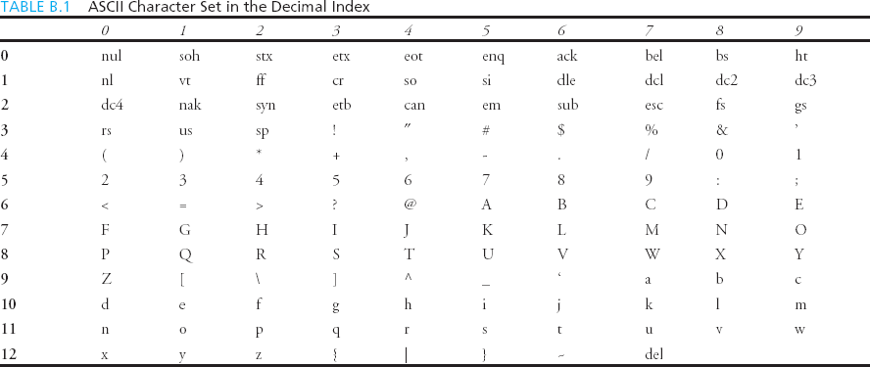
ASCII Character Set is a subset of the Unicode from \u0000 to \u007f

Slide 17
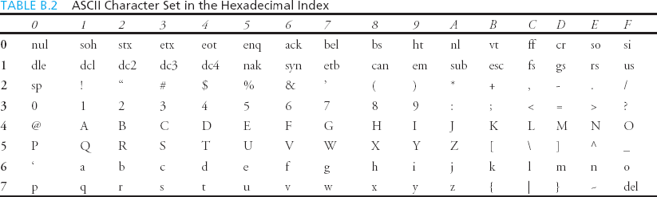
ASCII Character Set is a subset of the Unicode from \u0000 to \u007f

Slide 18
3.4.3. Casting between char and Numeric Types
chars have ordinal values based on their position in the ASCII character set, and we can manipulate them to extract this information.
Essentially, chars are integers in disguise.
int number = 'a'; // Same as int number = (int)'a’;
Returns 97
char letter = 97; // Same as char letter = (char)97;
Returns a
Switch to code – CharMath

Slide 19
3.4.3. Casting between char and Numeric Types
int i = ‘2’ + ‘3’;
Returns 101
int j = 2 + ‘b’;
Returns 100 What is char(j)?
d

Slide 20
3.4.4. Comparing and Testing Characters
if (ch >= 'A' && ch <= 'Z')
System.out.println(ch + " is an uppercase letter"); else if (ch >= 'a' && ch <= 'z')
System.out.println(ch + " is a lowercase letter"); else if (ch >= '0' && ch <= '9')
System.out.println(ch + " is a numeric character");

Slide 21
3.4.4. Comparing and Testing Characters
Method Description
isDigit(ch) isLetter(ch) isLetterOfDigit(ch) isLowerCase(ch) isUpperCase(ch) toLowerCase(ch) toUpperCase(ch)
Returns true if the specified character is a digit. Returns true if the specified character is a letter.
Returns true if the specified character is a letter or digit. Returns true if the specified character is a lowercase letter. Returns true if the specified character is an uppercase letter. Returns the lowercase of the specified character.
Returns the uppercase of the specified character.

Slide 22
3.4.4. Comparing and Testing Characters
Character.isDigit(‘a’): Character.isLetter(‘a’): Character.isUpperCase(‘a’):
False True False
The Character class is defined in java.lang package and is used to test characters.

Slide 23
3.5. Primitive vs Non-Primitive Data Types
Primitive:
Basic built in data types that store values directly in memory
Start with a lowercase letter
int, byte, short, boolean, char, etc.
Defaults to values like 0, false, \u0000 (null character)
Requires a Wrapper class (object version of primitive type) to make function calls
Double.parseDouble(“2.5”), Integer.parseInt(“7”)
Non-primitive:
Complex data types that store references to objects instead of actual values in memory
Start with a capital letter
String, Object, Array, any Class
Defaults to null
Can make function calls
String message = “Hi”;
message = message.toUpperCase(); → “HI”;

Slide 24
3.5. The String Type
The char type only represents one character.
To represent a string of characters, use the data type called String. For example,
String message = "Welcome to Java";
String is actually a predefined class in the Java library just like the System class and Scanner class.
The String type is not a primitive type.
It is known as a reference type.
Any Java class can be used as a reference type for a variable.
Reference data types will be thoroughly discussed in “Objects and Classes” lecture.
For the time being, you just need to know how to declare a String variable, how to assign a string to the variable, how to concatenate strings, and to perform simple operations for strings.

Slide 25
3.5. The String Type
Instance Methods: use for objects. Strings are objects.
referenceVariable.methodName(arguments)
String message = "Welcome to Java";
message.length();
Simple Methods for String Objects
Method Description
length() charAt(index) concat(s1) toUpperCase() toLowerCase() trim()
Returns the number of characters in this string.
Returns the character at the specified index from this string. Returns a new string that concatenates this string with string s1. Returns a new string with all letters in uppercase.
Returns a new string with all letters in lowercase.
Returns a new string with whitespace characters trimmed on both sides.

Slide 26
3.5. Mutability
Mutability: You can change its value without changing its identity.
Primitives:
Immutable! A primitive’s identity is explicitly determined by its value.
The number 1 inherently means a value of 1.
Non-primitive:
Most are mutable. ie. changed bob’s age to 25, still the same Person
public static void main(String[] args) {
Person bob = new Person("Bob", 24);
System.out.println(bob.toString());
bob.setAge(25);
System.out.println(bob.toString());
}
Strings are immutable! You cannot modify a character in a string without needing to replace the whole string.
→
Person(Bob, 24)
Person(Bob, 25)

Slide 27
3.5.1. Getting String Length
String message = "Welcome to Java"; System.out.println("The length of " + message + " is "
+ message.length());
System.out.println("The length of " + “A” + " is "
+ “A”.length());
System.out.println("The length of " + message + " is "
+ “”.length());

Slide 28
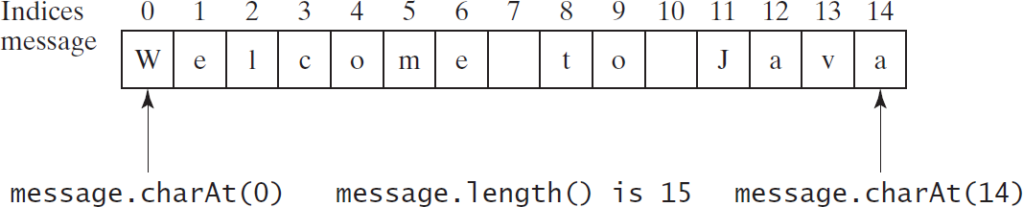
3.5.2. Getting Characters from a String
String message = "Welcome to Java"; System.out.println("The first character in message is "
+ message.charAt(0));
System.out.println("The first character in message is "
+ message.charAt(7));

Slide 29
3.5.3. Converting Strings
"Welcome".toLowerCase() "Welcome".toUpperCase() " Welcome ".trim()
returns a new string, welcome. returns a new string, WELCOME. returns a new string, Welcome.

Slide 30
3.5.4. String Concatenation
String s3 = s1.concat(s2); or String s3 = s1 + s2;
// Three strings are concatenated
String message = "Welcome " + "to " + "Java";
// String Chapter is concatenated with number 2
String s = "Chapter " + 2;
Chapter 2
// String Supplement is concatenated with character B
String s1 = "Supplement " + 'B’;
Supplement B
message += “ and Java is fun”;
Welcome to Java and Java is fun

Slide 31
3.5.5. Reading a String from the Console
Scanner input = new Scanner(System.in); System.out.print("Enter three words separated by spaces: ");
String | s1 | = | input.next();
String | s2 | = | input.next();
String | s3 | = | input.next();
System.out.println("s1 is " + s1); System.out.println("s2 is " + s2); System.out.println("s3 is " + s3);
Suppose the input is Welcome to Java.
s1 is Welcome s2 is to
s3 is Java

Slide 32
3.5.6. Reading a Character from the Console
Scanner input = new Scanner(System.in); System.out.print("Enter a character: "); String s = input.nextLine();
char ch = s.charAt(0);
Welcome to Java
Reads an entire line.
s is Welcome to Java
System.out.println("The character entered is " + ch);
ch is W

Slide 33
3.5.7. Comparing Strings
Comparison Method for String Objects
Description
Method
equals(s1) equalsIgnoreCase(s1)
Returns true if this string is equal to string s1.
Returns true if this string is equal to string s1; it is case insensitive.
Returns an integer greater than 0, equal to 0, or less than 0 to indicate whether this string is greater than, equal to, or less than s1.
compareTo(s1)
compareToIgnoreCase(s1) Same as compareTo except that the comparison is case
insensitive.
startsWith(prefix) endsWith(suffix)
Returns true if this string starts with the specified prefix. Returns true if this string ends with the specified suffix.
Note Strings are not primitive, so they store references.
We don’t want to compare the reference locations; we want to compare the values.

Slide 34
3.5.7. Comparing Strings
if (string1 == string2)
System.out.println("string1 and string2 are the same object"); else
System.out.println("string1 and string2 are different
objects");
if (string1.equals(string2))
System.out.println("string1 and string2 are the same object"); else
System.out.println("string1 and string2 are different
objects");

Slide 35
3.5.7. Comparing Strings
String | s1 | = | "Welcome | to | Java";
String | s2 | = | "Welcome | to | Java";
String | s3 | = | "Welcome | to | C++";
System.out.println(s1.equals(s2)); System.out.println(s1.equals(s3));
// true
// false
"Welcome to Java".startsWith("We") returns true. "Welcome to Java".startsWith("we”) returns false
"Welcome to Java".endsWith("va") "Welcome to Java".endsWith("v") "Welcome to Java".contains("to") "Welcome to Java".contains("To”)
returns true. returns false. returns true. returns false.

Slide 36
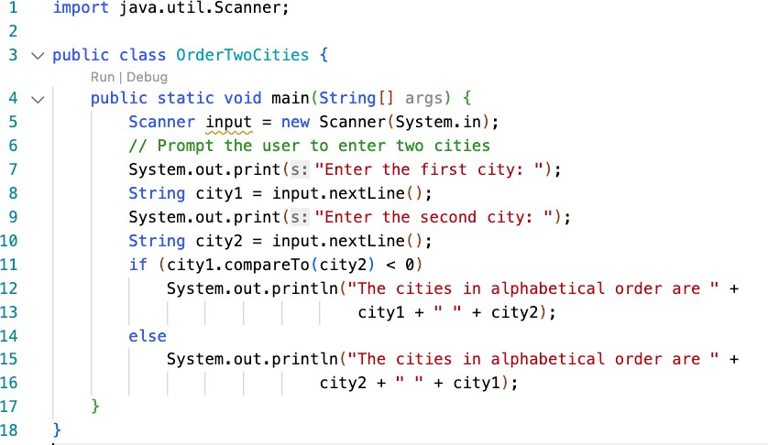
3.5.7. Comparing Strings
New York
Boston
Boston > New York
∴ 1

Slide 37
3.5.7. Comparing Strings
If input.next() were used?
Switch to code – AlphabetizeCities

Slide 38
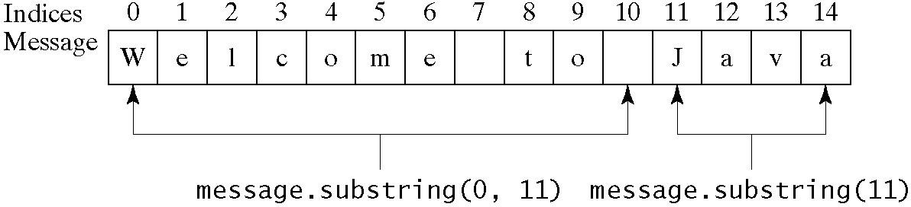
3.5.8. Obtaining Substrings
The String Class Contains the Methods for Obtaining Substrings
Method Description
substring(beginIndex)
Returns this string’s substring that begins with the character at the specified
beginIndex and extends to the end of the string, as shown in Figure 4.2.
substring(beginIndex, endIndex)
Returns this string’s substring that begins at the specified beginIndex and extends to the character at index endIndex – 1, as shown in Figure 9.6. Note that the character at endIndex is not part of the substring.

Slide 39
3.5.9. Finding a Character or a Substring in a String
The String Class Contains the Methods for Finding Substrings
Method Description
indexOf(ch)
Returns the index of the first occurrence of ch in the string. Returns -1 if not matched.
Returns the index of the first occurrence of ch after fromIndex in the string.
Returns -1 if not matched.
Returns the index of the first occurrence of string s in this string. Returns -1 if not matched.
Returns the index of the first occurrence of string s in this string after
fromIndex. Returns -1 if not matched.
Returns the index of the last occurrence of ch in the string. Returns -1 if not matched.
Returns the index of the last occurrence of ch before fromIndex in this string. Returns -1 if not matched.
Returns the index of the last occurrence of string s. Returns -1 if not matched. Returns the index of the last occurrence of string s before fromIndex.
Returns -1 if not matched.
indexOf(ch, fromIndex)
indexOf(s)
indexOf(s, fromIndex)
lastIndexOf(ch)
lastIndexOf(ch, fromIndex)
lastIndexOf(s) lastIndexOf(s,
fromIndex)

Slide 40
3.5.9. Finding a Character or a Substring in a String
"Welcome | to | Java".indexOf('W')returns 0.
"Welcome "Welcome | to to | Java".indexOf('o')returns 4. Java".indexOf('o', 5)returns 9.
"Welcome | to | Java".indexOf("come")returns 3.
"Welcome | to | Java".indexOf("Java", 5)returns | 11.
"Welcome | to | Java".indexOf("java", 5)returns | −1.

Slide 41
3.5.9. Finding a Character or a Substring in a String
"Welcome | to | Java".lastIndexOf('W')returns0.
"Welcome | to | Java".lastIndexOf('o')returns9.
"Welcome | to | Java".lastIndexOf('o', 5)returns4.
"Welcome | to | Java".lastIndexOf("come")returns3.
"Welcome | to | Java".lastIndexOf("Java", 5)returns−1.
"Welcome | to | Java".lastIndexOf("Java")returns11.

Slide 42
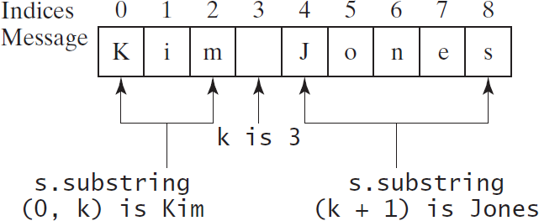
3.5.9. Finding a Character or a Substring in a String
int k = s.indexOf(' ');
String firstName = s.substring(0, k); String lastName = s.substring(k + 1);

Slide 43
3.5.10. Conversion between Strings and Numbers
intValue = 123
Converts a string into an int
intString = “123”
int intValue = Integer.parseInt(intString);
double doubleValue = Double.parseDouble(doubleString);
String s = number + ""; Converts a number into a string

Slide 44
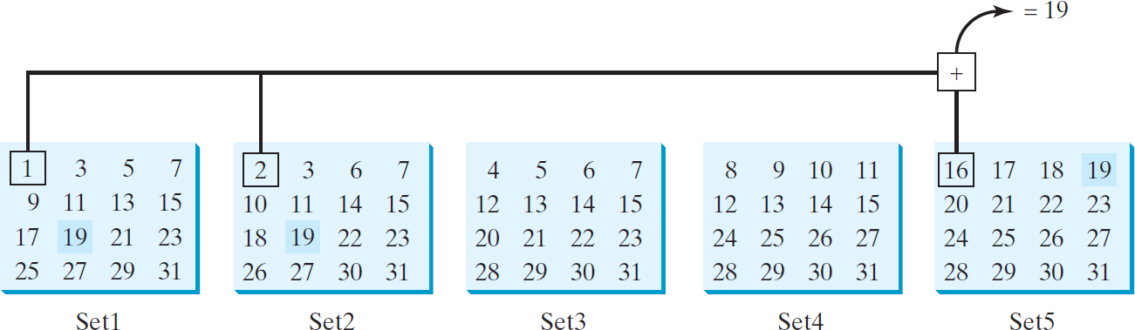
3.5.11. Problem: Guessing Birthday
The program can guess your birth date. Run to see how it works.

Slide 45
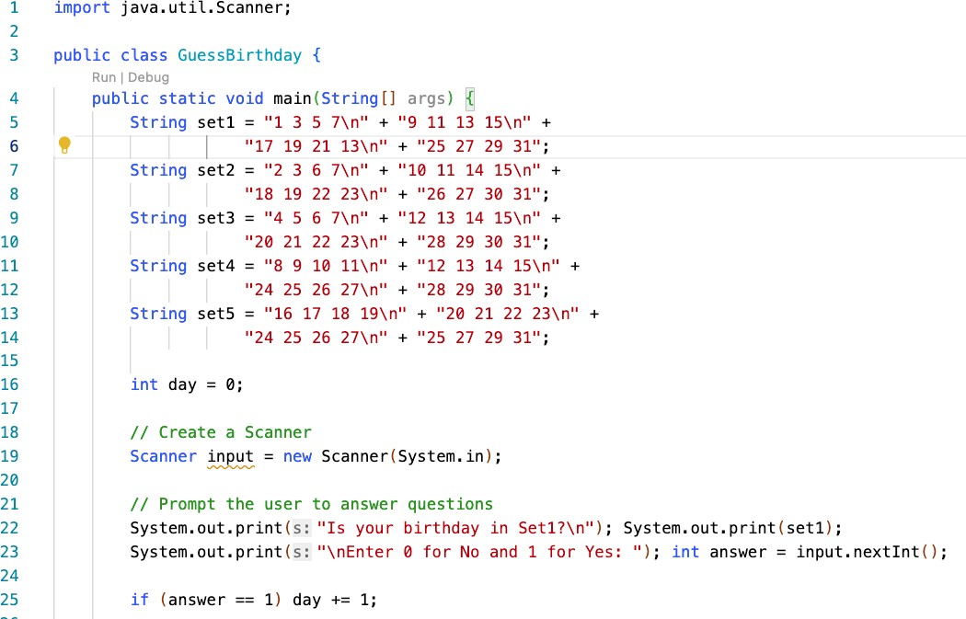
3.5.11. Problem: Guessing Birthday

Slide 46
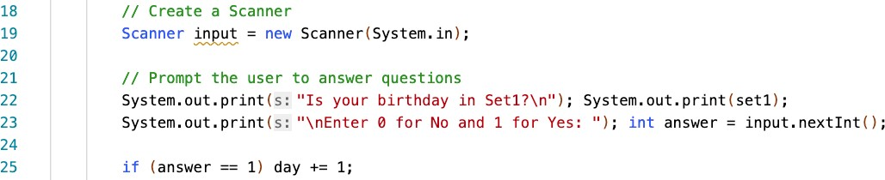
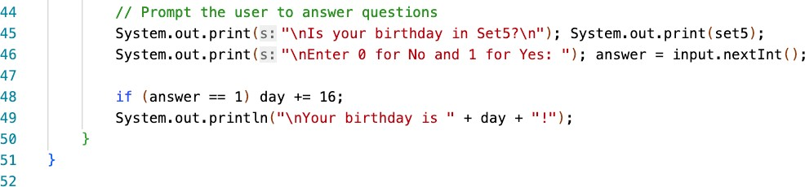
3.5.11. Problem: Guessing Birthday

Slide 47
3.6. Formatting Output
Use the printf statement.
System.out.printf(format, items);
Where format is a string that may consist of substrings and format specifiers.
A format specifier specifies how an item should be displayed. An item may be a numeric value, character, boolean value, or a string.
Each specifier begins with a percent sign.

Slide 48
3.6. Formatting Output
Frequently-Used Specifiers
Specifier | Output | Example
%b | a boolean value | true or false
%c | a character | 'a'
%d | a decimal integer | 200
%f | a floating-point number | 45.460000
%e | a number in standard | 4.556000e+01
scientific notation a string
%s
"Java is cool"

Slide 49
3.6. Formatting Output
int count = 5;
double amount = 45.56;
items
System.out.printf("count is %d and amount is %f", count, amount);
display
count is 5 and amount is 45.560000

