Slide 1

CS 501- Introduction to JAVA Programming
Lecture 11 - Exception Handling and Text I/O

Slide 2

Checked vs Unchecked Exceptions
Checked Exceptions occur at compile time, meaning the compiler requires they be handled using try-catch blocks and throws.
IOException, SQLException, ClassNotFoundException
Unchecked Exceptions occur at run time, meaning the compiler does not require explicit handling, but your code still must use try-catch blocks and throws.
NullPointerException, IndexOutOfBoundsException, ArithmeticException, ClassCastException, IllegalArgumentException

Slide 3
Simple Example
public static int division(int a, int b) throws ArithmeticException {
return a / b;
}
public static void calc(a, b) {
try {
System.out.println(division(a, b));
} catch (ArithmeticException e) {
System.err.println(e);
}
}

Slide 4
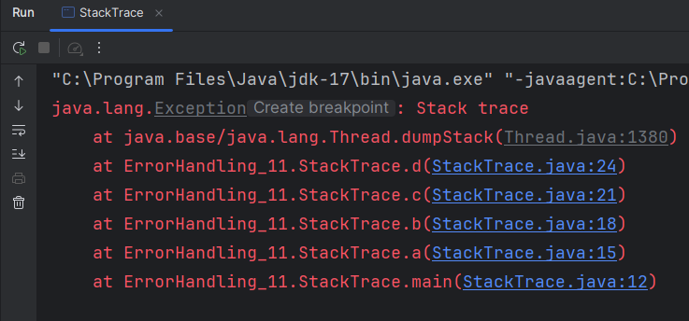
Stack Trace
A handler for an exception is found by propagating the exception backward through a chain of method calls, starting from the current method.
Switch to Code - StackTrace

Slide 5
Declaring Exceptions
declaring exceptions: Every method must state the types of checked exceptions it might throw.
public void myMethod()
throws IOException
public void myMethod()
throws IOException, OtherException

Slide 6
Throwing Exceptions
throwing an exception: When the program detects an error, the program can create an instance of an appropriate exception type and throw it.
throw new TheException();
TheException ex = new TheException(); throw ex;

Slide 7
Catching Exceptions
try {
statements; // Statements that may throw exceptions
}
catch (Exception1 exVar1) { handler for exception1;
}
catch (Exception2 exVar2) { handler for exception2;
}
...
catch (ExceptionN exVar3) { handler for exceptionN;
}

Slide 8
Catching Exceptions
main method {
...
try {
...
invoke method1; statement1;
}
catch (Exception1 ex1) { Process ex1;
}
statement2;
}
method1 {
...
try {
...
invoke method2; statement3;
}
catch (Exception2 ex2) { Process ex2;
}
statement4;
}
method2 {
...
try {
...
invoke method3; statement5;
}
catch (Exception3 ex3) { Process ex3;
}
statement6;
}
An exception is thrown in method3
Call Stack
method3
method2 method1 main method
method2
method1 main method
method1
main method
main method

Slide 9
Catch or Declare Checked Exceptions
Suppose p2 is defined as follows:
void p2() throws IOException {
if (a file does not exist) {
throw new IOException("File does not exist");
}
...
}

Slide 10
Exception Advantages
Using exception handling enables a method to throw an exception to its caller.
Without this capability, a method must either handle the exception itself or terminate the program.

Slide 11
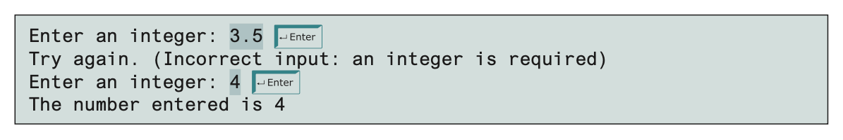
Handling InputMismatchException
By handling InputMismatchException, your program will continuously read an input until it is correct.
import java.util.*;
public class InputMismatchExceptionDemo {
public static void main(String[] args) {
Scanner input = new Scanner(System.in); boolean validInput = false;
while (!validInput) {
//try block
//Display the result
//catch block
}
}
}
29

Slide 12
Handling InputMismatchException
//try block
try {
System.out.print("Enter an integer:");
int number = input.nextInt();
//Display the result
System.out.println("The number entered is " + number);
validInput = true;
//catch block
} catch (InputMismatchException ex) {
System.out.println("Try again. (" +
"Incorrect input: an integer is required)");
input.nextLine();
}
30

Slide 13
Rethrowing Exceptions
Java allows an exception handler to rethrow the exception if the handler cannot process the exception (or simply wants to let its caller be notified of the exception)
try {
// statements
}
catch(Exception ex) {
// handling statements before rethrowing throw ex;
}

Slide 14
The finally Clause
The finally clause is always executed regardless of whether an exception occurred or not.
try {
//statements;
}
catch(TheException ex) {
//handling ex;
}
finally {
//finalStatements;
}

Slide 15
The finally Clause
try {
statements;
}
catch(TheException ex) { handling ex;
}
finally { finalStatements;
}
Next statement;

Slide 16
Trace a Program Execution
Suppose no exceptions in the statements
try {
statements;
}
catch(TheException ex) { handling ex;
}
finally { finalStatements;
}
Next statement;

Slide 17
Trace a Program Execution
statements is executed and we go to finally
try {
statements;
}
catch(TheException ex) { handling ex;
}
finally {
finalStatements;
}
Next statement;

Slide 18
Trace a Program Execution
Next statement in the method is executed
try {
statements;
}
catch(TheException ex) { handling ex;
}
finally { finalStatements;
}
Next statement;

Slide 19
Trace a Program Execution
try {
statement1;
statement2; statement3;
}
catch(Exception1 ex) { handling ex;
}
finally { finalStatements;
}
Next statement;
Suppose an exception of type Exception1 is thrown in statement2

Slide 20
Trace a Program Execution
try {
statement1;
statement2; statement3;
}
catch(Exception1 ex) { handling ex;
}
finally { finalStatements;
}
Next statement;
We skip statement3 and go straight to handling the exception.

Slide 21
Trace a Program Execution
try {
statement1;
statement2; statement3;
}
catch(Exception1 ex) { handling ex;
}
Once handled, enter finally. Never execute statement3
finally {
finalStatements;
}
Next statement;

Slide 22
Trace a Program Execution
try {
statement1;
statement2; statement3;
}
catch(Exception1 ex) { handling ex;
}
finally { finalStatements;
}
The next statement in the method is now executed.
Next statement;

Slide 23
Rethrowing Exceptions

Slide 24
Trace a Program Execution
try {
statement1;
statement2 throws an exception of type Exception2.
statement2;
statement3;
}
catch(Exception1 ex) { handling ex;
}
catch(Exception2 ex) { handling ex;
throw ex;
}
finally { finalStatements;
}
Next statement;

Slide 25
Trace a Program Execution
try {
statement1; statement2;
statement3;
}
catch(Exception1 ex) { handling ex;
}
catch(Exception2 ex) {
Handling exception
handling ex; throw ex;
}
finally { finalStatements;
}
Next statement;

Slide 26
Trace a Program Execution
try {
statement1; statement2;
statement3;
}
catch(Exception1 ex) { handling ex;
}
catch(Exception2 ex) { handling ex;
throw ex;
}
finally {
Execute the final block
finalStatements;
}
Next statement;

Slide 27
Trace a Program Execution
try {
statement1; statement2;
statement3;
}
catch(Exception1 ex) { handling ex;
}
catch(Exception2 ex) { handling ex;
Rethrow the exception and control is transferred to the caller
throw ex;
}
finally { finalStatements;
}
Next statement;

Slide 28
Cautions When Using Exceptions
Exception handling separates error-handling code from normal programming tasks.
Be aware, however, that exception handling usually requires more time and resources because it requires instantiating a new exception object, rolling back the call stack, and propagating the errors to the calling methods.

Slide 29
When to Throw Exceptions
An exception occurs in a method.
If you want the exception to be processed by its caller, you should create an exception object and throw it.
If you can handle the exception in the method where it occurs, there is no need to throw it.

Slide 30
When to Use Exceptions
Use the try-catch block to deal with unexpected error conditions.
Do not use it to deal with simple, expected situations.
//Bad
try {
System.out.println(refVar.toString());
}
catch (NullPointerException ex) { System.out.println("refVar is null");
}
//Good
if (refVar != null) System.out.println(refVar.toString());
else
System.out.println("refVar is null");

Slide 31
Defining Custom Exception Classes
Use default exception classes whenever possible.
Define custom exception classes if the predefined classes are not sufficient.
Define custom exception classes by extending Exception or a subclass of Exception.
Switch to Code - CustomException

Slide 32
Assertions
An assertion is a Java statement that enables you to assert an assumption about your program.
An assertion contains a Boolean expression that should be true during program execution.
Assertions can be used to assure program correctness and avoid logic errors – VERY USEFUL FOR TESTING!

Slide 33
Declaring Assertions
An assertion is declared using the new Java keyword
assert
assert assertion; or
assert assertion : detailMessage;
assertion is a Boolean expression
detailMessage is a primitive-type or an Object value.

Slide 34
Executing Assertions
When an assertion statement is executed, Java evaluates the assertion.
If it is false, an AssertionError will be thrown.
The AssertionError class has a no-arg constructor and seven overloaded single-argument constructors of type int, long, float, double, boolean, char, and Object.
Since AssertionError is a subclass of Error, when an assertion becomes false, the program displays a message on the console and exits.

Slide 35
Executing Assertions Example
A best practice is to place assertions in a switch statement without a default case.
switch (month) {
case 1: ... ; break;
case 2: ... ; break;
...
case 12: ... ; break;
default: assert false : "Invalid month: " + month
}

Slide 36
Running Programs with Assertions
By default, the assertions are disabled at runtime.
To enable it, use the switch –enableassertions, or –ea
for short, as follows:
java –ea AssertionDemo
Assertions can be selectively enabled or disabled at class level or package level.
The disable switch is –disableassertions or –da for short.
For example, the following command enables assertions in package package1 and disables assertions in class Class1.
java –ea:package1 –da:Class1 AssertionDemo

Slide 37
Using Exception Handling or Assertions
Assertion should not be used to replace exception handling.
Exception handling deals with unusual circumstances
during program execution.
Assertions are to assure the correctness of the program.
Exception handling addresses robustness.
Assertion addresses correctness.
Like exception handling, assertions are not used for normal tests, but for internal consistency and validity checks.
Assertions are checked at runtime and can be turned
on or off at startup time.

Slide 38
Using Exception Handling or Assertions
Do not use assertions for argument checking in public methods.
Assertions should be used for testing purposes
For example, the following code in the Circle class should be rewritten using exception handling.
public void setRadius(double newRadius) { assert newRadius >= 0;
radius = newRadius;
}

Slide 39
Using Exception Handling or Assertions
Use assertions to reaffirm assumptions.
This gives you more confidence to assure correctness of the program.
A common use of assertions is to replace assumptions with assertions in the code.
A best practice is to use assertions liberally.
Assertions are checked at runtime and can be turned on or off at startup time, unlike exception handling.

Slide 40
The File Class
The File class is intended to provide an abstraction that deals with most of the machine-dependent complexities of files and path names in a machine- independent fashion.
The filename is a string.
The File class is a wrapper class for the file name and its directory path.

Slide 41
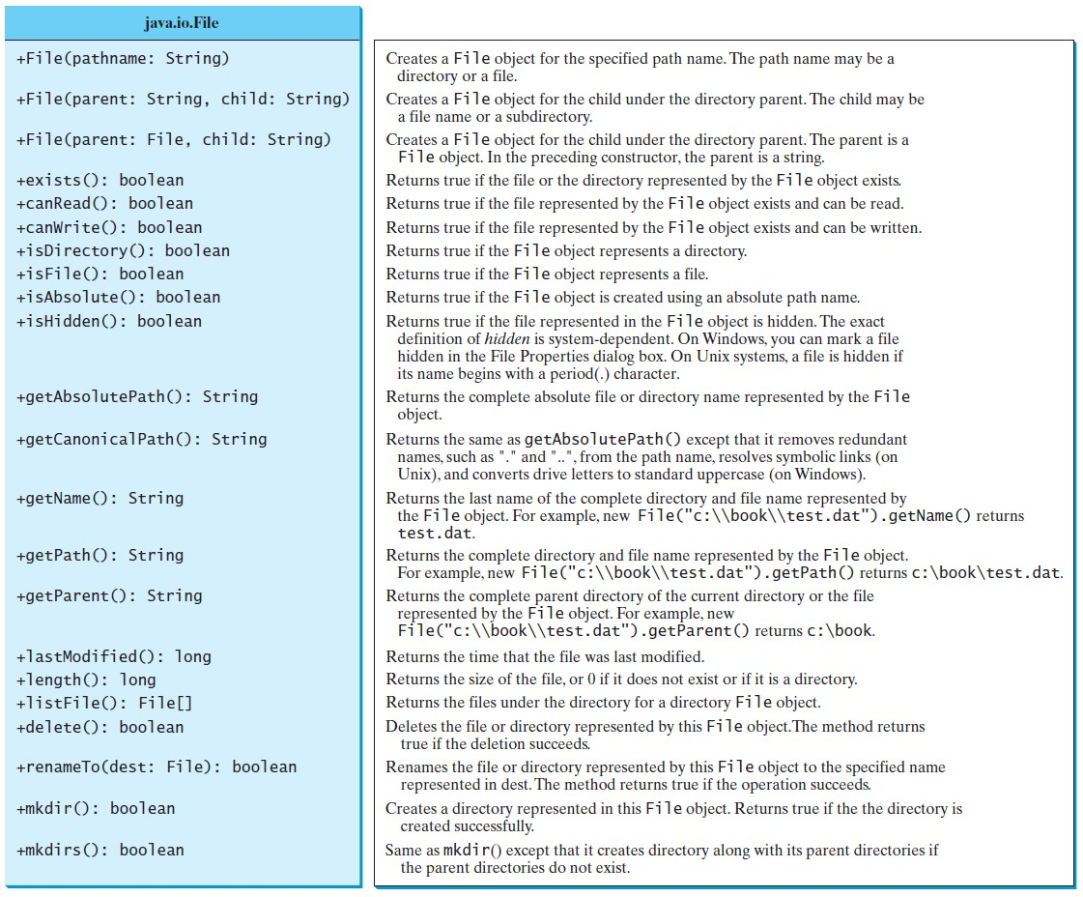
Obtaining file properties and manipulating file

Slide 42
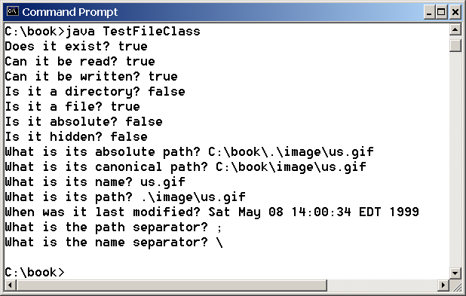
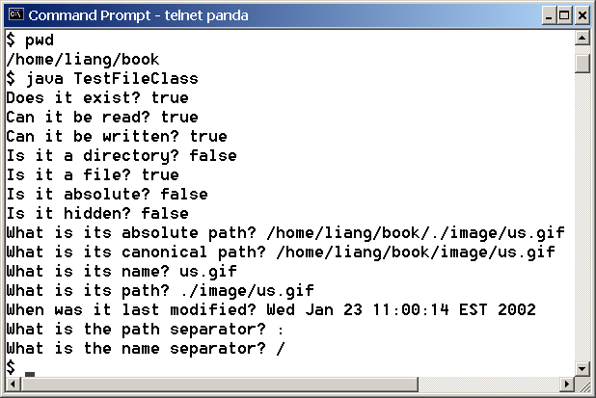
Problem: Explore File Properties
Objective: Write a program that demonstrates how to create files in a platform-independent way and use the methods in the File class to obtain their properties.

Slide 43
Problem: Explore File Properties
public class TestFileClass {
public static void main(String[] args){
java.io.File file = new java.io.File("image/us.gif");
System.out.println("Does it exist? " + file.exists()); System.out.println("The file has " + file.length() + " bytes"); System.out.println("Can it be read? " + file.canRead()); System.out.println("Can it be written? " + file.canWrite()); System.out.println("Is it a directory? " + file.isDirectory()); System.out.println("Is it a file? " + file.isFile()); System.out.println("Is it absolute? " + file.isAbsolute()); System.out.println("Is it hidden? " + file.isHidden()); System.out.println("Absolute path is " + file.getAbsolutePath()); System.out.println("Last modified on " +
new java.util.Date(file.lastModified()));
}
}
68

Slide 44
Text I/O
A File object encapsulates the properties of a file or a path, but does not contain the methods for reading/writing data from/to a file.
In order to perform I/O, you need to create objects using appropriate Java I/O classes.
The objects contain the methods for reading/writing data from/to a file.
File
Scanner
PrintWriter
Switch to Code – FileHandling

Slide 45
Writing Data Using PrintWriter
java.io.PrintWriter
+PrintWriter(filename: String)
+print(s: String): void
+print(c: char): void
+print(cArray: char[]): void
+print(i: int): void
+print(l: long): void
+print(f: float): void
+print(d: double): void
+print(b: boolean): void Also contains the overloaded
println methods.
Also contains the overloaded printf methods.
Creates a PrintWriter for the specified file. Writes a string.
Writes a character.
Writes an array of character. Writes an int value.
Writes a long value. Writes a float value.
Writes a double value. Writes a boolean value.
A println method acts like a print method; additionally it prints a line separator. The line separator string is defined by the system. It is \r\n on Windows and \n on Unix.
The printf method was introduced in §4.6, “Formatting
Console Output and Strings.”

Slide 46
Writing Data Using PrintWriter
public class WriteData {
public static void main(String[] arg) throws java.io.IOException {
java.io.File file = new java.io.File("scores.txt");
if (file.exists()) {
System.out.println("File already exists"); System.exit(1); }
//create a file
java.io.PrintWriter output = new java.io.PrintWriter(file);
// Write formatted output to the file
output.print("John T Smith ");
output.println(90);
output.print("Eric K Jones "); output.println(85);
//close the file
output.close();
}
}
71

Slide 47
Reading Data Using Scanner
j ava.util.Scanner
+Scanner(source: File)
+Scanner(source: St ring)
+close()
+hasNext (): boolean
+next(): String
+nextByte(): byte
+nextShort (): short
+nextInt(): int
+nextLong(): long
+nextFloat (): float
+nextDouble(): doubl e
+useDel imit er(pattern: St ring): Scanner
Creates a Scanner object to read data from t he speci fied file. Creates a Scanner object to read data from t he speci fied string. Clos es th is scanner.
Returns true if thi s scanner has another t oken in its input.
Returns next token as a stri ng. Returns next token as a b yt e.
Returns next token as a short. Returns next token as an int. Returns next token as a long. Returns next token as a float.
Returns next token as a d oubl e.
Sets t hi s scanner’s delimiting pat tern.

Slide 48
Reading Data Using Scanner
import java.util.Scanner;; public class ReadData {
public static void main(String[] args) throws Exception {
java.io.File file = new java.io.File("scores.txt");
//Crate a scanner for the file
Scanner input = new Scanner(file);
//read data from file
while ( ) {
input.hasNext()
String firstName = input.next();
String mi = input.next();
String lastName = input.next(); int score = input.nextInt();
System.out.println(firstName +" " + mi + " " + lastName + " " + score);
}
//close the file
input.close();
}
}

Slide 49
Problem: Replacing Text
Write a class named ReplaceText that replaces a string in a text file with a new string.
The filename and strings are passed as command-line arguments as follows:
java ReplaceText sourceFile targetFile oldString newString
For example, invoking
java ReplaceText FormatString.java t.txt StringBuilder StringBuffer
replaces all the occurrences of StringBuilder by StringBuffer
in FormatString.java and saves the new file in t.txt.

Slide 50
import java.io.*; import java.util.*;
public class ReplaceText {
public static void main(String[] args) throws Exception {
// Check command line parameter usage if (args.length != 4) {
System.out.println("Usage: java ReplaceText sourceFile targetFile oldStr newStr"); System.exit(1);
}
// Check if source file exists
File sourceFile = new File(args[0]); if (!sourceFile.exists()) {
System.out.println("Source file " + args[0] + " does not exist"); System.exit(2);
}
// Check if target file exists
File targetFile = new File(args[1]); if (targetFile.exists()) {
System.out.println("Target file " + args[1] + " already exists");
System.exit(3);
75

Slide 51
try (
// Create input and output files
Scanner input = new Scanner(sourceFile);
PrintWriter output = new PrintWriter(targetFile);
) {
while (input.hasNext()) { String s1 = input.nextLine();
String s2 = s1.replaceAll(args[2], args[3]); output.println(s2);
}
}
}
}

Slide 52
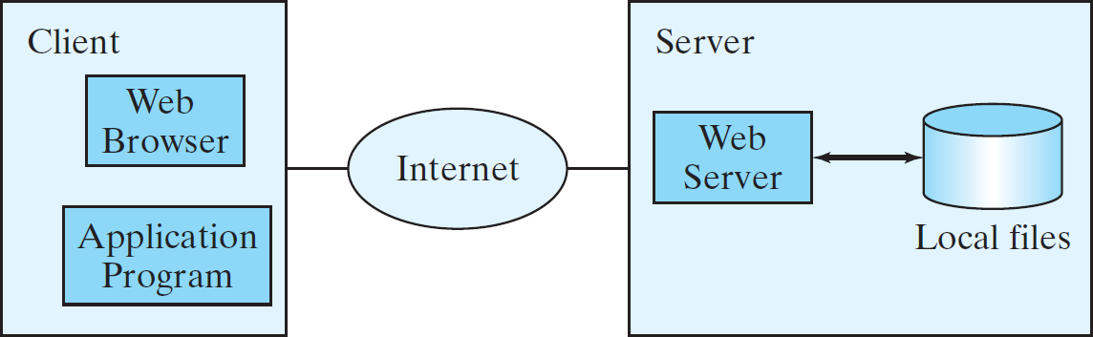
Reading Data from the Web
Just like you can read data from a file on your computer, you can read data from a file on the Web.

Slide 53
Reading Data from the Web
URL url = new URL("www.google.com/index.html");
After a URL object is created, you can use the openStream() method defined in the URL class to open an input stream and use this stream to create a Scanner object as follows:
Scanner input = new Scanner(url.openStream());

Slide 54
import java.util.Scanner; public class ReadFileFromURL {
public static void main(String[] args){
System.out.print("Enter a URL: ");
String URLString = new Scanner(System.in).next();
try {
java.net.URL url = new java.net.URL(URLString);
int count = 0;
Scanner input = new Scanner(url.openStream());
while (input.hasNext()) {
String line = input.nextLine(); count += line.length(); }
System.out.println("The file size is " + count + " characters"); }
catch (java.net.MalformedURLException ex) {
System.out.println("Invalid URL"); }
catch (java.io.IOException ex) {
System.out.println("I/O Errors: no such file");
}
}
}
79

