Slide 1
Chapter 1 Introduction to Computers, Programs, and Java

Slide 2
Objectives
To understand computer basics, programs, and operating systems (§§1.2–1.4).
To describe the relationship between Java and the World Wide Web (§1.5).
To understand the meaning of Java language specification, API, JDK, and IDE (§1.6).
To write a simple Java program (§1.7).
To display output on the console (§1.7).
To explain the basic syntax of a Java program (§1.7).
To create, compile, and run Java programs (§1.8).
To use sound Java programming style and document programs properly (§1.9).
To explain the differences between syntax errors, runtime errors, and logic errors (§1.10).
To develop Java programs using NetBeans (§1.11).
To develop Java programs using Eclipse (§1.12).

Slide 3
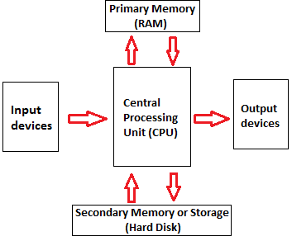
What is a Computer?
Electronic device to process, store, and retrieve data.
CPU: Reads and executes instructions from memory
Memory: Storage for data and instructions

Slide 4
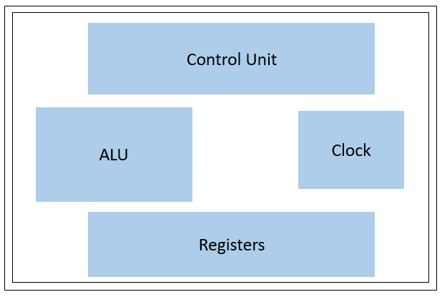
CPU – Central Processing Unit
This is the brain of a computer. The CPU coordinates communication between all hardware components. The Control unit reads and decodes instructions from memory. The ALU (arithmetic logic) executes the instruction using binary stored in the Registers at a speed determined by the Clock.
The unit of measurement of clock speed is the hertz (Hz), with 1 hertz equaling 1 pulse per second. Good CPUs can hold >2GHz
https://www.javatpoint.com/computer-components

Slide 5
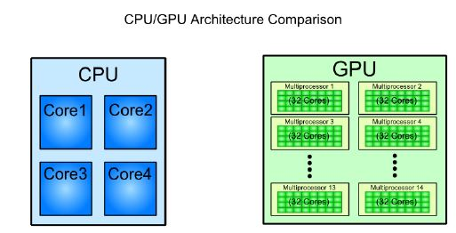
GPU – Graphics Processing Unit
This is the brawn of a computer. The GPU handles calculations through mass-parallelization, optimized for performing thousands of smaller tasks in parallel.
The CPU sends instructions to the GPU for processing.
https://www.tutorialspoint.com/cuda/cuda_introduction_to_the_gpu.htm

Slide 6
Storage Devices
Hardware components that retain digital information in one of two ways: Primary Storage (RAM) which can access data fast but is lost when the device powers off, and Secondary Storage (SSD/HDD) which is persistent but the CPU must send a request to retrieve from.
RAM (Random Access Memory): Files/programs load from your long term storage into RAM for faster retrieval by the CPU
SSD (Solid State Drive): Uses flash memory to store data, no moving parts makes them faster on average
HDD (Hard Disk Drive): Spinning magnetic disk with a read/write mechanical arm.

Slide 7
Primary Memory
RAM: As discussed, this is data the CPU has direct access to for extremely fast reading/writing. However, this is volatile, meaning the data is lost upon shutdown.
ROM (Read-Only Memory): Non-volatile storage used to store non-changing essentials like firmware (low-level software to interact with hardware), bootloaders (kicks off the OS during startup), factory settings and lookup tables.
A memory unit is an ordered sequence of bytes, 1 byte = 8 bits. When we write to memory, we are directly replacing whatever was stored in that address previously.

Slide 8
How is Data Stored?
Data of various kinds, such as numbers, characters, and strings, are encoded as a series of bits (zeros and ones). Computers use zeros and ones because digital devices have two stable states, which are referred to as zero and one by convention. The programmers need not to be concerned about the encoding and decoding of data, which is performed automatically by the system based on the encoding scheme. The encoding scheme varies. For example, character ‘J’ is represented by 01001010 in one byte. A small number such as three can be stored in a single byte. If computer needs to store a large number that cannot fit into a single byte, it uses a number of adjacent bytes. No two data can share or split a same byte. A byte is the minimum storage unit.

Slide 9
Monitor Resolution and Dot Pitch
resolution
The screen resolution specifies the number of pixels in horizontal and vertical dimensions of the display device. Pixels (short for “picture elements”) are tiny dots that form an image on the screen. A common resolution for a 17-inch screen, for example, is 1,024 pixels wide and 768 pixels high. The resolution can be set manually. The higher the resolution, the sharper and clearer the image is.
dot pitch
The dot pitch is the amount of space between pixels, measured in millimeters. The smaller the dot pitch, the sharper the display.

Slide 10
Communication Devices
Computers have a Network Interface Card (NIC) which can communicate directly to a router via either an ethernet (wired) or Wi-Fi (wireless) connection. Routers create Local Area Networks (LAN) and manage network traffic between local devices. To gain access to the internet, a router must be connected to a modem which connects to your internet service provider (ISP). The modem is responsible for facilitating the transfer of data between the router and the internet.

Slide 11
Programs
Computer programs, known as software, are instructions to the computer.
You tell a computer what to do through programs. Without programs, a computer is an empty machine. Computers do not understand human languages, so you need to use computer languages to communicate with them.
Programs are written using programming languages.

Slide 12
Programming Languages
Machine Language Assembly Language High-Level Language
Machine language is a set of primitive instructions built into every computer. The instructions are in the form of binary code, so you have to enter binary codes for various instructions. Program with native machine language is a tedious process. Moreover the programs are highly difficult to read and modify. For example, to add two numbers, you might write an instruction in binary like this:
1101101010011010

Slide 13
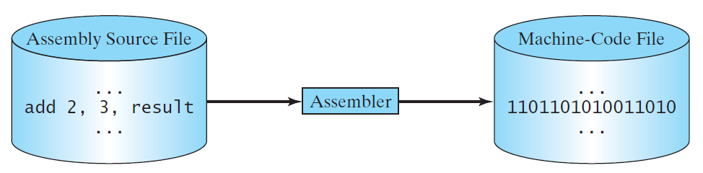
Programming Languages
Machine Language Assembly Language High-Level Language
Assembly languages were developed to make programming easier. An assembler is used to convert assembly language programs into machine-readable code. For example, to add two numbers, you might write an instruction in assembly code like this: ADDF3 R1, R2, R3
Super Mario: https://gist.github.com/1wErt3r/4048722

Slide 14
Programming Languages
Machine Language Assembly Language High-Level Language
High-level languages are further abstractions from machine language with the purpose of being significantly easier to read and use. They come with features like English-like syntax and automatic memory management, so we don’t accidentally overwrite critically important data.

Slide 15
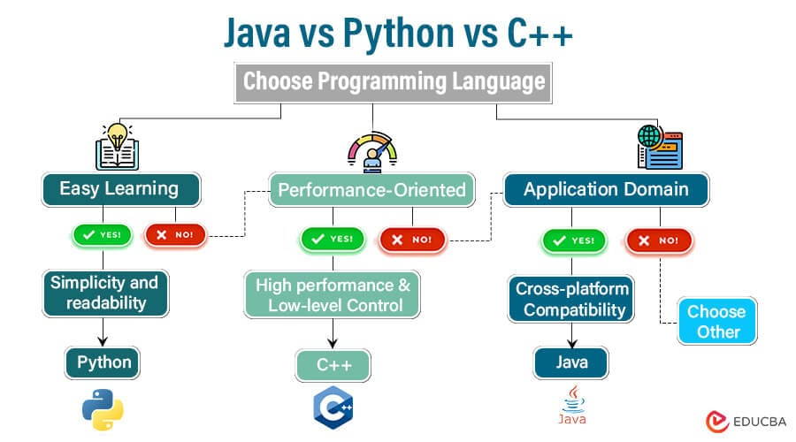
Popular High-Level Languages
https://www.educba.com/java-vs-python-vs-cpp/

Slide 16
Interpreting/Compiling Source Code
A program written in a high-level language is called a source program or source code. Because a computer cannot understand a source program, a source program must be translated into machine code for execution. The translation can be done using another programming tool called an interpreter or a compiler.

Slide 17
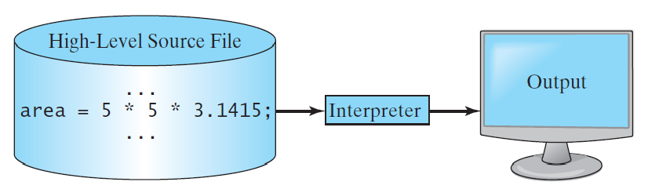
Interpreting Source Code
An interpreter reads one statement from the source code, translates it to the machine code or virtual machine code, and then executes it right away, as shown in the following figure. Note that a statement from the source code may be translated into several machine instructions.

Slide 18
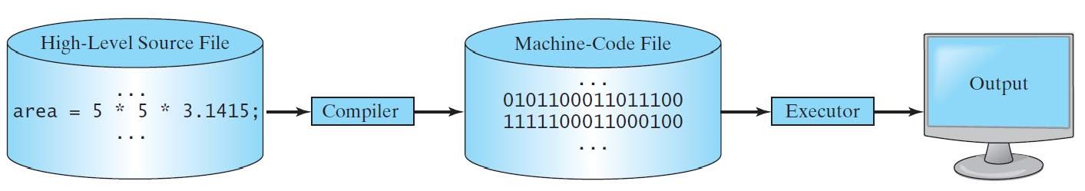
Compiling Source Code
A compiler translates the entire source code into a machine-code file, and the machine-code file is then executed, as shown in the following figure.

Slide 19
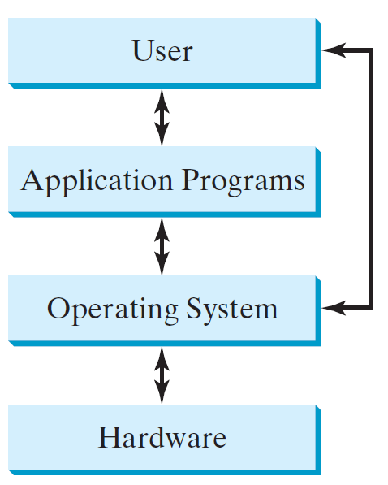
Operating Systems
The operating system (OS) is a program that manages and controls a computer’s activities. The popular operating systems for general-purpose computers are Microsoft Windows, Mac OS, and Linux. Application programs, such as a Web browser or a word processor, cannot run unless an operating system is installed and running on the computer.

Slide 20
Why Java?
Java is an extremely widely-used, highly-portable, extensively supported, and competitively quick programming language.
It is an industry standard for large codebases.
Java has a Java Virtual Machine (JVM) meaning its compiled code is system independent.
Tons of libraries from Apache Commons, Google Guava, Spring, Jakarta
Only somewhat slower than C++, and much less painful

Slide 21
Java, Web, and Beyond
Java can be used to develop standalone applications.
Java can be used to develop applications running from a browser.
Java can also be used to develop applications for hand-held devices.
Java can be used to develop applications for Web servers.

Slide 22
Java’s History
James Gosling and Sun Microsystems
Oak
Java, May 20, 1995, Sun World
HotJava
The first Java-enabled Web browser
Early History Website:
http://www.java.com/en/javahistory/index.jsp

Slide 23
Characteristics of Java
Companion Website
Java Is Simple
Java Is Object-Oriented
Java Is Distributed
Java Is Interpreted
Java Is Robust
Java Is Secure
Java Is Architecture-Neutral
Java Is Portable
Java's Performance
Java Is Multithreaded
Java Is Dynamic
Java is partially modeled on C++, but greatly simplified and improved. Easier to read and understand, automatic garbage collection and other features to prevent the user from created unintended, often problematic behaviors

Slide 24
Characteristics of Java
Companion Website
Java Is Simple
Java Is Object-Oriented
Java Is Distributed
Java Is Interpreted
Java Is Robust
Java Is Secure
Java Is Architecture-Neutral
Java Is Portable
Java's Performance
Java Is Multithreaded
Java Is Dynamic
Java is inherently object-oriented. Object-oriented programming (OOP) is a design paradigm centered around creating blueprints or templates for objects called classes.
One of the central issues in software development is how to reuse code. Object-oriented programming provides great flexibility, modularity, clarity, and reusability through encapsulation, abstraction, inheritance, and polymorphism.

Slide 25
Characteristics of Java
Companion Website
Java Is Simple
Java Is Object-Oriented
Java Is Distributed
Java Is Interpreted
Java Is Robust
Java Is Secure
Java Is Architecture-Neutral
Java Is Portable
Java's Performance
Java Is Multithreaded
Java Is Dynamic
Distributed computing involves several computers working together on a network. Java is designed to make distributed computing easy. Since networking capability is inherently integrated into Java, writing network programs is like sending and receiving data to and from a file.

Slide 26
Characteristics of Java
Companion Website
Java Is Simple
Java Is Object-Oriented
Java Is Distributed
Java Is Interpreted
Java Is Robust
Java Is Secure
Java Is Architecture-Neutral
Java Is Portable
Java's Performance
Java Is Multithreaded
Java Is Dynamic
You need an interpreter to run Java programs. The programs are compiled into the Java Virtual Machine code called bytecode. The bytecode is machine-independent and can run on any machine that has a Java interpreter, which is part of the Java Virtual Machine (JVM).

Slide 27
Characteristics of Java
Companion Website
Java Is Simple
Java Is Object-Oriented
Java Is Distributed
Java Is Interpreted
Java Is Robust
Java Is Secure
Java Is Architecture-Neutral
Java Is Portable
Java's Performance
Java Is Multithreaded
Java Is Dynamic
Java compilers can detect many problems that would first show up at execution time in other languages.
Java has eliminated certain types of error-prone programming constructs found in other languages.
Java has a runtime exception-handling feature to provide programming support for robustness.

Slide 28
Characteristics of Java
Companion Website
Java Is Simple
Java Is Object-Oriented
Java Is Distributed
Java Is Interpreted
Java Is Robust
Java Is Secure
Java Is Architecture-Neutral
Java Is Portable
Java's Performance
Java Is Multithreaded
Java Is Dynamic
Java implements several security mechanisms to protect your system against harm caused by stray programs.

Slide 29
Characteristics of Java
Companion Website
Java Is Simple
Java Is Object-Oriented
Java Is Distributed
Java Is Interpreted
Java Is Robust
Java Is Secure
Java Is Architecture-Neutral
Java Is Portable
Java's Performance
Java Is Multithreaded
Java Is Dynamic
Write once, run anywhere
With a Java Virtual Machine (JVM), you can write one program that will run on any platform.

Slide 30
Characteristics of Java
Companion Website
Java Is Simple
Java Is Object-Oriented
Java Is Distributed
Java Is Interpreted
Java Is Robust
Java Is Secure
Java Is Architecture-Neutral
Java Is Portable
Java's Performance
Java Is Multithreaded
Java Is Dynamic
Because Java is architecture neutral, Java programs are portable. They can be run on any platform without being recompiled.

Slide 31
Characteristics of Java
Companion Website
Java Is Simple
Java Is Object-Oriented
Java Is Distributed
Java Is Interpreted
Java Is Robust
Java Is Secure
Java Is Architecture-Neutral
Java Is Portable
Java's Performance
Java Is Multithreaded
Java Is Dynamic
Java’s performance has been improved impressively over the years with every new version.

Slide 32
Characteristics of Java
Companion Website
Java Is Simple
Java Is Object-Oriented
Java Is Distributed
Java Is Interpreted
Java Is Robust
Java Is Secure
Java Is Architecture-Neutral
Java Is Portable
Java's Performance
Java Is Multithreaded
Java Is Dynamic
Multithread programming is smoothly integrated in Java, whereas in other languages you have to call procedures specific to the operating system to enable multithreading.

Slide 33
Characteristics of Java
Companion Website
Java Is Simple
Java Is Object-Oriented
Java Is Distributed
Java Is Interpreted
Java Is Robust
Java Is Secure
Java Is Architecture-Neutral
Java Is Portable
Java's Performance
Java Is Multithreaded
Java Is Dynamic
Java was designed to adapt to an evolving environment. New code can be loaded on the fly without recompilation. There is no need for developers to create, and for users to install, major new software versions. New features can be incorporated transparently as needed.

Slide 34
JDK Versions
JDK 1.02 (1995)
JDK 1.1 (1996)
JDK 1.2 (1998)
JDK 1.3 (2000)
JDK 1.4 (2002)
JDK 1.5 (2004) a. k. a. JDK 5 or Java 5
JDK 1.6 (2006) a. k. a. JDK 6 or Java 6
JDK 1.7 (2011) a. k. a. JDK 7 or Java 7
JDK 1.8 (2014) a. k. a. JDK 8 or Java 8
Java 9, 10, 11, 12, 13, 14.

Slide 35
JDK Editions
Java Standard Edition (J2SE)
J2SE can be used to develop client-side standalone applications or applets.
Java Enterprise Edition (J2EE)
J2EE can be used to develop server-side applications such as Java servlets, Java ServerPages, and Java ServerFaces.
Java Micro Edition (J2ME).
J2ME can be used to develop applications for mobile devices such as cell phones.
This book uses J2SE to introduce Java programming.

Slide 36
Popular Java IDEs
IntelliJ – we will be using this
NetBeans
Eclipse

Slide 37
A Simple Java Program
Listing 1.1
// This program prints Welcome to Java!
public class Welcome {
public static void main(String[] args) {
System.out.println("Welcome to Java!");
}
}
Note: Clicking the green button displays the source code with interactive animation. You can also run the code in a browser. Internet connection is needed for this button.
Welcome

Slide 38
Trace a Program Execution
animation
Enter main method
// This program prints Welcome to Java!
public class Welcome {
public static void main(String[] args) {
System.out.println("Welcome to Java!");
}
}

Slide 39
Trace a Program Execution
animation
Execute statement
// This program prints Welcome to Java!
public class Welcome {
public static void main(String[] args) {
System.out.println("Welcome to Java!");
}
}

Slide 40
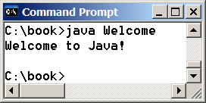
Trace a Program Execution
animation
// This program prints Welcome to Java!
public class Welcome {
public static void main(String[] args) {
System.out.println("Welcome to Java!");
}
}
print a message to the console

Slide 41
Two More Simple Examples
WelcomeWithThreeMessages
ComputeExpression

Slide 42

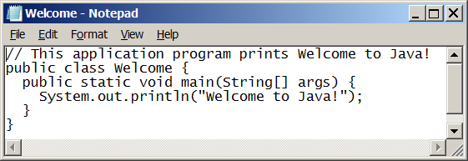
Creating and Editing Using NotePad
To use NotePad, type
notepad Welcome.java
from the DOS prompt.

Slide 43

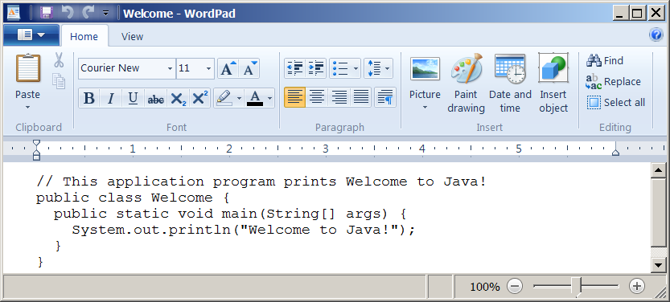
Creating and Editing Using WordPad
To use WordPad, type
write Welcome.java
from the DOS prompt.

Slide 44
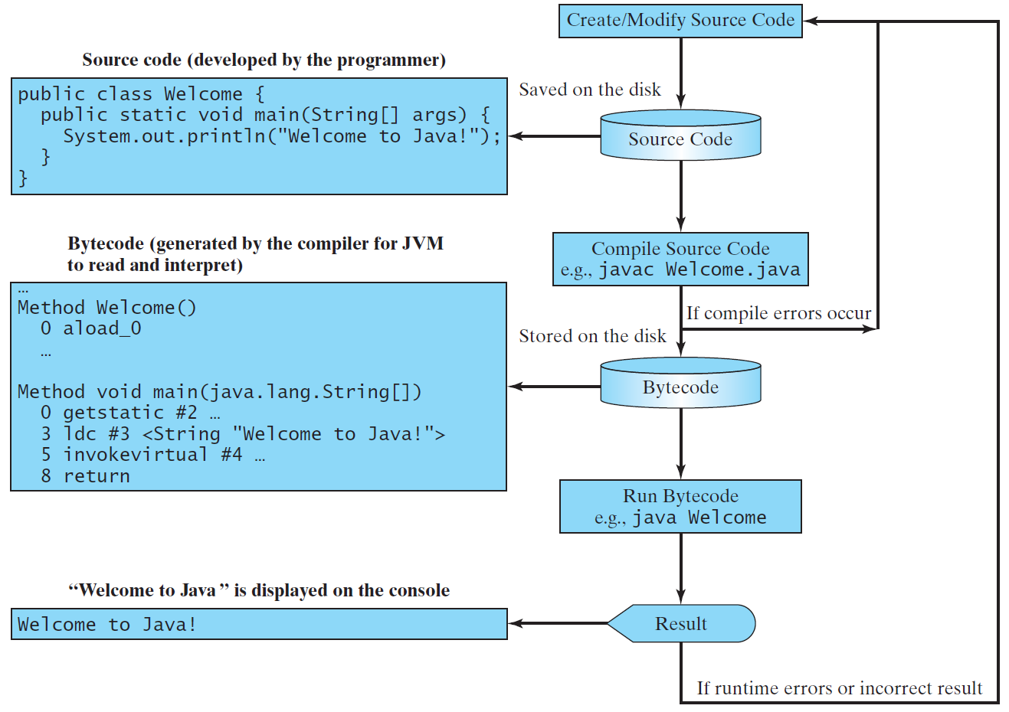
Creating, Compiling, and Running Programs

Slide 45
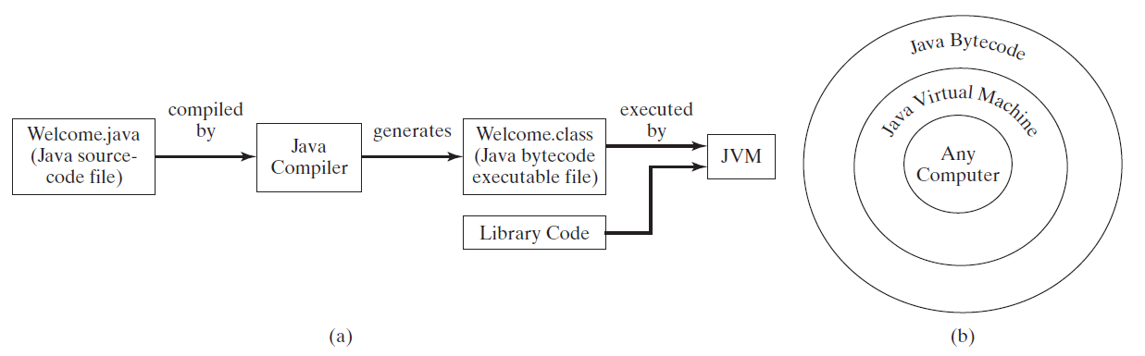
Compiling Java Source Code
You can port a source program to any machine with appropriate compilers. The source program must be recompiled, however, because the object program can only run on a specific machine. Nowadays computers are networked to work together. Java was designed to run object programs on any platform. With Java, you write the program once, and compile the source program into a special type of object code, known as bytecode. The bytecode can then run on any computer with a Java Virtual Machine, as shown below. Java Virtual Machine is a software that interprets Java bytecode.

Slide 46
Supplements on the Companion Website
Companion Website
See Supplement I.B for installing and configuring JDK
See Supplement I.C for compiling and running Java from the command window for details
www.pearsonhighered.com/liang

Slide 47
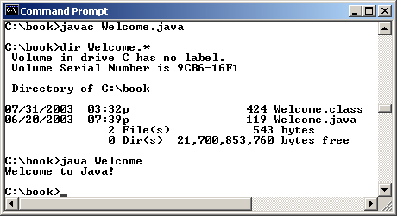
Compiling and Running Java from the Command Window
Companion Website
Set path to JDK bin directory
set path=c:\Program Files\java\jdk1.8.0\bin
Set classpath to include the current directory
set classpath=.
Compile
javac Welcome.java
Run
java Welcome

Slide 48
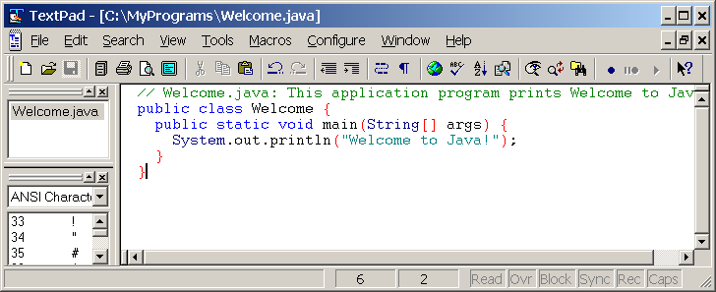
Compiling and Running Java from TextPad
Companion Website
See Supplement II.A on the Website for details

Slide 49
Anatomy of a Java Program
Class name
Main method
Statements
Statement terminator
Reserved words
Comments
Blocks

Slide 50
Class Name
Every Java program must have at least one class. Each class has a name. By convention, class names start with an uppercase letter. In this example, the class name is Welcome.
// This program prints Welcome to Java!
public class Welcome {
public static void main(String[] args) {
System.out.println("Welcome to Java!");
}
}

Slide 51
Main Method
Line 2 defines the main method. In order to run a class, the class must contain a method named main. The program is executed from the main method.
// This program prints Welcome to Java!
public class Welcome {
public static void main(String[] args) {
System.out.println("Welcome to Java!");
}
}

Slide 52
Statement
A statement represents an action or a sequence of actions. The statement System.out.println("Welcome to Java!") in the program in Listing 1.1 is a statement to display the greeting "Welcome to Java!“.
// This program prints Welcome to Java!
public class Welcome {
public static void main(String[] args) {
System.out.println("Welcome to Java!");
}
}

Slide 53
Statement Terminator
Every statement in Java ends with a semicolon (;).
// This program prints Welcome to Java!
public class Welcome {
public static void main(String[] args) {
System.out.println("Welcome to Java!");
}
}

Slide 54
Keywords
Keywords are words that have a specific meaning to the compiler and cannot be used for other purposes in the program. For example, when the compiler sees the word class, it understands that the word after class is the name for the class.
// This program prints Welcome to Java!
public class Welcome {
public static void main(String[] args) {
System.out.println("Welcome to Java!");
}
}

Slide 55
Blocks
A pair of braces in a program forms a block that groups components of a program.

Slide 56
Special Symbols

Slide 57
{ … }
// This program prints Welcome to Java!
public class Welcome {
public static void main(String[] args) {
System.out.println("Welcome to Java!");
}
}

Slide 58
( … )
// This program prints Welcome to Java!
public class Welcome {
public static void main(String[] args) {
System.out.println("Welcome to Java!");
}
}

Slide 59
;
// This program prints Welcome to Java!
public class Welcome {
public static void main(String[] args) {
System.out.println("Welcome to Java!");
}
}

Slide 60
// …
// This program prints Welcome to Java!
public class Welcome {
public static void main(String[] args) {
System.out.println("Welcome to Java!");
}
}

Slide 61
" … "
// This program prints Welcome to Java!
public class Welcome {
public static void main(String[] args) {
System.out.println("Welcome to Java!");
}
}

Slide 62
Programming Style and Documentation
Appropriate Comments
Naming Conventions
Proper Indentation and Spacing Lines
Block Styles

Slide 63
Appropriate Comments
Include a summary at the beginning of the program to explain what the program does, its key features, its supporting data structures, and any unique techniques it uses.
Include your name, class section, instructor, date, and a brief description at the beginning of the program.

Slide 64
Naming Conventions
Choose meaningful and descriptive names.
Class names:
Capitalize the first letter of each word in the name. For example, the class name ComputeExpression.
This will be taken into consideration in the homeworks!

Slide 65
Proper Indentation and Spacing
Indentation
Indent four spaces.
Can choose to use two space or tab instead but be consistent!
Spacing
Use blank line to separate segments of the code.
Your choice -- emphasize readability!

Slide 66
Block Styles
Use end-of-line style for braces.

Slide 67
Programming Errors
Syntax Errors
Detected by the compiler
Runtime Errors
Causes the program to abort
Logic Errors
Produces incorrect result

Slide 68
Syntax Errors
public class ShowSyntaxErrors {
public static void main(String[] args) {
System.out.println("Welcome to Java”);
}
}
ShowSyntaxErrors

Slide 69
Runtime Errors
public class ShowRuntimeErrors {
public static void main(String[] args) {
System.out.println(1 / 0);
}
}
ShowRuntimeErrors

Slide 70
Logic Errors
public class ShowLogicErrors {
public static void main(String[] args) {
System.out.print("35 Celsius is ");
System.out.println((9 / 5) * 35 + 32 + “Fahrenheit”);
}
}
ShowLogicErrors

Slide 71
Compiling and Running Java from NetBeans
Companion Website
See Supplement I.D on the Website for details

Slide 72
Compiling and Running Java from Eclipse
Companion Website
See Supplement II.D on the Website for details

