Slide 1

CS 501 – Introduction to JAVA Programing
Lecture 2 – Elementary Programming, Selections

Slide 2
Elementary Programming
To learn
how to solve practical problems programmatically.
to learn Java primitive data types and related subjects, such as variables, constants, data types, operators, expressions, and input and output.

Slide 3
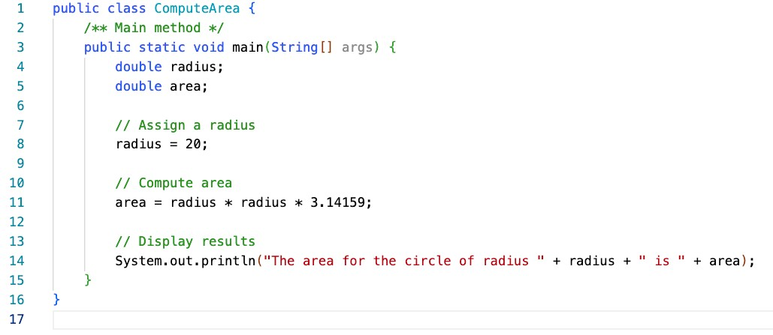
Example – Area of Circle

Slide 4
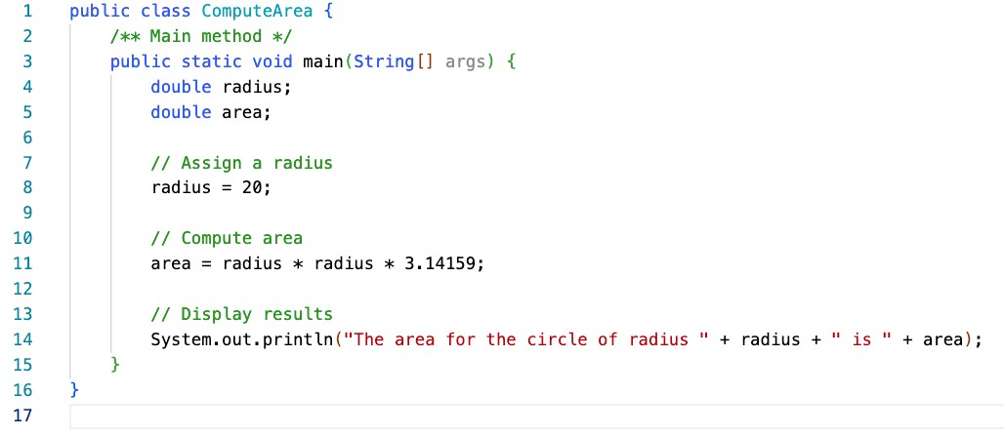
Example – Area of Circle
Allocate memory for radius and area.
No values

Slide 5
Example – Area of Circle
Assign 20 to radius:
Area: No values

Slide 6
Example – Area of Circle
Computes the area using assigned radius

Slide 7
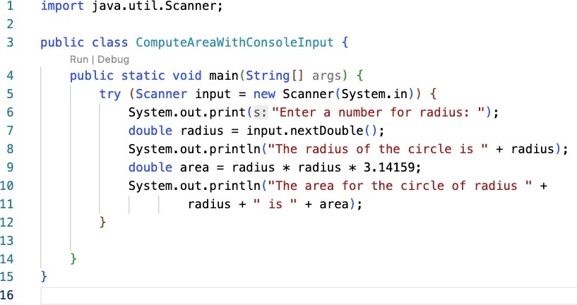
Example – Reading Input from the Console
Explicit Import.
Alternatively, it can be replaced with java.util.*; .

Slide 8
Example – Reading Input from the Console
Create a Scanner object

Slide 9
Example – Reading Input from the Console
Use the method nextDouble() to obtain a double value.

Slide 10
Identifiers
Identifiers are the names that identify the elements such as classes, methods, and variables in the program.
An identifier is a sequence of characters that consist of letters, digits, underscores (_), and dollar signs ($).
An identifier must start with a letter, an underscore (_), or a dollar sign ($). It cannot start with a digit.
An identifier cannot be a reserved word. (See Appendix A, “Java Keywords,” for a list of reserved words).
An identifier cannot be true, false, or null.
An identifier can be of any length.
Examples of illegal identifiers:
2A, d+4

Slide 11
Variables
Variables are used to represent values that may be changed in the program, e.g., radius, area
Variable declaration tells the compiler to allocate appropriate memory space for the variable based on its data type.
The syntax for variable declaration is in the order of datatype and the name. For example,
int x;
x = 1;
// Declare x to be an
// integer variable;
// Assign 1 to x;
int x = 1;
Int x = 5 + 2; // Assign the value for the
// expression to x
double radius = 1.4; char a = ‘A’;
double radius; // Declare radius to
// be a double variable; radius = 1.0; // Assign 1.0 to radius;
char a;
a = 'A';
// Declare a to be a
// character variable;
// Assign 'A' to a;

Slide 12
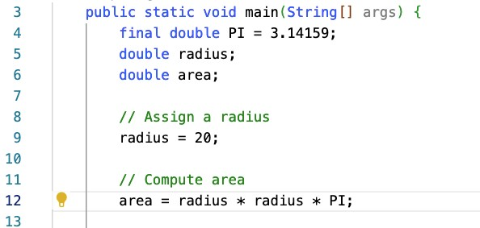
Named Constants
A named constant is an identifier that represents a permanent value.
The named constant declaration can be done as
final datatype CONSTANTNAME = VALUE; final double PI = 3.14159;
final int SIZE = 3;

Slide 13
Naming Conventions
Choose meaningful and descriptive names.
Variables and method names:
Use lowercase. If the name consists of several words, concatenate all in one, use lowercase for the
first word, and capitalize the first letter of each subsequent word in the name. For example, the variables radius and area, and the method computeArea.
Class names:
Capitalize the first letter of each word in the name. For example, the class name ComputeArea.
Constants:
Capitalize all letters in constants, and use underscores to connect words. For example, the constant PI and MAX_VALUE

Slide 14
Numerical Data Types and Operations
Name | Range | Storage Size
byte | –2⁷ to 2⁷ – 1 (-128 to 127) | 8-bit signed
short | –2¹⁵ to 2¹⁵ – 1 (-32768 to 32767) | 16-bit signed
int | –2³¹ to 2³¹ – 1 (-2147483648 to 2147483647) | 32-bit signed
long | –2⁶³ to 2⁶³ – 1 (i.e., -9223372036854775808 to 9223372036854775807) | 64-bit signed
float | Negative range: | 32-bit IEEE 754
-3.4028235E+38 to -1.4E-45
Positive range:
1.4E-45 to 3.4028235E+38
Negative range:
-1.7976931348623157E+308 to -4.9E-324
double
64-bit IEEE 754
Positive range:
4.9E-324 to 1.7976931348623157E+308

Slide 15
Numerical Data Types and Operations
Scanner input = new Scanner(System.in); int value = input.nextInt();
Method Description
nextByte() nextShort() nextInt() nextLong() nextFloat() nextDouble()
reads an integer of the byte type. reads an integer of the short type. reads an integer of the int type. reads an integer of the long type. reads a number of the float type. reads a number of the double type.

Slide 16
Numerical Data Types and Operations
Name
Meaning
Example
Result
+
Addition
34 + 1
35
-
Subtraction
34.0 – 0.1
33.9
*
Multiplication
300 * 30
9000
/
Division
1.0 / 2.0
0.5
If both variables are integer, 1 / 2 = 0.
%
Remainder
20 % 3
2

Slide 17
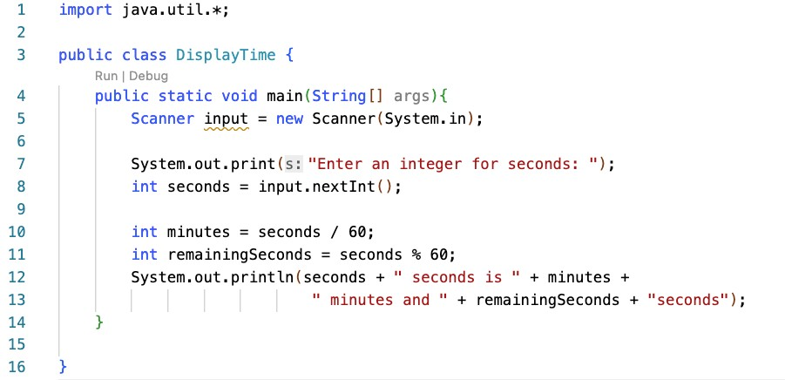
Example: % Operator
Create a scanner

Slide 18
Example: % Operator
Read an integer seconds
If input is 500, seconds=500

Slide 19
Example: % Operator
500 / 60 = 8
500 % 60 = 20

Slide 20
Example: % Operator
Suppose today is Saturday and you and your friends are going to meet in 10 days. What day is in 10 days?
Saturday is the 6th day in a week
A week has 7 days
(6 + 10) % 7 is 2
The 2nd day in a week is Tuesday
After 10 days

Slide 21

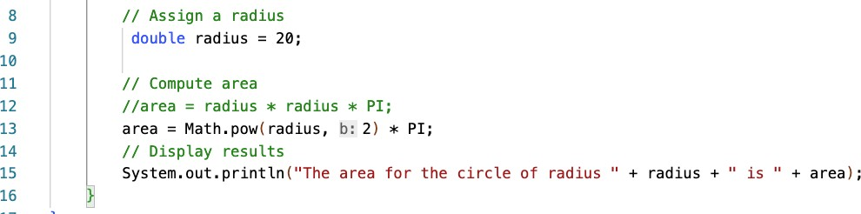
Exponent Operation
Math.pow(a,b) were a is the base and b is the exponent.

Slide 22
Literals
A literal is a constant value that appears directly in the program.

Slide 23
Literals - Integer
An integer literal can be assigned to an integer variable as long as it can fit into the variable. A compilation error would occur if the literal were too large for the variable to hold.
The statement byte b = 1000 would cause a compilation error,
because 1000 cannot be stored in a variable of the byte type.
An integer literal is assumed to be of the int type, whose value is between -2³¹ (-2147483648) to 2³¹–1 (2147483647).
To denote an integer literal of the long type, append it with the letter L or l. L is preferred because l (lowercase L) can easily be confused with 1 (the digit one).

Slide 24
Literals – Floating-Point
Floating-point literals are written with a decimal point.
By default, a floating-point literal is treated as a double type value.
5.0 is considered a double value, not a float value.
Can make a number a float by appending the letter f or F, and make a number a double by appending the letter d or D.
use 100.2f or 100.2F for a float number
100.2d or 100.2D for a double number.
System.out.println("1.0 / 3.0 is " + 1.0 / 3.0);
displays 1.0 / 3.0 is 0.3333333333333333
16 digits
System.out.println("1.0F / 3.0F is " + 1.0F / 3.0F);
displays 1.0F / 3.0F is 0.33333334
7 digits

Slide 25
Scientific Notation
Floating-point literals can also be specified in scientific notation.
E (or e) represents an exponent and it can be either in lowercase or uppercase.
o 1.23456e+2, same as 1.23456e2, is equivalent to 123.456.
o 1.23456e-2 is equivalent to 0.0123456.

Slide 26
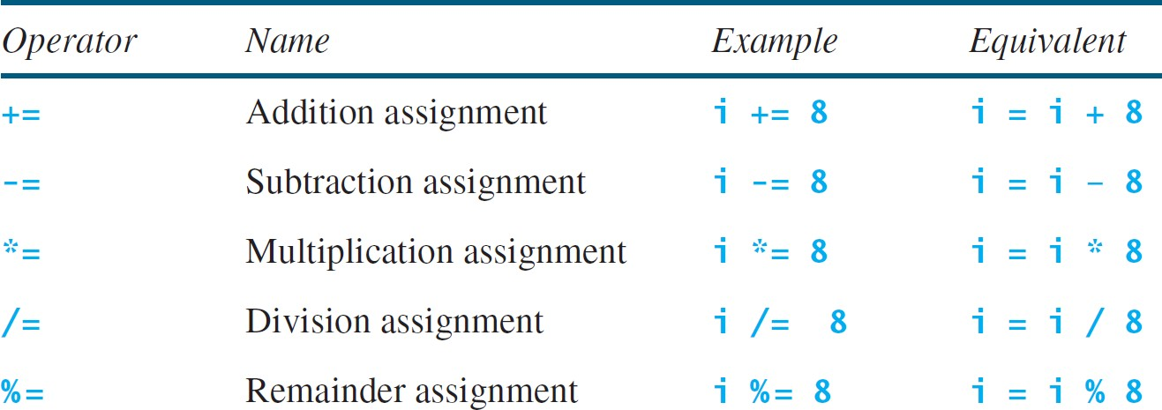
Augmented Assignment Operators

Slide 27
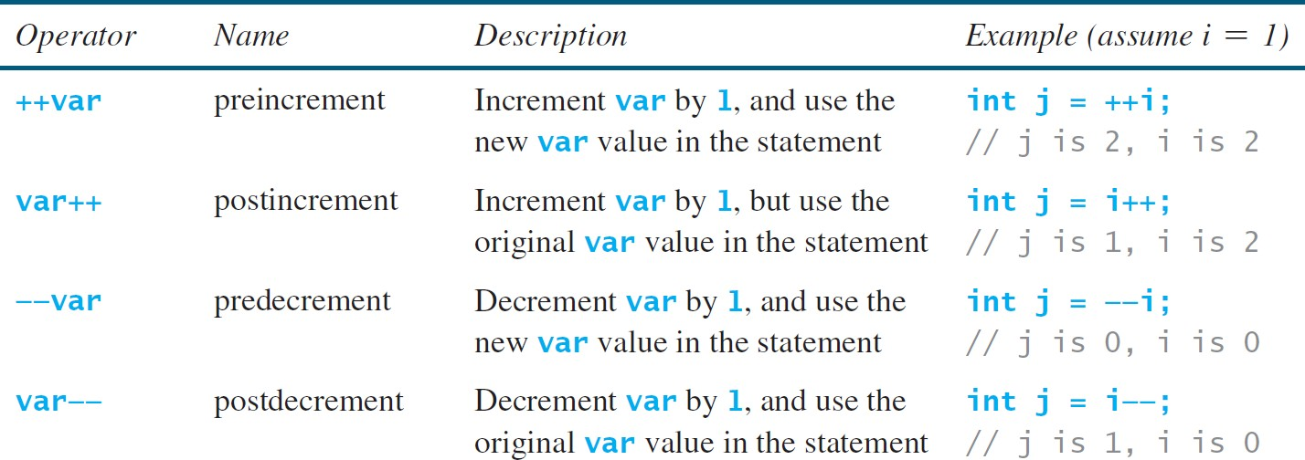
Increment and Decrement Operators
int i = 10;
int newNum = 10 * i++;
Same effect as
int newNum = 10 * i; i = i + 1;
int i = 10;
int newNum = 10 * (++i);
Same effect as
i = i + 1;
int newNum = 10 * i;

Slide 28
Numeric Type Conversion
When performing a binary operation involving two operands of different types, Java automatically converts the operand based on the following rules:
If one of the operands is double, the other is converted into double.
Otherwise, if one of the operands is float, the other is converted into float.
Otherwise, if one of the operands is long, the other is converted into long.
Otherwise, both operands are converted into int.
In Java, an augmented expression of the form x1 op= x2 is implemented as x1 = (T)(x1 op x2), where T is the type for x1. Therefore, the following code is correct.
Implicit casting
double d = 3; (type widening)
int sum = 0;
sum += 4.5; // sum becomes 4 after this statement
sum += 4.5 is equivalent to sum = (int)(sum + 4.5).
Explicit casting
int i = (int)3.0; (type narrowing)
int i = (int)3.9; (Fraction part is truncated)
What is wrong? int x = 5 / 2.0;

Slide 29
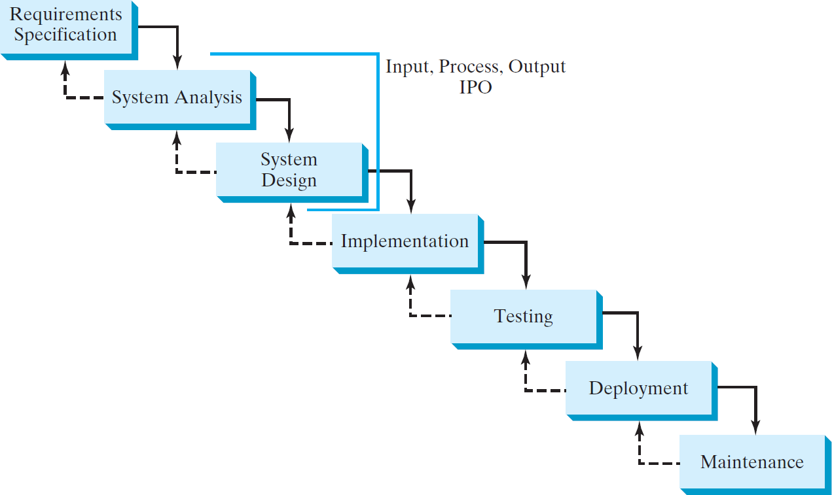
Software Development Process

Slide 30
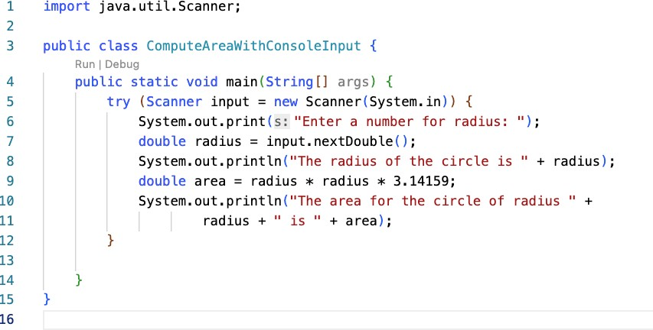
Selections

Slide 31
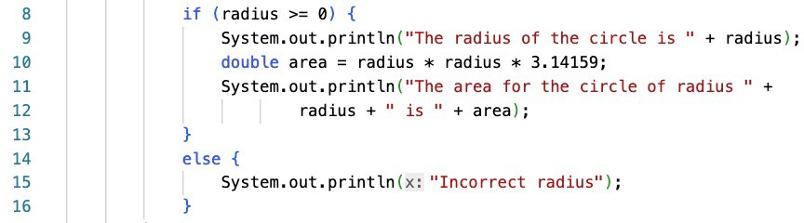
Selections

Slide 32
boolean Data Type, Values, and Expressions
Often in a program you need to compare two values, such as whether i is greater than j.
Java provides six comparison operators (also known as relational operators) that can be used to compare two values.
The result of the comparison is a Boolean value: true or false.
boolean b = (1 > 2);

Slide 33
boolean Data Type, Values, and Expressions
Java Operator | Mathematics Symbol | Name | Example (radius is 5) | Result
< | < | less than | radius < 0 | false
<= | ≤ | less than or equal to | radius <= 0 | false
> | > | greater than | radius > 0 | true
>= | ≥ | greater than or equal to | radius >= 0 | true
== | = | equal to | radius == 0 | false
!= | ≠ | not equal to | radius != 0 | true

Slide 34
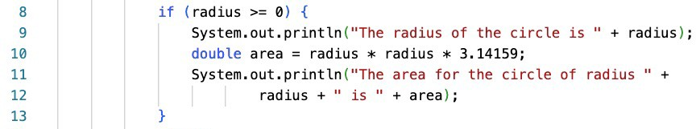
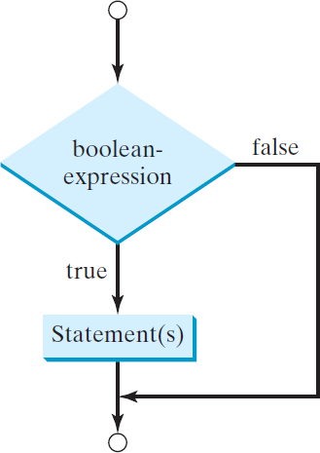
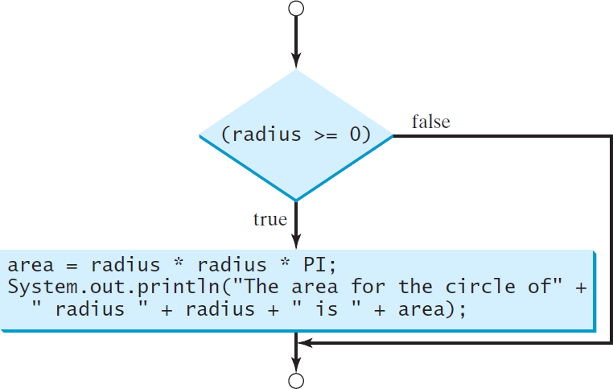
if Statements
if (boolean-expression) { statement(s);
}

Slide 35
if Statements
if i > 0 {
System. out. println( "i is po sitive " );
}
if ( i > 0 ) {
Sys tem.out .printl n( "i is positi ve " );
}
(a) W ron g
(b) Corre ct
if ( i > 0 ) {
S y s t e m. o u t . p ri n t l n ( "i i s po sitive " );
}
if (i > 0 )
Syste m.out. println ( "i is positiv e " );
Equ iva le nt
(a)
(b)

Slide 36

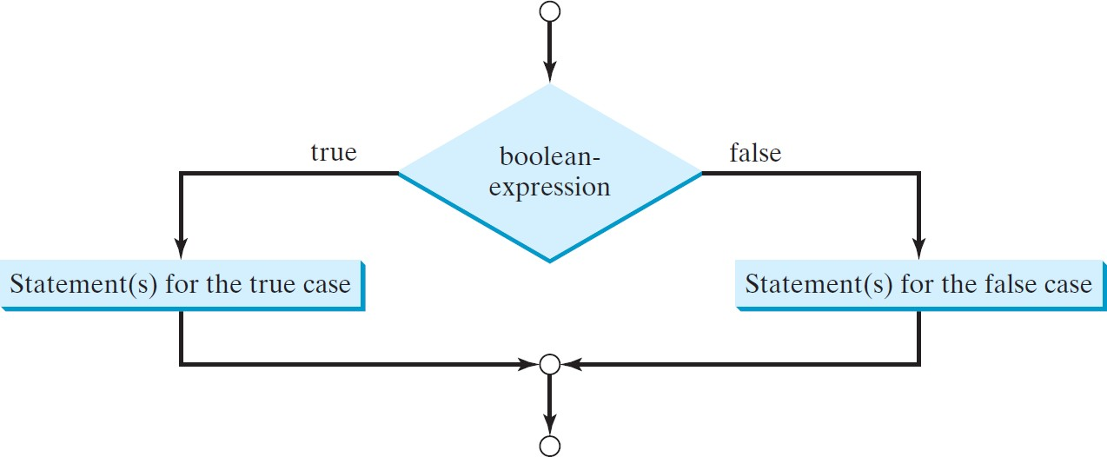
if Statements
if (boolean-expression) { statement(s)-for-the-true-case;
}
else {
statement(s)-for-the-false-case;
}

Slide 37
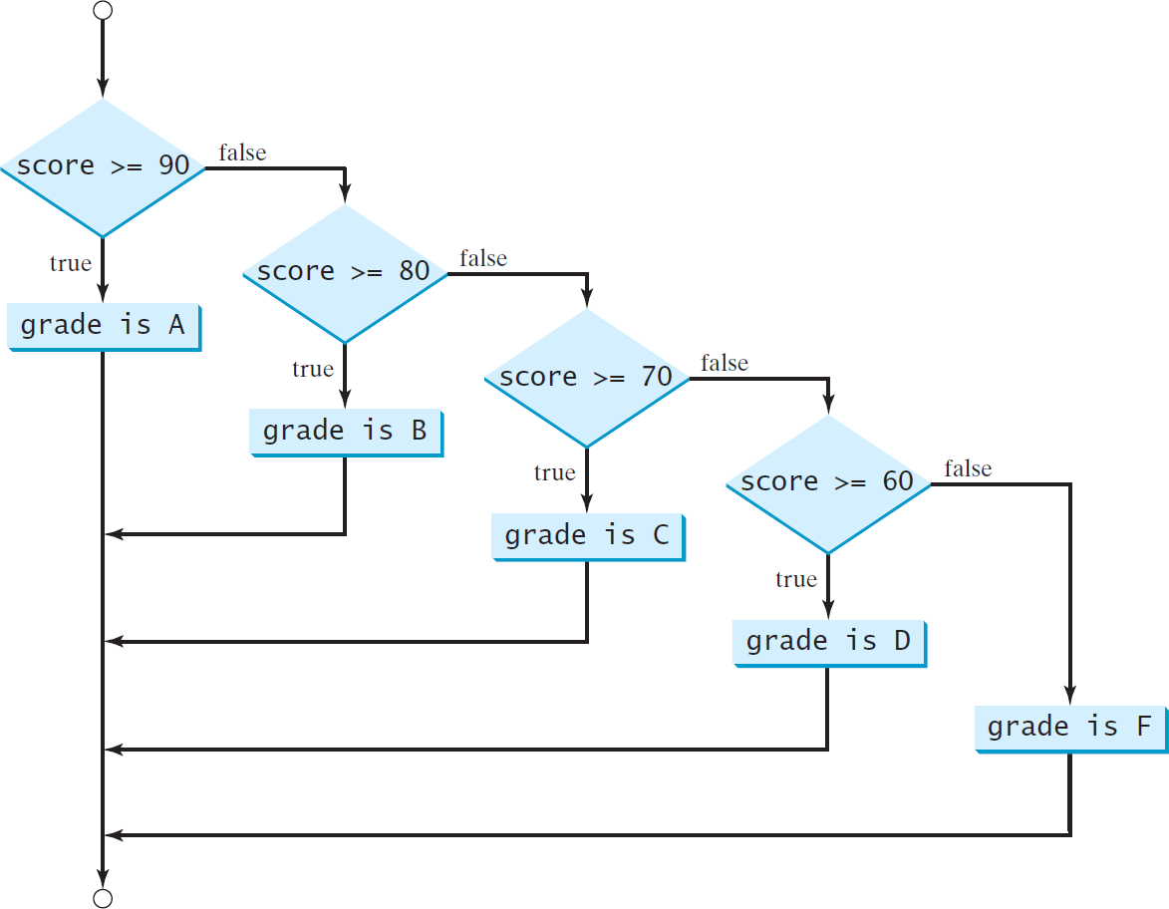
if Statements

Slide 38

if Statements
if (score >= 90.0) System.out.print("A");
else
if (score >= 80.0) System.out.print("B");
else
if (score >= 70.0) System.out.print("C");
else
if (score >= 60.0) System.out.print("D");
else
System.out.print("F");
if (score >= 90.0) System.out.print("A");
else if (score >= 80.0)
System.out.print("B");
else if (score >= 70.0) System.out.print("C");
else if (score >= 60.0) System.out.print("D");
else
System.out.print("F");
Equivalent
This is better
(a)
(b)
The else clause matches the most recent if clause in the same block.

Slide 39
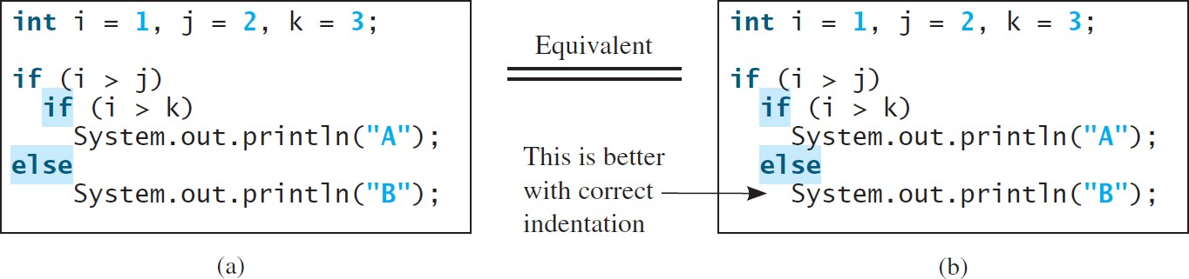
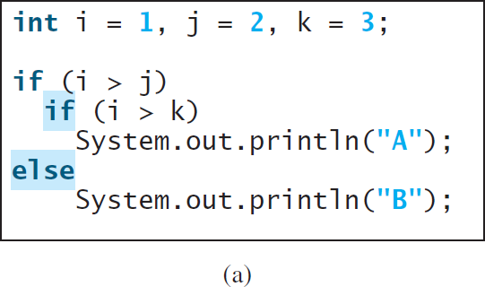
if Statements
To force the else clause to match the first if clause, you must add a pair of braces.
{
}

Slide 40
Logical Operators
Operator | Name | Description
! | not | logical negation
&& | and | logical conjunction
|| | or | logical disjunction
^ | exclusive or | logical exclusion

Slide 41
Logical Operators
p | !p | Example (assume age = 24, weight = 140)
true | false | !(age > 18) is false, because (age > 18) is true.
false | true | !(weight == 150) is true, because (weight == 150) is false.

Slide 42
Logical Operators
p₁ | p₂ | p₁ && p₂ | Example (assume age = 24, weight = 140)
false | false | false | (age <= 18) && (weight < 140) is false, because both conditions are both false.
false | true | false
true | false | false | (age > 18) && (weight > 140) is false, because (weight > 140) is false.
true | true | true | (age > 18) && (weight >= 140) is true, because both (age > 18) and (weight >= 140) are true.

Slide 43
Logical Operators
p₁ | p₂ | p₁ || p₂ | Example (assume age = 24, weihgt = 140)
false | false | false
false | true | true | (age > 34) || (weight <= 140) is true, because (age > 34) is false, but (weight <= 140) is true.
true | false | true | (age > 14) || (weight >= 150) is false, because (age > 14) is true.
true | true | true

Slide 44
Logical Operators
p₁ | p₂ | p₁ ^ p₂ | Example (assume age = 24, weight = 140)
false | false | false | (age > 34) ^ (weight > 140) is true, because (age > 34) is false and (weight > 140) is false.
false | true | true | (age > 34) ^ (weight >= 140) is true, because (age > 34) is false but (weight >= 140) is true.
true | false | true | (age > 14) ^ (weight > 140) is true, because (age > 14) is true and (weight > 140) is false.
true | true | false

Slide 45
Logical Operators - Example
Here is a program that checks whether a number is divisible by 2 and 3, whether a number is divisible by 2 or 3, and whether a number is divisible by 2 or 3 but not both:
System.out.println("Is " + number + " divisible by 2 and 3? " +
((number % 2 == 0) && (number % 3 == 0)));
System.out.println("Is " + number + " divisible by 2 or 3? " + ((number % 2 == 0) || (number % 3 == 0)));
System.out.println("Is " + number +
" divisible by 2 or 3, but not both? " + ((number % 2 == 0) ^ (number % 3 == 0)));

Slide 46
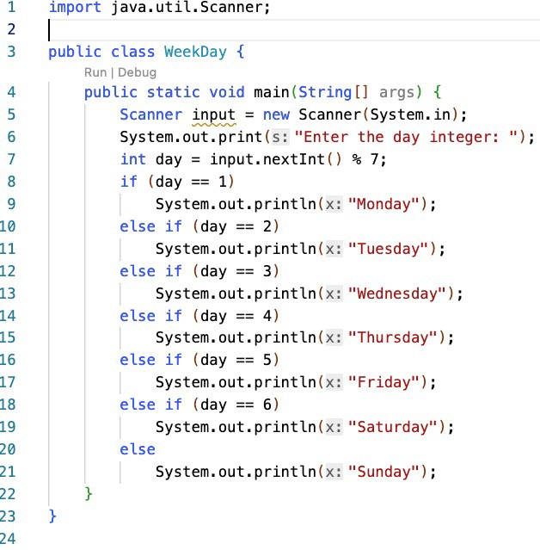
switch Statements

Slide 47
switch Statements
The switch-expression must yield a value of char, byte, short, or int type and must always be enclosed in parentheses.
The value1, ..., and valueN must have the same data type as the value of the switch-expression.
The resulting statements in the case statement are executed when the value in the case statement matches the value of the switch-expression.
o Note that value1, ..., and valueN are constant expressions, meaning that they cannot contain variables in the expression, such as 1 + x.
switch (switch-expression) { case value1: statement(s)1;
break;
case value2: statement(s)2; break;
…
case valueN: statement(s)N; break;
default: statement(s)-for-default;
}

Slide 48
switch Statements
The keyword break is optional, but it should be used at the end of each case in order to terminate the remainder of the switch statement.
If the break statement is not present, the next case statement will be
executed.
switch (switch-expression) { case value1: statement(s)1;
break;
case value2: statement(s)2; break;
…
case valueN: statement(s)N; break;
default: statement(s)-for-default;
}
The default case, which is optional,
can be used to perform actions when none of the specified cases matches the switch-expression.
When the value in a case statement matches the value of the switch-expression, the statements starting from this case are executed until either a break statement or the end of the switch statement is reached.

Slide 49
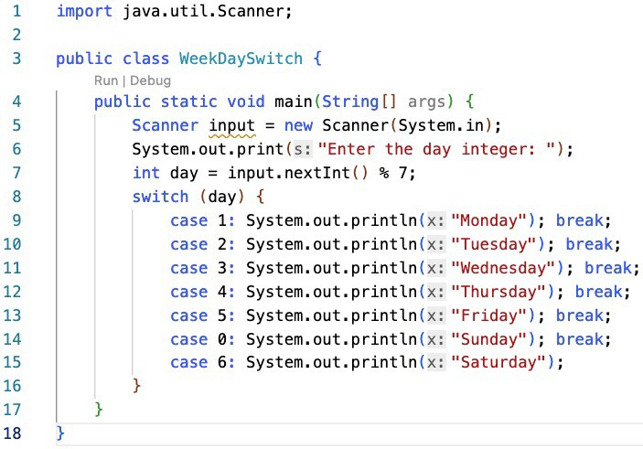
switch Statements

Slide 50
Conditional Operators
if (x > 0) y = 1 else
y = -1;
y = (x > 0) ? 1 : -1;
(boolean-expression) ? expression1 : expression2
Ternary operator Binary operator Unary operator

Slide 51
Conditional Operators
if (num % 2 == 0) System.out.println(num + “is even”);
else
System.out.println(num + “is odd”);
System.out.println(
(num % 2 == 0)? num + “is even” : num + “is odd”);

Slide 52
Operator Precedence
1. var++, var--
2. +, - (Unary plus and minus), ++var,--var
(type) Casting
! (Not)
*, /, % (Multiplication, division, and remainder)
6. +, - (Binary addition and subtraction)
7. <, <=, >, >= (Relational operators)
8. ==, !=; (Equality)
^ (Exclusive OR)
&& (Conditional AND) Short-circuit AND
|| (Conditional OR) Short-circuit OR
12. =, +=, -=, *=, /=, %= (Assignment operator)

Slide 53
Operator Precedence and Associativity
The expression in the parentheses is evaluated first. (Parentheses can be nested, in which case the expression in the inner parentheses is executed first.)
When evaluating an expression without parentheses, the operators are applied according to the precedence rule and the associativity rule.
If operators with the same precedence are next to each other, their associativity determines the order of evaluation.
All binary operators except assignment operators are left-associative.
Assignment operators are right-associative. Therefore, the expression
a – b + c – d is equivalent to ((a – b) + c) – d
a = b += c = 5 is equivalent to a = (b += (c = 5))

Slide 54
Operator Precedence and Associativity - Example
Applying the operator precedence and associativity rule, the expression 3 + 4 * 4 > 5 * (4 + 3) - 1 is evaluated as follows:
3 + 4 * 4 > 5 * (4 + 3) - 1
inside parentheses first
3 + 4 * 4 > 5 * 7 – 1
multiplication
3 + 16 > 5 * 7 – 1
multiplication
3 + 16 > 35 – 1
addition
19 > 35 – 1
subtraction
19 > 34
greater than
false

Slide 55
Conclusion
From the circle area computing program, we learned
How to handle variables
How to solve problems using operators and methods
How to control the condition if necessary (e.g., if statement)
From the day determining program, we learned
How to write the algorithm simpler using switch statement
We discussed the use of logical operators to make the conditional statement simpler (in a single line statement).
We discussed the precedence of operators in the problems.

