Slide 1

CS 501 – Introduction to JAVA Programing
Lecture 5 – Methods Lecture 6 – 1-D Array Lecture 7 – M-D Array

Slide 2

5.1. Opening Problem
Find the sum of integers from 1 to 10, from 20 to 30, and from 35 to 45, respectively.

Slide 3
5.1. Opening Problem
int sum = 0;
sum += i;
System.out.println("Sum from 1 to 10 is " + sum);
sum = 0; sum += i;
System.out.println("Sum from 20 to 30 is " + sum);
sum = 0; sum += i;
System.out.println("Sum from 35 to 45 is " + sum);

Slide 4
5.1. Opening Problem
int | sum | = | 0;
for (int sum += |  | i i | = ; | 1; | i | <= | 10; | i++)
System.out.println("Sum from 1 to 10 is " + sum);
sum = 0; for (int | i | = | 20; | i | <= | 30; | i++)
sum += | i;
System.out.println("Sum from 20 to 30 is " + sum);
sum = 0;
for (int i = 35; i <= 45; i++) sum += i;
System.out.println("Sum from 35 to 45 is " + sum);

Slide 5
5.1. Opening Problem
public static void main(String[] args) { System.out.println("Sum from 1 to 10 is " + sum(1, 10)); System.out.println("Sum from 20 to 30 is " + sum(20, 30)); System.out.println("Sum from 35 to 45 is " + sum(35, 45));
}

Slide 6
5.1. Opening Problem
public | static | int | sum(int | i1, | int | i2) | {
int | sum = 0;
for (int i = i1; i <= i2; i++) sum += i;
return sum;
}
public static void main(String[] args) { System.out.println("Sum from 1 to 10 is " + sum(1, 10)); System.out.println("Sum from 20 to 30 is " + sum(20, 30)); System.out.println("Sum from 35 to 45 is " + sum(35, 45));
}

Slide 7
5.2. Defining Methods
A method is a collection of statements that are grouped together to perform an operation.
Define a method
Invoke a method
public static int max(int num1, int num2) {
int result;
if (num1 > num2) result = num1;
else
result = num2;
return result;
}
int z = max(x, y);
actual parameters (arguments)

Slide 8
5.2. Defining Methods
Method signature is the combination of the method name and the parameter list.
Define a method
Invoke a method
int z = max(x, y);
actual parameters (arguments)
public static int
max(int num1, int num2)
{
int result;
if (num1 > num2) result = num1;
else
result = num2;
return result;
}

Slide 9
5.2. Defining Methods
The variables defined in the method header are known as formal parameters.
Define a method
Invoke a method
public static int max(int num1, int num2) {
int result;
if (num1 > num2) result = num1;
else
result = num2;
return result;
}
int z = max(x, y);
actual parameters (arguments)

Slide 10
5.2. Defining Methods
When a method is invoked, you pass a value to the parameter. This value is referred to as
actual parameter or argument.
Define a method
Invoke a method
public static int max(int num1, int num2) {
int result;
if (num1 > num2) result = num1;
else
result = num2;
return result;
}
int z = max(x, y);
actual parameters (arguments)

Slide 11
5.2. Defining Methods
A method may return a value. The returnValueType is the data type of the value the method returns. If the method does not return a value, the returnValueType is the
keyword void.
Define a method
Invoke a method
public static int max(int num1, int num2) {
int result;
if (num1 > num2) result = num1;
else
result = num2;
result;
}
int z = max(x, y);
actual parameters (arguments)
return

Slide 12
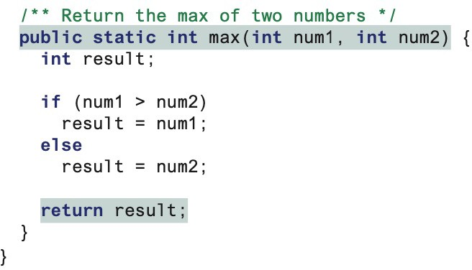
5.3. Calling Methods
Testing the max method
This program demonstrates calling a method max to return the largest of the int values.

Slide 13
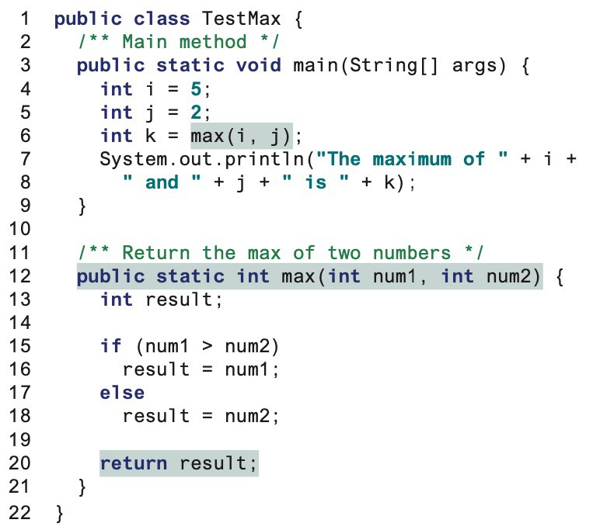
5.3. Calling Methods

Slide 14
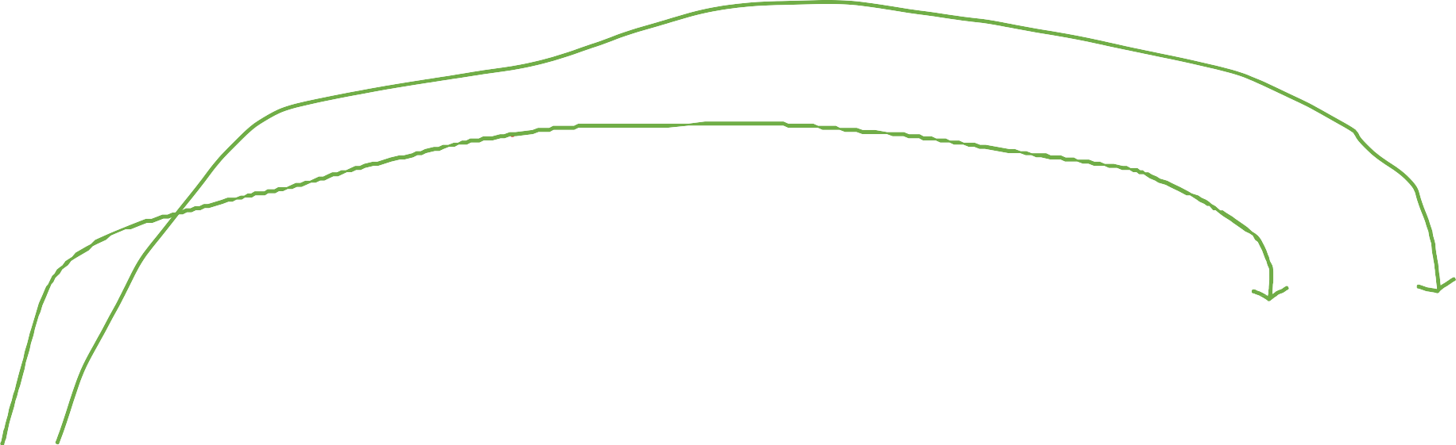
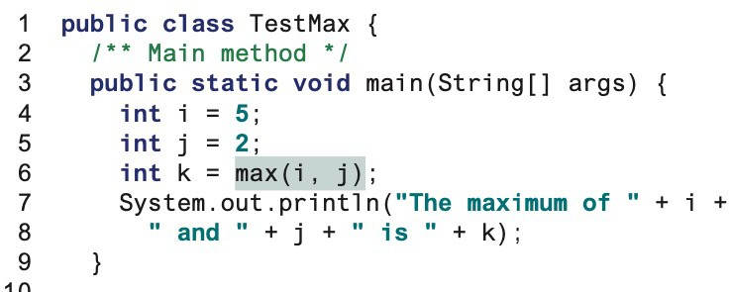
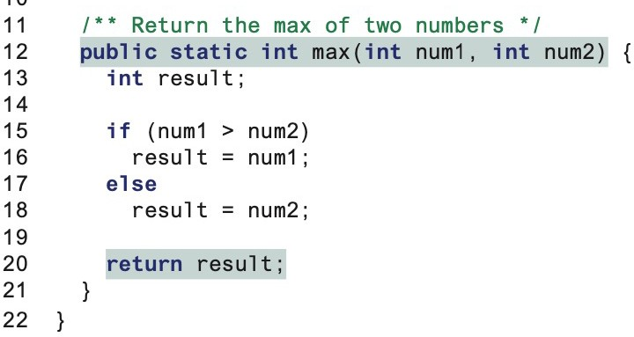

5.3. Calling Methods
pass j to num2
pass i to num1
Call max
k = result

Slide 15
5.3. Calling Methods
A return statement is required for a value-returning method. The method shown below in (a) is logically correct, but it has a compilation error because the Java compiler thinks it possible that this method does not return any value.
public static int sign(int n) { if (n > 0)
return 1;
else if (n == 0) return 0;
else if (n < 0) return –1;
}
public static int sign(int n) {
Should be ^{if (n > 0)} return 1;
else if (n == 0) return 0;
else
return –1;
}
(b)
(a)
To fix this problem, delete if(n < 0) in (a), so that the compiler will see a return
statement to be reached regardless of how the if statement is evaluated.

Slide 16
5.3. Calling Methods
NOTE: One of the benefits of methods is for reuse. The max method can be invoked from any class besides TestMax. If you create a new class Test, you can invoke the max method using ClassName.methodName (e.g., TestMax.max).

Slide 17
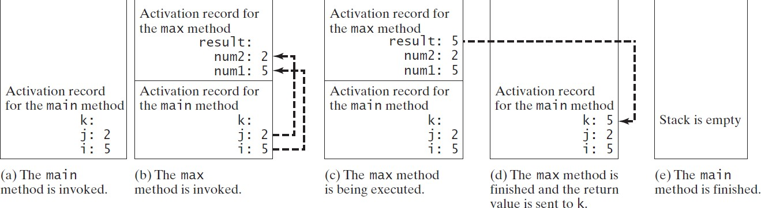
5.3. Calling Methods
call stack: Each time a method is invoked, the system creates an activation record that stores parameters and variables for the method and places the activation record in an area of memory.
also known as an execution stack, runtime stack, or machine stack
When a method calls another method, the caller’s activation record is kept intact and a new activation record is created for the new method called.
When a method finishes its work and returns to its caller, its activation record is removed from the call stack.

Slide 18
5.3. Calling Methods
i is declared and initialized
public static void main(String[] args) {
int i = 5;
int j = 2;
int k = max(i, j);
System.out.println(
"The maximum between " + i + " and " + j + " is " + k);
}
public static int max(int num1, int num2) { int result;
if (num1 > num2) result = num1;
else
result = num2;
i: 5
return result;
The main method is invoked.
}

Slide 19
5.3. Calling Methods
j is declared and initialized
public static void main(String[] args) { int i = 5;
int j = 2;
int k = max(i, j);
System.out.println(
"The maximum between " + i + " and " + j + " is " + k);
}
public static int max(int num1, int num2) { int result;
if (num1 > num2) result = num1;
else
result = num2;
j: 2
i: 5
return result;
}
The main method is invoked.

Slide 20
5.3. Calling Methods
Declare k
public static void main(String[] args) { int i = 5;
int j = 2;
int k
= max(i, j);
System.out.println(
"The maximum between " + i + " and " + j + " is " + k);
}
public static int max(int num1, int num2) { int result;
Space required for the main method
k:
j: 2
i: 5
if (num1 > num2) result = num1;
else
result = num2;
return result;
The main method is invoked.
}

Slide 21
5.3. Calling Methods
Invoke max(i, j)
public static void main(String[] int i = 5;
int j = 2;
args) {
int k =
max(i, j);
System.out.println(
"The maximum between " + i + " and " + j + " is " + k);
}
public static int max(int num1, int num2) { int result;
Space required for the main method
k:
j: 2
i: 5
if (num1 > num2) result = num1;
else
result = num2;
return result;
}
The main method is invoked.

Slide 22

5.3. Calling Methods
public static void main(String[] int i = 5;
int j = 2;
int k = max(i, j);
^{ar}p^{g}a^{s}s⁾s t{he values of i and j to num1 and num2
System.out.println( "The maximum between " and " + j + " is "
" + i +
+ k);
num2: 2
num1: 5
}
Space required for the main method
k:
j: 2
i: 5
The max method is invoked.
public static int max(i | nt num1, int num2) | {
int result; if (num1 > num2) result = num1; else result = num2; return result; }

Slide 23
5.3. Calling Methods
public static void main(String[] args) { int i = 5;
Declare result
int j = 2;
int k = max(i, j);
System.out.println( "The maximum between " and " + j + " is "
" + i +
+ k);
result: num2: 2
num1: 5
}
public static int max(int
num1, int num2) {
Space required for the main method
k:
j: 2
i: 5
int result;
if (num1 > num2) result = num1;
else
result = num2;
return result;
The max method is invoked.
}

Slide 24
5.3. Calling Methods
public static void main(String[] args) { int i = 5;
int j = 2;
int k = max(i, j);
System.out.println(
"The maximum between " + i + " and " + j + " is " + k);
}
result: num2: 2
num1: 5
Space required for the main method
k:
j: 2
i: 5
public static int max(int int result;
^{num}(n^{1,}um^{i}1^{nt}> ^{n}n^{u}u^{m}m²2⁾) {is true
if (num1 > num2)
result = num1; else
result = num2;
return result;
The max method is invoked.
}

Slide 25

5.3. Calling Methods
public static void main(String[] int i = 5;
int j = 2;
int k = max(i, j);
args) {
Space required for the max method
result: 5
num2: 2
num1: 5
System.out.println( Assign num1 to result
"The maximum between " + i + " and " + j + " is " + k);
}
Space required for the main method
k:
j: 2
i: 5
public static int max(int num1, int num2) { int result;
if (num1 > num2)
result = num1;
else
result = num2;
The max method is invoked.
return result;
}

Slide 26

5.3. Calling Methods
public static void main(String[] int i = 5;
int j = 2;
int k = max(i, j);
args) {
Space required for the max method
result: 5
num2: 2
num1: 5
System.out.println( "The maximum between " and " + j + " is "
" + i +
+ k);
}
Return result and
public static int max(int^{as}n^{s}u^{ig}m^{n}1,^{it} i^{to}nt^{k} num2) {
Space required for the main method
k:5
j: 2
i: 5
int result;
if (num1 > num2) result = num1;
else
result = num2;
return result;
The max method is invoked.
}

Slide 27
5.3. Calling Methods
public static void main(String[] int i = 5;
int j = 2;
int k = max(i, j);
args) {
Execute print statement
System.out.println(
"The maximum between " + i + " and " + j + " is " + k);
}
Space required for the main method
k:5
j: 2
i: 5
public static int max(int num1, int num2) { int result;
if (num1 > num2) result = num1;
else
result = num2;
return result;
}
The main method is invoked.

Slide 28
5.4. Passing Parameters
public static void nPrintln(String message, int n) { for (int i = 0; i < n; i++)
System.out.println(message);
}
Suppose you invoke the method using nPrintln(“Computer Science”, 15);
What is the output?
Can you invoke the method using nPrintln(15, “Computer Science”);

Slide 29
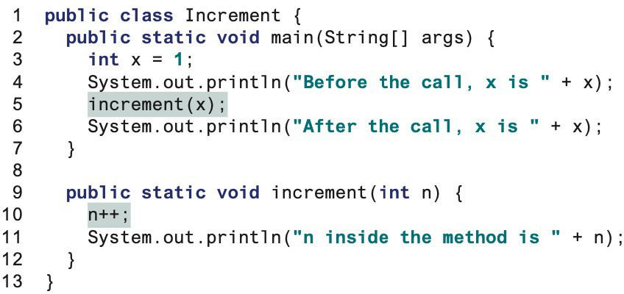
5.4. Passing Parameters
This program demonstrates passing values to the methods.
Before the call, x is 1
After the call, x is 1
n inside the method is 2

Slide 30
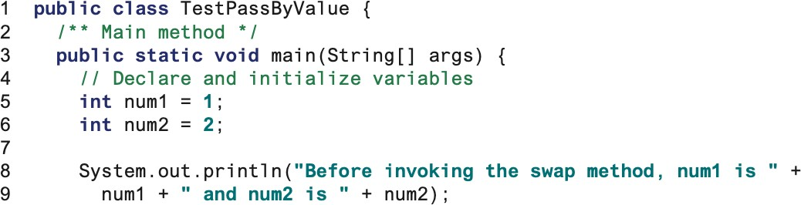
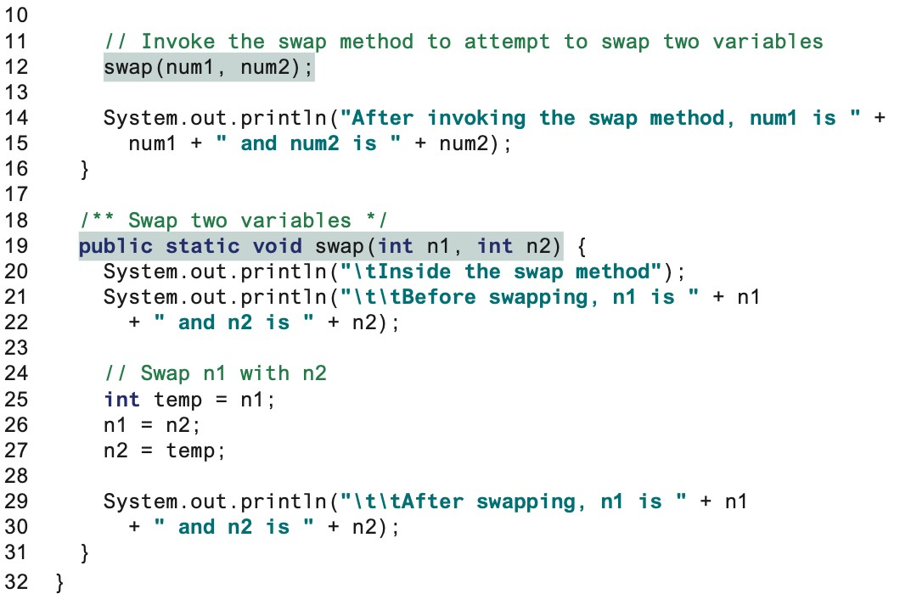
5.4. Passing Parameters
num1=1, num2=2
num1=1, num2=2 num1=1, num2=2
temp=1,n1=2,n2=1
n1=2,n2=1
Switch to Code - PassByVlaue

Slide 31
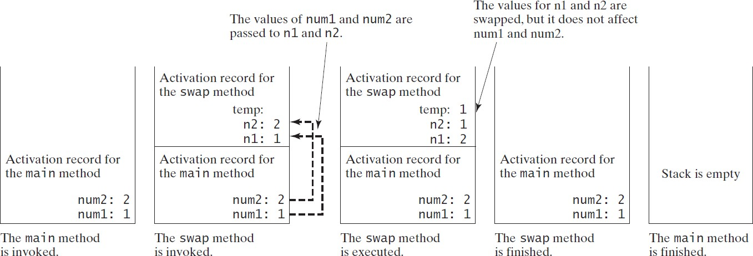
5.4. Passing Parameters – Stack Memory
L19
L25,26 & 27
L5 & 6
L12

Slide 32
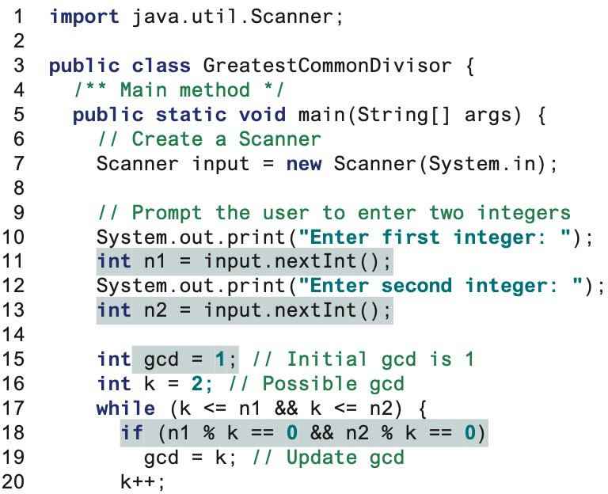
5.5. Modularizing Code
Methods can be used to reduce redundant coding and enable code reuse. Methods can also be used to modularize code and improve the quality of the program.

Slide 33
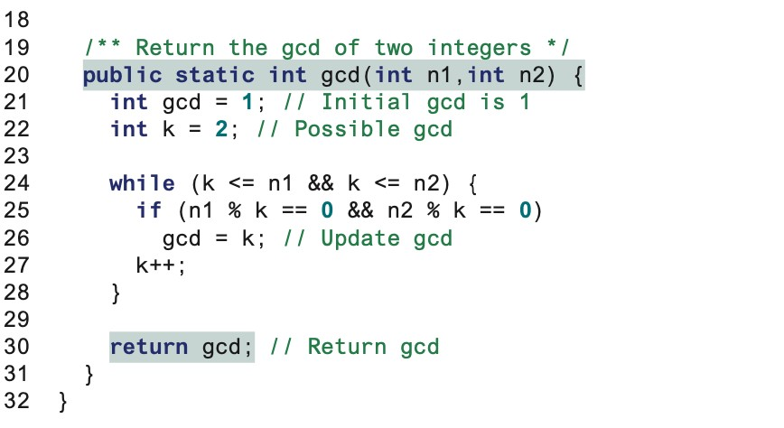
5.5. Modularizing Code

Slide 34
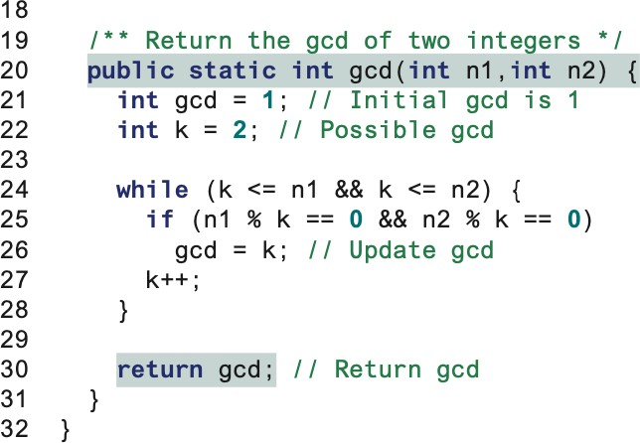
5.5. Modularizing Code
Advantage:
It isolates the problem for computing the gcd from the rest of the code in the main method. Thus, the logic becomes clear, and the program is easier to read.
The errors on computing the gcd are confined in the gcd method, which narrows the scope of debugging.
The gcd method now can be reused by other programs.

Slide 35
5.5. Modularizing Code
Overloading the max Method
public static double max(double num1, double num2) {
if (num1 > num2)
return num1; else
return num2;
}

Slide 36
5.5. Modularizing Code
ambiguous invocation: Sometimes there may be two or more possible matches for an invocation of a method, but the compiler cannot determine the most specific match.
Ambiguous invocation could cause a compile error.
Switch to code – overload,
AmbiguousInvocation

Slide 37
5.5. Modularizing Code
public class AmbiguousOverloading {
public static void main(String[] args) { System.out.println(max(1, 2));
}
public static double max(int num1, double num2) { if (num1 > num2)
return num1; else
return num2;
}
public static double max(double num1, int num2) { if (num1 > num2)
return num1; else
return num2;
}
}

Slide 38
5.5. Modularizing Code
public class AmbiguousOverloading {
public static void main(String[] args) { System.out.println(max(1.5, 2.3));
}
public static double max(int num1, double num2) { if (num1 > num2)
return num1; else
return num2;
}
public static double max(double num1, int num2) { if (num1 > num2)
return num1; else
return num2;
}
}

Slide 39
5.6. Scope of Local Variables
A local variable: a variable defined inside a method.
Scope: the part of the program where the variable can be referenced.
The scope of a local variable starts from its declaration and continues to the end of the block that contains the variable. A local variable must be declared before it can be used.
You can declare a local variable with the same name multiple times in different non- nesting blocks in a method, but you cannot declare a local variable twice in nested blocks.

Slide 40
5.6. Scope of Local Variables
A variable declared in the initial action part of a for loop header has its scope in the entire loop.
But a variable declared inside a for loop body has its scope limited in the loop body from its declaration and to the end of the block that contains the variable.
public static void method1() {
.
.
for (int i = 1; i < 10; i++) {
.
.
int j;
.
.
.
The scope of i
The scope of j
}
}

Slide 41
5.6. Scope of Local Variables
public static void method1() { int x = 1;
int y = 1;
for (int i = 1; i < 10; i++) { x += i;
}
for (int i = 1; i < 10; i++) { y += i;
}
}
public static void method2() {
int i = 1; int sum = 0;
for (int i = 1; i < 10; i++) sum += i;
}
}

Slide 42
5.7. Method Abstraction
The key to developing software is to apply the concept of abstraction.
Separate the use of a method from its implementation
The concept of method abstraction can be applied to the process of developing programs. When writing a large program, you can use the divide-and-conquer strategy
You can think of the method body as a black box that contains the detailed implementation for the method.
Optional arguments for Input
Optional return value
Method Header
Method body
Black Box

Slide 43
Benefits of Methods
Write a method once and reuse it anywhere.
Information hiding. Hide the implementation from the user.
Reduce complexity.

Slide 44
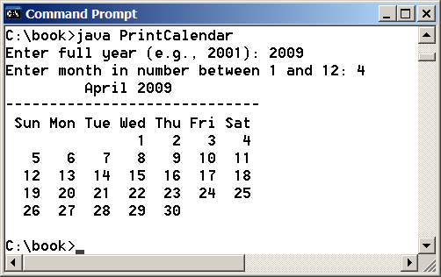
5.8. Case Study - PrintCalendar
Let us use the PrintCalendar to demonstrate the stepwise refinement approach.

Slide 45
5.8. Case Study - PrintCalendar
printCalendar
(main)
readInput
printMonth
getMonthName
printMonthBody
getStartDay
getTotalNumOfDays
getNumOfDaysInMonth
isLeapYear

Slide 46
5.8. Case Study - PrintCalendar
Top-down approach is to implement one method in the structure chart at a time from the top to the bottom.
Stubs can be used for the methods waiting to be implemented.
A stub is a simple but incomplete version of a method.
The use of stubs enables you to test invoking the method from a caller.
Implement the main method first and then use a stub for the printMonth method.
For example, let printMonth display the year and the month in the stub.
Bottom-up approach is to implement one method in the structure chart at a time from the bottom to the top.
For each method implemented, write a test program to test it.
Both top-down and bottom-up methods are fine.
Both approaches implement the methods incrementally and help to isolate programming errors and makes debugging easy.

Slide 47
5.8. Case Study - PrintCalendar
printCalendar
(main)
readInput
printMonth
printMonthTitle
printMonthBody
getMonthName
getStartDay
getTotalNumOfDays
getNumOfDaysInMonth
isLeapYear

Slide 48
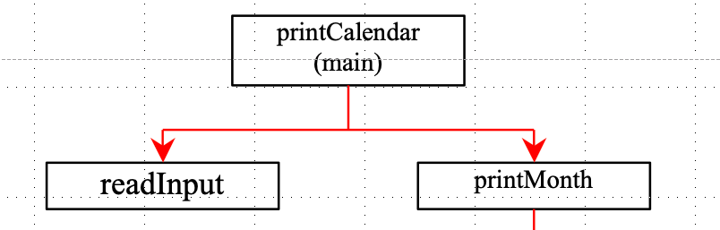
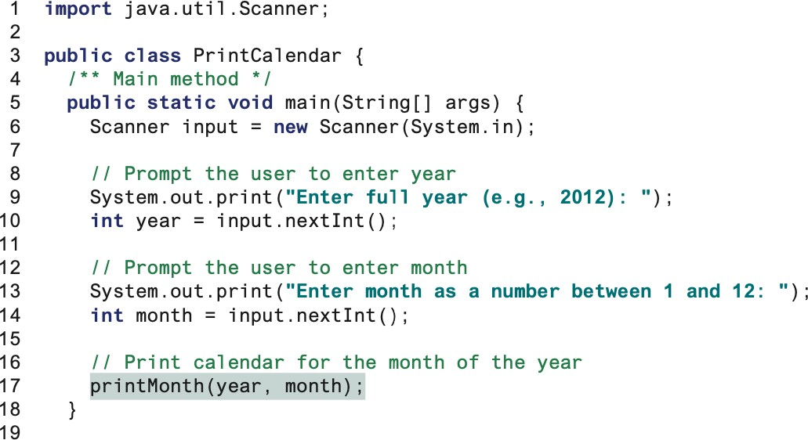
5.8. Case Study - PrintCalendar

Slide 49
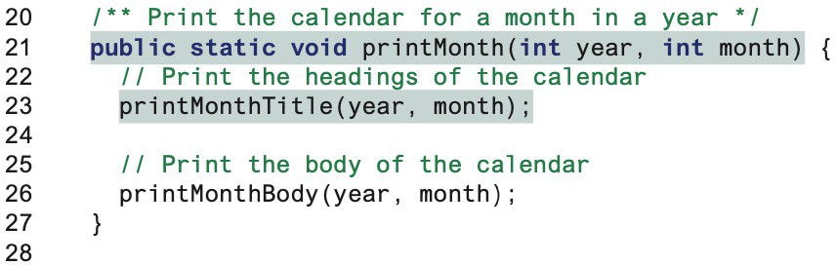
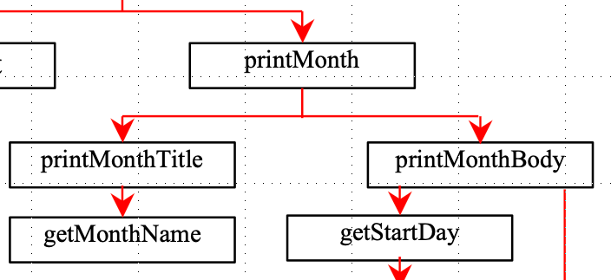
5.8. Case Study - PrintCalendar

Slide 50
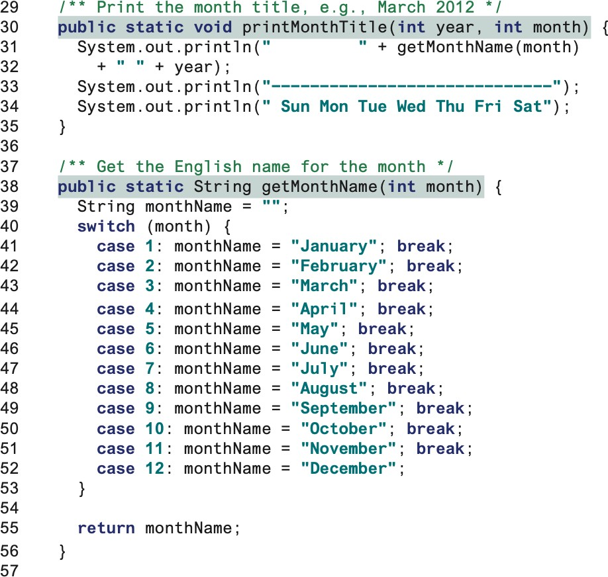

5.8. Case Study - PrintCalendar

Slide 51
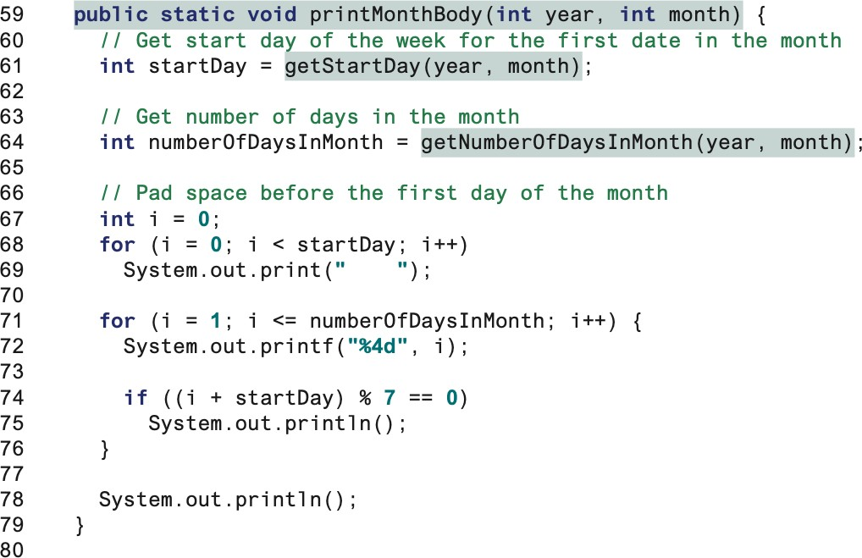
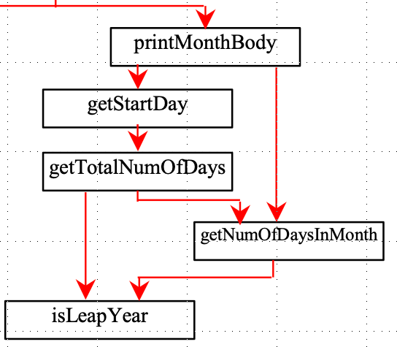
5.8. Case Study - PrintCalendar

Slide 52
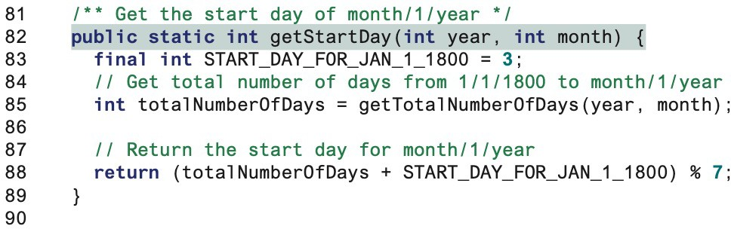
5.8. Case Study - PrintCalendar

Slide 53
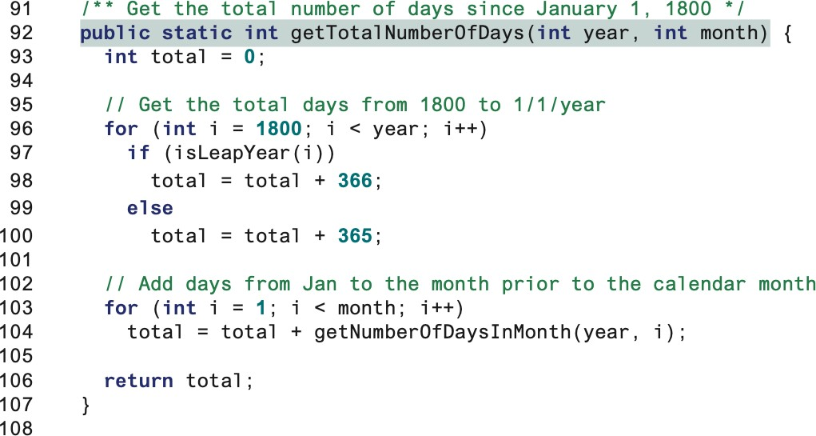
5.8. Case Study - PrintCalendar

Slide 54
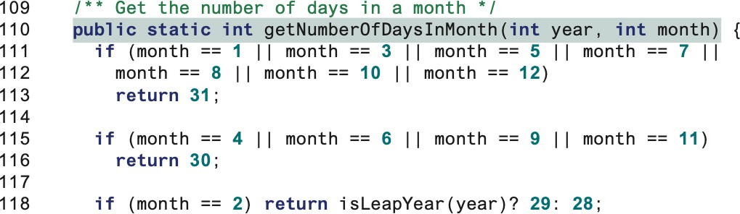
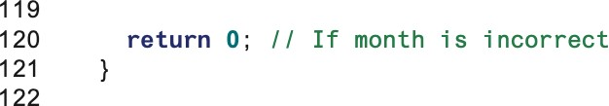
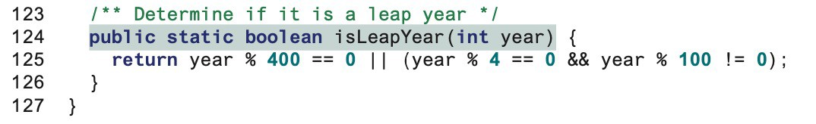
5.8. Case Study - PrintCalendar

Slide 55
5.8. Case Study - PrintCalendar
Simpler Program:
The stepwise refinement breaks it into smaller methods.
This simplifies the program and makes the whole program easier to read and understand.
Reusing Methods:
The Stepwise refinement promotes code reuse within a program.
The isLeapYear method is defined once and invoked from the getTotalNumberOfDays and
getNumberOfDaysInMonth methods.
This reduces redundant code.

Slide 56
5.8. Case Study - PrintCalendar
Easier Developing, Debugging, and Testing:
Since each subproblem is solved in a method, a method can be developed, debugged, and tested individually.
This isolates the errors and makes developing, debugging, and testing easier.
When implementing a large program, use the top-down and/or bottom-up approach.
Do not have to write the entire program at once.
Better Facilitating Teamwork:
When a large problem is divided into subprograms, subproblems can be assigned to different programmers.
This makes it easier for programmers to work in teams.

