Slide 1
Lecture 13: Generics
Disclaimer: This is a harder one to grasp, if there’s one to pay attention to, this is it.

Slide 2
ArrayLists
ArrayLists are resizable array implementations of the List interface in Java. Unlike regular arrays, these can grow and shrink dynamically.
Some nice features of ArrayLists:
Dynamic Resizing: No fixed size required.
Fast Random Access: Uses array-like indexing
Maintains insertion order
import java.util.ArrayList;
ArrayList<Type> list = new ArrayList<>();

Slide 3
Basic Operations on ArrayLists
Adding Elements:
Accessing Elements:
Updating Elements:
ArrayList<String> names = new ArrayList<>();
names.add("Alice");
names.add("Bob");
System.out.println(names); // [Alice, Bob]
System.out.println(names.get(0)); // Alice
names.set(1, "Charlie");
System.out.println(names); // [Alice, Charlie]

Slide 4
Basic Operations on ArrayLists
Removing Elements:
Iterating over Elements via For-Each:
Iterating over Elements via Traditional For:
names.remove("Alice");
System.out.println(names); // [Charlie]
for (String name : names) {
System.out.println(name);
}
for (int i = 0; i < names.size(); i++) {
System.out.println(names.get(i));
}

Slide 5
ArrayList vs Arrays: Key Differences
Feature | Array | ArrayList
Size | Fixed | Dynamic
Performance | Faster | Slightly slower
Methods | Basic | Rich API
Type Safety | Enforced | Enforced (with Generics)
When to use ArrayLists over default arrays?
Basically always
Dynamic resizing is a blessing for adding and removing elements

Slide 6
What are generics?
Generics allow classes, interfaces, and methods to work with type parameters, ensuring type safety and code reusability.
Type Safety: Ensure a collection only contains elements of a specific type. This prevents runtime errors caused by type mismatches.
Code Reusability: Generics allow you to write methods, classes, and interfaces that work with any object type, so you don’t need to replicate the same code for different data types.
Elimination of Type Casting: self-explanatory
List<String> list = new ArrayList<>();
list.add(“Java”);
String s = list.get(0);

Slide 7
Generics with ArrayLists
ArrayLists in Java are typically used with generics to ensure the list only contains elements of a particular type.
Without generics, you could add any type of object to an ArrayList, leading to potential issues later on, like requiring explicit casting to cast the objects back to some standard type:
public class Main {
public static void main(String[] args) {
ArrayList list = new ArrayList(); // No type safety
list.add("Hello");
list.add(10); // Allowed, but problematic later
String s = (String) list.get(0); // Explicit casting required
System.out.println(s.toUpperCase()); // Works
}
}

Slide 8
Generic ArrayList
You can specify the type of the elements the ArrayList should hold.
If you try to add the wrong type, the compiler will catch the error before the program runs.
public class Main {
public static void main(String[] args) {
ArrayList<String> list = new ArrayList<>(); // Type-safe ArrayList
list.add("Hello");
// list.add(10); // Compilation error
// (intended to prevent mixing types)
String s = list.get(0); // No casting needed
System.out.println(s.toUpperCase()); // Works safely
}
}

Slide 9
Generic Syntax
DataStructure<Type of element stored within>
In ArrayList<String>
ArrayList is the class you’re working with
<String> is the type parameter which tells Java this list can only hold String objects.
Type parameters can be from any class
e.g. Integer, Double, Book, Bird
Switch to code - BasicGeneric

Slide 10
Generic Method Example
We can define generic methods that work with any type
This way, only the method is generic, not the whole class
class Util {
// Generic method to print any type of object
public static <T> void print(T item) {
System.out.println(item);
}
}
public class Main {
public static void main(String[] args) {
Util.print("Hello, World!"); // Works with String
Util.print(100); // Works with Integer
Util.print(3.14); // Works with Double
}
}
Switch to Code - GenericMethod

Slide 11
Bounded Generics
Generic classes can also be restricted using bounded types.
For example, a generic class T can be restricted to only work with Number and its subclasses (Integer, Double, etc)
Note the extends is contained within the <>
// Only accepts Number or its subclasses
class Calculator<T extends Number> {
private T num;
public Calculator(T num) {
this.num = num;
}
public double square() {
return num.doubleValue() * num.doubleValue();
}
}

Slide 12
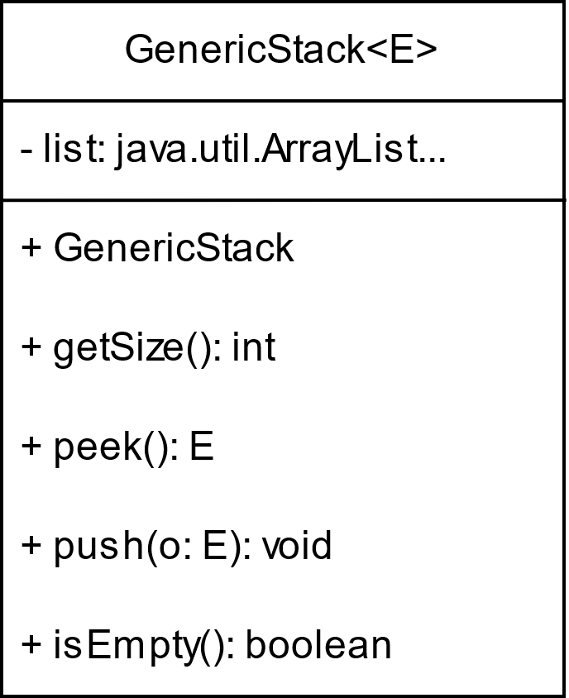
Generic Stack
Now that we’re equipped with ArrayLists, let’s put them to use revising the Stack class we’d made earlier on.
Switch to code - GenericStack

Slide 13
Raw Types
A raw type is a generic class or interface used without specifying the type parameter.
Before Java 5 (in 2004), all collections operated on Object, requiring explicit type casting.
Mixing types and requiring explicit type casting can lead to ClassCastExceptions.
public class Main {
public static void main(String[] args) {
ArrayList list = new ArrayList(); // Raw type usage
list.add("Hello");
list.add(10); // No compile-time check
String s = (String) list.get(0); // Explicit casting required
}
}

Slide 14
Why Raw Types Exist
Backwards Compatibility
Raw types allow old code to work without modification
Transition to Generics
Raw types enable smooth adoption of generics in codebases
Works with both raw and generic lists, maintaining compatibility:
class LegacyPrinter {
public void printList(ArrayList list) { // Accepts raw type
for (Object item : list) {
System.out.println(item);
}
}
}

Slide 15
Wildcard Generic Types
Wildcard generic types use a question mark (?) to represent an unknown type in a generic class, interface, or method.
This allows generic code to handle different parameterized types without knowing their exact type.
This can resolve issues where the class is parameterized to take in one class object but one of its methods can take any subtype of that class object.
Note: Unbounded wildcards should only be used when method can be handled by functionality provided by the Object class!
Switch to code - WildCardGenerics

Slide 16
Upper Bounded Wildcards
These wildcards can be used when you want to relax the restrictions on a variable.
If we want to write a method that works for List<Integer>, List<Double>, List<Float>, etc. we can instead write List<? extends Number>
Use Case: When you need to read elements but not modify the collection
Syntax: CollectionType <? extends Type>
Switch to code - UpperBoundedWildcard

Slide 17
Lower Bounded Wildcards
Restricts a type T to T or any of its superclasses.
Use case: When you need to modify the collection but don’t care about reading exact types.
Syntax: CollectionType<? super Type>
Switch to code - LowerBoundedWildcards

Slide 18
Type Erasure
Generics are implemented using an approach called type erasure.
The compiler uses the generic-type information to compile the code, but erases it afterwards.
Generics are present at compile time, but once the compiler confirms the generic type is used safely, it converts the generic type to a raw type.
Becomes the equivalent at runtime to
ArrayList<String> list =
new ArrayList<>();
list.add(“example”);
String word = list.get(0);
ArrayList<String> list =
new ArrayList<>();
list.add(“example”);
String word = (String)list.get(0);

Slide 19
From Compilation to Runtime
When generic classes, interfaces, and methods are compiled, the compiler replaces the generic type with the Object type.
If the generic type is bounded, the compiler replaces it with the bounded type.
public static <E extends Shape> boolean equalArea(E shape1, E shape2) {
return shape1.getArea() == shape2.getArea();
}
becomes
public static boolean equalArea(Shape shape1, Shape shape2) {
return shape1.getArea() == shape2.getArea();
}

Slide 20
java.lang.reflect.Array.newInstance()
Due to type erasure, we cannot directly create arrays of generic types at runtime (like new E[size]) because the compiler doesn’t know what concrete type E actually is during execution.
Instead, we must define a generic array as follows:
Here, list[0].getClass() gets the actual runtime Class object
For example, if E is Integer, this returns the Integer class
Array.newInstance() creates the new Object array with the specified class and dimension
Finally, we cast to E[] because newInstance() returns an object
E[] result = (E[]) Array.newInstance(list[0].getClass(), list.length)

Slide 21
java.lang.reflect.Array.newInstance()
This is necessary because the straightforward attempt of new E[5] results in compilation error
Another way would be to blindly downcast.
Assuming E extends Number, this would look like:
As we discussed earlier on, this is not safe. If E is an Integer, we would have an array that claims to be Integer[]but is actually Number[]
Since Number is an abstract class it doesn’t have implementations for arithmetic operations.
E[] result = (E[])new Number[list.length];

Slide 22
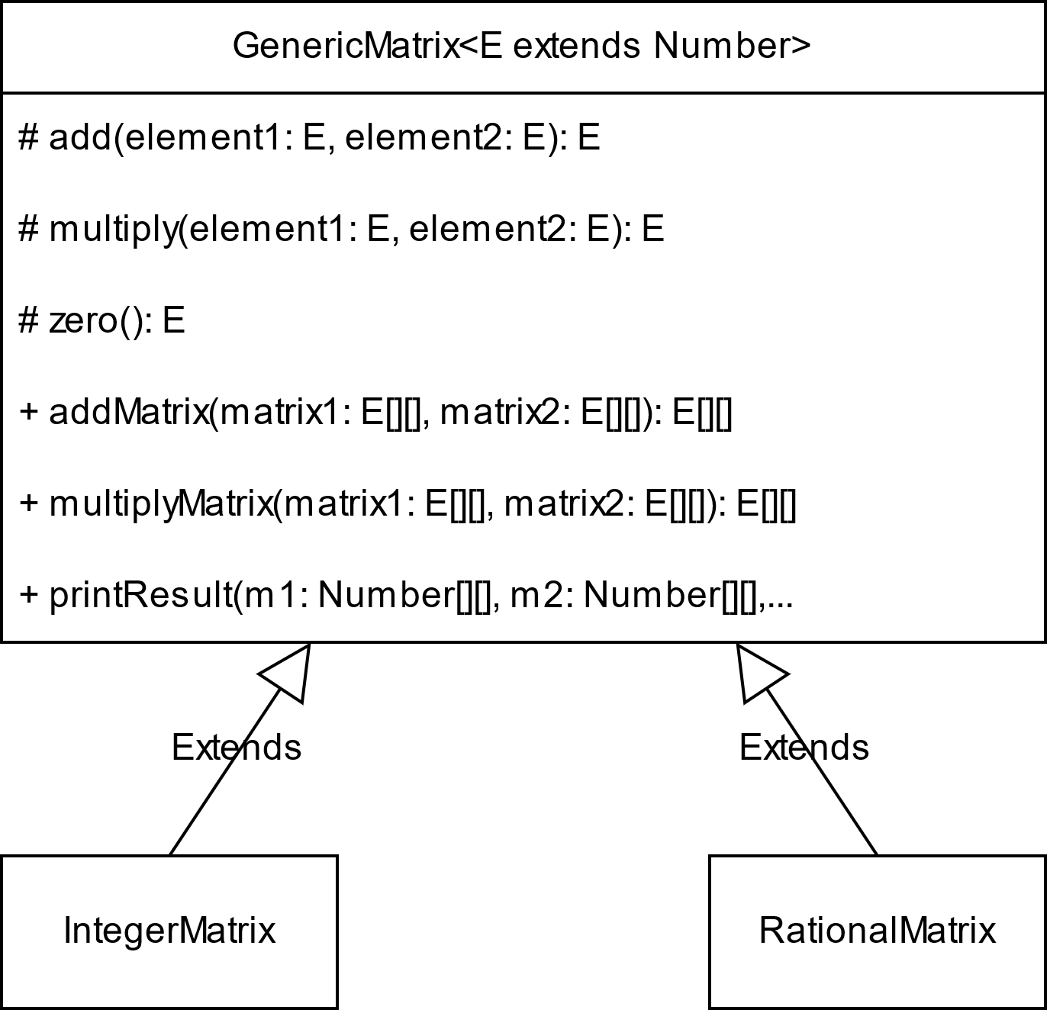
Abstract Generic Matrix
# means protected
italicized means abstract (pretend the first 3 are italicized)
Switch to code – GenericMatrix

